Slide 1

Python RegEx

Slide 2

Agenda
History about RegEx
What are Regular Expressions?
Why we use Regular Expressions?
Basic Regular Expression operation
Email verification using Regular Expression
Phone Number verification using Regular expression
Web scraping using Regular Expression

Slide 3
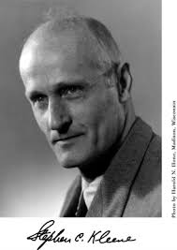
History
Regular expression originated in 1951 found by the great mathematician Stephen Cloe Kleene.
Popular use in 1968 in two ways:
i) Pattern matching in a text editor
ii) Lexical analysis in compiler
In 1980 the more complicated regex arose in PERL(Practical Extraction and Reporting Language).
Starting in 1997 , Philip Hazel developed regular expressions which was used in PHP and apache HTTP server.
Today regex is supported in programming languages, text processing program ,advanced text editor and some other programs.

Slide 4
Regular Expressions: 8 Different languages
Python
Java
Ruby
RegEx
PHP
Swift
C
Scala
Groovy

Slide 5
What are Regular Expressions?
A regular expression is basically used for describing a search pattern.
We can use regular expressions :
i)Search a specific string in a large amount of data.
ii)You can verify that a string has a proper format or not.
iii)You can find a string and replace with another string.
iv)You can format the data into proper form for importing.
Python has a built-in package called re , which can be used to access Regular Expressions.

Slide 6

Why We Use Regular Expressions?
How to find
the date and
Time from the
Log file?
Jul 1 03:27:12
Syslog:
[m-JAVA][
1/JUL/2013
03:27:12.818][j:
[SessionThread
<]^lat
Com/avc/abc/m
Agr/service/find
.something(abc
/1235/locator/a
bc;Ljava/lang/S
tring;)Labc/abc/
Abcd/abcd;(byt
ecode:7)
Date and Time

Slide 7
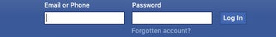
How to
verify these
e-mail
Address?
Sc #.com
sk@gmail.com
dk@gmail.com
ds@gmail.com
cf@gmail.com

Slide 8
Student Database:
Name: Kate
Age:32
Address:F-127,Starc
Tower, Newyork
59006
Name: Neel
Age:65
Address:d-2,Newyork
59006
………………………………
………………………………
Replace the string
59006
59006
59006
59006
59006
59076
59076
59076
59076
59076
Find a particular string from student data

Slide 9
REGULAR EXPRESSION
OPERATIONS
Find a word in a string
Generate an iterator
Match one of any of several letters
Match series of range of characters
Replace string
Match a single character

Slide 10
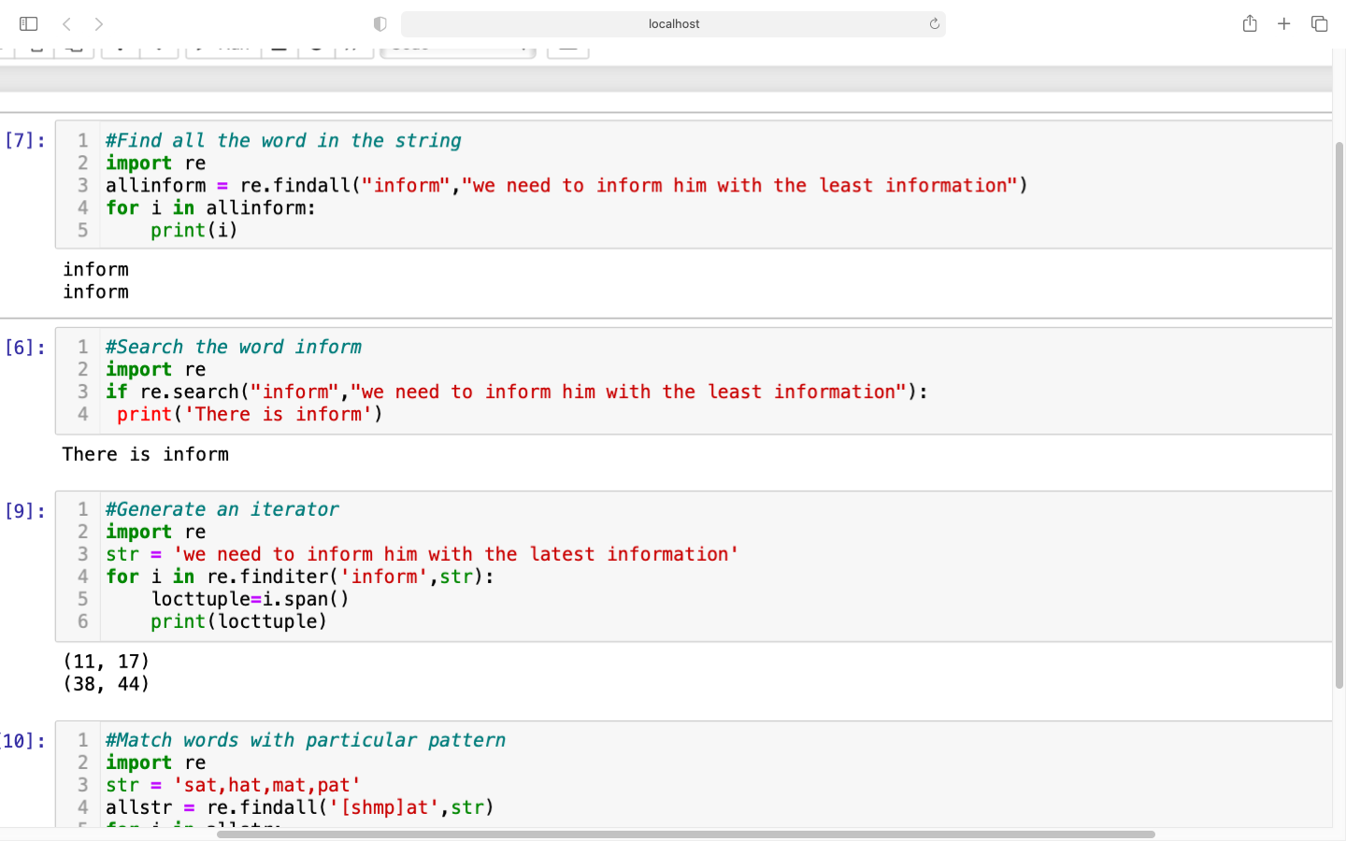
Find a word in a string
Output
Output

Slide 11
Generate an iterator
Output

Slide 12
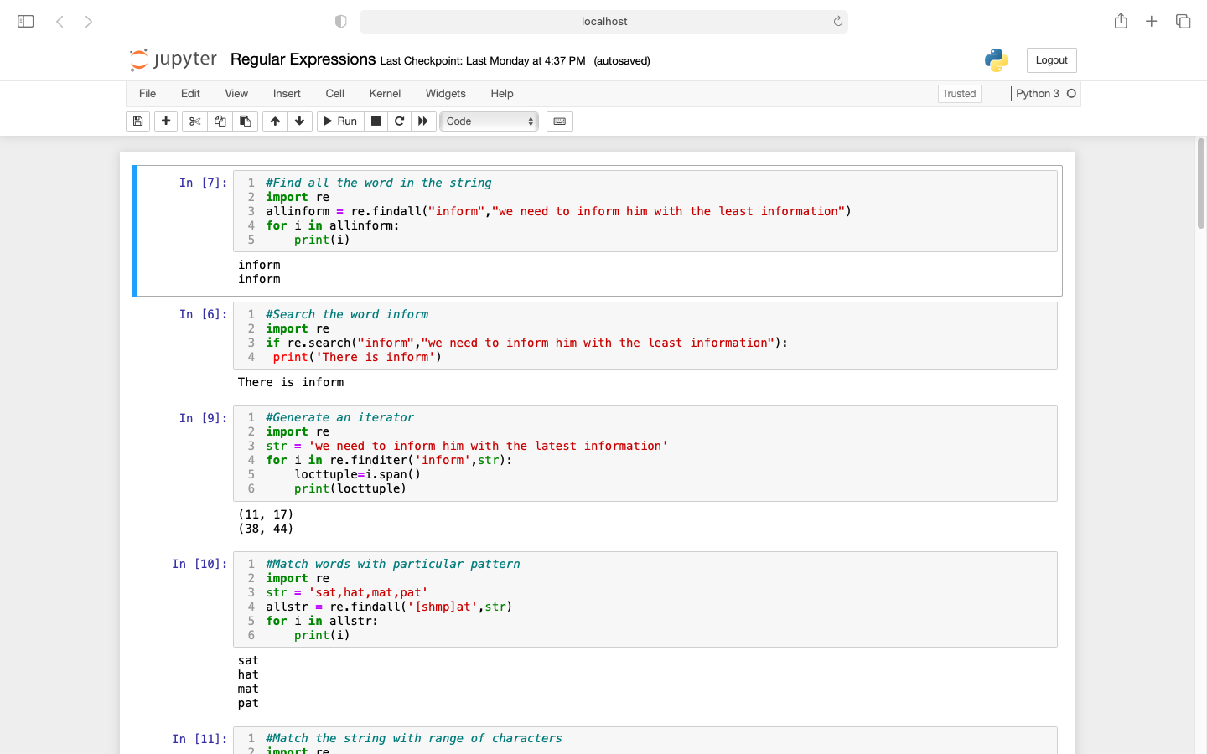
Match words with particular pattern
Output

Slide 13
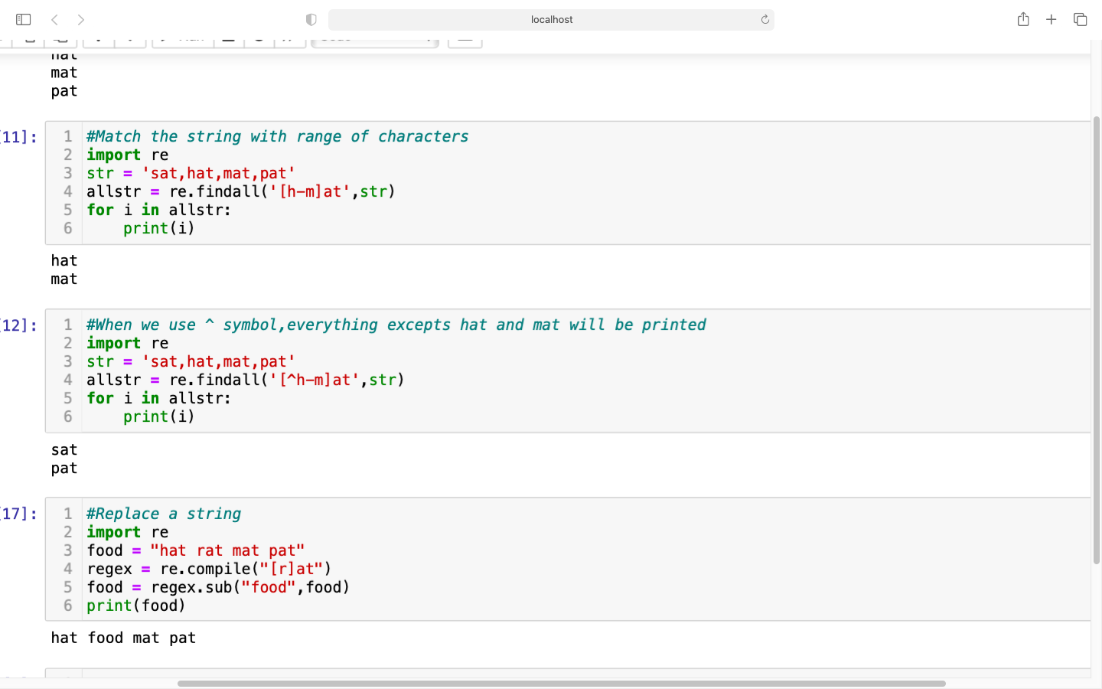
Match series of range of characters
Output

Slide 14
Using ^ in the range of characters
Output

Slide 15
Replace a particular string
Output

Slide 16
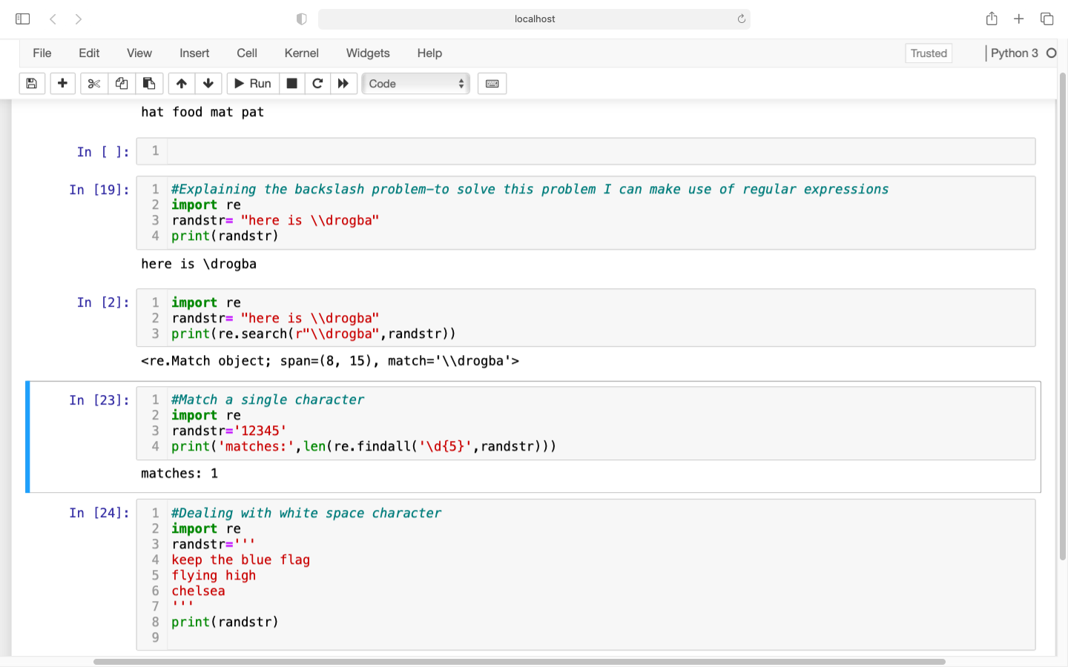
Escape Character problem
Output
Output

Slide 17
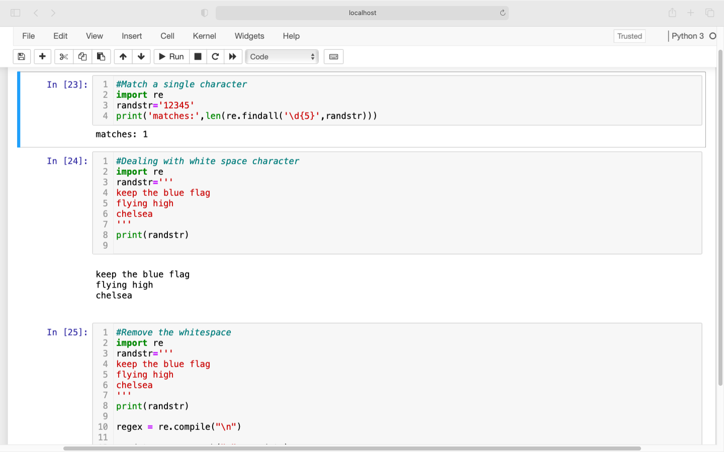
Match a Single character
Output

Slide 18
Dealing with white space
Output

Slide 19
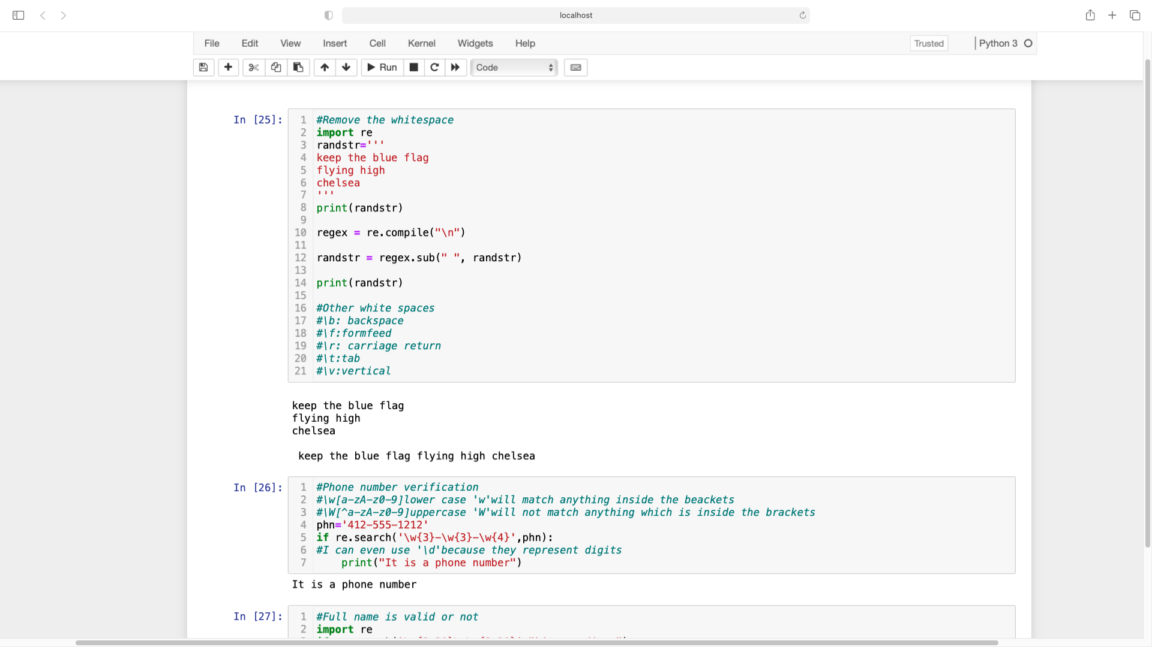
Dealing with white space
Output

Slide 20

Phone number verification
Here we are supposed to verify the phone numbers
Problem Statement:
To verify the phone numbers.
Phone Number
444-122-1243
123-122-78999
111-123-23
67-7890-2019
All phone numbers should have:
3 starting digits and ‘-’ sign
3 middle digit and ‘-’ sign
4digits in the end

Slide 21

E-mail verification
Here we are supposed to verify the E-mail addresses
Problem Statement:
To verify the E-mail addresses.
E-mail:
Sauraph@gmail.com
Reyshma@com
Kv.com
123 @ .com
E-mail address should include:
1 to 20 lowercase and uppercase letters, numbers, plus._-+
An@ symbol
2 to 20 lowercase and uppercase numbers, plus.-
A period
2 to3 lowercase and uppercase letters

Slide 22





Web Scraping
Problem Statement:
Scrap all the phone numbers from a webpage using Regular Expressions.

Slide 23
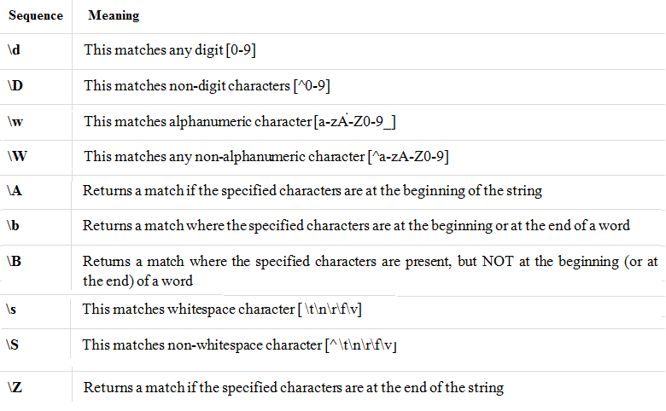

Slide 24
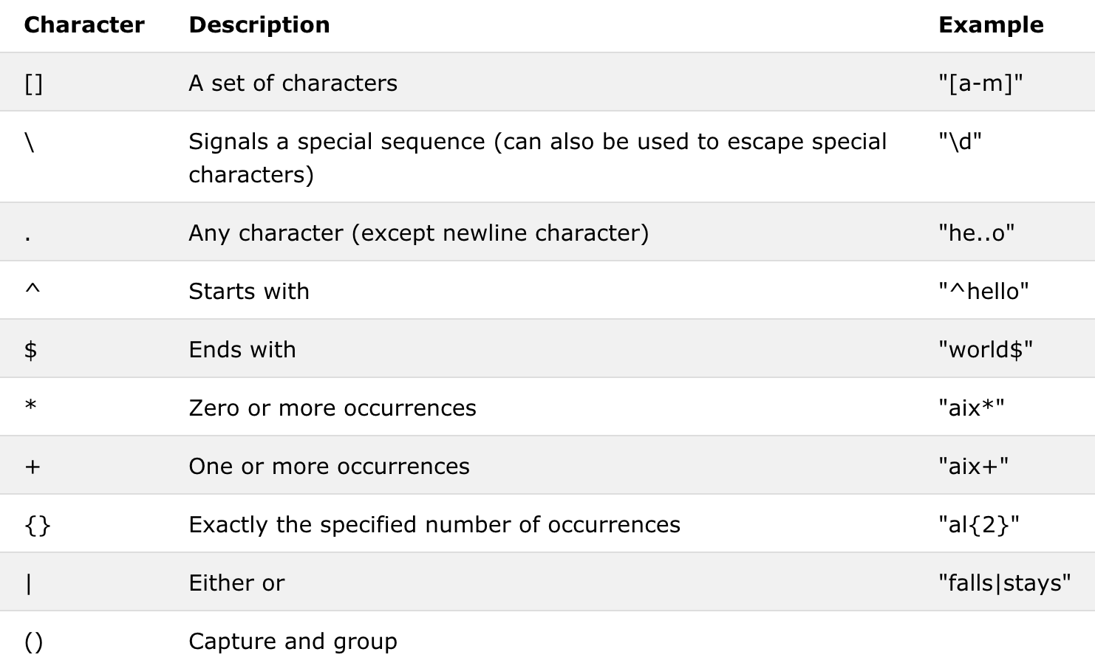

Slide 25
