Slide 1

REVOLUTIONIZING BANKING
IN DIGITAL BONDS USING BLOCKCHAIN
By
Ryaan Riaz Ahamed

Slide 2
DEFI
Decentralized finance works on the same principle as cryptocurrencies’ distributed ledger technology (DLT). It eliminates the need for centralized intermediaries—banks, brokerage firms—and establishes stable Peer-to-Peer (P2P) networks for secure transactions.
This makes the technology highly disruptive; it empowers individuals with an internet connection to directly participate in economic transactions with the relevant parties.

Slide 3

Problem statement:
Traditional bond markets can lack transparency, making it difficult for investors to access detailed information about the bond issuer.
Traditional bonds involve counterparty risk, meaning that the bondholder is dependent on the financial stability and creditworthiness of the issuer.
This fiat currency transactions involves bureaucracy and not diplomatic
Traditional bond markets typically have limited trading hours.

Slide 4

What is digital bond
Digital bonds are a type of bond that is issued and traded using blockchain technology powered by cryptocurrency.
A bond is a type of debt instrument issued by a borrower (such as a corporation or government) to raise capital, which is then lent to the borrower for a fixed period of time at a fixed interest rate.

Slide 5

Smart contracts using blockchain:
Smart contracts are simply programs stored on a blockchain that run when predetermined conditions are met. They typically are used to automate the execution of an agreement so that all participants can be immediately certain of the outcome, without any intermediary's involvement or time loss.
Blockchain stores data in the form of blocks which have header and body. Header have hash value, previous block’s hash, version, Merkel tree root, difficulty and nonce. By using the Proof Of Stake(pos) concept you can retrieve and store block in blockchain.

Slide 6

How DB differs from traditional bond:
Digital bonds allow for more efficient and secure issuance, trading, and settlement. Because the blockchain ledger is immutable and transparent, it can help increase transparency and reduce the risk of fraud.
Digital bonds can also potentially reduce costs associated with traditional bond issuance and trading, as intermediaries such as banks and brokers may not be required and promote individual investors using small investment amounts.

Slide 7
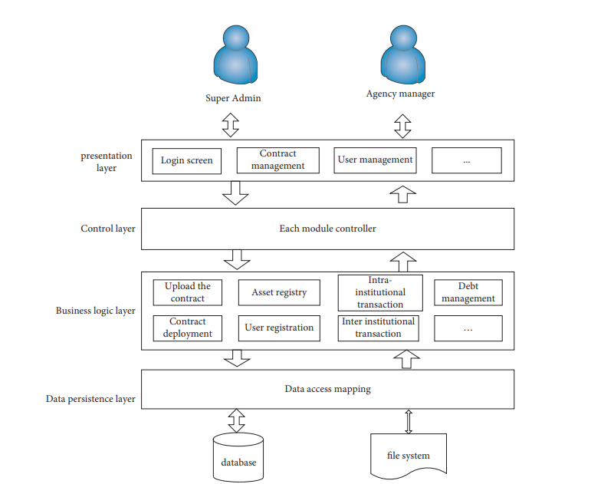
Architecture of DB

Slide 8
Working of digital bond:
First, the process typically consists of creating a digital representation of the bond (or the beneficial ownership in the bond) which is sold to investors and stored on the Trading platform.
In the second case, the bond is listed and stored on the digital exchange.
The digital bond settles via SIX Digital Exchange (SDX) distributed ledger-based central securities depository (CSD) network through atomic settlement technology. Settlement via SDX CSD is instant and automatic and does not require a central clearing counterparty.

Slide 9
Technology used:
Blockchain Technology
Smart contract
SHA 256 – for hashing
Proof of Stake (POS)
XDC – for crypto transactions

Slide 10
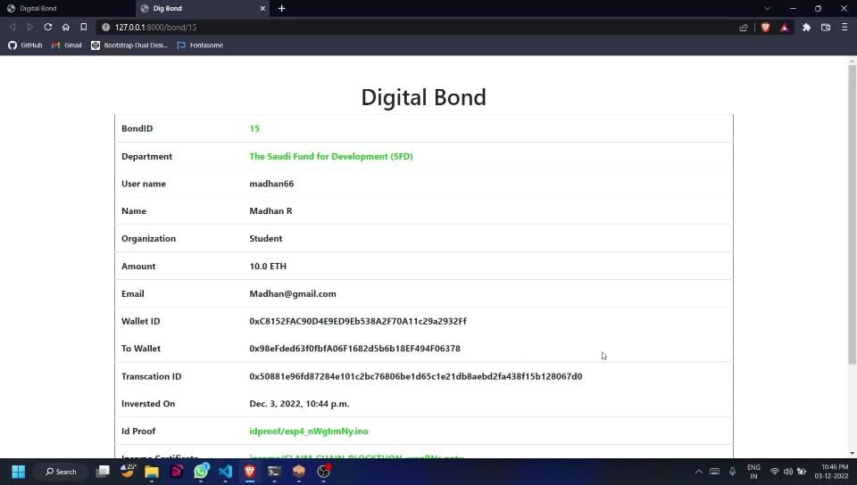
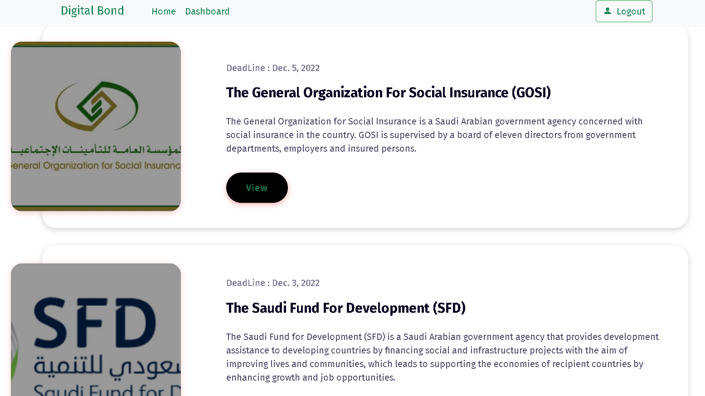
Deployment

Slide 11
Future scope:
According to a 2021 Gartner report, at least 20% of large organizations will shift to digital currencies by 2024 for payments, stored value, or collateral. Alexander Bant, Gartner’s Chief of Research, believes that the uptick of digital currency among C-level executives for business purposes and the emergence of Central Bank Digital Currencies (CBDC), will further boost the global blockchain infrastructure. Large enterprises will eventually incorporate blockchain within their applications and harness its ability to leverage high-yield investments.

Slide 12
Conclusion:
In conclusion, digital bonds utilizing blockchain technology offer numerous benefits and potential advantages for both issuers and investors. By leveraging blockchain's inherent characteristics such as transparency, immutability, and security, digital bonds can revolutionize the traditional bond market in several ways.

