Slide 1
Kubernetes Training

Slide 2

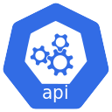
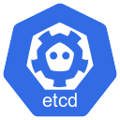
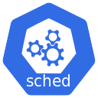
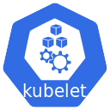
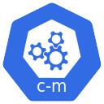
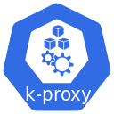
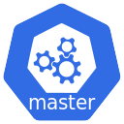
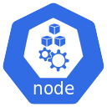
Kubernetes Architecture
Architecture
Notes:
When you install Kubernetes on a System, you are actually installing the following components. An API Server. An ETCD service. A kubeletservice. A Container Runtime, Controllers and Schedulers.
The API server acts as the front-end for kubernetes. The users, management devices, Command line interfaces all talk to the API server to interact with the kubernetescluster.
Next is the ETCD key store. ETCD is a distributed reliable key-value store used by kubernetesto store all data used to manage the cluster. Think of it this way, when you have multiple nodes and multiple masters in your cluster, etcdstores all that information on all the nodes in the cluster in a distributed manner. ETCD is responsible for implementing locks within the cluster to ensure there are no conflicts between the Masters.
The scheduler is responsible for distributing work or containers across multiple nodes. It looks for newly created containers and assigns them to Nodes.
The controller are the brain behind orchestration. They are responsible for noticing and responding when nodes, containers or endpoint get down. The controllers makes decision to bring up new containers in the such cases.
The container runtime is the underlying software that is used to run containers. In our case docker.
Kubelet is the agent that runs on each node in the cluster. The agent is responsible for making sure that containers are running on the nodes a expected.
Kubeproxy is the additional component in the Node. It takes care of networking within Kubernetes.

Slide 3
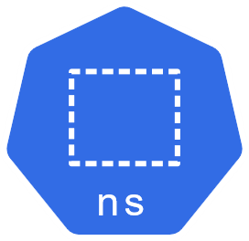
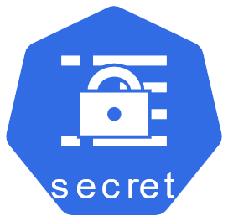
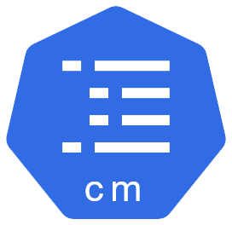
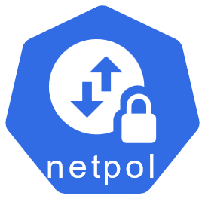
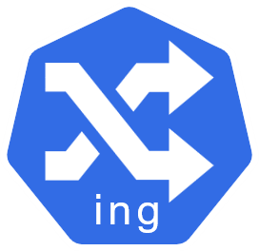
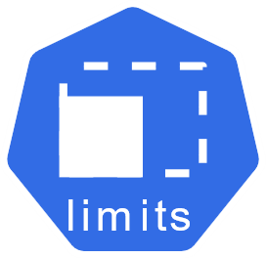
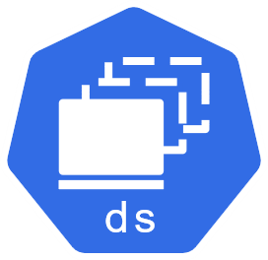
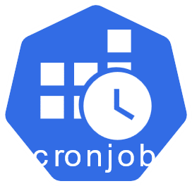
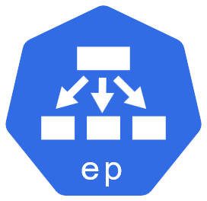
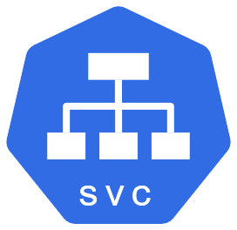
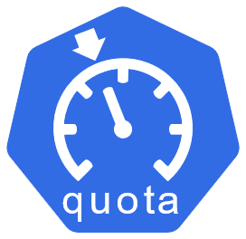

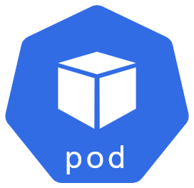
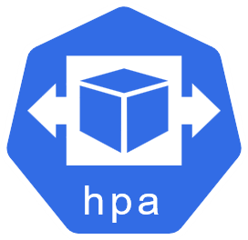
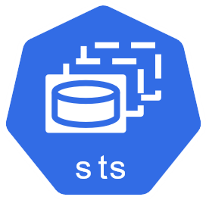
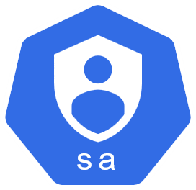
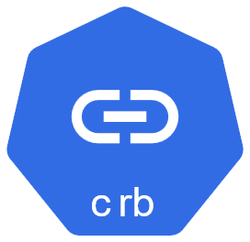
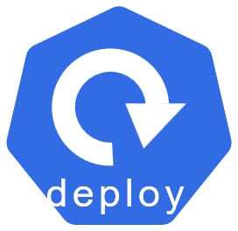
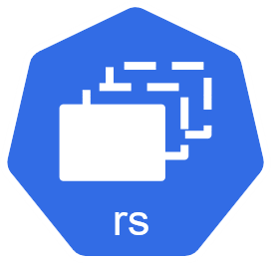
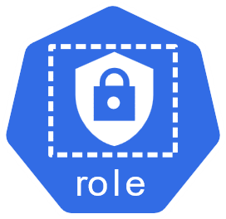
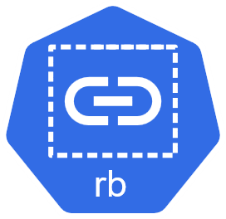
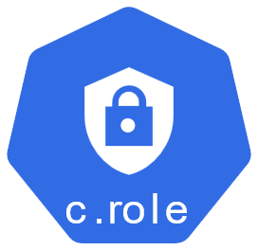
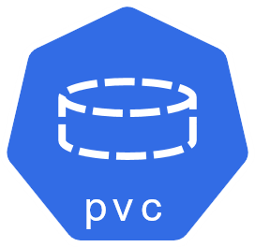
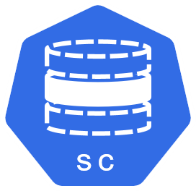
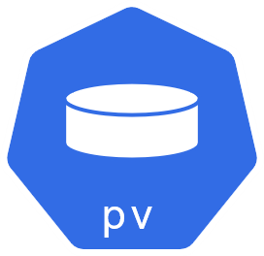
Kubernetes Connecting Dots
Creates
Reference
Pod Generator
RBAC
Storage
Configuration
Network/ Expose
Storage

Slide 4
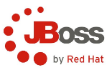




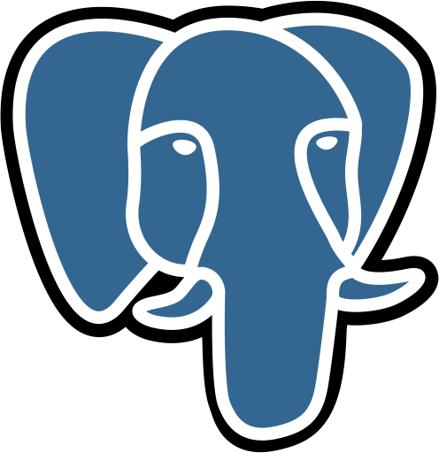

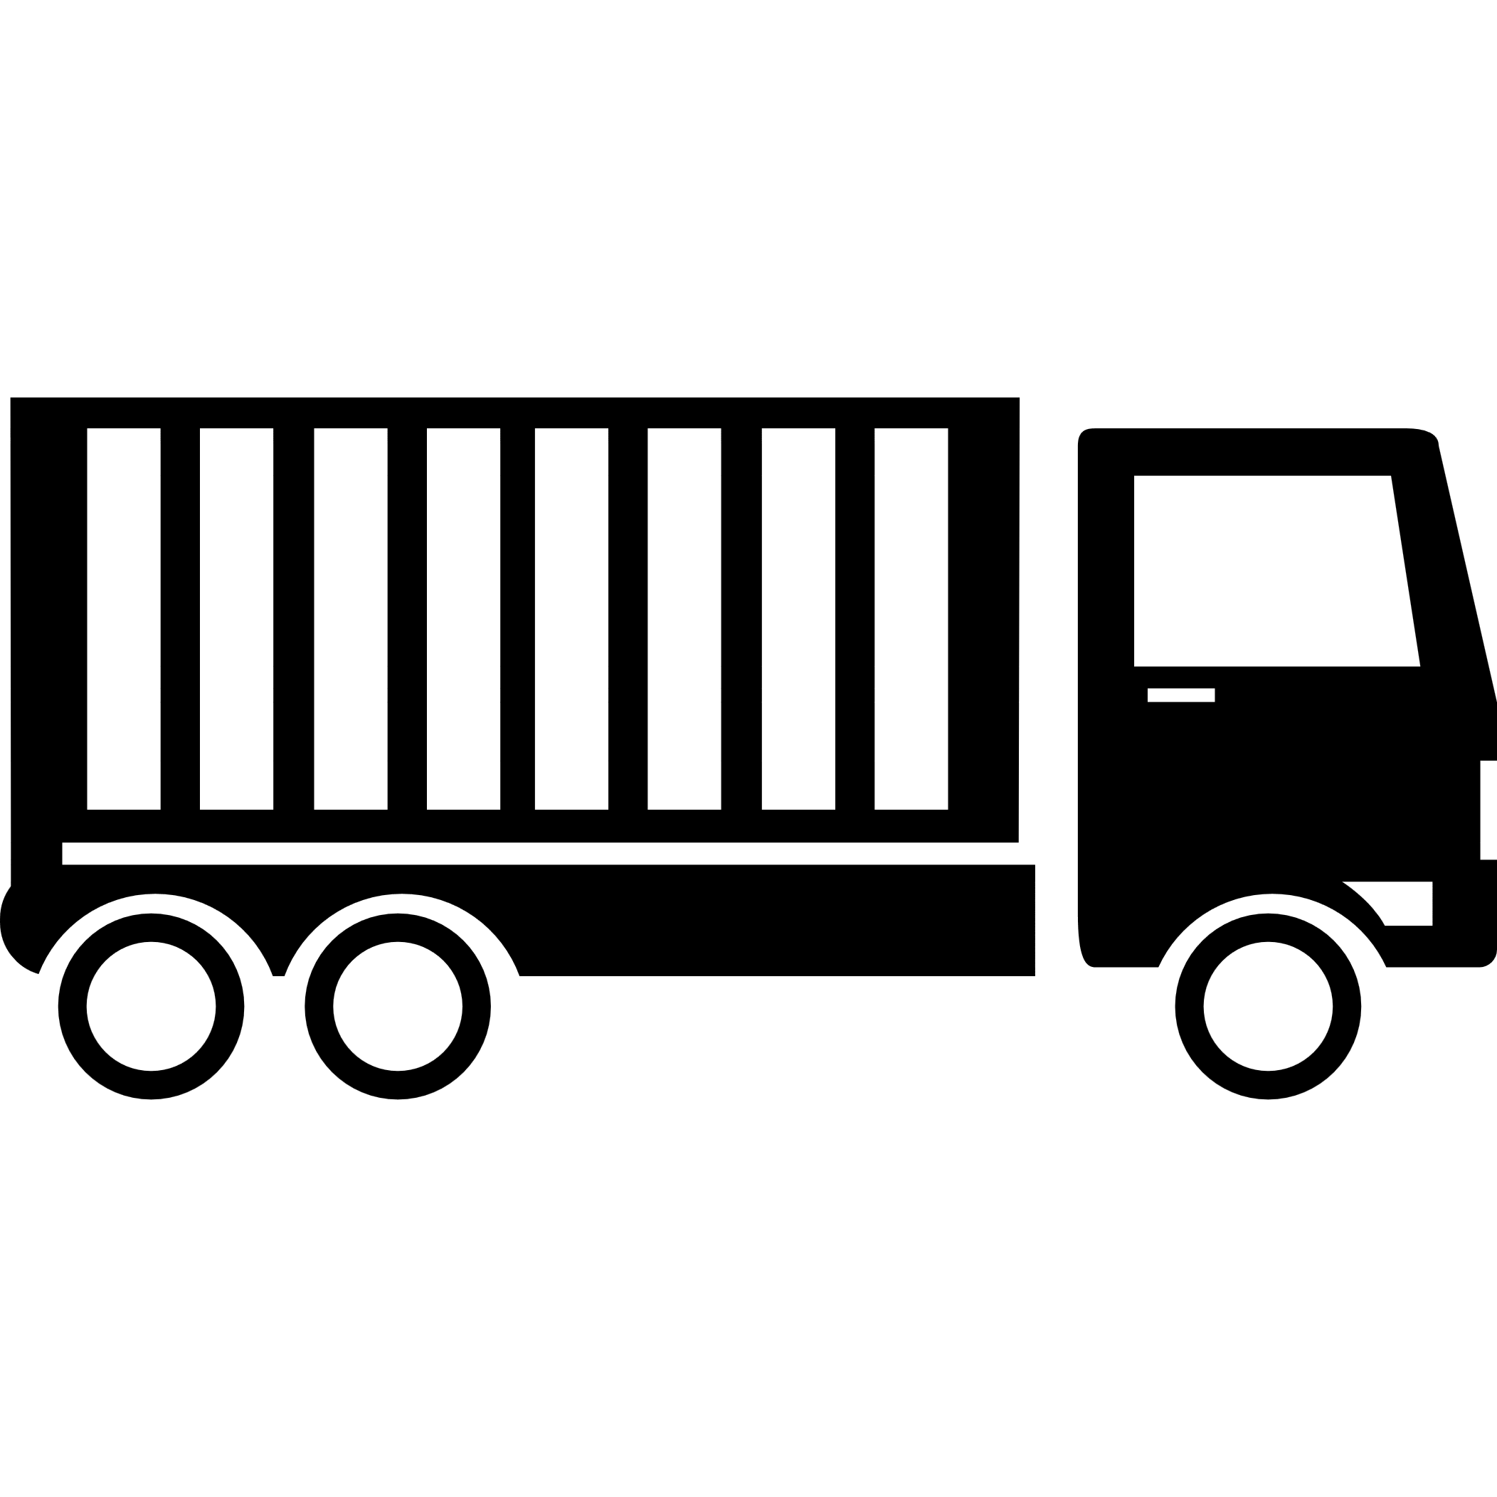


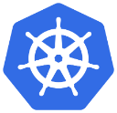
POD
Notes:
Here we see the simplest of simplest cases were you have a single node kubernetes cluster with a single instance of your application running in a single docker container encapsulated in a POD. What if the number of users accessing your application increase and you need to scale your application? You need to add additional instances of your web application to share the load. Now, were would you spin up additional instances? Do we bring up a new container instance within the same POD? No! We create a new POD altogether with a new instance of the same application. As you can see we now have two instances of our web application running on two separate PODs on the same kubernetes system or node.
What if the user base FURTHER increases and your current node has no sufficient capacity? Well THEN you can always deploy additional PODs on a new node in the cluster. You will have a new node added to the cluster to expand the cluster’s physical capacity. <pause> SO, what I am trying to illustrate in this slide is that, PODs usually have a one-to-one relationship with containers running your application. To scale UP you create new PODs and to scale down you delete PODs. You do not add additional containers to an existing POD to scale your application. <pause> Also, if you are wondering how we implement all of this and how we achieve load balancing between containers etc, we will get into all of that in a later lecture. For now we are ONLY

Slide 5
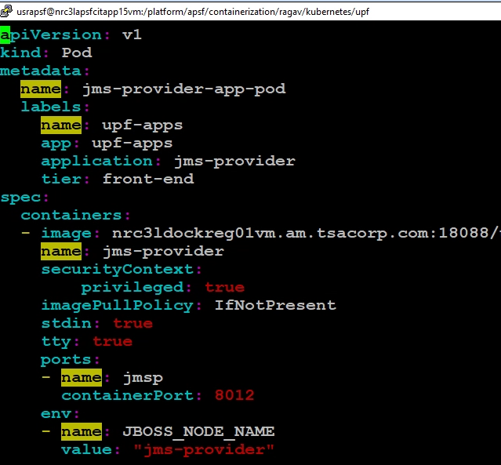
Pod YAML in Kubernetes
string
string
Kind | Version
Pod | v1
Service | v1
ReplicaSet | apps/v1
Deployment | apps/v1
ConfigMap | v1
Dictionary
List/Array
1st in the array list

Slide 6
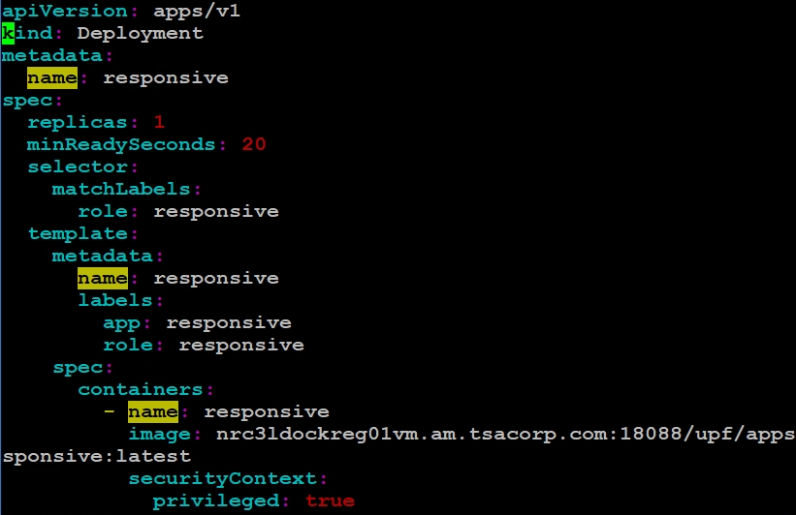
Deployment YAML in Kubernetes
string
string
Kind | Version
Pod | v1
Service | v1
ReplicaSet | apps/v1
Deployment | apps/v1
ConfigMap | v1
Dictionary
1st item in the list
List/Array

Slide 7
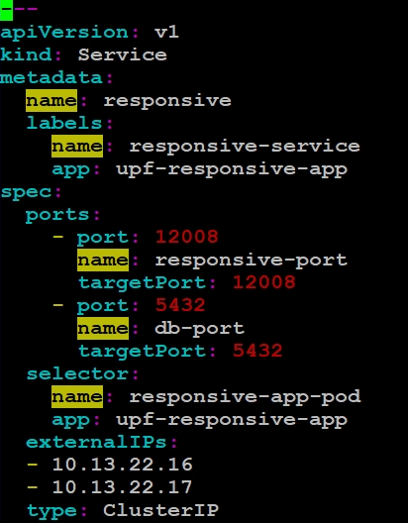
Service YAML in Kubernetes
string
Kind | Version
Pod | v1
Service | v1
ReplicaSet | apps/v1
Deployment | apps/v1
ConfigMap | v1
string
Dict
List/Array
1st item in the list

Slide 8
Thank you for your attention
Prince Infocity II, 6A, 6th Floor
No. 283/3 & 283/4 | Rajiv Gandhi Salai (OMR)
Kandanchavadi | Chennai – 600096 | India

