Slide 1
AI CAPABILITY STACK
Maintenance Wizard turns plant evidence, live IoT telemetry, and adapter-backed AI into governed action.
4
assistant personas: Neo, Trinity, Morpheus, Smith
Neo, Trinity, Morpheus, and Smith run on deterministic services plus llama-server adapter serving: ingestion, monitoring, retrieval, risk, prediction, work orders, learning review, and reports.
5
sample steel-plant assets in the demo set
SENSE
RETRIEVE
REASON
ACT
LEARN
5
alerts, sensors, anomalies
Qdrant evidence and learning
RCA, PM, prediction context
work orders, plans, reports
judge, approve, tune
data paths: file, JSON, IoT stream, simulator, feedback
RAG+PEFT
immediate grounding plus controlled specialization
Sources: README AI Capabilities, Monitoring, setup guide, architecture data flow
01

Slide 2
ASSISTANT OPERATING MODEL
The AI personas split the maintenance workload instead of acting like one generic chatbot.
Each assistant is grounded by the same app context, role checks, provider adapter, retrieval layer, streaming contract, and deterministic guardrails.
Neo + Trinity
Morpheus
Smith
Command center + work execution
Diagnosis and planning
Reliability execution
Neo handles dashboard answers, asset lookup, and app-owned tables. Trinity guides technician execution, supervisor follow-up review, problem codes, completion summaries, and approved work-order actions.
RCA, probable root causes, immediate actions, planned actions, PM plan drafting, Fishbone structure, RAG evidence and confidence context.
Failure probability explanation, RUL drivers, degradation narrative, cautions, recommended next steps, technician-ready PM steps.
Visible in dashboard, Work Execution, and role-specific assistance.
Visible in diagnose, RCA Workspace, and PM planning flows.
Visible in Reliability tab and PM task conversion.
Sources: README assistant roles, architecture work-order assistant service, demo script
02

Slide 3
AI WORKFLOW
AI adds judgment around deterministic plant controls, not instead of them.
01
02
03
04
05
Plant state
Evidence
AI reasoning
Workflow
Learning
alerts, readings, spares, work history
manuals, SOPs, logs, approved learning
root causes, actions, PM/RCA, explanations
work orders, plans, reports, feedback
judge scores, approval, JSONL, model versions
CONTROL RAIL
JWT role guards | Pydantic schemas | structured JSON validation | deterministic fallback | reviewer approval | audit records
Sources: docs/architecture.md LLM Boundaries and Data Flow
03

Slide 4
RAG + PEFT ARCHITECTURE
RAG improves answers immediately; PEFT turns approved learning into controlled model specialization.
The same learning sources can feed prompt-time retrieval today and LoRA/QLoRA adapter candidates later, but only after judge scoring and human approval.
SOURCE KNOWLEDGE
QDRANT RAG
LIVE ASSISTANTS
Document chunks, approved learning examples, and indexed plant records retrieved into prompts with asset context.
Neo, Morpheus, Smith, recommendations, reranking, labeling, document intelligence.
- SOPs and manuals
- Logs and history
- Engineer feedback
- Work-order outcomes
- Approved assistant interactions
LEARNING REVIEW
PEFT ADAPTER CANDIDATE
LLM-as-a-Judge score, reviewer approval, dataset snapshots, evaluations, deployment verification.
Approved JSONL -> LoRA/QLoRA trainer -> candidate model -> evaluation -> promotion or rollback.
Sources: docs/rag-peft-nats-learning-architecture.md, docs/peft-training.md
04

Slide 5
INGESTION + MONITORING FABRIC
Ingestion covers static knowledge, operational records, simulator-fed IoT telemetry, monitoring alerts, and learning signals.
Every path lands in typed storage and retrieval indexes so monitoring, diagnosis, prediction, planning, and reporting can reuse the evidence.
FILES
.txt .md .csv .log .json .pdf
Recommendations
NORMALIZE + INDEX
root causes, actions, evidence
JSON RECORDS
equipment, alerts, spares, sensors, history
Parser, document intelligence, schema validation, chunking, embedding metadata, repository writes.
Prediction
risk, RUL, drivers
NATS IOT + SIM
JetStream consumer, simulator, ACK, DLQ
PM/RCA
FEEDBACK
root cause, action, outcome, notes
SQLite local store + Qdrant vector collection
plans, tasks, Fishbone
Reports
LEARNING JOBS
judge, dataset, evaluation, PEFT
insights, alerts, logs, Markdown
Sources: README ingestion modes, docs/architecture.md API Surface and Data Flow
05

Slide 6
REPORTS
Reports package AI recommendations into maintenance handoff artifacts.
The reporting layer exports structured maintenance intelligence and Markdown summaries that carry risk, RUL, actions, evidence, and learning notes.
MAINTENANCE INSIGHT BUNDLE
WHAT THE REPORT CARRIES
Structured maintenance reports
risk and health summary
Markdown export keeps the demo portable while typed endpoints expose each report family to the UI.
Abnormal alert reports
failure probability and RUL
Maintenance decision summaries
Digital maintenance log entries
root causes and actions
Markdown export
evidence and learning notes
Sources: backend/app/services/reports.py, README Decision-Support Features
06

Slide 7
GOVERNED AI
Every AI capability is paired with a control that limits operational risk.
The system is intentionally not online self-training. It is auditable RAG reuse and PEFT-ready preparation with human approval, evaluations, and rollback.
CAPABILITY
CONTROL
EVIDENCE
RESULT
LLM output
Pydantic schema validation
structured JSON contracts
validated or explicit error
RAG reuse
judge score + approval
Qdrant payload filters
grounded prompts
PEFT
dataset, eval, deploy gates
artifact hashes and versions
candidate only
Actions
role guards and backend rules
JWT current user context
no model-owned writes
Streaming
timeouts and final events
provider labels and logs
readable live UI
Authoritative services: auth, ingestion, risk/RUL, persistence, work-order state, approval, evaluation, promotion, rollback.
Sources: docs/architecture.md LLM Boundaries, Continuous Improvement
07

Slide 8
DEMO PATH
The demo proves the architecture through visible workflows, not just architecture diagrams.
Narrative: show the AI assistants first, then reveal the RAG, PEFT, ingestion, and report machinery that makes them credible and repeatable.
01
Dashboard
02
Asset detail
03
Diagnose
04
Reliability
plant health and role-aware Neo
alerts, anomalies, evidence
Morpheus root causes and actions
Smith prediction narrative and RUL
05
Ingestion
06
Learning
07
Reports
files, records, streaming status
RAG status, examples, datasets, PEFT
refresh, review, export Markdown
Sources: docs/demo_script.md, README Project Layout and Current Capabilities
08

Slide 9
SYSTEM ARCHITECTURE
The architecture separates user workflows, deterministic services, AI enrichment, and learning stores.
React and FastAPI expose the workflow. Retrieval, risk, prediction, and learning services enrich decisions while SQLite, Qdrant, and NATS keep state and async flow explicit.
PLANT USERS + UI
FASTAPI + AUTH
MAINTENANCE APIS
AI ADAPTER
Admin, engineers, planners, operators
React dashboard, assets, ingestion, reports
Typed HTTP API
JWT current user
Role guards and validation
Dashboard, assets, diagnosis, prediction, work orders, PM/RCA, reports, users
Mock, OpenAI-compatible, Ollama
Readable streams + schemas
INGESTION
RETRIEVAL
RISK + PREDICTION
LEARNING LOOP
STORES
Files, JSON records, NATS IoT stream
Parser, document intelligence, Qdrant RAG, reranking
Anomalies, criticality, spares, labels, RUL drivers
Feedback, judge, approved JSONL, PEFT workers
SQLite operational store
Qdrant vectors
NATS JetStream
Sources: docs/architecture.md System Diagram, Components, API Surface
09

Slide 10
FULL TECH STACK
The prototype runs on a production-aligned local stack, from UI and APIs to RAG, streaming, IoT monitoring, llama-server adapter serving, and PEFT hooks.
The stack is intentionally provider-agnostic: deterministic local demo paths stay available while OpenAI-compatible, Ollama, Qdrant, NATS, and PEFT integrations can be enabled.
BACKEND API
Python 3, FastAPI, Pydantic, Uvicorn
AI PROVIDERS
Mock, OpenAI-compatible chat, Ollama chat
STREAMING
NATS JetStream, durable consumers, ACK, DLQ
PERSISTENCE
SQLite local store, startup migrations
LOCAL LLM
llama-server Qwen2.5 7B base + LoRA adapter
LEARNING
LLM-as-a-Judge, approvals, JSONL snapshots
FRONTEND
React, TypeScript, Vite, CSS modules, lucide-react
ASSISTANTS
Neo, Trinity, Morpheus, Smith role-aware modes
PEFT TRAINER
Transformers, PEFT, TRL, bitsandbytes, Accelerate
AUTH
bcrypt hashes, JWT bearer tokens, role guards
RAG/VECTOR
Qdrant, deterministic embeddings, SQLite fallback
TESTS
Pytest, Vitest, Testing Library, Playwright
REPORTS
Typed insight reports, Markdown export
PARSING
Text/Markdown/CSV/log/JSON, pypdf PDFs
ORCHESTRATION
Bash scripts, Docker NATS/Qdrant, IoT simulator, Kind runner
Source: README.md Tech Stack and setup guide
10

Slide 11
FEATURE COVERAGE
Beyond the AI layer, the app covers the maintenance lifecycle end to end.
The AI assistants are connected to implemented product surfaces: assets, diagnosis, reliability, planning, work execution, learning review, user administration, and exports.
Asset intelligence
Decision support
Reliability
Plant dashboard, company asset table, lazy-loaded asset detail, health and risk views
Chat, diagnose, retrieved evidence, root causes, actions, spares strategy
Anomaly detection, failure probability, RUL, confidence intervals, degradation trend
Work management
PM + RCA
Learning + admin
Work-order queue, lifecycle, planning, dispatch, material blockers, technician logs
Morpheus PM/RCA drafts, Fishbone capture, Smith technician-ready PM steps
Feedback, labels, Learning Review, datasets, model versions, RBAC users
Demo proof: five steel-plant assets, role-specific screens, streaming-enabled local stack, typed APIs, and Markdown report export.
Sources: README.md Current Capabilities and Decision-Support Features
11

Slide 12
HACKATHON OBJECTIVES
The application addresses each hackathon objective with implemented maintenance workflows.
AI improves judgment and explanation, while deterministic services keep scoring, ingestion, role access, persistence, and work-order transitions controlled.
OBJECTIVE
APP MECHANISMS
PROOF / OUTPUT
Faster and more accurate diagnosis
Chat + Diagnose APIs, Qdrant evidence retrieval, structured LLM validation, deterministic fallback
Recommendation panel returns diagnosis, confidence, actions, spares, evidence
Probable root causes of failures
Morpheus RCA, retrieved SOP/manual/history evidence, prior feedback, Fishbone capture
Root-cause list, RCA workspace, learning notes, cited evidence
Degradation and remaining useful life
Prediction API, risk service, anomaly findings, labels, confidence intervals, degradation trend
Smith reliability narrative, failure probability, RUL drivers
Proactive abnormality and catastrophic risk
Rolling baseline, z-score, thresholds, trend delta, severity and criticality scoring
Anomaly findings, health risk notes, critical/high alerts
Prioritized maintenance actions
Risk level, active alerts, equipment criticality, spares availability, lead time, material readiness
Immediate/planned actions, work-order planning, procurement blockers
Structured insights and reports
Typed report service, maintenance insight bundles, abnormal alert reports, decision summaries
Markdown export with diagnosis, risk, RUL, actions, evidence
Traceability: each theme objective maps to a visible screen, typed API, persisted record, or report artifact.
Sources: README Decision-Support Features, docs/architecture.md Data Flow and LLM Boundaries
12

Slide 13
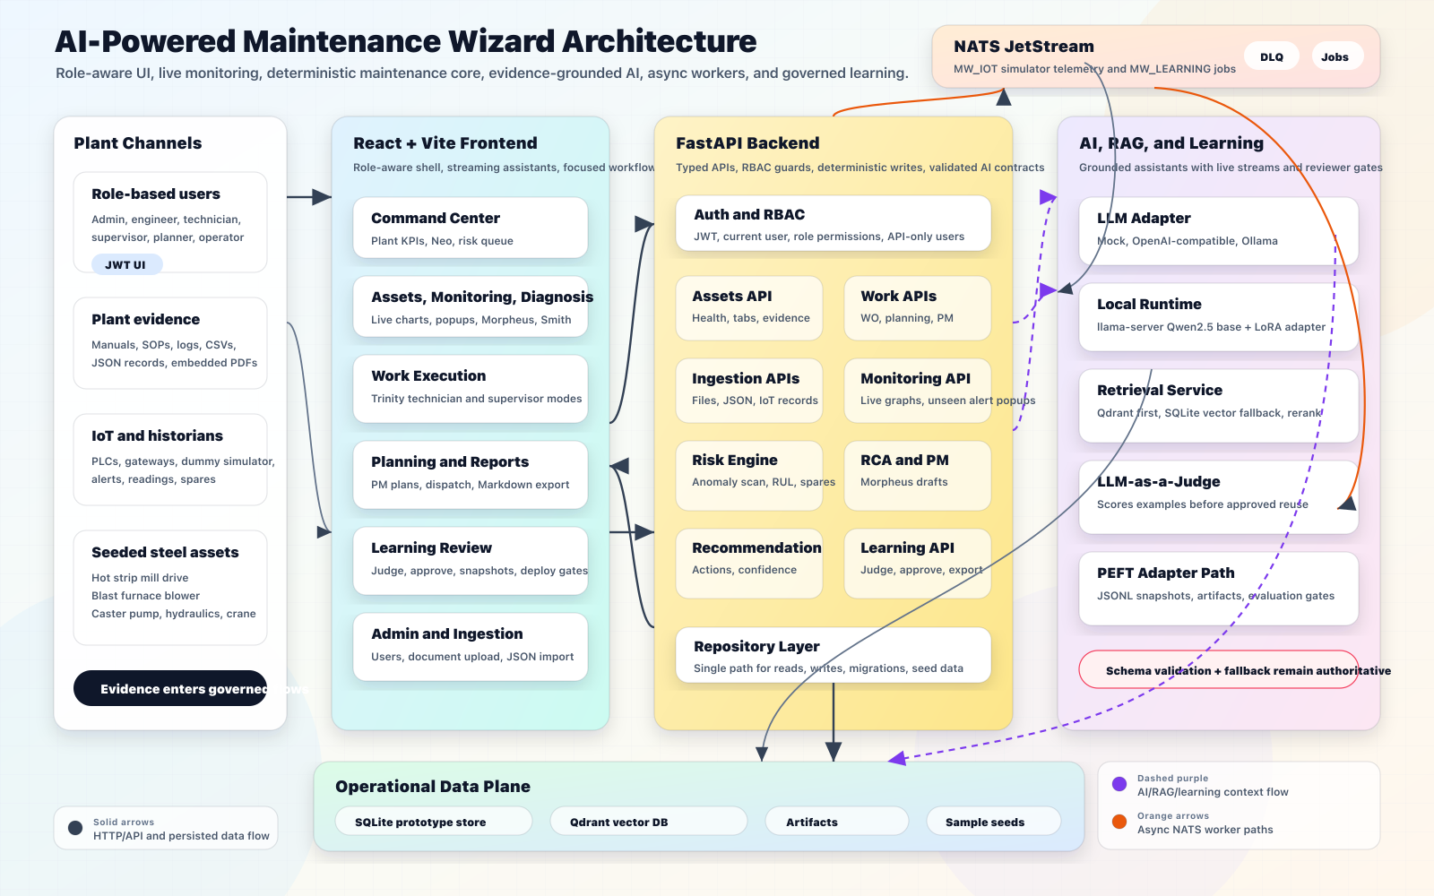
SYSTEM ARCHITECTURE
13
Maintenance Wizard application architecture
Role-aware UI, deterministic maintenance services, evidence-grounded AI, async workers, RAG storage, and reviewer-controlled learning.
Diagram view: plant channels -> React workflows -> FastAPI/RBAC -> deterministic services -> AI/RAG/learning -> operational data stores.

