Slide 1
LOGISTICS MANAGEMENT SYSTEM

Slide 2
TABLE OF CONTENTS
01
02
03
04
Objective
Problem statement
Proposed solution
UML diagram

Slide 3
01
Project objective

Slide 4

Project Objective:
To develop a comprehensive logistics management system that enhances the efficiency and effectiveness of managing the movement and storage of goods within a supply chain.
GOALS:
Streamline logistics operations
Reduce operational costs.
Improve customer satisfaction

Slide 5
02
Problem statement

Slide 6
Problem statement:
The objective of this project is to develop a state-of-the-art logistics management system that integrates all aspects of the supply chain, from order management to final delivery.
This system will streamline and optimize logistics processes, ensuring efficient transportation planning, warehouse management, and shipment tracking.
By providing real-time visibility and robust analytics, the system will enable businesses to make data-driven decisions, reduce operational costs, and enhance customer satisfaction.

Slide 7
03
Proposed system

Slide 8
Proposed Solution:
Integrated Logistics Platform
Real-Time Tracking and Visibility
Advanced Analytics and Reporting
Scalable and Customizable Architecture

Slide 9
04
UML diagram

Slide 10
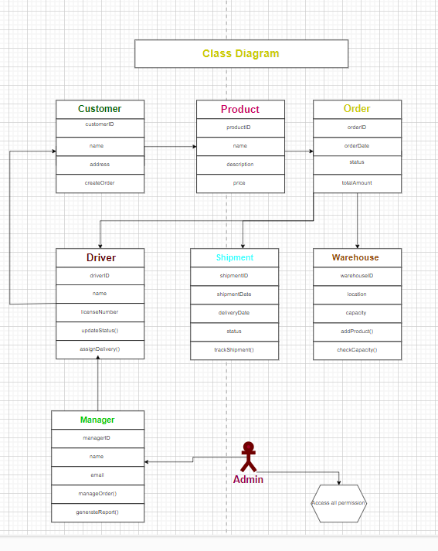
Class diagram:

Slide 11
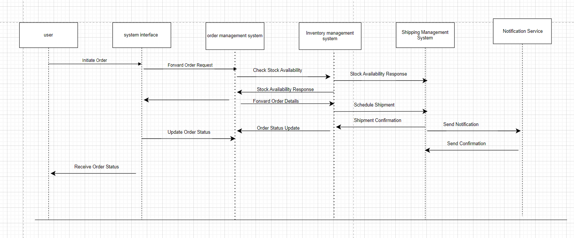
Sequence diagram:

Slide 12
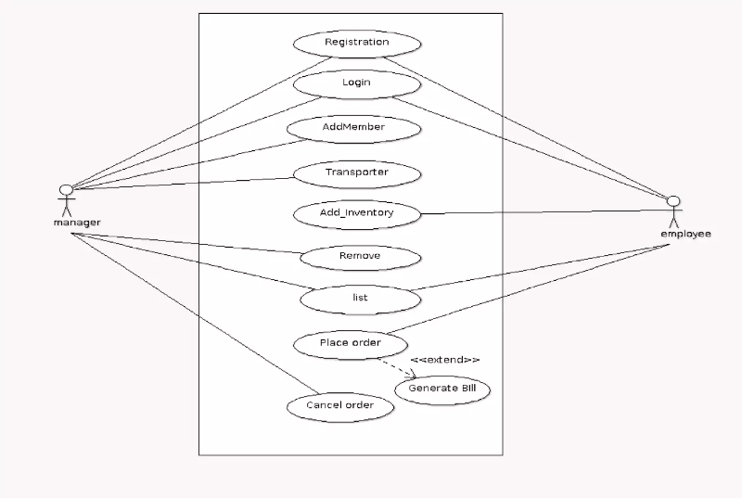
Use case diagram:

Slide 13
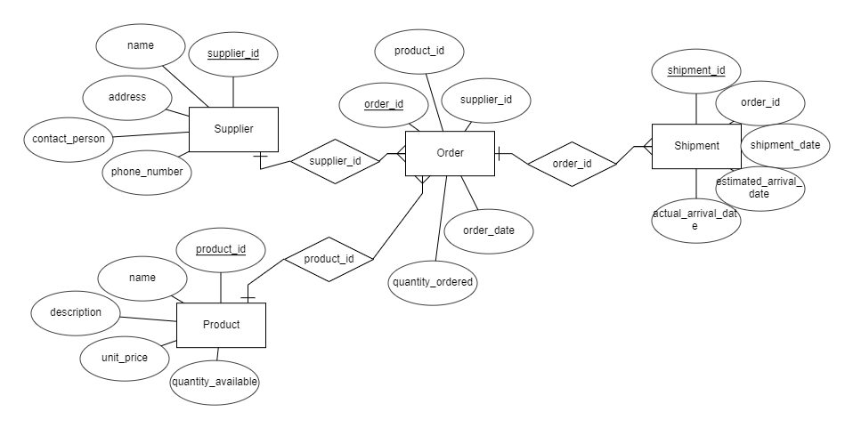
ER diagram:

Slide 14


