Slide 1
Digital Portfolio
STUDENT NAME: RAGAVI B
NMID: 86151B1ED3735D8A9F5410C0636DFBCD
DEPARTMENT: BCA-II Year
COLLEGE: GOVERNMENT ARTS COLLEGE ,CHIDAMBARAM
1

Slide 2
PROJECT TITLE
Digital Portfolio
A Digital Portfolio is a personal website that displays an individual’s skills, education, projects, and achievements in a well-organized and attractive format.
It is designed using HTML, CSS, and optionally JavaScript to create a simple and responsive layout.
2

Slide 3

AGENDA
Problem Statement
Project Overview
End Users
Tools and Technologies
Portfolio design and Layout
Features and Functionality
Results and Screenshots
Conclusion
Github Link
3/21/2024 Annual Review
3

Slide 4

PROBLEM STATEMENT
Problem statement
To design and develop a personal portfolio website for a BCA student that displays details such as profile, education, skills, and contact information in a simple and responsive manner.
The website should:
Provide smooth navigation across sections like Home, About, Skills, Education, and Contact.
Present information clearly with an attractive layout. Work on both mobile and desktop devices.
4

Slide 5

PROJECT OVERVIEW
Project Overview – Digital Portfolio Website
Project Title:Personal Digital Portfolio
N.DHARANI BCA Student
Objective: To design and develop a responsive portfolio website to showcase academic background, skills, and contact details professionally.
5

Slide 6
PROJECT OVERVIEW
Key Features :
Navigation Bar – Links to Home, About, Skills, Education, and Contact sections.
Hero Section – Displays name, title, location, and social links.
About Section – Overview of education and career interests.
Skills Section – Programming skills in Python, C++, and C. Education Section – Academic details and learning focus.
Contact Form – Allows visitors to get in touch via email.
Responsive Design – Compatible with mobile and desktop devices.

Slide 7
PROJECT OVERVIEW
Technologies Used:
HTML5 – Structure of the website.
CSS3 – Styling and layout design.Font Awesome – Icons for visual enhancement.
JavaScript – Interactive features (toggle menu, contact form).
Expected Outcome:
A professional-looking personal portfolio website that highlights academic and career achievements, helping in internships, job applications, and professional networking.

Slide 8

WHO ARE THE END USERS?
Potential Employers / Recruiters
To review your skills, education, and contact information for internships or job opportunities.
College Faculty / Academic Evaluators
To assess your project work, presentation, and technical knowledge.
Peers / Collaborators
Fellow students, developers, or friends who may want to collaborate on projects.
General Visitors
Anyone interested in learning about your background, skills, and academic journey.
8

Slide 9

TOOLS AND TECHNIQUES
Tools Used
HTML5 – Structure and content of the website.
CSS3 – Styling, layout, and visual design. Font Awesome – Icons for navigation and sections.
JavaScript – Interactivity (menu toggle, form handling).
Code Editor(codepen/ easy coder web)–
For writing and edit Chrome code.
Web Browser(Chrome)– For testing and running the website.
9

Slide 10
TOOLS AND TECHNIQUES
Techniques Used
Responsive Web Design (RWD) – Ensuring website works on mobile, tablet, and desktop. Navigation Bar Design – Smooth section linking for user-friendly experience.
Section-Based Layout – Dividing content into
Hero, About, Skills, Education, and Contact sections.
Form Handling Technique – Collecting user input in the contact form.
Use of External Libraries – Font Awesome for icons.

Slide 11
POTFOLIO DESIGN AND LAYOUT
Design
Minimal & Professional Look – Clean and simple interface with a focus on content.
Font Awesome Icons– For visual appeal and navigation clarity.
Color Scheme – Soft background with readable text contrast.
Typography – Clear headings and readable body text.
11

Slide 12
PORTFOLIO DESIGN AND LAYOUT
Layout
Navigation Bar – Fixed menu with Home, About, Skills, Education, and Contact sections.
Hero Section – Name, title, location, and quick action buttons (LinkedIn, Contact).
About Section – Personal introduction and highlights (Education Focus, Interests, Goals).
Skills Section – List of technical skills (Python, C++, C).
Education Section – Details of academic background and highlights.
Contact Section – Contact details, social links, and message form.
Footer – Copyright and brief info.

Slide 13
FEATURES AND FUNCTIONALITY
Features
Responsive Design – Works on desktop, tablet, and mobile.
Navigation Bar – Easy access to all sections (Home, About, Skills, Education, Contact).
Hero Section – Profile name, title, and location displayed prominently.
Interactive Buttons – LinkedIn and contact
links open directly.
Font Awesome Icons – For better visual representation of sections.
Contact Form – Users can send messages
directly.
Footer – Displays copyright and basic information.

Slide 14
FEATURES AND FUNCTIONALITY
Functionality
Smooth Scrolling between sections using navigation links. Clickable Social Media Buttons to redirect to LinkedIn.
Form Submission to collect visitor messages (can be linked to email or database in future).
Mobile-Friendly Layout ensuring proper alignment across all devices.

Slide 15
RESULTS AND SCREENSHOTS
Results
A fully functional personal digital portfolio website was created.
Showcases profile, education, skills, and contact information in an interactive layout.
Responsive design works seamlessly on desktop and
mobile devices.
Provides easy navigation and direct LinkedIn integration.
3/21/2024 Annual Review
15

Slide 16
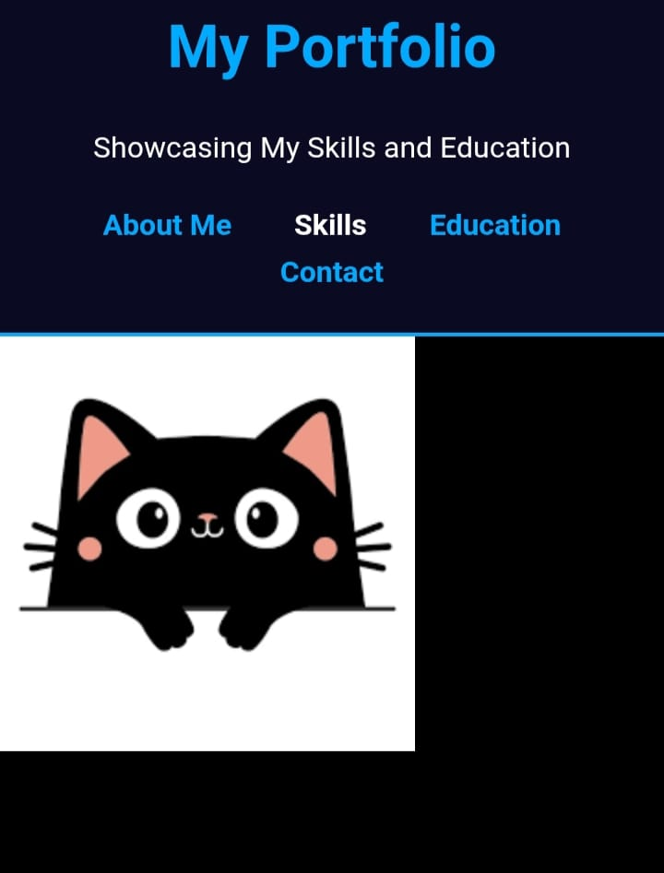
Screenshot
Homepage– Showing name, title, and avatar.

Slide 17
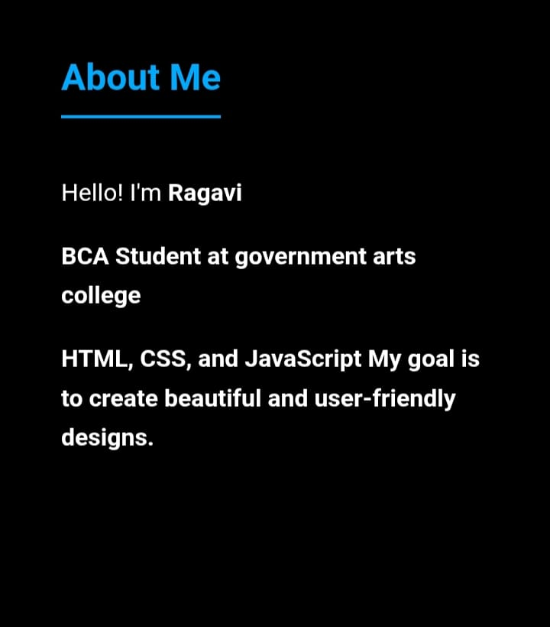
About Section – Displaying bio and highlights.

Slide 18
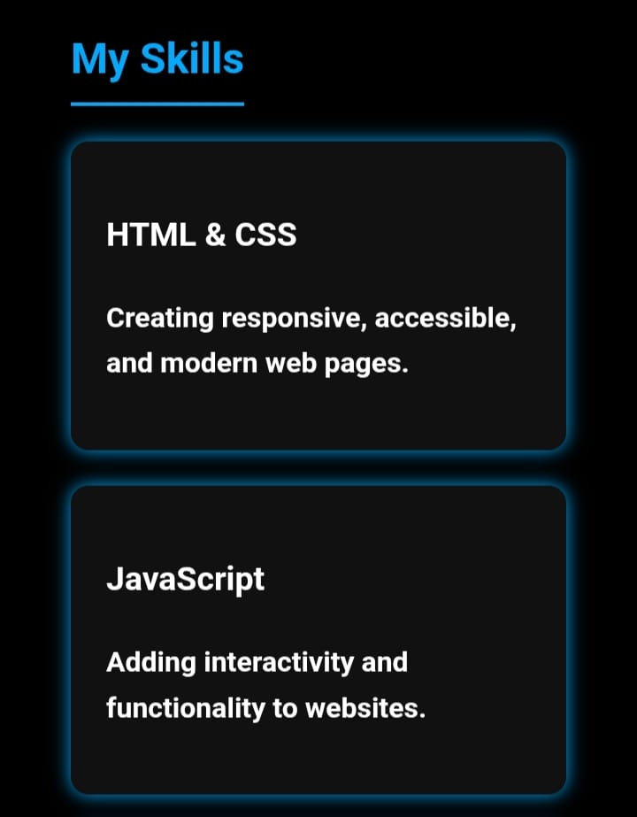
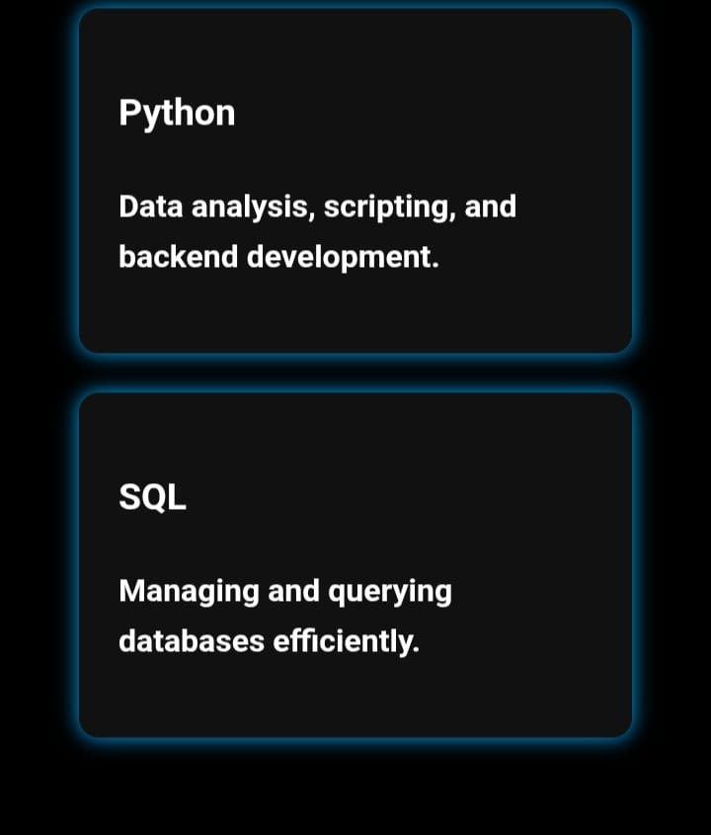
Skills Section – Listing programming languages.

Slide 19
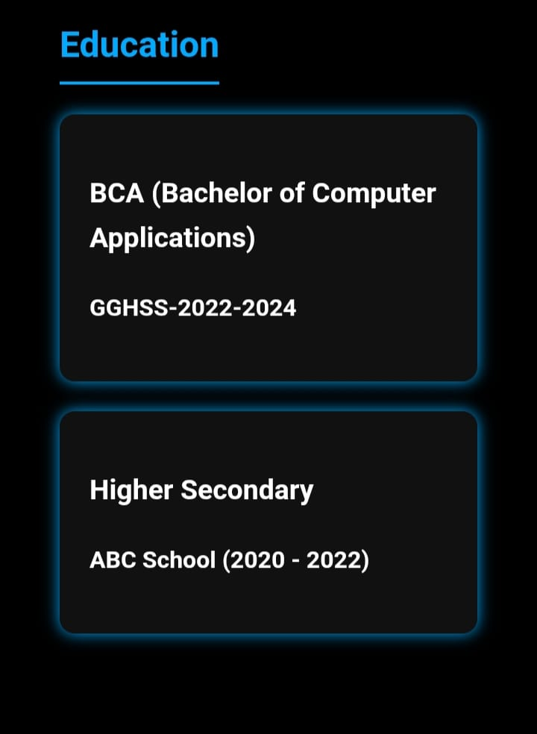
Education Section – College name, course, and highlights.

Slide 20
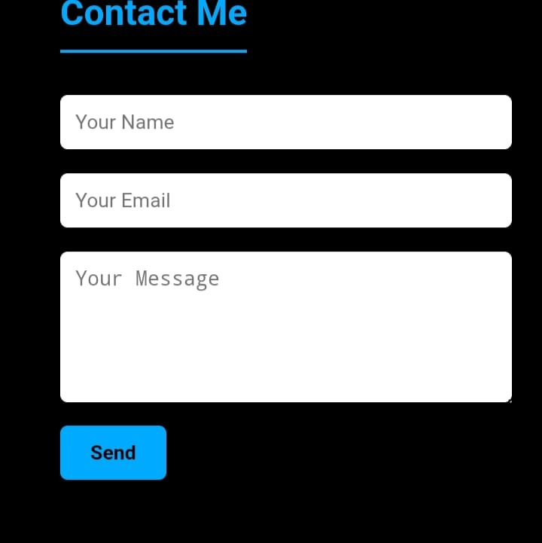
Contact Section – Email, LinkedIn, and contact form.

Slide 21
CONCLUSION
Conclusion for Digital Portfolio Project
“The Digital Portfolio effectively showcases my personal profile, academic background, technical skills, and career aspirations in an organized and visually appealing format. It serves as a professional platform for potential employers, faculty, and collaborators to learn about my abilities and achievements. The project demonstrates my knowledge of web development using HTML, CSS, and JavaScript and highlights my capability to create user-friendly and responsive designs.”
“THANK YOU”
21

