Slide 1
EventMate
Team Member's:
Manisha
Ragavi
Sanjana
Ranjeetha M
Aagam Kasliwal

Slide 2

Introduction to project
EventMate is an intelligent event management platform designed to simplify the process of planning, organizing, and scheduling events.
Traditional event management often involves challenges such as manual scheduling, tracking resources, sending timely reminders, and ensuring smooth coordination between participants. EventMate addresses these challenges that automates and optimizes the entire workflow.
The system enables users to create and manage events, schedule sessions, allocate resources, and send personalized notifications.

Slide 3
Project Description
EventMate is a smart event management system designed to simplify the entire process of planning, scheduling, and managing events. The project integrates a React-based frontend with a Spring Boot backend, providing a seamless and secure platform for both users and organizers.
Frontend (React) – Provides an interactive UI for users to register, log in, create and manage events.
Backend (Spring Boot + Java) – Manages business logic, user authentication, and database operations.
Database (MySQL) – Stores user information, events, and scheduling data.
Build Tool (Maven) – Handles dependency management and project build process.

Slide 4

Frontend and Backend
The frontend of EventMate is developed using React.js, a popular JavaScript library for building dynamic and interactive user interfaces. It leverages reusable components such as event cards, forms, and buttons, which help maintain a consistent look and feel throughout the application.
React.js enables real-time updates on the page without full reloads, allowing users to smoothly browse events, book tickets, and manage their profiles. The frontend communicates seamlessly with the backend to fetch and display event and user data, ensuring efficient performance
Additionally, the application is designed to be responsive, providing an optimal experience across desktops, tablets, and mobile devices.

Slide 5
Objective of Project
Provide a digital event management platform
The primary objective is to create an online system where users can easily manage their events without relying on manual methods. This reduces complexity, saves time, and ensures smooth organization of activities.
Simplify event creation and scheduling
EventMate allows users to add, edit, and delete events with proper time and date management. This ensures that event planning becomes more structured, avoiding conflicts and overlaps.
Ensure secure user authentication and data handling
By using JWT-based login and registration, the system guarantees that only authorized users can access their event data. This provides both privacy and data security.
Deliver a reliable, scalable, and user-friendly solution
With a React frontend and Spring Boot backend, the system is designed to be responsive, interactive, and capable of handling multiple users efficiently, ensuring a smooth user experience.

Slide 6
Features
User Registration & Authentication – Secure signup and login for attendees and organizers.
Event Creation & Management – Organizers can create, update, and manage events with details like date, venue, and description.
Event Booking & Ticketing – Attendees can browse events, book tickets, and receive confirmations.
Search & Filters – Users can search events by category, date, or location and apply filters for easy navigation.

Slide 7
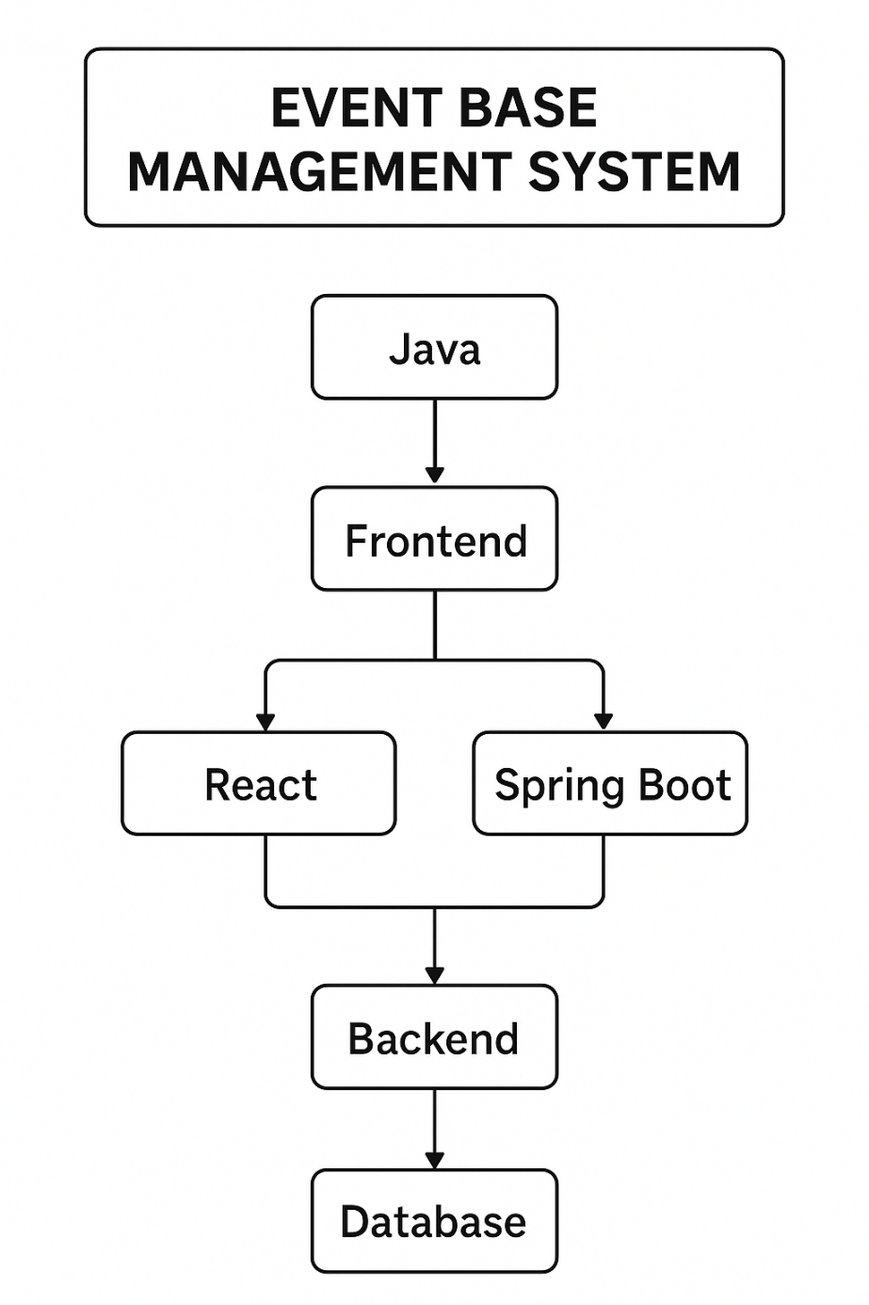
Flow Chart

Slide 8
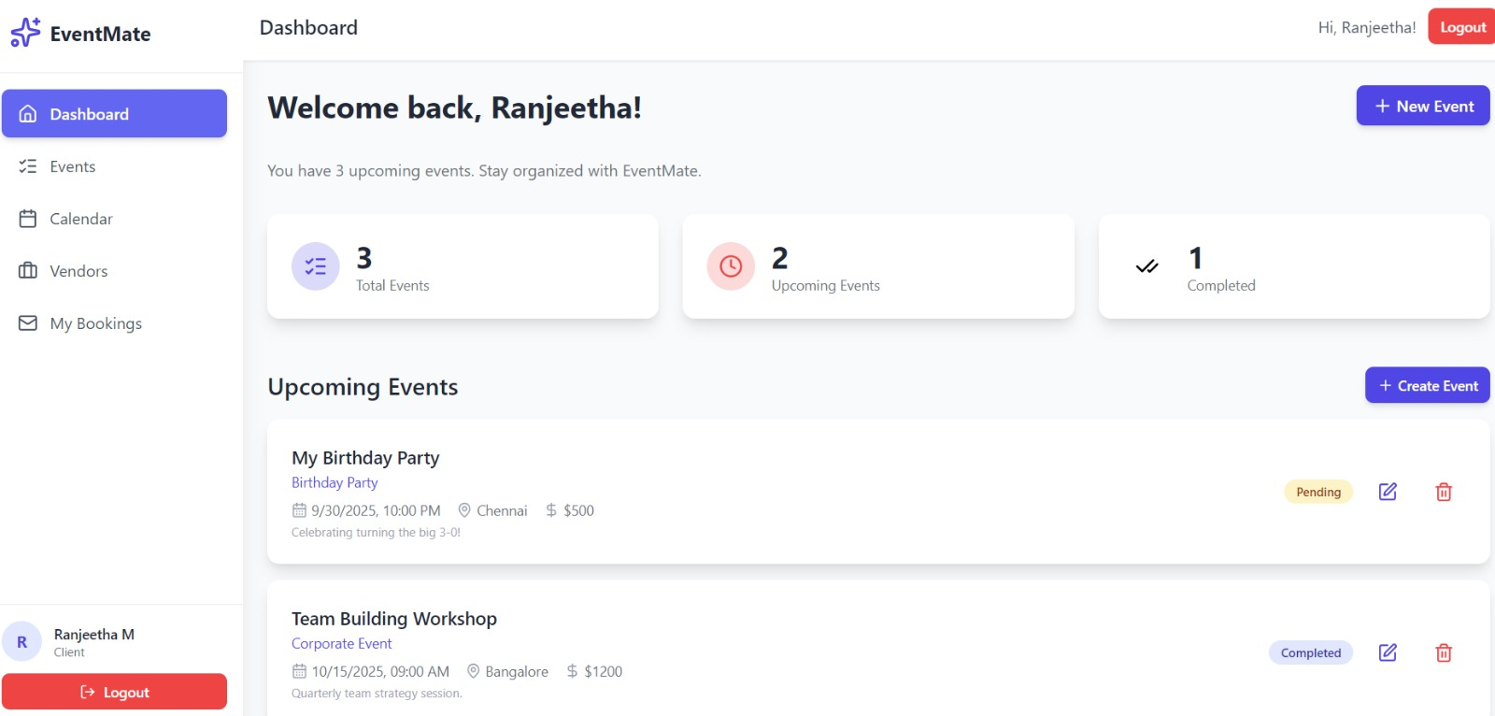
CLIENT PAGE:

Slide 9
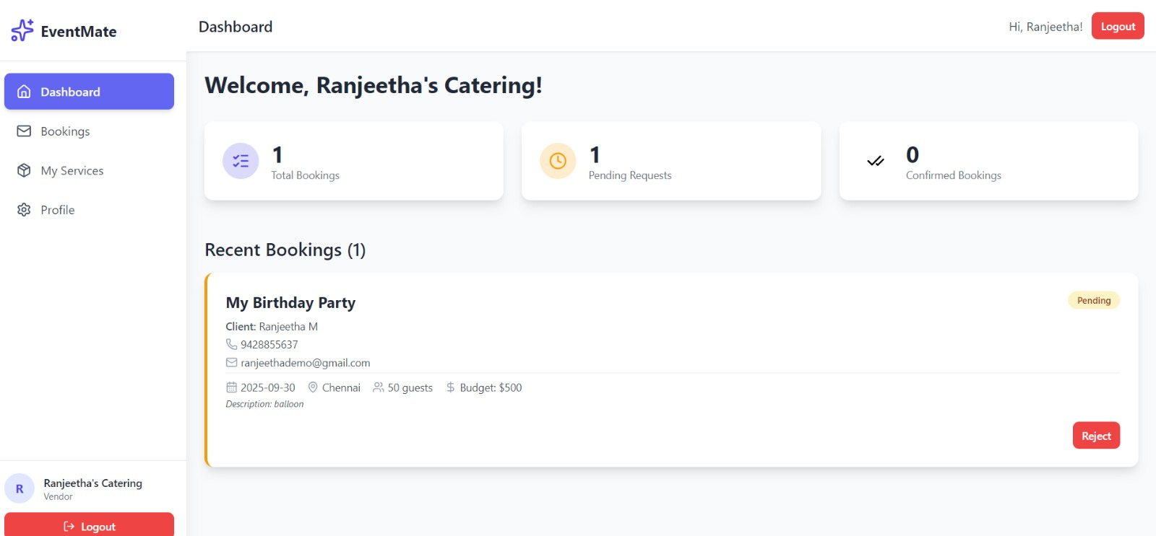
VENDOR PAGE:

Slide 10
Connecting Spring with Database
Spring Boot backend connects to the MySQL database using configurations in the application.properties file, including the database URL, username, and password. Each table is mapped to a Java entity class, and Spring Data JPA handles CRUD operations through repository interfaces. When the frontend sends a request, the controller receives it, and the service layer processes the business logic. The repository interacts with the database to fetch or update data. The result is then sent back through the service and controller to the frontend.

Slide 11
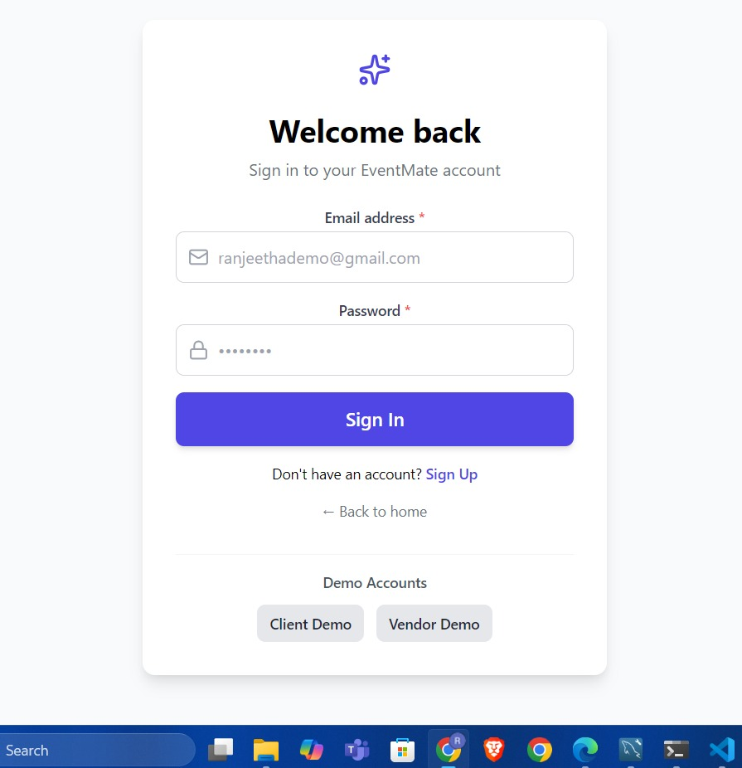
Connecting to Login Page
When a user enters their credentials on the login page, the React frontend sends these details to the Spring Boot backend through an API request. The backend receives this request in the authentication controller, which forwards it to the authentication service. The service then interacts with the UserRepository to verify the credentials stored in the MySQL database. If the username and password match the stored values, the backend generates a JWT token and sends it back as a response.
The React frontend receives this response, stores the token securely, and grants the user access to the home page and other features. If the credentials are invalid, an error message is returned instead.

Slide 12
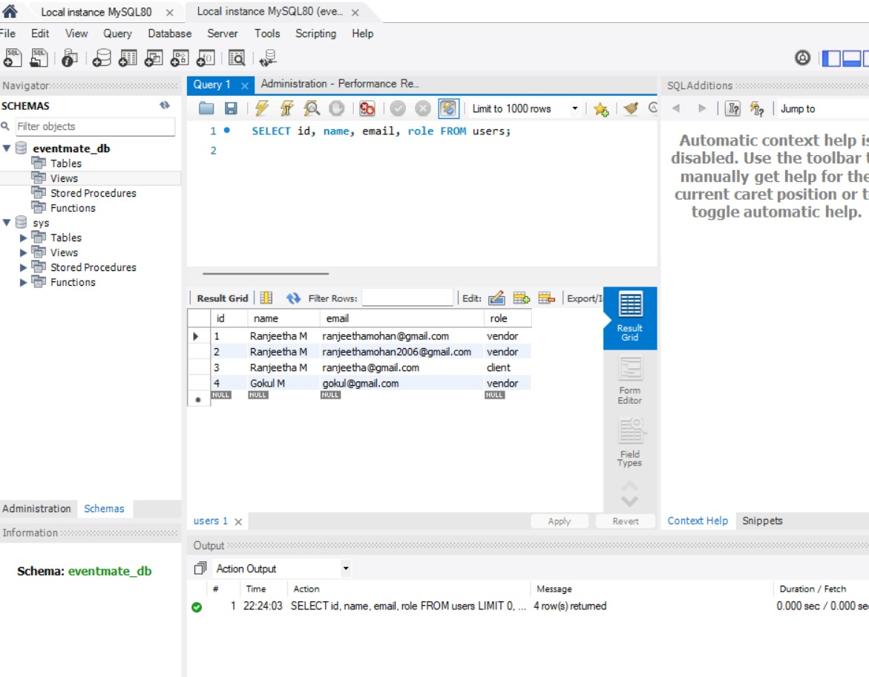
DataBase:

Slide 13
AI Processing work flow
Phase 1 : Rule-based AI
Pattern recognition
Mathematical calculations
Keyword matching
User Input → Text Analysis → Pattern Recognition
→ Context Understanding → Response Generation → UI Display
The AISuggestionsCard.jsx component serves as the core of the AI interaction system in the EventMate application. It is responsible for handling user inputs, processing them intelligently, and generating real-time event suggestions
Key Functions:
• getPersonalizedSuggestions()
• generateSuggestions()
• Pattern matching algorithms
• Real-time processing simulation

Slide 14
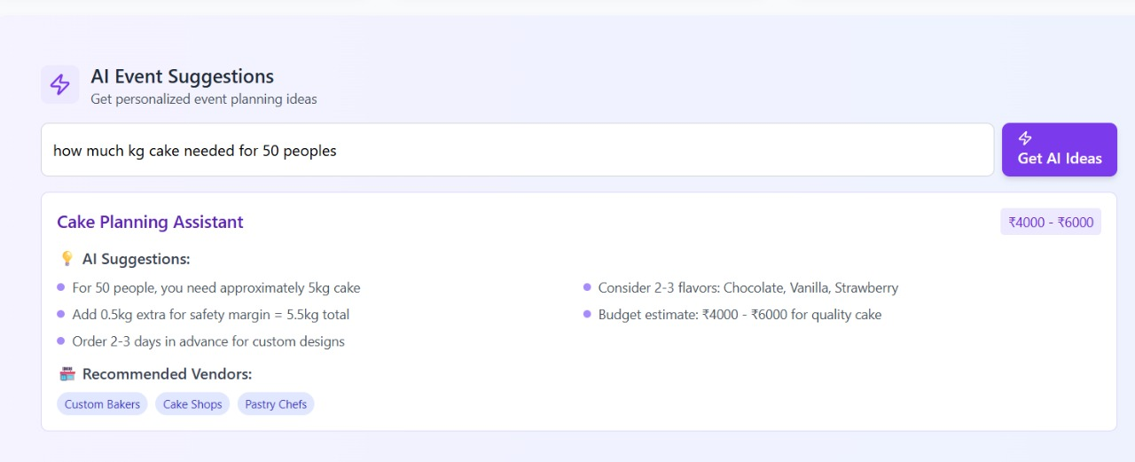

Slide 15
AI Processing work flow
User Selects Vendor → Date Selection → Availability Check
→ Conflict Detection→ Alternative Suggestions→ Booking Confirmation
1. Availability Check Algorithm
Objective:
To verify whether a vendor is available on a selected date and time before confirming a booking.
Process:
User selects vendor and date/time.
System queries the vendor’s booking database.
Checks for overlapping time slots using timestamp comparison.
If slot is free → proceed to booking.
If slot is occupied → trigger conflict detection.
Key Features:
Real-time database verification.
Time complexity optimized with indexed date queries.
Handles multiple requests concurrently.

Slide 16
2. Smart Alternative Matching
Objective:
Suggest suitable alternative vendors automatically when the preferred one is unavailable.
Matching Criteria:
Category similarity (e.g., same service type).
Location proximity (distance-based sorting).
Price range tolerance (within ±10% of original vendor).
Customer ratings & reliability score.
Availability during the requested time window.
Algorithmic Approach:
Uses weighted scoring system to rank alternatives.
Employs AI/ML model (optional) for personalized recommendations.

Slide 17
3. Smart Alternative Matching
Extended Workflow:
Collect user preference data (category, price, ratings).
Fetch vendor list meeting base criteria.
Calculate similarity score using weighted attributes.
Sort and present top 3–5 matches to user.
Offer one-click booking for selected alternative.
4. Conflict Detection Process
Objective:
Identify and manage double-booking or overlapping time slots efficiently.
Workflow:
Each booking request runs through a conflict check module.
Compares requested time window against all existing vendor bookings.
Detects overlaps using interval comparison (start1 < end2 && start2 < end1).
If conflict exists → notify user & invoke alternative matching engine.
Else → confirm booking and lock time slot.
Highlights:
Prevents double-booking errors.
Maintains booking integrity across all vendors.
Logs conflict data for analytics and system improvement.

Slide 18
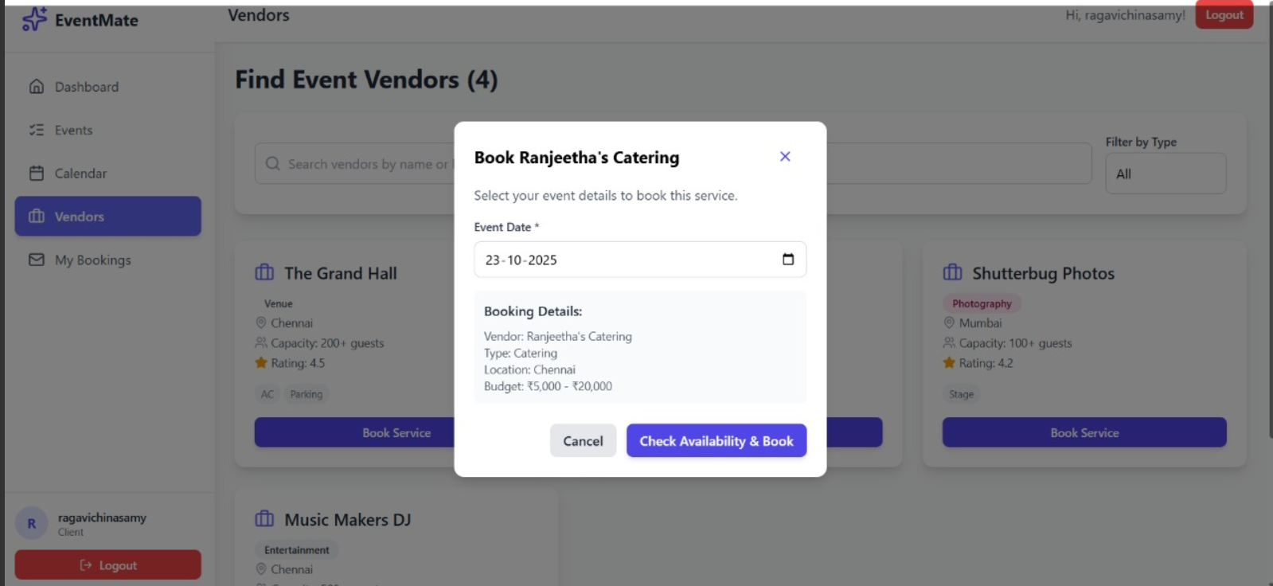

Slide 19
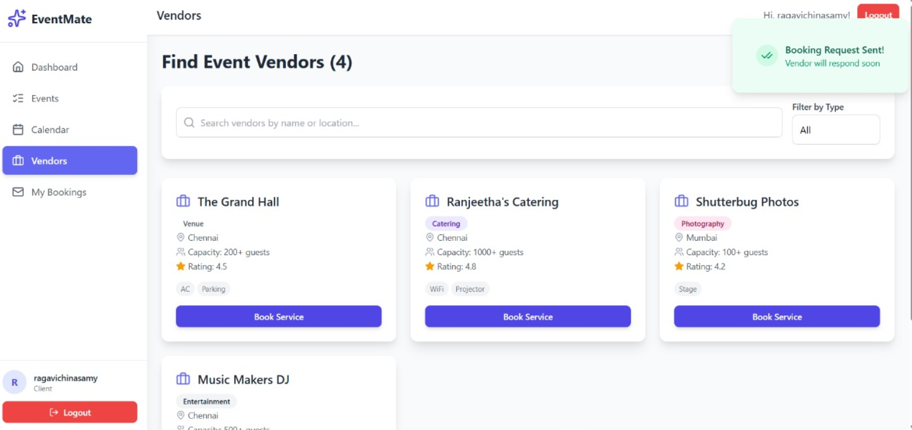

Slide 20
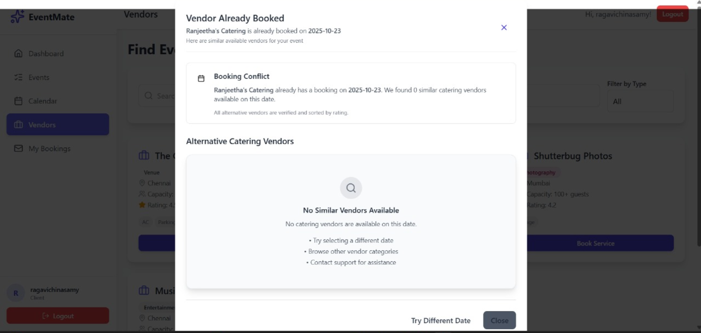

Slide 21
Conclusion:
EventMate provides a reliable and user-friendly platform for managing events by integrating a React frontend, Spring Boot backend, and MySQL database. The project highlights how modern technologies can be combined to deliver a scalable and practical solution for personal, academic, and professional event management, with scope for future enhancements like calendar integration and mobile support.

Slide 22
THANK YOU

