Slide 1
Breaking Down MicroFrontends
Understanding the What, Why, When, and How

Slide 2
What is MFE?

Slide 3
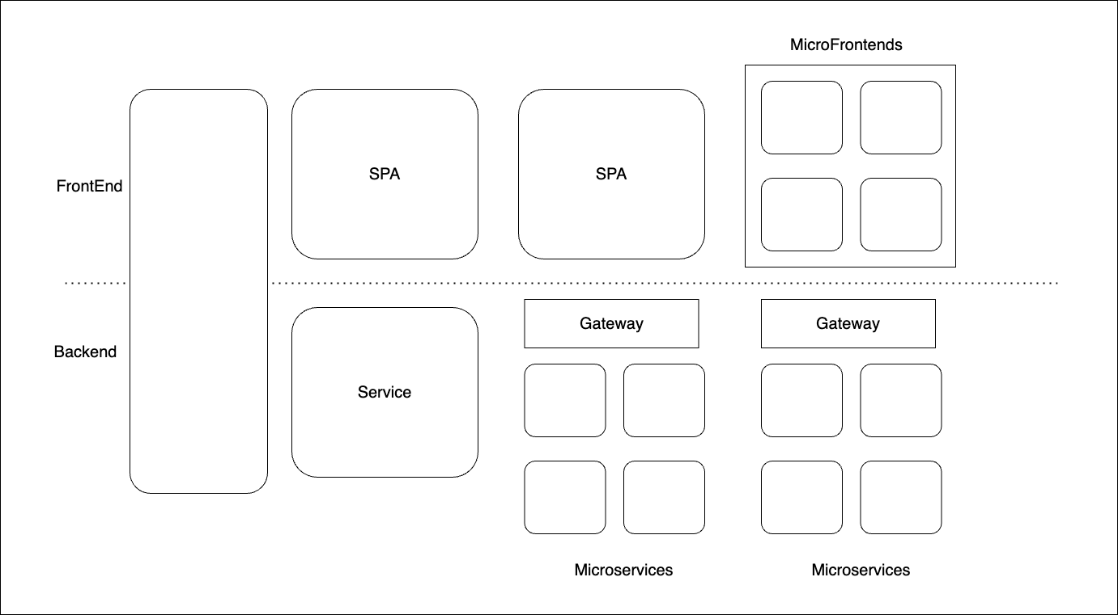

Slide 4
How to MFE?

Slide 5
Components
Micro frontend apps - a portion of the webpage
Host or Container App
MicroFrontend framework – loading, unloading

Slide 6
MicroFrontendPatterns
Server-side include (SSI) pattern
Client-side include (CSI) pattern
Build-time integration pattern
Runtime integration pattern
Hybrid integration pattern

Slide 7
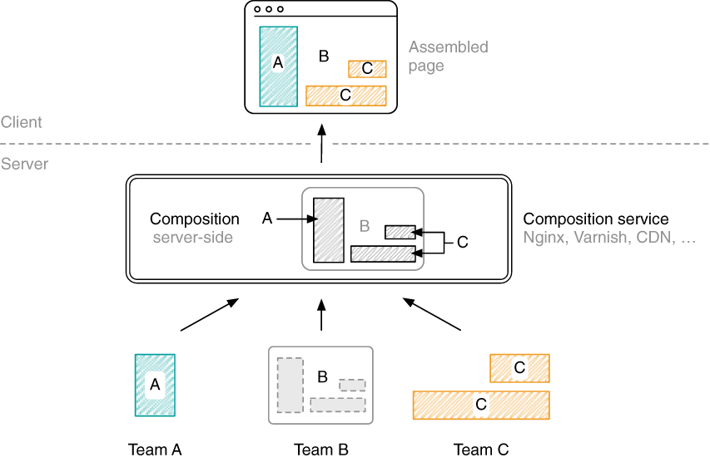
Server Side Composition
Source: Microfrontends in Action Book

Slide 8
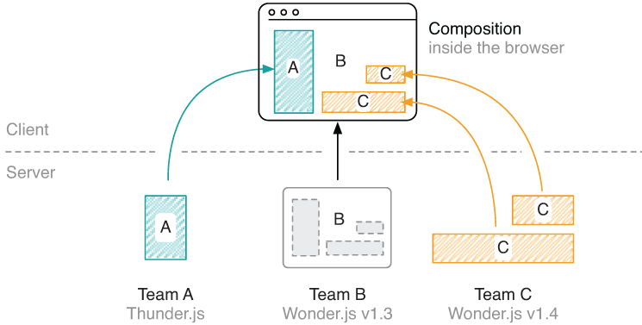
Client Side Composition
Source: Microfrontends in Action Book

Slide 9
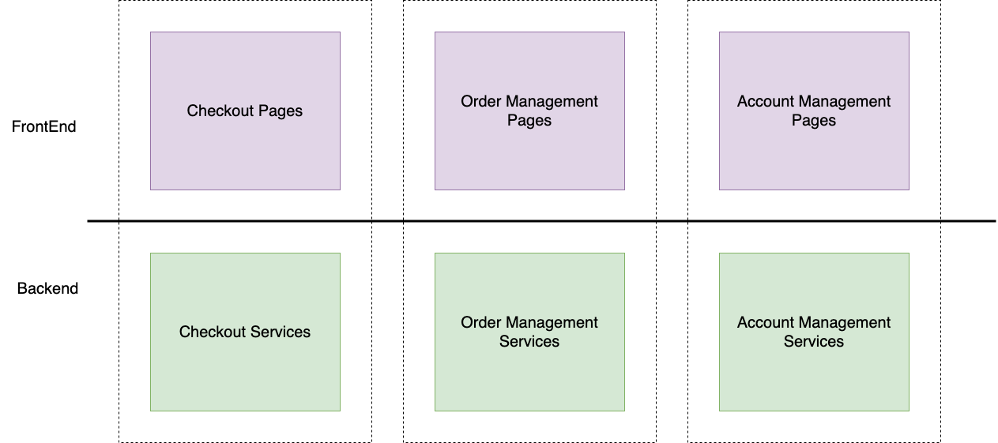
Vertical Teams

Slide 10
Why MFE?

Slide 11
Advantages
Independent development and deployment – SCALABILITY
Modular architecture – MAINTAINABILITY
Technology independence – FLEXIBILITY
Improved user experience
Faster Time-to-Market
Notes:
smaller, more cohesive and maintainable codebases
more scalable organisations with decoupled, autonomous teams
the ability to upgrade, update, or even rewrite parts of the frontend in a more incremental fashion than was previously possible

Slide 12
When MFE?

Slide 13
Good Fit
Large, complex applications
Independent development teams
High traffic or performance requirements
Complex user interfaces
Limited risk tolerance
Ecommerce, Banking, Social Media, Gaming,…

Slide 14
Challenges in MFE?

Slide 15
Trade-offs
Increased complexity
Cross-team collaboration
Integration testing
Data sharing

Slide 16
When not to MFE?

Slide 17
Monolith would be better
Small applications
Tight coupling between components
Limited developers
Limited need for flexibility or scalability

Slide 18
MFE Security?

Slide 19
Security Best Practices
Use HTTPS
Implement proper authentication and authorization
Implement content security policies (CSP)
Isolate micro frontends
Use security headers

Slide 20
MFE fails to load?

Slide 21
Error Handling
Failover mechanisms
Progressive loading strategies
Caching stratergies
Service workers – Offline access

Slide 22
Implementing MFE?

Slide 23
Tools and Frameworks
Single-spa
Module Federation
OpenComponents
Bit
Luigi
iFrame

Slide 24
Show it working!

Slide 25
Thank you!

