Slide 1
Project Title
Java Application For E-Commerce Implementations
Console-Based Shopping Cart using CRUD Operations in Java

Slide 2
Project Highlights
Project Highlights
• Java Console Application
• CRUD Operations
• Shopping Cart
• Cashout & Billing
• Menu Driven System

Slide 3
Project Overview
Abstract
• The E-Commerce Management System is a Java-based application developed to manage online shopping operations efficiently. The system allows users to view available products, add products to the shopping cart, update product details, and remove products when required. It implements the basic CRUD operations such as Insert, Update, Delete, and Display to manage product information effectively.
• The Insert operation is used to add new products with details such as product ID, name, price, and quantity. The Update operation enables modification of existing product information, including price and stock availability. The Delete operation removes unwanted or unavailable products from the system. The Display operation shows the list of available products and their details to users.
• The application also includes cart management and checkout functionalities to simulate a real-world online shopping experience. The project aims to provide a simple, user-friendly, and efficient platform for managing products and customer purchases. This system demonstrates the practical implementation of Java programming concepts, data management, and menu-driven application development in an E-Commerce environment.

Slide 4
Algorithm
Steps
• E-COMMERCE CONSOLE APPLICATION:
• ALGORITHM: Step 1: Start 1. Start the program. 2. Initialize the product list with Product ID, Product Name, and Price. 3. Initialize an empty shopping cart. Step 2: Display Menu 4. Display the following menu options: • Display Products • Add Product to Cart • Remove Product from Cart • View Cart • Checkout • Exit Step 3: User Choice 5. Read the user's choice from the keyboard. Step 4: Perform Operation 6. If choice = 1, display all available products. 7. If choice = 2, enter Product ID and add the product to the cart. 8. If choice = 3, enter Product ID and remove the product from the cart. 9. If choice = 4, display cart items and total amount. 10. If choice = 5, generate the bill and clear the cart. 11. If choice = 6, exit the program. 12. Otherwise, display "Invalid Choice". Step 5: Repeat 13. Return to the main menu. 14. Repeat the process until the user selects Exit. Step 6: Stop 15. End the program.

Slide 5
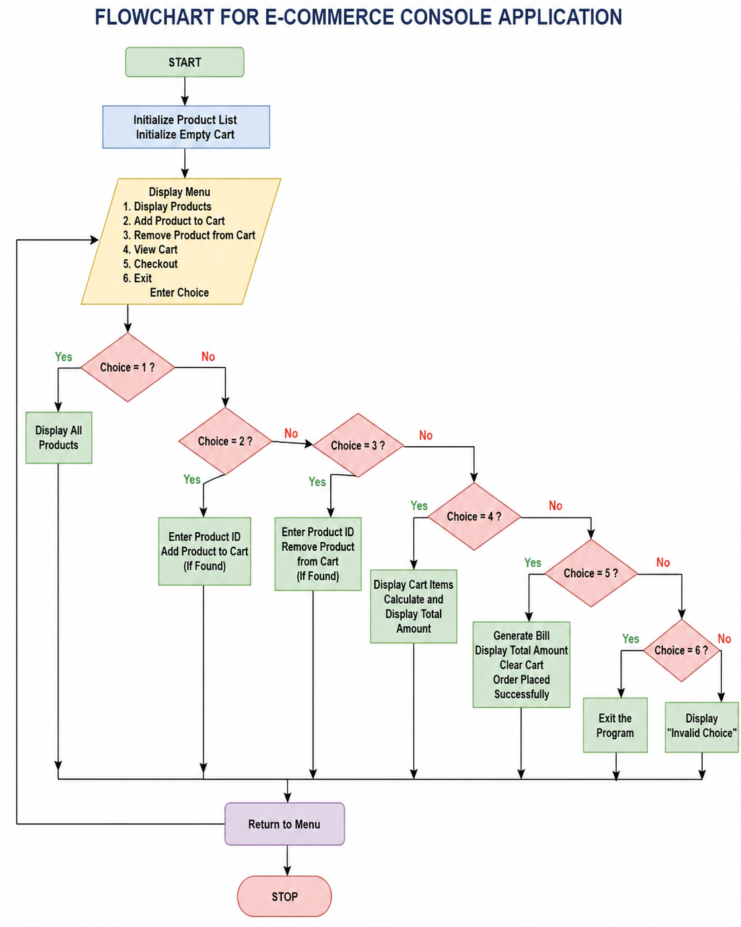
Flowchart
Explanation
• Initialize products and cart
• Display menu
• Perform selected operation
• Loop until Exit

Slide 6
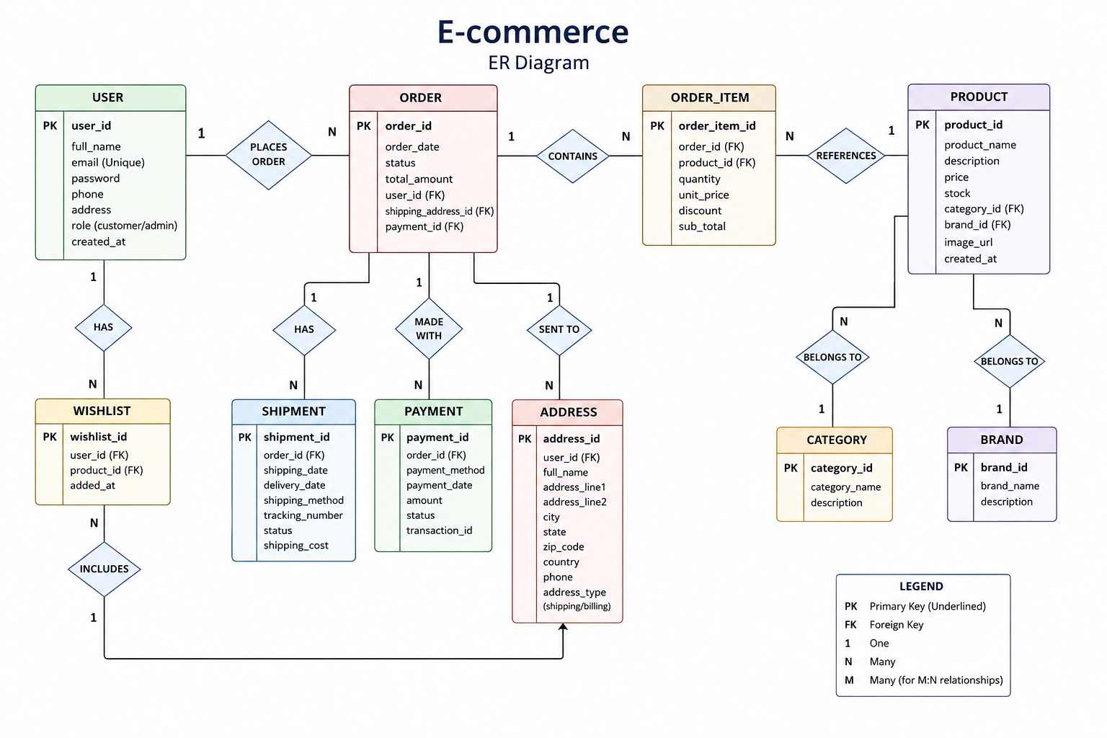
ER Diagram
Entities
• User
• Product
• Order
• Order Item
• Payment
• Shipment
• Address

Slide 7
Insert & Display Operation
Insert
• Adds new product using Product ID, Name, Price and Quantity.
• Method is executed through menu selection.
• Shows success/error message.
Display
• Displays all available products.
• Method is executed through menu selection.
• Shows success/error message.

Slide 8
Update & Delete Operation
Update
• Updates existing product details.
• Method is executed through menu selection.
• Shows success/error message.
Delete
• Deletes product using Product ID.
• Method is executed through menu selection.
• Shows success/error message.

Slide 9
Add To Cart & View Cart Operation
Add To Cart
• Adds selected products into shopping cart.
• Method is executed through menu selection.
• Shows success/error message.
View Cart
• Shows purchased items and total amount.
• Method is executed through menu selection.
• Shows success/error message.

Slide 10
Cashout Operation
Cashout
• Generates invoice and clears cart.
• Method is executed through menu selection.
• Shows success/error message.

Slide 11
Methods Used
Methods
• insertProduct()
• displayProducts()
• updateProduct()
• deleteProduct()
• addToCart()
• viewCart()
• cashout()

