Slide 1
EZ-Recipe: Pinoy dish at your comfort mobile application
Submitted By:
Bernales, Ricky
Gamsawen, Mae
Guibani, Jasper Dredd
Marquez, Omar
Oania, Cedric

Slide 2
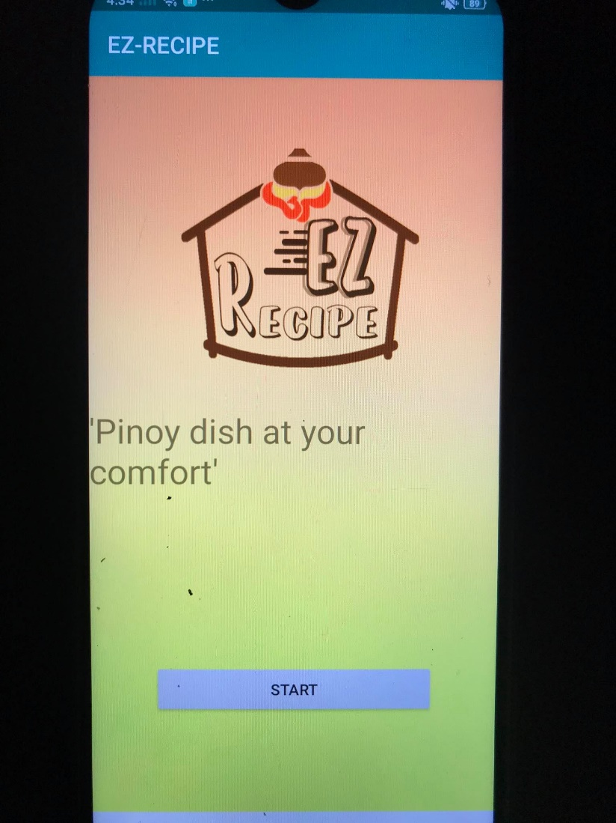
Main page
This page shows the logo for EZ-Recipe with the slogan “Pinoy dish at your comfort”. At the bottom you will see the start button and once you press it, you will proceed on the next page which is the categories page.

Slide 3
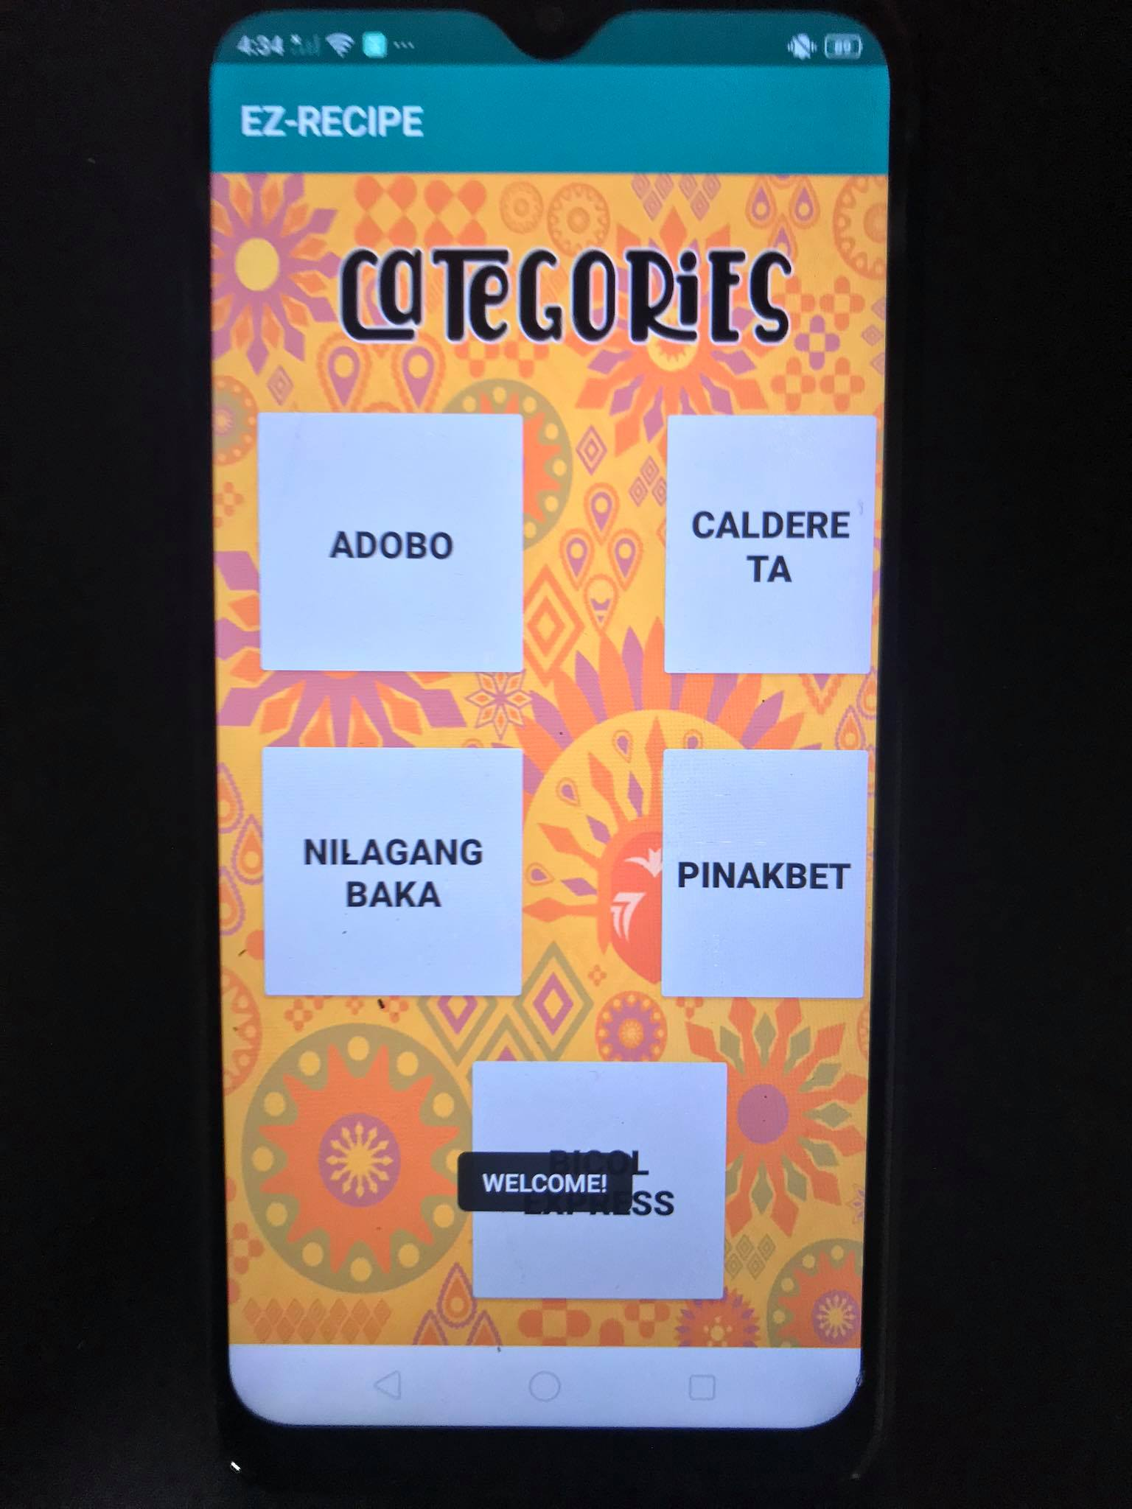
Categories page
This shows the 5 famous Filipino dishes that can be cooked by anyone. These are Adobo, Caldereta, Nilagang Baka, Pinakbet, and Bicol Express. Once you press on each of the categories, you will be directed to the ingredients page of each Pinoy delicacy.

Slide 4
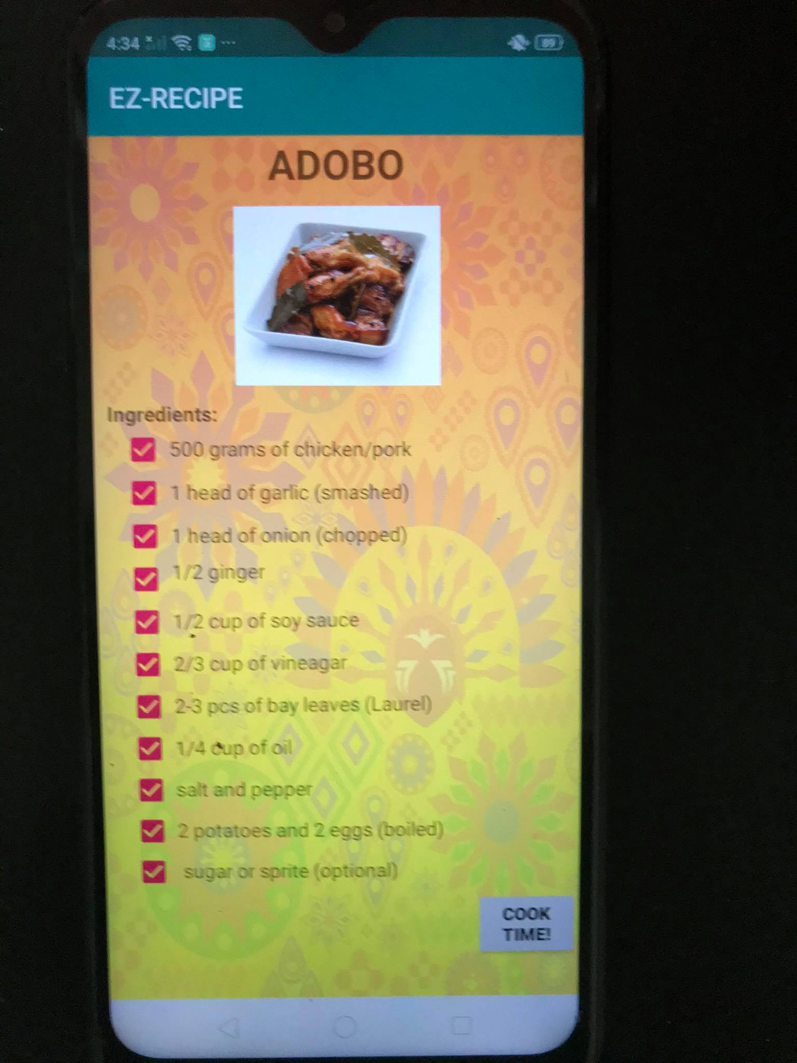
Adobo ingredients page
Once you press the “Adobo” button in the categories page, you will be directed to this page which shows the ingredients needed to cook adobo. Once you completed checking the boxes, press the “COOK TIME!” button located at the bottom right.

Slide 5
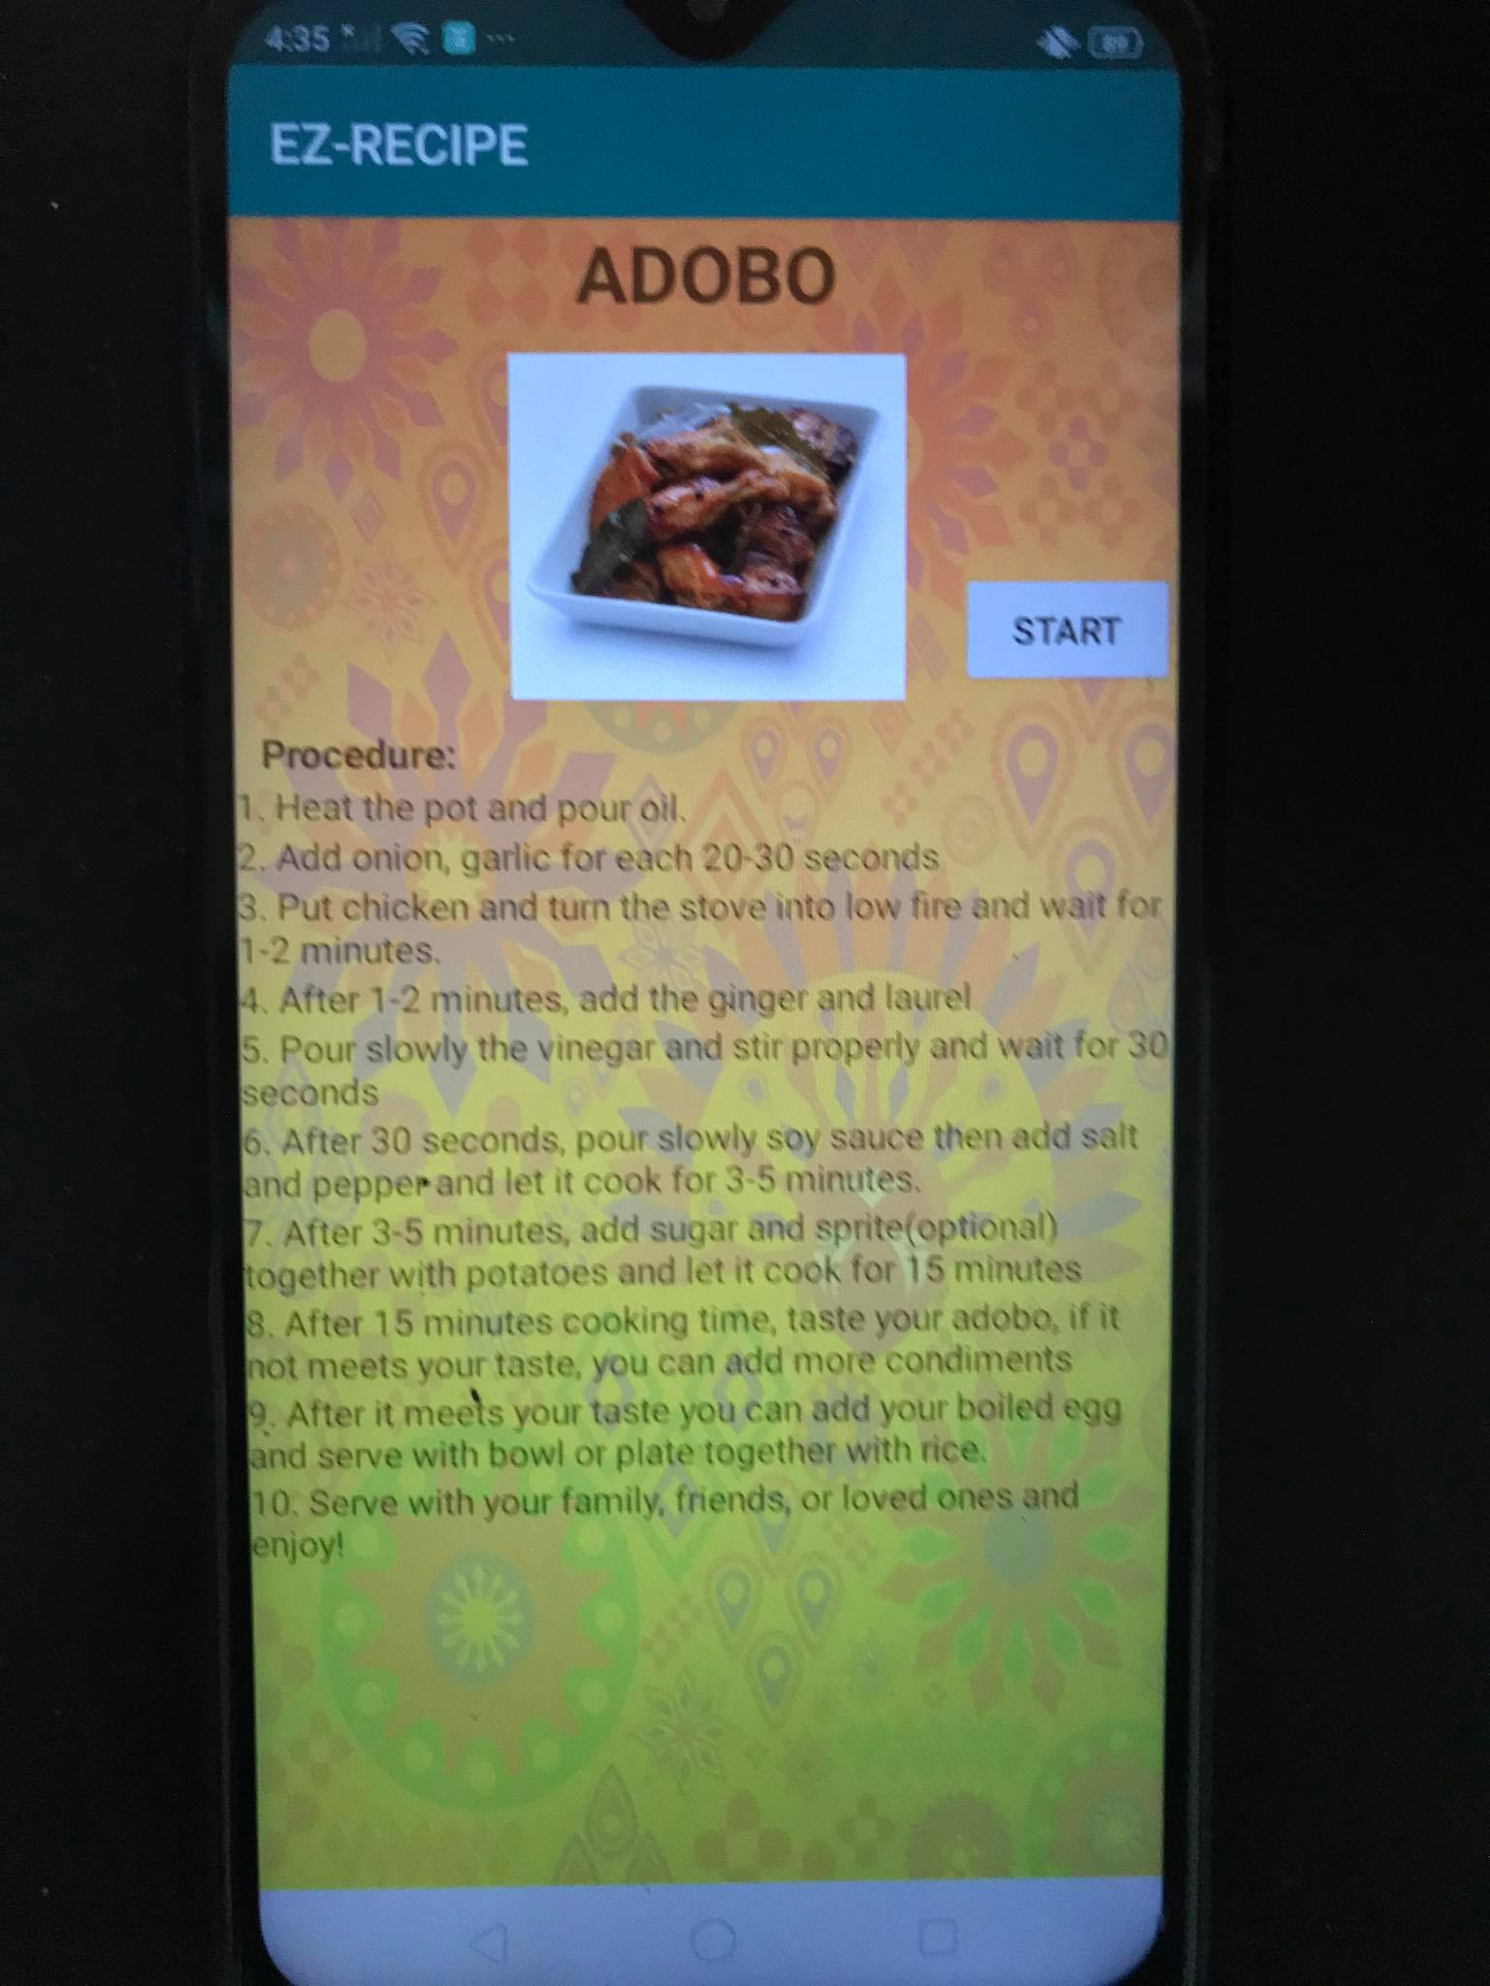
Cooking procedure for adobo page
On this page you will see the image of the Adobo that is already cooked. The steps on how to cook Adobo is shown also for every user to follow. A total of 10 steps should be followed and cooking time can be set by clicking the “START” button at the right side. Estimated cooking time is set to 15 minutes.

Slide 6
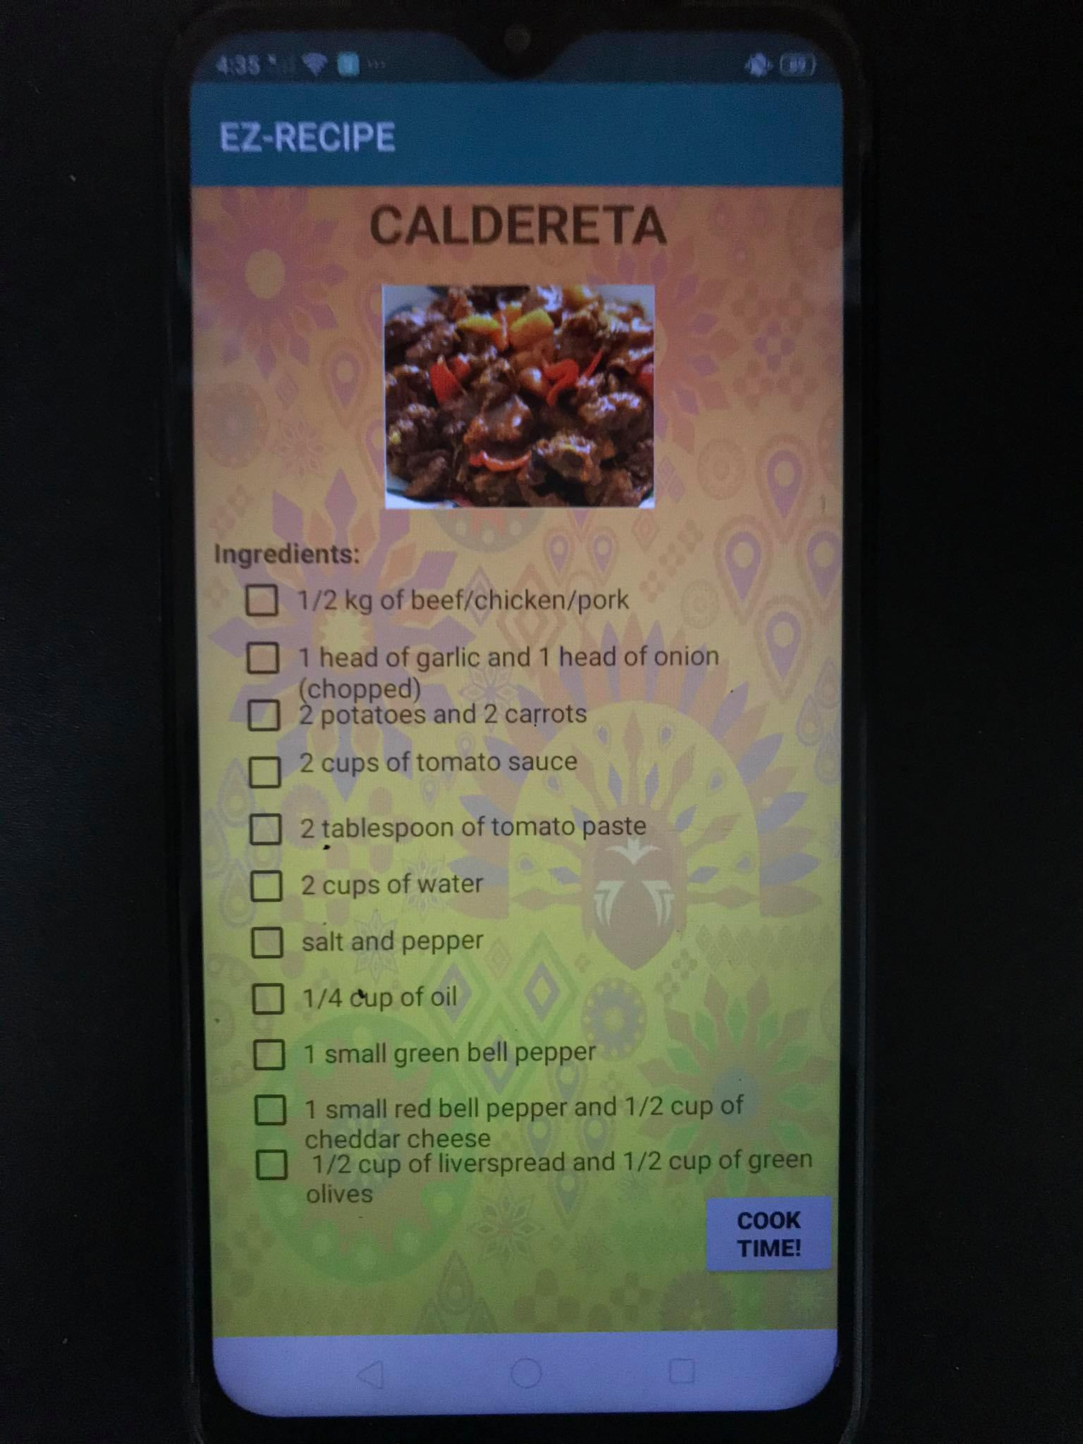
Caldereta ingredients page
This shows the required ingredients in cooking Calderata. Same with the previous slide, once you are done checking all the boxes, press “COOK TIME!” at the bottom right.

Slide 7
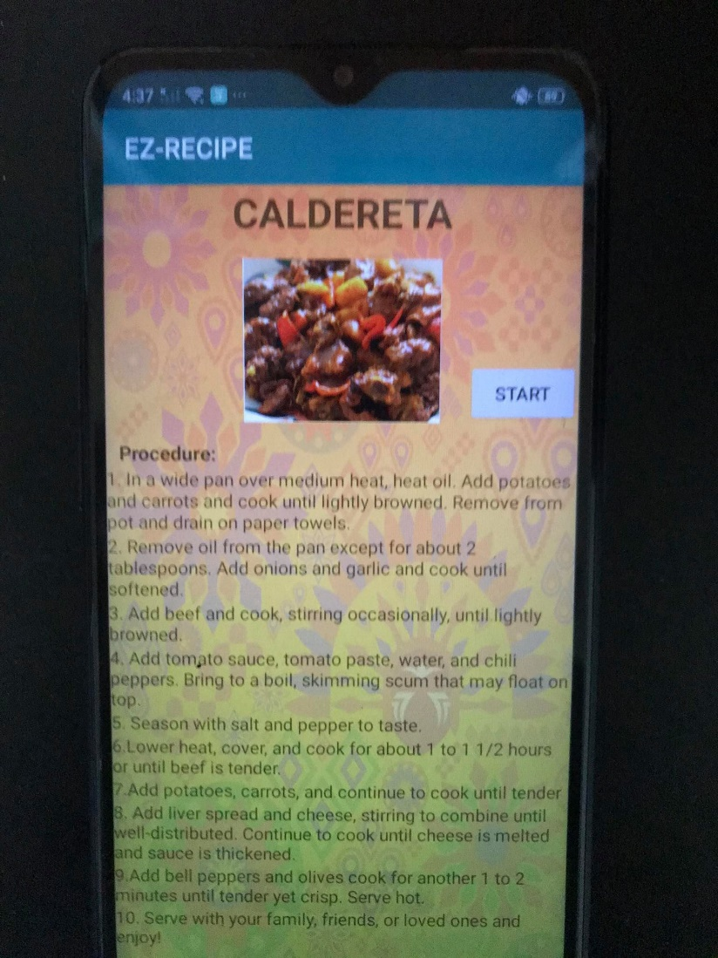
Cooking procedure for caldereta page
This page shows the procedures in cooking Calderata. It has 10 steps to follow and time limit set here is estimated at 15 minutes.

Slide 8
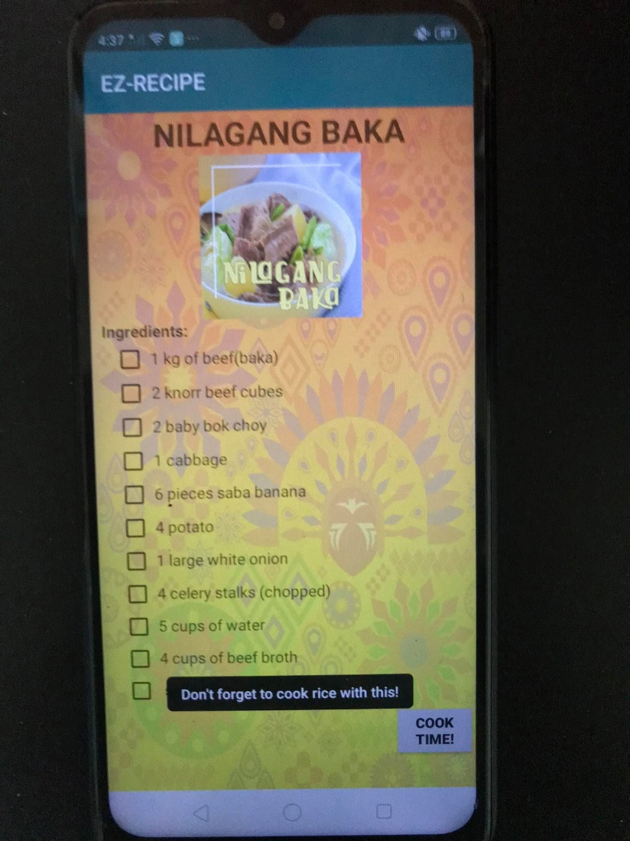
Nilagang baka ingredients page
This activity on the mobile app shows ingredients for Nilagang Baka. It also has its toast or notification and similar to the first 2 dishes, press “COOK TIME!” located at the right bottom to be directed on the cooking instructions.

Slide 9
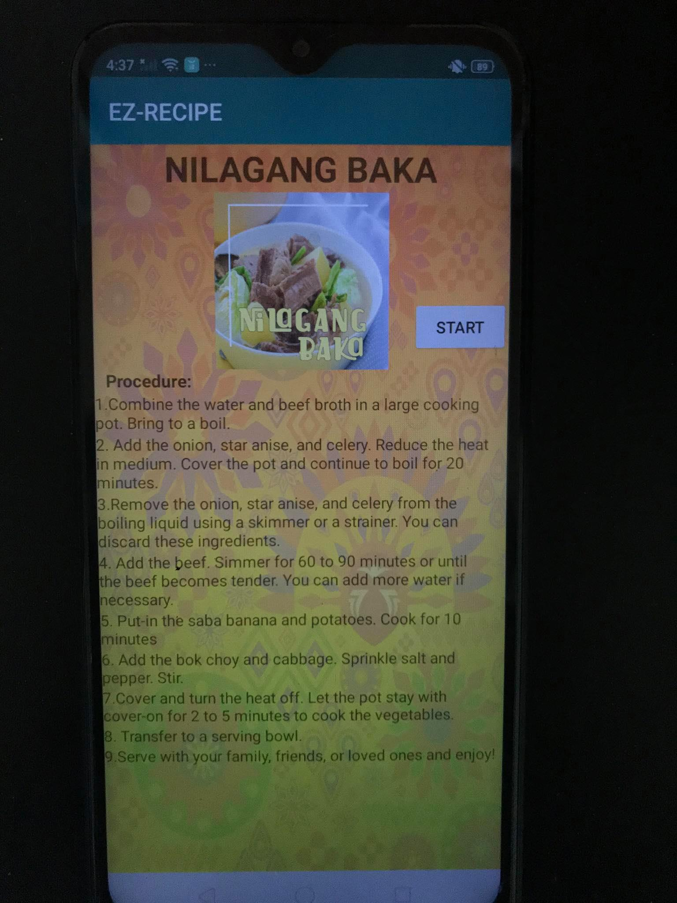
Cooking procedure for nilagang baka page
After pressing “COOK TIME!” on the previous page, nine steps needs to be followed on how to cook Nilagang Baka. Pressing the “START” button on the right side will set its timer for you which is the feature similar to the other dishes on this application. Time completion to cook this dish should take around 1 hour and 4 minutes.

Slide 10
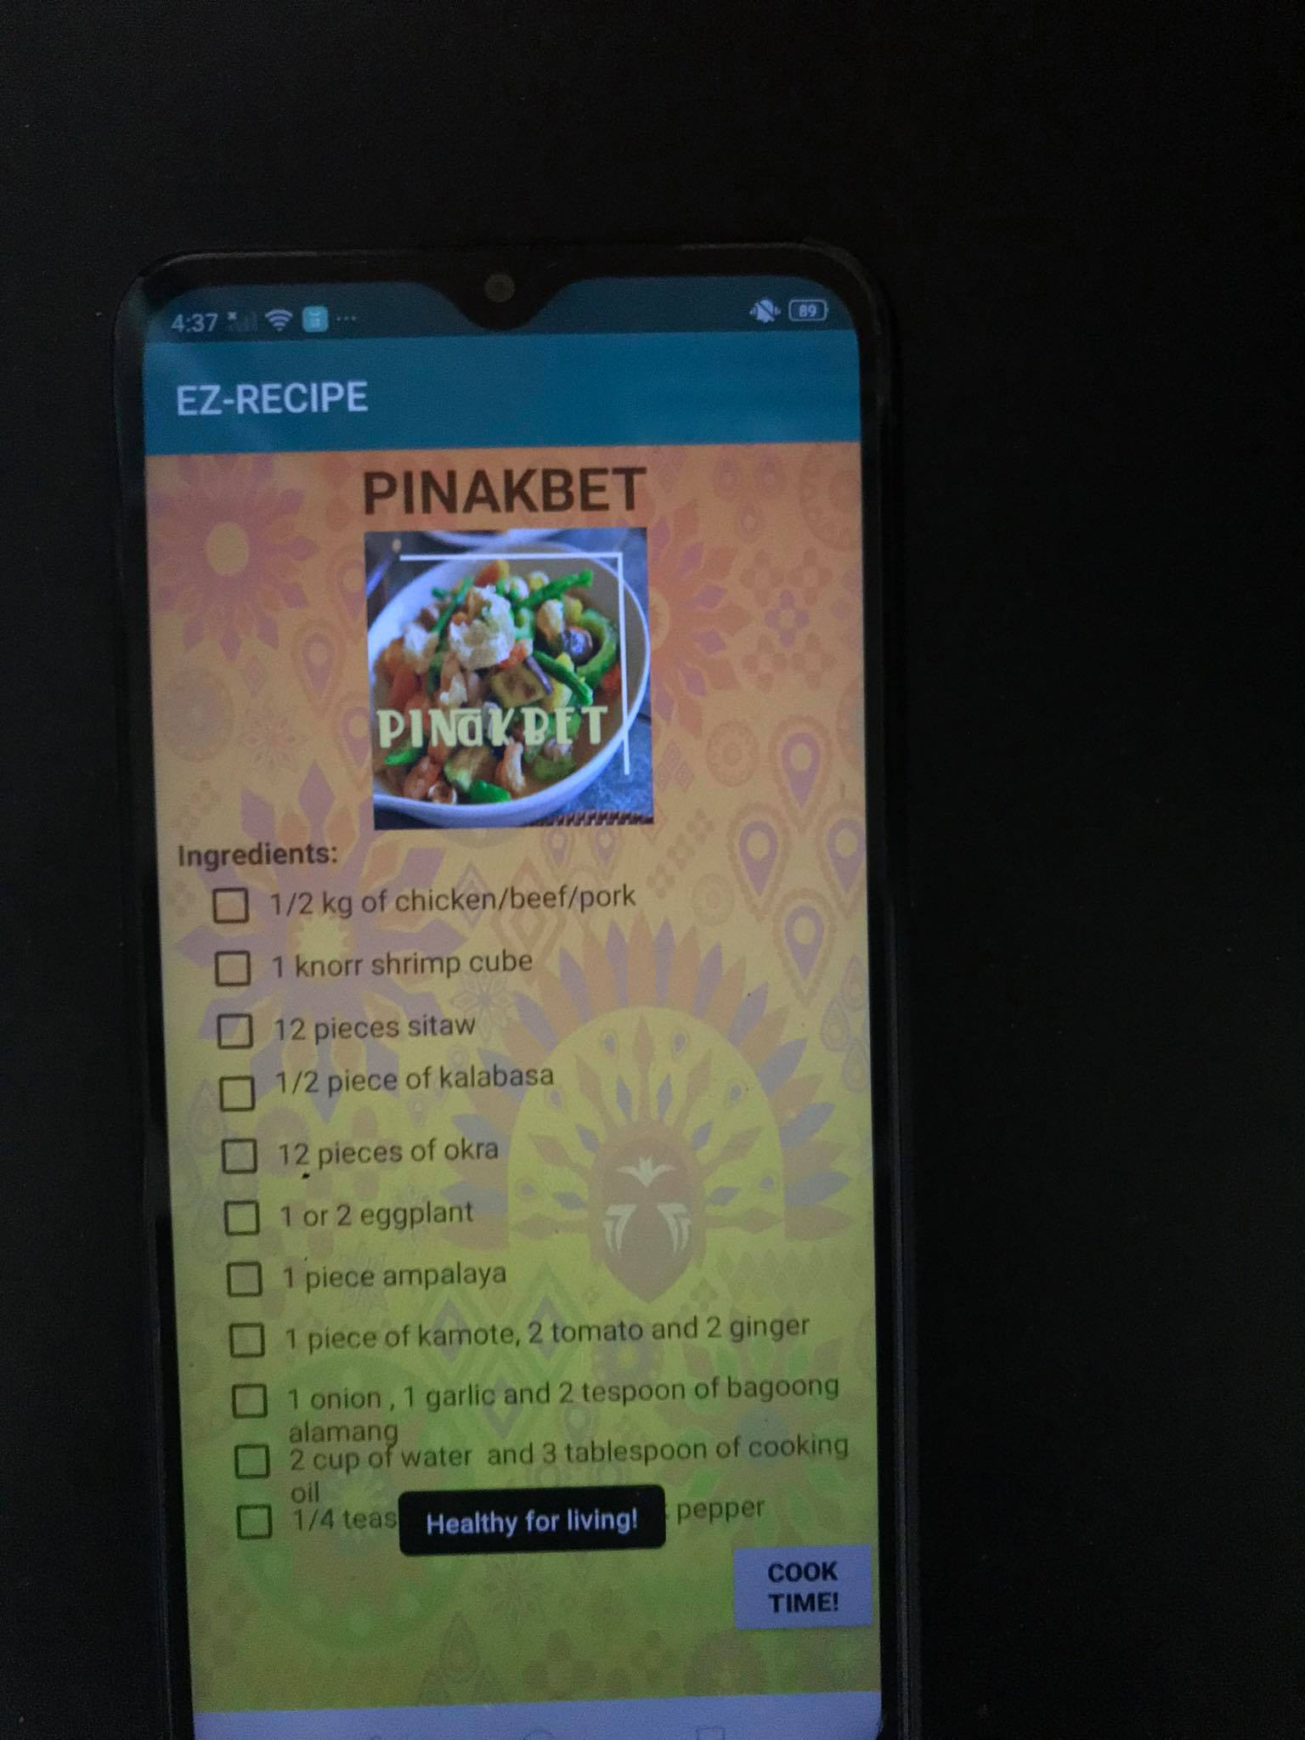
Pinakbet ingredients page
This page shows the 11 ingredients for Pinakbet and the toast message “Healthy for living!”. Once the user presses “COOK TIME!”, the user will be directed to the cooking instructions for Pinakbet page.

Slide 11
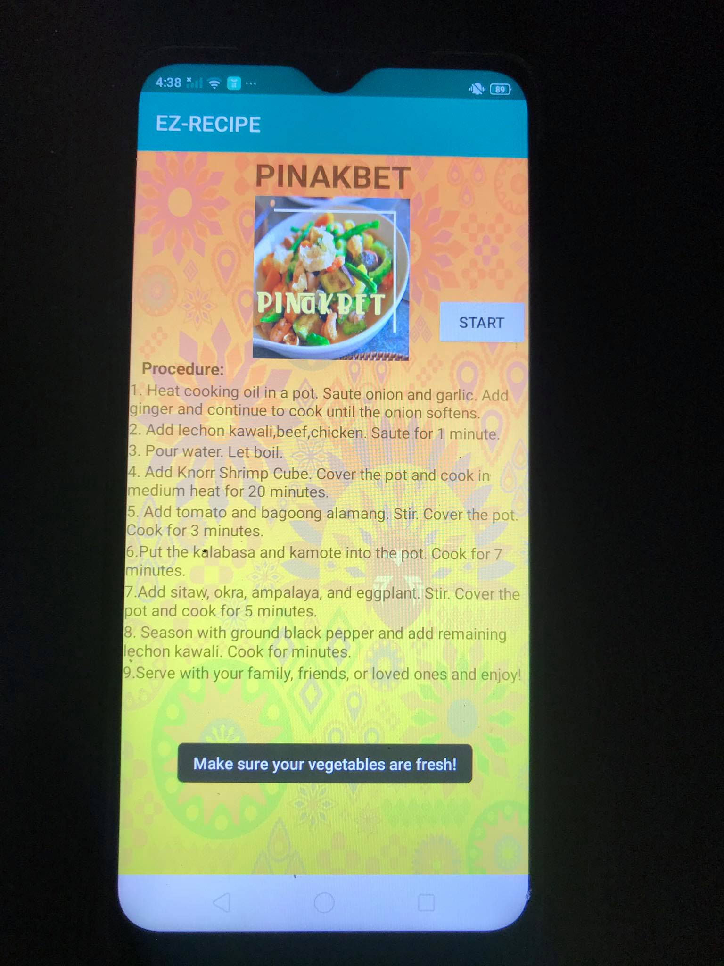
Cooking procedure for pinakbet page
This page shows the 9 steps on how to cook Pinakbet. This dish will have around 30 minutes to cook. You may set the timer by pressing the “START” button located at the right side.

Slide 12
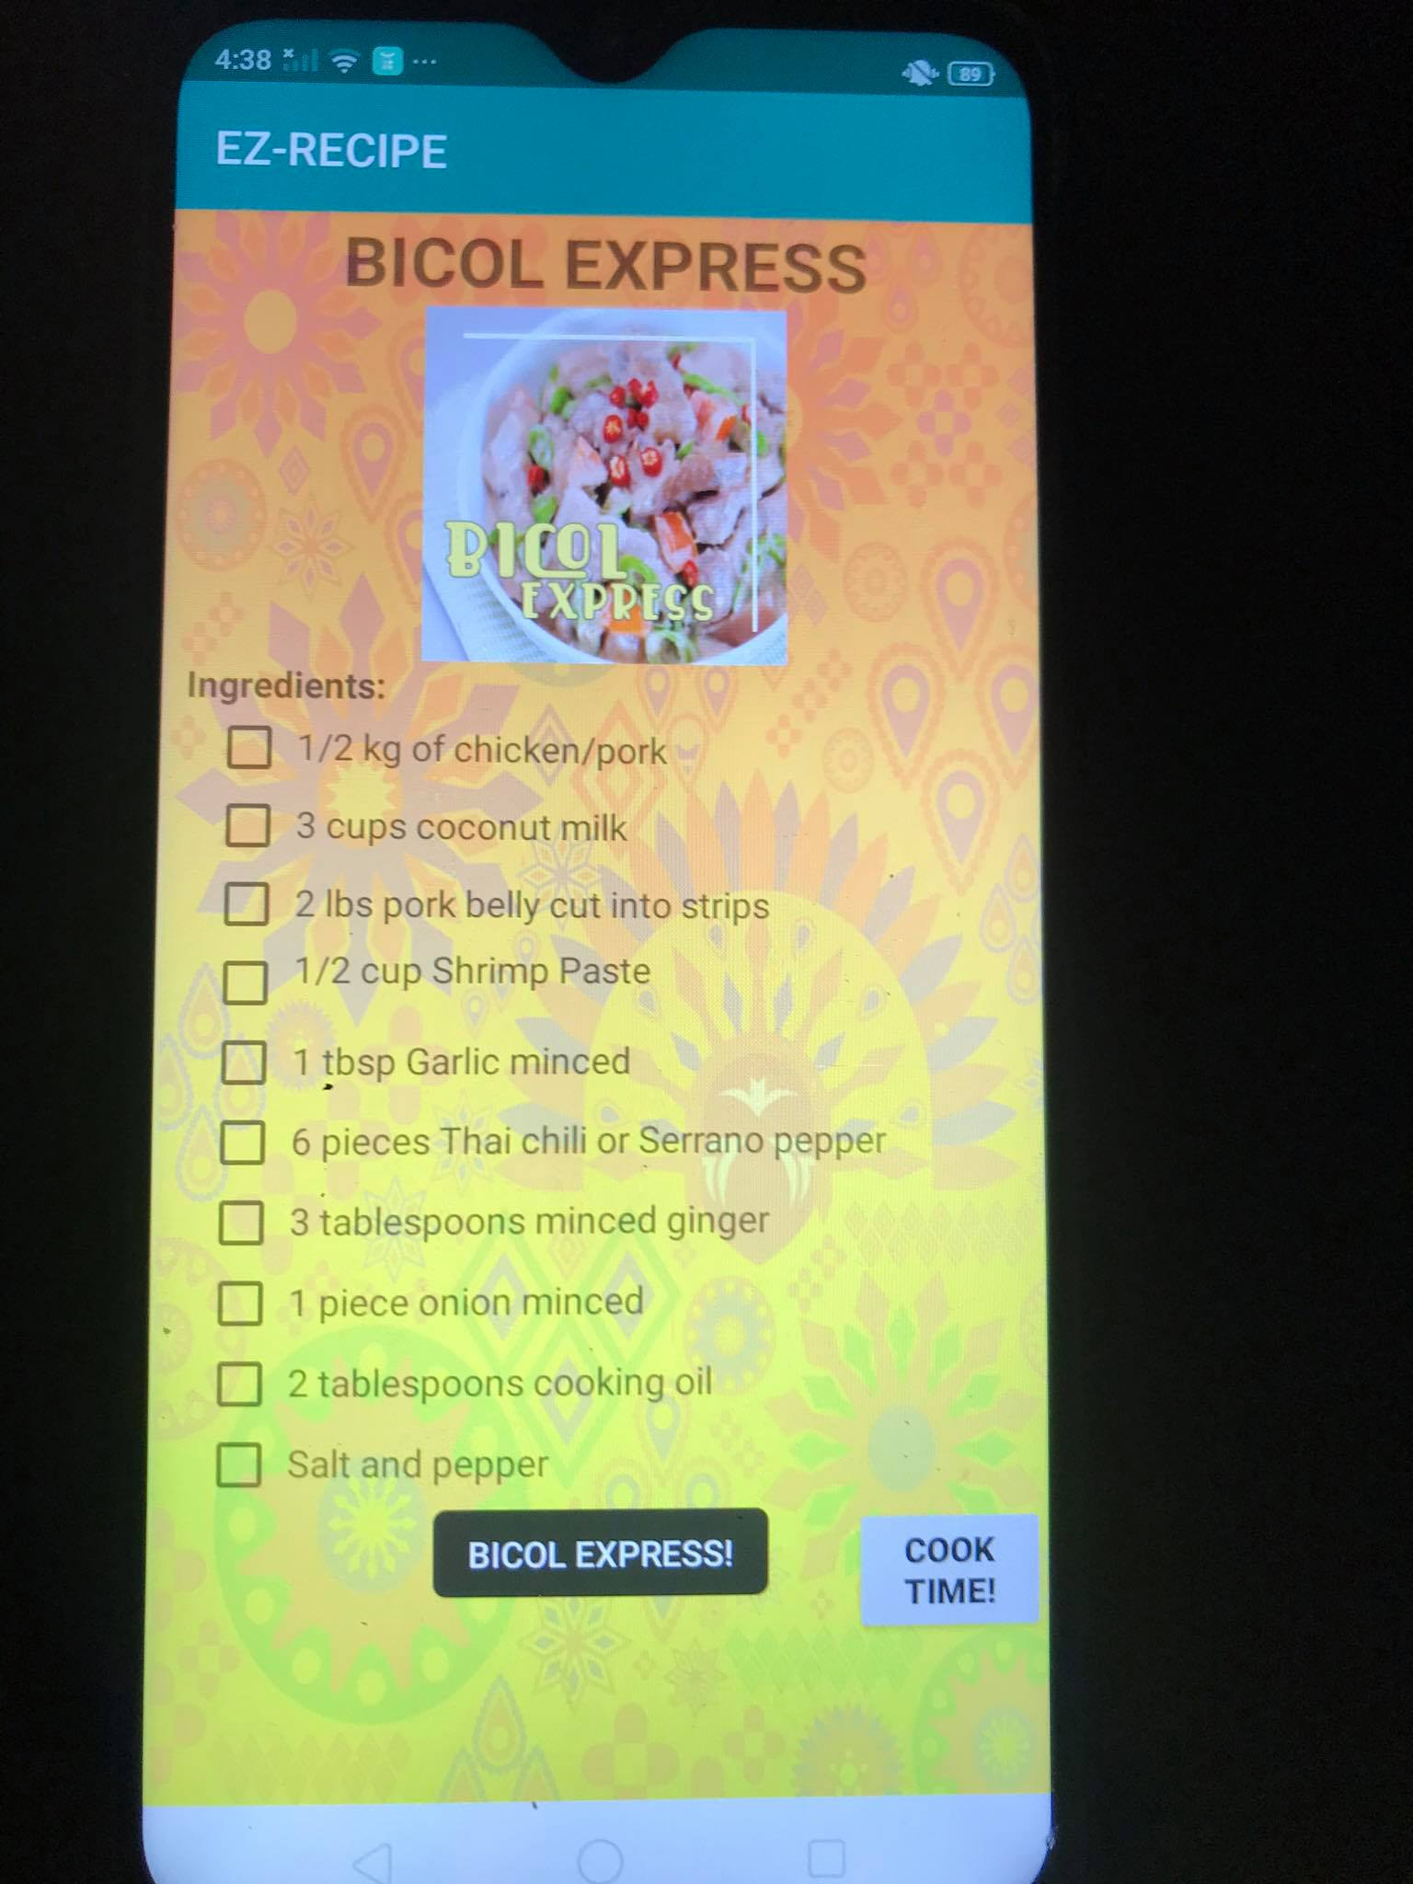
Bicol express ingredients page
This shows the page of the 10 ingredients needed to cook Bicol Express. Just like with the other 4 dishes discussed, once the user clicks on “COOK TIME!”, the user will be directed on the page on how to cook Bicol Express.

Slide 13
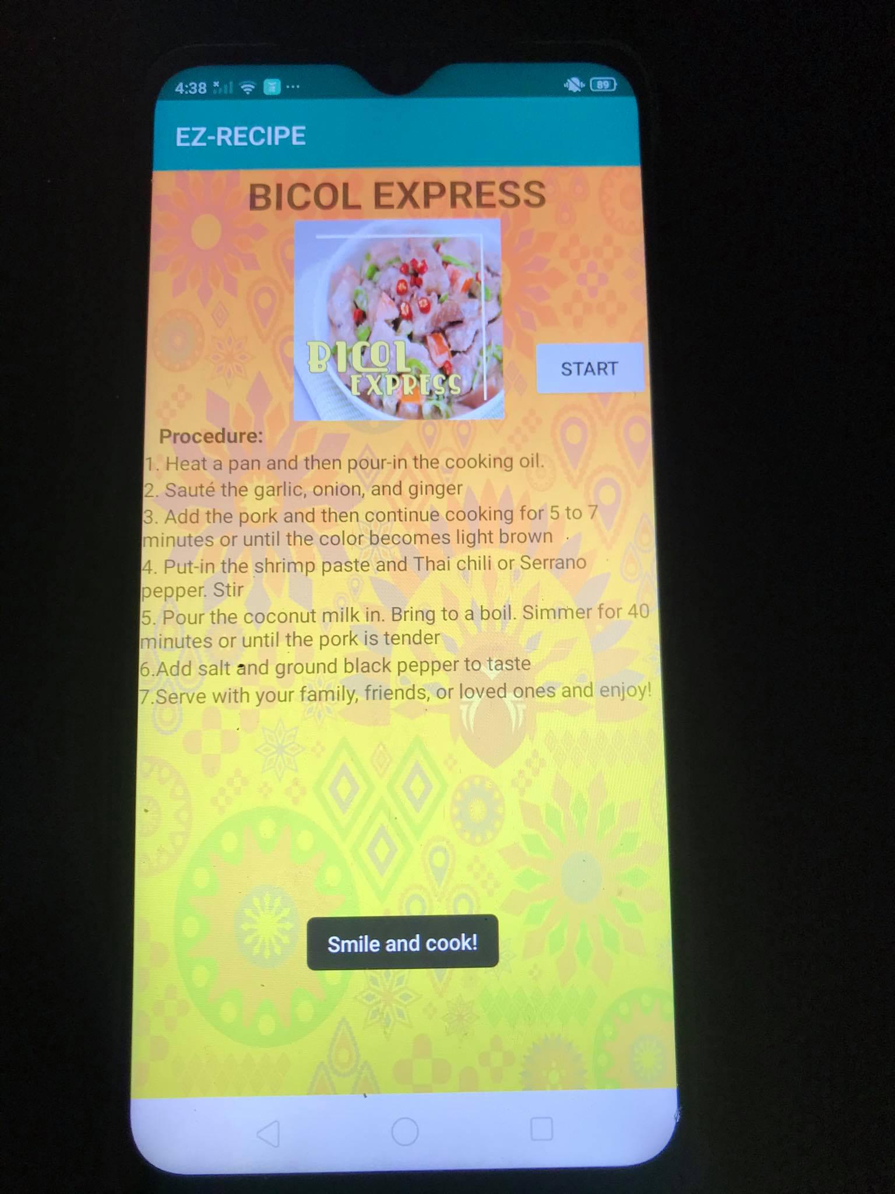
Cooking procedure for bicol express page
Finally, this page shows the 7 steps on how to cook Bicol Express that takes around 30 minutes. And if the user would like to set the timer, they may do so by pressing the “START” button at the right side just like the other dishes on the mobile application.

Slide 14
Contribution of each group member:
Bernales, Ricky – Created the initial design for the mobile app with Mr. Marquez and Mr. Guibani and created the Powerpoint presentation.
Gamsawen, Mae – Created the background for the mobile application and provided resources on how to cook Caldereta.
Guibani, Jasper Dredd – Shared the procedures on how to cook Nilagang Baka.
Marquez, Omar – Created the code for the mobile application together with Mr. Guibani and researched for the ingredients and procedures on the other dishes.
Oania, Cedric – Provided the images for each of the Filipino dish and shared the procedures and ingredients for Bicol Express.

