Slide 1
The DNS is…
The “Domain Name System”
What Internet users use to reference anything by name on the Internet
The mechanism by which Internet software translates names to attributes such as addresses

Slide 2
The DNS is also…
A globally distributed, scalable, reliable database
Comprised of three components
  A “name space”
  Servers making that name space available
  Resolvers (clients) which query the servers about the name space

Slide 3
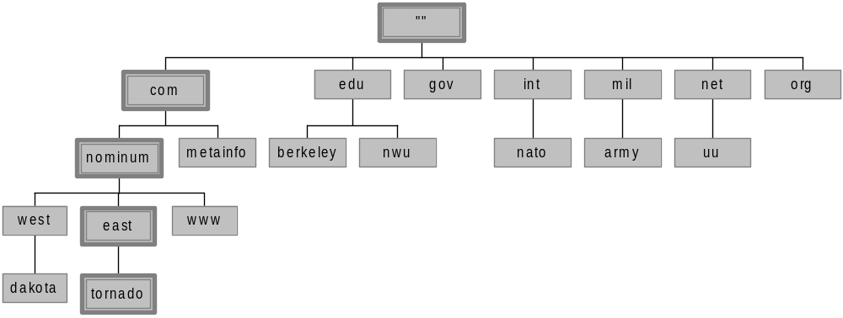
Domain Names
A domain name is the sequence of labels from a node to the root, separated by dots (“.”s), read left to right
  The name space has a maximum depth of 127 levels
  Domain names are limited to 255 characters in length
A node’s domain name identifies its position in the name space

Slide 4
Subdomains
One domain is a subdomain of another if its domain name ends in the other’s domain name
  So sales.nominum.com is a subdomain of
    nominum.com & com
  nominum.com is a subdomain of com

Slide 5
Name Servers
Name servers store information about the name space in units called “zones”
  The name servers that load a complete zone are said to “have authority for” or “be authoritative for” the zone
Usually, more than one name server are authoritative for the same zone
  This ensures redundancy and spreads the load
Also, a single name server may be authoritative for many zones

Slide 6
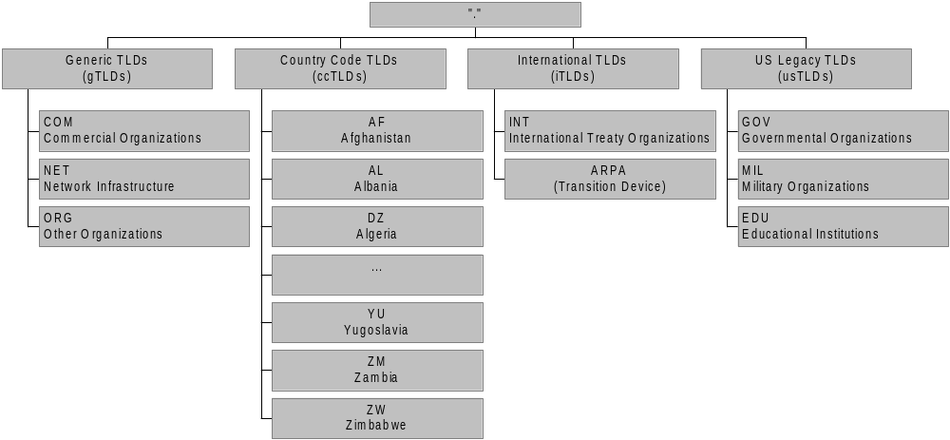
The Current TLDs
Notes:
ARPA: originally was the acronym for the Advanced Research Projects Agency (ARPA), the funding organization in the United States that developed the precursor of the Internet (ARPANET),
it now stands for Address and Routing Parameter Area.

Slide 7
Internet Corporation for Assigned Names and Numbers (ICANN)
ICANN’s role: to oversee the management of Internet resources including
  Addresses
    Delegating blocks of addresses to the regional registries
  Protocol identifiers and parameters
    Allocating port numbers, etc.
  Names
    Administration of the root zone file
    Oversee the operation of the root name servers
Notes:
Root zone file lists the names and numeric IP addresses of the authoritative DNS servers for all top-level domains (TLDs)

Slide 8
The Root Nameservers
The root zone file lists the names and IP addresses of the authoritative DNS servers for all top-level domains (TLDs)
The root zone file is published on 13 servers, “A” through “M”, around the Internet
Root name server operations currently provided by volunteer efforts by a very diverse set of organizations

