Slide 1
Linux Containers and Dockers
When, Pros and Cons
Dr. Fabio Fumarola

Slide 2
Contents
The Evolution of IT
The Solutions: Virtual Machines vs Vagrant vs Docker
Differences
Examples: Vagrant, Boot2Docker, Docker, Docker Hub
Orchestrate Docker
Mesosphere
CoreOS

Slide 3
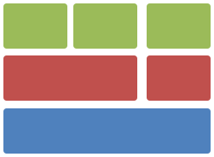

From 1995 to 2015
Thin app on mobile, tablet
Client-Server App
Assembled by developers using best available services
Well-defined stack:
- O/S
- Runtime
- Middleware
Running on any available set of physical resources
(public/private/
virtualized)
Monolithic
Physical
Infrastructure

Slide 4

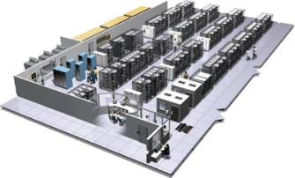

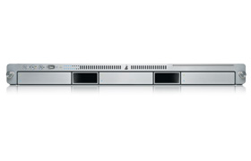
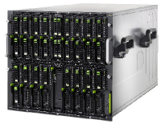

2015 in Detail
User DB
Static website
postgresql + pgv8 + v8
Queue
Analytics DB
nginx 1.5 + modsecurity + openssl + bootstrap 2
Redis + redis-sentinel
hadoop + hive + thrift + OpenJDK
Background workers
Web frontend
Python 3.0 + celery + pyredis + libcurl + ffmpeg + libopencv + nodejs + phantomjs
Ruby + Rails + sass + Unicorn
API endpoint
Python 2.7 + Flask + pyredis + celery + psycopg + postgresql-client
Production Cluster
Development VM
Public Cloud
QA server
Disaster recovery
Customer Data Center
Contributor’s laptop
Production Servers

Slide 5
Challenges
How to ensure that services interact consistently?
How to avoid to setup N different configurations and dependencies for each service?
How to migrate and scale quickly ensuring compatibility?
How to replicate my VM and services quickly?

Slide 6
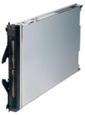
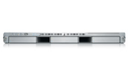


How to deal with different confs?
Static website
Web frontend
Background workers
User DB
Analytics DB
Queue
 | Development VM | QA Server | Single Prod Server | Onsite Cluster | Public Cloud | Contributor’s laptop | Customer Servers
? | ? | ? | ? | ? | ? | ?
? | ? | ? | ? | ? | ? | ?
? | ? | ? | ? | ? | ? | ?
? | ? | ? | ? | ? | ? | ?
? | ? | ? | ? | ? | ? | ?
? | ? | ? | ? | ? | ? | ?

Slide 7
1. Virtual Machines

Slide 8
Virtual Machines
App
A
App
A’
App
B
Run on top of an Hypervisor
Pros
  fully virtualized OS
  Totally isolated
Cons
  Needs to take a snapshot of the entire VM to replicate
  Uses a lot of space
  Slow to move around
Bins/
Libs
Bins/
Libs
Bins/
Libs
VM
Guest
OS
Guest
OS
Guest
OS
Guest
OS
Guest
OS
Hypervisor
Host OS
Server

Slide 9
Virtualization - Hypervisor
What’s the difference between a ‘Type 1’ hypervisor and a ‘Type 2’ hypervisor?
What’s a Hypervisor?
A ‘hypervisor’ is the essence of the cloud technology that we all enjoy today. Nowadays there exist many stable and feature-rich hypervisors: RetHat KVM, VMware, Microsoft Hyper-V, Oracle VirtualBox and Xen to name the more popular ones. But with so many hypervisors around all with competing features, what makes them different from one another? One of the main differences between hypervisor platforms is their classification as a ‘Type 1’ or a ‘Type 2’ hypervisor. So what’s the difference between a Type 1 and a Type 2 hypervisor you ask?

Slide 10
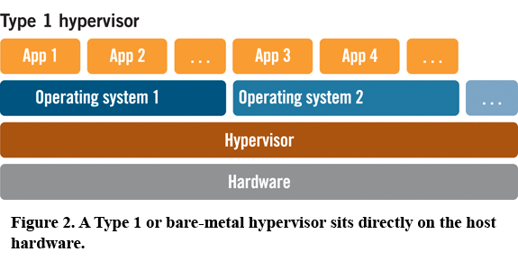
Type 1 Hypervisors
In short, a Type 1 hypervisor is a virtualization platform which is delivered as an integral part of an operating system.

Slide 11
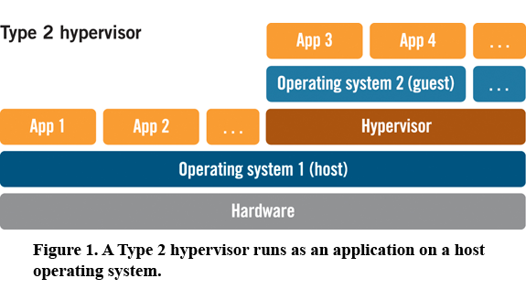
Type 2 Hypervisors
On the contrary, a Type 2 hypervisor is a virtualization platform which is delivered as a process that runs within an operating system.

Slide 12
Examples of Type 1 and 2
A List of Hypervisors and Their Types
For your interest, following is a listing the hypervisors mentioned above and their associated ‘type’:
KVM: Type 2
VMware ESXi: Type 1
VMWare Player: Type 2
Microsoft Hyper-V: Type 1
Oracle VirtualBox: Type 2
Xen: Type 2

Slide 13
Hypervisors Trend
2011
  XEN: Default choice given Rackspace and Amazon use
  KVM: Bleeding edge users
2012
  KVM: Emerges as the lead
  XEN: Loses momentum

Slide 14
Hipervisors Trend
2013
  KVM: Maintains lead (around 90%+ for Mirantis)
  Vmware: Emerges as a surprising second choice
  Containers (LXC, Parallels, Docker): Web Hosting and SAS focused
  Xen and HyperV: Infrequent requests (XenServer.org)
2014 – 2015
  ???
Notes:
CoreOS

Slide 15
2. Vagrant

Slide 16
Vagrant
Open source VM manager released in 2010
It allows you to script and package VMs config and the provisioning setup via a VagrantFile
It is designed to run on top of almost any VM tool: VirtualBox, VMVare, AWS, OpenStack¹
It can be used together with provisioning tools such as shell scripts, Chef and Puppet.
1. https://github.com/cloudbau/vagrant-openstack-plugin

Slide 17
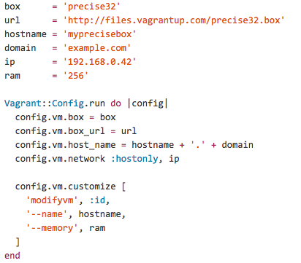
Vagrant: idea
Use a VagrantFile to install
an operating system
Required libraries and software
and finally run programs and processes of your final application

Slide 18
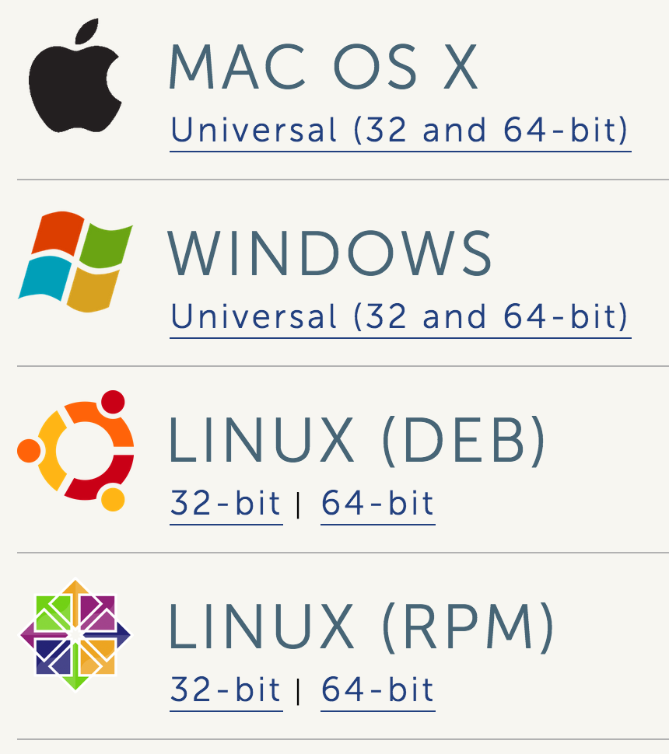
Vagrant: Feature
Command-Line Interface
Vagrant Share
VagrantFile
Boxes
Provisioning
Networking
Synced Folders
Multi-Machine
Providers
Plugins
https://www.vagrantup.com/downloads

Slide 19
Vagrant: Demo
It allows us to interact with Vagrant
It offers the following commands: box, connect, destroy, halt, init, login, package a vm, rdp, …
https://docs.vagrantup.com/v2/cli/index.html

Slide 20
Vagrant Example
Download and install VirtualBox and Vagrant
This will place a VagrantFile in the directory
Install a Box
Using a Box -> https://vagrantcloud.com/
$ mkdir vagrant_first_vm && cd vagrant_first_vm
$ vagrant init
$ vagrant box add ubuntu/trusty64
Vagrant.configure("2") do |config|
config.vm.box = "ubuntu/trusty64"
end

Slide 21
Vagran: Start
Start the box
Login into the vm
You can destroy the vm by
$ vagrant up
$ vagrant ssh
$ vagrant destroy

Slide 22
Vagrant: Synced Folders
By default, it shares your project directory to the /vagrant directory on the guest machine.
If you create a file on your guest os the file will be on the vagrant vm.
$ vagrant up
$ vagrant ssh
$ ls /vagrant
--Vagrantfile
$ touch pippo.txt
$vagrant ssh
$ls /vagrant/

Slide 23
Vagrant: Provisioning
Let’s install Apache via a boostrap.sh file
If you create a file on your gues os the file will be on the vagrant vm. (vagrant reload --provision)
#!/usr/bin/env bash
apt-get update
apt-get install -y apache2
rm -rf /var/www
ln -fs /vagrant /var/www
Vagrant.configure("2") do |config|
config.vm.box = "hashicorp/precise32"
config.vm.provision :shell, path: "bootstrap.sh"
end

Slide 24
Vagrant: Networking
Port Forwarding: llows you to specify ports on the guest machine to share via a port on the host machine
By running vagrant reload or vagrant up we can see on http://127.0.0.1:4567 our apache
It supports also bridge configurations and other configurations (https://docs.vagrantup.com/v2/networking/)
Vagrant.configure("2") do |config|
config.vm.box = "hashicorp/precise32"
config.vm.provision :shell, path: "bootstrap.sh"
config.vm.network :forwarded_port, host: 4567, guest: 80
end

Slide 25
Vagrant: Share and Provider
It is possible to share Vagrant box via vagrant cloud (but?)
Providers
By default Vagrant is configured with VirtualBox but you can change the provider
How?
$ vagrant up --provider=vmware_fusion
$ vagrant up --provider=aws
$ vagrant plugin install vagrant-aws

Slide 26
Vagrant: AWS Vagrantfile
Vagrant.configure("2") do |config|
# config.vm.box = "sean"
config.vm.provider :aws do |aws, override|
aws.access_key_id = "AAAAIIIIYYYY4444AAAA”
aws.secret_access_key = "c344441LooLLU322223526IabcdeQL12E34At3mm”
aws.keypair_name = "iheavy"
aws.ami = "ami-7747d01e"
override.ssh.username = "ubuntu"
override.ssh.private_key_path = "/var/root/iheavy_aws/pk-XHHHHHMMMAABPEDEFGHOAOJH1QBH5324.pem"
end
end

Slide 27
3. Docker

Slide 28
Quick Survey
How many people have heard of Docker before this Seminar?
How many people have tried Docker ?
How many people are using Docker in production ?

Slide 29
What is Docker?
"With Docker, developers can build any app in any language using any toolchain. “Dockerized” apps are completely portable and can run anywhere - colleagues’ OS X and Windows laptops, QA servers running Ubuntu in the cloud, and production data center VMs running Red Hat.”
Docker.io

Slide 30
Docker in simple words
It is a technology that allow you running applications inside containers (not VM)
This assures that libraries and package needed by the application you run are always the same.
This means you can make a container for Memcache and another for Redis and they will work the same in any OS (also in Vagrant).

Slide 31
Why Docker?
Fast delivery of your applications
Deploy and scale more easily
Get higher density and run more workload
Faster deployment makes for easier management

Slide 32
How does docker work?
LinuX Containers (LXC)
Control Groups & Namespaces (CGroups)
AUFS
Client – Server with an HTTP API

Slide 33
LXC- Linux Containers
It is a user-space interface for the Linux kernel containment features
Through a powerful API and simple tools, it lets Linux users easily create and manage system or application containers.
Currently LXC can apply the following kernel features to contain processes:
  Kernel namespaces (ipc, uts, mount, pid, network and user)
  Apparmor and SELinux profiles
  Seccomp policies
  Chroots (using pivot_root)
  Kernel capabilities & Control groups (cgroups)

Slide 34
Cgroups
Control groups is a Linux kernel feature to limit, account and isolate resource usage (CPU, memory, disk I/O, etc) of process groups.
Features:
  Resource limitation: limit CPU, memory…
  Prioritization: assign more CPU etc to some groups.
  Accounting: to measure the resource usage.
  Control: freezing groups or check-pointing and restarting.

Slide 35
LCX based Containers
It allows us to run a Linux system within another Linux system.
A container is a group of processes on a Linux box, put together is an isolated environment.
Container
From the inside it looks like a VM
From the outside, it looks like normal processes
App A
App A’
App B
App B’
App B’
App B’
App B’
Bins/Libs
Bins/Libs
Docker Engine
Host OS
Server

Slide 36
Docker Features
VE (Virtual Environments) based on LXC
Portable deployment across machines
Versioning: docker include git-like capabilities for tracking versions of a container
Component reuse: it allows building or stacking already created packages. You can create ‘base images’ and then running more machine based on the image.
Shared libraries: there is a public repository with several images (https://registry.hub.docker.com/)

Slide 37
Why are Docker Containers lightweight?
VMs
Containers
App
A
App
A
App
A’
App
A
App
A
App Δ
Bins/
Libs
Bins/
Libs
Bins/
Libs
Bins/
Libs
Bins/
Guest
OS
Guest
OS
Guest
OS
Guest
OS
Original App
(No OS to take
up space, resources,
or require restart)
Copy of
App
No OS. Can
Share bins/libs
Modified App
Union file system allows
us to only save the diffs
Between container A and container A’

Slide 38
Prerequisites
I use Oh My Zsh¹ with the Docker plugin² for autocompletion of docker commands
Linux at least with kernel 3.8 but 3.10.x is recommended
  $ uname –r
MacOS or Windows via Boot2Docker³ or via Vagrant
https://github.com/robbyrussell/oh-my-zsh
https://github.com/robbyrussell/oh-my-zsh/wiki/Plugins#docker
http://boot2docker.io/

Slide 39
Docker Installation Ubuntu
AUFS support
    $ sudo apt-get update
    $ sudo apt-get intall linux-image-extra-`uname –r`
Add docker repo
    $ sudo sh –c “curl https://get.docker.io/gpg | apt-key add -”
    $ sudo sh –c “echo deb http://get.docker.io/ubuntu docker \
    main > /etc/apt/sources.list.d/docker.list”
Install
    $ sudo apt-get update
    $ sudo apt-get install lxc-docker

Slide 40
Docker install Vagrant
Create the folders
$ mkdir ~/boot2docker
$ cd ~/boot2docker
Init the vagrant box
$ vagrant init yungsang/boot2docker
$ vagrant up; export DOCKER_HOST=tcp://localhost:2375
Check docker
$ docker version
  * NOTE: the YungSang boot2docker opens up port forwarding to the network, so is not safe on public wifi.

Slide 41
Docker Installation Vagrant
Clone the docker repository
$ git clone https://github.com/dotcloud/docker.git
Startup the vagrant image
$ vagrant up
SSH into the image
$ vagrant ssh
Docker client works normally

Slide 42
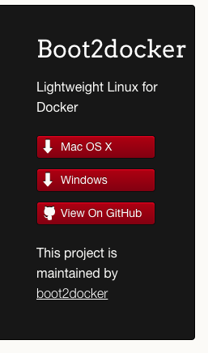
Docker install boot2docker
http://boot2docker.io/

Slide 43
Base Commands

Slide 44
Docker: hello world
Get one base image from https://registry.hub.docker.com
  $ sudo docker pull centos
List images on your system
$ sudo docker images
Check the images
  $ sudo docker images
Run your first container
  $ sudo docker run centos:latest echo “hello world”

Slide 45
An Interactive Container
Run bash in your container
  $ sudo docker run -t -i centos /bin/bash
The -t flag assigns a pseudo-tty or terminal inside our new container
The -i flag allows us to make an interactive connection by grabbing the standard in (STDIN) of the container
We also specified a command for the container

Slide 46
A Daemonized Hello world
Run a sh script
  sudo docker run -d centos:6 /bin/sh –c ‘while true; do echo hello world; sleep 1; done’
The -d flag tells Docker to run the container and put it in the background, to daemonize it.
To list the docker containers running
  $ docker ps
To get the logs of the container
  $ sudo docker logs container_id
To stop the container:
  $ sudo docker stop container_id

Slide 47
A web container with docker
To run a Python Flask application
  $ sudo docker run -d -P training/webapp python app.py
The -P flag is new and tells Docker to map any required network ports inside our container to our host.
To view our application with the port mapping
  $ sudo docker ps –l
We can see that the default flask port 5000 is exposed to 49155
  $ sudo docker run -d -p 5000:5000 training/webapp python app.py
Check the url to continue the guide
  https://docs.docker.com/userguide/usingdocker/

Slide 48
Working with docker images
To find images go to
  https://hub.docker.com/
To pull an image
  $ sudo docker pull training/sinatra
Updating and committing an image
  $ sudo docker run -t -i training/sinatra /bin/bash
  # gem install json
  $ sudo docker commit -m="Added json gem" -a="Kate Smith" \
  0b2616b0e5a8 ouruser/sinatra:v2
  $ sudo docker images

Slide 49
Create an image from a Dockerfile
FROM library/centos:centos6
MAINTAINER fabio fumarola fabiofumarola@gmail.com
RUN yum install -y curl which tar sudo openssh-server openssh-clients rsync
# passwordless ssh
RUN ssh-keygen -q -N "" -t dsa -f /etc/ssh/ssh_host_dsa_key
RUN ssh-keygen -q -N "" -t rsa -f /etc/ssh/ssh_host_rsa_key
RUN ssh-keygen -q -N "" -t rsa -f /root/.ssh/id_rsa
RUN cp /root/.ssh/id_rsa.pub /root/.ssh/authorized_keys
EXPOSE 22
CMD ["/usr/sbin/sshd", "-D"]

Slide 50
Build and run an image
$docker build –t fabio/centos:ssh .
$docker run –i –t fabio/centos:ssh /bin/bash
Or
$docker run –d fabio/centos:ssh /bin/bash
Check the following commands:
  $ docker top
  $ docker logs
  $ docker inspect

Slide 51
Other Commands
Docker cp: copy a file from container to host
Docker diff: print container changes
Docker top: display running processes in a container
Docker rm /rmi: delete container/image
Docker wait: wait until container stop and print exit code
More on: http://docs.docker.io/en/latest/commandline/cli

Slide 52
Docker vs Vagrant?
Less memory for Dockers w.r.t VMs
With a VM you get more isolation, but is much heavier. Indeed you can run 1000 of Dockers in a machine but not thousand of VMs with Xen.
A VM requires minutes to start a Docker seconds
There are pros and cons for each type.
If you want full isolation with guaranteed resources a full VM is the way to go.
If you want hundred of isolate processes into a reasonably sized host then Docker might be the best solution

Slide 53
Orchestrate Docker with Machine, Swarm and Compose
http://blog.docker.com/2015/02/orchestrating-docker-with-machine-swarm-and-compose/

Slide 54
Motivation
Docker Engine works well for packaging applications making much easier to
  build,
  deploy
  and move between providers.
But, to deploy complex application consisting of multiple services we need to resort to shell scripts.

Slide 55
Motivation
This isn’t ideal
We’d like to have a more controllable method to distribute applications in the cloud.
We need that our distributed application is:
  Portable across environments: run seamlessly in testing, staging and production
  Portable across providers: move the applications between different cloud providers
  Composable: split up an application in multiple services

Slide 56
How to Orchestrate Dockers
There are three new tools that can be used to orchestrate docker containers:
Machine,
Swarm,
Compose.

Slide 57
Docker Machine
It lets easily deploy docker engines on your computer, on cloud providers and in a data center.
It supports the following providers:
  Amazon EC2
  Microsoft Azure
  Microsoft Hyper-V
  DigitalOcean
  Google Compute Engine
  OpenStack
  Rackspace
  SoftLayer
  VirtualBox
  VMware Fusion
  VMware vCloud Air
  VMware vSphere

Slide 58
Docker Machine
It is supported on Windows, OSX, and Linux.
  Windows - x86_64
  OSX - x86_64
  Linux - x86_64
  Windows - i386
  OSX - i386
  Linux - i386
At the lab we will explore how to use it.

Slide 59
Swarm and Weave
Swarm allows us to connect together several docker containers deployed on different sub-networks.
This happens when you need to deploy dockers in several machines and you want to achieve resilience through load balancing.
It pools together several Docker Engines into a single virtual host.
http://blog.docker.com/2015/02/scaling-docker-with-swarm/

Slide 60
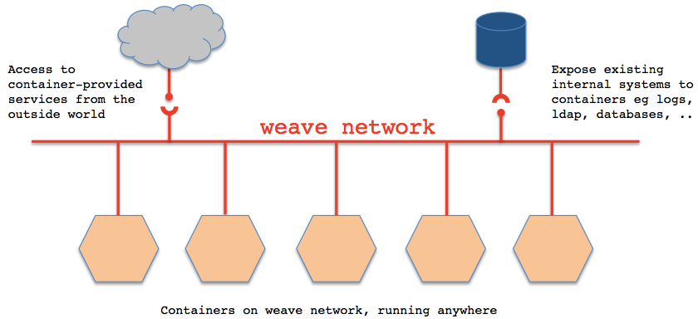
Swarm and Weave
css
https://github.com/zettio/weave

Slide 61
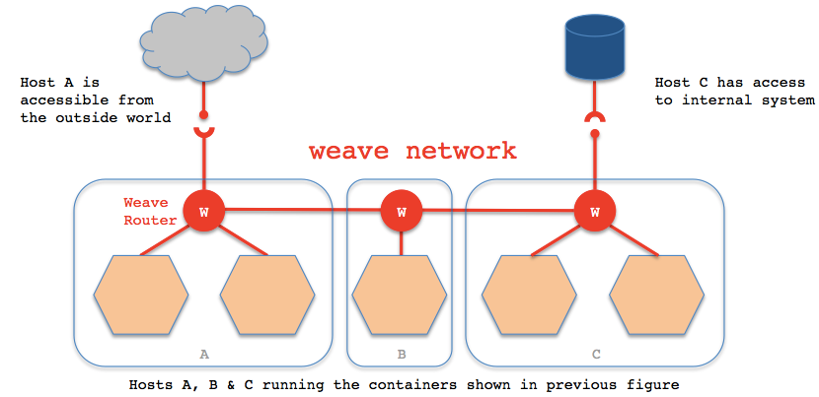
Swarm and Weave

Slide 62
Compose
It is a way of defining and running multi-container distributed applications with Docker.
When you need to setup an application that requires other services (e.g. redis, postgres,…) it is possible to use compose.
Next, you define the components that make your app so they can be run together in an isolate environment.

Slide 63
Compose
It is based on a dockerfile and on a yaml configuration file
Dockerfile | docker-compose.yml
FROM python:2.7 WORKDIR /code ADD requirements.txt /code/ RUN pip install -r requirements.txt ADD . /code CMD python app.py | web: build: . links: - redis ports: - "5000:5000" redis: image: redis

Slide 64
Mesosphere
http://mesosphere.com/

Slide 65
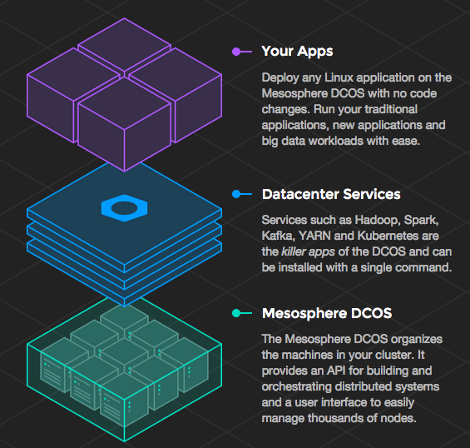
Mesosphere
It is an apache project that allows you to separate
  the application you deploy
  From the datacenter administration

Slide 66
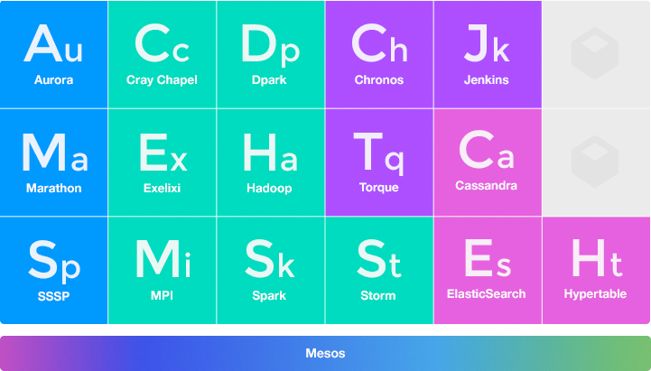
Frameworks on Mesos

Slide 67



Additional Contributions

Slide 68
Core OS

Slide 69
CoreOS
A minimal operating system
Painless updating: utilizes active/passive scheme to update the OS as single unit instead of package by package.
Docker container
Clustered by default
Distributed System tools: etcd key-value store
Service discovery: easily locate where service are running in the cluster
High availability and automatic fail-over

Slide 70
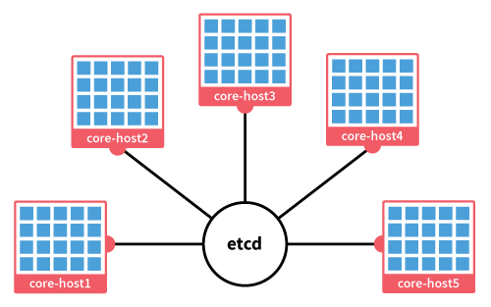
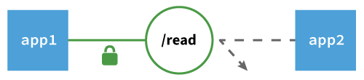
CoreOS
Clustered by default
High availability and a
utomatic fail-over

Slide 71
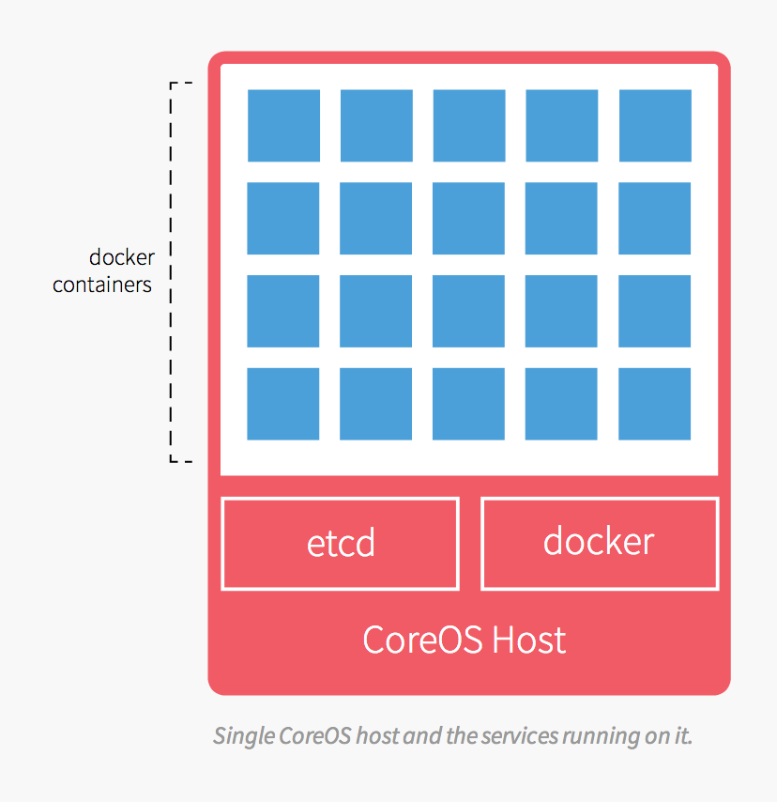
Docker with CoreOS
Features
Automatically runs on each CoreOS machine
Updated with regular automatic OS updates
Integrates with etcd
Networking automatically configured
Example Akka cluster + Docker + CoreOS
https://github.com/dennybritz/akka-cluster-deploy

Slide 72
References
http://www.iheavy.com/2014/01/16/how-to-deploy-on-amazon-ec2-with-vagrant/
https://docs.vagrantup.com/v2/
Vagrant: Up and Running Paperback – June 15, 2013
https://github.com/patrickdlee/vagrant-examples
https://linuxcontainers.org/ LXC
https://www.kernel.org/doc/Documentation/cgroups/
http://lamejournal.com/2014/09/19/vagrant-vs-docker-osx-tales-front/
https://medium.com/@_marcos_otero/docker-vs-vagrant-582135beb623
https://coreos.com/using-coreos/docker/

