Slide 1
Colors, Selectors, BOX model
Day 8

Slide 2
HTML Colors
HTML colors are specified with predefined color names, or with RGB, HEX, HSL, RGBA, or HSLA values.
Color Values
In HTML, colors can also be specified using RGB values, HEX values, HSL values, RGBA values, and HSLA values.
rgb(255, 99, 71), #ff6347, hsl(9, 100%, 64%)
background color set with RGBA and HSLA values, which adds an Alpha channel to the color (here we have 50% transparency):
rgba(255, 99, 71, 0.5)hsla(9, 100%, 64%, 0.5)

Slide 3
RGB Color Values
An RGB color value represents RED, GREEN, and BLUE light sources.
An RGBA color value is an extension of RGB with an Alpha channel (opacity).
rgb(red, green, blue)
Each parameter (red, green, and blue) defines the intensity of the color with a value between 0 and 255.(256 x 256 x 256 = 16777216 possible colors!)

Slide 4
RGB Color
Red - rgb(255, 0, 0)
Green - rgb(0, 255, 0)
Blue - (0,0,255)
Black -(0,0,0)
White - (255,255,255)

Slide 5
RGBA Color Values
RGBA color values are an extension of RGB color values with an Alpha channel - which specifies the opacity for a color.
An RGBA color value is specified with:
rgba(red, green, blue, alpha)
The alpha parameter is a number between 0.0 (fully transparent) and 1.0 (not transparent at all):

Slide 6
2.HEX Colors
A hexadecimal color is specified with: #RRGGBB, where the RR (red), GG (green) and BB (blue) hexadecimal integers specify the components of the color.
color values
#rrggbb
Where rr (red), gg (green) and bb (blue) are hexadecimal values between 00 and ff (same as decimal 0-255)
For example, #ff0000 is displayed as red, because red is set to its highest value (ff), and the other two (green and blue) are set to 00.

Slide 7
HEX Colors
Red - #ff0000
Green - #00ff00
Blue - #0000ff
Black - 000000
white - ffffff

Slide 8
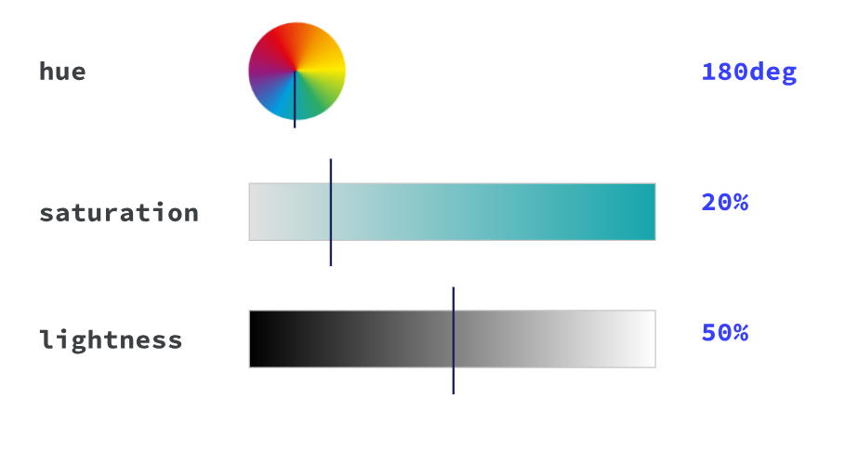
3.HSL and HSLA Colors
HSLA color values are an extension of HSL with an Alpha channel (opacity).
HSL Color Values - hsl(hue, saturation, lightness)
In HTML, a color can be specified using hue, saturation, and lightness (HSL)
Hue is a degree on the color wheel from 0 to 360. 0 is red, 120 is green, and 240 is blue.
Saturation is a percentage value, 0% means a shade of gray, and 100% is the full color.
Lightness is also a percentage value, 0% is black, and 100% is white.

Slide 9
HSLA Color Values
hsla(hue, saturation, lightness, alpha)
The alpha parameter is a number between 0.0 (fully transparent) and 1.0 (not transparent at all)
Eg: Color picker

Slide 10
CSS Selectors
A CSS selector selects the HTML element(s) you want to style.
We can divide CSS selectors into five categories:
1.Simple selectors (select elements based on name, id, class)
2.Combinator selectors (select elements based on a specific relationship between them)
3.Pseudo-class selectors (select elements based on a certain state)
4.Pseudo-elements selectors (select and style a part of an element)
5.Attribute selectors (select elements based on an attribute or attribute value)

Slide 11
CSS id Selector
The id selector uses the id attribute of an HTML element to select a specific element.
The id of an element is unique within a page, so the id selector is used to select one unique element!
To select an element with a specific id, write a hash (#) character, followed by the id of the element.
eg
#para1 {
text-align: center;
color: red;
}

Slide 12
Tag selector
When HTML tags are used to specifically identify which section of web pages in CSS, they are called selectors.
Eg: body {
background: # FC9;
font-family: Tahoma;
colour: # F60;
}

Slide 13
CSS class Selector
The class selector selects HTML elements with a specific class attribute.
To select elements with a specific class, write a period (.) character, followed by the class name.
eg:
.center {
text-align: center;
color: red;
}

Slide 14
Universal Selector
The universal selector (*) selects all HTML elements on the page
Eg:* {
text-align: center;
color: blue;
}

Slide 15
Grouping Selector
The grouping selector selects all the HTML elements with the same style definitions.
It will be better to group the selectors, to minimize the code.
To group selectors, separate each selector with a comma.
eg :
h1, h2, p {
text-align: center; color: red;
}

Slide 16
Pseudo Class Selector
button:hover{
font-weight:800;
}

Slide 17
Pseudo Element Selector
p::first-line{
color:blue;
}
It only select first line of p tag

Slide 18
CSS SPACING PROPERTIES - Box Model
CSS - Margin, Border and Padding
Using CSS we can wrap the content, we can set the distance between the content and the border, and the space with other elements on the page. For that, the following CSS attributes will be used
margin - The distance with other elements on page or page.
border - a line that surrounds the element
padding - the distance between the border and the content itself
content - the content can be whatever you like, for example text, image, div, span, etc

Slide 19
Border
Border will just draw a simple border around the HTML element.
Border-style
border-width
Border color
Border-radius

Slide 20
Border-style
The border-style attribute is the one that is used to change the border look. These are the values that can be used with border-style.
Eg: None, Solid, Dotted, Dashed, Double, Groove, ridge, inset, outset

Slide 21
Border-width
The border-width property is used to set the border's width. It is set in pixels.
You can also use the one of the three pre-defined values, thin, medium or thick to set the width of the border.
Eg: border-width: 5px;

Slide 22
Border color
There are three methods to set the color of the border.
Name: It specifies the color name. For example: "red".
RGB: It specifies the RGB value of the color. For example: "rgb(255,0,0)".
Hex: It specifies the hex value of the color. For example: "#ff0000".
There is also a border color named "transparent". If the border color is not set it is inherited from the color property of the element.

Slide 23
Border-radius
This CSS property sets the rounded borders and provides the rounded corners around an element, tags, or div. It defines the radius of the corners of an element.
It is shorthand for border top-left-radius, border-top-right-radius, border-bottom-right-radius and border-bottom-left-radius.
It gives the rounded shape to the corners of the border of an element.
We can specify the border for all four corners of the box in a single declaration using the border-radius. The values of this property can be defined in percentage or length units.
Eg: border-radius: 30px;
border-radius: 20% 10% ;(top-left and bottom-right )
border-radius: 10% 30% 20% 40%;
(first value will be the radius of top-left, the second value will be used for the top-right, the third value will be applied on bottom-right, and the fourth value is used for bottom-left.)

Slide 24
Margin
The margin is basically just space around the box and it will be transparent.
To define the space around our box model we will set the margin for all four sides of the element: TOP, RIGHT, BOTTOM, LEFT.
margin: 30px 20px 30px 50px; /* up, right, bottom, left */
margin: 30px 20px 50px; /* up, right and left, bottom */
margin: 30px 20px; /* up and bottom, right and left */
margin: 30px; /* up, bottom, right, left - This will just set a 30ps width margin around the element. */

Slide 25
Padding
Padding refers to the region between the content and the border. We will set this region, same way as the margin attribute.
padding-top:10px;
padding-bottom:10px;
padding-right:20px;
padding-left:20px;

Slide 26
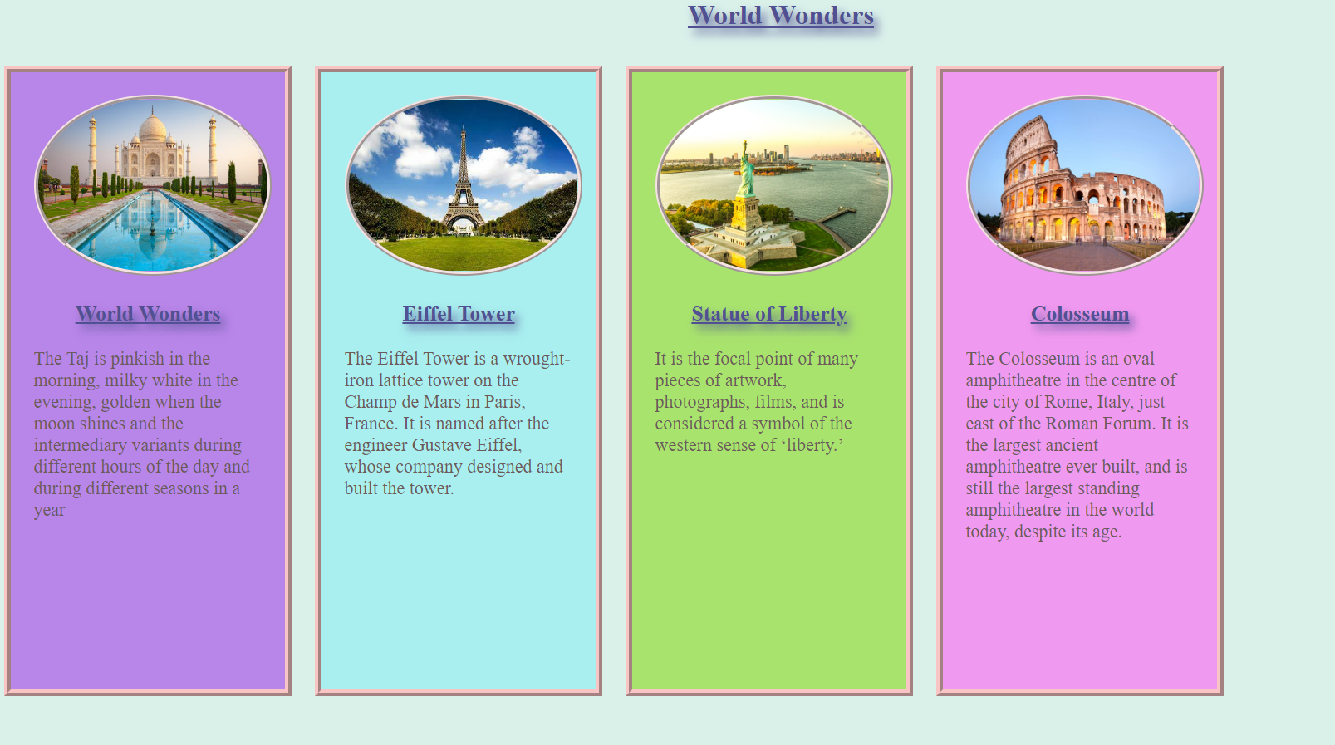
TASK
World wonder site

