Slide 1





INTELLIGENT GARBAGE CLASSIFICATION USING DEEP LEARNING
Team :V.RAGESH
rageshkarambayaym@gmail.com
Guide: P. Raja, (Master Trainer, Edunet Foundation)
Disclaimer: The content is curated for educational purposes only.
Notes:
Slides: Prepare a short slide deck (10-12 slides) summarizing the project objectives, methodology, and key results.

Slide 2
OUTLINE
Abstract of the Project
Problem Statement
Proposed Solution
System Architecture
Live Demo of the Project
Embedded Video of Project
Conclusion
Future Scope

Slide 3
Abstract
Officials in developing countries like India usually acknowledge the need for better management. However, little efforts are done to improve the situation, and changes take a long period of time. As we know, India's population is equivalent to 17.7% of the total population. With the rise of development of smart cities across India, a Smart Garbage Management system is very necessary. Since the amount of waste is multiplying day by day. It is essential to bring the best approach to manage this problem because the generated waste exceeds 2 billion tones. The existing gms in India practices collection of domestic and industrial waste and dumping into big dumping yards . Solid waste separation is done by laborers which is not so systematic, consumes a lot of time and it is not even completely feasible due to large amounts of garbage. The purpose of this research is to build a real time application which recognizes the type of waste and categorize it into defined categories. By implementing this Trashnet classification system ,we want to reduce the physical efforts and effectively segregate the waste into different categories. The model used for this study is Convolution Neural Network (CNN), a Machine Learning algorithm which is used on a dataset containing images of garbage . This system ensures a best way for waste management and will also speed up the segregation process with higher accuracy. This study lasts with remarkable results and is successful to classify various images of waste in correct classes.

Slide 4
Problem Statement
World bank’s calculation that India’s waste will reach 3.77 lakh tons by 2025, which makes waste management one of the vital issues in our country. It has been predicted that since the growth of population reaches 9.6 billion people by 2050 . It is very difficult to deal with the lot of waste. To further add to this problem, the world sees India, a country which generates 1.43 lakh tones of solid waste per day. This review gives out various problems related to Waste management in smart and automated cities, where the waste collection system is not developed[16].Presently in India, there is no automatic waste segregation system at domestic level and so the need of the hour is developing a tamp, cheap cost , eco friendly and feasible classification model for urban households[2]

Slide 5
Proposed Solution
The garbage collection in India still depends on unorganized collection of waste. The segregation process is still handled by mankind which has many health issues, time consuming, costly and less effective . In the existing system, all the garbage collected from households and industries was dumped on the outskirts of towns and cities. Due to uncontrolled dumping of waste, it gave rise to the problems like overflowing landfills but also contributed a huge amount in terms of ground waste pollution and Global warming .
A new concept uses deep learning algorithms to segregate the waste at initial level thus making waste management more powerful. The designed method sorts the waste into different categories with higher accuracy. This study reviews the best and effective approach to segregate the garbage into different types.
The proposed method mainly focuses on identification and segregation of waste by using deep learning algorithms like convolution neural networks(CNN) . Usually, all the toxic wastes are dumped with recyclable waste which causes huge damage to land. This project proposes an idea where to segregate the toxic waste with higher accuracy.

Slide 6
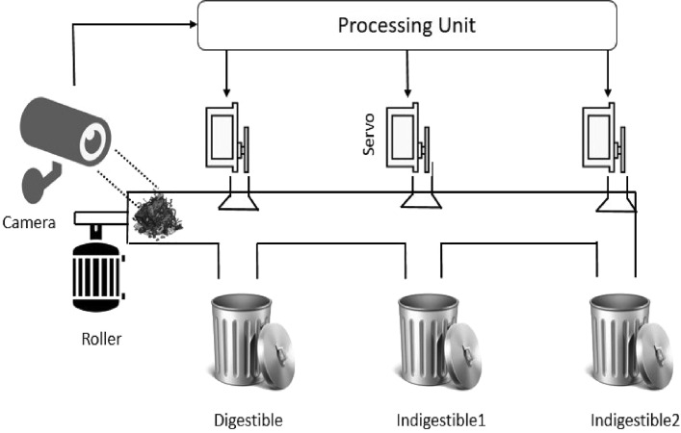
System Architecture

Slide 7
Conclusion
The proposed thought predominantly centers on the recognizable proof and order of the waste that is very nearly dumping in squander canister. Generally, landfill is used to dump the unsegregated waste and made to rot which takes several years in the case of nonbiodegradable waste and the blending of poisonous hurtful squanders will debase the land assets and water resources . This task proposes a thought where the machine all alone can distinguish the loss without human intercession dependent on the arrangement of datasets, independent of its shape and size, effectively and order them [8]. Our proposed framework can learn without anyone else and hence can constantly refresh itself if there should arise an occurrence of new materials. The points of interest to the proposed framework would incorporate simple disintegration, lesser wellbeing risks and quicker procedure that requires just an underlying venture and is programmed. Tweaked CNN structures were utilized in the proposed technique.

Slide 8
Future Scope
● This project indeed has a very vast scope not only in India but Globally too because the project is very effective in segregating the waste this segregation will finally lead to protecting our environment and people’s health which is major problem in today’s world
● Project can be further improved in many ways
A: It is obvious that after a certain period of time the bin will get full. Using modules such as wifi and proximity sensors etc. the data that bin is filled completely can be sent to the concerned authoritywho can then be alerted to see and empty the bin.
B: Work can also be extended in introducing a robot in the bin which automatically dumps the bin when it finds it to be full.

Slide 9
Thank you!
Notes:
thank you very much for joining this PPT, keep learning.
9

