Slide 1
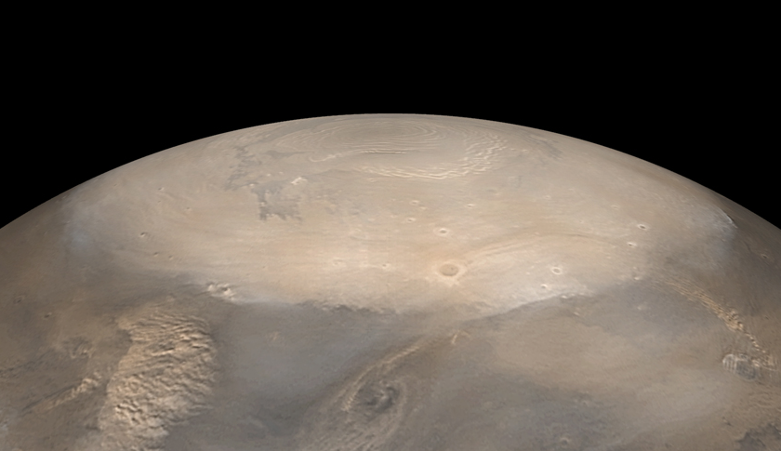
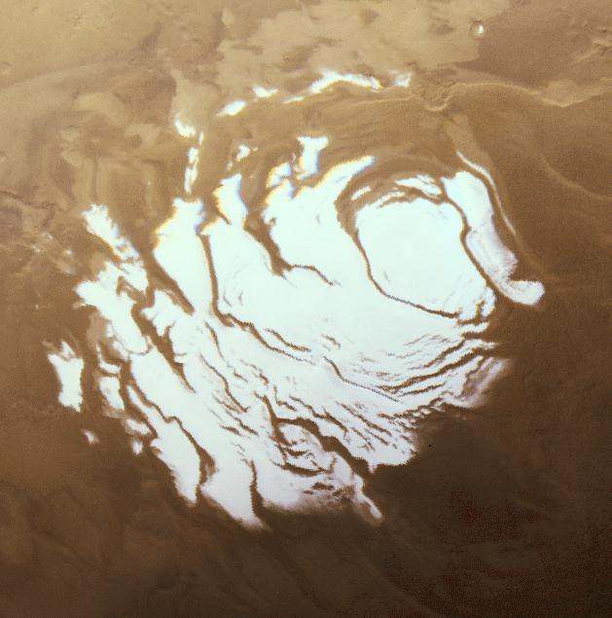
North pole
South pole
Image by MGS MOC
Image by Viking Orbiter

