Slide 1
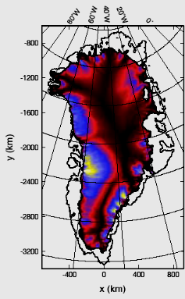
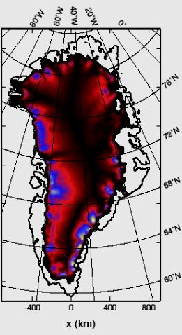
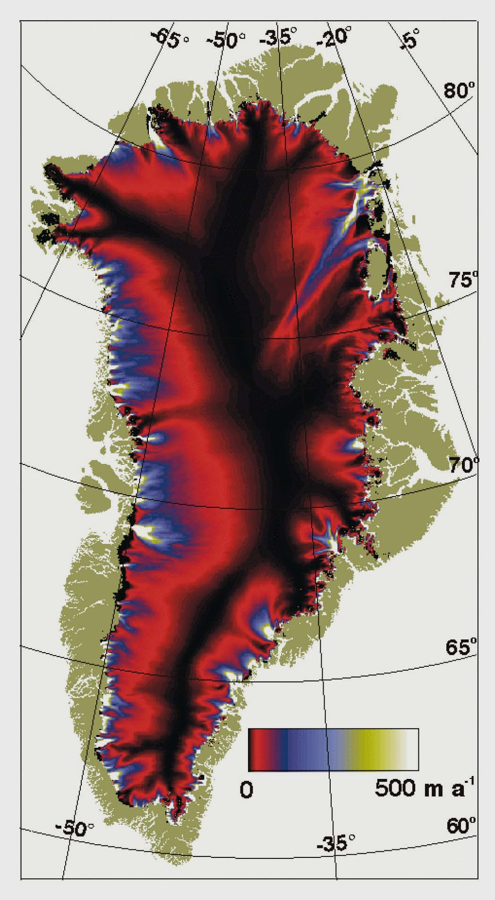
SICOPOLIS (SIA)
Elmer/Ice (FS)
Balance velocities
(Bamber et al., 2001)

