Slide 1
Research assignment
Title of the article :
ArticEvent-based Workflow Analysis in Healthcare.
Raghad Hamdeh

Slide 2
AGENDA
1.
3.
2.
4.
The main purpose
BPMN Model
The main purpose of using the Event-driven Process Chains (EPC).
I converted the EBC model to BPMN for this article.
My opinion
Conclusion

Slide 3

About The Article:
This study describes a promising method for evaluating Key Performance Indicators (KPIs) in hospitals that is based on the newly developed EPC model.
They put their model and methodology to the test with a group of doctors and medical professionals. Clinical trials were also used to validate the model.
Several hospital tracks, including acute heart attack and stroke tracks.
in collaboration with a major German university hospital, they assessed the model's suitability for specialization and time measurement.
Clinical Competence Center Cardiology, Siemens Healthcare, German university hospital

Slide 4
The main purpose of using the (EPC(
EPC notation represents the temporal and logical dependencies of events and processes, as well as explicit event notation, allowing for the measurement of process performance.
Because of these considerations, the EPC is an appropriate method for clinical process measurement efforts. Furthermore, non-technical professionals such as physicians or other clinical staff can quickly and easily understand a typical clinical process due to clinical task-oriented EPC notation.
for analysis Performing the process, the article approach focuses on the entire treatment process. The foundation for continuous performance measurement, clinical quality improvement, and risk reduction is provided by standardized forms that allow for specific clinical analysis and evaluation workflow. in the delivery of healthcareIn most cases, it directly translates into better service, better patient outcomes, and lower treatment costs.

Slide 5
My opinion:
From what I have learned about JCAHO it defines quality of care as the extent to which patient care services increase the likelihood of desired outcomes and are consistent with current professional standards.Knowledge. A. Donabedian classifies quality into three categories: structural, process, and outcome. This internationally recognized classification is based on the assumption that all quality dimensions are interrelated. A comprehensive and integrated assessment of care quality is represented by a simultaneous analysis of only three dimensions. An EPC unit is an example of a sub-process (such as an imaging procedure) carried out by an imaging modality (eg during a CT scan)it designed primarily to analyze the clinical workflow by means of process metrics. Secondly it accelerates the modeling of disease-specific 66 and hospital-specific clinical pathways and the measurement of KPIs in hospitals. which I turn it into a BPMN model.Time measurements are possible with EPC-events. Because events do not have a time duration (unlike functions), they can be registered with a timestamp. As a result, special events (for example, "Procedure") were added to the model."Procedure started" and "Procedure completed" or "Acquisition started" and "Acquisition completed") .They represent the beginning and end of the workflow, respectively the process within. The process cycle time between two such events can be calculated, allowing bottlenecks to be identified and analyzed. The calculated time difference between "Procedure started" and "Procedure finished," for example, provides the duration of the entire imaging procedure, including device adjustment times and possibly multiple image acquisitions.

Slide 6
illustrates the BPNM-module which models the workflow at an imaging modality (i.e. device used to acquire images of the body).
“
“

Slide 7
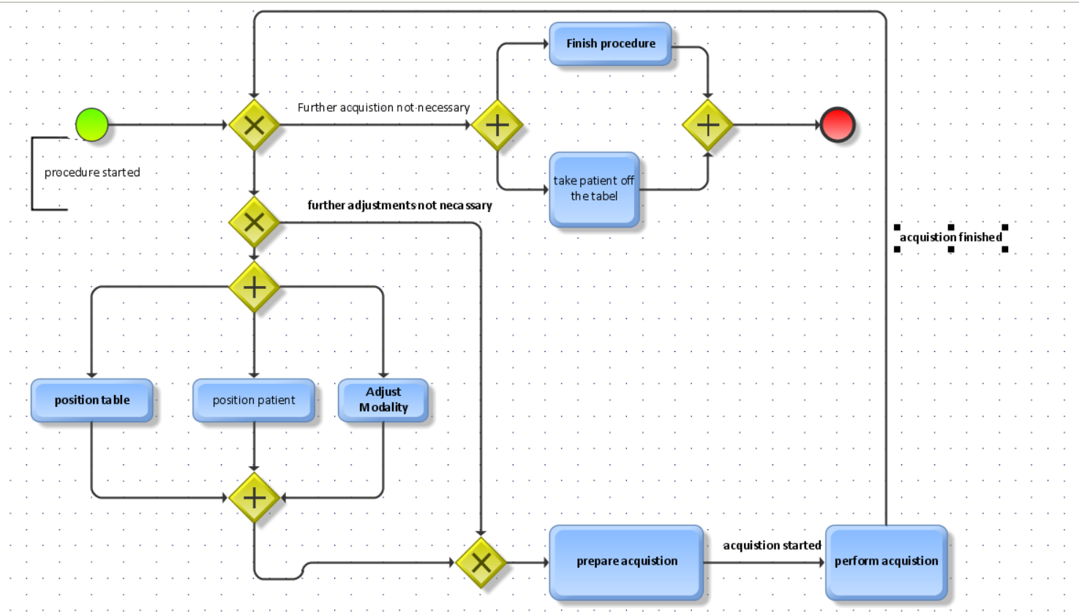

Slide 8
A clinical pathway is an evidence-based treatment process for continuous quality improvement in patient care . In addition, a clinical pathway serves as the basis for quality improvement and can be used as an instrument for data collection and process monitoring . Clinical care often varies depending on the condition of the patient and disease progression. Based on a newly developed EPC-model, our paper presents a promising approach for measuring KPIs in the health care environment.
Conclusion

