Slide 1
Needs Assessment & Technology Evaluation
CPIT 435
LAB 05 : Process Mapping

Slide 2
Process Mapping
Objective:
Understand the Process Mapping
Start with some basic concept of Flow Chart UML
Working with Visio 2013
Activity Outcomes:
How to create a Flow Chart By Use Visio. We are using it in this Lab.

Slide 3
Process Mapping
Outline
What is Process Mapping
Purpose of process mapping
Benefits of process mapping
Types of process mapping
Process mapping symbols
How to create a process map
Process Mapping Symbols and Notation
Draw Process Mapping about all ideas by use (Visio)

Slide 4
What is Process Mapping
Is a planning and management tool that visually describes the flow of work. Process maps show a series of events that produce an end result. A process map is also called a flowchart, process flowchart, process chart, functional process chart, functional flowchart, process model, workflow diagram, business flow diagram or process flow diagram.

Slide 5
Purpose of process mapping
Organizations and businesses to improve efficiency.
Help teams brainstorm ideas for process improvement,
Increase communication and provide process documentation.
Identify repetition and delays.
Help to define process boundaries, process ownership, process responsibilities and effectiveness measures or process metrics.

Slide 6
Benefits of process mapping
Process maps help you to understand the important characteristics of a process, allowing you to produce helpful data to use in problem solving.
Process maps let you strategically ask important questions that help you improve any process.

Slide 7
Benefits of process mapping
Flowcharts and process maps are used to:
Increase understanding of a process
Analyze how a process could be improved
Show others how a process is done
Improve communication between individuals engaged in the same process
Provide process documentation
Plan projects

Slide 8
Benefits of process mapping
Process maps save time & simplify projects because they:
Create and speed up the project design
Provide effective visual communication of ideas, information and data
Help with problem solving and decision making
Identify problems and possible solutions
Can be built quickly and economically

Slide 9
Benefits of process mapping
Process maps save time & simplify projects because they:
Show processes broken down into steps and use symbols that are easy to follow
Show detailed connections and sequences
Show an entire process from the beginning to the end

Slide 10
Types of process mapping
The most common process map types include:
High-Level Process Map
Work Flow Diagram
Activity Process Map
Detailed Process Map
Value Stream Map
Document Map
Rendered Process Map
Swimlane (or Cross-functional) Map
Value-Added Chain Diagram

Slide 11
Types of process mapping
High-Level Process Map: high-level representation of a process involving interactions between Supplier, Input, Process, Output, Customer (SIPOC)
Work Flow Diagram: a work process shown in “flow” format; doesn’t utilize Unified Modeling Language (UML) symbols.

Slide 12
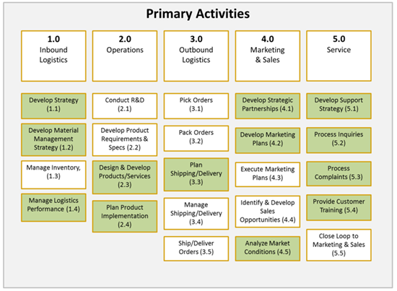
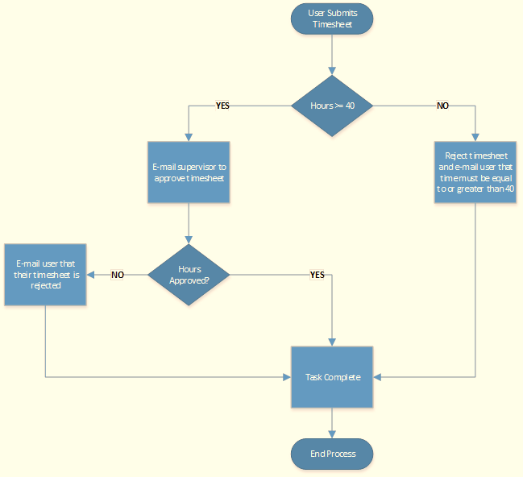
Types of process mapping
High-Level Process Map
Work Flow Diagram

Slide 13
Types of process mapping
Activity Process Map: represents value added and non-value added activities in a process
Detailed Process Map: provides a much more detailed look at each step in the process
Document Map: documents are the inputs and outputs in a process

Slide 14
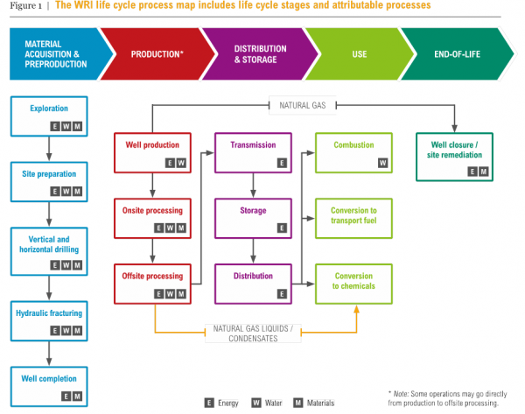
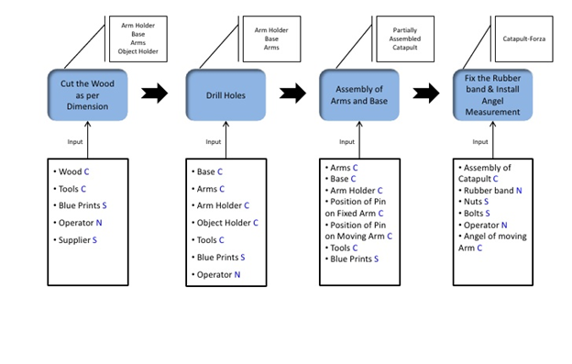
Types of process mapping
Activity Process Map:
Detailed Process Map:

Slide 15
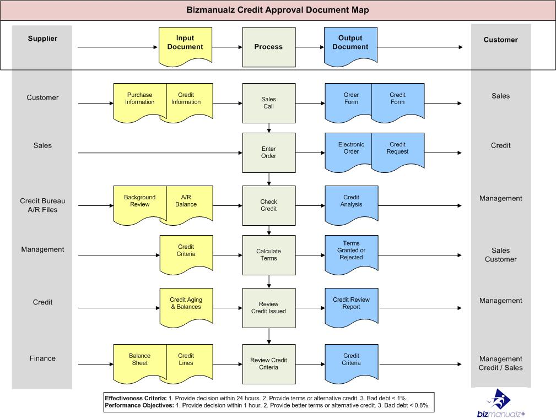
Types of process mapping
Document Map:

Slide 16
Types of process mapping
Value Stream Map: a lean-management technique that analyzes and improves processes needed to make a product or provide a service to a customer.
Rendered Process Map: represents current state and/or future state processes to show areas for process improvement

Slide 17
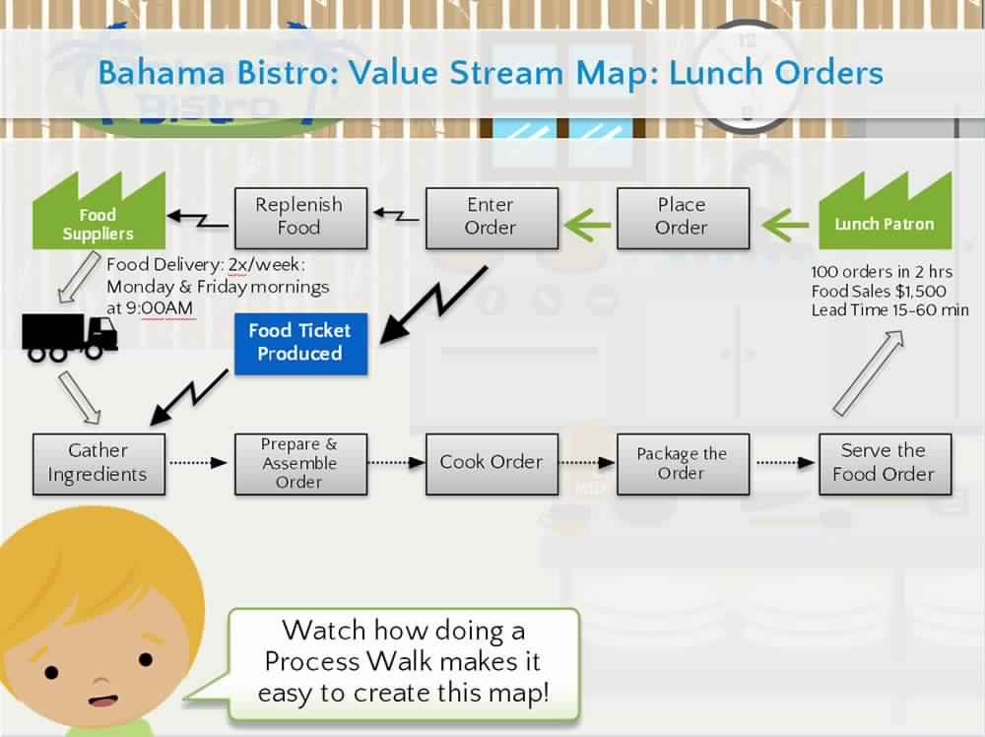
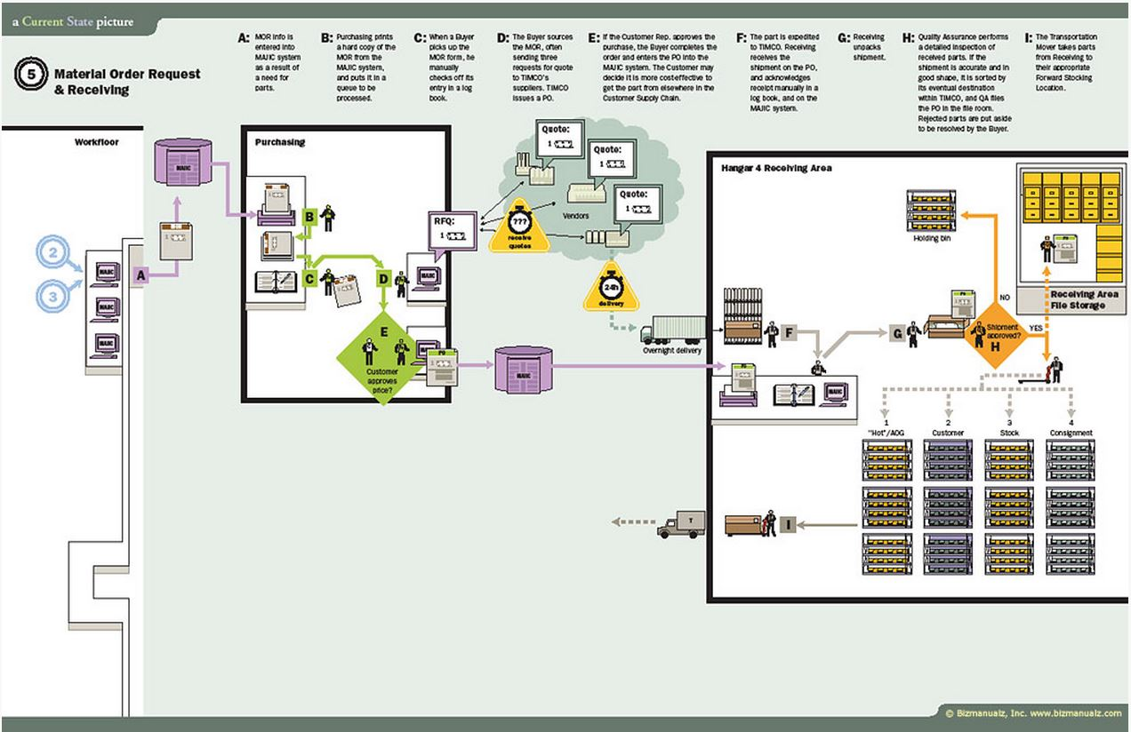
Types of process mapping
Value Stream Map:
Rendered Process Map:

Slide 18
Types of process mapping
Swimlane (or Cross-functional) Map: separates out the sub-process responsibilities in the process
Value-Added Chain Diagram: unconnected boxes that represent a very simplified version of a process for quick understanding

Slide 19
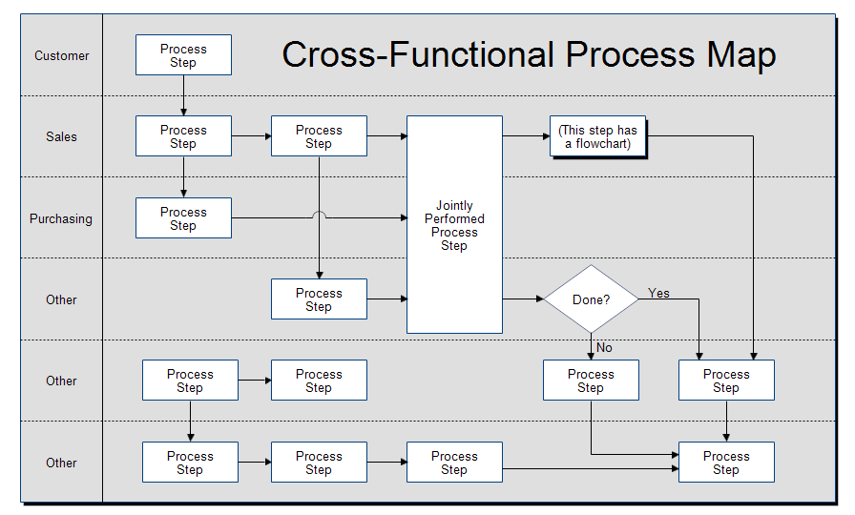
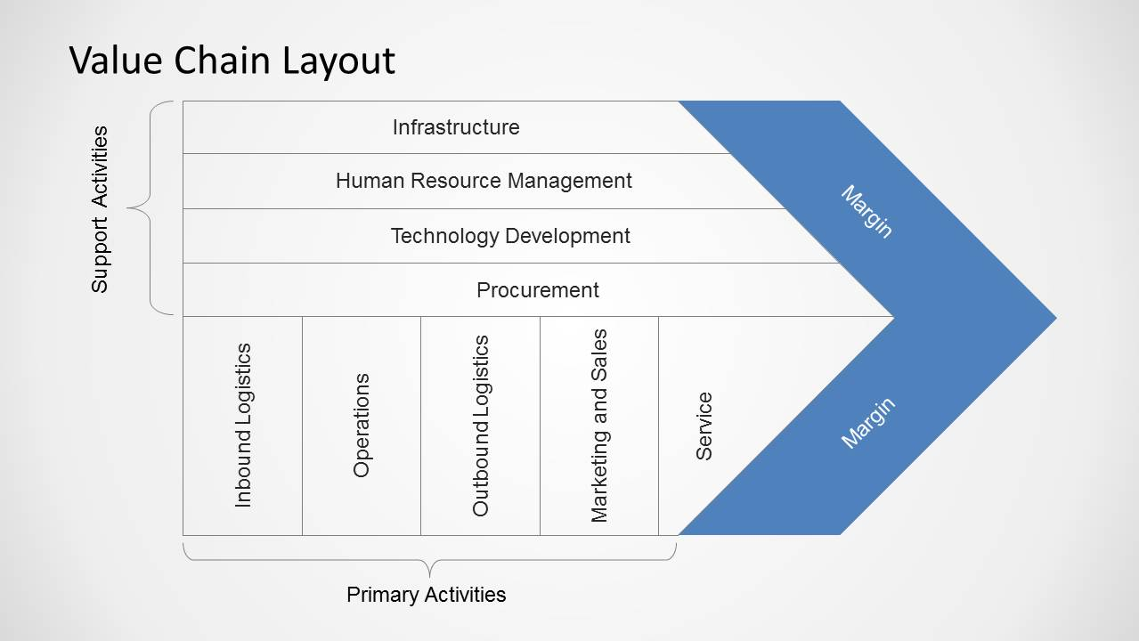
Types of process mapping
Swimlane (or Cross-functional) Map:
Value-Added Chain Diagram:

Slide 20
Process mapping symbols
Basic symbols are used in a process map to describe key process elements.
Each process element is represented by a specific symbol such as an arrow, circle, diamond, box, oval or rectangle.
These symbols come from the Unified Modeling Language or UML, which is an international standard for drawing process maps.

Slide 21
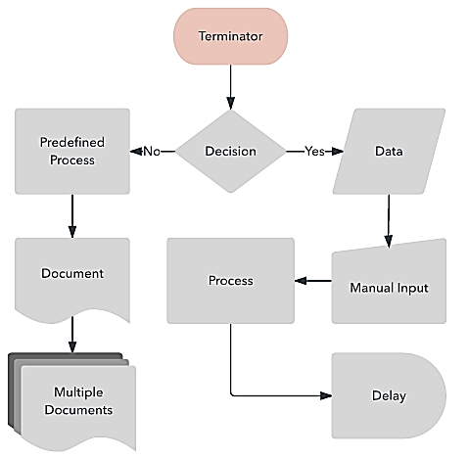
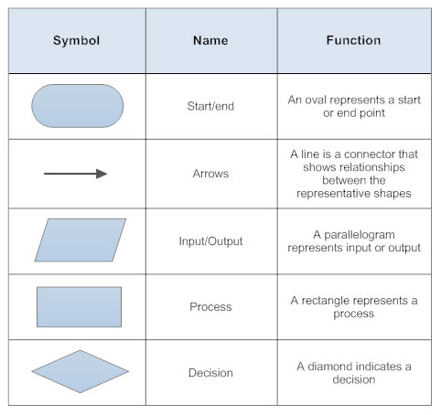
Process mapping symbols

Slide 22
How to create a process map
Step 1: Identify the problem :
What is the process that needs to be visualized?
Type its title at the top of the document.
Step 2: Brainstorm activities involved:
Decide what level of detail to include.
Determine who does what and when it is done.

Slide 23
How to create a process map
Step 3: Figure out boundaries:
Where or when does the process start?
Where or when does the process stop?
Step 4: Determine and sequence the steps
It’s helpful to have a verb begin the description.
You can show either the general flow or every detailed action or decision.

Slide 24
How to create a process map
Step 5: Draw basic flowchart symbols
Each element in a process map is represented by a specific flowchart symbol.​ Lucid chart makes it simple to create and rearrange shapes, add labels and comments and even use custom styling in your process map.

Slide 25
Ovals show the beginning of a process or the stopping of a process.
Arrows represent the flow of direction.
Rectangles show an operation or activity that needs to be done.
Diamonds show a point where a decision must be made. Arrows coming out of a diamond are usually labeled yes or no. Only one arrow comes out of an activity box. If more than is needed, you should probably use a decision diamond.
A parallelogram shows inputs or outputs.

Slide 26
Step 6: Finalize the process flowchart
Review the flowchart with others stakeholders (team member, workers, supervisors, suppliers, customers, etc.) for consensus.
Make sure you’ve included important chart information like a title and date, which will make it easy to reference.

Slide 27
Helpful questions to ask:
Is the process being run how it should?
Will team members follow the charted process?
Is everyone in agreement with the process map flow?
Is anything redundant?
Are any steps missing?

Slide 29
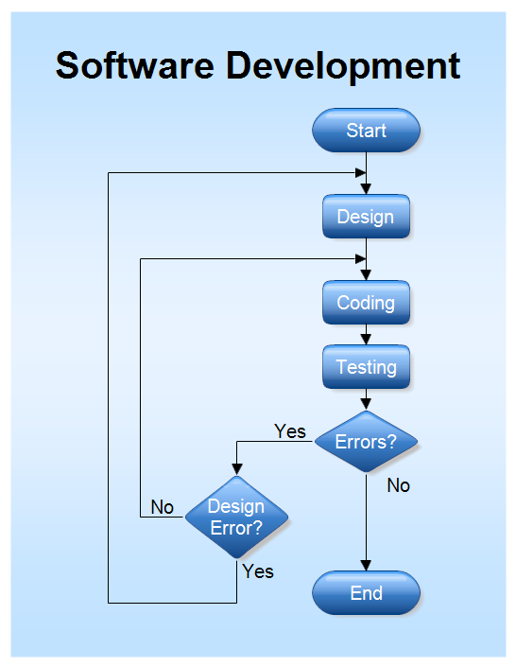

Slide 30
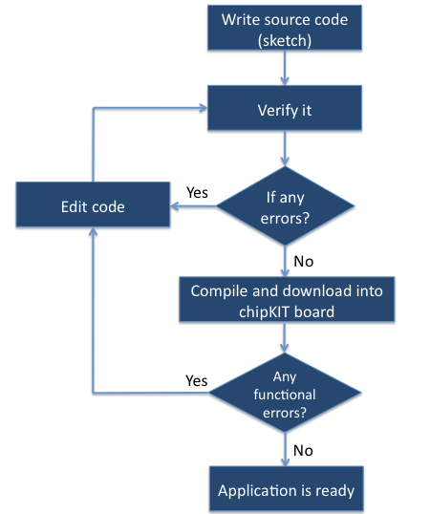

Slide 31
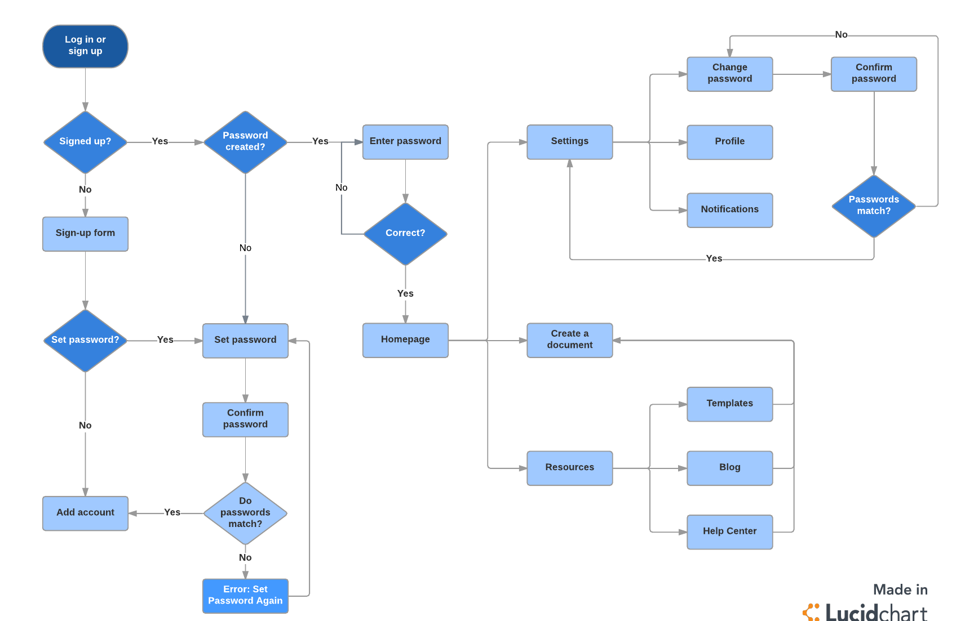

Slide 32
You and your team are required to draw flow chart for your application .

