Slide 1


HeartIntel
Our team
DevOps CA II Case Study
GS
Gunveer Singh
23070122098
HR
Harsh Rajput
23070122102
AI powered heart disease prediction, delivered through a complete DevOps pipeline
MA
Mohammad Ahmad
23070122140
GitHub Actions
Docker
Kubernetes
RS
Raghav Sharma
Ansible
Prometheus
Grafana
23070122171
Notes:
Introduce the project and the team. HeartIntel started as the RoomFit hostel allocation project and was adapted into a heart disease risk predictor. This deck covers the DevOps lifecycle we built around it: source control, containers, CI/CD, Kubernetes, Ansible and monitoring.

Slide 2




From a hostel project to healthcare AI
Origin
Challenge
Goal
Adapted from the RoomFit hostel roommate allocation project into a healthcare prediction service.
Run an ML powered web app reliably. Before DevOps it meant manual runs, hardcoded configuration and no containers.
Automate CI/CD, containerize every service and make production observable and repeatable.
One push to main builds the code, packages the images and rolls the release out to Kubernetes.
Notes:
Explain the before and after. Before: services started by hand, credentials in code, nothing containerized. The goal of this CA was to wrap the application in a full delivery pipeline.

Slide 3





A four tier cloud native architecture
User browser
React 19 SPA
Spring Boot API
Flask ML service
Guided 5 step form
Nginx, port 80
Java 21, port 8080
Random Forest, port 5002
One prediction
The React form posts 11 clinical values to the Spring Boot API. The API forwards them to the Flask model, saves the returned risk percentage and sends it back to the browser.
Stored in a Docker volume locally and in Kubernetes for production
PostgreSQL 15
Users and history
Notes:
Walk the request path left to right. The browser loads the React app, the form posts to the Spring Boot API, the API calls the Flask service which runs a custom Random Forest, and the result is stored in the database and returned. Be ready to say that the Flask service is not yet containerized, so it is the next item on our roadmap.

Slide 4





The full technology stack
Frontend
Backend
ML service
React 19, react router 7, framer motion
Spring Boot 3.1 on Java 21
Python Flask, custom Random Forest in NumPy
Database
Containers
Orchestration
PostgreSQL 15 Alpine in Docker and Kubernetes
Docker with 2 multi stage Dockerfiles
Kubernetes with NGINX Ingress
CI/CD
Infrastructure
Monitoring
GitHub Actions, 3 job pipeline
Ansible, 10 task playbook
Prometheus and Grafana
Notes:
Quick tour of the stack. Application layers on the top row, delivery and operations tooling below. Every DevOps tool on this slide has its own slide later in the deck.

Slide 5



Version control with GitHub
One repository for everything
Application code, pipeline, Docker, Kubernetes and Ansible files live together.
Planned improvements
Branch protection on main
Pull request and issue templates
Versioned release tags instead of latest
Mandatory code review before merge
Pipeline triggers
Every push or pull request to main starts the CI/CD workflow.
Clean history
Build output, node_modules, environment files and logs are kept out of the repo.
Notes:
Keep this short. Mention that the workflow triggers on main. The right hand card lists governance practices we would add next.

Slide 6


Lean images with multi stage builds
Stage 1: Build
Discarded
Stage 2: Run
Shipped
Maven 3.9.6 with JDK 21. Dependencies are cached as their own layer.
Eclipse Temurin 21 JRE Alpine. Only the built JAR ships, on port 8080.
Backend
Stage 1: Build
Discarded
Stage 2: Run
Shipped
Node 18 Alpine. The npm install layer is cached, then npm run build.
Nginx Alpine serves the static build with a try_files rule for single page routing, on port 80.
Frontend
Images are published to Docker Hub under the gunveer06 account.
Notes:
Explain why multi stage matters: the build tools are thrown away and only the runtime artifact ships, so images are smaller and have a smaller attack surface. The frontend Nginx config includes a try_files rule so React Router paths work on refresh.

Slide 7



One command local stack with Docker Compose
frontend
backend
db
Nginx, port 80
Spring Boot, port 8080
PostgreSQL 15, port 5432
Frontend waits for backend, backend waits for database
Persistence
Wiring
Startup order
A named volume keeps database data across restarts.
The backend receives its datasource URL and credentials through environment variables.
depends_on starts the services in sequence, from database to frontend.
Notes:
Docker Compose gives a developer the whole stack with a single command. Known gap to mention if asked: the Flask ML service and healthchecks are not in the Compose file yet.

Slide 8
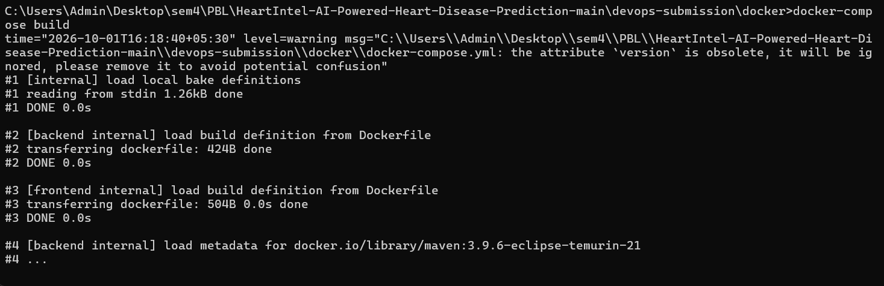
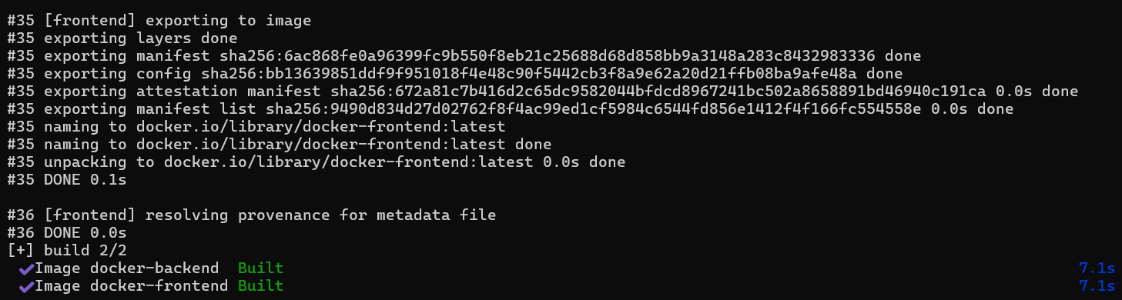
Evidence: building the Docker images
What the build shows
Compose built both the backend and frontend images
Backend base image: Maven 3.9.6 on Eclipse Temurin 21
Each image finished in about 7 seconds
Compose flags the version attribute as obsolete, a small cleanup item
Notes:
Terminal capture from the project machine, run from the docker folder of the devops submission. Both images built successfully.

Slide 9

Automated CI/CD with GitHub Actions
1
Build and test
2
Dockerize and push
3
Deploy to Kubernetes
Set up Java 21 and build with the Maven wrapper
Set up Node 18, npm install and build the React app
Log in to Docker Hub with secrets
Build and push the backend image
Build and push the frontend image
Write the kubeconfig from a secret
kubectl apply on 4 manifests
Rollout restart of both deployments
Trigger
3 repository secrets
Push or pull request to the main branch
DOCKER_USERNAME, DOCKER_PASSWORD and KUBECONFIG
Notes:
Three jobs run in sequence using the needs keyword, so a failed build never reaches Docker Hub or the cluster. Be honest about two things if asked: the build step skips tests, and the workflow file currently sits inside the devops submission folder, so it must live at the repository root .github folder for GitHub to run it automatically.

Slide 10




Kubernetes deployment and rolling updates
/
Frontend service
Pod 1
Pod 2
Nginx, port 80
2 replicas
NGINX Ingress
Users
app.heartintel.com
/api
Backend service
Pod 1
Pod 2
Pod 3
Spring Boot, port 8080
3 replicas, limits of 500m CPU and 512Mi memory
Rolling updates, surge 1, unavailable 1
Requests and limits on every pod
Rollback with kubectl rollout undo
Notes:
Traffic enters through the NGINX Ingress. Slash goes to the frontend service with two pods and slash api goes to the backend service with three pods. Everything runs in a dedicated production namespace with a ConfigMap and a Secret for configuration. Rolling updates keep the app available during a release.

Slide 11
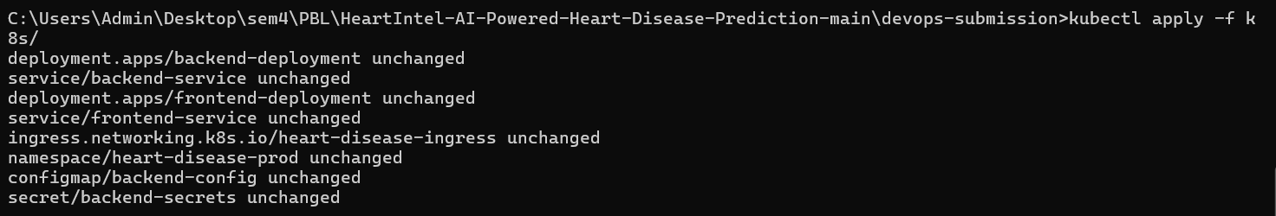
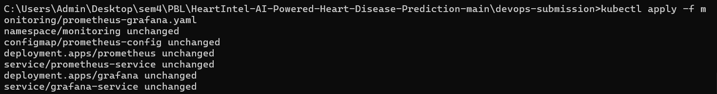
Evidence: applying the Kubernetes manifests
What it shows
Namespace, ConfigMap and Secret applied first
Deployments, services and ingress applied from the manifests folder
Prometheus and Grafana applied from their own manifest
Output reads unchanged, so the cluster already matched the files
Commands were run from the devops submission folder.
Notes:
Three kubectl apply runs: base configuration, application manifests and the monitoring stack. Unchanged means the cluster state already matched the manifests from an earlier apply.

Slide 12

Evidence: rolling update to version 2
Set image to v2
Pods replaced gradually
Rollout status
kubectl set image
Surge 1, unavailable 1
2 of 3 replicas updated
Update the backend deployment to image version 2
Watch the rollout progress
Notes:
The backend image was switched to version 2 and Kubernetes replaced pods gradually. The status output shows two of three replicas updated while the old pods kept serving traffic. If something failed, kubectl rollout undo returns to the previous version.

Slide 13

Server provisioning with Ansible
1
2
3
4
5
Update apt cache and upgrade packages
Install base packages and git
Install Java 21
Add the Docker GPG key
Add the Docker apt repository
6
7
8
9
10
Install Docker engine and containerd
Start and enable Docker
Install kubectl
Create the heartapp user
Create app directory and env file
Targets Ubuntu servers over SSH
Inventory with web and database groups
Variables for app user and app directory
Notes:
The playbook turns a blank Ubuntu machine into a deployment host with Java, Docker, kubectl and an app user. It is repeatable and idempotent. Limitation to mention: it provisions the server but does not yet deploy the application, and the inventory IPs are placeholders.

Slide 14
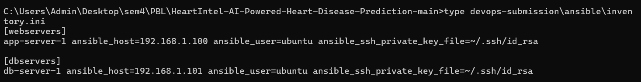
Evidence: the Ansible inventory
Two groups
Two hosts
SSH access
webservers and dbservers
app server one and db server one
ubuntu user with a private key file
The host addresses are private network placeholders. Replace them with real server addresses before a live run.
Notes:
The inventory defines a web server group and a database server group, both reached over SSH as the ubuntu user. The addresses are placeholders for this submission.

Slide 15
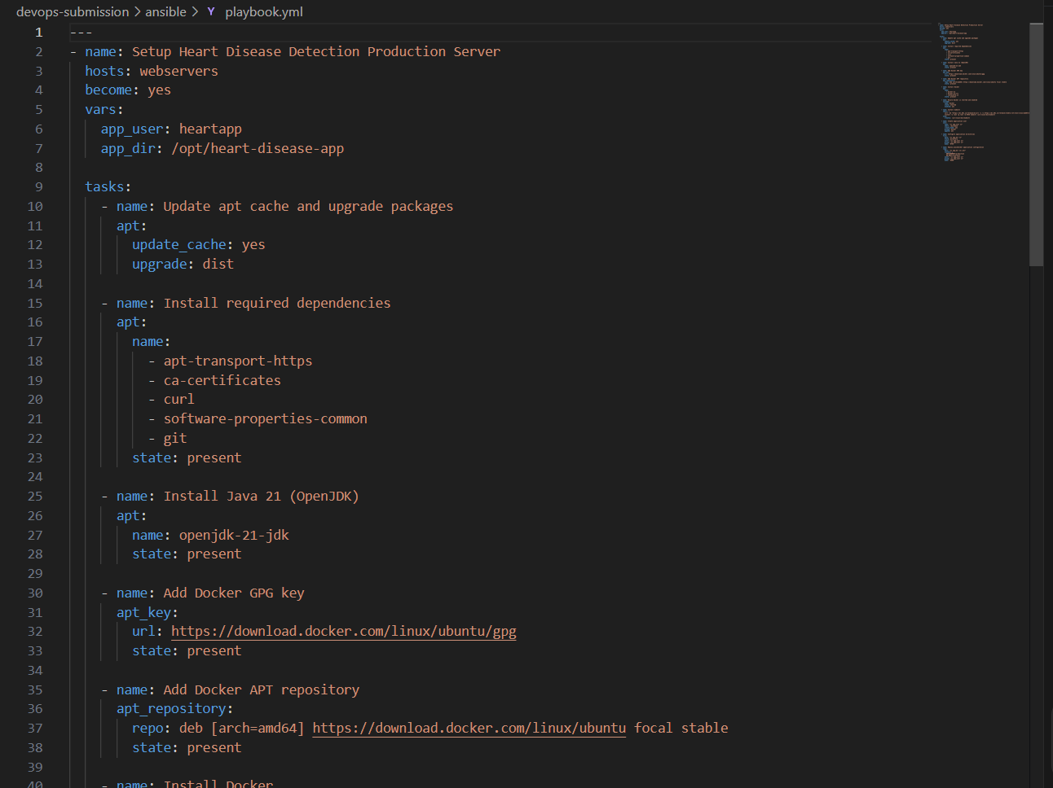
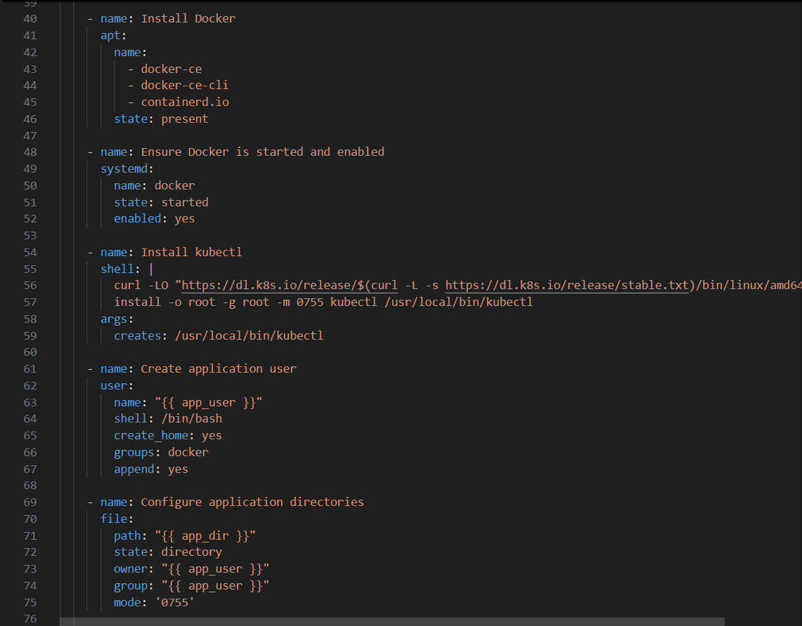
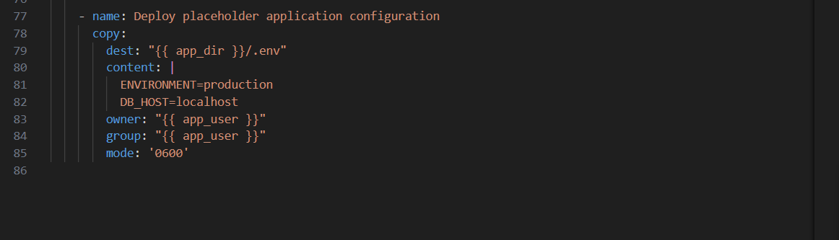
Evidence: the Ansible playbook
Notes:
The playbook is shown in three parts: package and Java setup, Docker and kubectl installation with the app user, and the final task that writes a placeholder environment file. It targets the web server group and runs with elevated privileges.

Slide 16

Testing and code quality today
Layer | Tool | Status
Frontend | Jest and React Testing Library | 1 starter test, needs fixing
Backend | JUnit Jupiter | No tests yet, build skips them
ML service | None | Not automated
API smoke test | PowerShell script | Manual, not in CI
Linting | ESLint config | Not enforced in CI
What we add next
Replace the starter test with real component tests
Write JUnit tests and run them in CI
Add lint, dependency and image scans
Add tests for the ML service
Notes:
Be upfront here. The honest state is that the pipeline builds but does not yet run meaningful tests. Our plan is to enable backend tests in CI first, then add lint and security scanning as quality gates.

Slide 17
Security: strengths and known gaps
Strengths
Known gaps
GitHub Actions secrets protect registry and cluster access
Database password hardcoded in 3 Java controllers
Kubernetes Secrets hold database credentials
User passwords stored without hashing
Alpine base images keep the attack surface small
No SAST, dependency or image scanning in CI
Dedicated app user created by Ansible
No pre commit hooks as a quality gate
Notes:
Present strengths first, then gaps. The most important gap is the database password hardcoded in source. The fix is to read it from environment variables, which the Kubernetes Secret already supports.

Slide 18





Monitoring with Prometheus and Grafana
Spring Boot backend
Prometheus
Grafana
Exposes a metrics endpoint
Scrapes every 15 seconds
Dashboards on port 3000
Planned Grafana panels
Uptime
CPU usage
JVM memory
Request count
Error rate
Status: the monitoring stack is deployed in its own namespace. The Spring Boot Actuator dependency still needs to be added so the metrics and health endpoints respond.
Notes:
Prometheus and Grafana manifests are deployed to a monitoring namespace. To be fully functional the backend needs the Spring Boot Actuator starter and Prometheus registry. Once added, the health probes and the scrape target both start working.

Slide 19
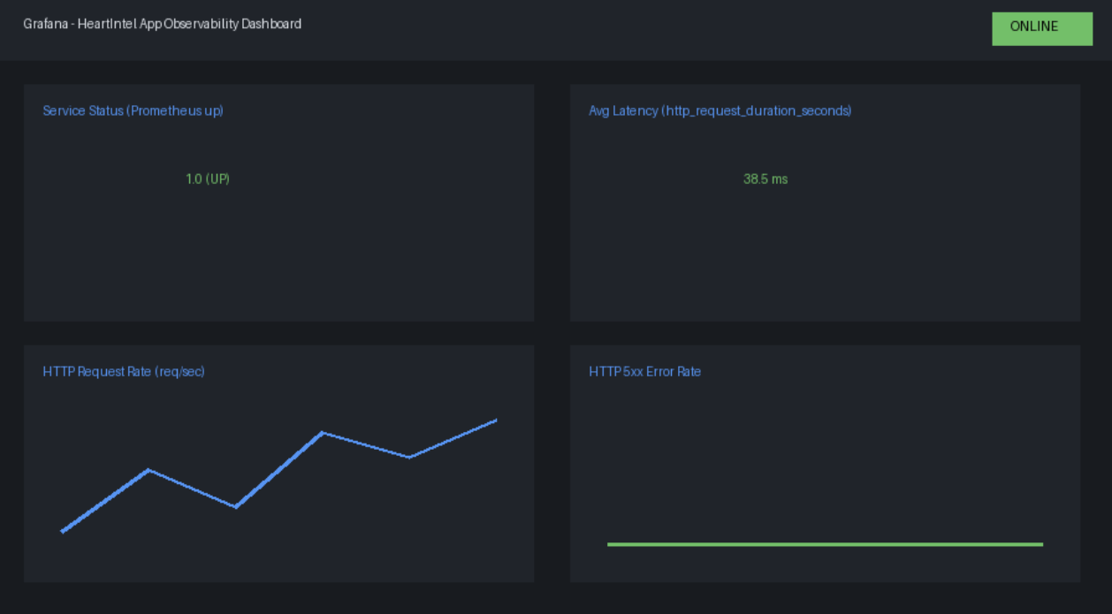
Dashboard design for the monitoring stack
Panels in the design
Service status from the Prometheus up metric
Average request latency
HTTP request rate over time
HTTP 5xx error rate
Illustrative mockup, not a live capture
Notes:
This is the planned dashboard layout, presented as a design mockup. Once the Actuator dependency is added and the stack is scraped, replace it with a live Grafana screenshot taken through kubectl port forward.

Slide 20
The project by the numbers
3
5
2
10
5
Pipeline jobs
Production pods
Multi stage images
Ansible tasks
Kubernetes manifests
2
15
11
5
3
Namespaces
Second scrape interval
Clinical input features
Fold cross validation
Pipeline secrets
Notes:
Use this slide as a quick summary of the delivery system we built. Pods: 3 backend and 2 frontend. Manifests span the application namespace and the monitoring namespace.

Slide 21

Challenges, lessons and what comes next
Challenges
Lessons
Next steps
Single page routing inside Nginx, solved with a try_files rule
Injecting database credentials safely into Kubernetes
Local MySQL versus containerized PostgreSQL mismatch
Multi stage builds give smaller, safer images
Infrastructure as code makes environments reproducible
Health probes keep traffic away from unready pods
Containerize the Flask ML service
Add Actuator, real tests and image scanning
Use environment based credentials, versioned tags and GitOps with ArgoCD
Notes:
Close the technical story with reflection. The most valuable next step is containerizing the ML service so the whole prediction path runs inside Kubernetes.

Slide 22
Thank you
Questions are welcome
GS
HR
MA
RS
Gunveer Singh
Harsh Rajput
Mohammad Ahmad
Raghav Sharma
23070122098
23070122102
23070122140
23070122171
HeartIntel: AI powered heart disease prediction with a full DevOps lifecycle
Notes:
Thank the audience and invite questions. Likely questions: why Kubernetes, how rollback works, how secrets are handled, what happens when a deployment fails.

