Slide 1
Java Training
raghav.ag
manohar.t

Slide 2
Variables
Class / Objects
Inheritance and polymorphism
Method overriding

Slide 3
Variables
Primitive
References
Instance variables
Local variables

Slide 4
Primitives
6 numeric primitives in java (all are signed)
byte -8, short – 16, int – 32, long 64
float – 32, double - 64
boolean JVM specific
char- 16 bits

Slide 5
Object reference variables
Contains a way to access the object
Like a remote control to do stuff on the object
Declaration, creation, assignment.
Arrays are objects too whether primitive or object array.

Slide 6
Objects
State and behavior
Methods can use both instance and local variables.
Instance values get default value local variables don’t.
Java is pass by value.
Value means bits inside the variable

Slide 7
Encapsulation
Hide data
Provide methods to expose behavior you want.
Mark instance variables as private
Even getters and setters are not good.
Pass values during construction or expose relevant methods.

Slide 8
Inheritance n Polymorphism
Is A and Has A
Access levels
Avoid duplication
Common protocol for group of classes

Slide 9
Abstract class, concrete class, interface
Superclass, Subclass
Compiler decides whether you can call a method based on reference not object

Slide 10
Multiple inhertitance

Slide 11
Static binding vs. dynamic binding
Static Binding | Dynamic Binding
It is a binding that happens at compile time. | It is a binding that happens at run time.
Actual object is not used for binding. | Actual object is used for binding.
It is also called early binding because binding happens during compilation. | It is also called late binding because binding happens at run time.
Method overloading is the best example of static binding. | Method overriding is the best example of dynamic binding.
Private, static and final methods show static binding. Because, they can not be overridden. | Other than private, static and final methods show dynamic binding. Because, they can be overridden.

Slide 12
Java Libraries

Slide 13
Collections

Slide 14
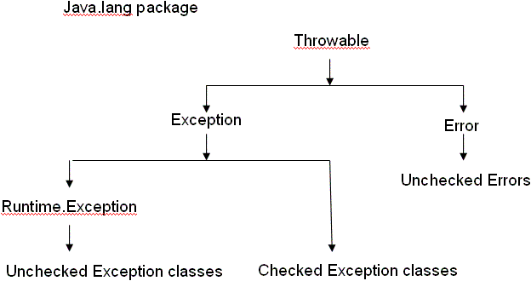
Exception

Slide 15
Comparing variables and equality of objects
If two objects are equal, then they must have the same hash code.
If two objects have the same hashcode, they may or may not be equal.

Slide 16
Problem
An Indian automobile company manufactures two wheeler bikes and four wheeler cars SUVs, hatchback and sedan. Each vehicle’s cost depends on parts and accessories Each vehicle has a fixed number of parts. Accessories depend on the model of the vehicle. Assume each vehicle cost is summation of price of parts and accessories. Design OO structure to come up with the price of each Vehicle.

