Slide 1
AI Hackathon 2019
Stage II
<End-To-End speech recognition system in Hindi language>
Team Registration ID - AIH19T-0178
Sai Vamsi Y,
Vignan Institute of Information,
wonderfulvamsi2018@gmail.com

Slide 2
Outline
Part I: Related work
Part II: Data Understanding
Part III: State of the art
Part IV: Experimental evaluation

Slide 3
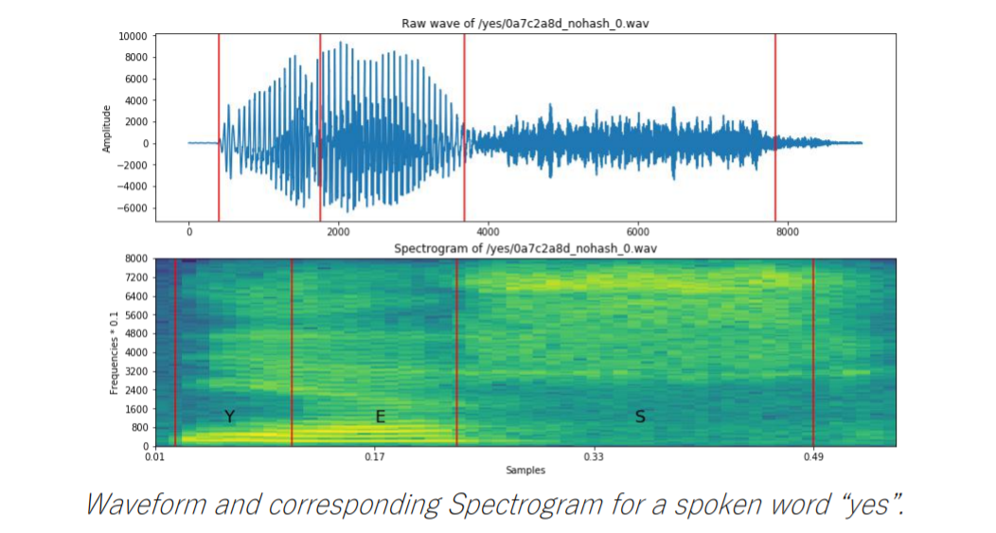
Part I : Related works
Refference:
https://arxiv.org/pdf/1512.02595v1.pdf
The given input (audio) is collected in form of wav. format which is transformed into our convineant form i.e into a array of floting points.
later a consturct 'Spectrogram' out of the values calculated so far.
A Spectrogram is a way of representing the audio signal. They convey 3-dimensional information in 2 dimensions (2D spectrograms). On the x-axis is time,on the y-axis is frequency. The amplitude of a particular frequency at a particular time is represented as the color intensity at that point.

Slide 4

And then comes the Textual Data it is converted into numbers by Label encoding ecah letter in the language.
Label Encoded Characters..
' - 1
<SPACE> - 2
a - 3, b - 4, c - 5,d - 6,
e - 7,f - 8,g - 9,h - 10,
i - 11,j - 12,k - 13,
l - 14,m - 15,n - 16,
o - 17,p - 18,q - 19,
r - 20,s - 21,t - 22,
u - 23,v - 24,w - 25, x - 26,y - 27,z -28.
Then this Cleaned Data will be feeded to the DNN with Softmax as an Activation fuction and
CTC loss function.

Slide 5
Part II: Data Understanding
Explain dataset used for training the model consists of Mono channel audio of various people spoken in Hindi and its Textual data in Hindi language.
Here we take the each Floating point of the paded audio Dataset and predicts which word does it mostly to be macthed.
Out of the Thousand samples of the Dataset.We shall split the samples into 60% for Training and 30% for Test and remaining 10% for validating the model.
Data Preprocessing..
The given input (audio) is collected in form of wav. format which is transformed into our convineant form i.e into a array of floting points and can be visulaized like the below.

Slide 6
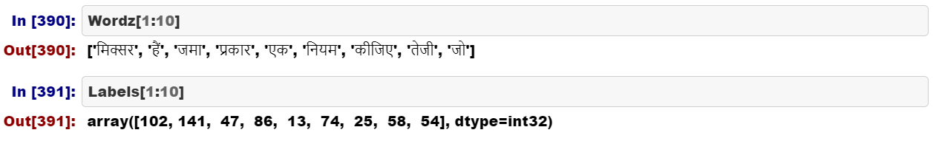
And then comes the Textual Data it is converted into numbers by Label encoding almost every word in the language.
Example of Label Encoded Words..
Then this Cleaned Data will be feeded to the DNN with Softmax as an Activation fuction and
SGD loss function.

Slide 7
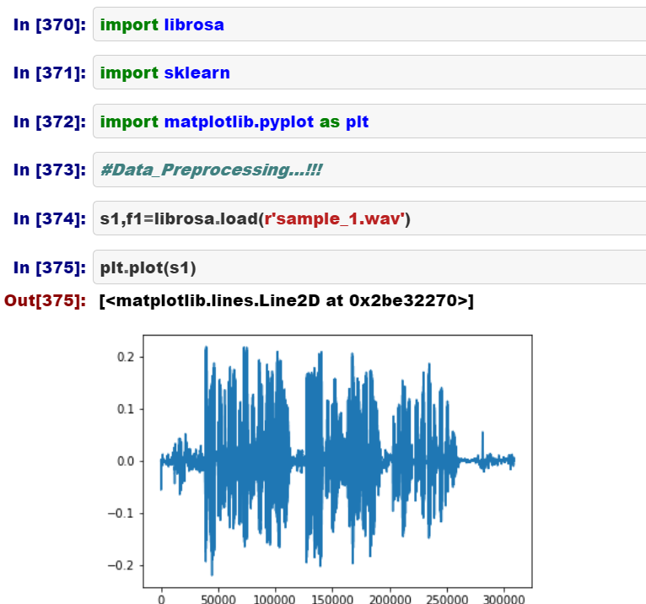
Part III: State of the art
The details of implemented solution..

Slide 8
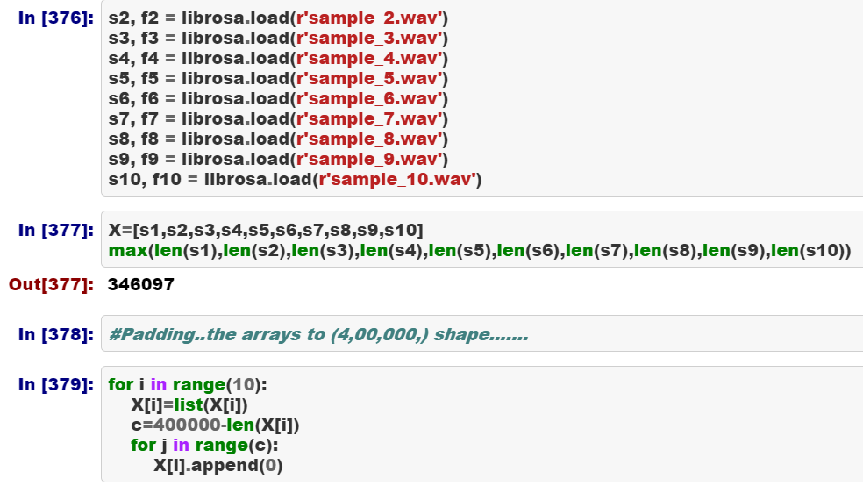
Reading & Padding the audio data..

Slide 9
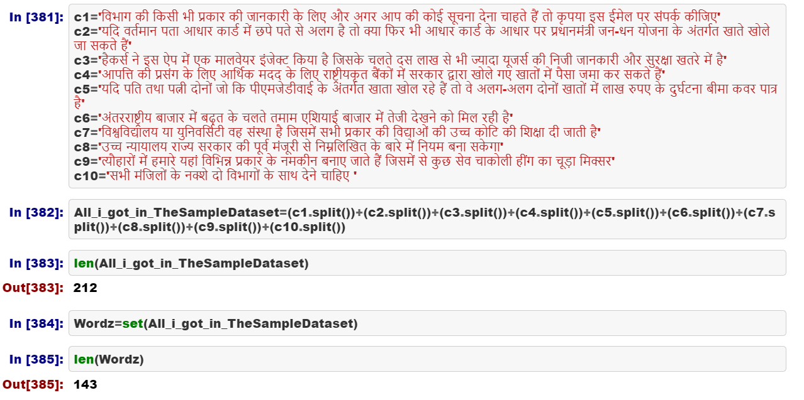
Finding the Uniuqe words in the Textual Data

Slide 10
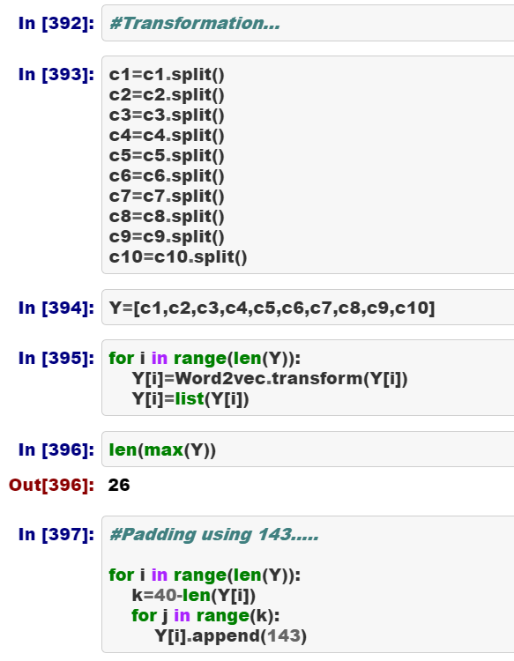
Padding the Textual Data..

Slide 11
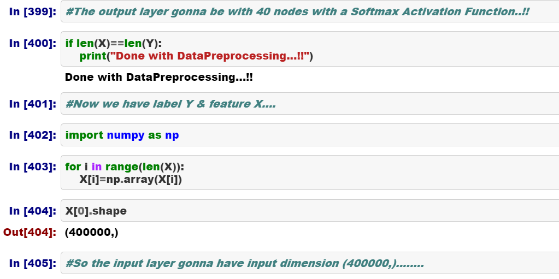

Slide 12
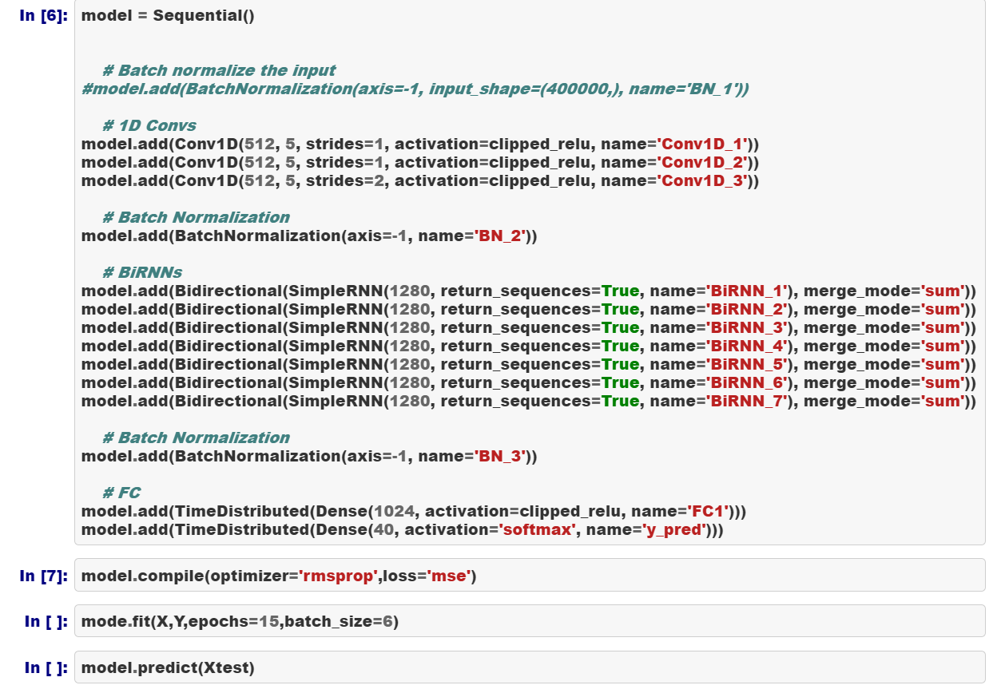
Now, Building the Model..

Slide 13
Compiling, Training and Testing the Model..
Here, Epochs are set to 15 and Batch size is been set to 6.
Since we had used only 10 samples in this model.
However, for the original one we gonna change those values.

Slide 14
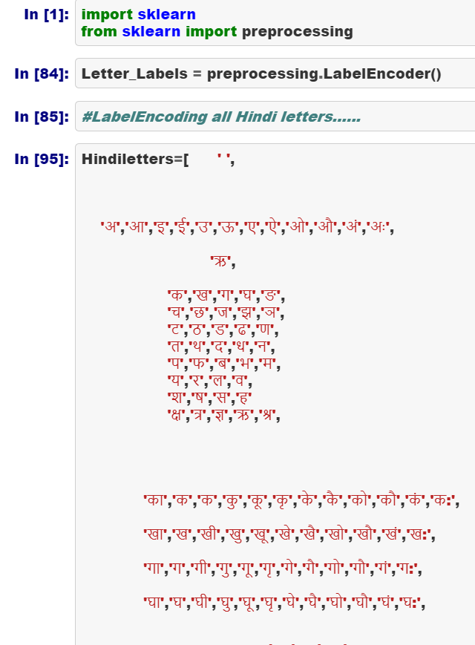
How we solved the problem i.e various approaches used :
Here, unlike in English language it is not possible for encoding each 'letter' in the text..
So we had Encoded each and every 'Word' insted of the 'letters'.
And Due to this we had used the SGD insted of CTC loss fuction.

Slide 15
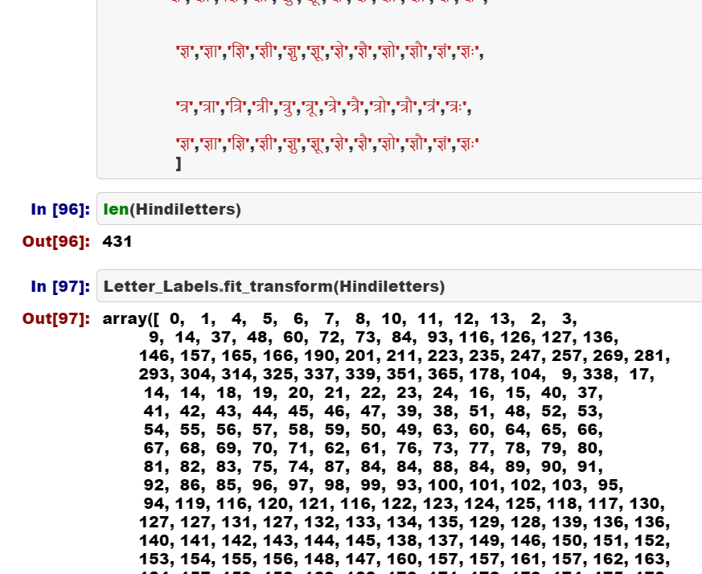
The problem we faced..

Slide 16
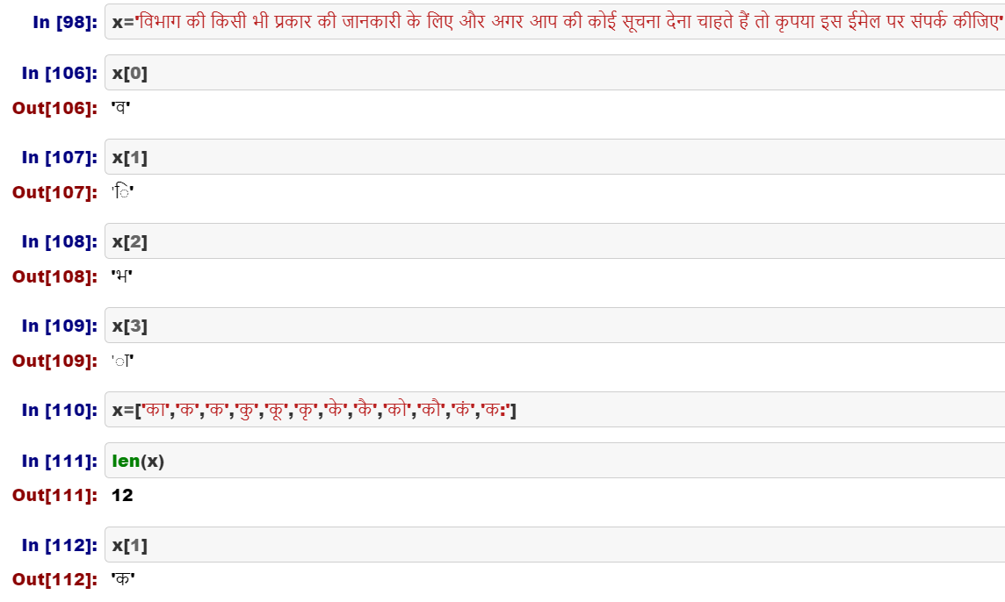
The problem we faced..

Slide 17
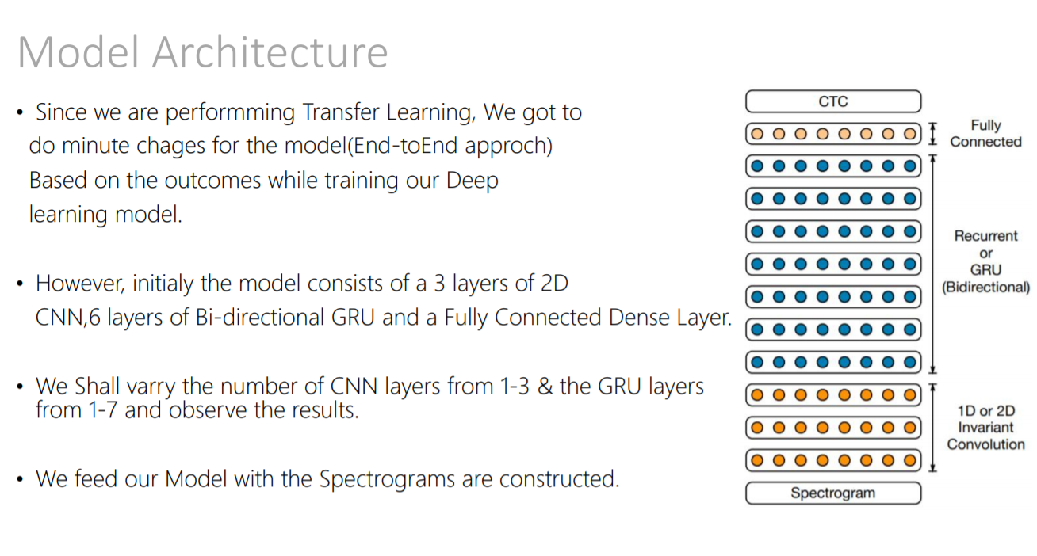

Slide 18
Frameworks used are..
librosa - Audio to array of Floating points
sklearn - Data preprocessing
keras - Deep learning
matplotlib - Visualization

Slide 19
Work Flow Overview, How it differ from existing technique & GPU utilization for training and inferencing..
First the model shall be trained with 60% of the Dataset and the with 40% Dataset for Testing.Till the we get a benchmark accuracy the weights will get updated continously through 'Back Propagation'
and 'Relu' as the activation functions for all the hidden layers.
Our model will not take a spectrograph as the input insted it will take the amplitude at each milli second, we are also Label encoding the words insted of letters and we gonna use SGD insted of CTC.
Training of the model will be done via the GPU nodes provided.

Slide 20
Part IV: Experimental evaluation
Unfortunately, Due to our Examinations we couldn't invest our time in the Hackathon till 4th Sep, So we couldn't report the issue regarding the Dataset in the cluster in the early state.Also this is the first time for us to use Cloud Computing that too 'Linux' and 'VIM' so we haven't Trained the yet.
So, we couldn't provide the details of :
Result Summaries for GPU
Accuracy, performance and running time
Metrics for Performance Evaluation
Methods for Performance Evaluation
Methods for Model Comparison

Slide 21
How to reproduce the result
We made Web,Android & IOS app for integrating our solution using Flutter & Firestore.
The Demo of the End product of our Solution.
https://drive.google.com/open?id=1B66RFYWaXZhULzpxdJOU2R6mCdOemFIS

Slide 22
Summary: Future Directions
At last we had managed to build the Model & the App.
But still we got to Train the model with the provided Dataset.
We are pretty sure that we gonna produce the Benchmark results once we get to know how to use the entire Dataset to Train the Model.

Slide 23
