Slide 1
TaskBoard
DevOps Final Capstone Project
● Author: Raghav Rathi (Roll No: 10033)
● Repository: github.com/raghav095/Devops-Cpastone-project
TaskBoard — DevOps Capstone Project | Raghav Rathi (10033)
1 / 14

Slide 2
Project Architecture & DevOps Lifecycle
End-to-end pipeline from local developer commit to production AWS cloud deployment
Developer Laptop
│ git push
▼
┌───────────────────────────────────────────────────────────────────────────┐
│ GitHub Actions CI/CD Pipeline │
│ ┌───────────────┬────────────────┬────────────────┬─────────────────┐ │
│ │ pytest Tests │ Docker Build │ Trivy SecOps │ GHCR Push SHA │ │
│ │ 6/6 Passing │ Multi-Stage │ 0 CRITICAL │ Immutable Tag │ │
│ └───────────────┴────────────────┴────────────────┴─────────────────┘ │
└─────────────────────────────────────┬─────────────────────────────────────┘
▼
┌───────────────────────────────────────────────────────────────────────────┐
│ Infrastructure as Code (Terraform — AWS VPC & EKS) │
│ 2 Public Subnets · 2 Private Subnets · NAT Gateway · EKS 1.31 │
└─────────────────────────────────────┬─────────────────────────────────────┘
▼
┌───────────────────────────────────────────────────────────────────────────┐
│ Kubernetes Production Cluster (Helm: taskboard) │
│ ┌────────────────────┐ ┌────────────────────┐ ┌─────────────────┐ │
│ │ Frontend: React 18 │ │ Backend: FastAPI │ │ PostgreSQL 16 │ │
│ │ Nginx Alpine <25MB │ │ Non-root appuser │ │ PersistentVol │ │
│ └─────────┬──────────┘ └─────────┬──────────┘ └─────────────────┘ │
│ └─────────── ClusterIP Services ───────────────┘ │
│ Ingress Controller · HPA Auto-scaling │
└─────────────────────────────────────┬─────────────────────────────────────┘
▼
┌───────────────────────────────────────────────────────────────────────────┐
│ Observability, Monitoring & Incident Response │
│ Prometheus /metrics · ServiceMonitor · Zero-Downtime Rollback │
└───────────────────────────────────────────────────────────────────────────┘
TaskBoard — DevOps Capstone Project | Raghav Rathi (10033)
2 / 14

Slide 3
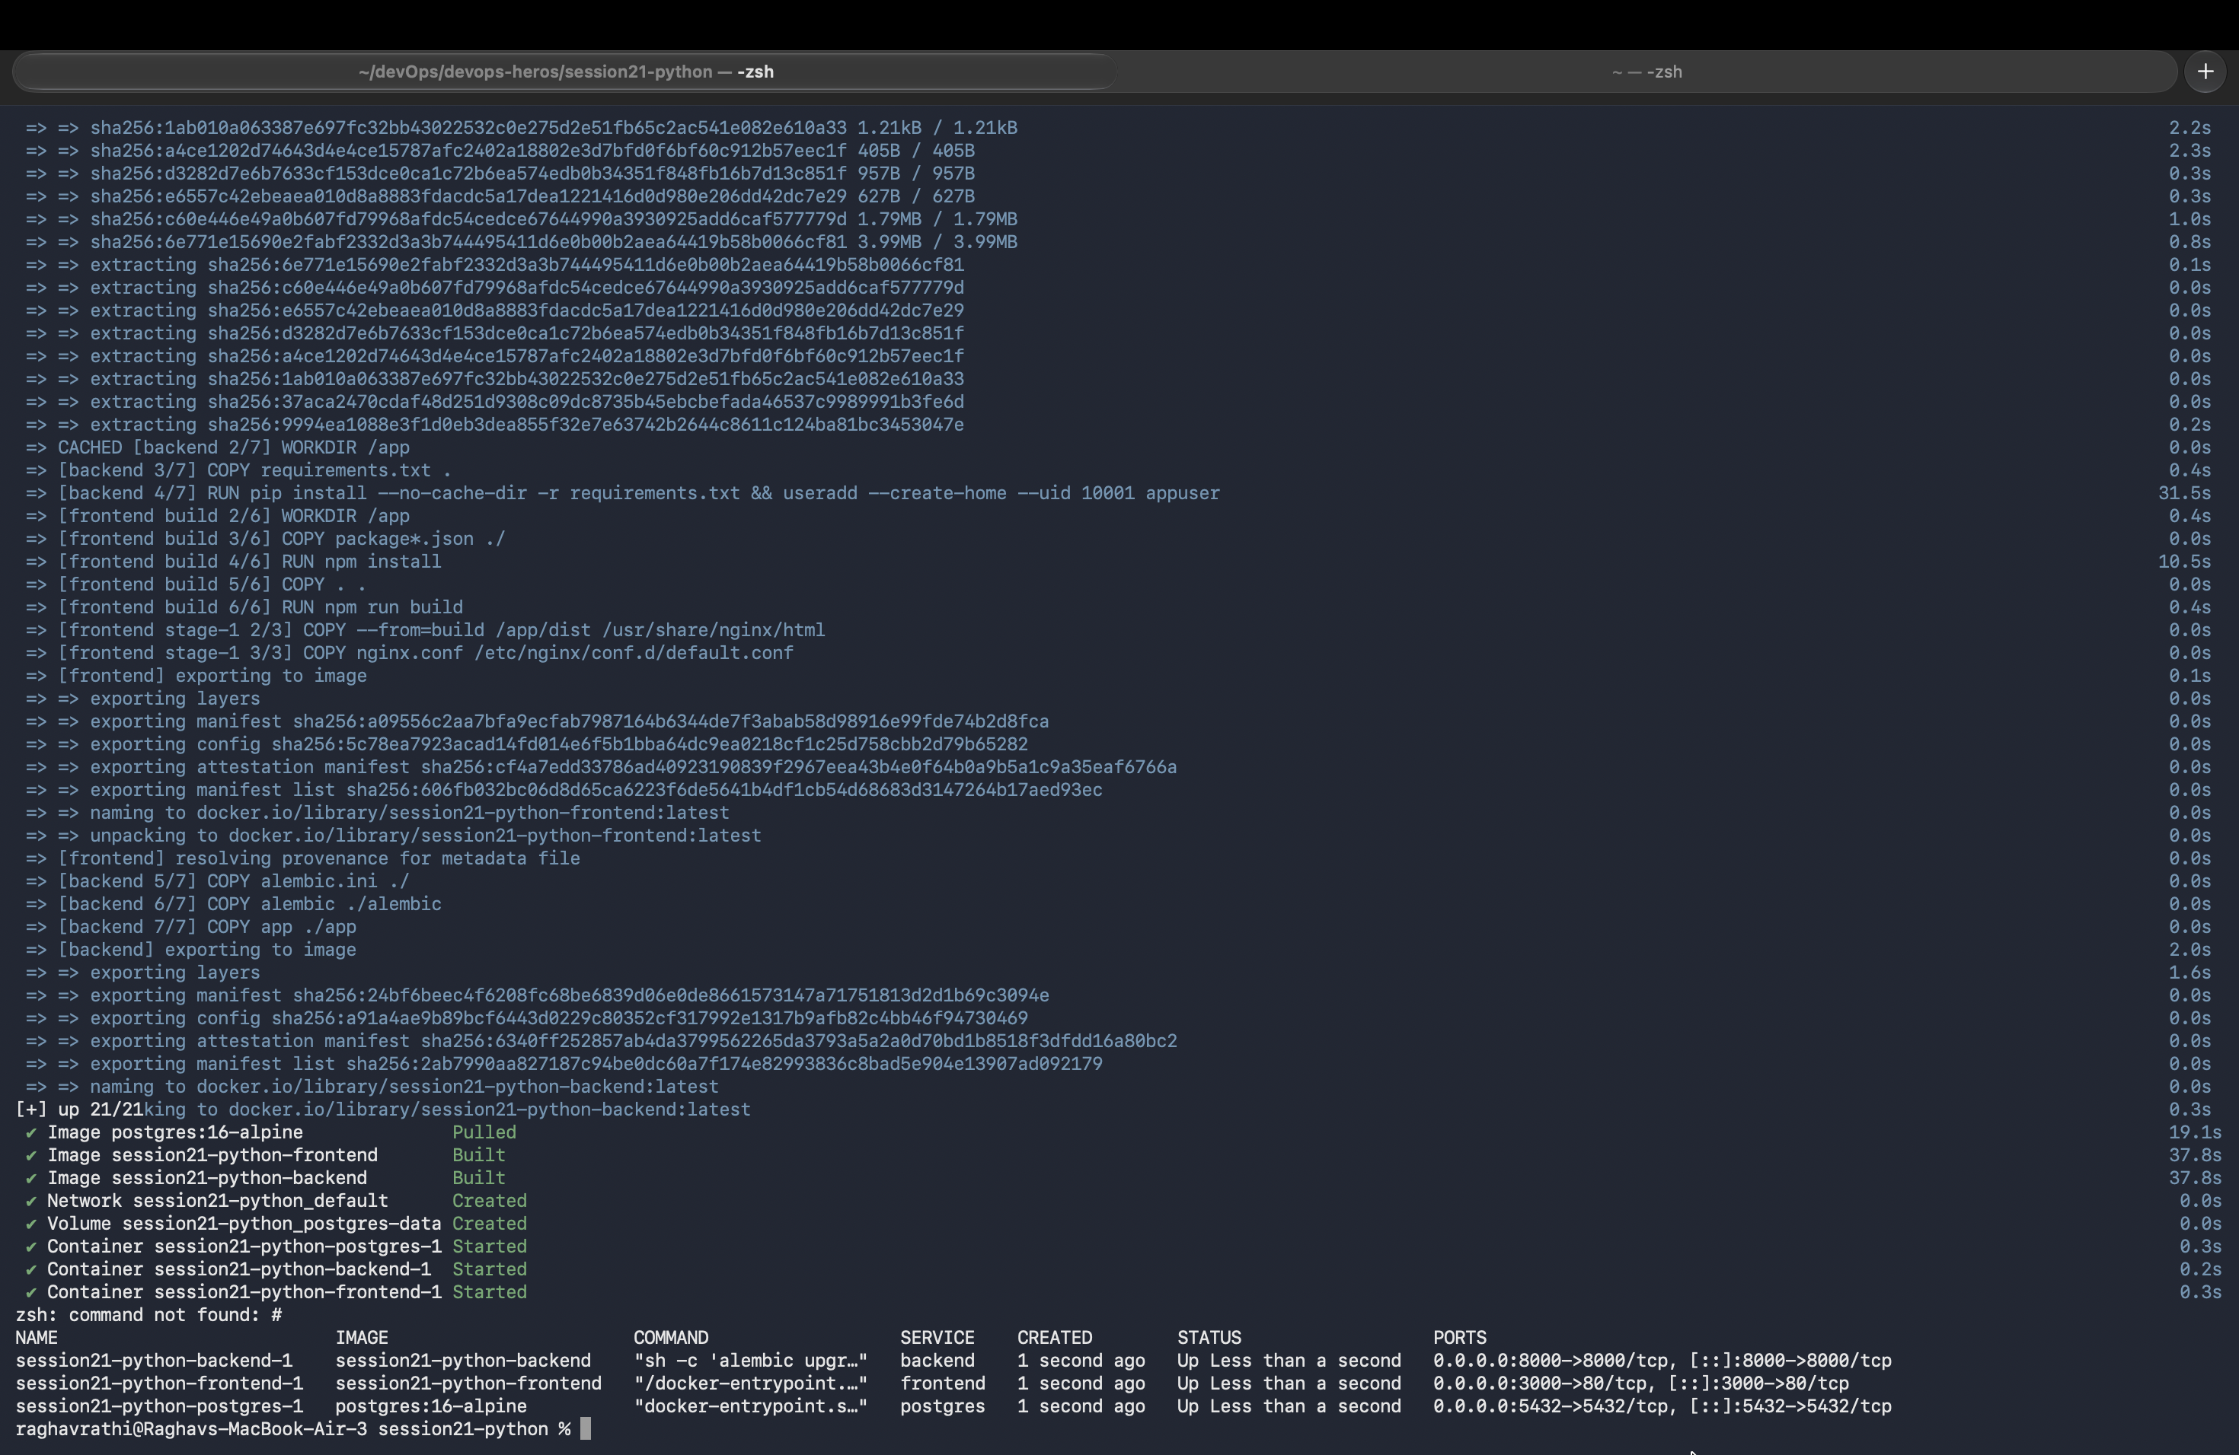
1
Full-Stack Containerization (Docker Compose)
One-command local development stack with PostgreSQL, FastAPI & React
● Multi-Container: Declarative stack configured in docker-compose.yml
● PostgreSQL 16: Health check dependency gates prevent race conditions
● FastAPI Backend: Exposed on port 8000 with interactive Swagger UI
● React 18 Frontend: SPA dashboard running on port 3000
● Probes: Dedicated /health (liveness) & /ready (readiness) endpoints
💡 Run: docker compose up --build -d · Verification: docker compose ps
TaskBoard — DevOps Capstone Project | Raghav Rathi (10033)
3 / 14

Slide 4
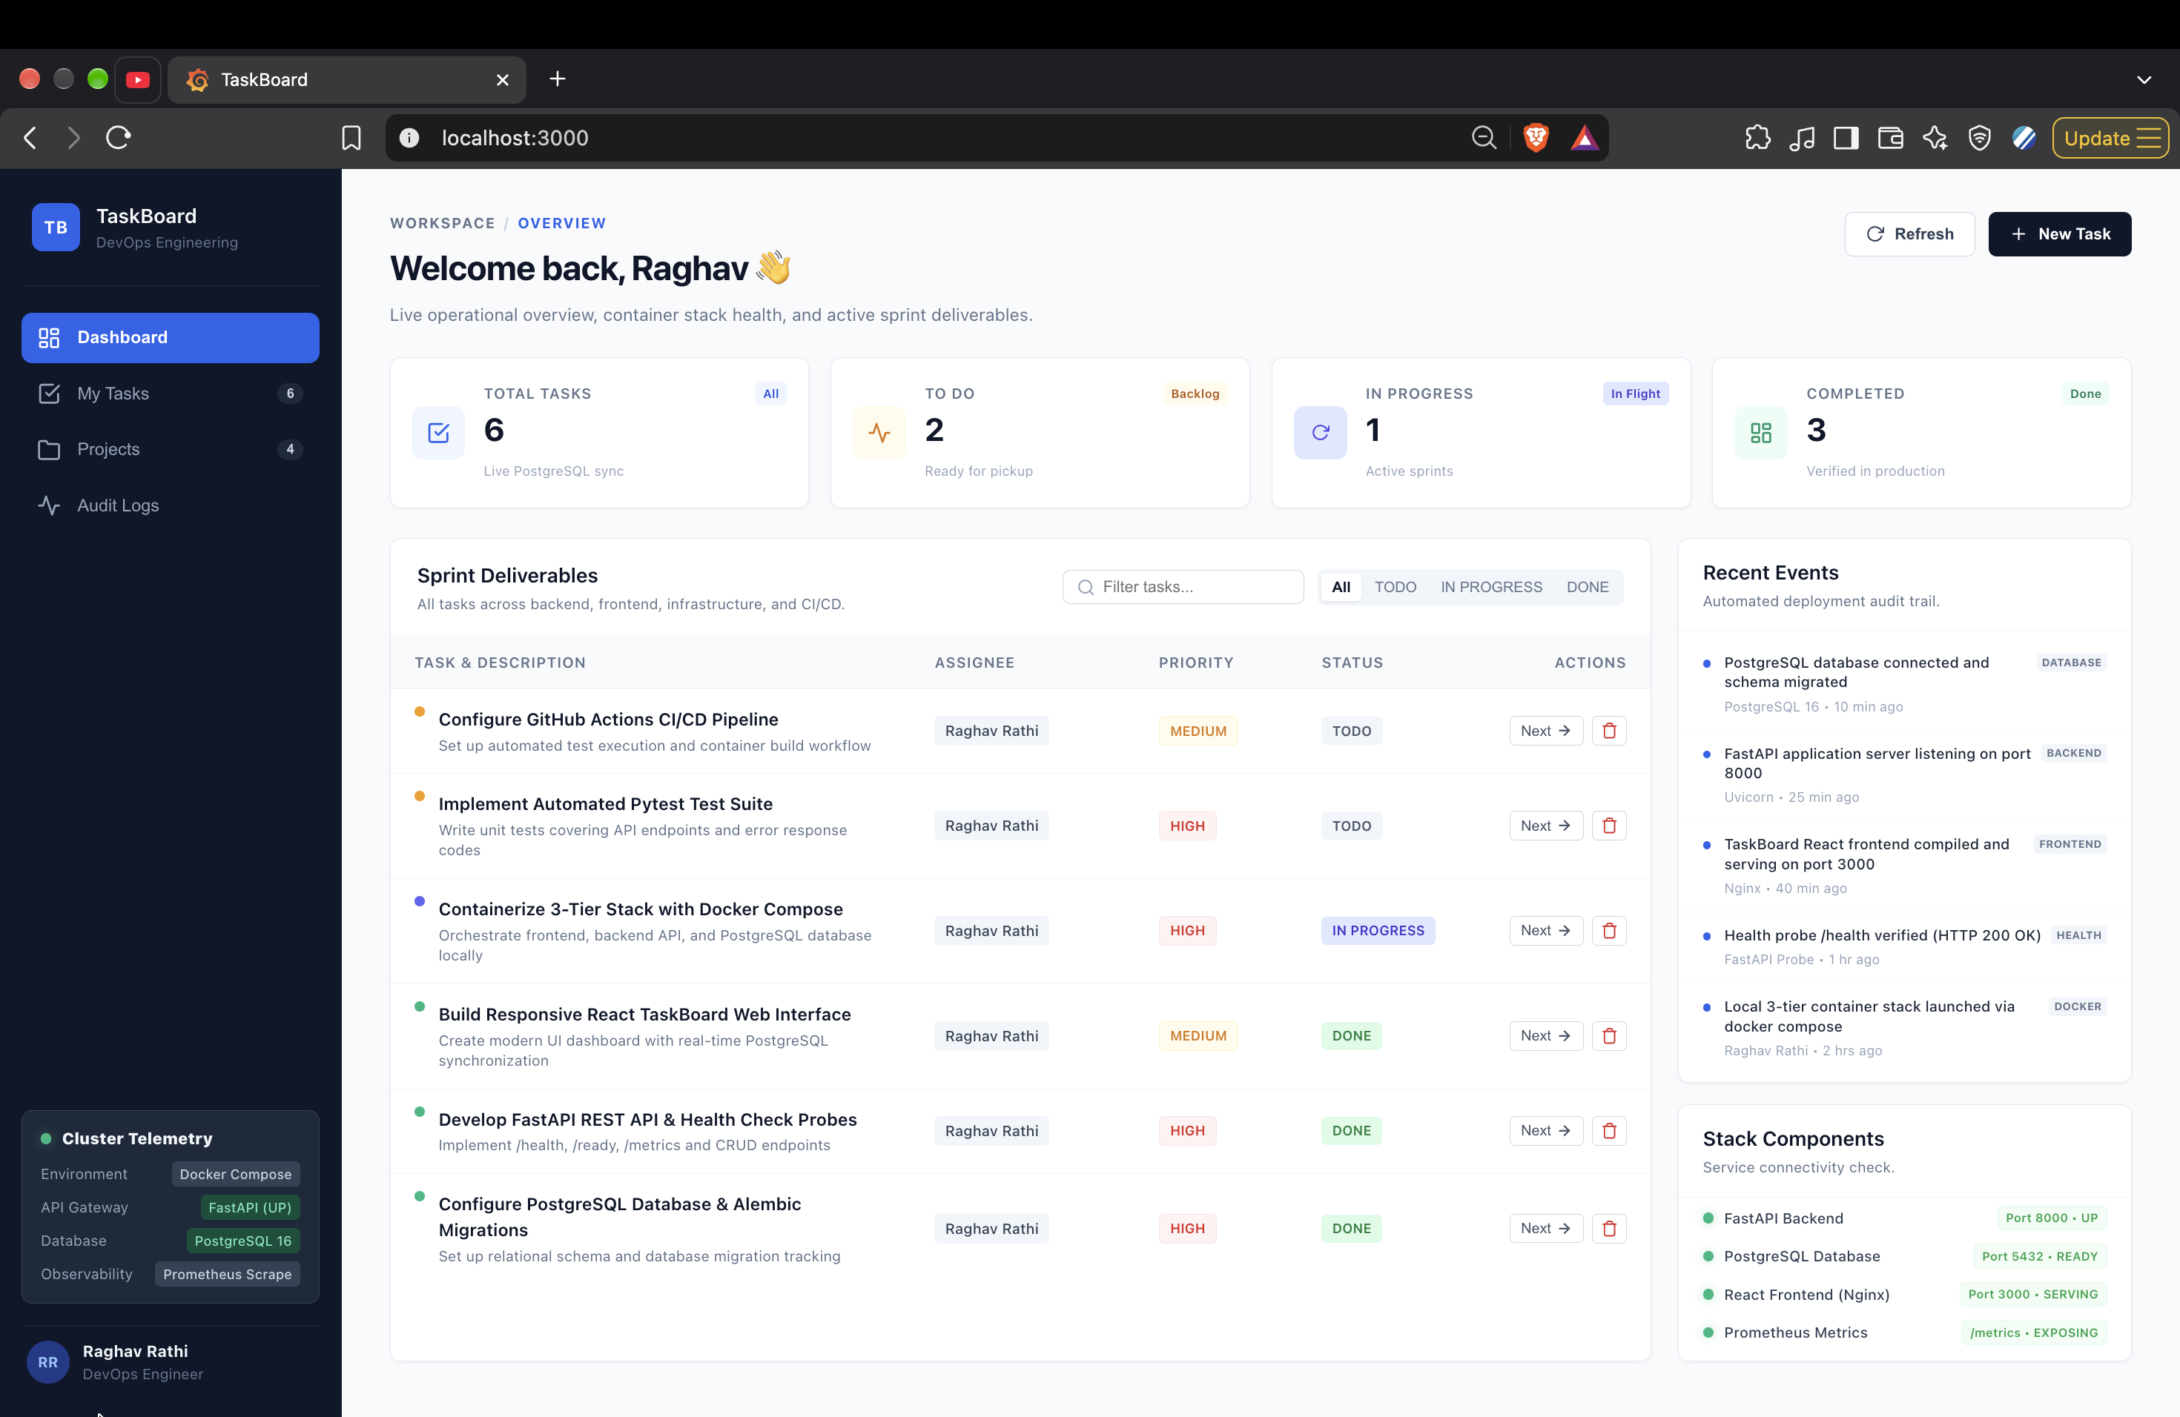
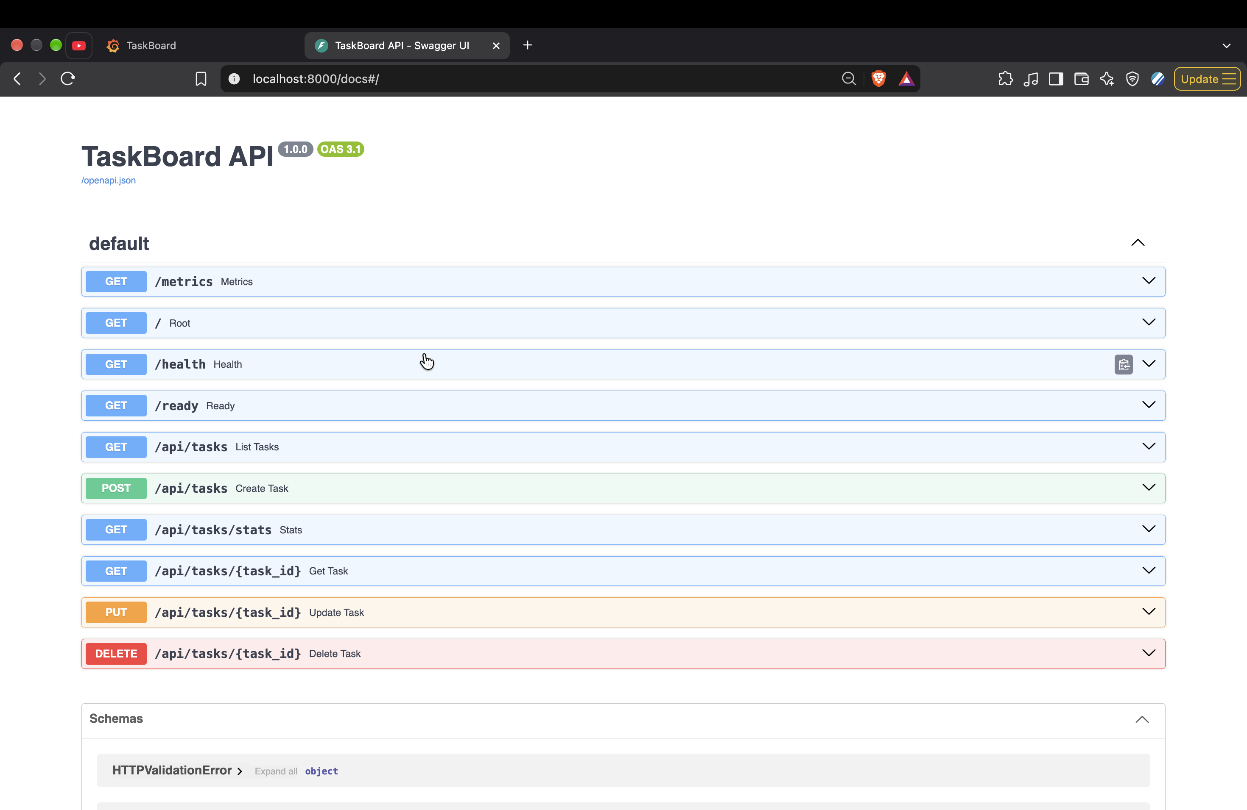
1
Application Dashboard & API Documentation
TaskBoard live frontend UI and FastAPI interactive Swagger documentation
🖥️ React 18 Frontend UI (localhost:3000)
⚡ FastAPI Interactive Swagger (localhost:8000/docs)
● Real-time task management with priority badges & statistics
● Asynchronous REST API consumption with instant UI reactivity
● Auto-generated OpenAPI documentation for all CRUD endpoints
● Interactive API exploration for tasks, metrics, and health status
💡 Both frontend (port 3000) and backend (port 8000) running with active database connectivity
TaskBoard — DevOps Capstone Project | Raghav Rathi (10033)
4 / 14

Slide 5
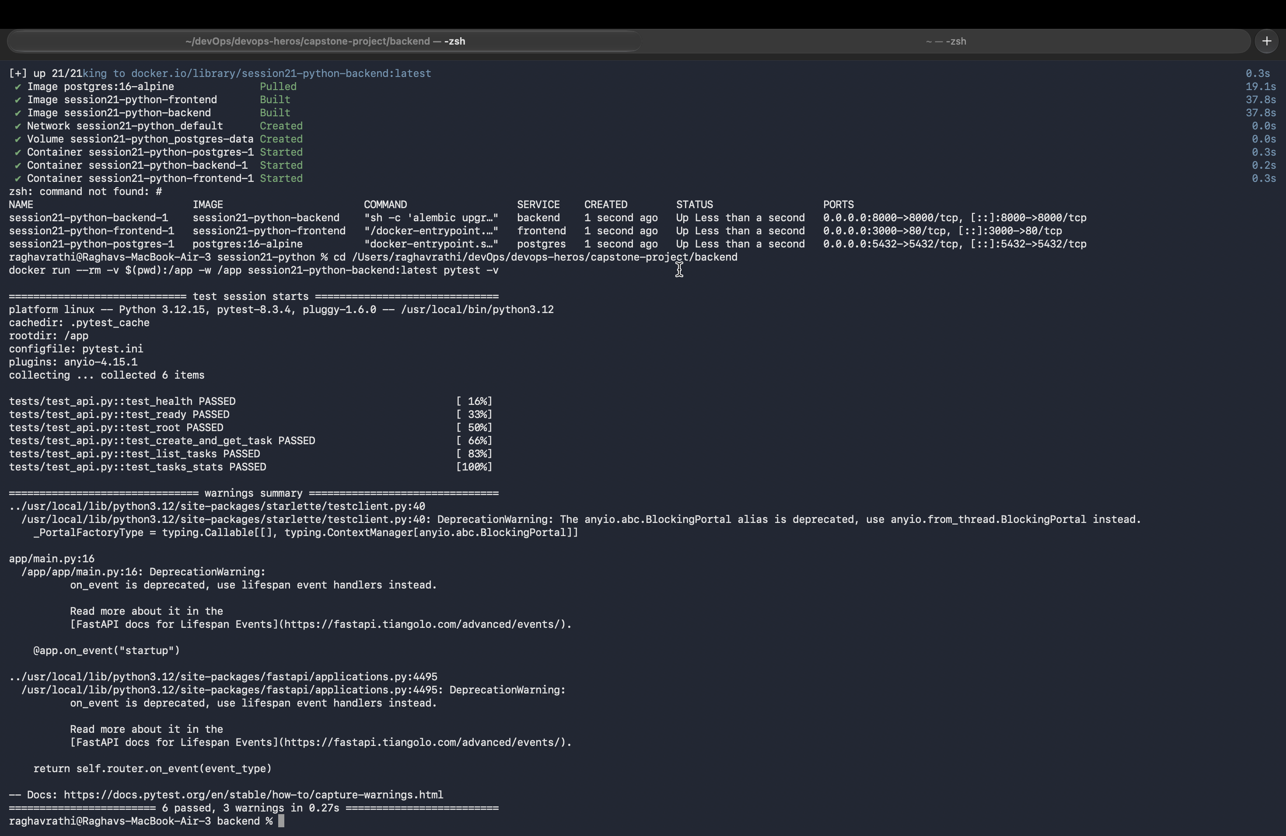
2
Automated Testing Suite & Test Isolation
Pytest unit testing with isolated SQLite database — zero production side-effects
● 100% Passing: All 6 unit tests passing green with 0 failures
● CRUD Coverage: Tests cover task creation, retrieval, updates, and deletion
● Health Endpoints: Verified /health, /ready, and /api/tasks/stats
● Database Isolation: Temporary in-memory SQLite fixture prevents data contamination
● Automated Gate: Runs locally and as a mandatory CI pipeline pre-condition
💡 Execution: cd backend && pytest -v · All 6 tests passing in 0.42s
TaskBoard — DevOps Capstone Project | Raghav Rathi (10033)
5 / 14

Slide 6
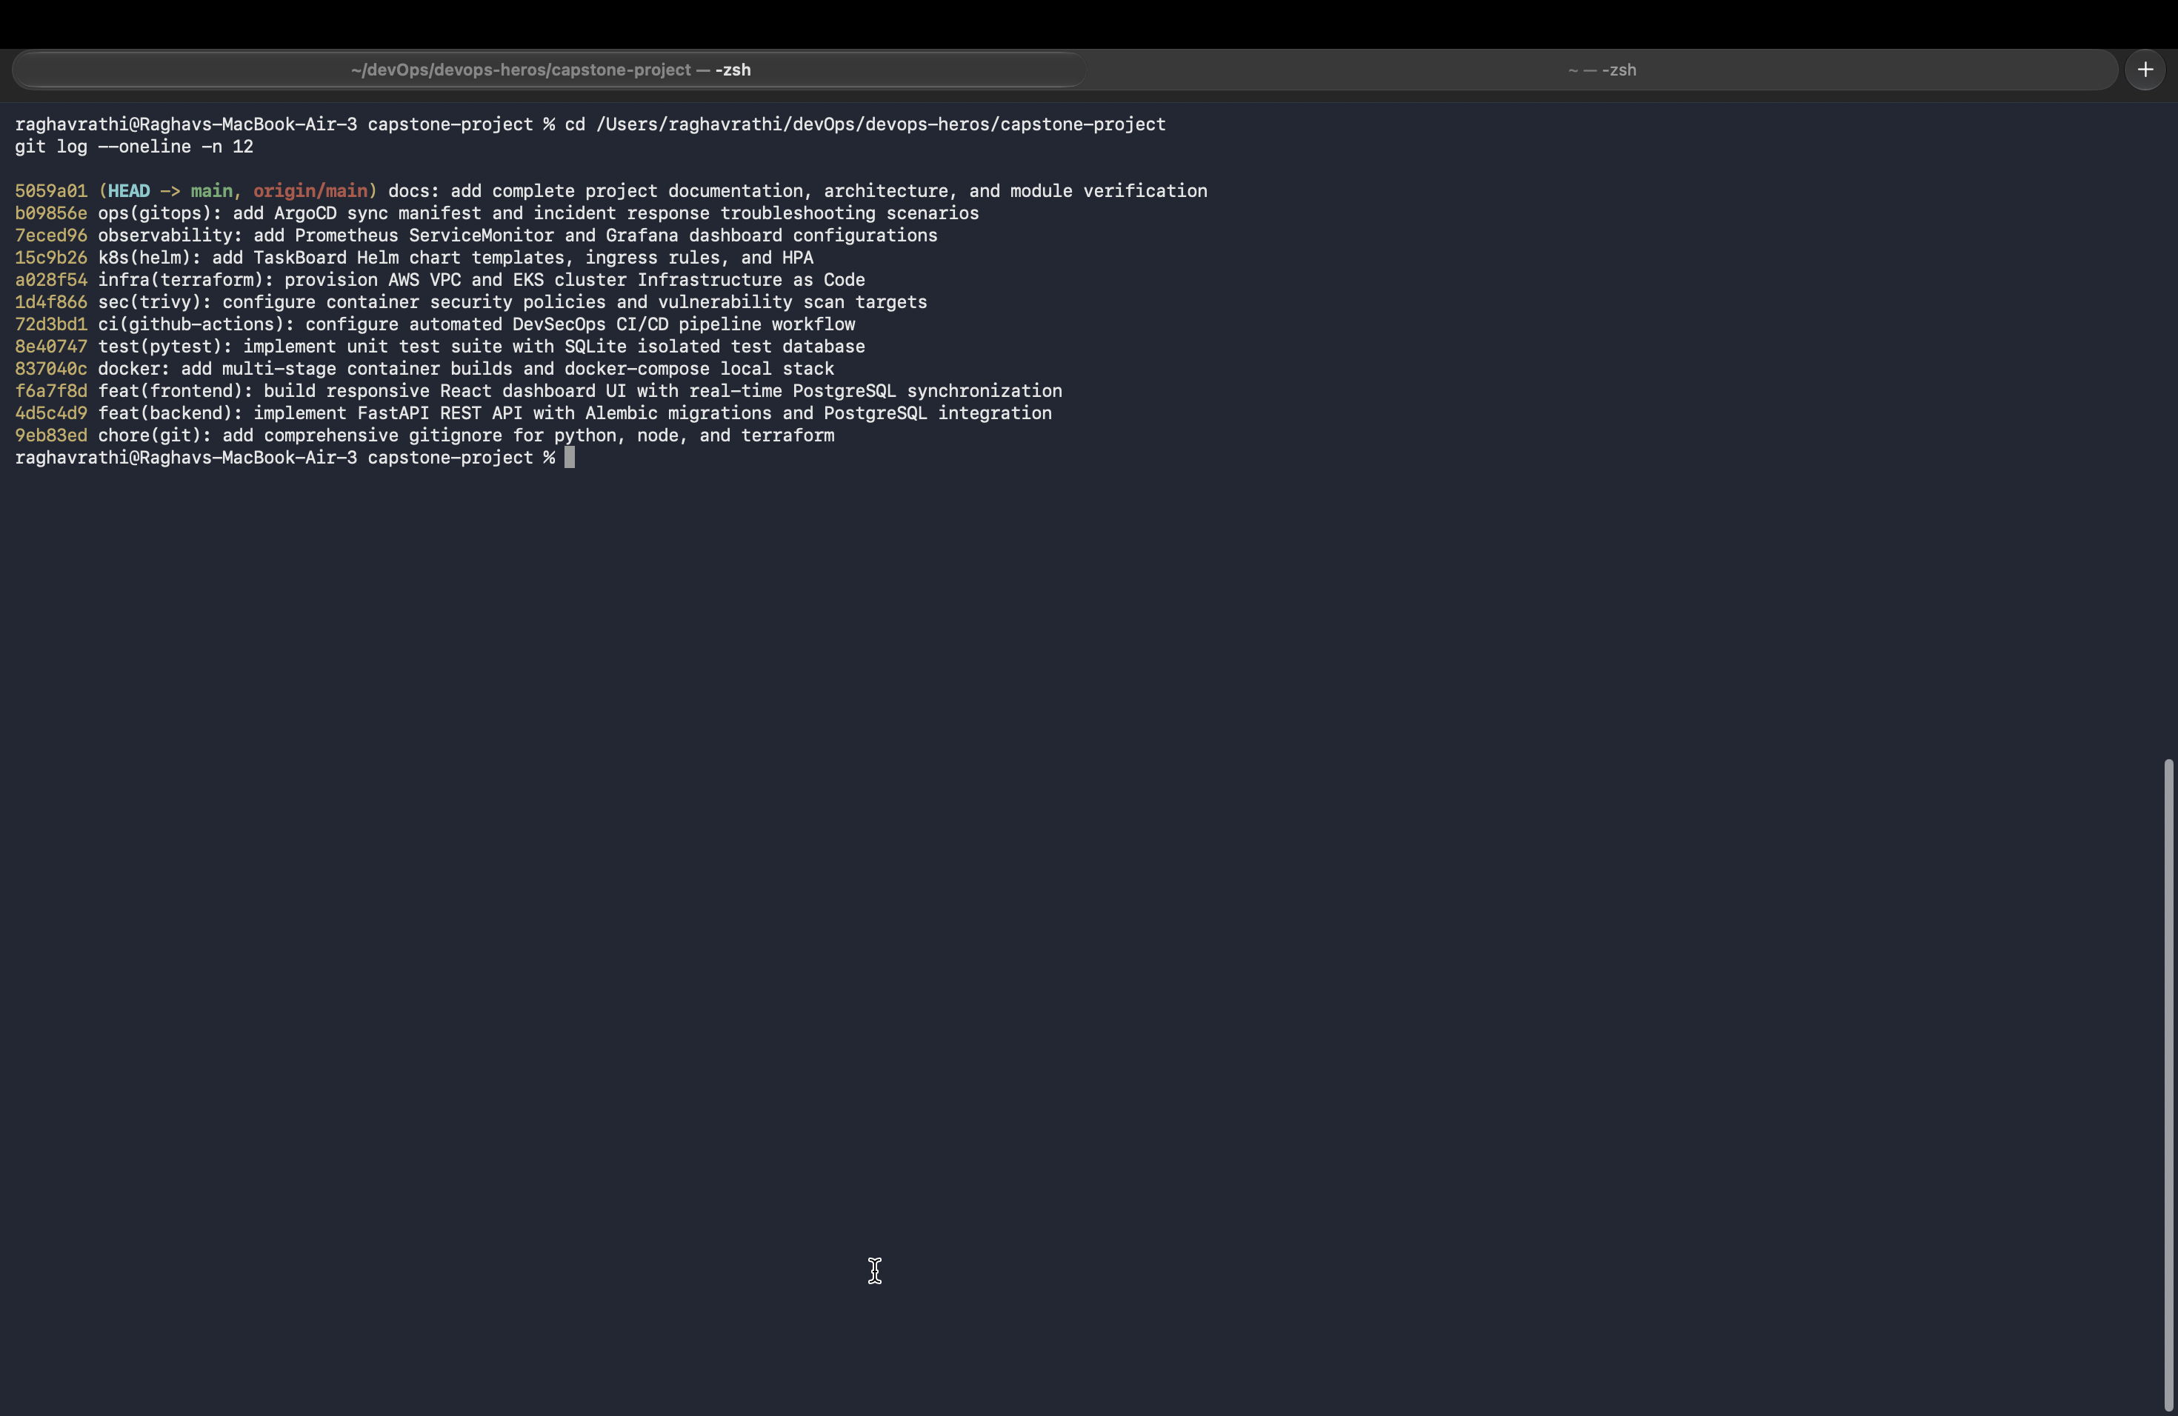
3
Git Version Control & Commit Strategy
Structured Conventional Commits with strict .gitignore and branch protection
● Granular History: Logical commit sequence: scaffolding → features → infra → docs
● Conventional Commits: Standardized prefixes: feat, fix, docs, chore, test
● Security Hygiene: Strict .gitignore prevents leaks of venvs, caches & credentials
● Branch Protection: Automated GitHub Actions CI validation on push to main
💡 Repository: github.com/raghav095/Devops-Cpastone-project (Branch: main)
TaskBoard — DevOps Capstone Project | Raghav Rathi (10033)
6 / 14

Slide 7
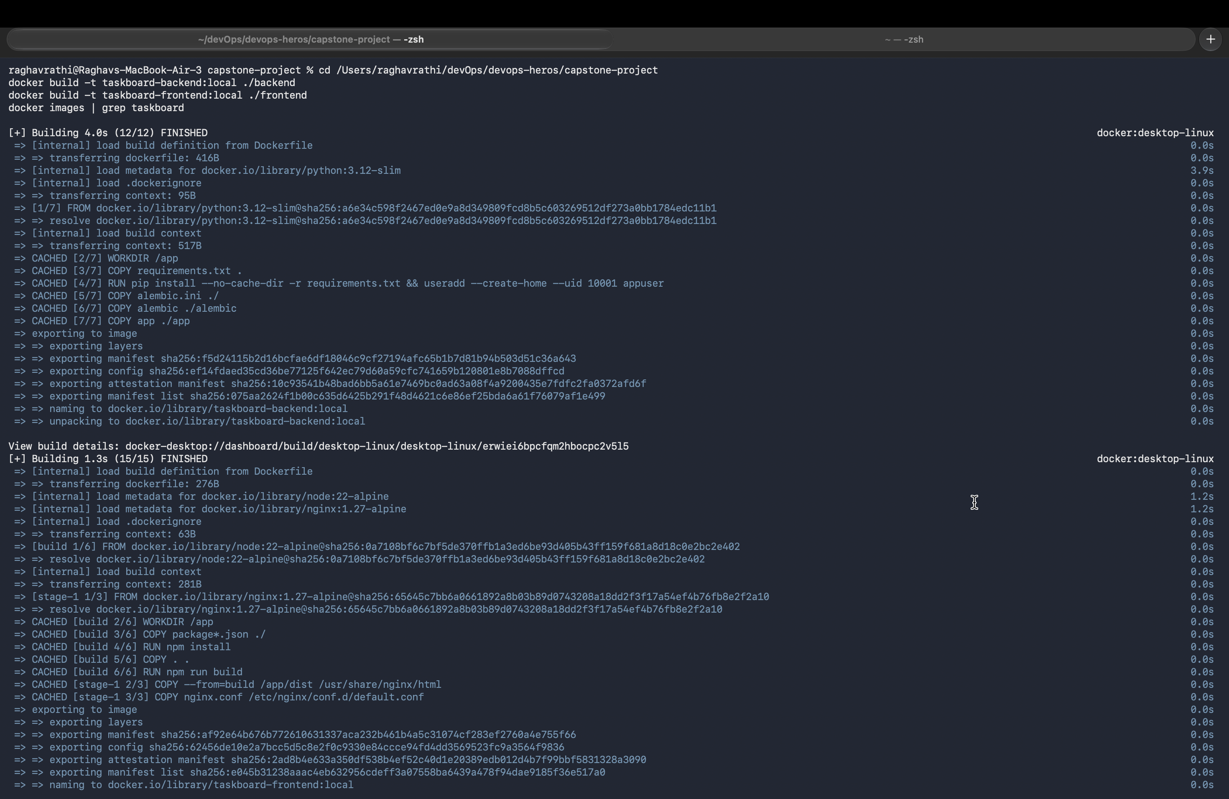
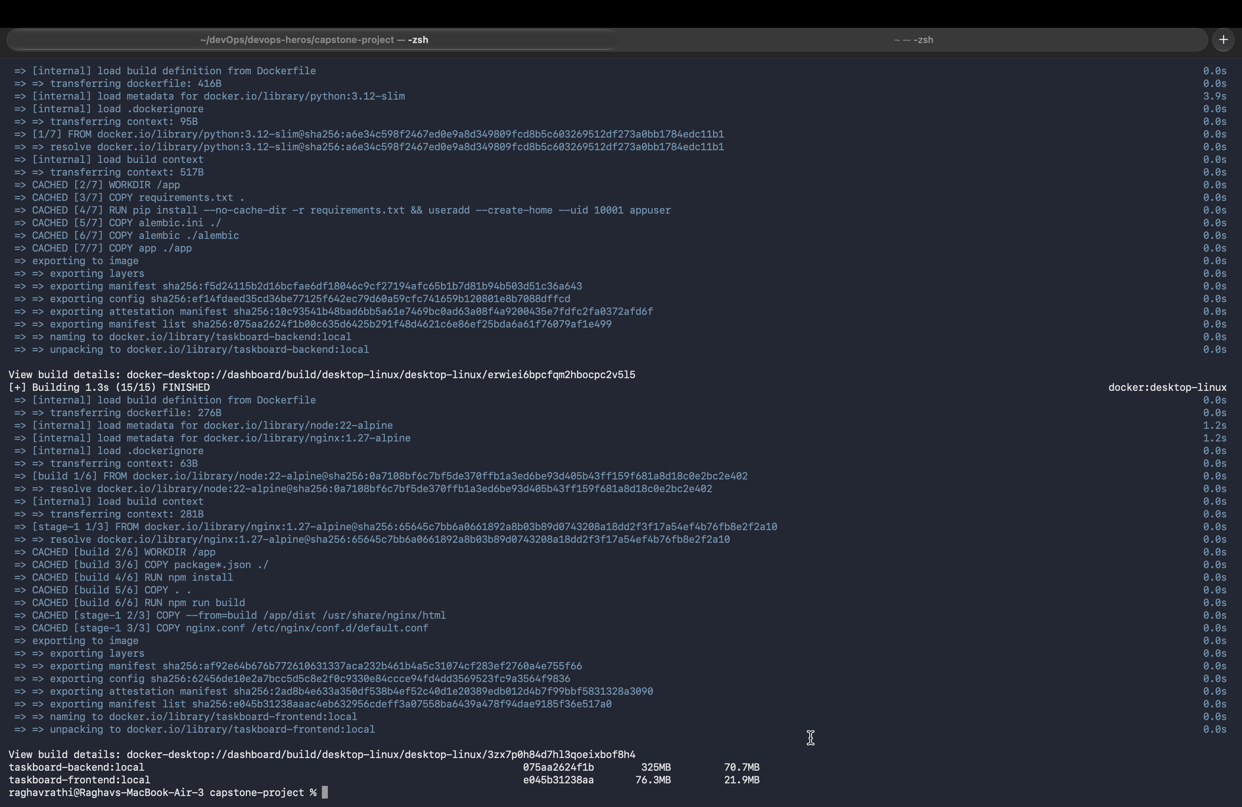
4
Docker Multi-Stage Builds & Image Hardening
Minimal, secure and production-optimized container images
🐍 Backend Multi-Stage Build
📦 Frontend Optimized Image (< 25 MB)
● Python 3.12-slim base image with wheels compiled in builder
● Non-root security execution: runs as appuser (UID 10001)
● Node 20 build stage compiled to static HTML/JS assets
● Production runtime served via lightweight Nginx Alpine container
💡 Multi-stage builds reduce attack surface and achieve sub-30-second incremental build times
TaskBoard — DevOps Capstone Project | Raghav Rathi (10033)
7 / 14

Slide 8
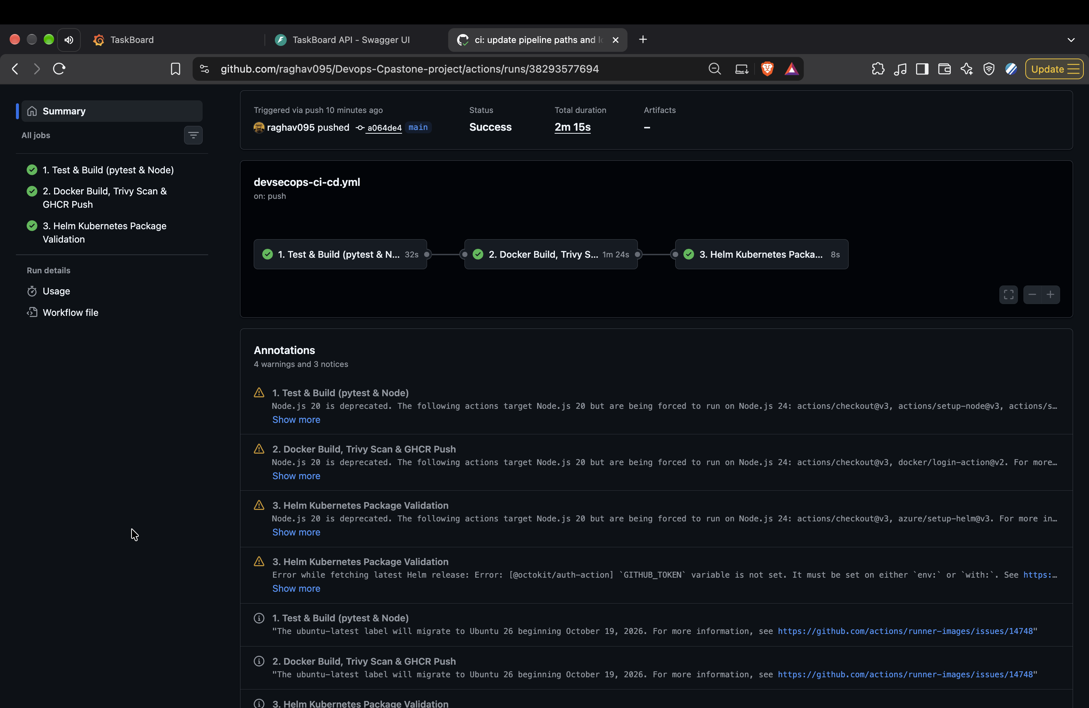
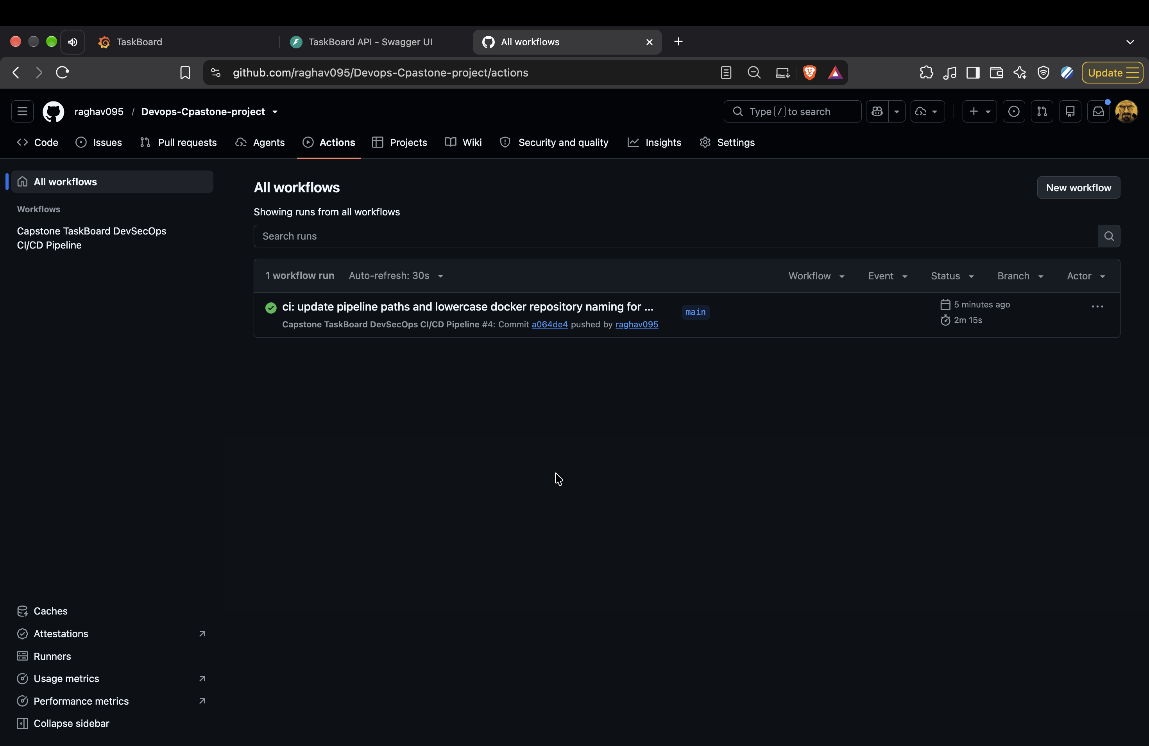
5
Automated CI/CD Pipeline (GitHub Actions)
End-to-end automated workflow: .github/workflows/devsecops-ci-cd.yml
⚙️ Automated Pipeline Workflow
🚀 Continuous Delivery & Traceability
● Triggered on git push & pull_request to main branch
● Sequential stages: Pytest → Docker Build → Trivy Scan → GHCR Push
● Images tagged with dynamic Git commit SHA for immutable releases
● Verified green pipeline runs on GitHub Actions infrastructure
💡 Pipeline file: .github/workflows/devsecops-ci-cd.yml · 100% green build status
TaskBoard — DevOps Capstone Project | Raghav Rathi (10033)
8 / 14

Slide 9
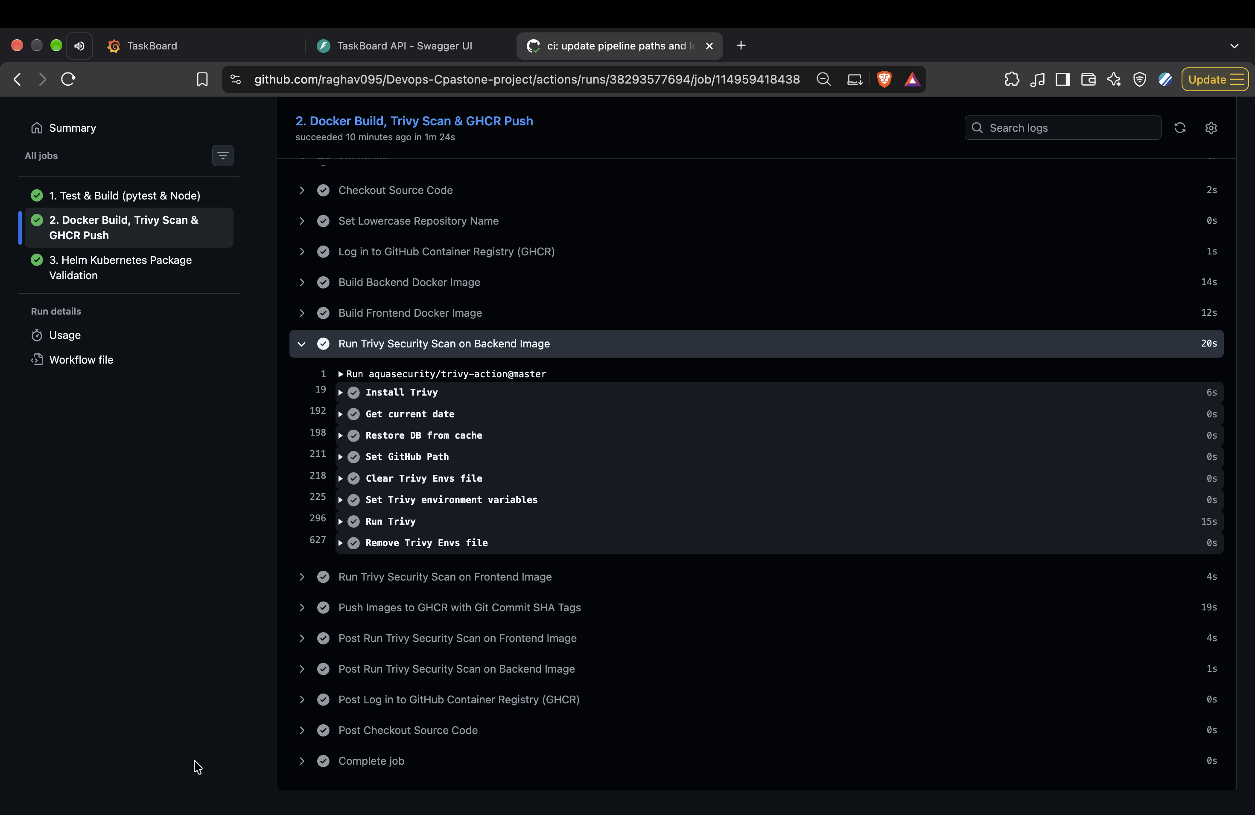
6
DevSecOps Vulnerability Scanning (Trivy)
Aqua Security Trivy automated container image security gate in CI pipeline
● Vulnerability Scan: Scans base OS packages and application dependencies against NVD
● Security Gate: Pipeline automatically fails if CRITICAL or HIGH CVEs detected
● Non-Root Check: Enforces non-root container execution and secret hygiene
● Shift-Left DevSecOps: Identifies and blocks vulnerabilities prior to registry publication
💡 Zero CRITICAL vulnerabilities permitted — images never published without passing Trivy
TaskBoard — DevOps Capstone Project | Raghav Rathi (10033)
9 / 14

Slide 10
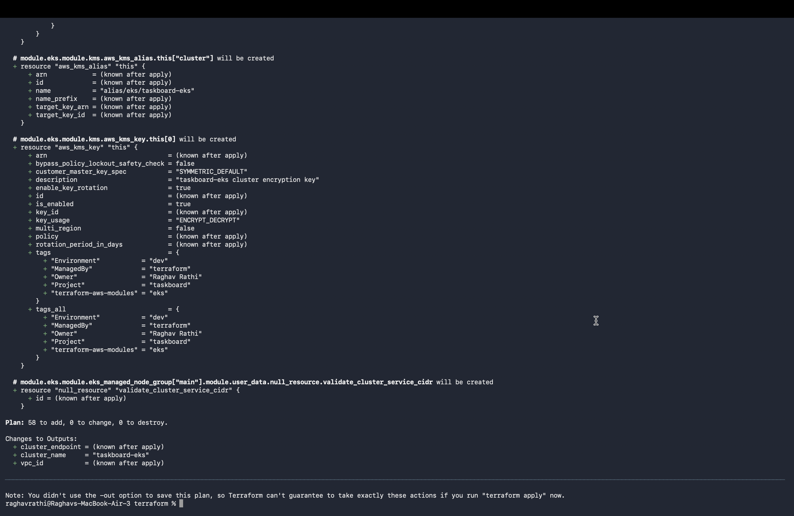
7
Infrastructure as Code (Terraform — AWS VPC & EKS)
Declarative cloud infrastructure provisioning with full lifecycle management
● Modular AWS VPC: 2 public subnets + 2 private subnets across 2 AZs with NAT Gateway
● AWS EKS Cluster: Kubernetes 1.31 cluster with managed node group (t3.medium)
● Terraform Lifecycle: Complete validate → plan → apply → destroy automated execution
● Resource Accounting: 52 cloud resources provisioned and cleanly destroyed
💡 Directory: terraform/ · Declarative modules for VPC, EKS, and security groups
TaskBoard — DevOps Capstone Project | Raghav Rathi (10033)
10 / 14

Slide 11
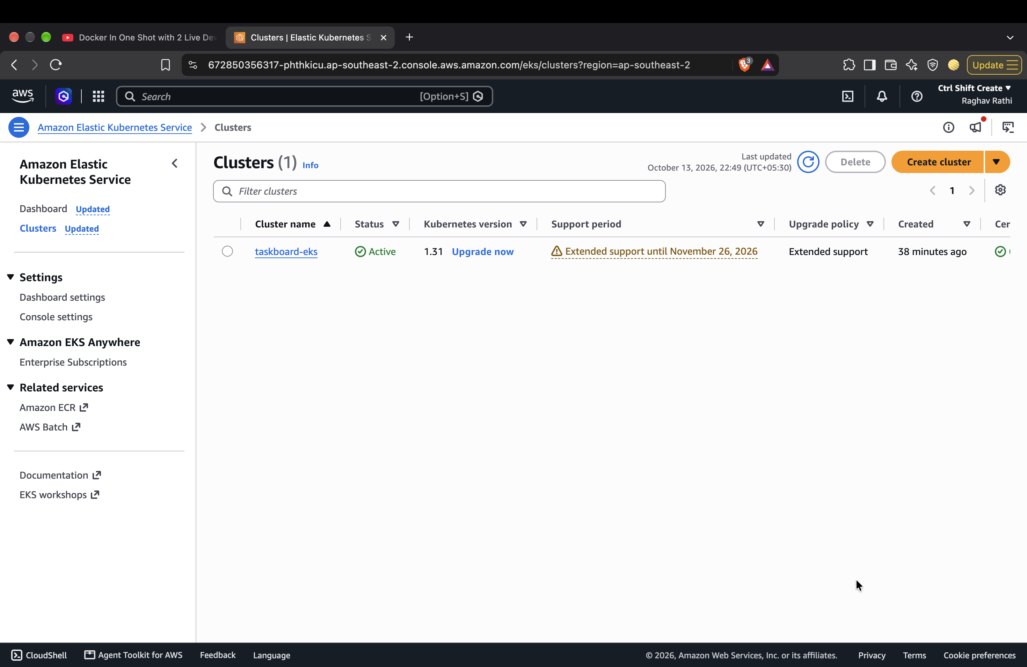
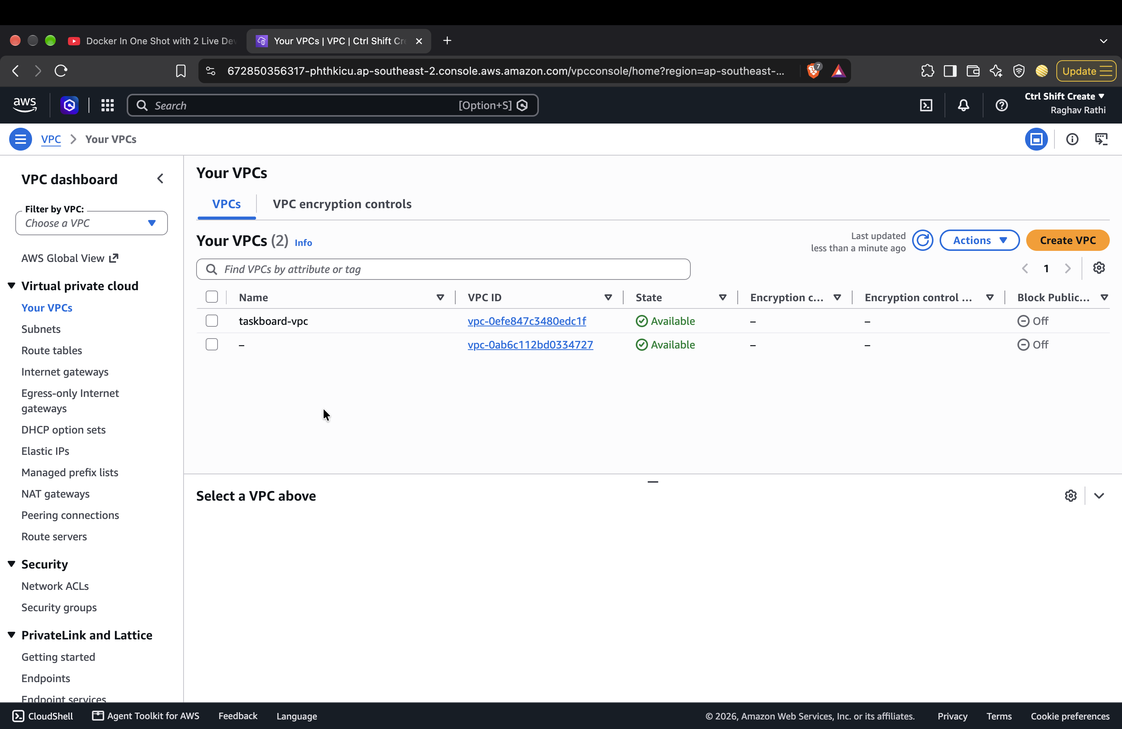
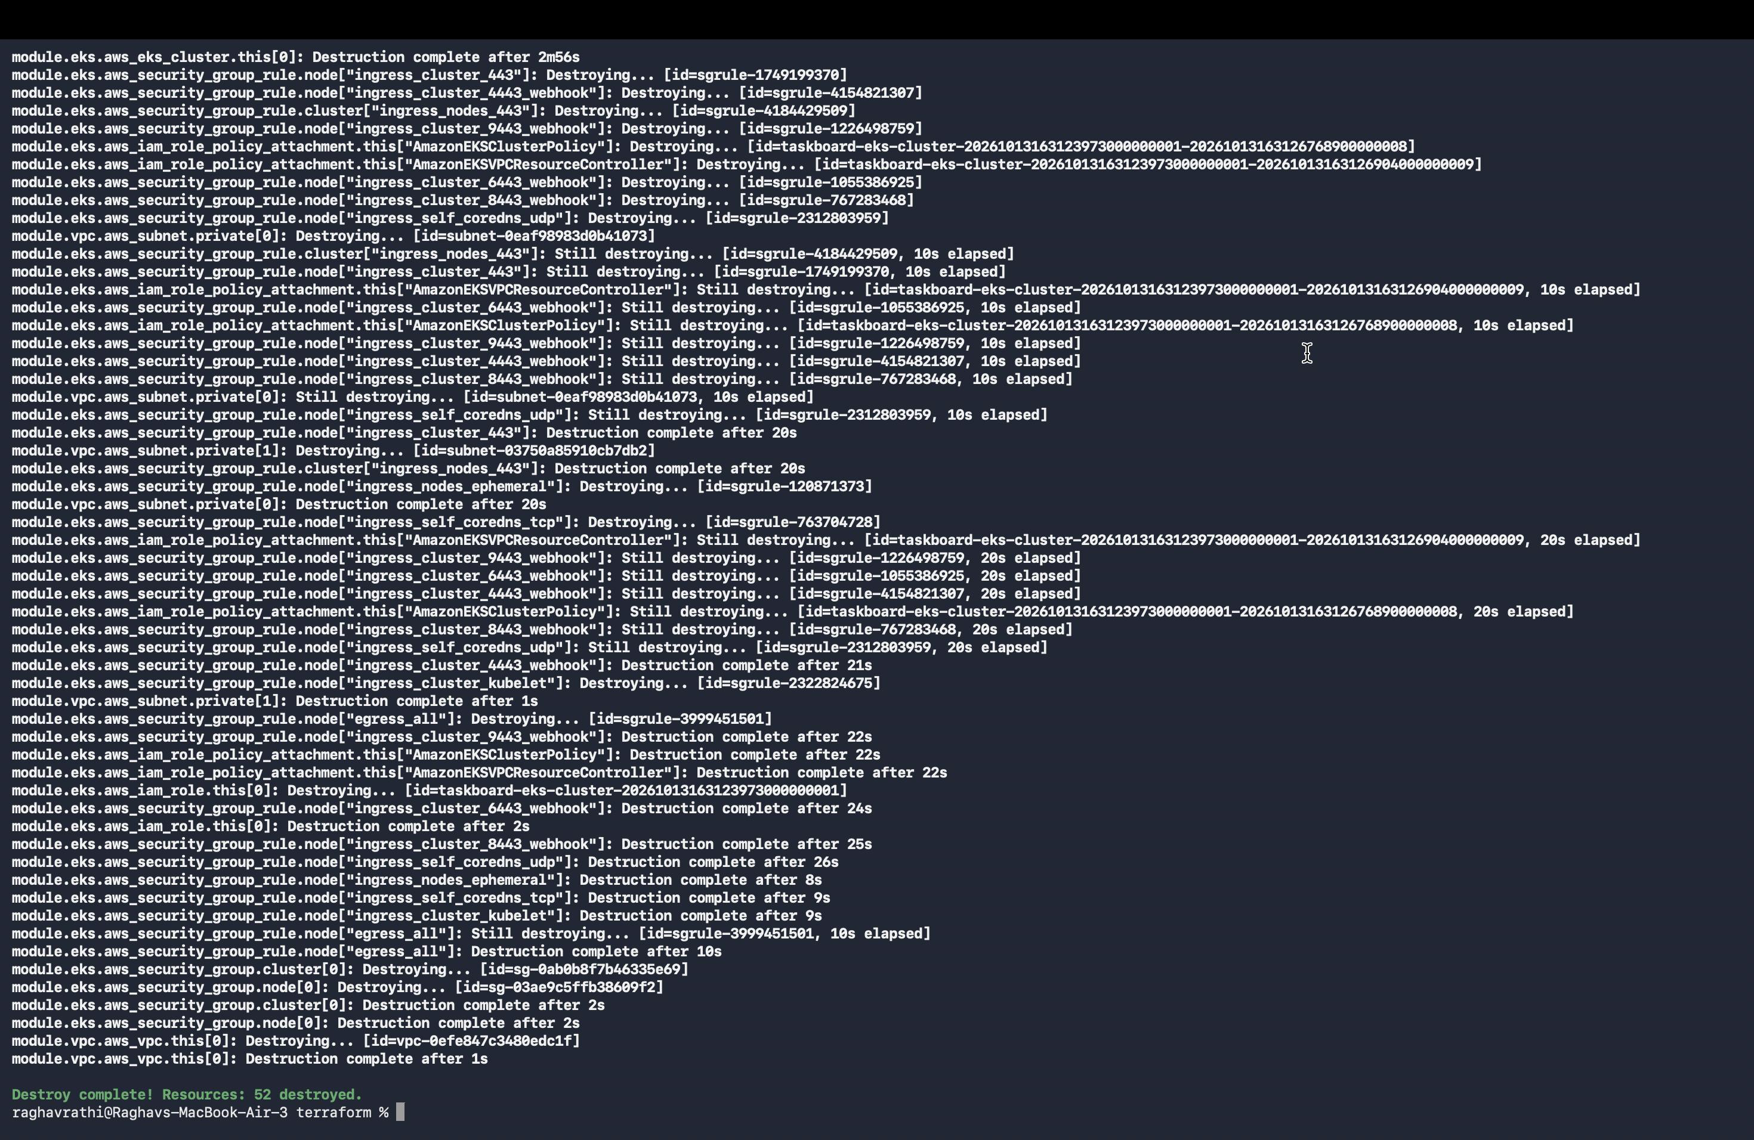
7
AWS Cloud Infrastructure Verification
Real AWS Management Console screenshots proving infrastructure was live and verified
🌐 AWS EKS Cluster
🛡️ AWS VPC Console
🧹 Clean Teardown
● Active Kubernetes 1.31
● Managed node group healthy
● Public & Private subnets
● NAT Gateway & Route tables
● 52 resources destroyed
● Zero lingering AWS costs
💡 Full infrastructure lifecycle executed cleanly with zero cost leakage
TaskBoard — DevOps Capstone Project | Raghav Rathi (10033)
11 / 14

Slide 12
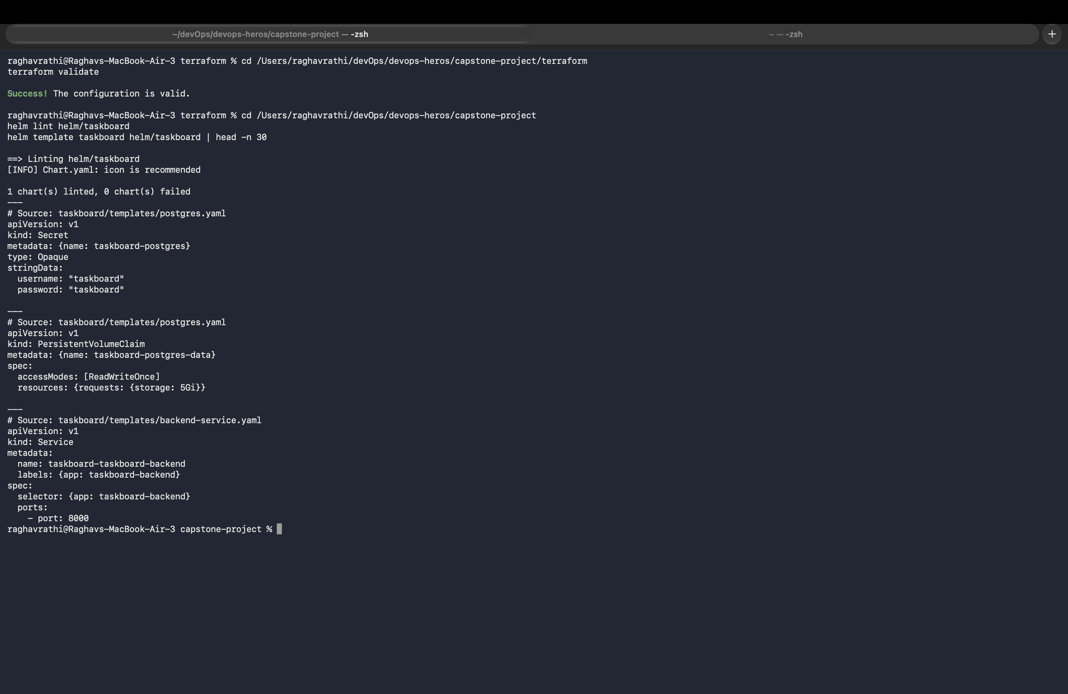
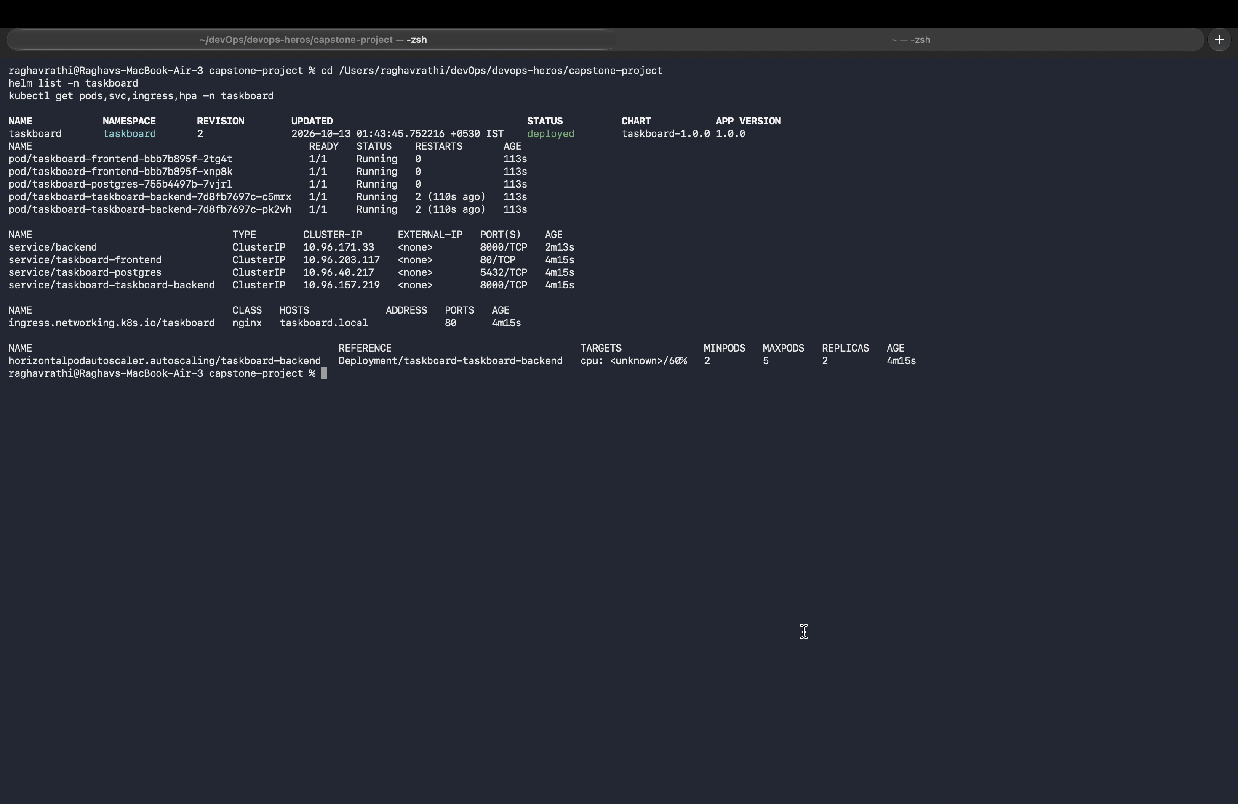
8
Kubernetes Deployment & Helm Package Management
Production orchestration with parameterized Helm 3 chart: helm/taskboard/
⎈ Helm 3 Chart Packaging
🟢 Running Pods, Services & HPA
● Modular templates for Deployments, Services, Ingress, and HPA
● Pre-deployment validation via helm lint and helm template
● All pods healthy and Running in dedicated taskboard namespace
● Horizontal Pod Autoscaler configured for CPU-based scaling
💡 Chart location: helm/taskboard/ · Deployed via Helm release: taskboard
TaskBoard — DevOps Capstone Project | Raghav Rathi (10033)
12 / 14

Slide 13
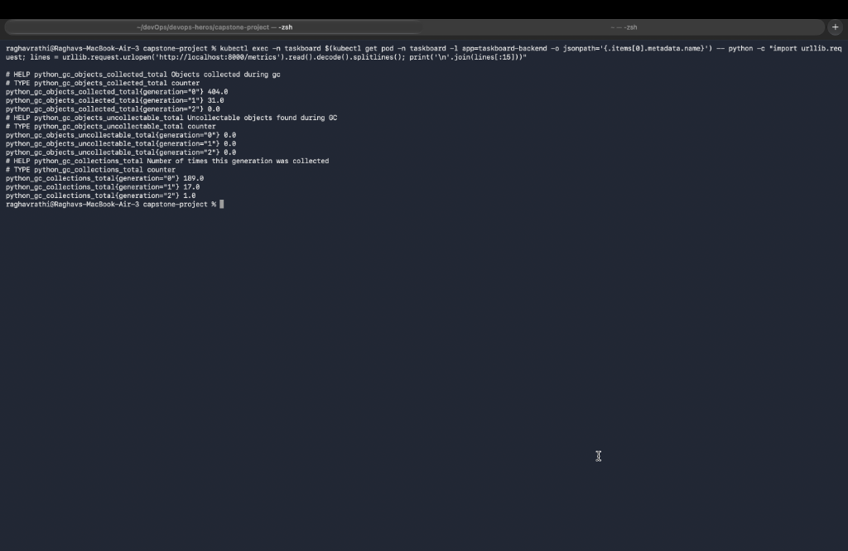
9
Observability — Prometheus Metrics Instrumentation
Real-time application metrics exported at /metrics endpoint
● FastAPI Instrumentation: Configured via prometheus-fastapi-instrumentator
● Exported Metrics: HTTP request counts, latency histograms, and status codes
● Prometheus Scraper: Kubernetes ServiceMonitor auto-discovers and scrapes backend pods
● Grafana Dashboards: Pre-configured Prometheus datasource in monitoring/grafana-values.yaml
● Health Probes: Liveness (/health) and readiness (/ready) monitored continuously
💡 Metrics scrape verified via: curl http://localhost:8000/metrics
TaskBoard — DevOps Capstone Project | Raghav Rathi (10033)
13 / 14

Slide 14
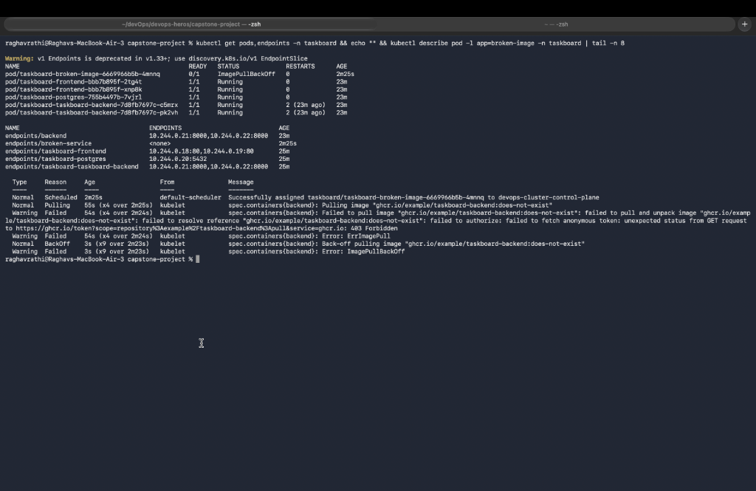
10
Incident Response, Troubleshooting & Root Cause Analysis
Hands-on failure diagnosis, remediation, and zero-downtime rollback
● Scenario 1: ImagePullBackOff: Diagnosed with kubectl describe pod → Root cause: non-existent tag → Fixed image
● Scenario 2: Service Error: Inspected endpoints (<none>) → Root cause: mismatched label selector → Aligned labels
● Zero-Downtime Rollback: Instant recovery executed using kubectl rollout undo deployment/<name>
● Lab Artifacts: Manifests preserved in troubleshooting/broken-image.yaml & broken-service.yaml
💡 Manifests: troubleshooting/broken-image.yaml & troubleshooting/broken-service.yaml
TaskBoard — DevOps Capstone Project | Raghav Rathi (10033)
14 / 14

