Slide 1
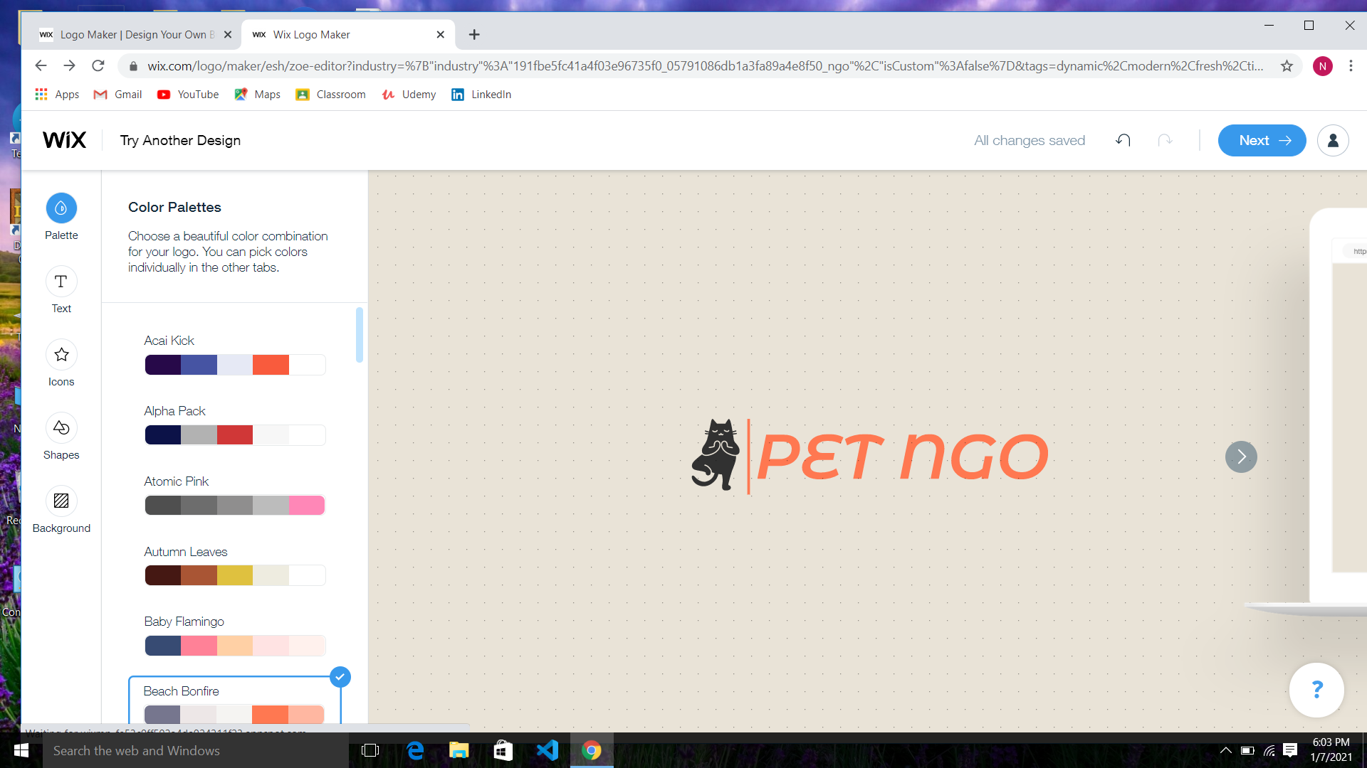
Made by:Shashank,Raghav,Stuti,Neelu
Submitted to:Muthuraj V

Slide 2
ABSTRACT
Nowadays animals are not taken care of properly mainly the pets who don’t have much experience in wild. So Pet NGO is a solution for this problem. It is an organization with people of like minds towards animals specially for pets. To solve there need of providing a simple and reliable management system we have come up with a solution in C++ with our database as simple text files. The software will be a terminal program which later can be upgraded into graphical user interface. In terminal as well we have made it user friendly and can be easily used by anyone with no programming background as well. We have used basic concepts of object oriented programming such inheritance privacy and authentication system a decent authentication system. We have implemented date and time for storing everything date and time wise in our file based database.

Slide 3
CITATION
Stackoverflow
geeksforgeeks

Slide 4
How the user will be prompted
First he will be ask for authentication. For that we have created a class customer .
CUSTOMER CLASS:-
Here are the two main functions -
1.SignUp
2.SignIn
Where we have used the concept of hashing password with a key .And then storing it in database.

Slide 5
AFTER AUTHENTICATION:-
After authentication the user will get four options:
1.Donation
2.Adoption
3.Report
4.Ticket booking
These all classes are inherited from the customer class .The user is going to choose from the above available options.

Slide 6
DONATE :-
If user chooses Donate option after authentication he/she will be asked if he wants to donate some money or see his previous transaction that he did with the PET NGO.
If the user chooses to donate, he/she will be asked how much money they want to donate and then it will be saved in our database with transaction Id and date time of the system .

Slide 7
REPORT:-
When the user finds any animals in streets or roadside he can choose the option “ Report” which will allow him to report our NGO about that animals and we will take the required actions.
Report class is same as the donation class but while storing report we will also store the report of animal as our stock of pets for adoption purposes and taking care of pets who are left on street.

Slide 8
Adoption :-
When the user chooses to adopt a pet from our NGO ,he will go for the “Adoption” option.
For adoption we will ask user which type of pet he wants( e.g. dog, cat)
Suppose user entered dog then we will search for dog in our database if we have any dog left in the database (we stored pets from the report class in our database).
We will just retrieve and give it to customer

Slide 9
Ticket Booking:
There are various shows that the PET NGO conducts on a daily basis for spreading awareness to people about taking care of the pets. For that shows we have implemented a decent ticket booking system in C++ where a person is stored in a structure of name gender and age and this structures are stored as an array of structure later on all of this is stored in our database for future references or if the user forgets his or her tickets we can provide it.

Slide 10
ADMIN:-
We have implemented a whole new header file with just one class as admin in which we have used same authentication system for authenticating the admin and then there are various functions for admin to see various things.
Function name | Use
displayUserByName(string) | displayUserByName(string)
displayDonationByUser(string) | displayDonationByUser(string)
displayReportsByUser(string) | displayReportsByUser(string)
displayPets(string) | displayPets(string)
displayAllTicketsOfToday() | displayAllTicketsOfToday()

Slide 11
File management:-
For storing all the data we have implemented a file structure system which stores all the information separably and easy to sort.
There are various functions to do this they all basically store data of different class so that we can retrieve it very quickly
For user it will be created a new folder of his username and his all the transactions and everything will be stored inside its own file structure
The admin folder contains a copy or link of the contents for the things user do in the system. Admin can access anything anytime

Slide 12
Utility functions:-
Above all the backend system is implemented for implementing those backend we need some utility functions for conversions grabing time and many other things so me have implemented various functions for that purposes in a file called utility.h

Slide 13
DESIGN:-
Now who doesn’t want a good looking app we all want that so for that we have implemented some basic functions for creating tables on terminal and changing colors of the text in the terminal and drawing a line and curve lines on the terminal.

Slide 14

THANK YOU

