Slide 1
Customer Experience Test Automation
Introduction
Purpose
Accomplishments / Evolution
Roll Out
Independent Product Testing
How its built
Execution
Reporting
Future…
Mark Atkinson
3/5/18

Slide 2
INTRODUCTION CXTA - Customer Experience Test Automation
The Test Automation frame work leverages available open source technology
CXTA validates product quality, usability and performance of CX Web Applications…
CXTA validates core functional APIs( micro service API )…
The following provides an explanation of CXTA, our purpose, technologies, philosophies, process, and our evolutionary plans for 2018.
Notes:
Communication piece is hacked up

Slide 3
PURPOSE Operational & Functional Process
Develop and deliver an automated testing frame work for Delta Dental technology teams …
Design with a developmental philosophy that enables seasoned development engineers to create test scripts to validate their own work…
Design the Framework with enough power and flexibility to meet current and future needs…
Continue iterating on Framework functional improvement…

Slide 4
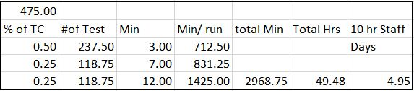
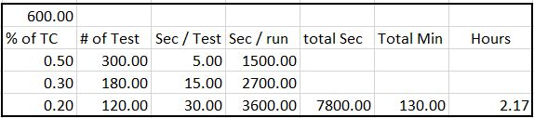
ACCOMPLISHMENTS / EVOLUTION
CXTA and the CX Market Place Development Team have matured.
We are able to do more and deliver to a greater audience.
California is no longer the horizon !
To scale as is projected we have to change how we develop tests…
We have to change how we select and execute tests…
Massive reduction in the number of hours Manual VS Automated
CA DHMO
AHMO

Slide 5
ACCOMPLISHMENTS / EVOLUTION
Dev staff productivity and confidence
A number of times Development has needed a confidence vote on the product. Each time I was able to provide within a number of hours a solid reporting on the product’s viability
Team Agility. Bug found, code fix submitted, automation run. Its Fixed !
Product Architect claimed at one point, “ That’s why I liked Test Automation so much.” My Automation ran the same script that forced the problem to the surface and ran identically proving the fix was successful
Big Fixes done at MOT on a development request.
We run out tests. We find a bug
We answer: Yes, we can rerun the pass for you
And within hours we can report a Full Run, Short Run, Focused Run providing confidence to the team.

Slide 6
ROLL OUT
CXTA is rolling out their first version of the Test Automation Framework
Development will write test automation scripts supporting their work…
This scripting will be page specific feature level integration tests
CXTA will develop and manage all Use Case End to End test automation
CXTA will maintain and enhance the Test Automation framework
Inclusion of development staff in the automation development process we align our teams much like the rest of the industry

Slide 7
INDEPENDENT PRODUCT TESTING
The ability to test a products full abilities independently of all other products is a pressing need…
CXTA's proposed solution reduces the overall quantity of source code that must be maintained. We see this as an evolutionary improvement. There is a cost…
CXTA sees a direct correlation in manner and approach between refactoring code base and new test data framework methodology giving us the ability to address content test data regionally or by product selection. Independent Product Testing opened a door for us …

Slide 8
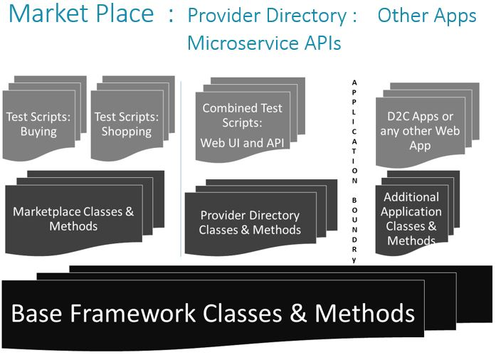
HOW IT’S BUILT
Git Repo Node.js, Protractor, JavaScript
Framework is Class/Object based
Core base level classes defining what is common to any component on a web page
Initiator Classes, Handlers, Helper Classes
Specialized components and methods build up from Core Classes and Methods

Slide 9
EXECUTION
Two primary modes
Schedule Based : Covers Regression Testing
On Demand : Covers all developer build initiated testing
All testing regardless of mode is configurable prior to run
Gives developers ability to focus testing of code in development
Configuration controlled testing
Evolutionary change in configuration and approach moves to control of what product and state being tested out of the script and to Framework Configuration… ...

Slide 10
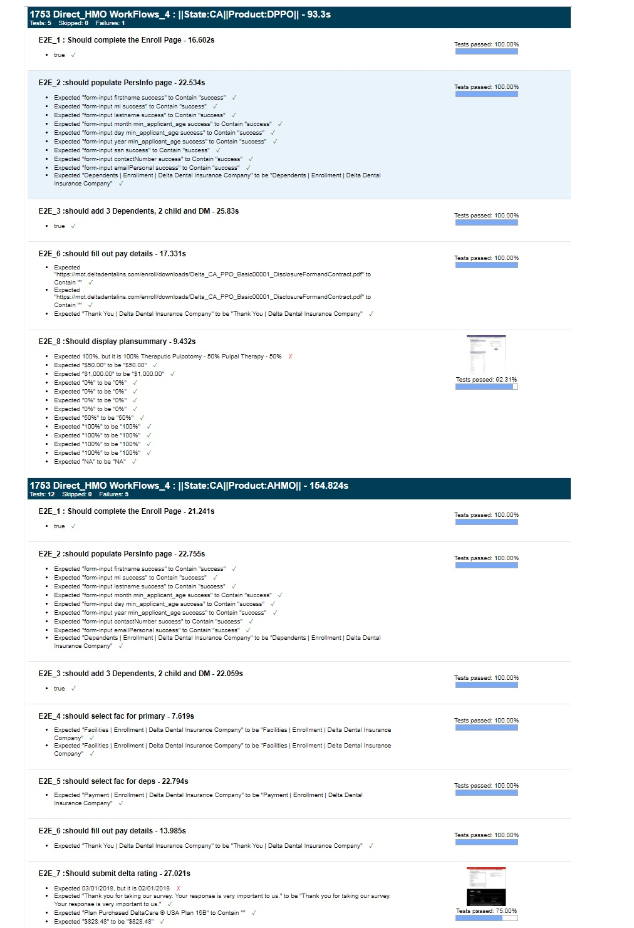
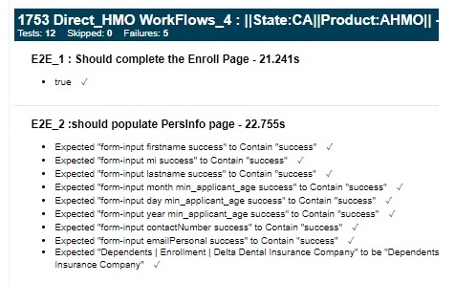
REPORTING
Reporting: Three levels of information
Hyper granular: Cover every Assert and Compare in Framework
Debugging and Framework Development tool

Slide 11
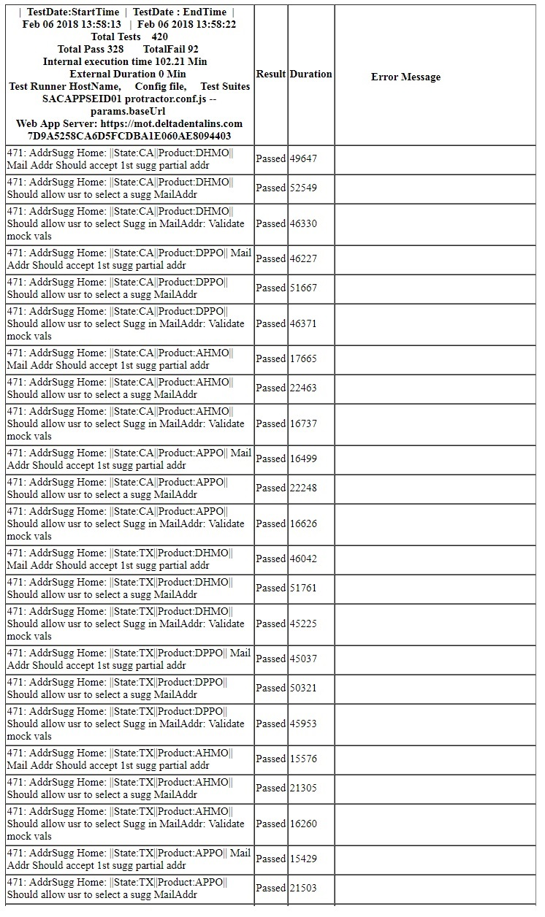
REPORTING
Reporting: Three levels of information
Test Run Specific: Pass / Fail assessment of all written script tests
Current Standard test run encompassing test report

Slide 12
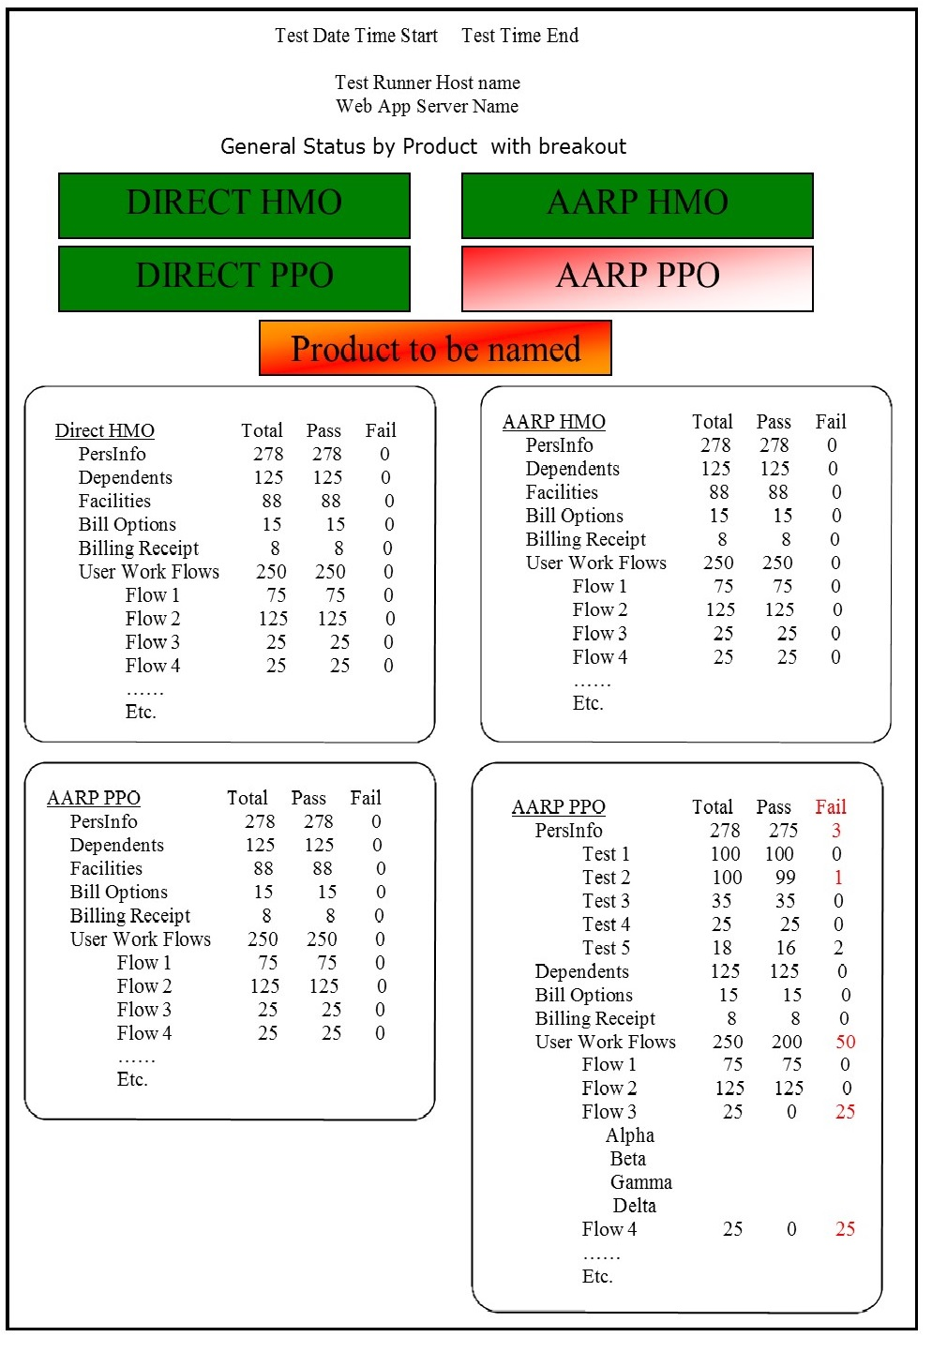
REPORTING
Reporting: Three levels of information
High Level Product Specific:
Go / No-go Product Dashboard
In Design Mode.
Provides:
Development Managers
Product Managers
A quick look at the current health and capability to ship the product

Slide 13
FUTURE
Mobile devices
Test Headless
Additional Application Coverage
New Support should be capable in ~10 working Days
Continue deriving mid layer commonality. Move commonality to the bottom Layer.
The smaller the mid layer, the easier to add add new capability ( new applications )

Slide 14
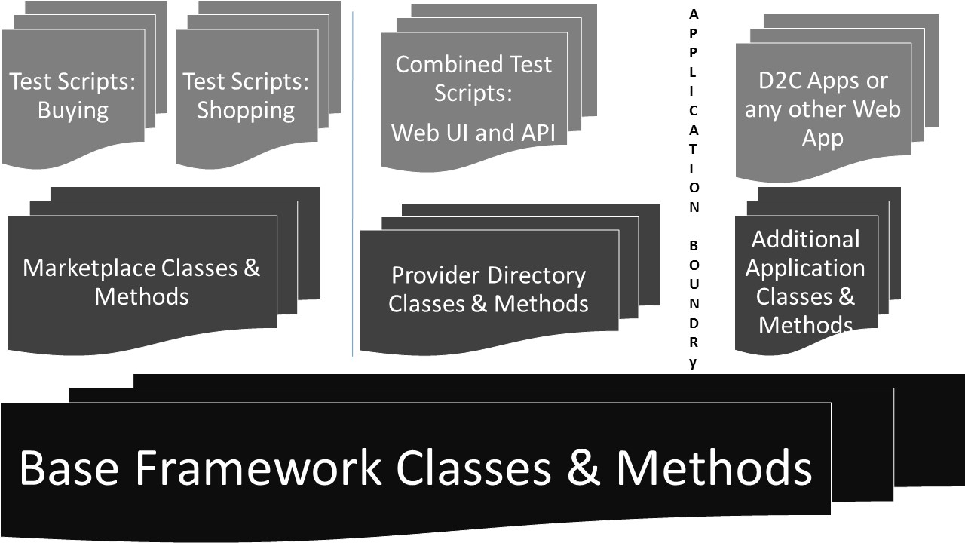
Market Place : Provider Directory : Other Apps Microservice APIs

Slide 15
Seconds
Small 5 %30
Med 15 %50
Large 30 %20
PPO HMO
PPO
One One
State State
AARP 600 TC 1800 TC
AARP + DIR 3600 TC
1800 TC
One State 2Hrs 6 Browsers
Currently
20 States
7 HMO & PPO
13 PPO only

