Slide 1
What is Test Automation
Execution of code to validate application workflows
Automatically compare expected outcome against actual outcome

Slide 2
Recap: What we’ve done
Page Object Model (Pattern) vs Flat Files
135 loc VS 2500 loc 4 e2e
Everything in the frame work is reusable: New development can be spun up in two days
Page Object Model Frame work is DONE !!

Slide 3
The Numbers on running tests MANUALLY
Best case: Open Browser-1min Navigate-1min Do test-1 min : Total 3 min
Medium Case: 1 – min , 1 – min, Do Test 5- min : Total 7 min
Worst Case : 1-min, 1-min, Dig around 5-min ; Test 5-min : Total 12 min
Best Case : 475 Test X 3 min = 1425 min or 24 hrs
3 staff 1 day, 1 staff 3 days
Average 475 X 3 min X 50% + 475 x 12 X 25% + 475 x 7 x 25%
712 + 1425 + 832 = 2969 min or 49 hrs
6 staff 1 day, 1 staff 6 days
This is the effort for one browser: We have three browsers !

Slide 4
!!! BUSINESS VALUE !!!
We Are Doing More for Less Manual Effort
And we are doing it more accurately
An Automation Regression pass runs in 2.5 hours
Automation Regression passes are scheduled to run every three hours
Automation Regression passes run on every build deployed to test

Slide 5
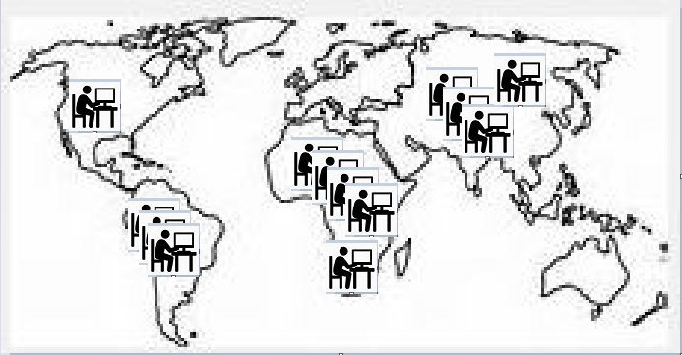


Manual Effort vs Test Automation

