Slide 1
Customer Experience Test Automation
Introduction
Purpose
Accomplishments / Evolution
Roll Out
Roles & Responsibilities
Proposed Timeline
Test Execution
Testing Types
Test Case Numbers
Reporting
How its built
Future
Appendix
Mark Atkinson
3/13/18

Slide 2
INTRODUCTION CXTA - Customer Experience Test Automation
The Test Automation frame work leverages available open source technology
Node, Protractor, JavaScript, Jenkins
CXTA validates product quality, usability and performance of CX Web Applications
Perf Quall: short test completion time, Usability: easy test authoring, Prod Qual: Pass rate
CXTA validates core functional APIs( micro service API )
Broker Value, aarp member #, PCP, CMS….. All supported by Microservice Information
The following provides an explanation of CXTA, our purpose, technologies, philosophies, process, and our evolutionary plans for 2018.

Slide 3
PURPOSE Operational & Functional Process
Our Purpose
My Team develops and delivered an automated testing frame work for Delta Dental technology teams ( CX, … )
Fairly new thinking : Testing PD and Micro services I realized this was more than just CX shop & buy
Our Purpose
Design with a developmental philosophy that enables seasoned development engineers to create test scripts to validate their own work
WE Designed mid Layer to off load manual steps: Tons of Code Level Documentation
Our Purpose
Design the Framework with enough power and flexibility to meet current and future needs
Framework allows execution of multiple browsers simultaneous parallelism. Open Source allows us to code throughout entire stack top to bottom.
Our Purpose
Continue iterating on Framework functional improvement
Continuous improvement refactoring the mid layer: smaller mid layer supports more apps

Slide 4
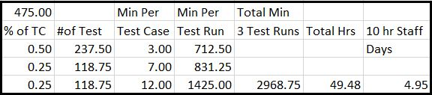
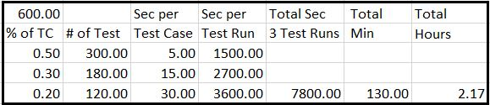
ACCOMPLISHMENTS / EVOLUTION
CXTA and the CX Market Place Development Team have matured.
We are able to do more and deliver to a greater audience.
To scale as projected
we have to change how we develop tests : roll out : page Integration test : Industry practice
we have changed how we select & control execution now in Scaling Mode : groups of states & Fcns are named phases
Massive reduction in the number of hours Manual VS Automated
A collection of Test Cases run manually
5
DAYS !
A similar collection of Test Cases run in Automation
2
HOURS !

Slide 5
ACCOMPLISHMENTS / EVOLUTION
Dev staff productivity and confidence
Development frequently comes to CXTA for confidence vote on the product.
Always able to provide within hours a report on product viability
Agile Team operation : Bug fix resolution cycle!
Short turn around on discover, fix , re test cycle
Product Architect claimed at one point, “ That’s why I liked Test Automation so much.” Test Automation ran the same script that forced the problem to the surface and ran identically proving the fix was successful
Increase in number of test points without more code. See Appendix: Test Case Numbers
Implementation of the ‘dataProvider’ technology
Provider Directory testing incorporates novel use of the API scripts
First access REST API and capture data. Then access PD UI requesting same information. Compare results
Micro Service REST API Testing accomplished in same framework
No need for another product or framework. It can all be done in CXTA Framework.
So, Next step is ……..

Slide 6
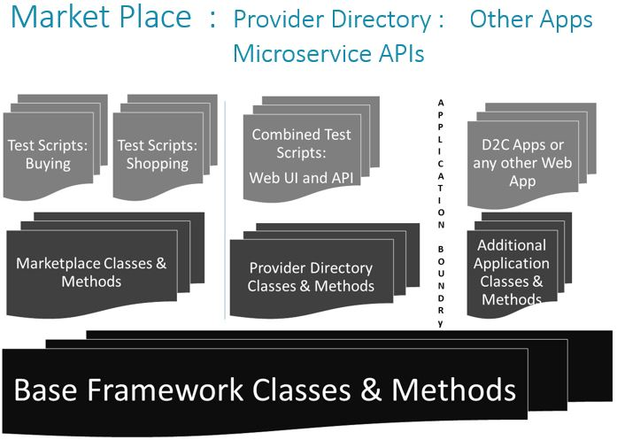
ROLL OUT
CXTA rolling out first public release of Test Automation Framework
Development staff will write test automation scripts supporting their work
This scripting will be page specific feature level integration tests
REST API test scripting covers all basic use and edge case work
CXTA team continues with Use Case End to End test automation
Inclusion of development staff in the automation development process we align our teams much like the rest of the industry
CXTA team continues development of the Test Automation framework
Refactoring the Mid Layer is key to adding more product under test

Slide 7
ROLES & RESPONSIBILITIES
ROLL OUT
Shopping & Buying Development Engineers
Responsible for all new Page Level Functional Integration Tests
Responsible for correcting all test failures in ../fitmp directory, keeping it completely operational
Provider Directory Development Engineers
Responsible for all new Template level Functional Integration Tests
Responsible for correcting all test failures in the ../fitpd directory, keeping all test operational
Core Technology API Team engineers
Responsible for adding new tests to the REST API regression suite
Responsible for correcting all test failures in the ../fitapi directory, keeping all test operational
CXTA Team engineers
Oversee and manage all Framework development.
Continual frame work improvement, evaluating all need for new coverage
Continually analyze mid layer code
Refactor content from mid layer to the lower common layer
Develop all End to End test automation scripts based on business use cases

Slide 8
PROPOSED TIME LINE
ROLL OUT
ROLL OUT & ENGINEERING ADOPTION
Refactor mid layer, ensure API is uniform
Write up training aids, examples of installation and configuration
Training staff in the use and operation
Test and debug initial installations
Timing on Roll out
Roll out First week April to the Core Tech Team REST API Test Framework
Roll out to Market place team at the end of April
Roll out to other teams on first or second week of May
Location for some kind of time specific
Gant Chart like layout of the roll out process.

Slide 9
TEST EXECUTION
Two primary modes
Schedule Based : Covers Regression Testing MOT - Cron
On Demand : Covers all developer build initiated testing DIT - Jenkins
Configuration controlled testing: Biggest Evolutionary Advance
Evolutionary change in configuration approach moves control of what product and state being tested out of the test script and into Framework Configuration
All testing regardless of mode is configurable prior to run
Developers use configuration to focus testing on development code
Gives CXTA ability to test on same deployed code w/out stepping on Dev

Slide 10
TESTING TYPES
Three primary types of testing
Page level Functional Integration
Complete page element analysis across all pages in application
Every Button, Field, Check Box, Link, etc. Functionally evaluated and error checked
Application level work flow : End to End
Designated user work flow execution pathways
Data driven
Micro Service REST APIs
Regression coverage for Micro service REST API Data type & Data range
Functional test use to supply data driven testing in CX Applications

Slide 11
TEST CASES NUMBERS
Test case numbers are a combination of a Phase release, A product under test, and the number of states we are testing against.
Phase 1 AARP HMO 5 states === 850 tests
Phase 1 DPPO X States === 1327 tests
Phase 2 All products All states === 73475 tests.

Slide 12
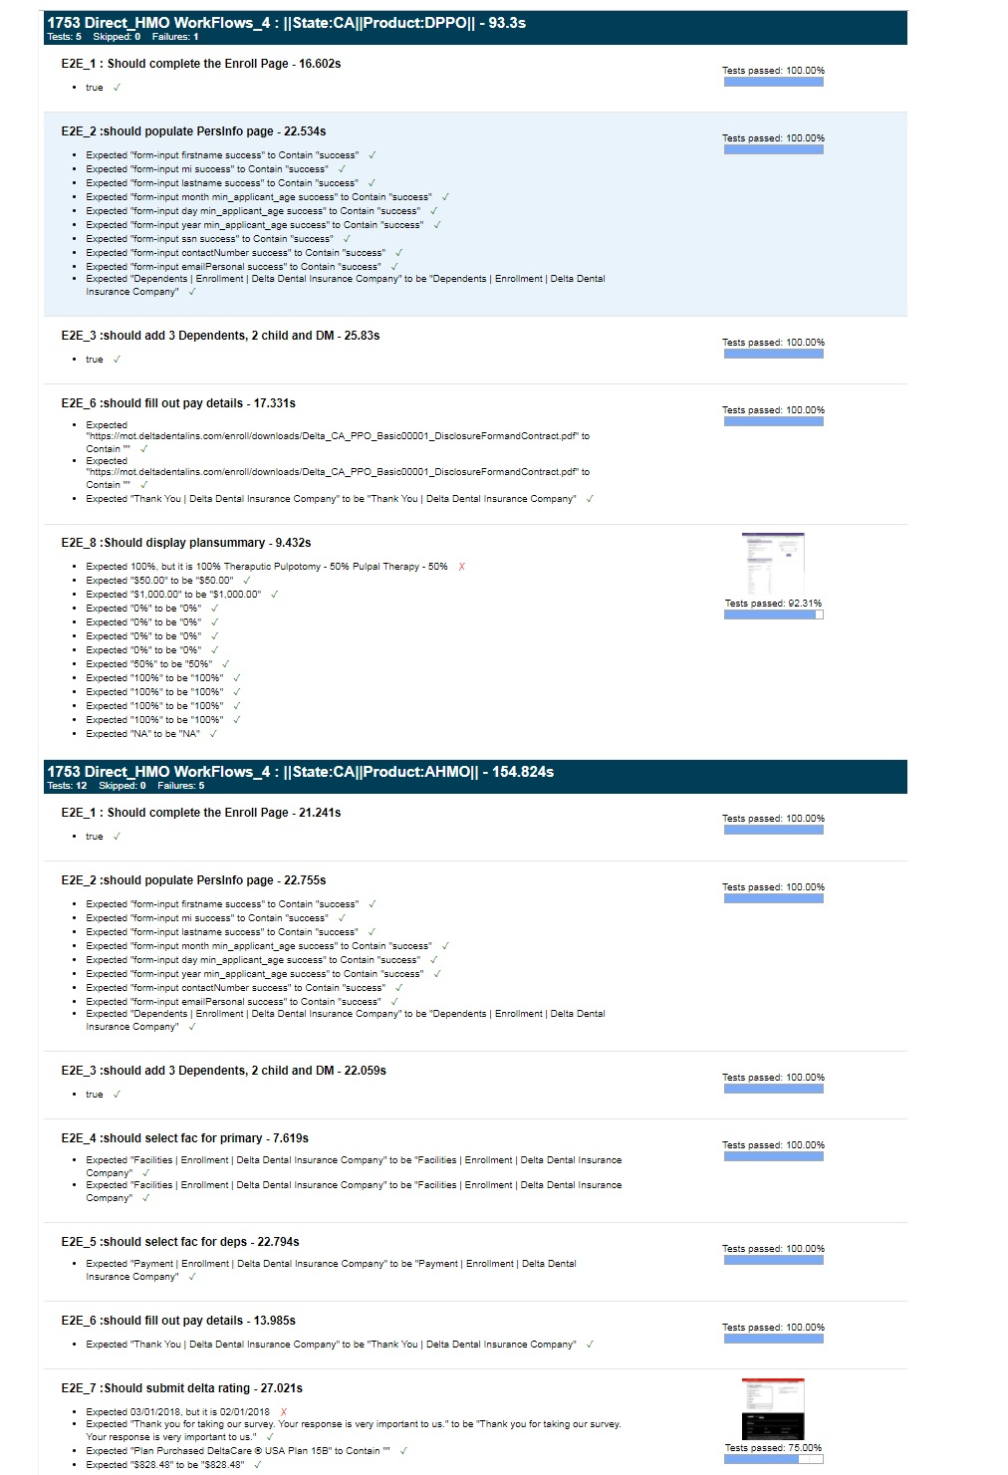
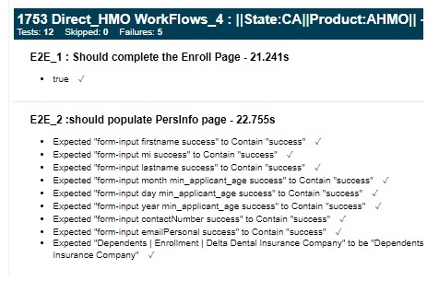
REPORTING
Three levels of reporting
Hyper granular:
Primary for debugging.
Covers every Assert or comparison in Framework
Debugging and Framework Development tool

Slide 13
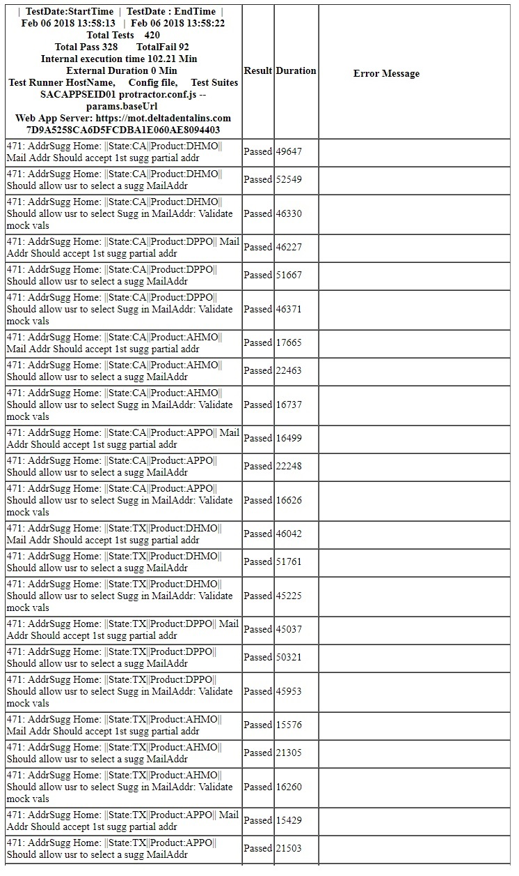
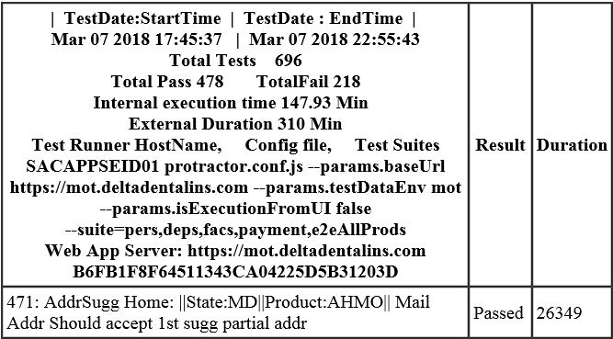
REPORTING
Three levels of reporting
Test Run Specific:
Test Function Pass / Fail
Current Standard test run encompassing test specific data and testRun specifics

Slide 14
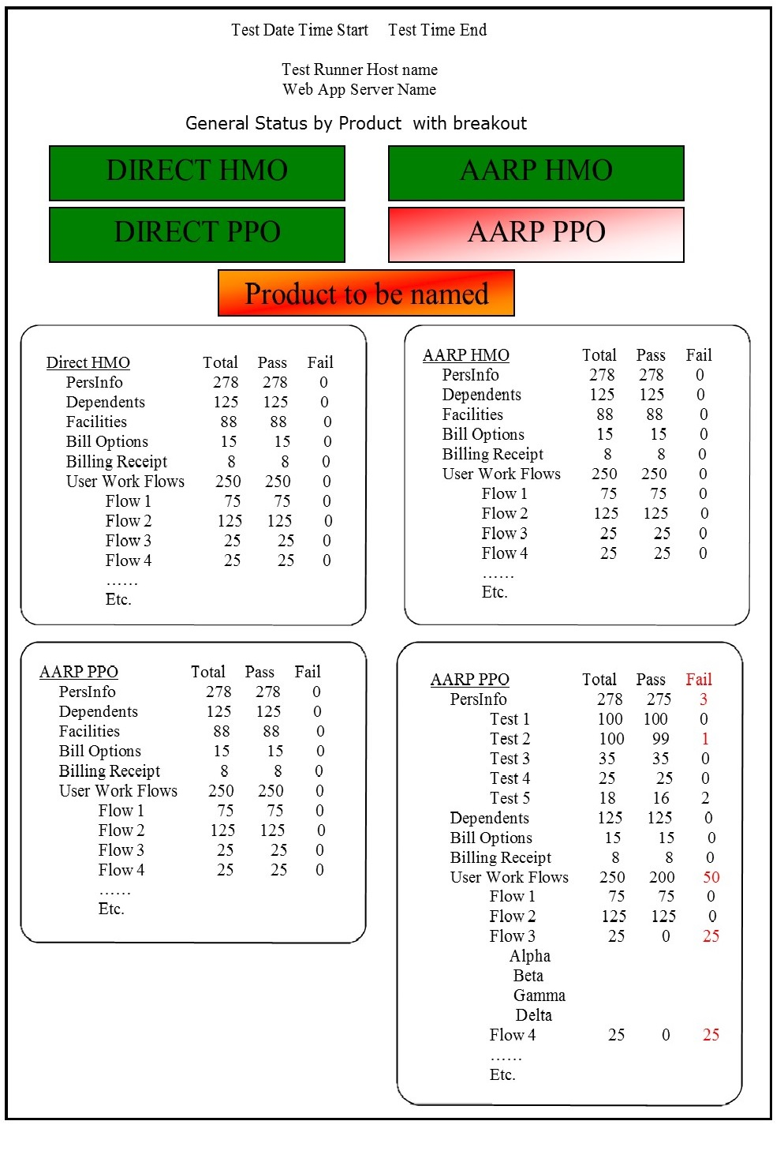
REPORTING
Three levels of reporting
ASPERIAIONAL PRESENTATION
High Level Dashboard
Product Specific:
Go / No-go Product Dashboard
Provides:
Development Managers &
Product Managers A quick look at the current health and capability to ship the product

Slide 15
HOW IT’S BUILT
Git Repo Node.js Protractor JavaScript Jenkins
Framework is Class
Object based
Core base level classes define …common components, Fields, …Buttons, Links
Mid Level: Specific to an Application, ...Collections of bases classes to ...perform Application page specific …action
Script Collection of actions specific to …test actions and methods build up …from Core & Mid Layer components

Slide 16
FUTURE
Refactor mid layer commonality. Move commonality to the bottom Layer.
The smaller the mid layer, the easier to add new capability ( new applications )
Decouple function calls in the upper layer from in the bottom layer and below
Keep calls to Protractor in the mid Layer ( page Objects )
Work in localized well isolated areas. Keep the churn away from the dev engineers
Ability to spin up new application
Adding support for new applications can be accomplished in ~10 working Days
Better Reporting
Test Headless : Trying to overcome CPU and Memory consumption
Mobile devices

Slide 17
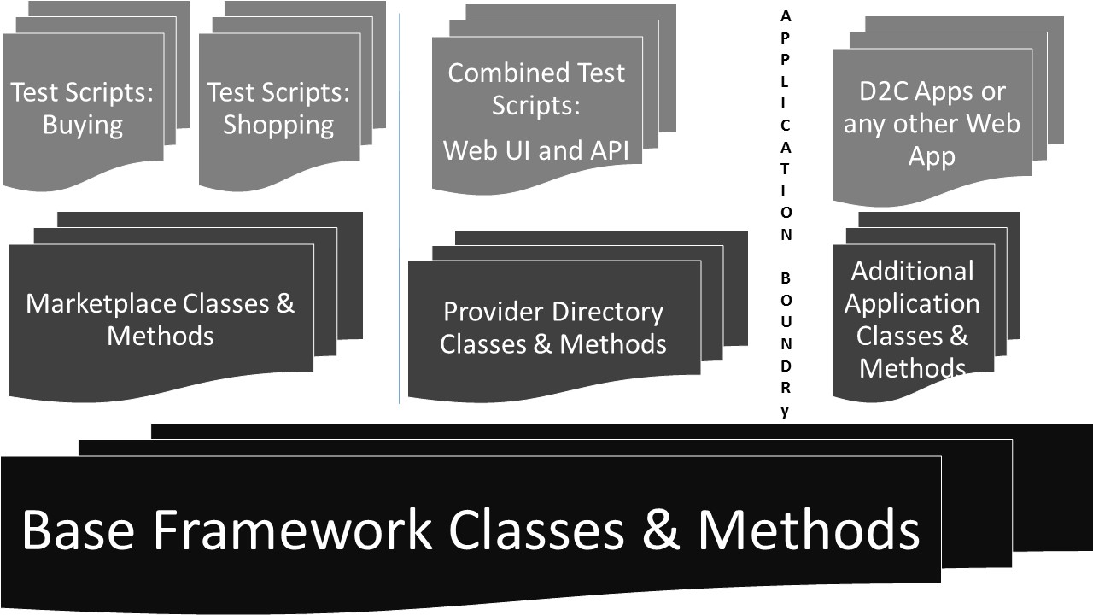
Market Place : Provider Directory : Other Apps Microservice APIs
Appendix:

Slide 18
Appendix:
Seconds
Small 5 %30
Med 15 %50
Large 30 %20
PPO HMO
PPO
One One
State State
AARP 600 TC 1800 TC
AARP + DIR 3600 TC
1800 TC
One State 2Hrs 6 Browsers
Currently
20 States
7 HMO & PPO
13 PPO only

