Slide 1
Test Automation Framework for
NextGen Platform
Mark Atkinson
4/4/18

Slide 2
INTRODUCTION NGTA - Next Generation platform Test Automation
The Test Automation frame work leverages available open source technology
Node, Protractor, JavaScript
NGTA validates product quality, usability and performance of CX Web Applications
NGTA validates core functional APIs( micro service API )
Node.js, Frisby
The following provides an explanation of NGTA , our purpose, technologies, philosophies, process, and our evolutionary plans for 2018 being developed by 2 local staff and 3 off shore staff.

Slide 3
PURPOSE Operational & Functional Process
The Next Generation Test Automation team develops and delivered an automated testing frame work for Delta Dental technology teams ( CX, . . . )
Design with a developmental philosophy that enables seasoned development engineers to create test scripts to validate their own work
Design the Framework with enough power and flexibility to meet current and future needs
Continue iterating on Framework functional improvement

Slide 4
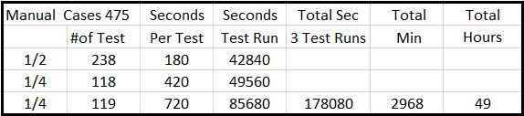
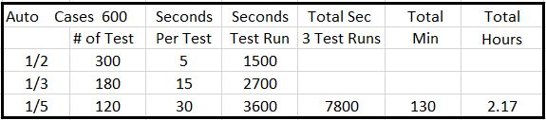
ACCOMPLISHMENTS / EVOLUTION
NGTA and the CX Market Place Development Team have matured since 2016.
We are able to do more and deliver to a greater audience.
To scale as projected
we have to change how we develop tests
we have changed how we select & control execution
Massive reduction in the number of hours Manual VS Automated
A collection of Manual Test Cases
5
DAYS !
A similar collection of Automated Test Cases
2
HOURS !

Slide 5
ACCOMPLISHMENTS / EVOLUTION
Dev staff productivity and confidence
Development frequently comes to NGTA for confidence vote on the product.
Always able to provide within hours a report on product viability
Agile Team operation : Bug fix resolution cycle!
Short turn around on discover, fix , re test cycle
Product Architect claimed at one point, “ That’s why I liked Test Automation so much.” Test Automation ran the same script that forced the problem to the surface and ran identically proving the fix was successful
Increase in number of test points without more code. See Pg. Test Case Numbers
Through implementation of the ‘dataProvider’ technology
Provider Directory testing incorporates novel use of the API scripts
First access REST API and capture data. Then access Provider Directory requesting same information from the Web Interface, Compare results
Micro Service REST API Testing accomplished in same Node.js framework
No need for another product or technology.
We use the same Node.js , Frisby http Library , JavaScript to automate all API calls.

Slide 6
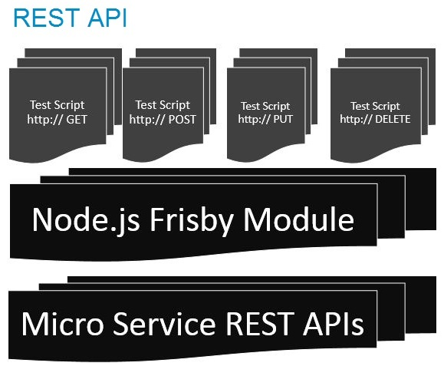
ARCHITECTURAL TECH STACK REST API
Node.js Frisby JavaScript
Persisted data is decoupled
REST API: The philosophical basis of Application Programming Interfaces is to decouple the consumer from the internal workings of the publisher
ACCESS: Engineering will only guarantee to honor an agreed upon Contract where actions will be performed upon receipt of a valid request.
VALIDATION: APIs that effect a change to the persisted data will be published with an API call that can return the new state that was changed.
This is the only acceptable method to validate APIs that change internal state and return status. Any greater access would break the Philosophical Contract

Slide 7
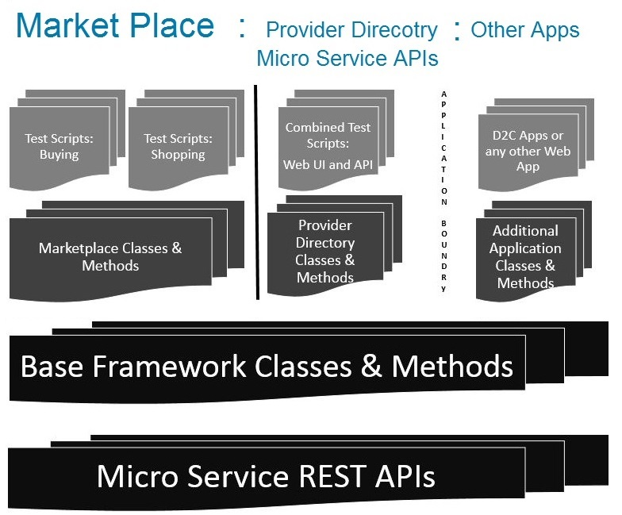
ARCHITECTURAL TECH STACK Market Place
Node.js Protractor JavaScript
Framework is Class
Object based
Scripting : Collection of actions specific to the domain of Test. Built from Core & Mid Layer components
Mid Layer : Actions limited to within the Application, Collections built up from base class methods and Protractor to perform Application specific actions
Core base level classes define common components, Fields, Buttons, Links
Micro Service REST APIs The underlying mechanism for acquiring persisted data yet decoupled from application

Slide 8
TEST EXECUTION
Two basic test execution modes
Schedule Based : Covers Regression Testing MOT - Cron
On Demand : Initiated via a build initiated testing DIT - Jenkins
Configuration controlled testing: Biggest Evolutionary Advance
In order to scale Market Place across states our research required we pull test data out of the test scripts, decoupling execution from configuration. Test data is now separate and usable all delivery phases
All testing regardless of primary mode is configurable prior to test run
Dev Integration tests will uses the configuration model to focus testing on new code
NGTA team can regression test same deployed code w/out stepping on newly developed code
Market Place Regression test & Content test is organized on phased deliveries
Phase_0 CA, TX, PA, FL, NY , Phase_1 DC, LA, MD, PR, TN, VI, AK, AL
Phase_2 DE, GA, MS, MT, NV, UT, WV , Phase_3 CT, IL, OH, WA, KY, MN, NH
Ultimately by Phase_7 we will have coverage across all 50 states and 3 territories

Slide 9
TESTING TYPES
Three primary types of testing
Page level Functional Integration
Static & Functional html element analysis for all pages in all products
Every Button, Field, Check Box, Link, page element is functionally evaluated and error checked
All page level functionality local to a page is executed and evaluated
Application level user work flow : Complete End to End Scenarios
Designated user work flow execution pathways
Extensive repeat execution with large data set Data driven
Micro Service REST APIs
Regression coverage for Micro service REST API
Additionally API testing is used to compare data for testing in CX UI Applications

Slide 10
TEST CASES NUMBERS Market Place
Test case results are the result of functional test written for a product X data points tested against X States Tested in
Phase 0 contains 4 products w/ 393, 478, 387, 442 test cases per product, total 1700 functional tests written. Factoring test data points and the states where the product is deployed the calculation 4 Products tested in 5 states totals 10125 tests
Phase 1 contains 2 products with 387, 442 test cases per product, total 829 functional tests written. Factoring test data points and the states where the product is deployed the calculation 2 Products tested in 8 States totals 4394 tests
Phase 2 contains 1 products with 442 test cases per product, total 442 functional tests written. Factoring test data points and the states where the product is deployed the calculation 1 Product tested in 7 States totals 3234 tests
Phase 3 contains 1 products with 442 test cases per product, total 442 functional tests written. Factoring test data points and the states where the product is deployed the calculation 1 Product tested in 7 States totals 3234 tests

Slide 11
TEST CASES NUMBERS Market Place & APIs
Test case results are the result of functional test written for a product X data points tested against X States Tested in
Phase 0 contains 4 products w/ 393, 478, 387, 442 test cases per product, total 1700 functional tests written. Factoring test data points and the states where the product is deployed the calculation 4 Products tested in 5 states totals 10125 tests
Remaining Phases up to 7 contains less products yet similar numbers of test cases per product
Products tested in a number of States totals of 3200 to 4400 tests
API Tests: Microservice API 185 X 414 data points tests = 76590 possible test

Slide 12
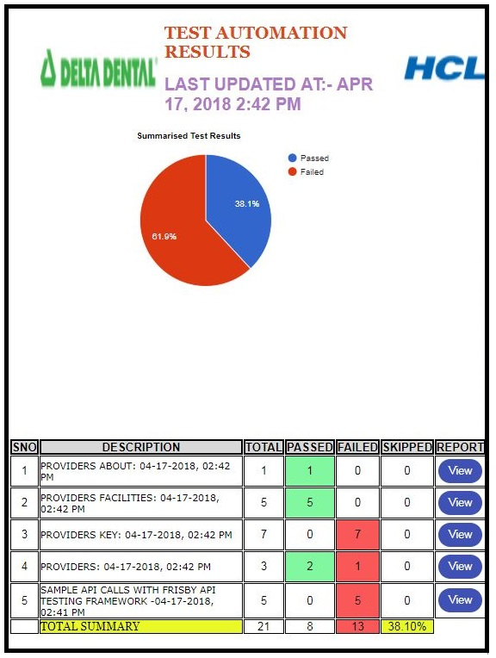
REPORTING
Three Desired levels of reporting
Test Run:
A collection of test cases by state, product, or function.
Case Specific
Very granular, covers every Assert or Compare in a given test case
Is a Key Development tool
Dash Board
Provides a view into the current state of a product w.r.t ship-ability

Slide 13
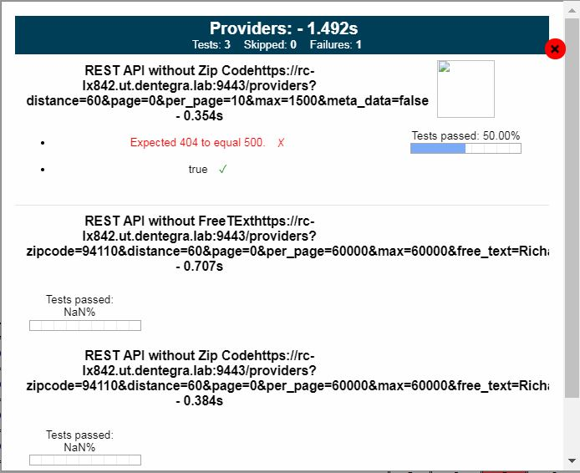
REPORTING
Three levels of reporting
Test Run Specific:
Test Function Pass / Fail
Current Standard test run encompassing test specific data and testRun specifics

Slide 14
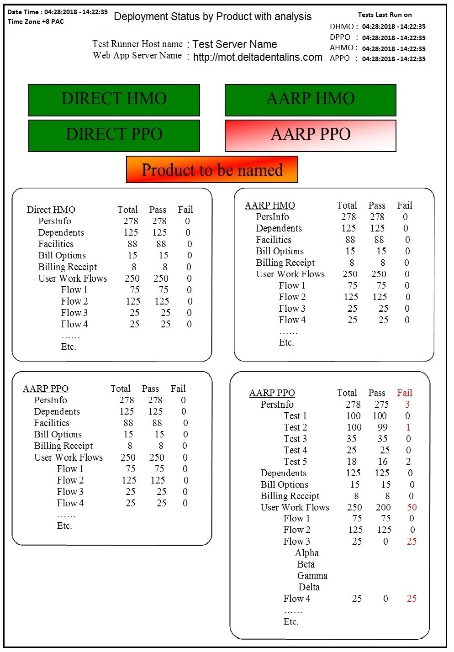
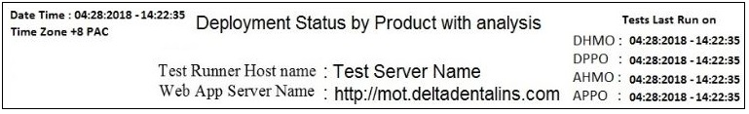
REPORTING
Three levels of reporting
ASPIRATIONAL PRESENTATION
High Level Dashboard
Product Specific:
Go / No-go Product Dashboard
Provides:
Development Managers &
Product Managers A quick look at the current health and capability to ship the product

Slide 15
FUTURE
Roll Out Framework to Development
Refactor Object layer commonality.
Move commonality to the Base Layer.
The smaller the object layer, the easier to add new capability ( new applications )
Improve top of Object layer making more uniform
The smoother the top of the object layer, the easier to write test cases
Decouple function calls in the upper layer from in the bottom layer and below
Keep calls to Protractor in the mid Layer ( page Objects )
Work in localized well isolated areas. Keep the churn away from the dev engineers
Ability to spin up new application
Adding support for new applications can be accomplished in ~10 working Days
Improved Reporting, add a dashboard, provide stasistics
Test Headless : Trying to overcome CPU and Memory consumption
Mobile devices

Slide 16
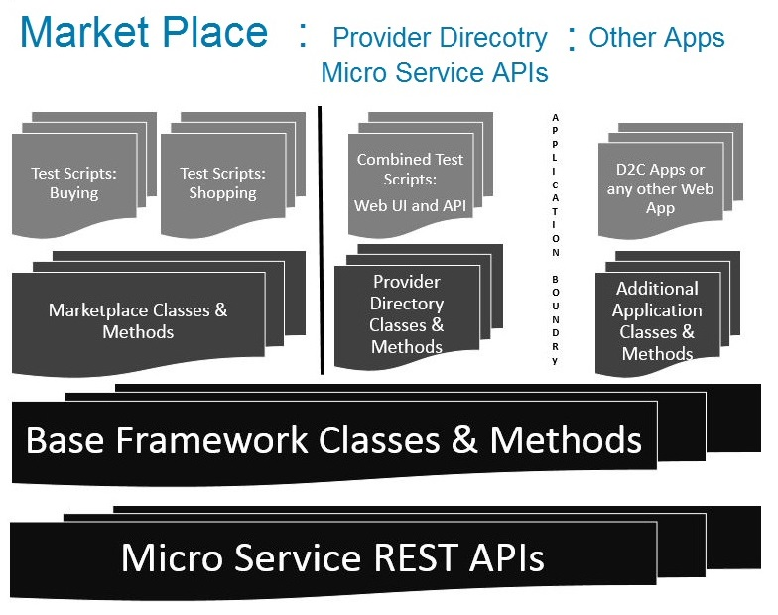
ROLL OUT
NGTA rolling out first public release of Test Automation Framework
Development staff will write test automation scripts supporting their work
This scripting will be page specific feature level integration tests
REST API test scripting covers all basic use and edge case work
NGTA team continues with Use Case End to End test automation
NGTA team continues development of the Test Automation framework
Refactoring the Mid Layer is key to adding more product under test
Development Engineers Focus Attention on this layer for testing
NextGen
Test Automation staff enhance and improve these layers
Dev engineers to develop API validation test scripting. Next Gen Test Auto team to fill out remaining REST API regression tests

Slide 17
ROLES & RESPONSIBILITIES
ROLL OUT
Shopping & Buying Development Engineers
Responsible for all new Page Level Functional Integration Tests
Responsible for correcting all test failures in ../fitmp directory, keeping it completely operational
Provider Directory Development Engineers
Responsible for all new Template level Functional Integration Tests
Responsible for correcting all test failures in the ../fitpd directory, keeping all test operational
Core Technology API Team engineers
Responsible for adding new tests to the REST API regression suite
Responsible for correcting all test failures in the ../fitapi directory, keeping all test operational
NGTA Team engineers
Oversee and manage all Framework development.
Continual frame work improvement, evaluating all need for new coverage
Continually analyze mid layer code
Refactor content from mid layer to the lower common layer
Develop all End to End test automation scripts based on business use cases

Slide 18
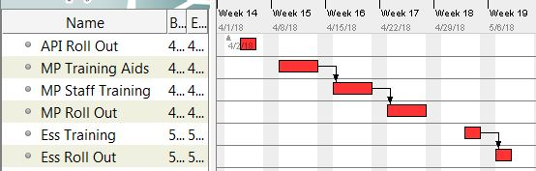
PROPOSED TIME LINE
ROLL OUT
ROLL OUT & ENGINEERING ADOPTION
Refactor mid layer, ensure API is uniform
Write up training aids, examples of installation and configuration
Training staff in the use and operation
Test and debug initial installations
Timing on Roll out
Roll out First week April to the Core Tech Team REST API Test Framework
Roll out to Market place team at the end of April
Roll out to other teams on first or second week of May

Slide 19
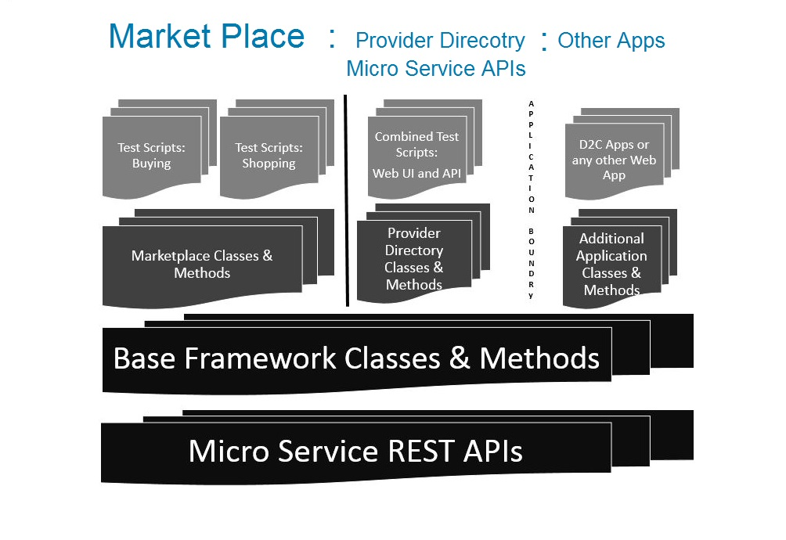
Appendix:

Slide 20
Appendix:
Seconds
Small 5 %30
Med 15 %50
Large 30 %20
PPO HMO
PPO
One One
State State
AARP 600 TC 1800 TC
AARP + DIR 3600 TC
1800 TC
One State 2Hrs 6 Browsers
Currently
20 States
7 HMO & PPO
13 PPO only

