Slide 1
BrainBot
LINK TO CODE
https://drive.google.com/open?id=0B9GA36OV-8nLM1dtbjVoQWQxMzg
Neurosky Mindwave Mobile neurofeedback controlled Arduino based robotic car
Raghav Ravisankar
Astha Mehta

Slide 2
Project Proposal
We want to design a setup that allows one to control the movement of a 3 wheel Arduino based robotic car (chassis) using a Neurosky headset.
At a basic level, we want to use the attention measure to accelerate the car (the higher the attention, the greater the acceleration).
Stretch Goal:
We intend to use the meditation, alpha and beta measures to display the emotional condition of the user on a color range from red, blue, green
We could use motor imagery using methods to compute direction

Slide 3
Things that you need
ThinkGear Neurosky Mindwave Mobile
Makeblock mBot (Arduino-based)
A Windows 8.1 + or Mac OS X computer with Bluetooth connection
Set up with the environment
Arduino IDE
Python 2.7 and some basic knowledge of python syntax
Thinkgear consider 0.1.1 python library - parser
Python Arduino Command API
Pyserial 3.3

Slide 4
Basic organization of project
mBot Arduino based robot with bluetooth
Arduino controls
Computer with bluetooth connection
getdata
ThinkGear Mindwave Mobile
parse
Arduino script to control robot
Serial
Port
Brain wave parser
Arduino control
ROBOTIC CAR
HEADSET

Slide 5
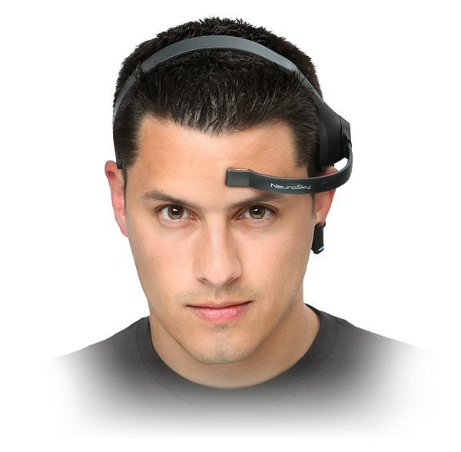
ThinkGear Mindwave Mobile
Attention and Meditation eSense measures
eSense is computed with a wide spectrum of brain wave in both time and frequency domains, including alpha and beta wave.
The attention meter emphasis on beta wave
The meditation meter emphasis on alpha wave.
It is designed to allow any person to control for entertainment purpose only.

Slide 6
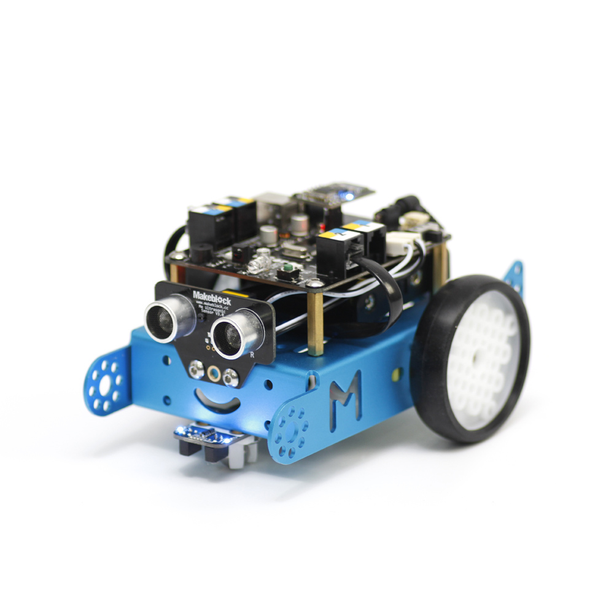
Makeblock mBot

Slide 7
Makeblock mBot (Arduino based)
Attention measure 25<A<50
Motor Speed = 80
Attention measure 50<A<75
Motor Speed = 150
Attention measure
75<A<100
Motor Speed = 200
Attention measure
A < 25
Motor Speed = 0

Slide 8
Bluetooth serial ports
Both the ThinkGear MindWave Mobile and the Arduino based mBot have a bluetooth connector to which we can communicate using serial ports
Serial ports: Oldest piece of computer technology that transmits data, been there for over 20 years: our USBs work on serial ports too!
Here we are using Bluetooth serial ports to connect to an Arduino based bluetooth serial port and to the thinkgear connector

Slide 9
Pyserial documentation
http://pyserial.readthedocs.io/en/latest/shortintro.html
Helps us connect our computer to any device with a serial port
Connects to bluetooth as a virtual serial port to get information from the headset
Provides interface that allow us to send Arduino commands to the mBot to make it move

Slide 10
ThinkGear consider 0.1.1 library
https://github.com/lanius/consider
Not proprietary because we couldn’t connect to the thinkgear with Neurosky connectors
Uses pyserial and threading python libraries to parse the information coming from serial bluetooth connection for ThinkGear into the correct measures
Allows us to easily obtain measures from the headset without much hassle!
Consider.packetgenerator().<measure>() -> value of <measure>

Slide 11
The consider 0.1.1 library class structure
C = Consider() #Creates Serial object with required port and Baudrate
P = c.packetgenerator() #Loops consistently getting packets of data from the thinkgear headset
Parses the data to get information of data set
p.attention() -> attention measure
p.meditation() -> meditation measure

Slide 12
EEG Bandwaves and corresponding measures
Delta: 1-3Hz -> Consider.packagegenerator().delta()
Theta: 4-7Hz -> Consider.packagegenerator().theta()
Alpha1: 8-9Hz -> Consider.packagegenerator().low_alpha()
Alpha2: 10-12Hz -> Consider.packagegenerator().high_alpha()
Beta1: 13-17Hz -> Consider.packagegenerator().low_beta()
Beta2: 18-30Hz -> Consider.packagegenerator().high_beta()
Gamma1: 31-40Hz -> Consider.packagegenerator().low_gamma()
Gamma2: 41-50Hz -> Consider.packagegenerator().high_gamma()

Slide 13
Other methods in Consider library in use
packetgenerator.Poor_signal() # Tells us if our signal is too weak
connect() #Starts connection
Consider.isRunning = boolean # Allows us to continue running connection or stop getting data from the headset
Closing the python application using KeyBoard Interrupt closes the program and sends Consider object to garbage collector

Slide 14
Python Arduino Command API
Allows us to send commands to Arduino through python
This API is used for us to be able to connect to a specific Arduino serial port
We do not use this implementation but this library allows us to use our arduino_controls.py
https://github.com/thearn/Python-Arduino-Command-API

Slide 15
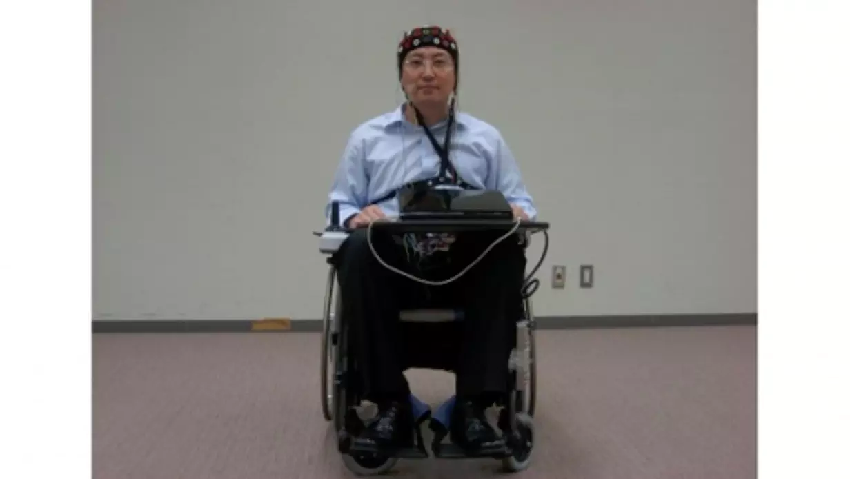
Practical applications
EEG controlled robot with puff detector to stop movement
Designed for people with severe disabilities, the Toyota/RIKEN wheelchair is fitted with an EEG detector in the form of a electrode array skull cap, a cheek puff detector and a display that assists with control. To turn left, right and move forward, the driver simply thinks about the movement and the wheelchair instantly and seamlessly responds. To stop the wheelchair, the driver puffs his/her cheek. A detector on the face picks up the signal and immediately stops the wheelchair. This form of braking is necessary for safety reasons as a puff detector is more reliable than the EEG reader.
http://newatlas.com/toyota-wheelchair-powered-brain-waves/12121/

Slide 16
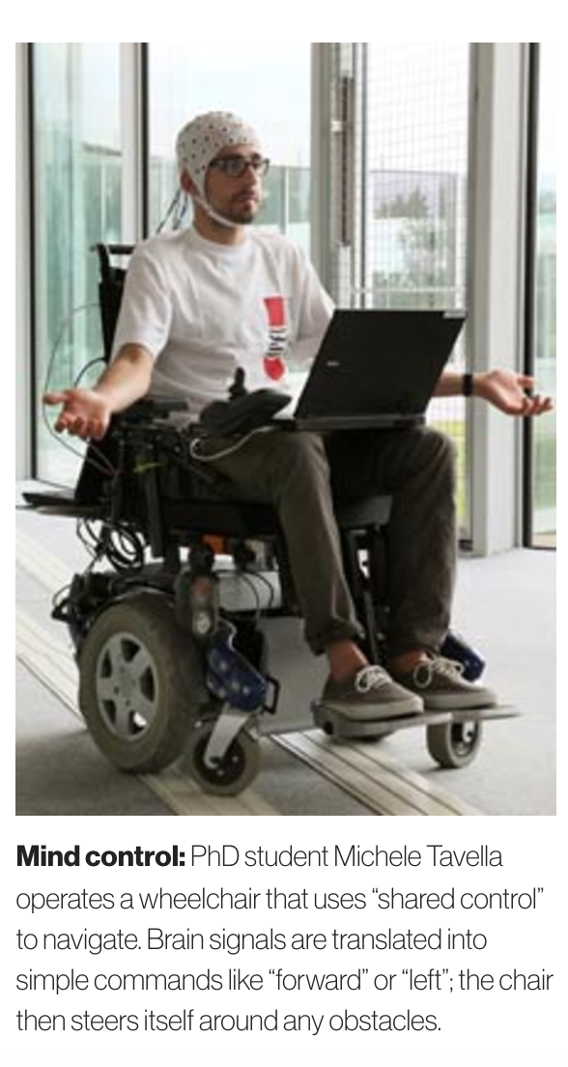
Practical applications
Brain controlled robot with obstacle avoidance
https://www.technologyreview.com/s/420756/wheelchair-makes-the-most-of-brain-control/
The wheelchair, developed by researchers at the Federal Institute of Technology in Lausanne, features software that can take a simple command like “go left” and assess the immediate area to figure out how to follow the command without hitting anything. The software can also understand when the driver wants to navigate to a particular object, like a table.

