Slide 1
My Project Task
I have created a web App

Slide 2
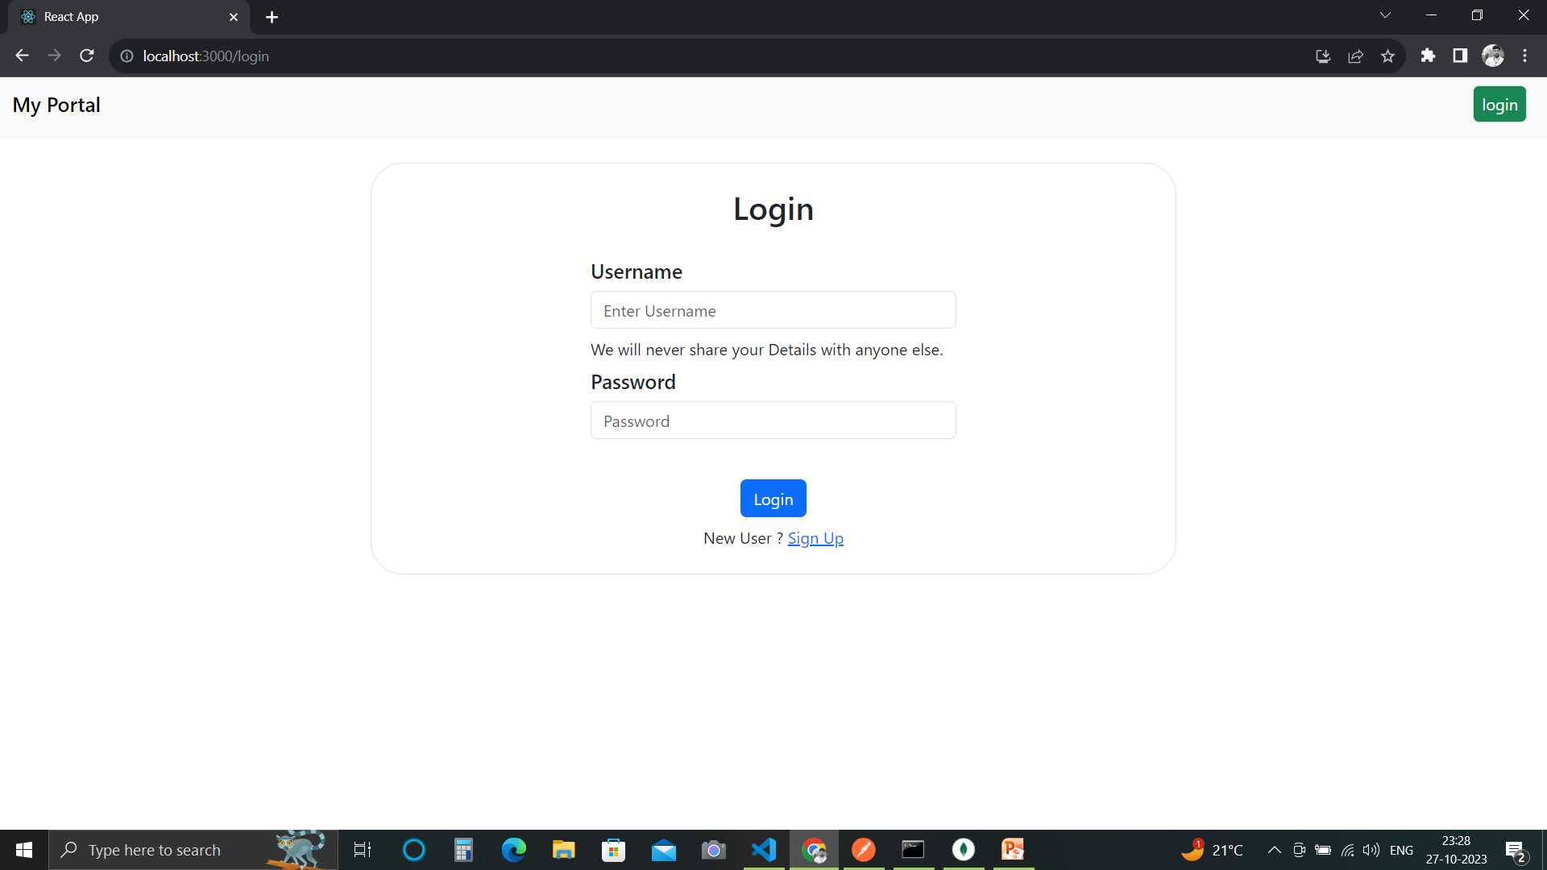
Login Page

Slide 3
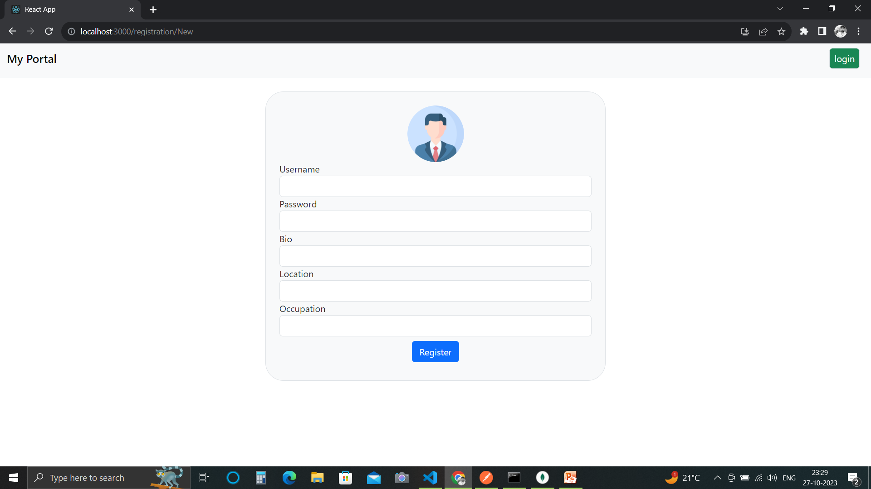
Registration Page

Slide 4
Server Info
Here I have used ,jwt token strategy with passport-jwt.
I have used mongoDB for storing user data.
Server is sending jwt token to app and I am storing it on local storage.
In edit profile I am getting some problem.

Slide 5
App Info
I have created five pages which are-
LoginPage,RegistrationPage,MyDetails,HomePage.
They are working except editing.
Profile picture can be changed but I am getting problem while sending to server.

