Slide 1


Topic: Data Modelling with Semi-Structured Data Over WebPages Using Document Store
1 N.Jagadeesh
2 V.Raghavendra
3 V.Aakash
4 Ch.Raghavendra
5 E. Shankar

Slide 2
Modules
Data
modelling
01
Semi
Structured
data
02
Document
store
03

Slide 3
What is Data Modelling?
Data modeling is the process of creating a visual representation of either a whole information system or parts of it to communicate connections between data points and structures. The goal is to illustrate the types of data used and stored within the system, the relationships among these data types, the ways the data can be grouped and organized and its formats and attributes.
A data model can be thought of as a flowchart that illustrates data entities, their attributes and the relationships between entities. It enables data management and analytics teams to document data requirements for applications and identify errors in development plans before any code is written.

Slide 4
Types of Data Modelling
1. Conceptual data model: This is a high-level visualization of the business or analytics processes that a system will support. It maps out the kinds of data that are needed, how different business entities interrelate and associated business rules.
2.Logical data model: Logical data models show how data entities are related and describe the data from a technical perspective. Once a conceptual data model is finished, it can be used to create a less-abstract logical one.
3. Physical data model: Physical models are specific to the database management system (DBMS) or application software that will be implemented. They define the structures that the database or a file system will use to store and manage the data. That includes tables, columns, fields, indexes, constraints, triggers and other DBMS elements.

Slide 5
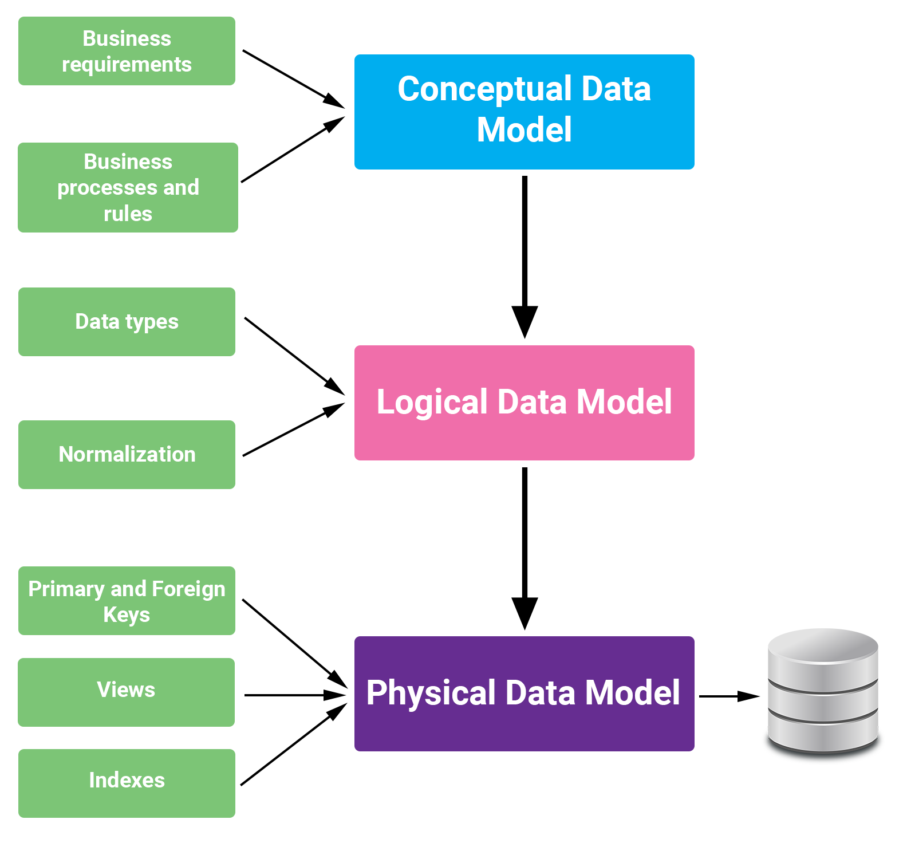
Types of Data Modelling

Slide 6
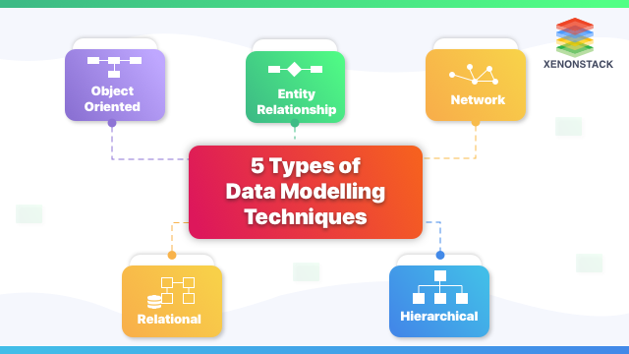
Data Modelling Techniques

Slide 7
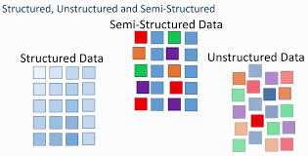
Types of Data

Slide 8
What is Semi-Structured Data?
Semi-structured data is a type of data that is not purely structured, but also not completely unstructured. It contains some level of organization or structure, but does not conform to a rigid schema or data model, and may contain elements that are not easily categorized or classified.
semi-structured data can be more challenging to work with than strictly structured data, it offers greater flexibility and adaptability, making it a valuable tool for data analysis and management.
It is the data that does not reside in a rational database but that have some organizational properties that make it easier to analyze. With some processes, we can store them in the relational database.

Slide 9
Sources of semi-structured Data
E-mails
XML and other markup languages
Binary executables
TCP/IP packets
Zipped files
Integration of data from different sources
Web pages

Slide 10
Examples for Semi-Structured Data
CSV
The three main languages used to interact or transfer data from a web server to a client are CSV, XML, and JSON (i.e., computer, Smartphone, etc.).
HTML
HTML or "Hyper Text Markup Language" is a hierarchical language, and it is similar to XML but unlike XML. HTML is used to create websites and visualize information. The commentaries used to display text and images on a computer screen provide the semi-structure of HTML, but the text and images themselves are unstructured.

Slide 11
Examples for Semi-Structured Data
Web Pages
Web pages are designed to be easily accessible with tabs like Home, About Us, Blog, Contact, and so on, or links to other pages within the text, to help users find the information they need. Of course, this is all authored in HTML, but we don't see that on the computer monitor. And the text and data on each of these pages are unstructured.
NoSQL Databases
Non-relational databases are commonly referred to as NoSQL ("not only structured query language" or "non SQL") databases, with the most common types being document, key-value, wide-column, and graph. They are versatile data storage devices because they can store both structured and unstructured data.

Slide 12
Document Store
A document store database (also known as a document-oriented database, aggregate database, or simply document store or document database) is a database that uses a document-oriented model to store data.
Document store databases store each record and its associated data within a single document. Each document contains semi-structured data that can be queried against using various query and analytics tools of the DBMS
document databases are similar to key-value databases in that, there’s a key and a value. Data is stored as a value. Its associated key is the unique identifier for that value.
The difference is that, in a document database, the value contains structured or semi-structured data. This structured/semi-structured value is referred to as a document.

Slide 13

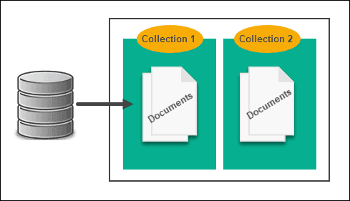
Document Store

Slide 14
Applications of Document Store
Web Applications
Catalog Data
Gaming
Networking/computing
User Generated Content

Slide 15
Examples of Document Store
MongoDB
DocumentDB
CouchDB
MarkLogic
OrientDB

