Slide 1
EXPOSYS DATA LABS Data science – Customer Segmentation Project
PPT by –
Name: Masabathula V S Raghavendra Rao
Internship stream chosen: Data Science/AI/ML
Topic: Customer Segmentation
Branch: CSE
College: National Institute of Technology-Andhra Pradesh.
email: iamraghava.22@gmail.com
Phone: 9390255829

Slide 2
What is customer segmentation and why we need it
A good understanding of customers is very essential for successful run of a business
Customer segmentation is the process of separating your customers into groups based on their interests and habits, so that each group can be treated effectively and with ease.
Segmentation offers a simple way of organizing and managing your company’s relationships with your customers.
There are a number of other reasons why customer segmentation is so important. Here are some of the things this process can help your business accomplish:
We can efficiently target a group of customers at a time, instead of looking at each customer individually.
Learning about your customers on a deeper level so you can tailor your content to their unique needs and challenges.
And many more….!

Slide 3
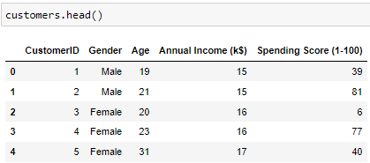
Our dataset and how we perform customer segmentation
Here is the imported dataset :
We will perform customer segmentation in the following steps :
First perform feature engineering on the data.
Then create Machine Learning models and train/fit them with the customers data we have.
Now, we will predict the cluster_labels of all the customers we have.
These labels are stored in the dataframe and are used to visualize customers of different clusters, and treat them separately.
Lets see how this is done using machine learning models.

Slide 4
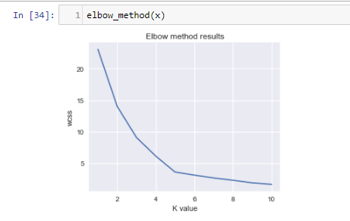
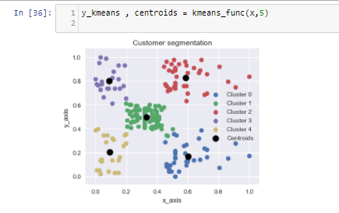
Segmentation using different Machine learning models
Using KMeans clustering algorithm :
Assume that we have calculated optimal number of clusters using elbow method.
We initialize the k cluster centroids , then find all the nearest data points to each cluster centres.
Now we have cluster labels, but not optimized.
We will calculate the new centroids for each cluster, and again find the nearest data points to it.
We repeat this process iteratively until the position of the new centroids do not change.
The figure is a scatter plot after our model has predicted the cluster labels.

Slide 5
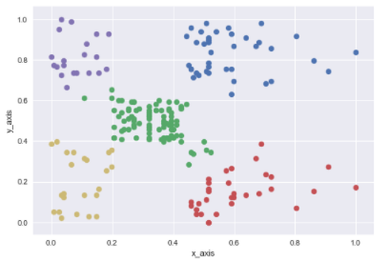
Using Hierarchical clustering algorithm:
We have n data points. So, we have n clusters initially.
Calculate the centroids ci of each cluster.
Find the nearest clusters and make them as a single cluster.
Calculate the new centroids for the new clusters formed.
Repeat the previous 2 steps iteratively until we remain with k clusters.
The figure is a scatter plot after our model has predicted the cluster labels.

Slide 6
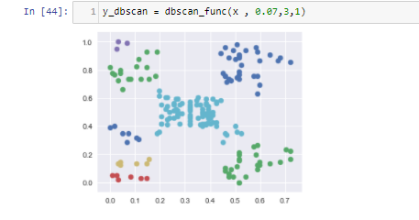

Using DBSCAN clustering algorithm:
Select a point from the dataset.
Provide the parameters - epsilon, min_samples
Match all the reachable points and check whether a point falls under core point category, border point category, or noise point category.
Classify each point into one of these three categories until there are no points are reachable.
So this is the end of calculating 1 cluster.
Now pick up any one point from the data which is not clustered.
Repeat the steps 3,4,5 until there are no points left those are not clustered in the dataset.
Get all the labels of each customer, which denotes the customer's cluster.
Now save these labels in the data frame and use them to treat the customers effectively
The figure is a scatter plot after our model has predicted the cluster labels.

Slide 7
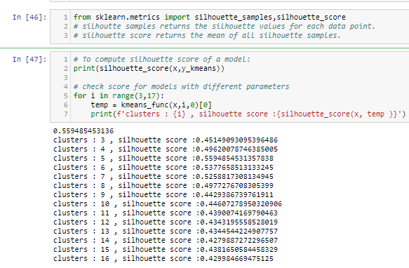
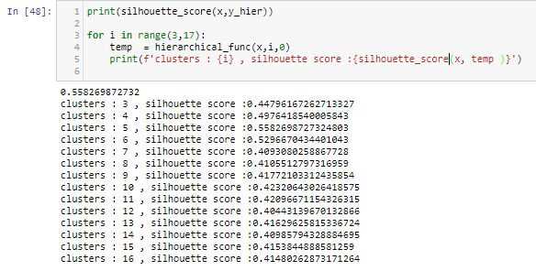
Silhouette Validation technique and finding best model
It is used to find/Check/Validate whether the chosen number of clusters for a specific model is correct and optimal or not.
Calculating silhouette score for KMeans for different values of clusters:
Calculating silhouette score for Hierarchical for different values of clusters:

Slide 8
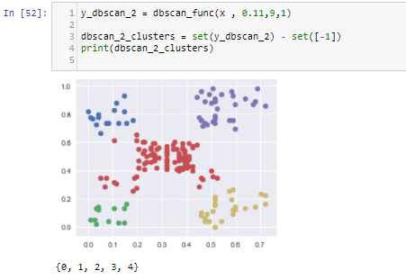
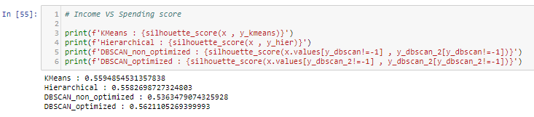
Calculating silhouette score for DBSCAN model:
Finding the BEST model:
Simple find the model with highest silhouette score. Now among KMeans and Hierarchical models, for all combinations of input data points, the silhouette score is more for the KMeans Model.
So, the best model for this customer segmentation dataset is KMeans Clustering Model.
The labels outputted by this model is considered ultimately.
DBSCAN model after Hyper parameter tuning:

Slide 9
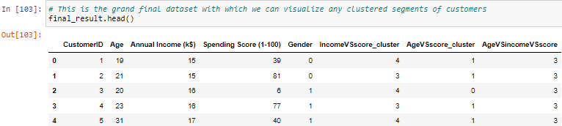
Our final dataset
We have found out the best model, which has high silhouette score, and using this model, we predict the cluster labels, save these labels in the data frame and then visualize the data.
Till now I have only discussed that I have calculated the cluster labels for the data: Annual VS Income.
But I also have done clustering based on 2 other meaningful combinations.
They are: Age VS score, and Age VS Income VS score.
So finally, we get three columns of cluster labels.
The final dataframe we have now is :

Slide 10
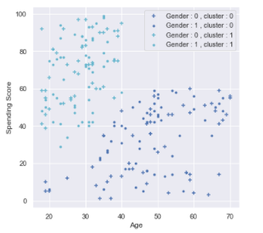
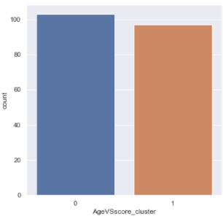
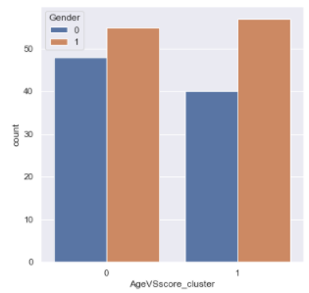
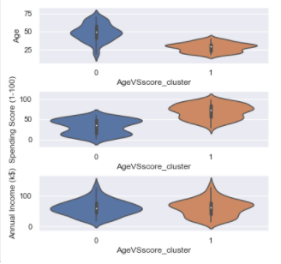
Visualize and analyse the clusters.
Now we got clusters of the customers corresponding to various combinations of features. Now using these cluster labels, we visualize the data and hence we can market each group effectively.
Visualizing the clustered data for the plot: Age VS Spending score:

Slide 11
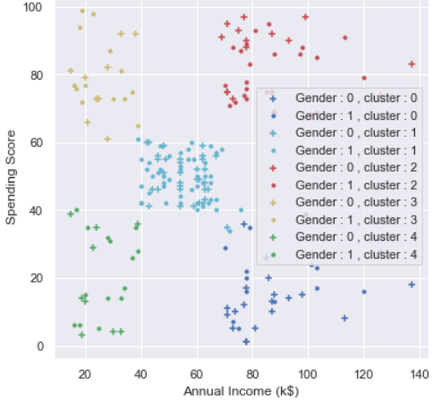
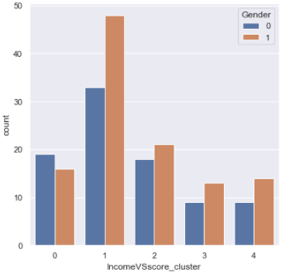
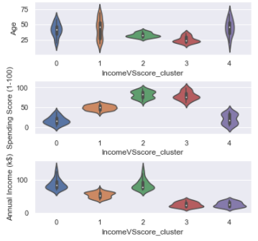
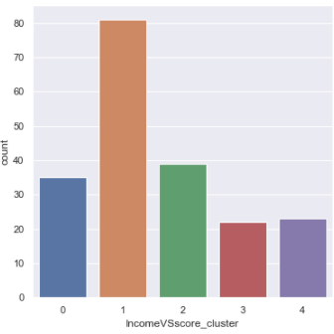
2. Visualizing the clustered data for the plot: Annual Income VS Spending score:

Slide 12
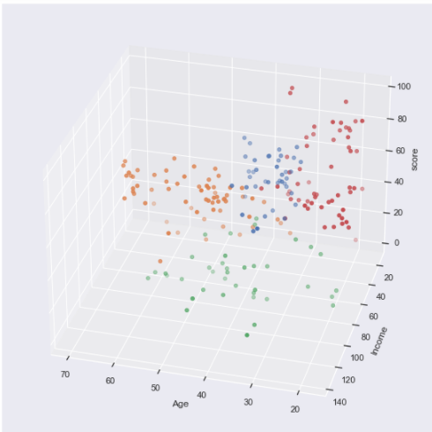
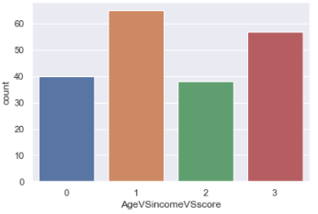
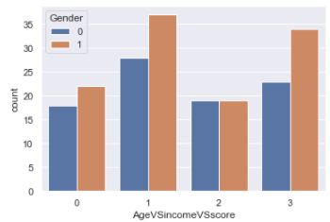
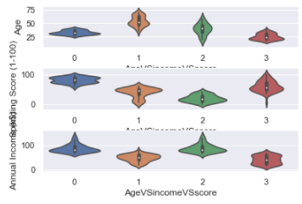
3. Visualizing the clustered data for the plot: Age VS Annual Income VS Spending score:

Slide 13
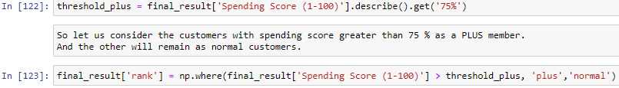
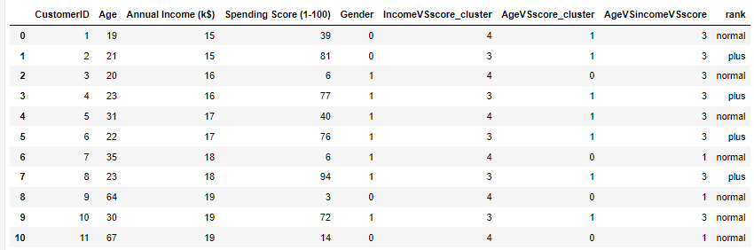
Rank the customers based on the spending scores

Slide 14
Treating different customers effectively
Now we have also visualized the data, so let’s take one of those cluster columns, and find out what should we do in order to perform an effective marketing.
Let’s take example of cluster: Income VS score.
The scatter plot for this is:
Let’s do a small analysis which is useful and meaningful.
Let’s say, our Aim is to increase the spending score. We have to look at the clusters which has less spending scores. Clusters 0,4 has very less spending score.
Treating cluster 0 (violet colored cluster): The customers of these cluster have reasonable annual income, so there is no problem of financial shortage here. We can make them spend more money on our products buy sending more notifications on our products, and making more attractive deals.
Treating cluster 4 (green colored cluster): On the other hand, the customers of this cluster has less annual income. So, they can’t spend more money at a time. The solution to increase the spending scores of this category is to offer more discounts and offers than usual.
So, this is a small analysis I have done to increase the spending scores of the customers in order to improve the business and marketing strategy.

Slide 15
Summary
Therefore, I want to conclude that, with the help of customer segmentation, we can market each group effectively and with ease, providing and satisfying the customers with appropriate needs.
This is the PPT for my project on Data Science project - Customer Segmentation.
Thankyou Exposys Data Labs for this opportunity.
PPT by : Masabathula V S Raghavendra Rao

