Slide 1
What is NodeJS?
A JavaScript runtime environment running Google Chrome’s V8 engine
  a.k.a. a server-side solution for JS
  Compiles JS, making it really fast
Runs over the command line
Designed for high concurrency
  Without threads or new processes
Never blocks, not even for I/O
Uses the CommonJS framework
  Making it a little closer to a real OO language

Slide 2
Concurrency: The Event Loop
Instead of threads Node uses an event loop with a stack
Alleviates overhead of context switching

Slide 3
Var vs CONST vs LET
Var can be re-declared and updated
Acts within scope
Let is block scoped
Can be updated but not redeclared
Const cannot be updated nor be redeclared

Slide 4
Threads VS Event-driven
Threads | Asynchronous Event-driven
Lock application / request with listener-workers threads | only one thread, which repeatedly fetches an event
Using incoming-request model | Using queue and then processes it
multithreaded server might block the request which might involve multiple events | manually saves state and then goes on to process the next event
Using context switching | no contention and no context switches
Using multithreading environments where listener and workers threads are used frequently to take an incoming-request lock | Using asynchronous I/O facilities (callbacks, not poll/select or O_NONBLOCK) environments

Slide 5
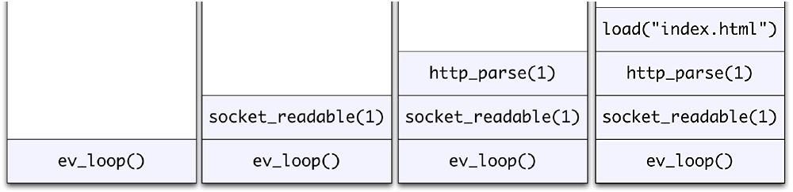
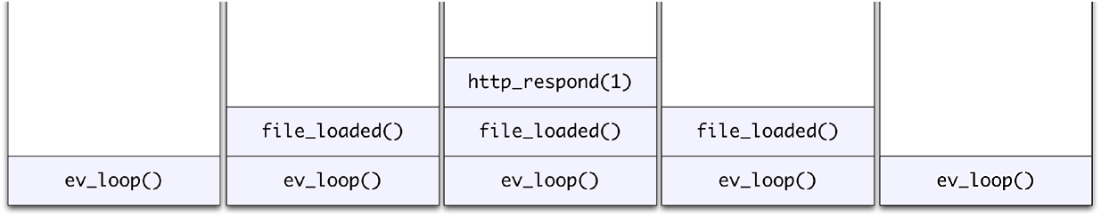
Event Loop Example
Request for “index.html” comes in
Stack unwinds and ev_loop goes to sleep
File loads from disk and is sent to the client

Slide 6
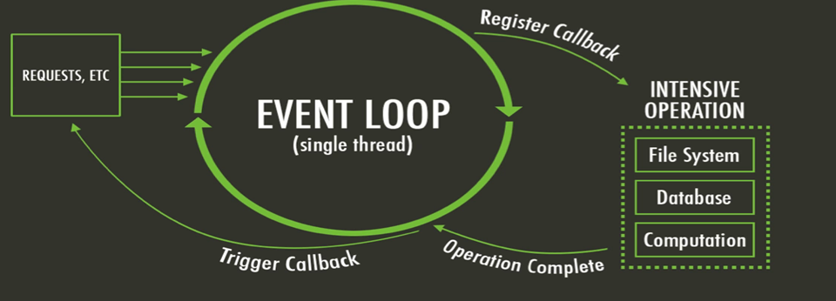
LOOP

Slide 7
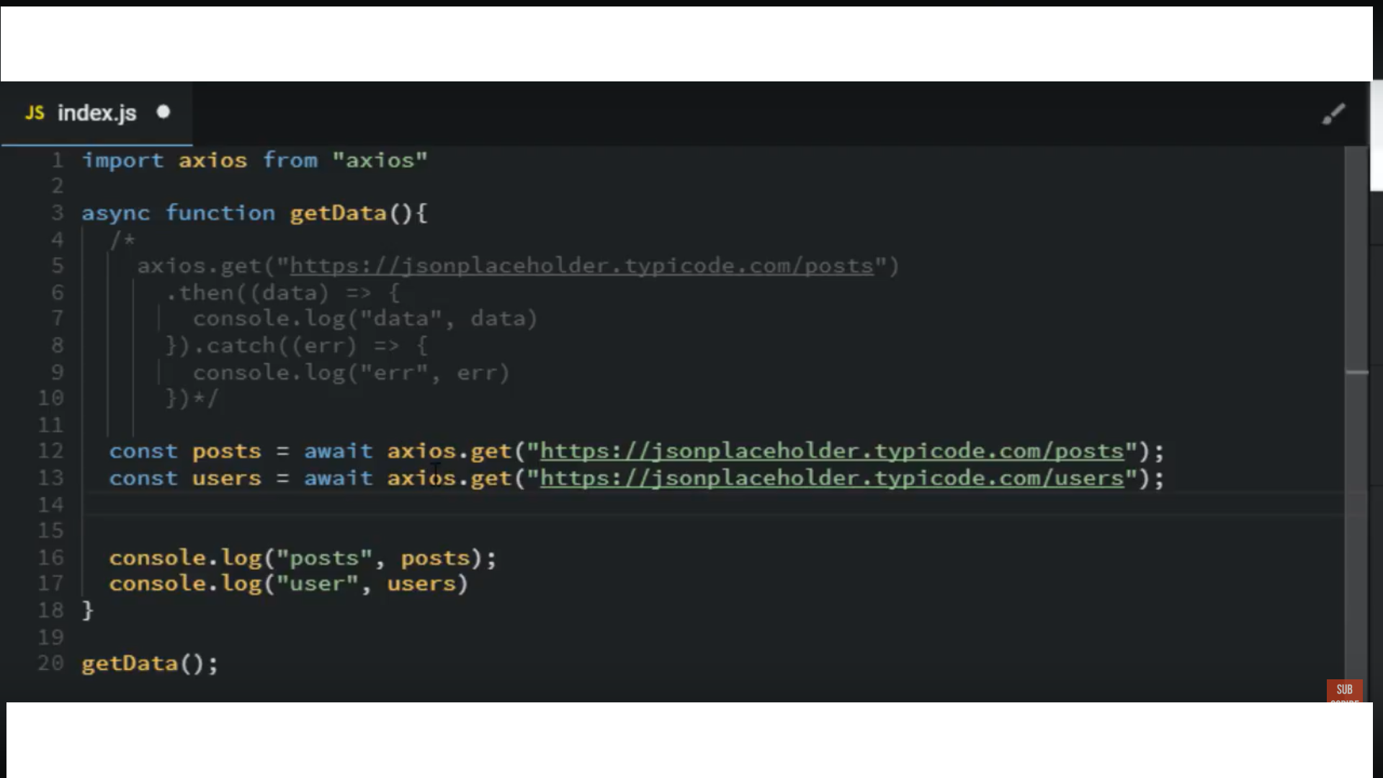

Slide 8
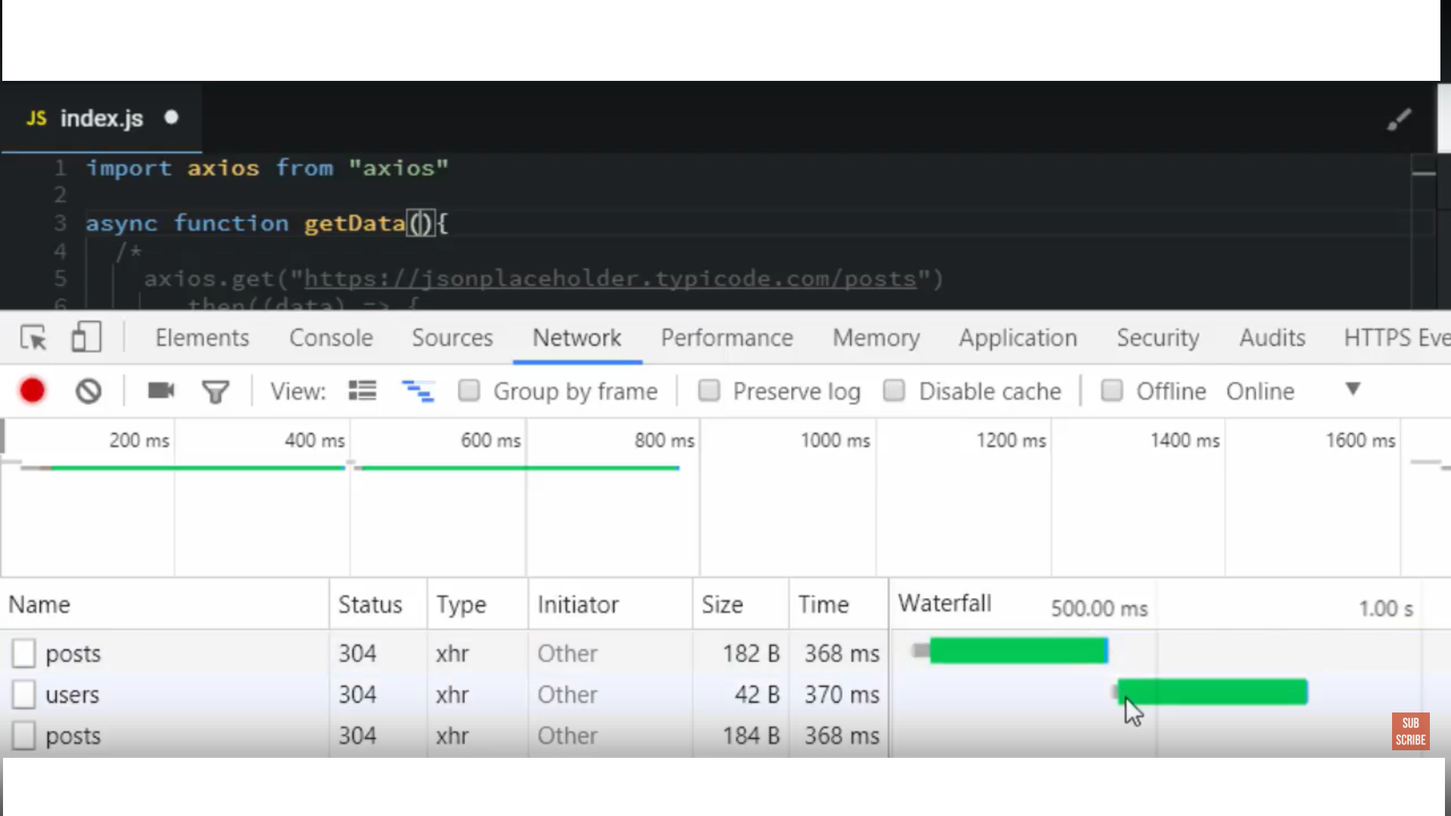

Slide 9
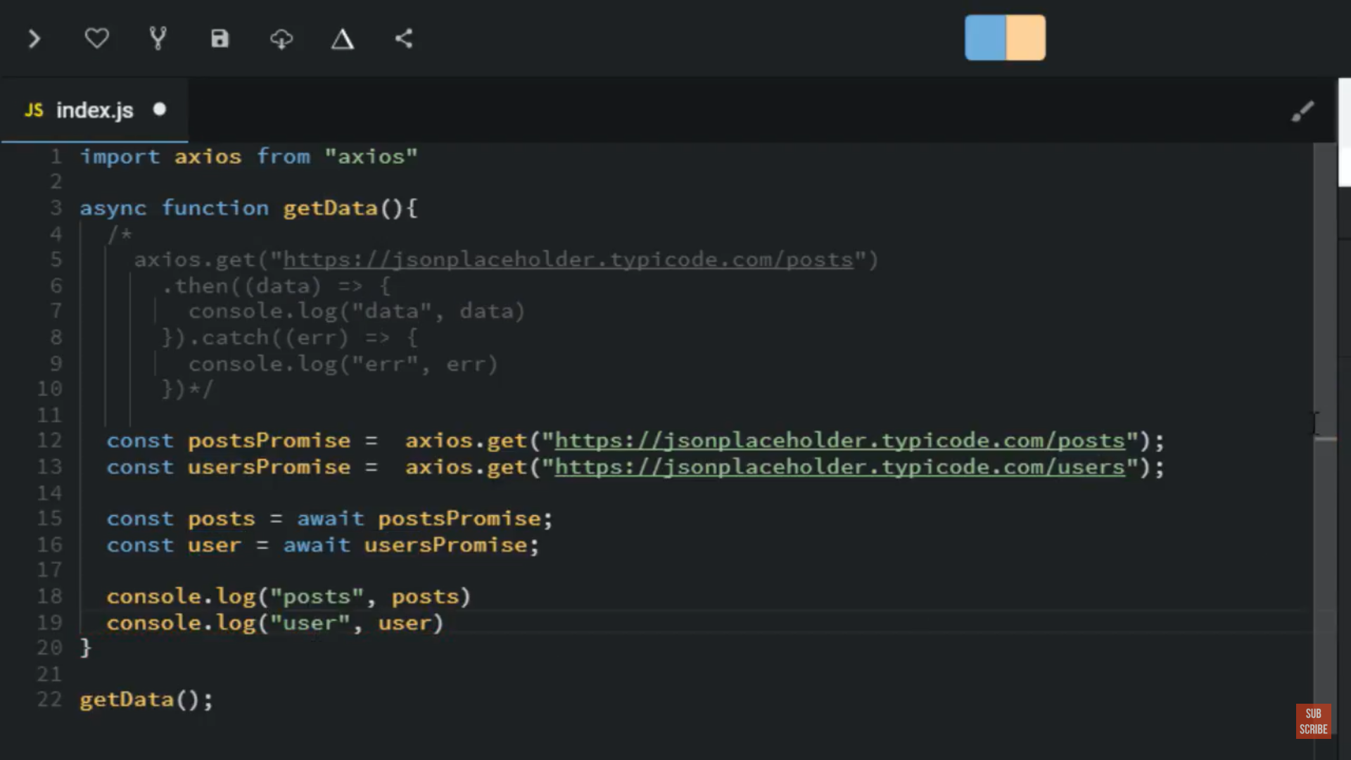

Slide 10
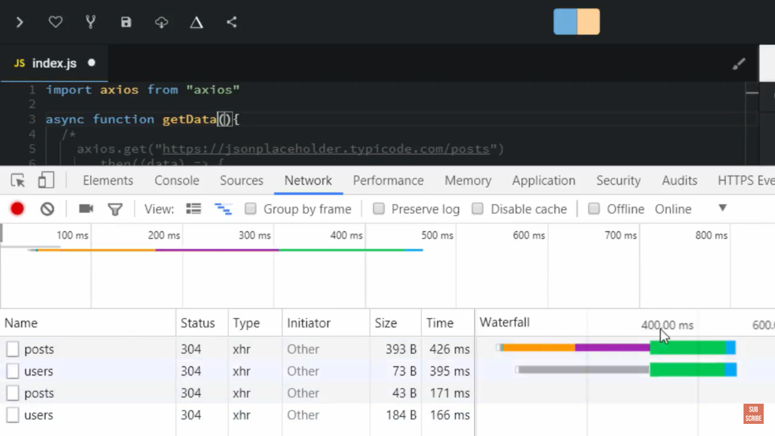

Slide 11
What can’t do with Node?
Node is a platform for writing JavaScript applications outside web browsers. This is not the JavaScript we are familiar with in web browsers. There is no DOM built into Node, nor any other browser capability.
Node can’t run on GUI, but run on terminal

Slide 12
Non-blocking I/O
Servers do nothing but I/O
  Scripts waiting on I/O requests degrades performance
To avoid blocking, Node makes use of the event driven nature of JS by attaching callbacks to I/O requests
Scripts waiting on I/O waste no space because they get popped off the stack when their non-I/O related code finishes executing

Slide 13
Consistancy
Use of JS on both the client and server-side should remove need to “context switch”
  Client-side JS makes heavy use of the DOM, no access to files/databases
  Server-side JS deals mostly in files/databases, no DOM
    JSDom project for Node works for simple tasks, but not much else

Slide 14
Node.js VS Apache
  It's fast
  It can handle tons of concurrent requests
  It's written in JavaScript (which means you can use the same code server side and client side)
Platform | Number of request per second
PHP ( via Apache) | 3187,27
Static ( via Apache ) | 2966,51
Node.js | 5569,30

Slide 15

Supports HTTP Method……
● GET
● POST
● PUT
● DELETE

Slide 16
When to use it ?
• Chat/Messaging
• Real-time Applications
• Intelligent Proxies
• High Concurrency Applications
• Communication Hubs
• Coordinators

Slide 17
Node.js for….
● Web application
● Websocket server
● Ad server
● Proxy server
● Streaming server
● Fast file upload client
● Any Real-time data apps
● Anything with high I/O

Slide 18
File package.json…..
{
"name": "node-js-getting-started",
"version": "0.2.5",
"description": "A sample Node.js app using Express 4",
"engines": {
"node": "5.9.1"
},
"main": "index.js",
"scripts": {
"start": "node index.js"
},
"dependencies": {
"body-parser": "^1.16.1",
"cookie-parser": "^1.4.3",
"cool-ascii-faces": "1.3.4",
"ejs": "2.4.1",
"express": "^4.13.3",
"express-session": "^1.15.1",
"mongodb": "^2.2.24",
"multer": "^1.3.0",
"pg": "4.x",
"pug": "^2.0.0-beta11"
},
"repository": {
"type": "git",
"url": "https://github.com/heroku/node-js-getting-started"
},
"keywords": [
"node",
"heroku",
"express"
],
"license": "MIT"
}
Project information
• Name
• Version
• Dependencies
• Licence
• Main file
Etc...

Slide 19
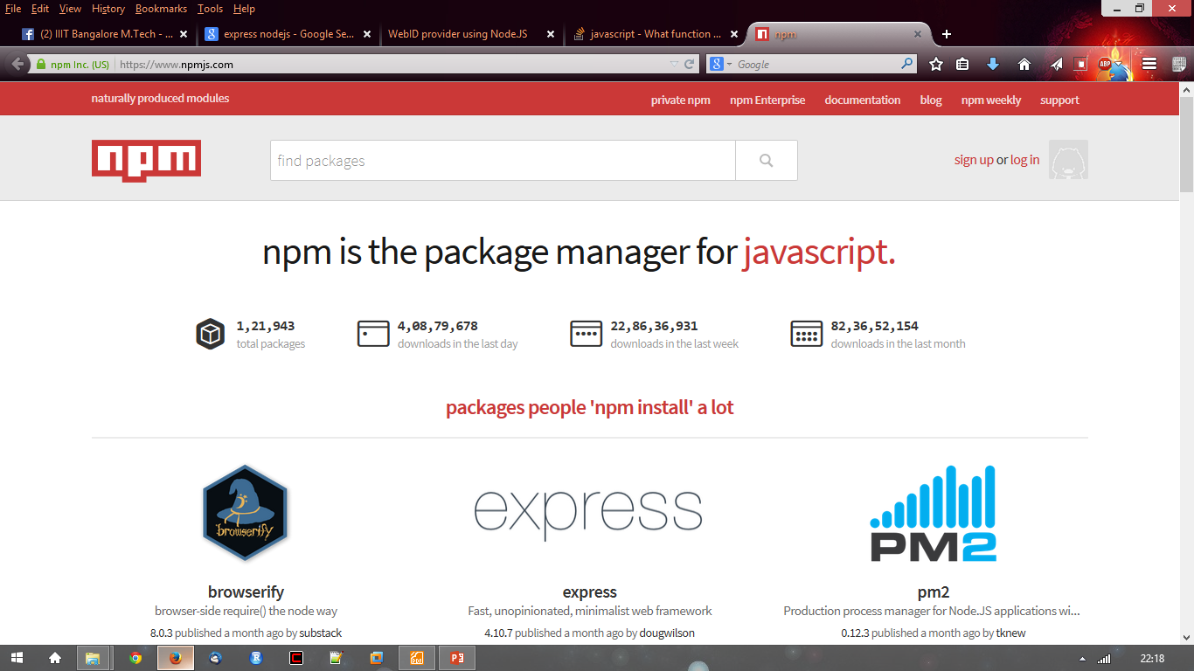
Node.js Modules….. MANY
● https://npmjs.org/
● # of modules = 1,21,943

Slide 20
Install a module…..inside your project directory
$npm install <module name>

Slide 21
Using module….. Inside your javascript code
var http = require(‘http’);
var fs = require(‘fs’);
var express = require(‘express’);

Slide 22
Hello World Example
STEP 1: create directory and call npm install and follow instructions
>mkdir myapp
>cd myapp
Use the npm init command to create a package.json file for your application. For more information, see Specifics of npm’s package.json handling.
> $ npm init
prompts you for a number of things, such as the name and version of your application. For now, you can simply hit RETURN to accept the defaults

Slide 23
Hello World example
Create file index.js with the following code:
http.createServer(function (request, response) {
// Send the HTTP header
// HTTP Status: 200 : OK
// Content Type: text/plain
response.writeHead(200, {'Content-Type': 'text/plain'});
// Send the response body as "Hello World“
response.end('Hello World\n'); }).listen(8081);
// Console will print the message
console.log('Server running at http://127.0.0.1:8081/');

Slide 24
Hello World example –package.json – describes application
{
    "name": "helloworld",
    "version": "1.0.0",
    "description": "simple hello world app",
    "main": "index.js",
    "scripts": {
    "test": "echo \"Error: no test specified\" && exit 1"
    },
    "author": "L. Grewe",
    "license": "ISC",
    "dependencies": {
    "express": "^4.14.1"
    }
}

Slide 25

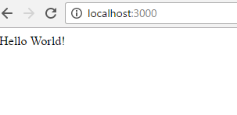
Run your hello world application
Run the app with the following command:
$ node app.js
Then, load http://localhost:3000/ in a browser to see the output.

Slide 26
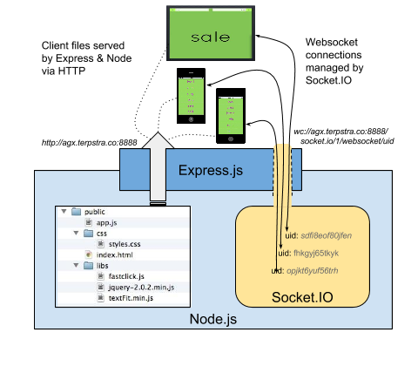
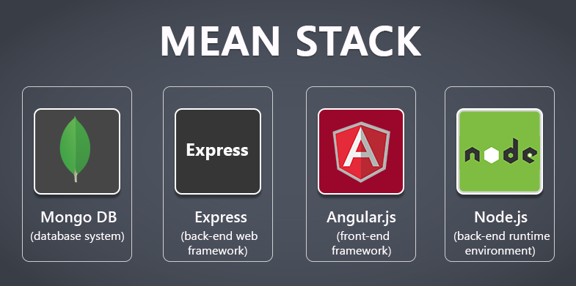
Express
minimal and flexible Node.js web application framework that provides a robust set of features for web and mobile applications.

Slide 27
Express gives ease of functionality
Routing
Delivery of Static Files
“Middleware” – some ease in development (functionality)
Form Processing
Simple forms of Authentication
Cookies and Session Manipulation
A lot of this you can do in NodeJS but, you may write more code to do it than
if you use the framework Express.
There are other alternatives than Express (the E in MEAN) like Sail, Meteor

Slide 28
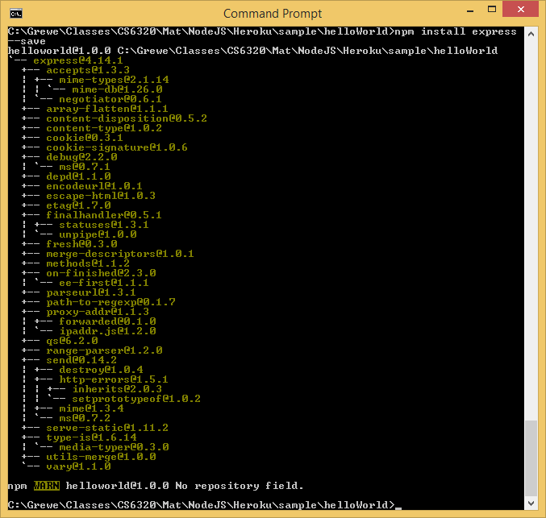
Install express
install Express (if you want it, most will)and any other dependencies needed
Now install Express in the myapp directory and save it in the dependencies list. For example:
>$ npm install express --save

Slide 29
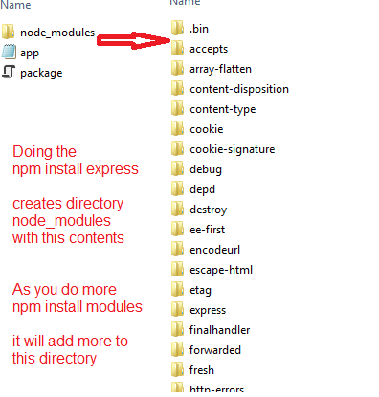
Express install
Will add files
to the node_modules
directory
If this is the first
module you
have installed for
current application
IT will create the
node_modules
directory first.

Slide 30
ALTERNATIVE to install - generator
npm install express-generator -g express helloapp
create : helloapp
create : helloapp/package.json
create : helloapp/app.js
create : helloapp/public
create : helloapp/public/images
create : helloapp/routes
create : helloapp/routes/index.js
create : helloapp/routes/users.js
create : helloapp/public/stylesheets
create : helloapp/public/stylesheets/style.css
create : helloapp/views create : helloapp/views/index.jade
create : helloapp/views/layout.jade
create : helloapp/views/error.jade
create : helloapp/bin
create : helloapp/bin/www
install dependencies:
$ cd helloapp && npm install
run the app:
$ DEBUG=helloapp:* npm start
create : helloapp/public/javascripts

Slide 31
Express – hello world code
index.js have the code
    var express = require('express')
    var app = express()
    app.get('/', function (req, res) {
    res.send('Hello World!')
    })
    app.listen(3000, function () {
    console.log('Example app listening on port 3000!')
    })
This says requires module express
Calls function express to initialize object app
App object has various methods like get
that responds to HTTP get request.
This code will be call the function specified when
a GET for the URI / is invoked
Sets up the HTTP server for listening port 3000

Slide 32
References
http://nodejs.org/
http://nodejs.org/cinco_de_node.pdf
http://ajaxian.com/archives/google-chrome-chromium-and-v8
http://blog.chromium.org/2010/12/new-crankshaft-for-v8.html
http://news.softpedia.com/news/IE9-RC-vs-Chrome-10-9-vs-Opera-11-vs-Firefox-11-Performance-Comparison-183973.shtml

