Slide 1
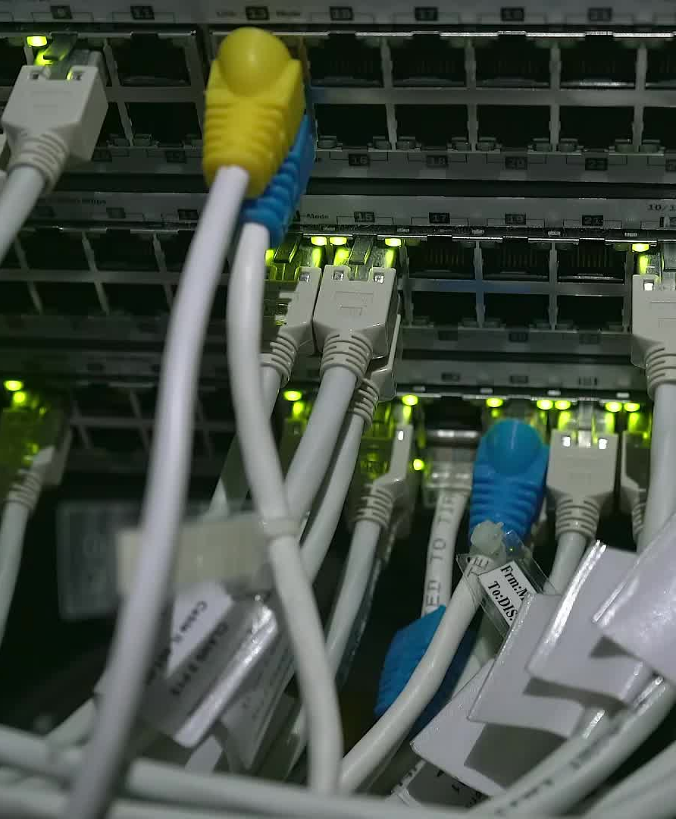
Telecom Churn Prediction With Machine Learning

Slide 2
Team Members
Raghavendra Aakula
Model Deployment
Brahma vamsi Madasu
Data collection, Data Cleaning
Kranthi Kumari Kannikanti
Model Development
Nandith Kurra
Model Deployment

Slide 3

BUSINESS objective
Customer churn is a major problem and one of the most important concerns for large companies. Due to the direct effect on the revenues of the companies, especially in the telecom field, companies are seeking to develop means to predict potential customer to churn. Therefore, finding factors that increase customer churn is important to take necessary actions to reduce this churn.

Slide 4

Proposed Solution
This project will have a machine learning model that can predict customers about to churn. It'll help the team to identify factors for customers churn and take necessary steps to overcome the problem.

Slide 5

Methodology

Slide 6

BUSINESS UNDERSTANDING
To properly analyze the data and pose business-related
queries about it, we should possess a fundamental
understanding of business within our domain.
For example, our question could be: In what ways will the company customize their plans based on customer demographics?
What particular information about the consumer base or data points will the company utilize to forecast customers about to churn?

Slide 7
DATA UNDERSTANDING
In this stage, we locate, gather, and examine the datasets that can support the accomplishment of our project objectives.
The dataset will be acquired from Kaggle.

Slide 8

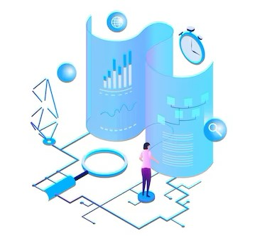
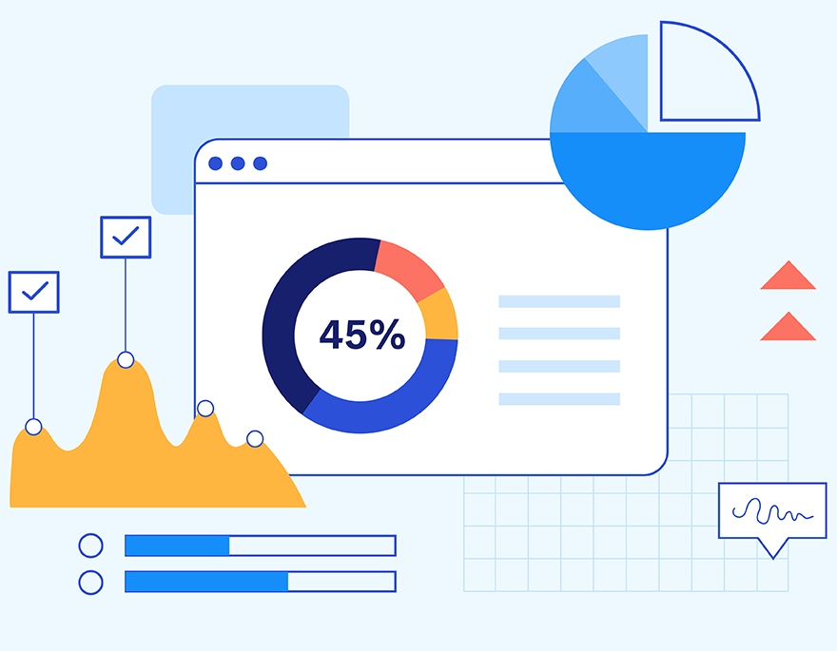








FURTHER PROCESS PLAN
DATA
CLEANING
DATA
MODELING
DATA
VISUALIZATION
DEPLOYMENT

Slide 9
FUTURE APPROACH
Customer Satisfaction and Feedback
• Analyze customer feedback, complaints, and satisfaction surveys to understand customers experiences. Which will help the company to bring the new customers to base.

Slide 10

Thank you

