Slide 1
AUTOMOBILES SALES
PERFORMANCE DASHBOARD
A slide-by-slide walkthrough of how the dashboard was built
Project Presentation

Slide 2
1. Project Objective
Start by defining what the dashboard needs to answer.
• Create a single view of automobile sales performance.
• Track revenue, profit, cars sold and total sales at a glance.
• Compare revenue across months, cities, states and sales channels.
• Use clear visuals so business users can identify patterns quickly.

Slide 3
2. Data Preparation
Prepare a consistent dataset before building visuals.
Review the fields
Clean the data
Create measures
Revenue amount, profit, car model, city, state, month and sales channel.
Check blanks, duplicate records, spelling consistency and data types.
Use consistent aggregation for total revenue, total profit, cars sold and sales.
Typical workflow: source data → cleaning and validation → calculated measures → dashboard visuals
The screenshot shows the final dashboard; exact source tables and transformation steps were not provided, so these are the recommended build steps.

Slide 4
3. Design the Dashboard Layout
Set up the page before adding charts.
• Use a dark navy background with light chart panels for contrast.
• Place the dashboard title at the top for immediate context.
• Put high-level KPI cards in the first row.
• Arrange trend and comparison charts beneath the KPIs.
• Keep titles, labels and spacing consistent across visuals.

Slide 5
4. Add the KPI Cards
The top row summarizes the headline metrics.
TOTAL REVENUE
TOTAL PROFIT
CARS SOLD
TOTAL SALES
572M
73.50M
500
500
Why this step matters: decision-makers can read the key results without inspecting every chart.

Slide 6
5. Visualize Monthly Revenue Trends
Line chart: revenue by month.
Chart setup
What the chart communicates
• X-axis: Month
• Y-axis: Sum of Revenue_INR
• Add point labels to show each month's value
• Use a line to make the overall direction easy to see
Revenue begins around 60M and trends downward overall, ending near 27M in March. The month order shown is May, Aug, Feb, Apr, Jun, Oct, Dec, Sep, Nov, Jul, Jan and Mar; verify chronological sorting if this is intended as a time series.
Build tip: sort month names using a month-number field so the line follows calendar order.

Slide 7
6. Compare Revenue by City
Horizontal bar chart: rank cities by revenue.
Chart setup
Key observation
• Category axis: City
• Value axis: Sum of Revenue_INR
• Sort bars from highest to lowest
• Keep data labels visible for quick comparison
Mumbai leads at about 81M, followed by Jaipur (69M) and Bengaluru (64M). Lucknow is around 45M. A horizontal bar chart makes city names easy to read and supports ranking.
Use this view to identify high-performing markets and cities that may need attention.

Slide 8
7. Compare Car-Model Counts by State
Column chart: count of Car_Model grouped by State.
Chart setup
Key observation
• Category axis: State
• Value axis: Count of Car_Model
• Show data labels above columns
• Keep the state names readable
Maharashtra has the highest count at 119. Rajasthan follows at 56 and Karnataka at 53. The remaining displayed states are clustered around 41–52.
This chart compares the distribution of car-model records across states; it is a count, not necessarily the number of unique models.

Slide 9
8. Break Down Revenue by Sales Channel
Donut chart: share of revenue by channel.
Chart setup
What it shows
• Category/legend: Sales_Channel
• Values: Sum of Revenue_INR
• Use a donut to emphasize share of total
• Add value and percentage labels
The displayed channel segments are approximately 204M (35.64%), 200M (35.04%) and 168M (29.32%). The three shares add to 100%, with the first two channels contributing similar proportions.
Keep the legend visible so viewers can match each segment to Online, Direct and Dealer.

Slide 10
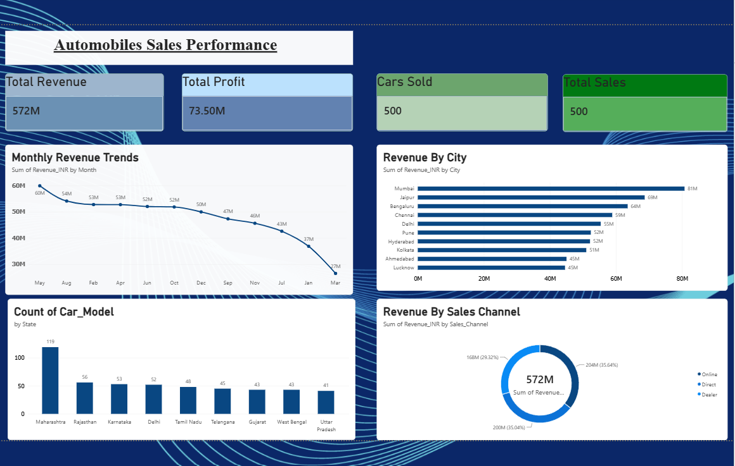
9. Assemble and Review the Dashboard
Bring the visuals together and check consistency.
Final checks: titles • units • labels • sorting • color consistency • KPI accuracy

Slide 11
10. Insights & Conclusion
Summarize what the dashboard helps a user understand.
• Headline performance: 572M revenue and 73.50M profit.
• City view: Mumbai is the strongest displayed revenue market.
• State view: Maharashtra has the highest displayed car-model count.
• Channel view: revenue is distributed across Online, Direct and Dealer.
• Next improvement: validate month sorting and confirm the definitions behind Cars Sold and Total Sales.
Thank you

