Slide 1
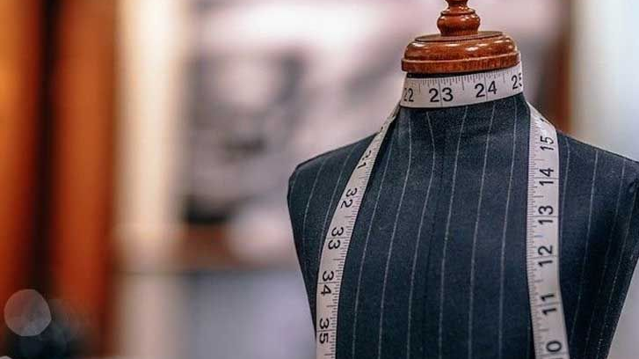
Deep Learning in Fashion Industry
Submitted by,
Raghava Devaraje Urs 015135653

Slide 2
Introduction
The fashion industry is one of the crucial industries for the global economy.
It is one of the most creative realms.
People around the world are willing to spend money to stay in trend
Easier shopping experience
Brands utilize machine learning methodologies to stay on top
Systems accumulate vast amount of data related to user preferences, shopping history, fashion influencer data and more.
Deep learning and computer vision techniques make use of the collected data to provide great customer experience.

Slide 3
Fashion research classification
Field | Subfield | Methodologies
Fashion Recognition | Clothing/Human Parsing | Graphical Model, Non-parametric Model, Parselets Representation Method, CNN Model, Adversarial Model
 | Landmark Detection | Deep Learning Methods
Fashion Understanding | Clothing Attribute Prediction | Single-task Learning, Multi-task Learning, Transfer Learning
 | Fashion Style Prediction | Supervised Learning, Unsupervised Learning
Fashion Applications | Fashion Retrieval | Cross-scenario Retrieval Model, Interactive Retrieval Model
 | Fashion Recommendation | Complementary Recommendation Model, Personalized Recommendation Model, Scenario-oriented Recommendation Model, Explainable Recommendation Model, Generative Model
 | Fashion Compatibility | Pairwise Compatibility Learning, Outfit Compatibility Learning
 | Fashion Image Synthesis | Pose Guided Generative Model, Text Guiled Generative Model, Virtual Try-on Model, Fashion Design Model

Slide 4
Low-level fashion
Clothing/Human parsing
Graphical models - Superpixel labeling, integrated system of clothing co-parsing, weakly supervised fashion parsing, and MRF-based color and category inference module.
Non-parametric models - Nearest neighbor style retrieval, Deep quasi-parametric human parsing framework, and Semi-supervised learning.
Parselets representation - Deformable Mixture Parsing Model and Simultaneous human parsing pose estimation.
CNN models - Contextualized CNN architecture, Active Template Regression, and Self-supervised structure-sensitive learning.
Adversarial models - Macro-Micro Adversarial Network (MMAN)
Landmark detection
Three-step deep fashion alignment framework, Deep landmark Network, Knowledge guided fashion network, and Global-local embedding module.

Slide 5
Middle-level fashion
Clothing Attribute Prediction
Single-task Learning - CRF based approach, Random forest approach, and Augmented deep CNN.
Multi-task Learning - Special-aware concept representations and end-to-end deep CNN.
Transfer Learning - Transfer learning model, and deep model built on Faster R-CNN model.
Fashion Style Prediction
Supervised Learning
Unsupervised Learning

Slide 6
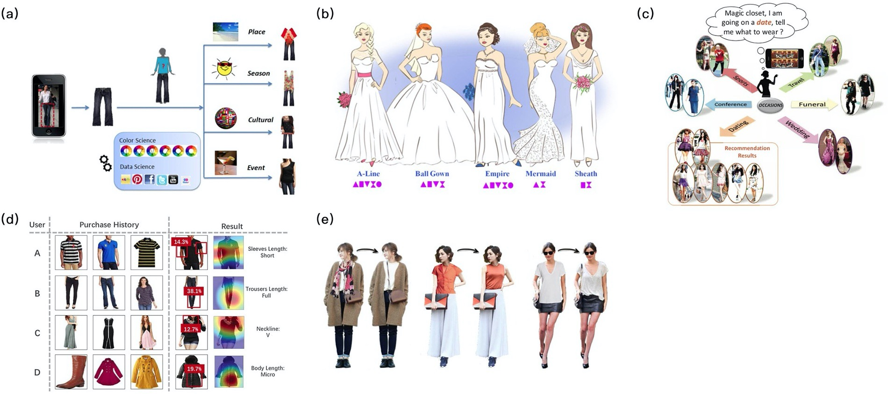
High-level Fashion
Fashion Retrieval
Cross-scenario Retrieval Model – WTBI, dual attribute-aware ranking network(DARN) and Deep bi-directional
Interactive Retrieval Model
Fashion Recommendation
Complementary Recommendation Model

Slide 7
High-level Fashion
Fashion Recommendation
Personalized Recommendation Model.
Scenario-oriented Recommendation Model

Slide 8
High-level Fashion
Generative Model

Slide 9
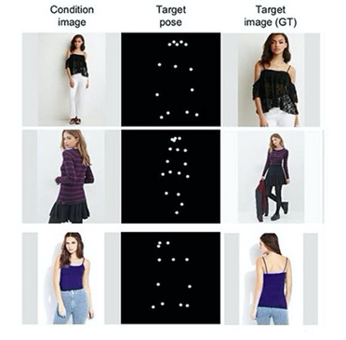
High-level fashion
Fashion Compatibility
Pairwise Compatibility Learning
Outfit Compatibility Learning
Fashion Image Synthesis
Pose Guided Generative Model

Slide 10
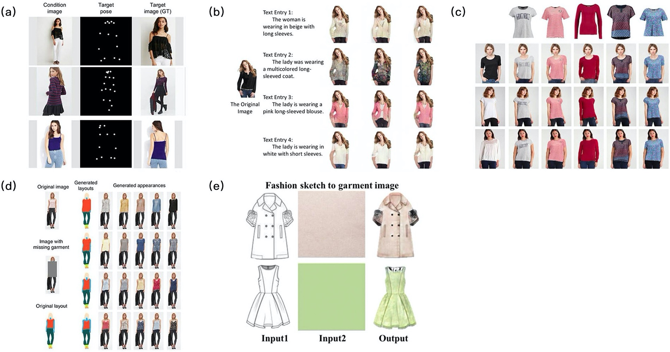
High-level fashion
Fashion Image Synthesis
Text Guided Generative Model

Slide 11
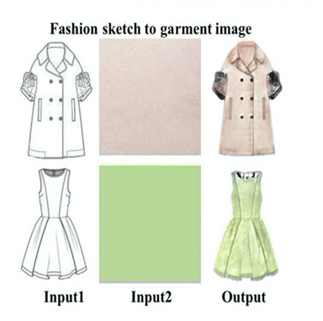
High-level fashion
Fashion Design Model
Virtual Try-on Model

Slide 12
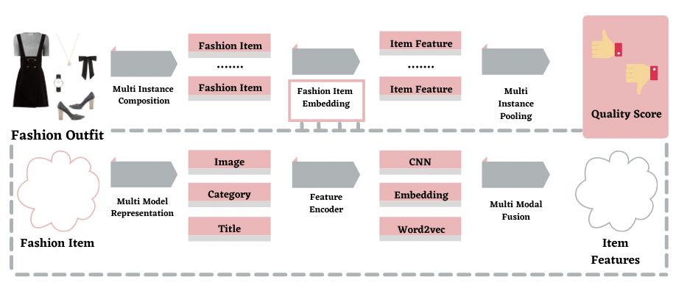
Recommendation systems
Widely used information filtering systems.
Clothes retrieval and recommendations for customers.
The deep learning approach : end-to-end system of encoding visual features through the deep convolutional network

Slide 13
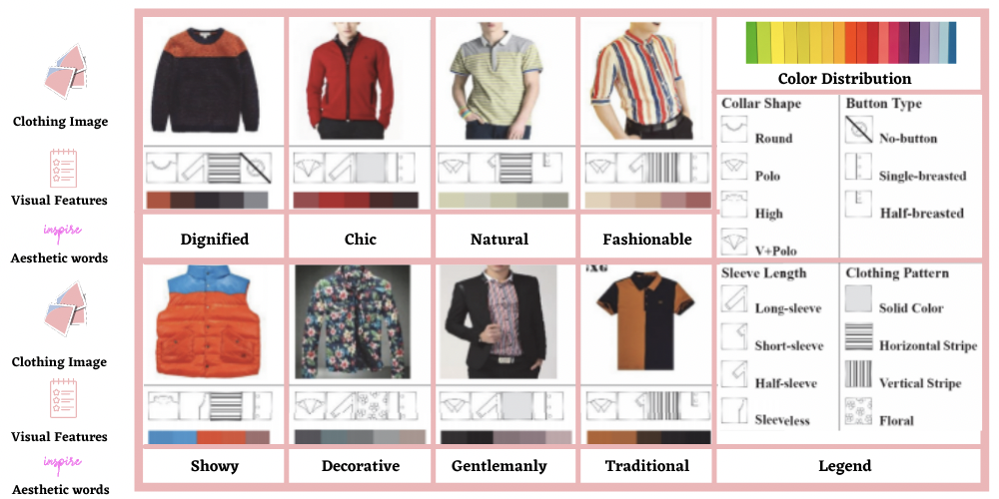
Aesthetics
Aesthetics and Fashion go hand in hand
Bridge the gap between the two by formulating a novel three level framework visual features, image-scale space and aesthetic words space.
This approach of aesthetic words mapping is based on a theory proposed by Kobayashi.

Slide 14
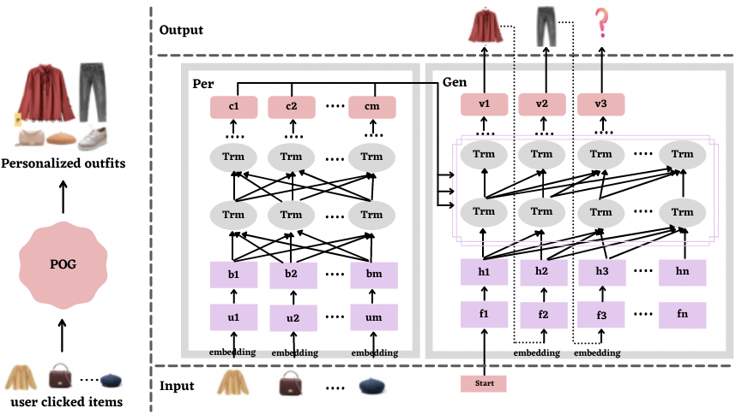
Personalization
Personalization promotes individuality and uniqueness.
A transformer encoder-decoder architecture approach is followed.

Slide 15
Conclusion
The scope for more advanced and sophisticated approaches increases to enable fashion brands,
To provide excellent customer service
To stay on top of the fashion industry.
AI and deep learning can help fashion manufacturers with better processes for manufacturing and inventory management.

