Slide 1


Used Cars Price Predict Project
Submitted by:
Raghavulu Patnala

Slide 2
ACKNOWLEDGMENT
Thanks for giving me the opportunity to work in FlipRobo Technologies as Intern and would like to express my gratitude to Data Trained Institute as well for trained me in Data Science Domain. This helps me to do my projects well and understand the concepts.
Dataset – FlipRobo Tech
Resources used – Google, GitHub, Blogs for conceptual referring.

Slide 3
Business Problem
With the covid 19 impact in the market, we have seen lot of changes in the car market. Now some cars are in demand hence making them costly and some are not in demand hence cheaper.
One of our clients works with small traders, who sell used cars.
So, we must predict the used cars price predict for our client through machine learning models.

Slide 4
Conceptual Background of the Domain Problem
With the change in market due to covid 19 impact, our client is facing problems with their previous car price valuation machine learning models.
Some cars are in demand and making them costly and some are not in demand, and it will be cheaper.
This will help our client to do better trade and help in his/her business to grow.

Slide 5
Motivation for the Problem Undertaken
Car is one of the most needed in everyone lives, and all people cannot afford to buy a new one and people who want to buy can exchange their old car in a good rate.
Our Prediction will help the client to sell the car in a smart way.

Slide 6
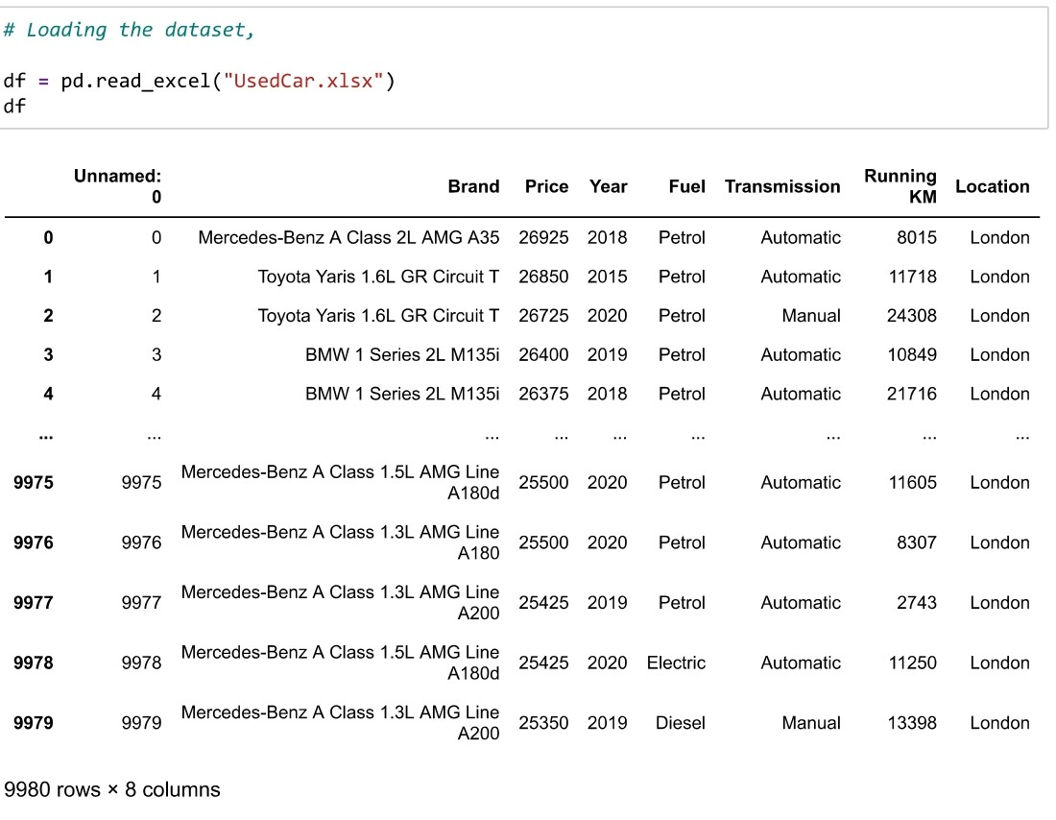
Data Sources and their formats
The data is collected from One of the famous websites for used cars and price are in Euros and it has 8 columns and 9980 rows.

Slide 7
Mathematical/ Analytical Modeling of the Problem
Our target Variable is Price and as the data is having continuous variables, hence this is Regression Problem.

Slide 8
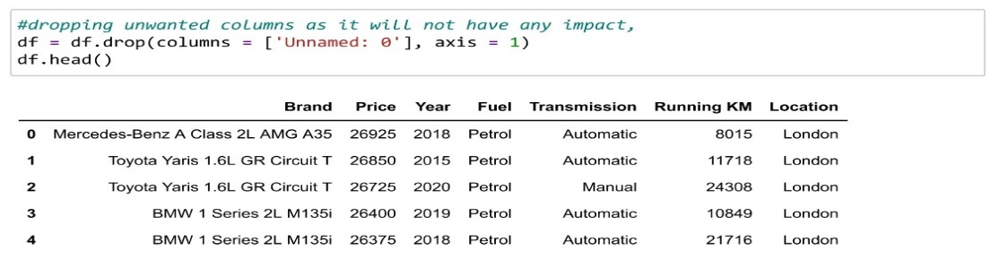
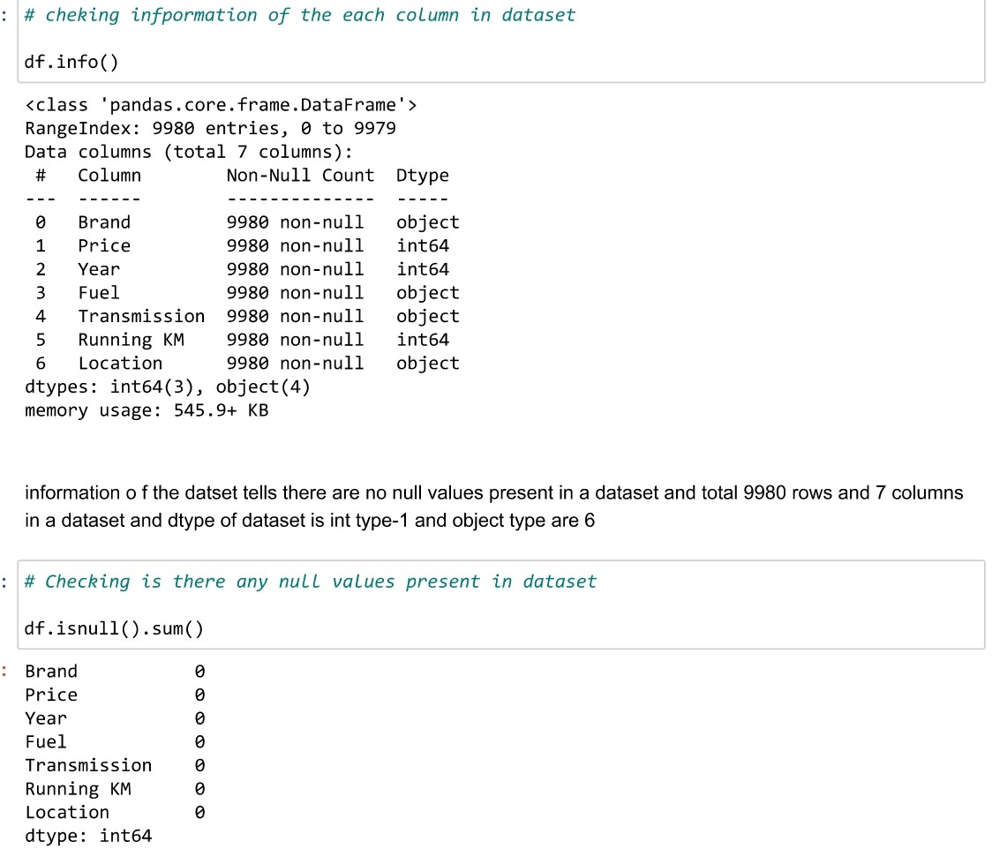
Data Pre-processing Done
Dropping the unwanted and less importance data,

Slide 9
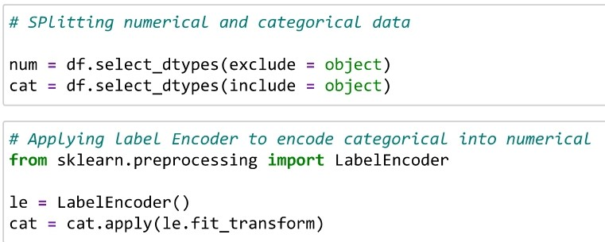
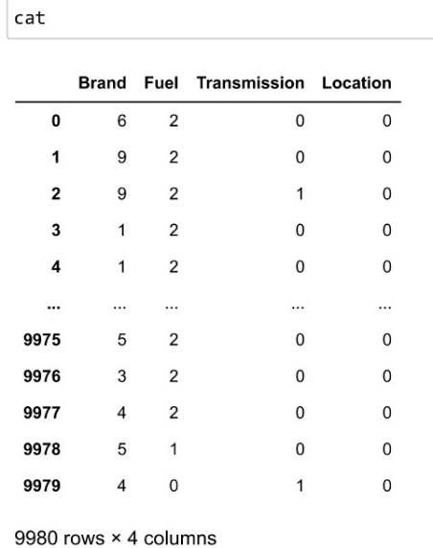
Data Pre-processing

Slide 10
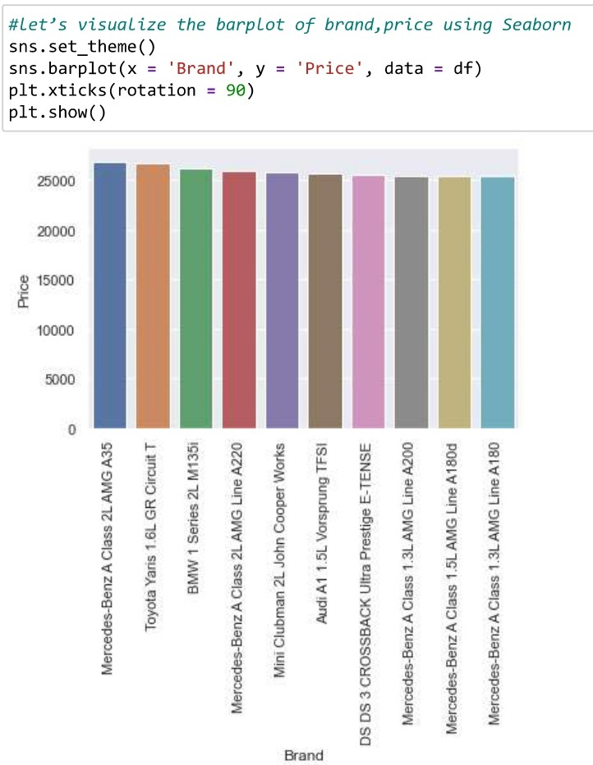
Data Visualization -
Almost all car brands are in demand but among all popular brands, Mercedes, Toyota and BMW are having high price than other brand cars.

Slide 11
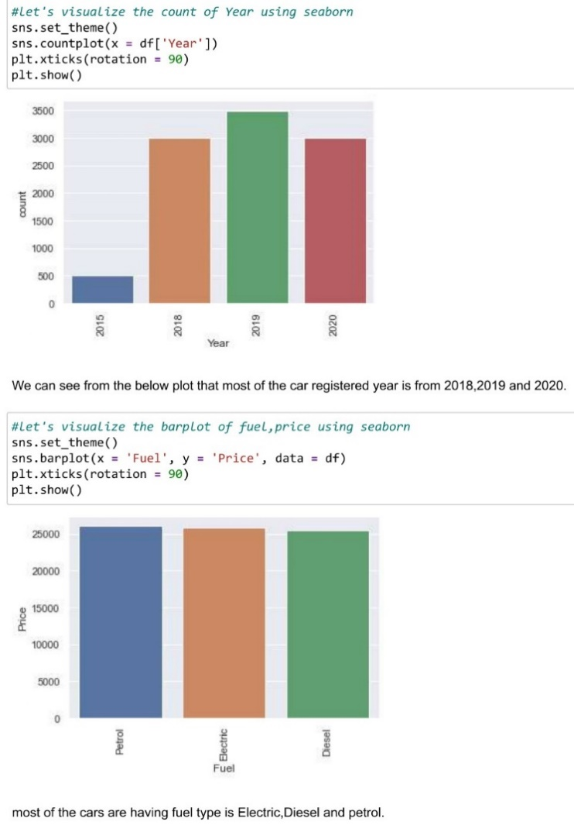
Data Visualization -
We can see from the below plot that most of the car registered year is from 2018,2019 and 2020.
Also, most of the cars are having fuel type is Electric , Diesel and petrol.

Slide 12
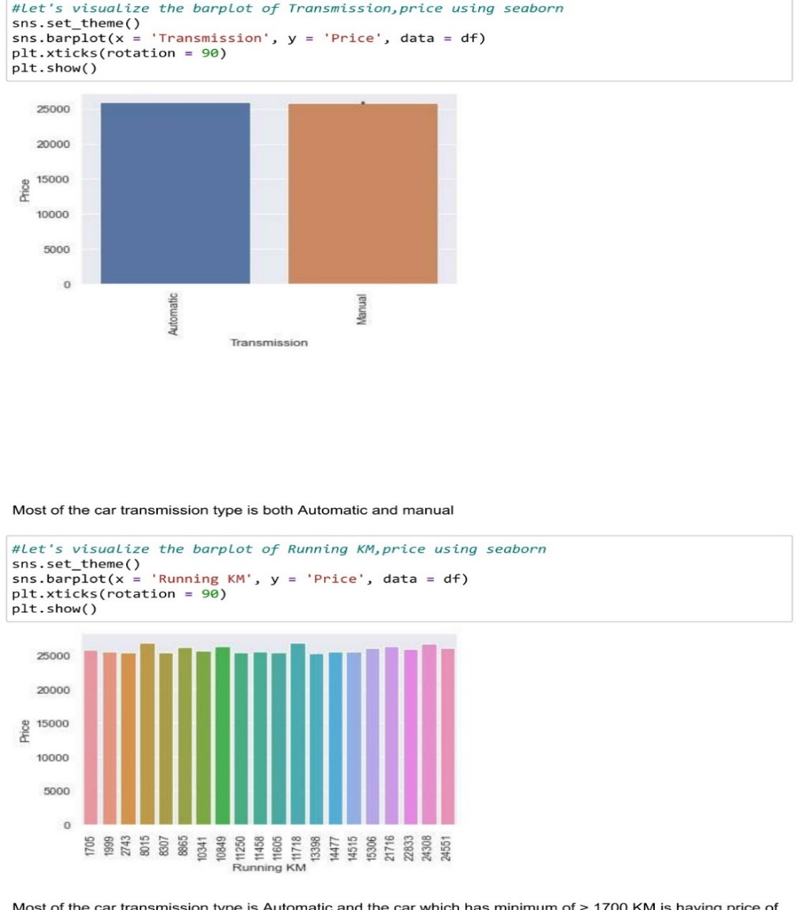
Data Visualization -
Most of the car transmission type is Automatic and the car which has minimum of > 1700 KM is having price of
> 25000 Euros.

Slide 13
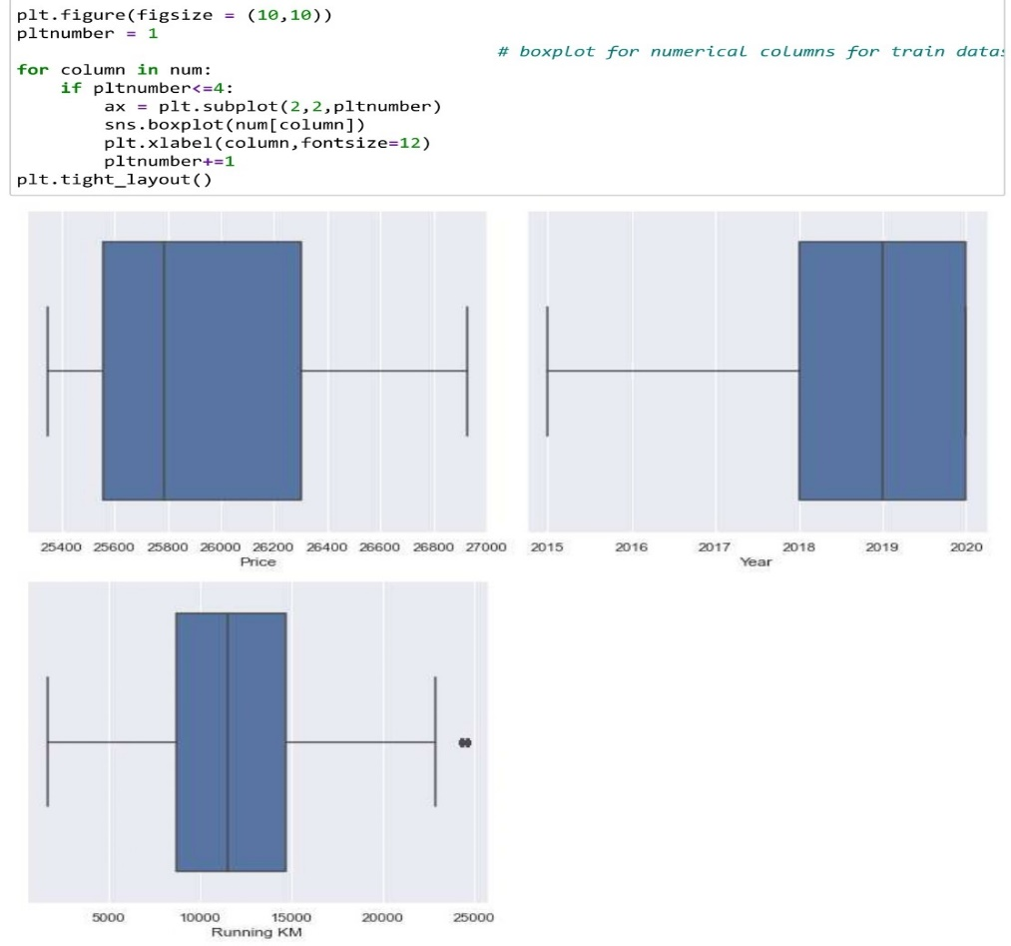
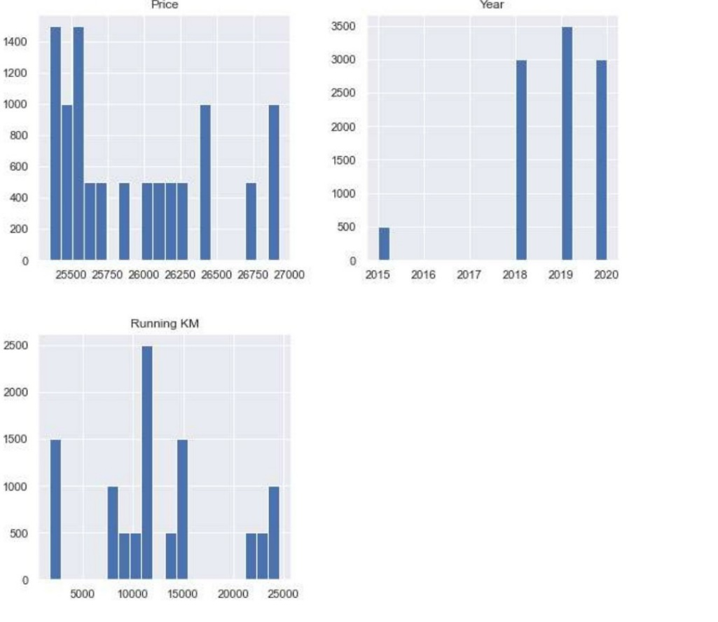
Data Visualization

Slide 14
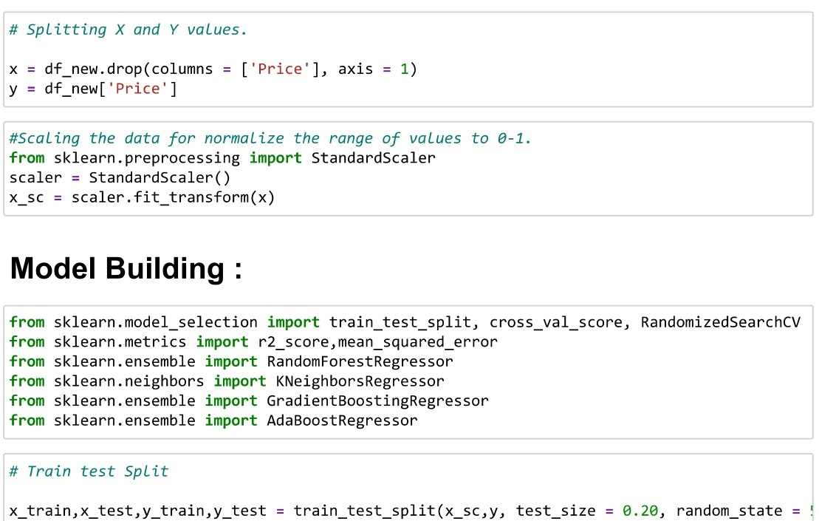
Standard-Scalar is applied to standardize the input data.
Splitted the train and test data for model building,
After train test split, we apply the below Regression algorithms and cross Val score to find the best scoring one.
Random Forest
K- Neighbors
Gradient Boost
Ada Boost

Slide 15
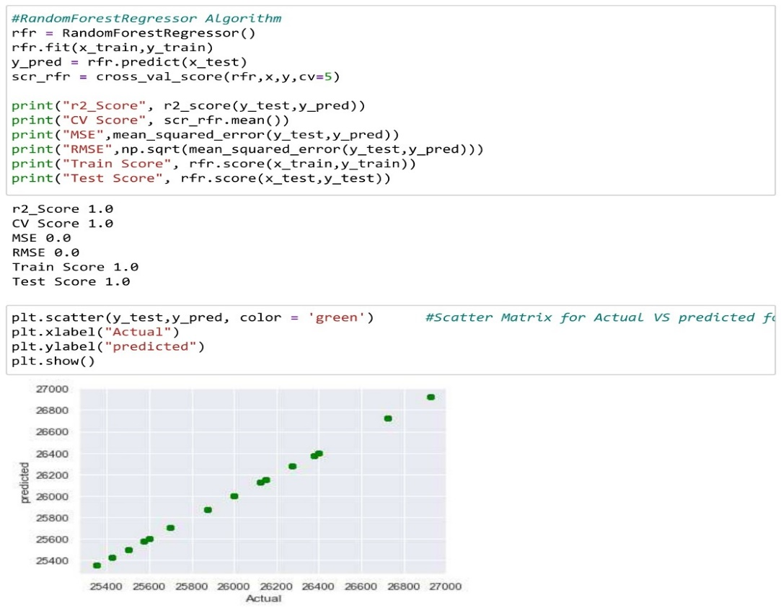
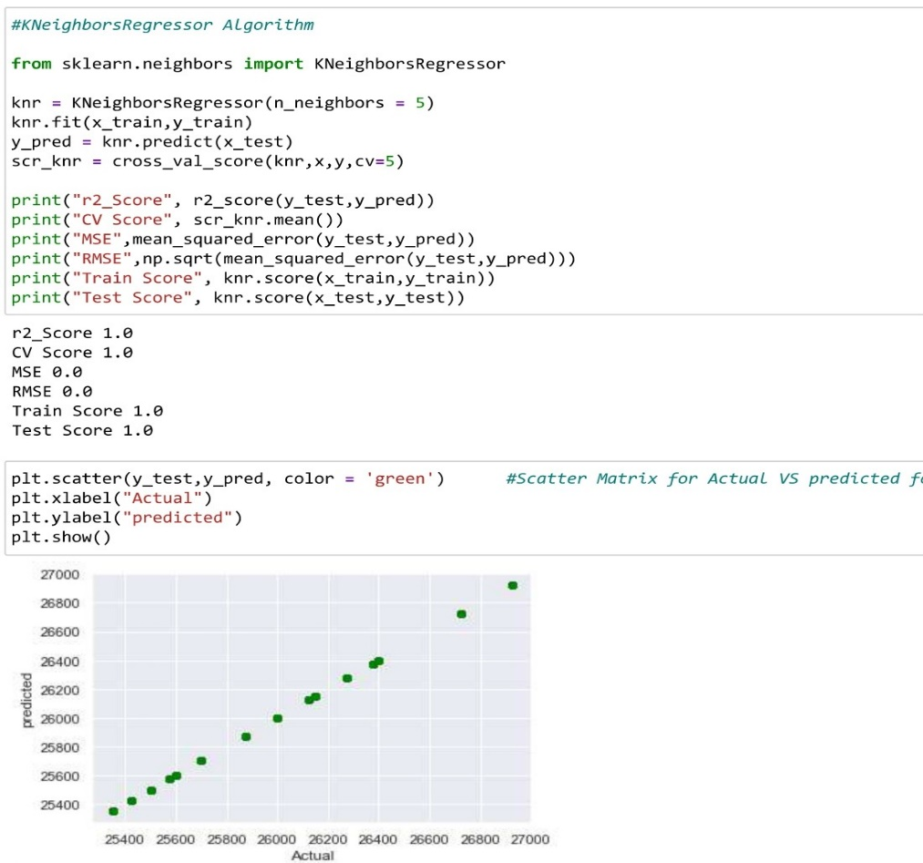
Model Building:
Random Forest has CV Score – 100%
K- Neighbors has CV Score – 100%

Slide 16
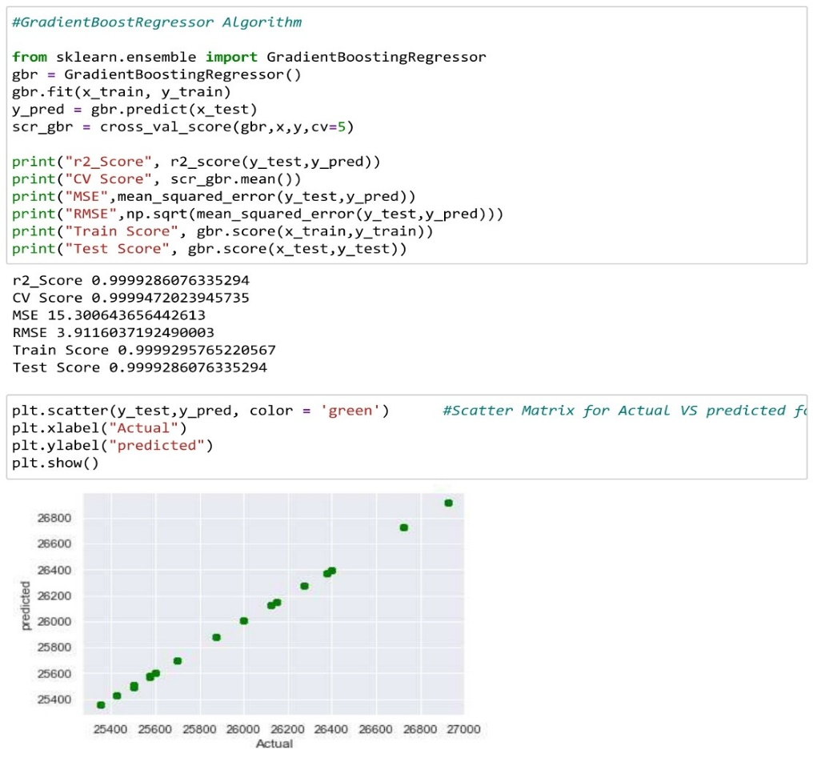
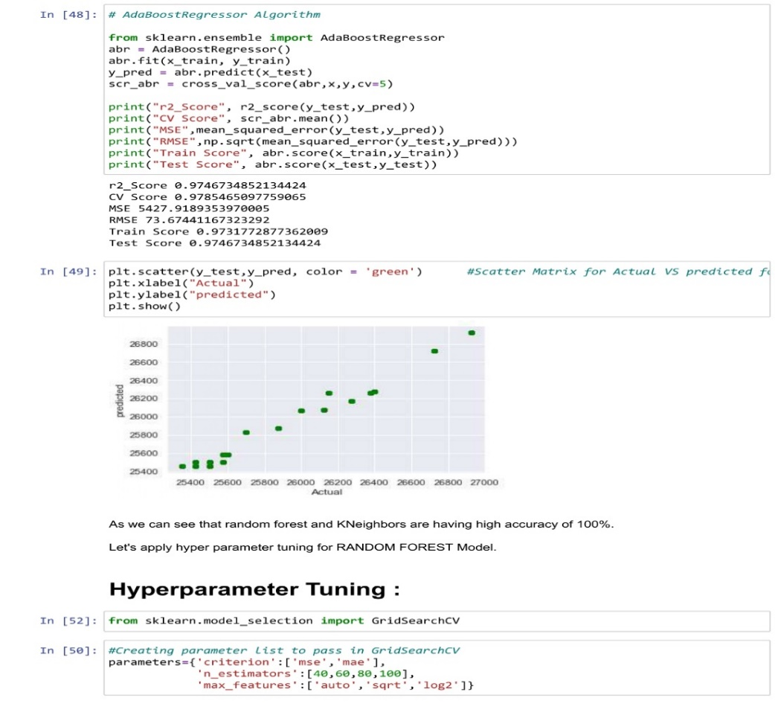
Gradient Boost has CV Score – 99.9%
Ada Boost has CV Score – 97.4%

Slide 17
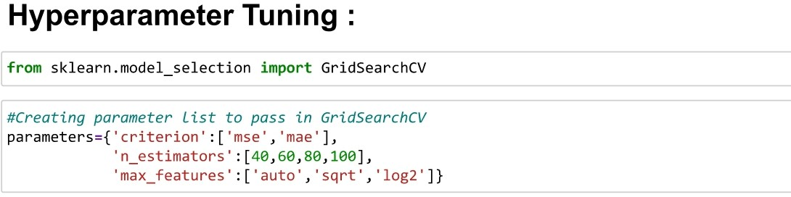
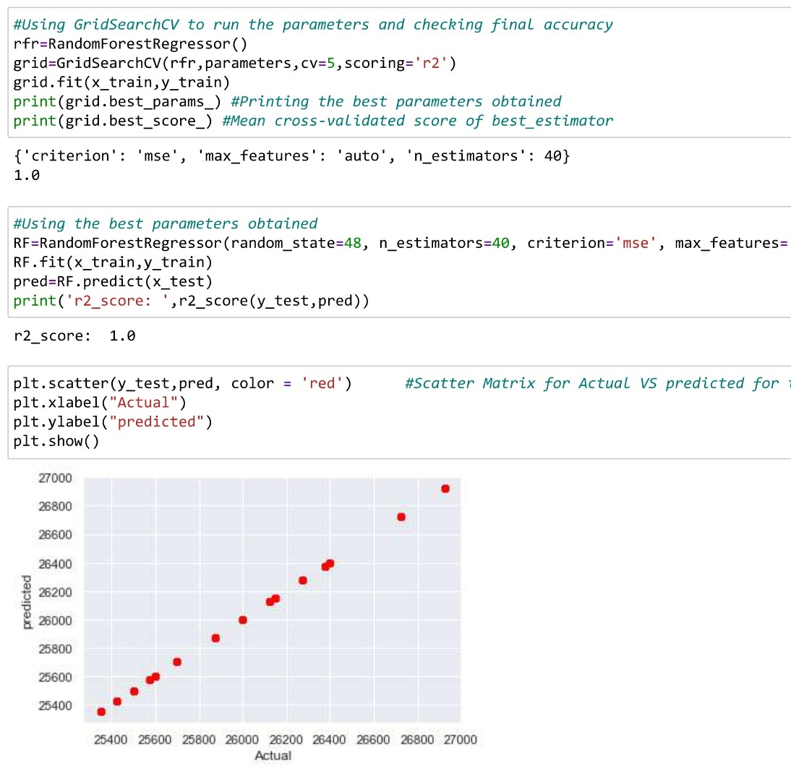
Hyper Parameter Tuning for the final model -> Random Forest

Slide 18
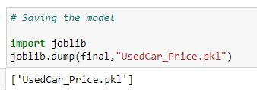
Finally Saving the model .pkl file and Loading the test data File,

Slide 19
Thank You !! ☺

