Slide 1

Micro-Credit Defaulter Project
Submitted by:
Raghavulu Patnala

Slide 2
ACKNOWLEDGMENT
Thanks for giving me the opportunity to work in FlipRobo Technologies as Intern and would like to express my gratitude to Data Trained Institute as well for trained me in Data Science Domain. This helps me to do my projects well and understand the concepts.
Dataset – FlipRobo Tech
Resources used – Google, GitHub, Blogs for conceptual referring.

Slide 3
Business Problem
A Microfinance Institution (MFI) is an organization that offers financial services to low-income populations.
MFS becomes very useful when targeting especially the unbanked poor families living in remote areas with not much sources of income.
It is widely accepted as a poverty-reduction tool, representing $70 billion in outstanding loans and a global outreach of 200 million clients.
The client wants some predictions that could help them in further investment and improvement in selection of customers for the credit.

Slide 4
Conceptual Background of the Domain Problem
Many microfinance institutions (MFI), experts and donors are supporting the idea of using mobile financial services (MFS) which they feel are more convenient and efficient, and cost saving, than the traditional high-touch model used since long for the purpose of delivering microfinance services.
They are collaborating with an MFI to provide micro-credit on mobile balances to be paid back in 5 days. The Consumer is believed to be defaulter if he deviates from the path of paying back the loaned amount within the time duration of 5 days. For the loan amount of 5 (in Indonesian Rupiah), payback amount should be 6 (in Indonesian Rupiah), while, for the loan amount of 10 (in Indonesian Rupiah), the payback amount should be 12 (in Indonesian Rupiah).
This problem contains data of customers who is defaulter / Non – defaulters and has the main account and data account recharge and total amount of sum amount and its frequency. So, we need to predict for each loan transaction, whether the customer will be paying back the loaned amount within 5 days of insurance of loan.

Slide 5
Motivation for the Problem Undertaken
This will help the client to get help on their future investment on telecom industry and that will improve the importance of communication in a person’s life, thus, focusing on providing their services and products to low-income families and poor customers that can help them in the need of hour.

Slide 6
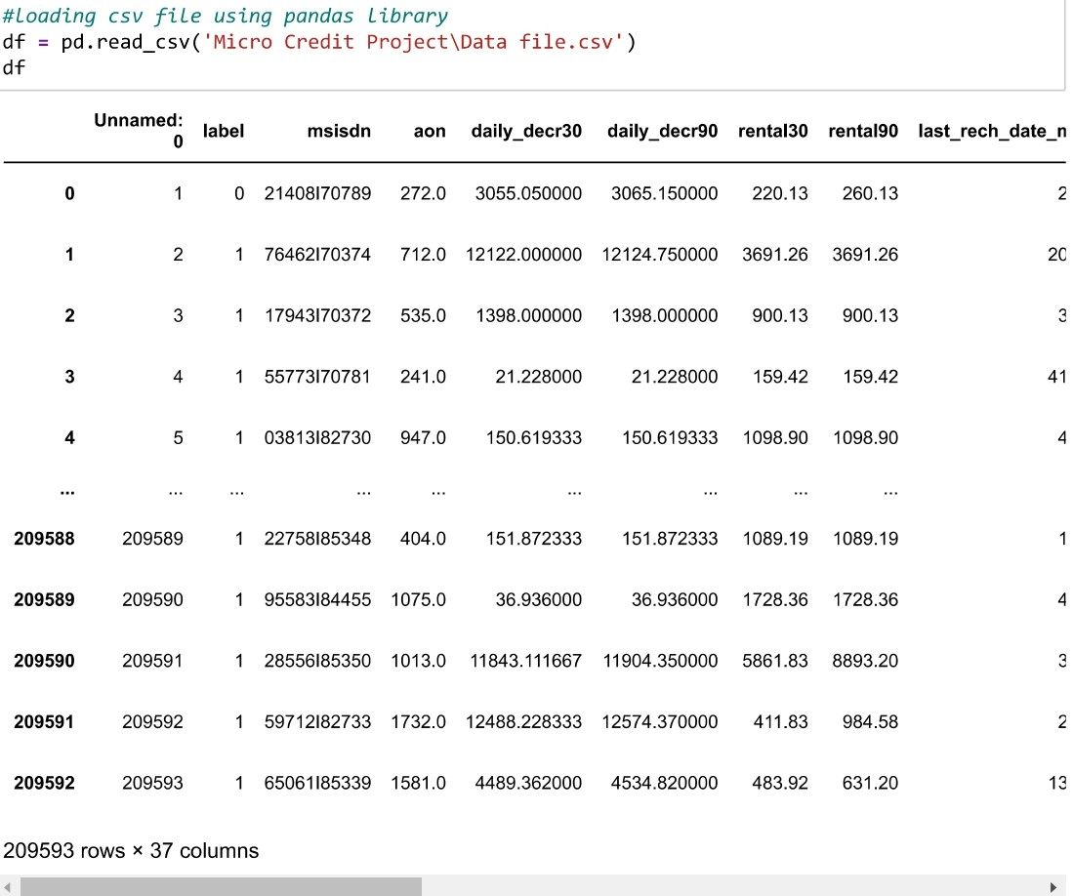
Data Sources and their formats
The sample data is provided to us from FlipRobo client database, and we can see there are 209593 rows and 37 columns in the given dataset.

Slide 7
Mathematical/ Analytical Modeling of the Problem
In this case, Label ‘1’ indicates that the loan has been payed i.e., Non- defaulter, while Label ‘0’ indicates that the loan has not been payed i.e., defaulter. In the provided dataset, our target variable "label" is a categorical with two categories: " defaulter " and " Non- defaulter ". Therefore, we will be handling this modelling problem as classification.

Slide 8
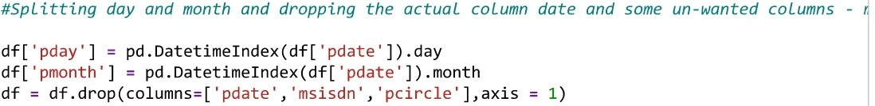
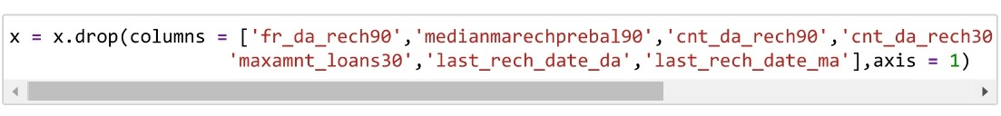
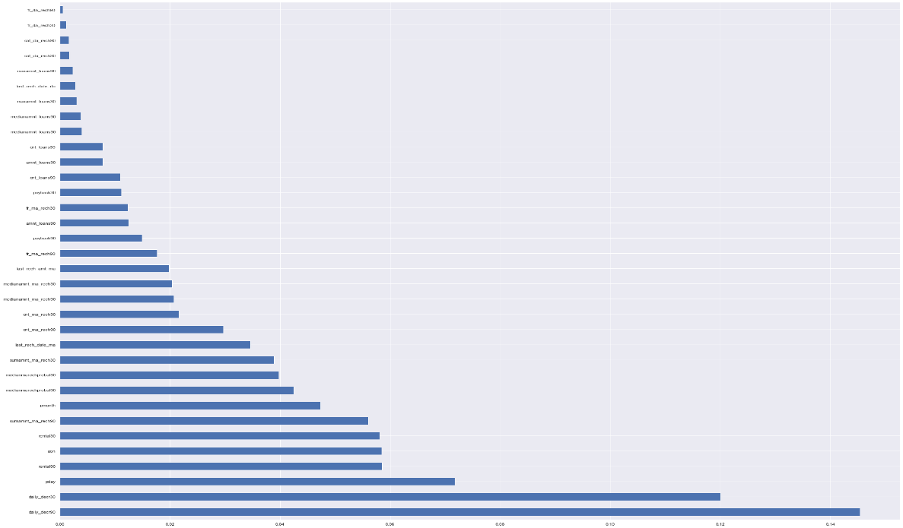
Data Pre-processing Done
Splitted day and month and Dropping unimportant columns.
Feature Importance

Slide 9
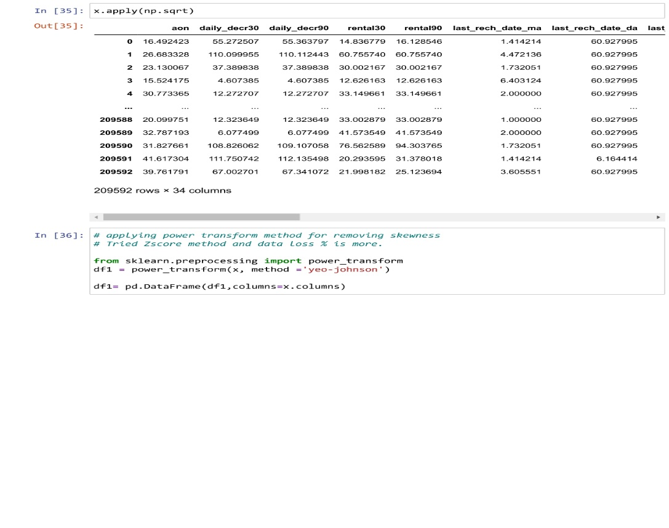
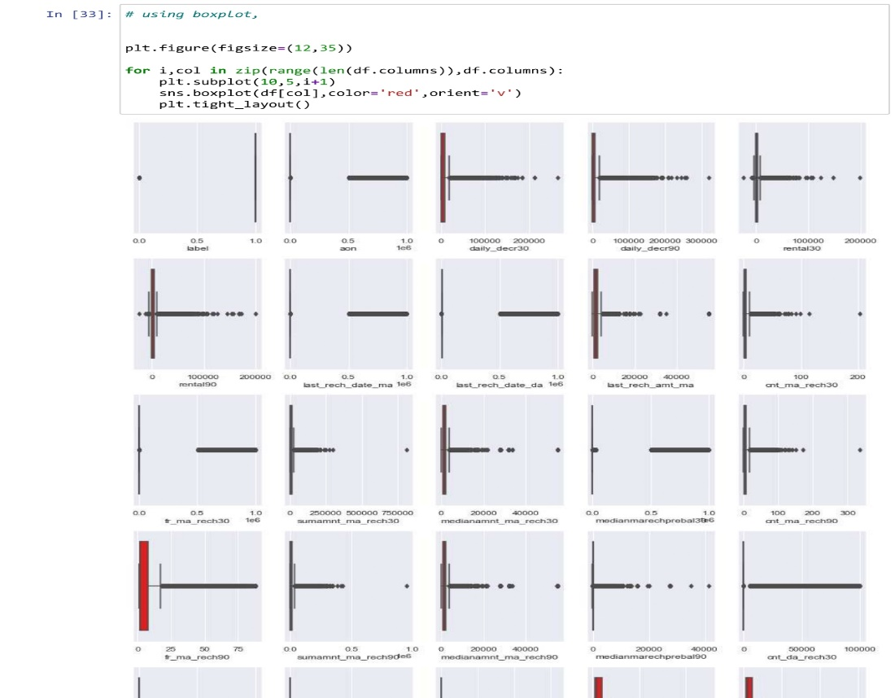
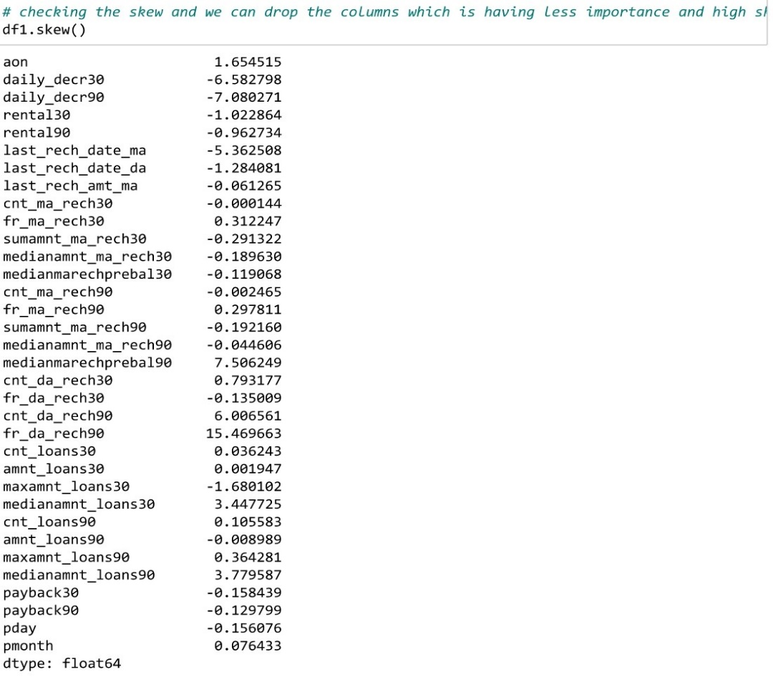
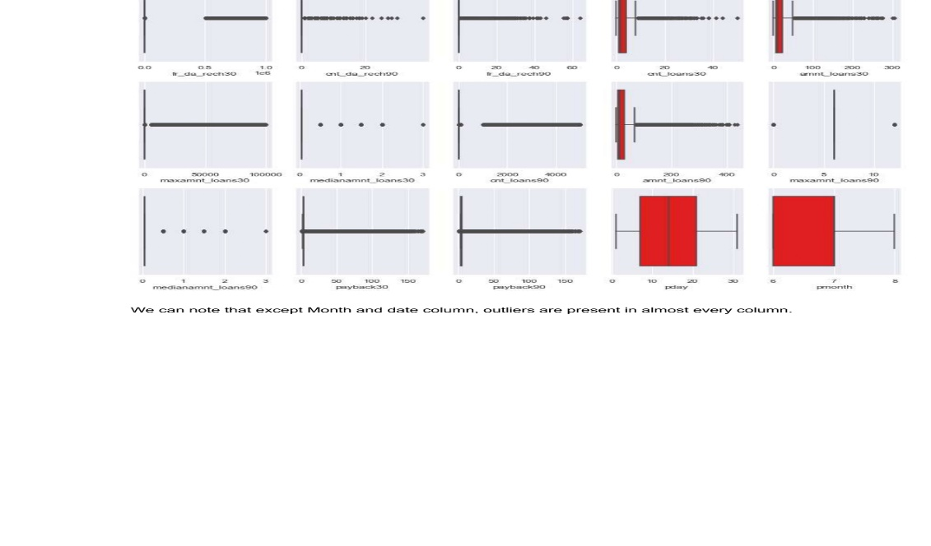
Outliers Handling

Slide 10
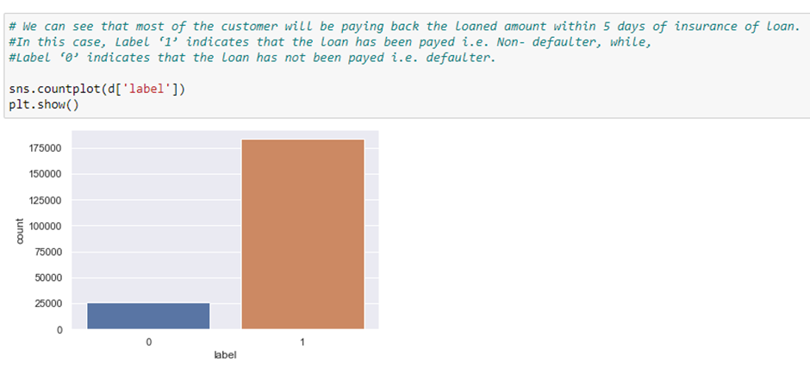
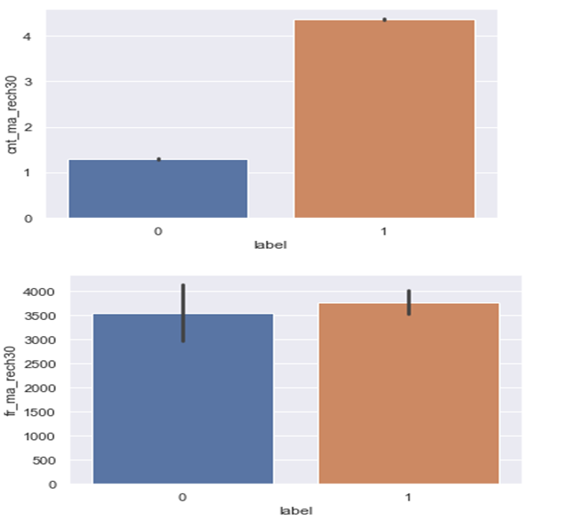
Some of the visualization about the data, Data Visualization - Frequency of main account recharged by Defaulters in < 30 days →

Slide 11
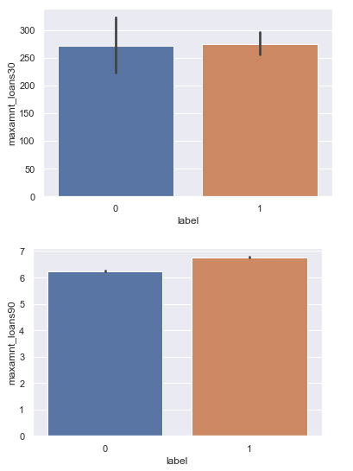
Some of the visualization about the data, Maximum amount of loans is taken by defaulters in < 30 days and there are 2 options 5Rs and 10Rs which customer needs to payback as 6Rs and 12Rs.

Slide 12
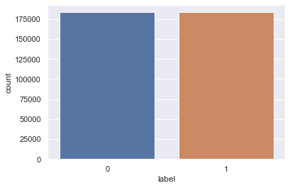
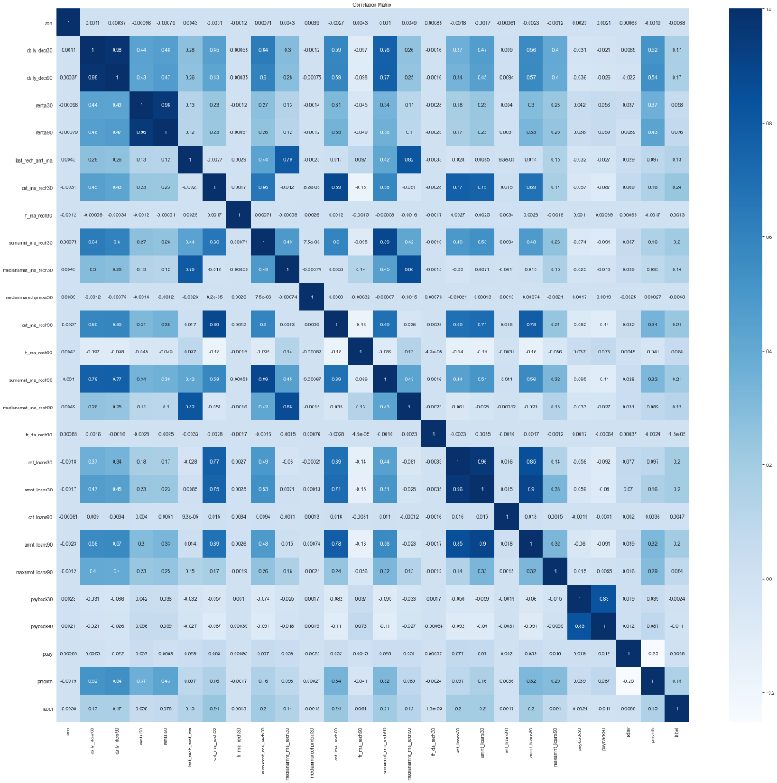
As classes are im-balanced, Applied SMOTE technique and balanced the classes.
Correlation matrix after dropping less importance feature and treated skew/outliers,

Slide 13
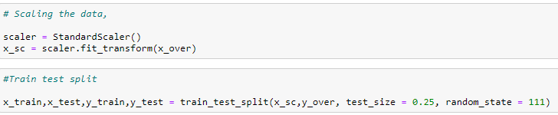
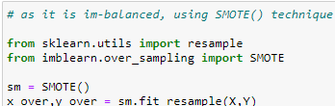
Standard-Scalar is applied to standardize the input data.
Splitted the train and test data for model building,
After train test split, we apply all the classification algorithms and cross Val score to find the best scoring one.
Used SMOTE() to balance the data before scaling the data,

Slide 14
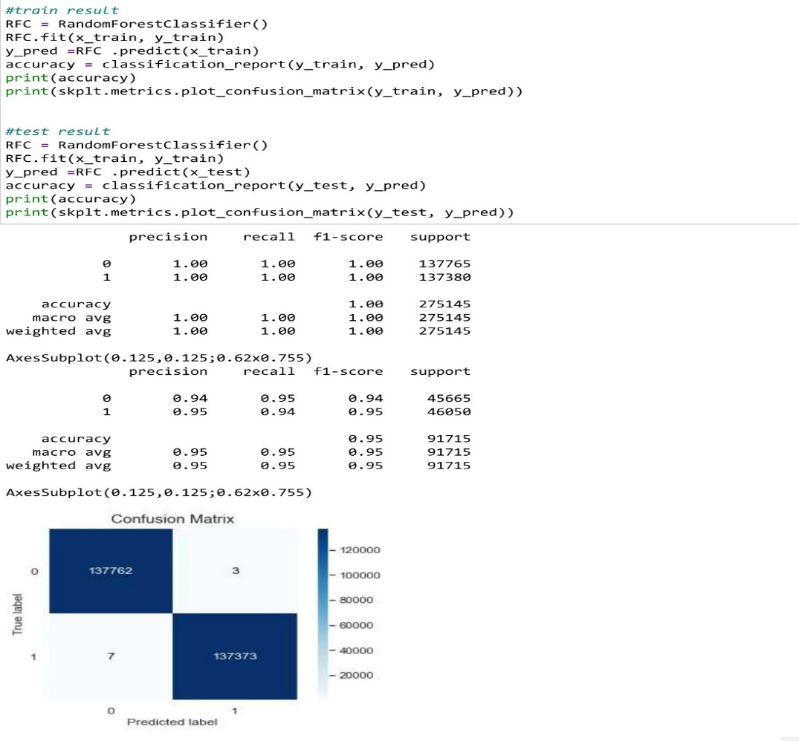
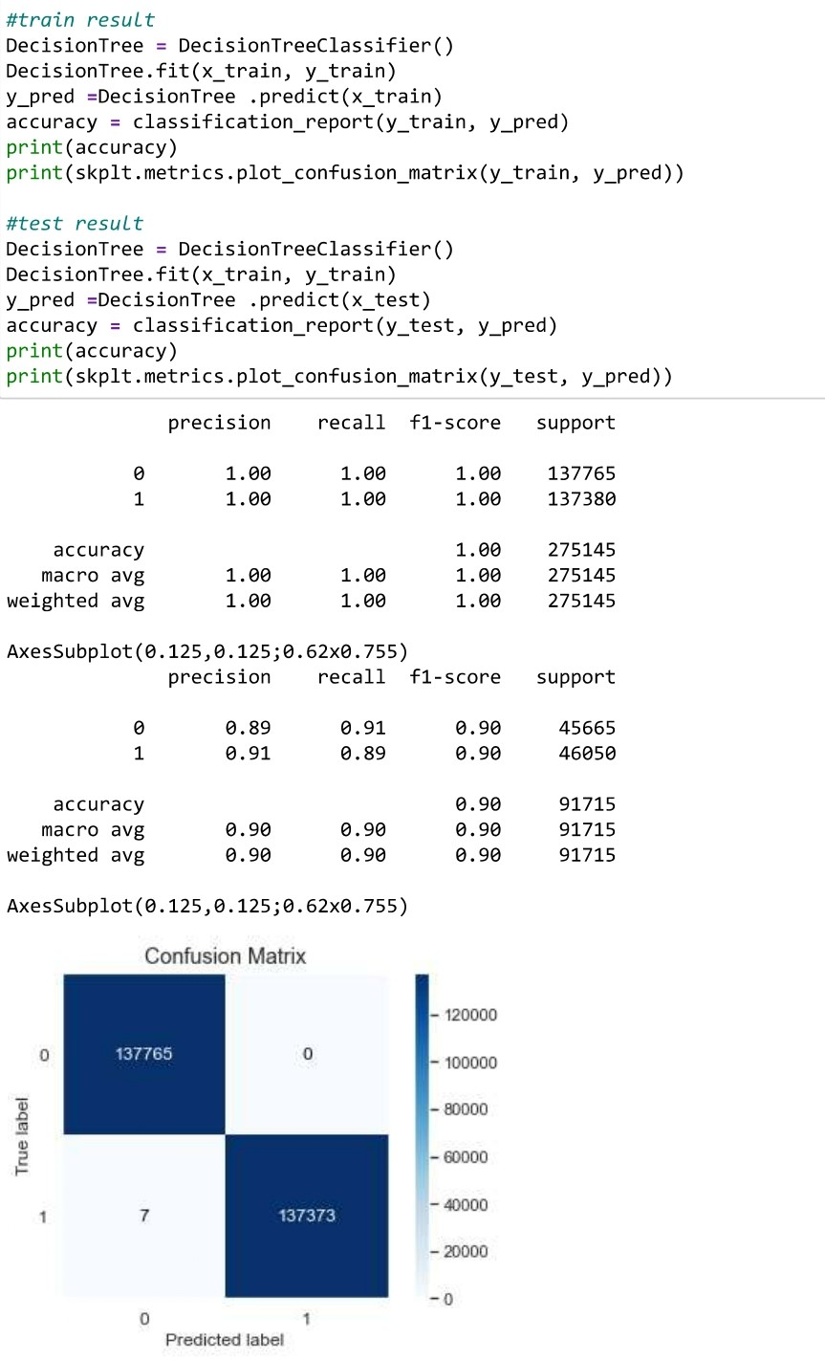
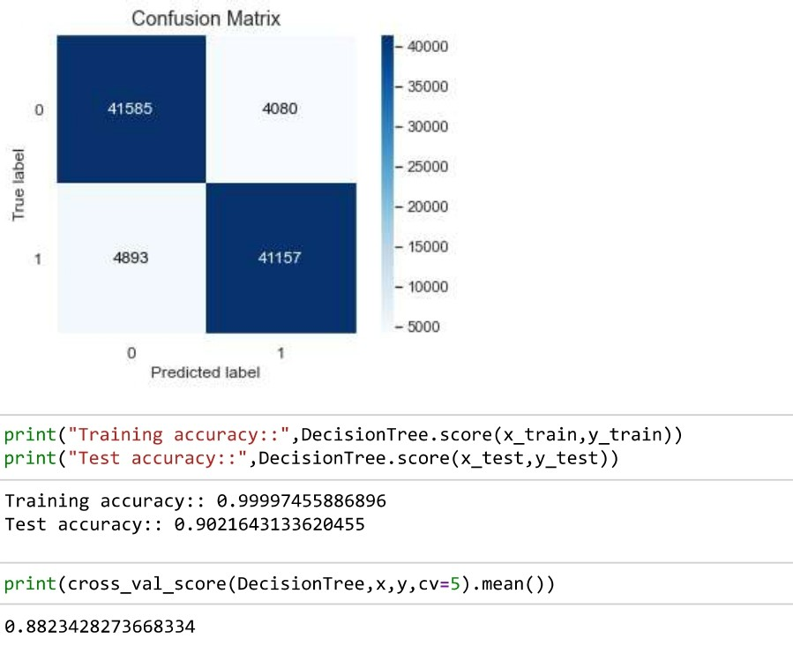
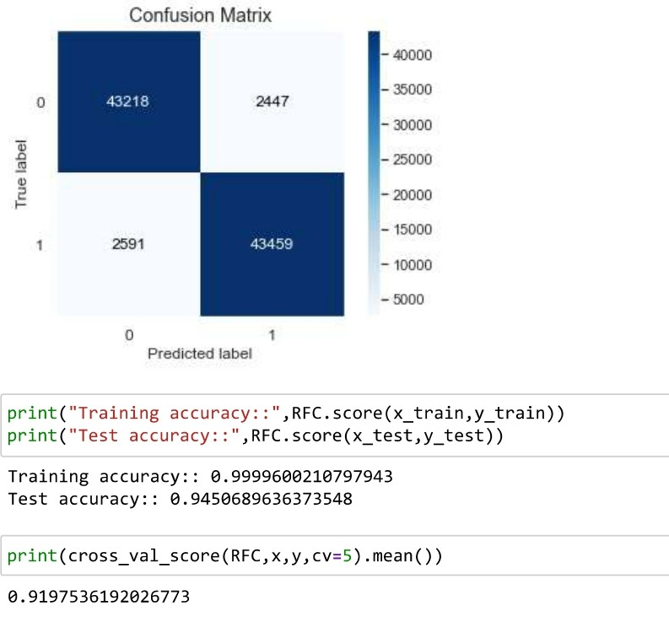
Decision tree Algorithm has Score -> 90.21% CV Score -> 88.23%
Random Forest Algorithm has Score -> 94.5% CV Score -> 91.2%

Slide 15
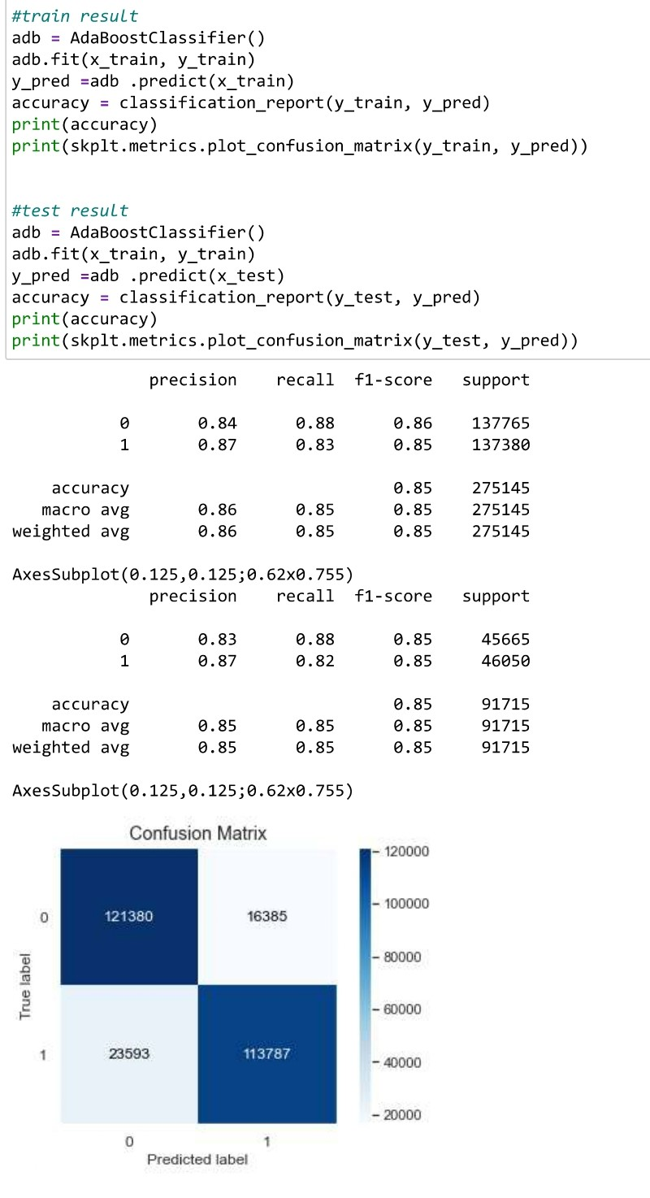
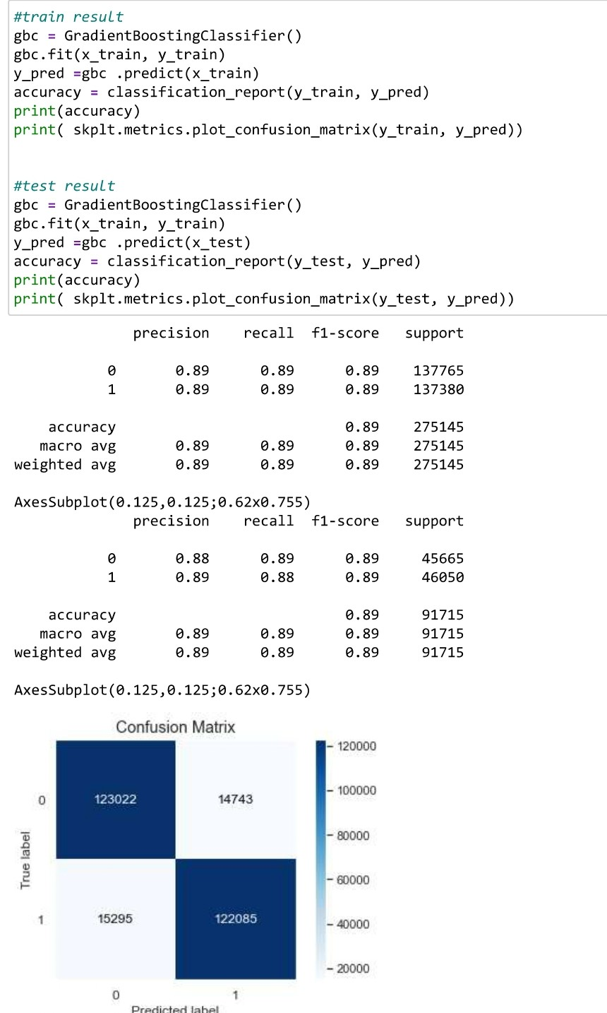
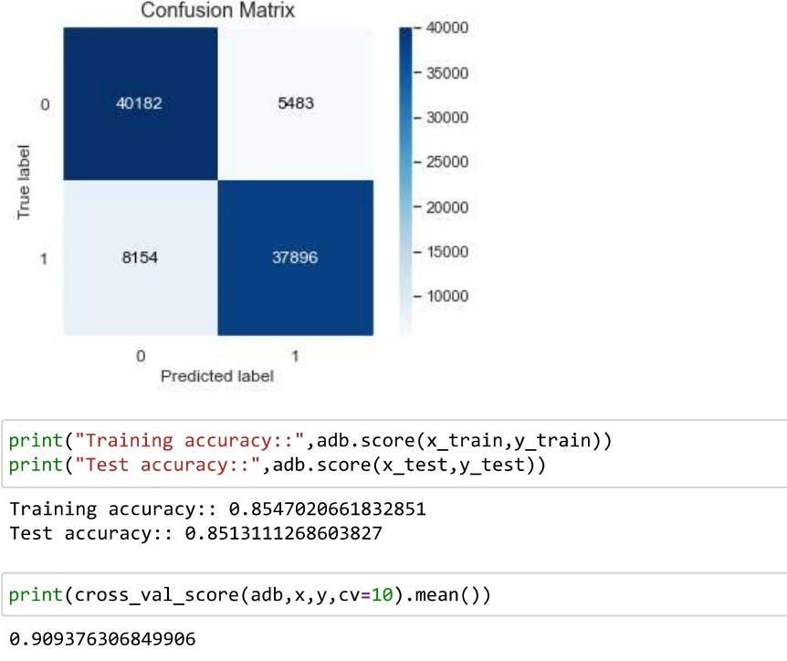
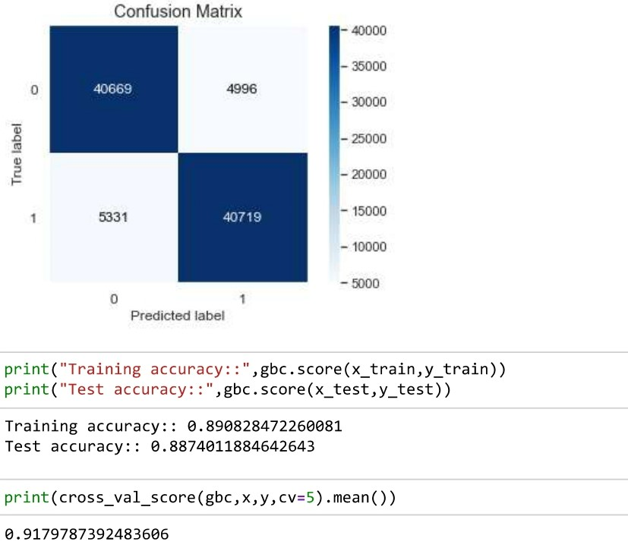
Ada Boost Algorithm has Score -> 85.1% CV Score -> 90.93%
Gradient Boost Algorithm has Score -> 88.7% CV Score -> 81.7%

Slide 16
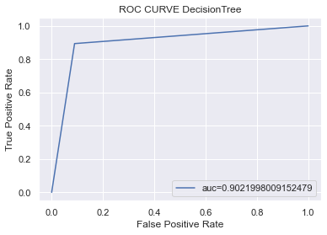
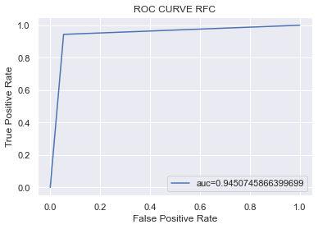
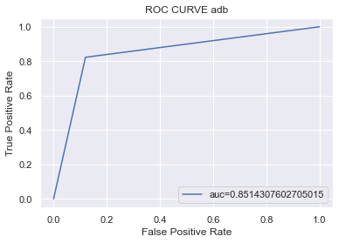
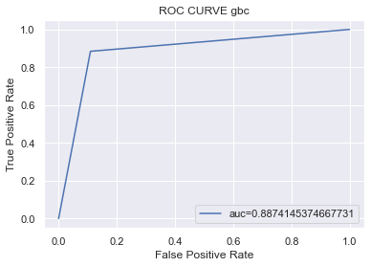
Roc Curve for all Models

Slide 17
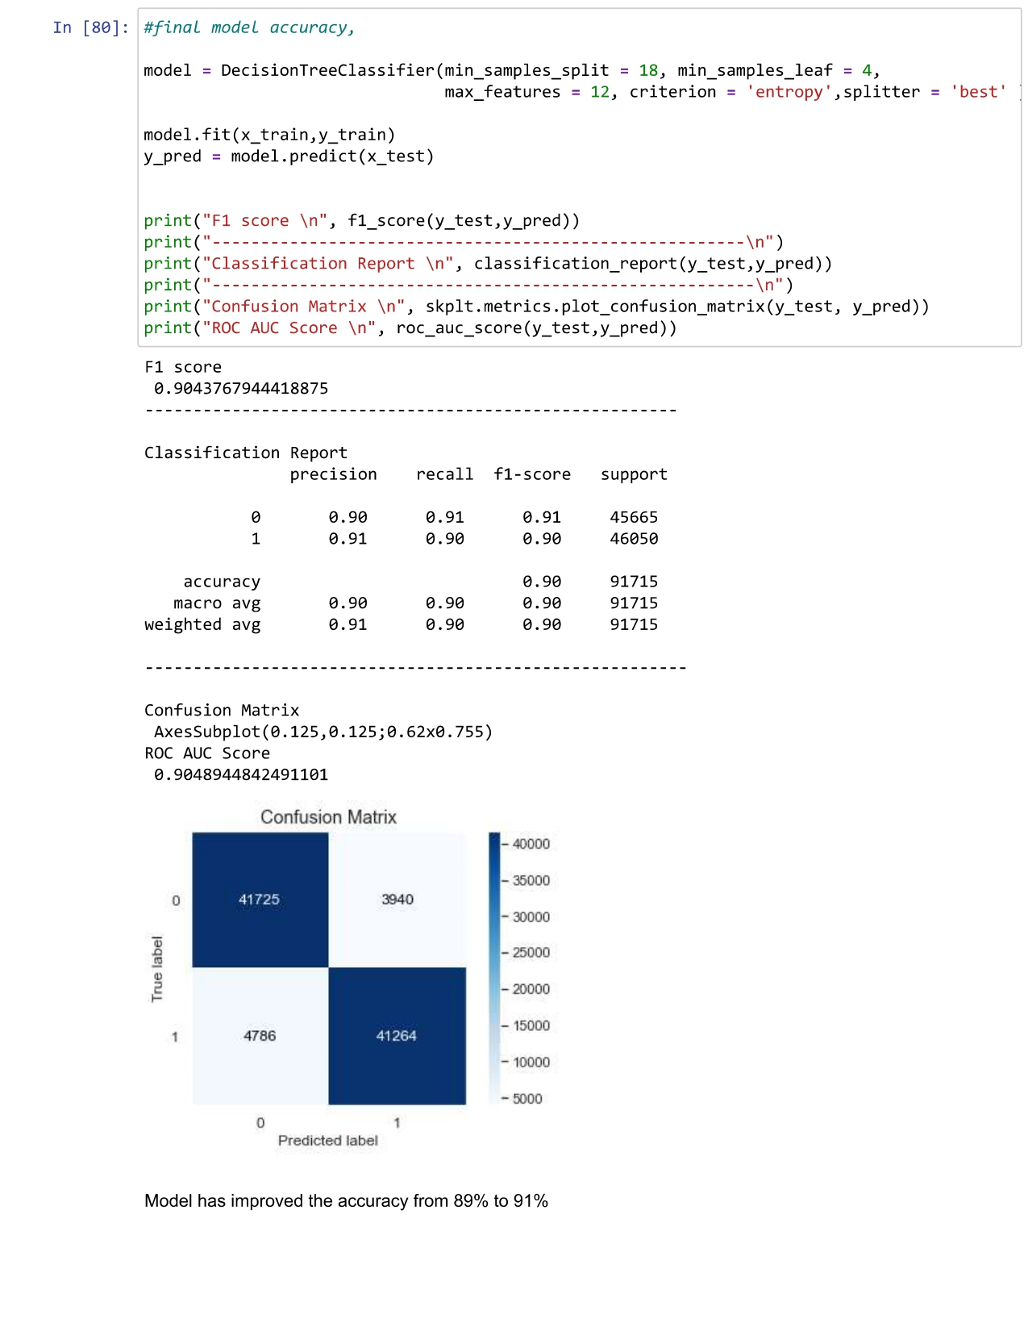
Hyper Parameter Tuning for the final model -> Decision Tree

Slide 18
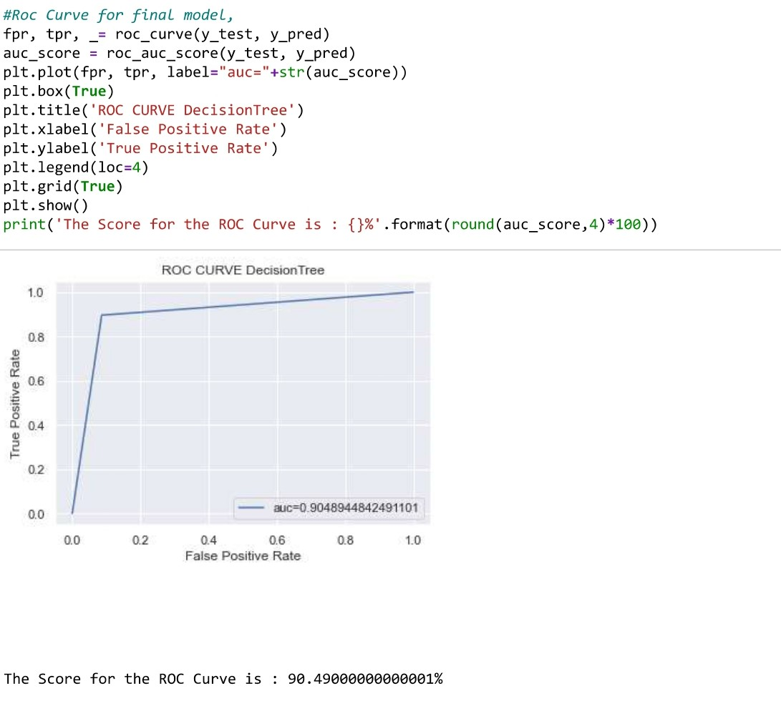
ROC Curve Final Model → Decision Tree

Slide 19
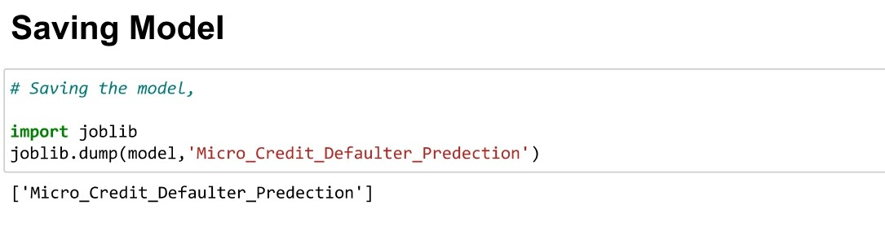
Finally Saving the Moldel

Slide 20
Thank You !! ☺

