Slide 1

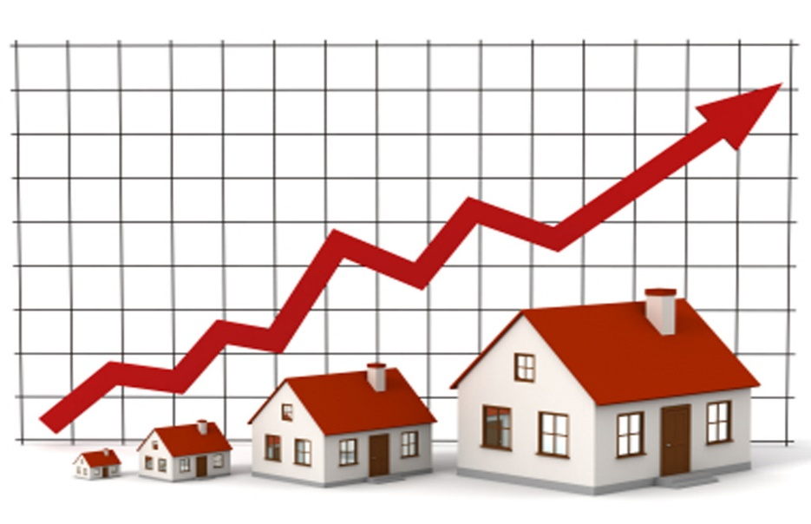
Housing Price predict Project
Submitted by:
P.V.Raghavulu

Slide 2
ACKNOWLEDGMENT
Thanks for giving me the opportunity to work in Flip Robo Technologies as Intern and would like to express my gratitude to Data Trained Institute as well for trained me in Data Science Domain. This helps me to do my projects well and understand the concepts.
Dataset – FlipRobo Tech
Resources used – Google, GitHub, Blogs for conceptual referring.

Slide 3
Business Problem
A US-based housing company named Surprise Housing has decided to enter the Australian market. The company uses data analytics to purchase houses at a price below their actual values and flip them at a higher price. For the same purpose, the company has collected a data set from the sale of houses in Australia.
The company is looking at prospective properties to buy houses to enter the market. You are required to build a model using Machine Learning in order to predict the actual value of the prospective properties and decide whether to invest in them or not.
For this company wants to know:
• Which variables are important to predict the price of variable?
• How do these variables describe the price of the house?

Slide 4
Conceptual Background of the Domain Problem
Houses are one of the necessary needs of each and every person around the globe and therefore housing and real estate market is one of the markets which is one of the major contributors in the world’s economy. It is a very large market and there are various companies working in the domain. The company is looking at prospective properties to buy houses to enter the market.
Data science comes as a very important tool to solve problems in the domain to help the companies increase their overall revenue, profits, improving their marketing strategies and focusing on changing trends in house sales and purchases.
A US-based housing company named Surprise Housing has decided to enter the Australian market. The company uses data analytics to purchase houses at a price below their actual values and flip them at a higher price.

Slide 5
Motivation for the Problem Undertaken
This model will then be used by the management to understand how exactly the prices vary with the variables. They can accordingly manipulate the strategy of the firm and concentrate on areas that will yield high returns. Further, the model will be a good way for the management to understand the pricing dynamics of a new market.

Slide 6
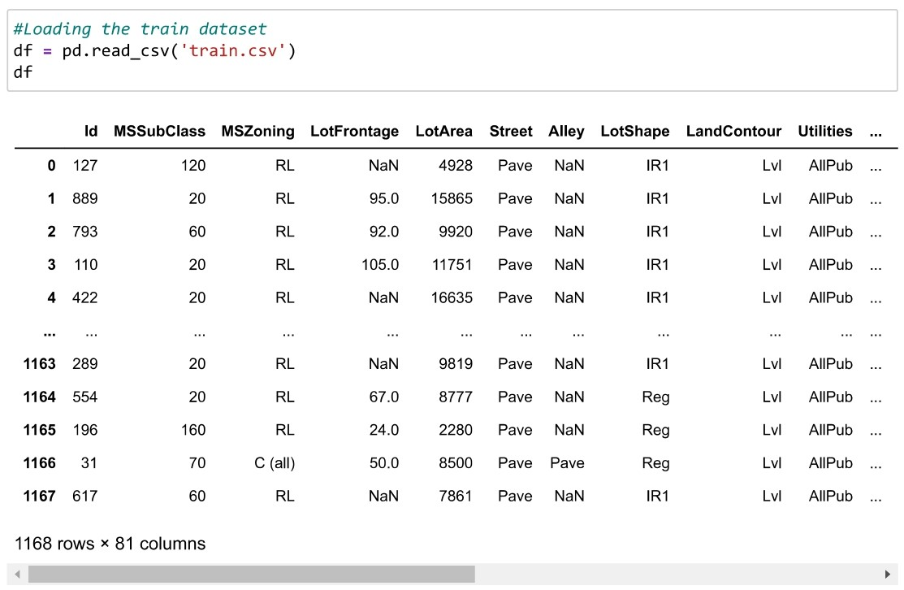
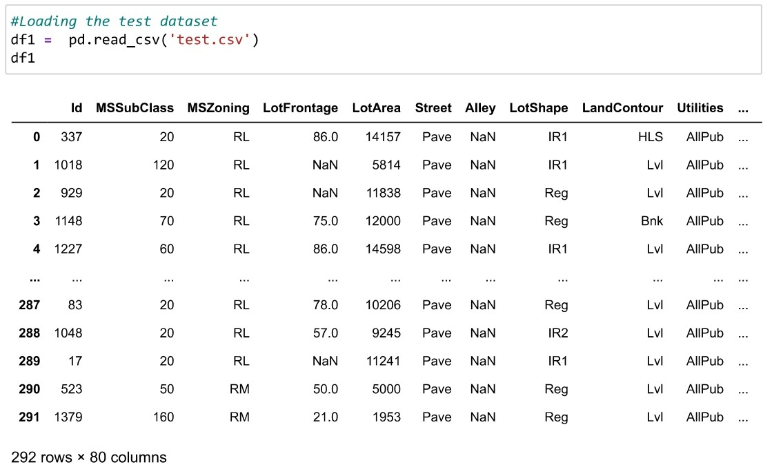
Data Sources and their formats
The sample data is provided to us from Flip Robo client database, and there are 2 Files – Train and Test datasets.
We need to train the data in Train dataset and predict the output using Test dataset.

Slide 7
Mathematical/ Analytical Modeling of the Problem
Our target variable is the “Sale Price” and need to predict the prices of the house. As the data is continuous and our problem is Regression. Therefore, we will be handling this modelling problem as classification.

Slide 8
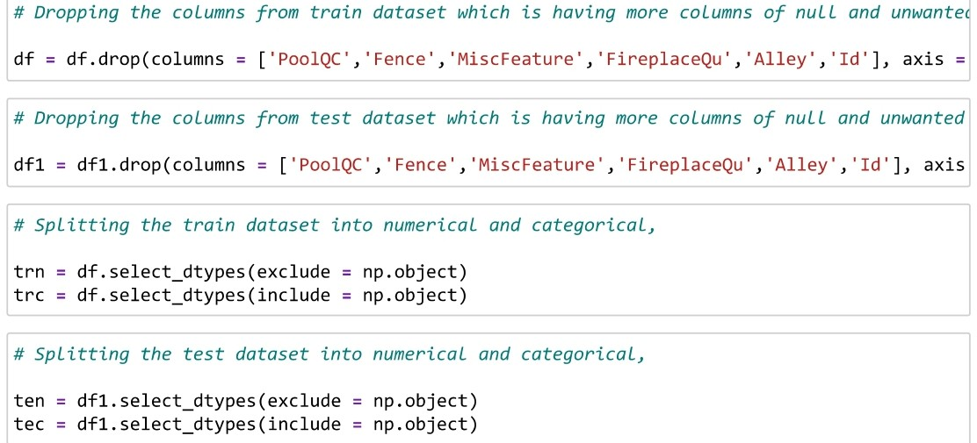
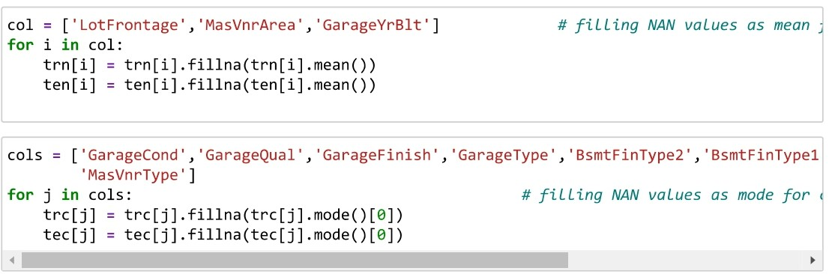
Data Pre-processing Done
Dropping the unwanted and less importance data,

Slide 9
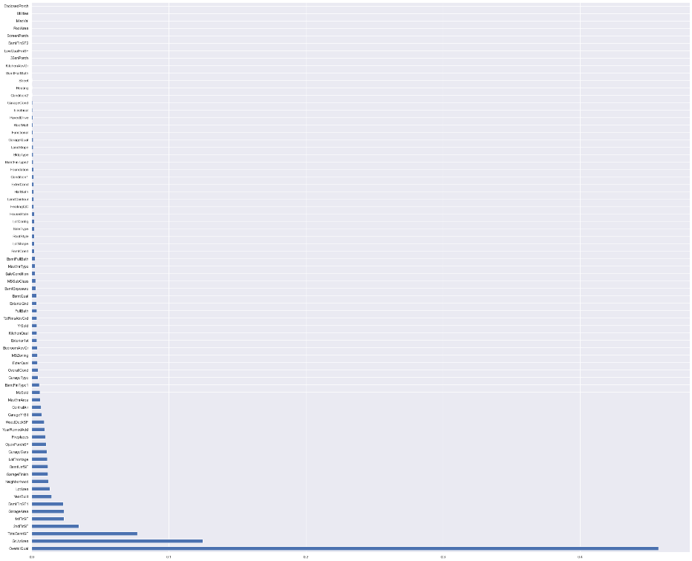
Data Pre-processing
Feature Importance-

Slide 10
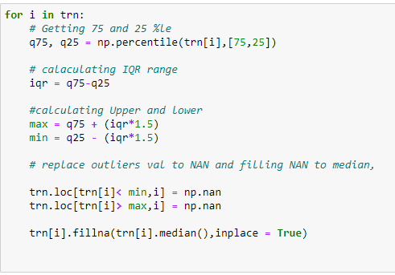
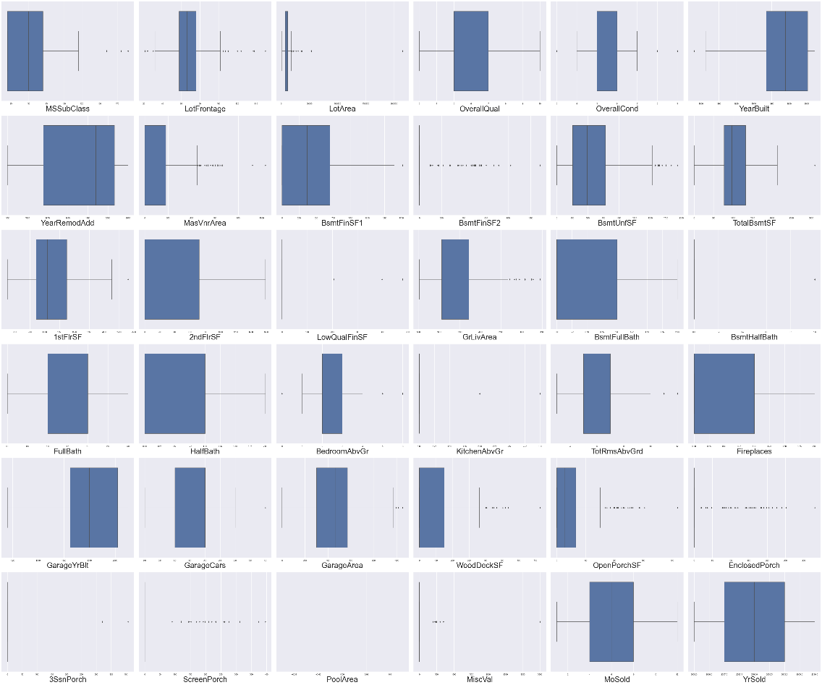
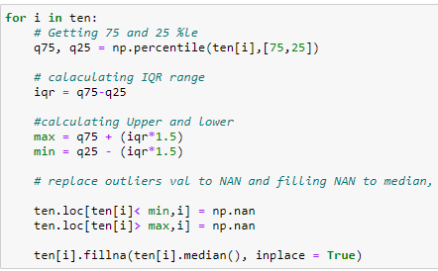
Outliers Handling

Slide 11
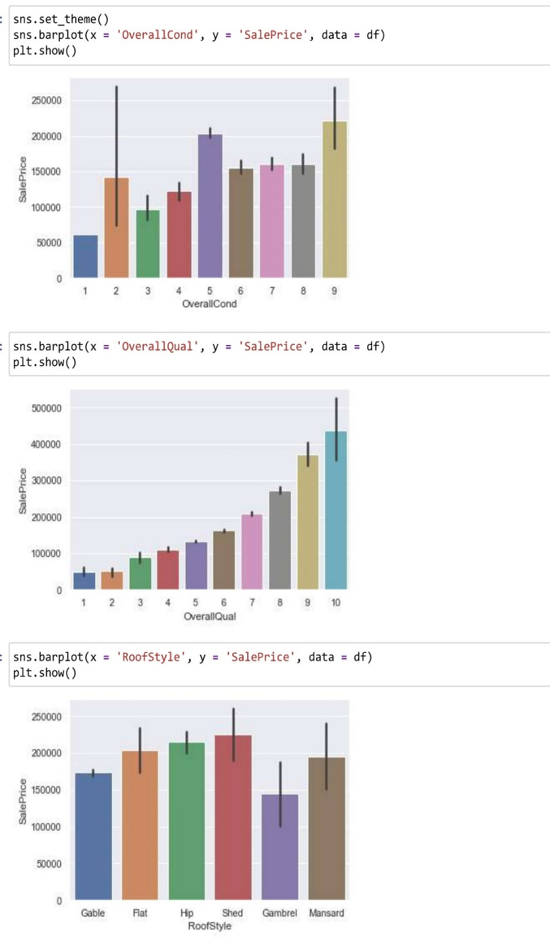
Data Visualization -
The below plot shows that rating of over all conditions of house which is greater than 5 has price of > 1.5L and the house which has rating of >8 of material and finishing of house price is >30L.
Also, the plot shows that most of the house roof style is shed / hip / flat.

Slide 12
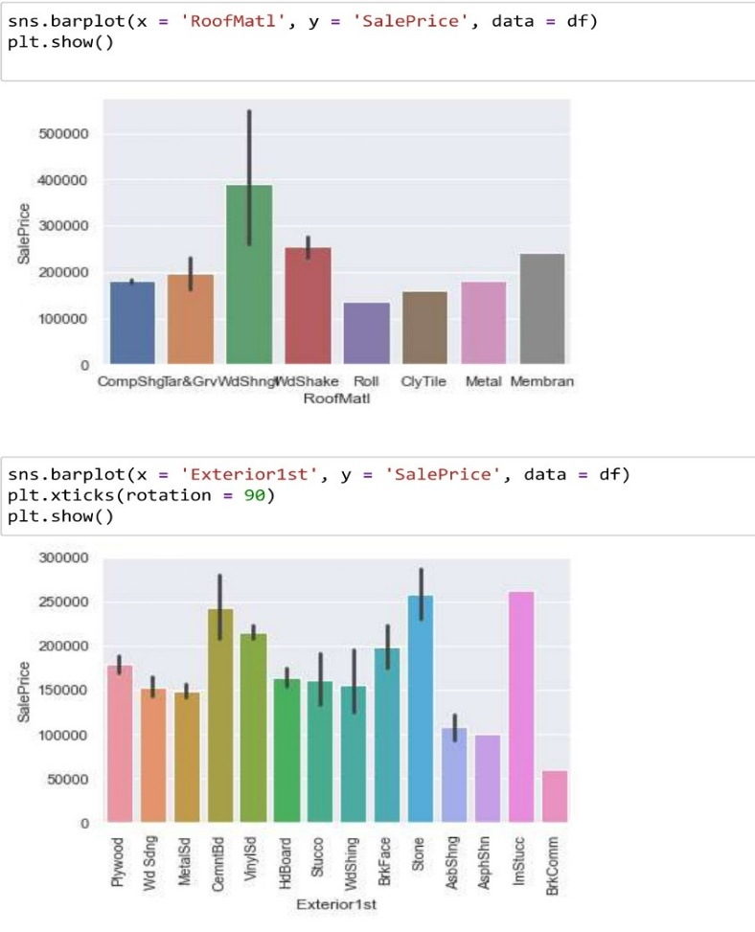
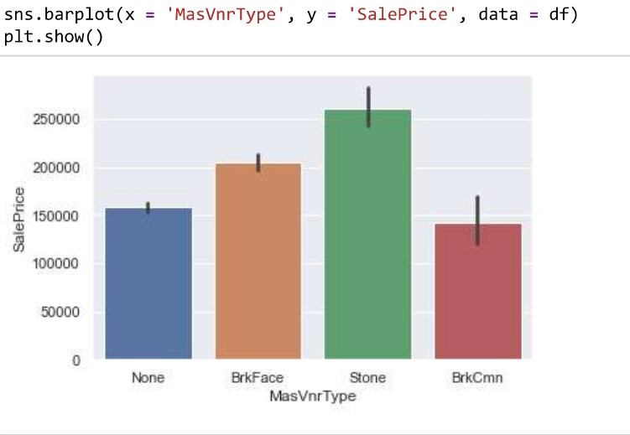
Data Visualization -
The below plot explains that most of the roof material in houses are Wood Shingles and the exterior used on houses are Imitation Stucco and Masonry veneer type of most of the houses are Stone and the houses which is satisfying these conditions are selling the house price >25L.

Slide 13
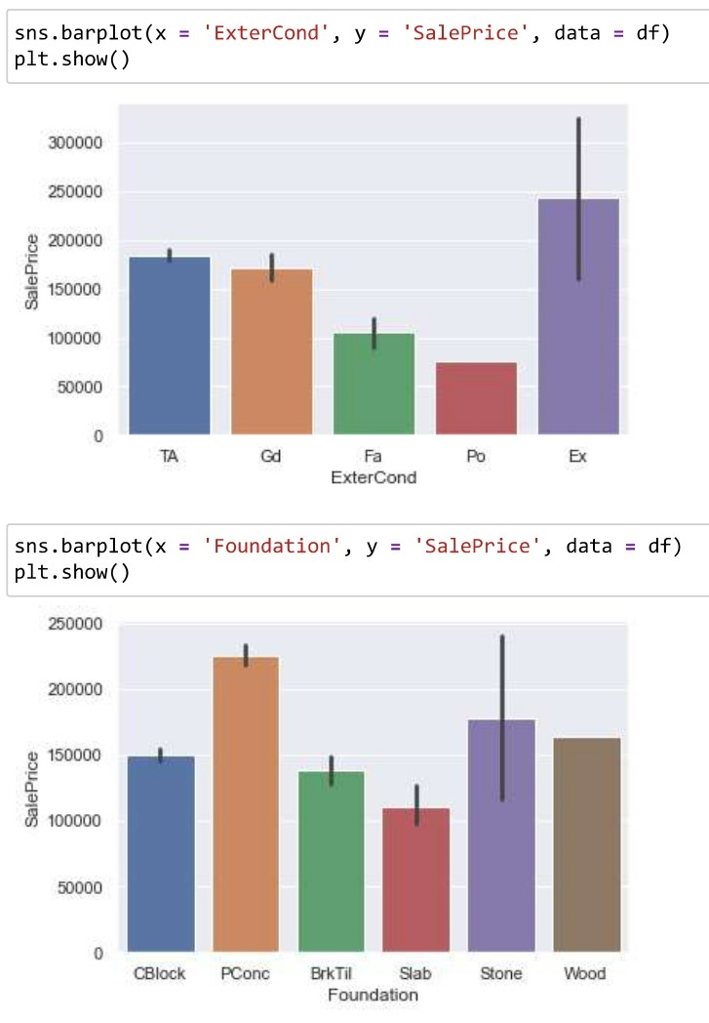
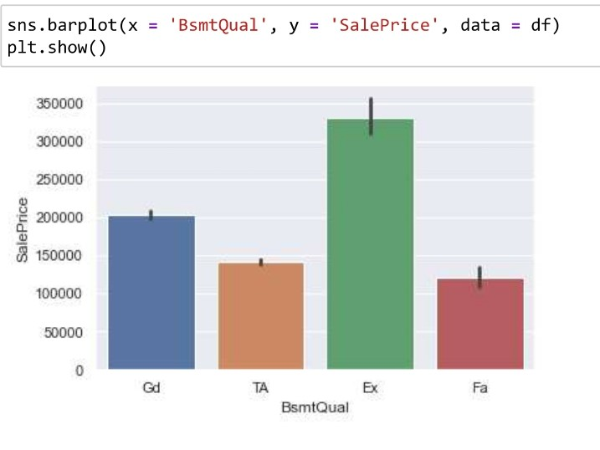
Data Visualization -
The exterior condition and basement of house which is having rating of Excellent has price of >20L.
Most of the house possess the foundation type as Poured Concrete and it has the high price of >20L.

Slide 14
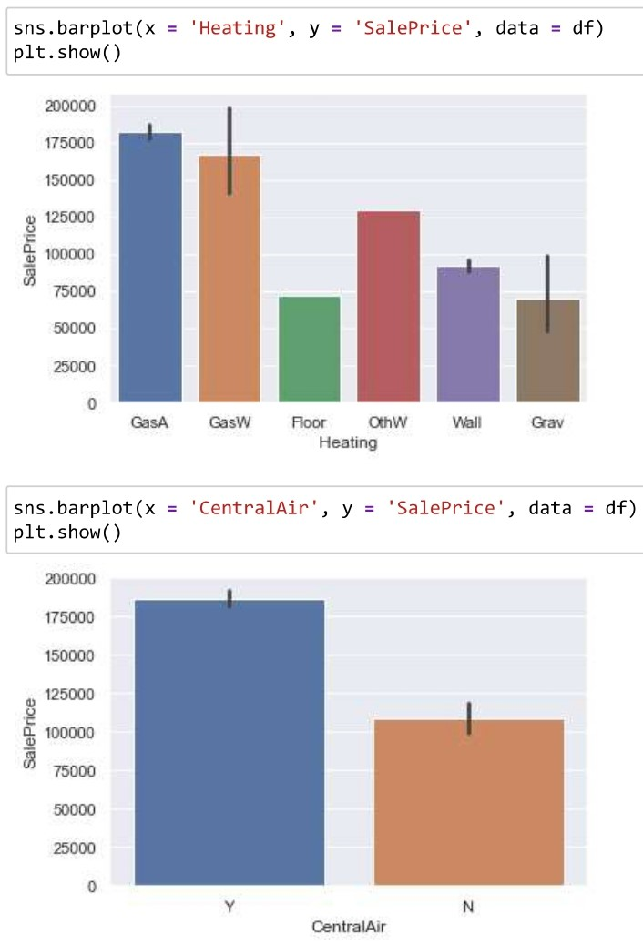
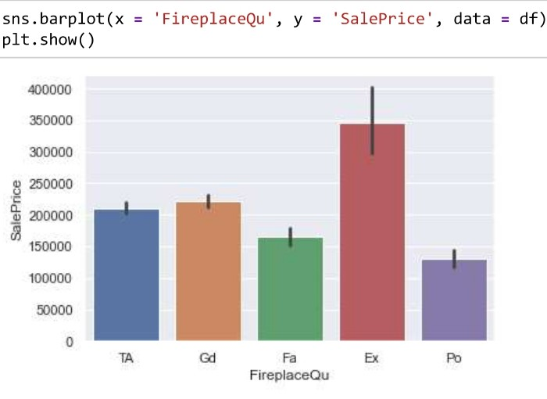
Data Visualization -
The plot shows that most of the house heating type is Gas forced warm air furnace and central air conditioned and fireplace quality should be excellent has price of >1.5L.

Slide 15
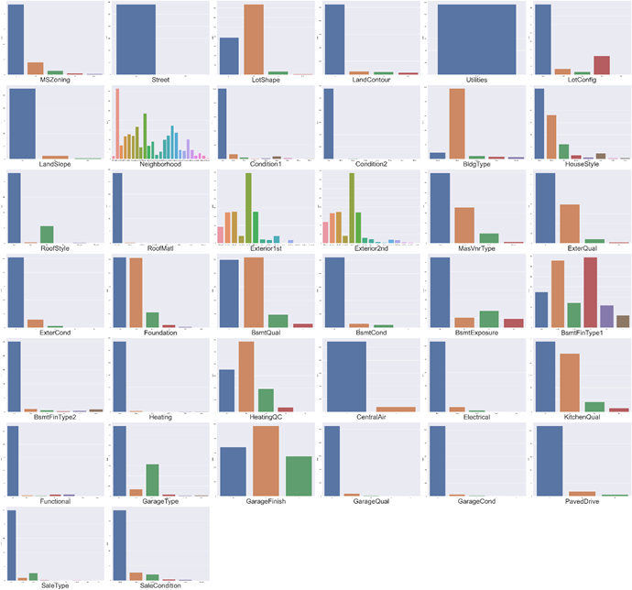
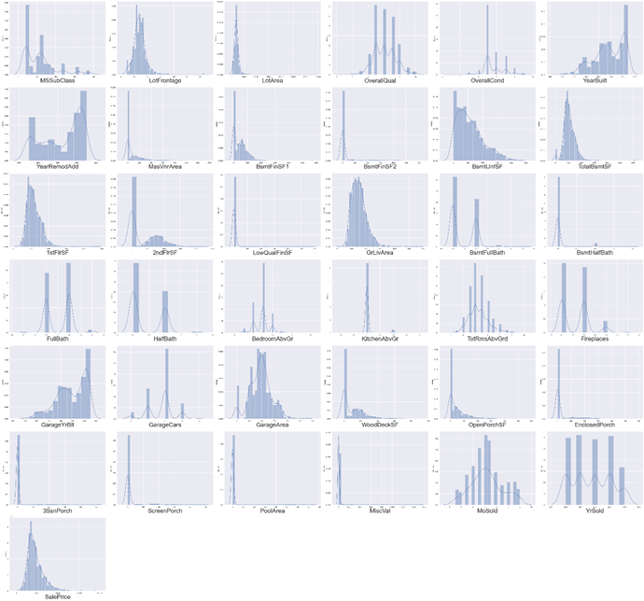
Data Visualization

Slide 16
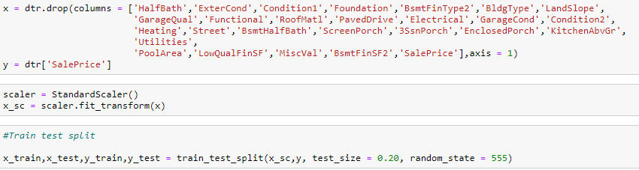
Standard-Scalar is applied to standardize the input data.
Splitted the train and test data for model building,
After train test split, we apply the below Regression algorithms and cross Val score to find the best scoring one.
Random Forest
K- Neighbors
Ada / Gradient Boost
Linear Regression

Slide 17
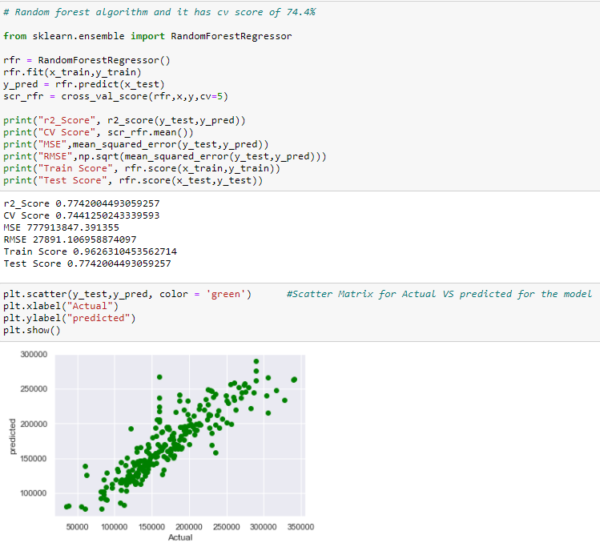
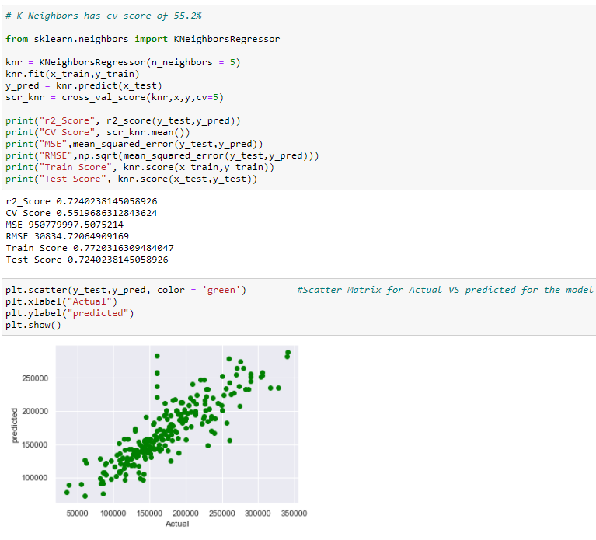
Model Building:
Random Forest has CV Score – 74.4%
K- Neighbors has CV Score – 55.2%

Slide 18
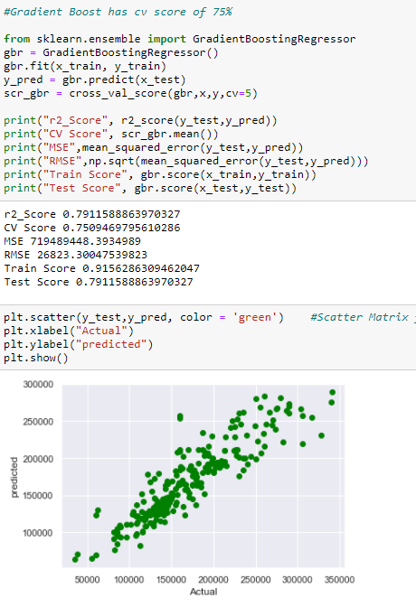
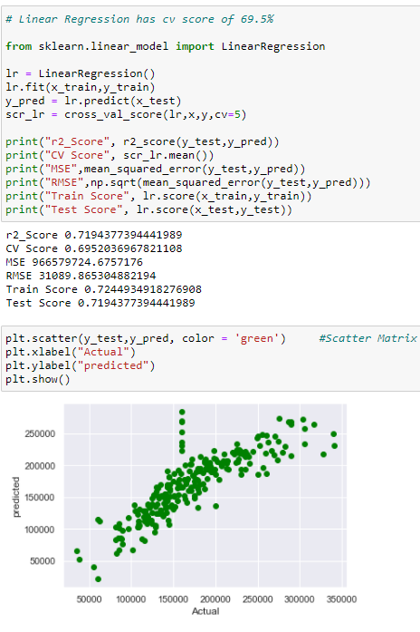
Gradient Boost has CV Score – 75%
Linear Regression has CV Score – 69.5%

Slide 19
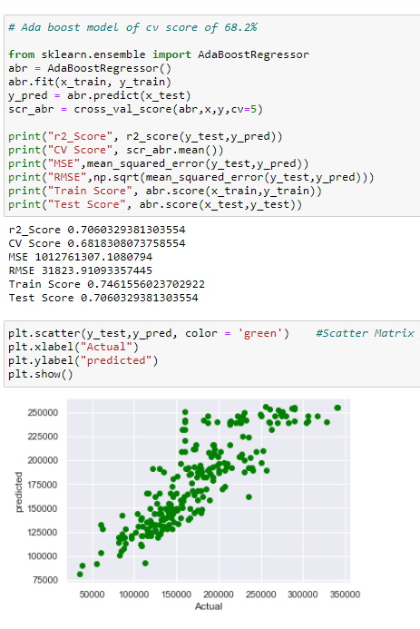
Ada Boost has CV Score – 75%

Slide 20
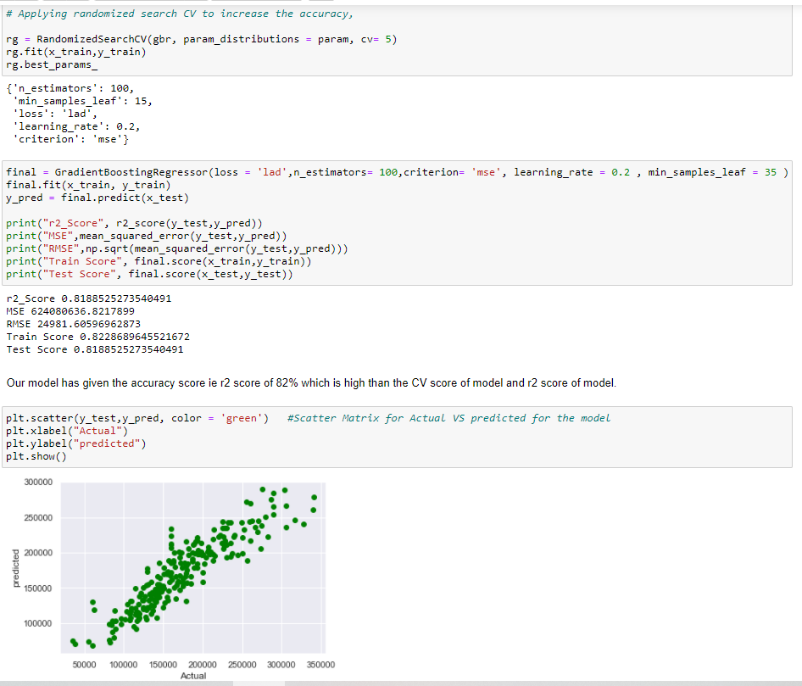
Hyper Parameter Tuning for the final model -> Gradient Boost

Slide 21
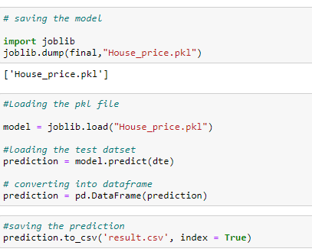
Finally Saving the model .pkl file and Loading the test data File,

