Slide 1

Flight Price Predict Project
Submitted by:
Raghavulu Patnala

Slide 2
ACKNOWLEDGMENT
Thanks for giving me the opportunity to work in FlipRobo Technologies as Intern and would like to express my gratitude to Data Trained Institute as well for trained me in Data Science Domain. This helps me to do my projects well and understand the concepts.
Dataset – FlipRobo Tech
Resources used – Google, GitHub, Blogs for conceptual referring.

Slide 3
Business Problem
We need to predict the flight price here as we know already that flight prices will vary due to many factors like festive time and booking ticket at a last moment and based on airlines also prices will vary too.
Keeping the flight full as they want it because last minute purchases are expensive.
Depends on the route and the duration between the places. This is also one of the factors that they can raise the price of the ticket at any time.

Slide 4
Motivation for the Problem Undertaken
Due to the high price strategy, all cannot afford to travel in flight, and it is the fastest mode of travel now a days.
Here, Predicting the prices will help us to know the cheapest and best route and it will help us to find the price of the flight.
This will help the all kinds of people to conclude when the prices will be high and when it will be less.

Slide 5
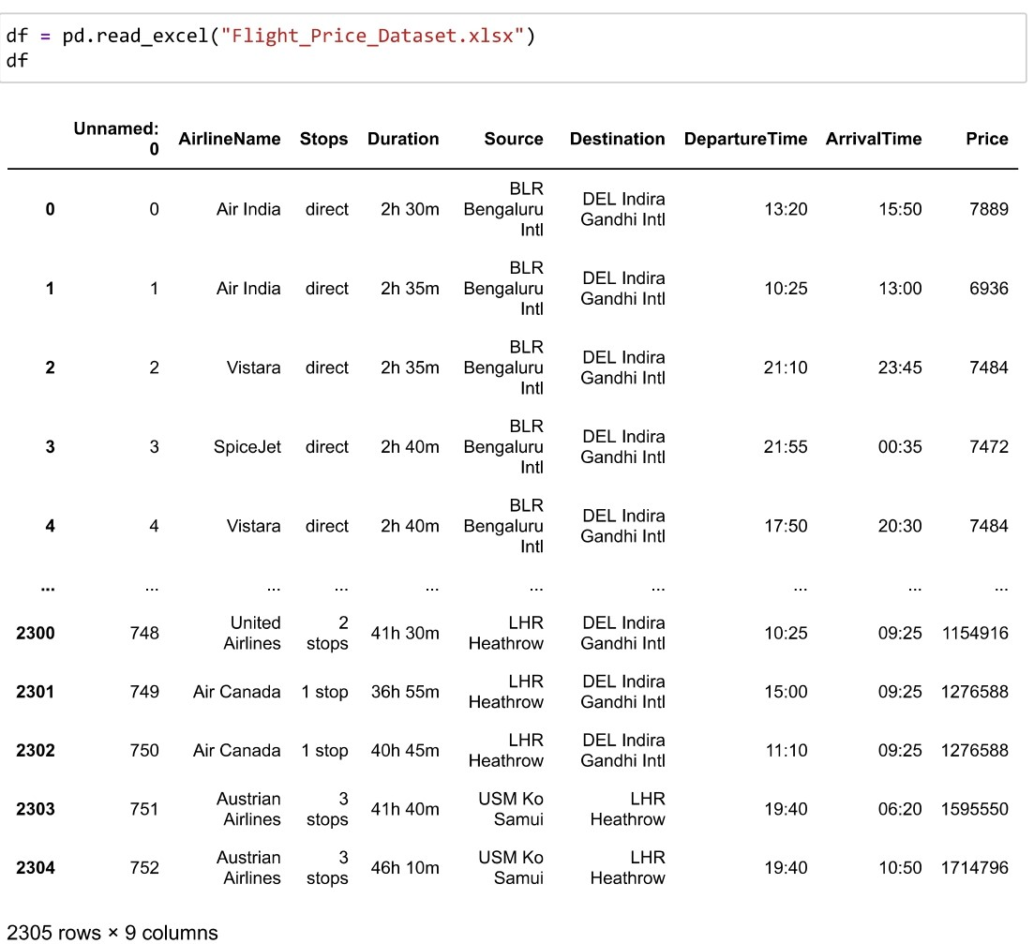
Data Sources and their formats
Data has been collected by me from one of the official websites of flight and it has 2305 rows and 9 columns.
Data doesn’t have any null values or missing data. So, we are good to pre-process the data.

Slide 6
Mathematical/ Analytical Modeling of the Problem
Our target Variable is Price and as the data is having continuous variables, hence this is Regression Problem.

Slide 7
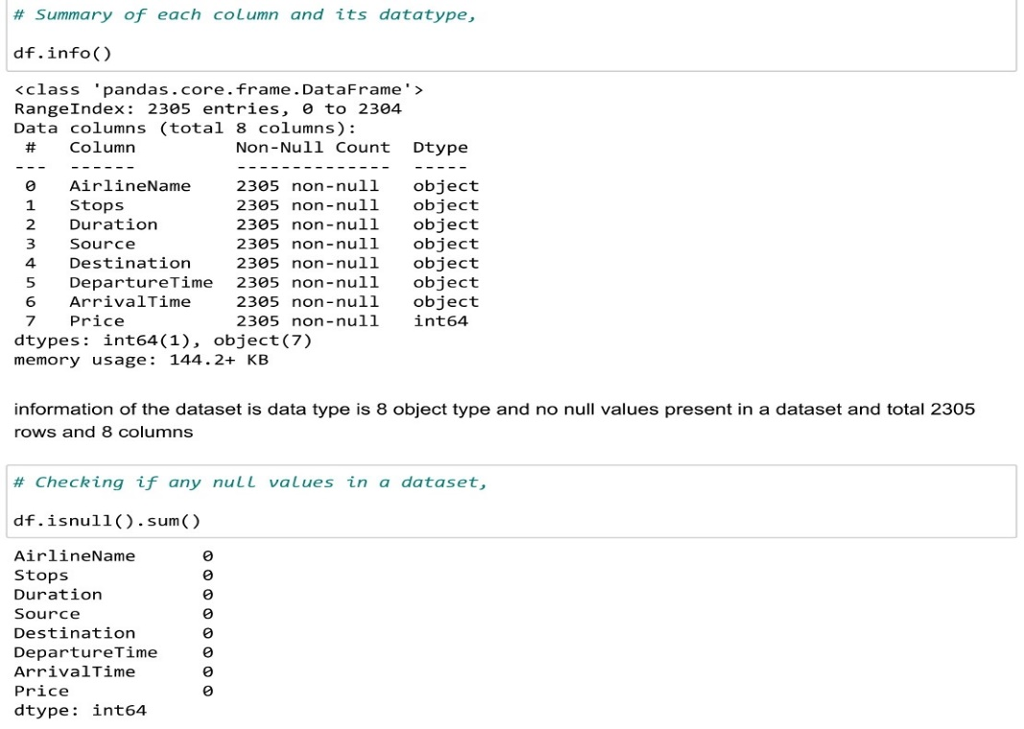
Data Pre-processing Done
We can see that we have object datatypes for most of the columns in dataset.
So, we need to convert those categorical columns into numerical columns as pre- processing step for better model.

Slide 8
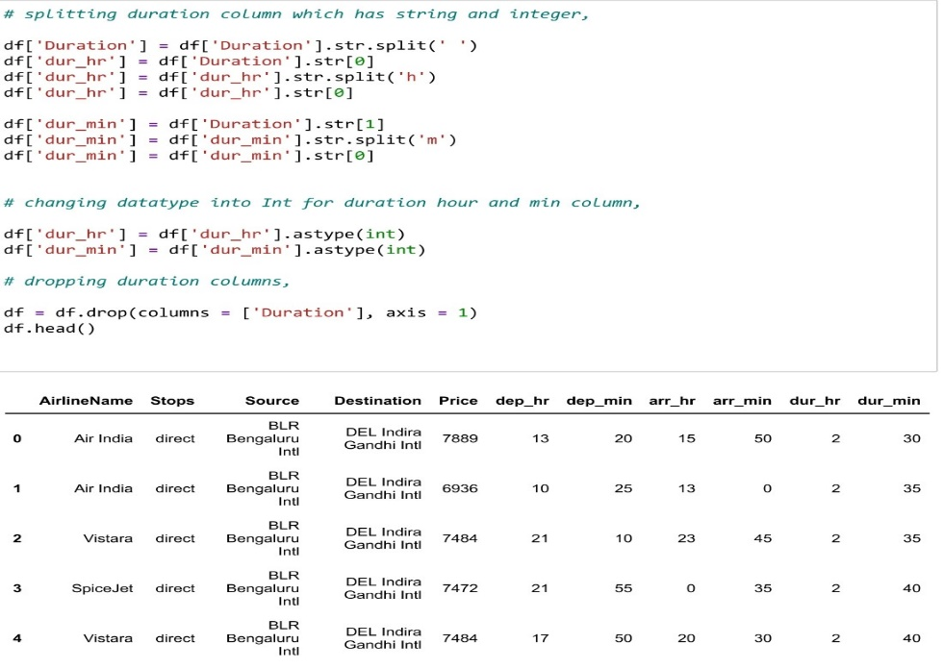
Data Pre-processing
Applying Datetime index to split the hour and minute from departure / arrival time and duration columns.

Slide 9
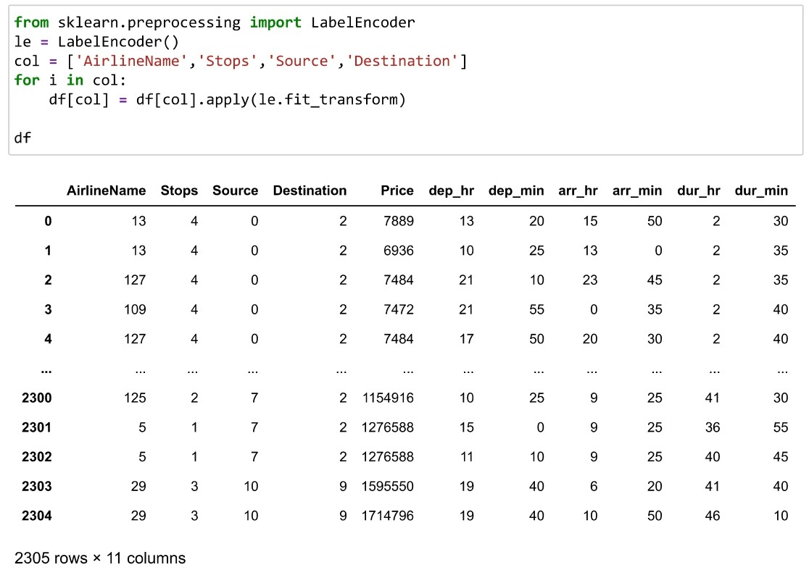
Data Pre-processing
Applying Datetime index to split the hour and minute from departure / arrival time and duration columns.

Slide 10
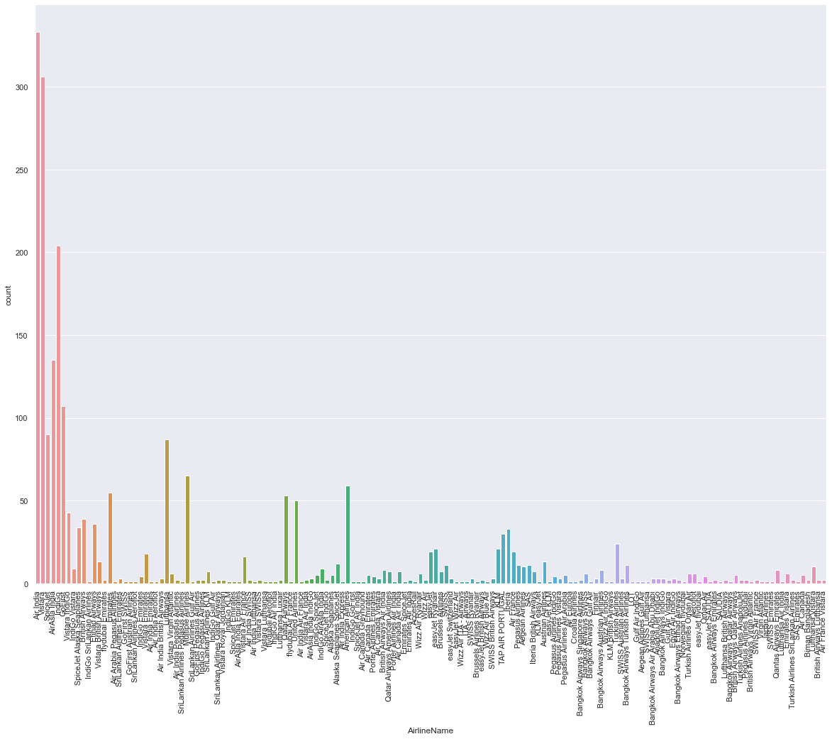
Data Visualization -
Almost all flight brands are in demand but among all popular brands, AirIndia,Vistara,Indigo are having brand flights

Slide 11
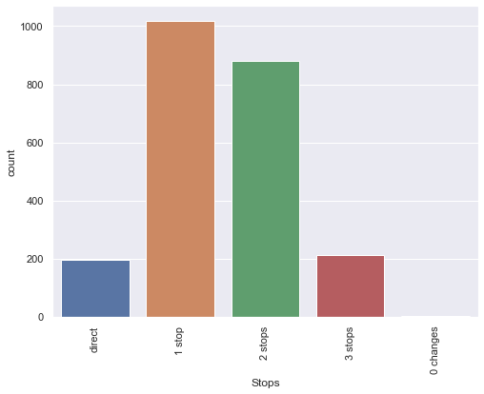
Data Visualization -
As we can see that there are stops such as – Direct, 1 /2/3 stops and either we can change or not change.
So as per the below chart, we can see that most of the flights has minimum 1 or 2 stops to proceed further.

Slide 12
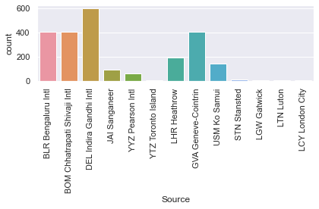
Data Visualization -
Passengers most booked departure place is DEL (Indhira Gandhi Intl)

Slide 13
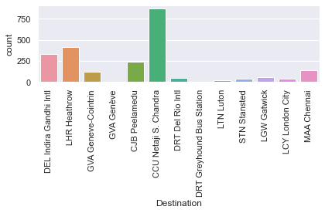
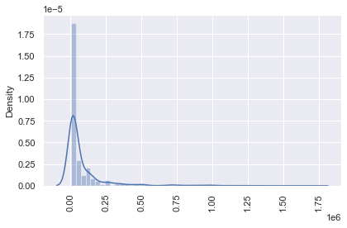
Data Visualization -
Most of the arrival place is CUU Netaji
Target variable price has some skewness on right side and its because depends on place, price will be varying

Slide 14
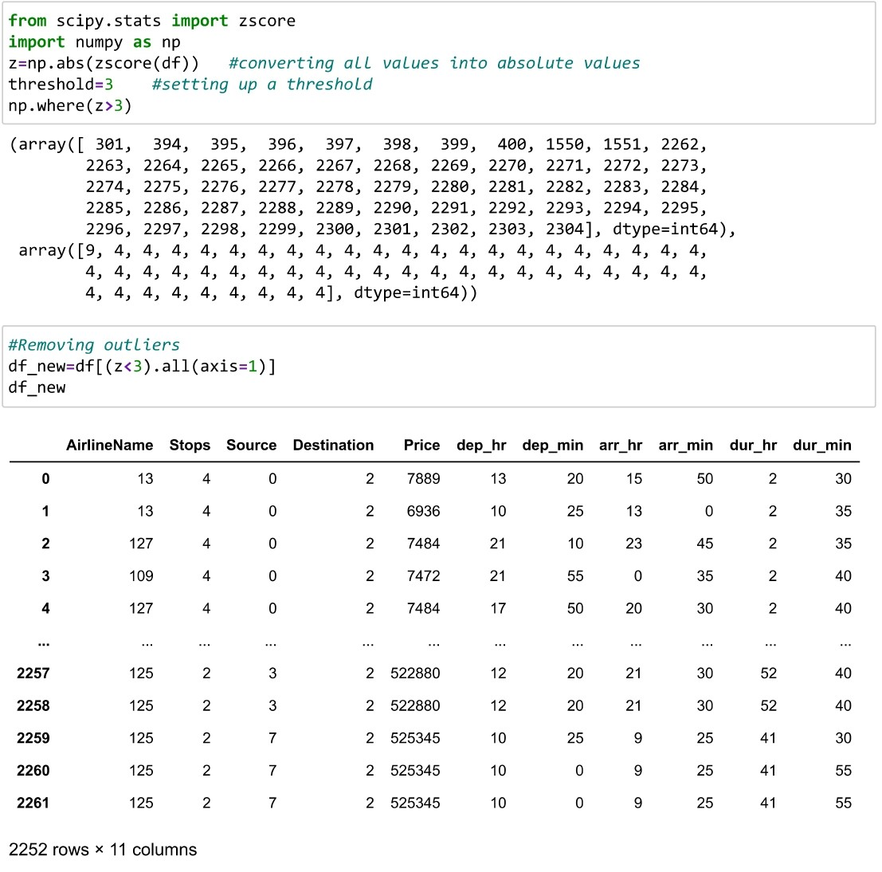
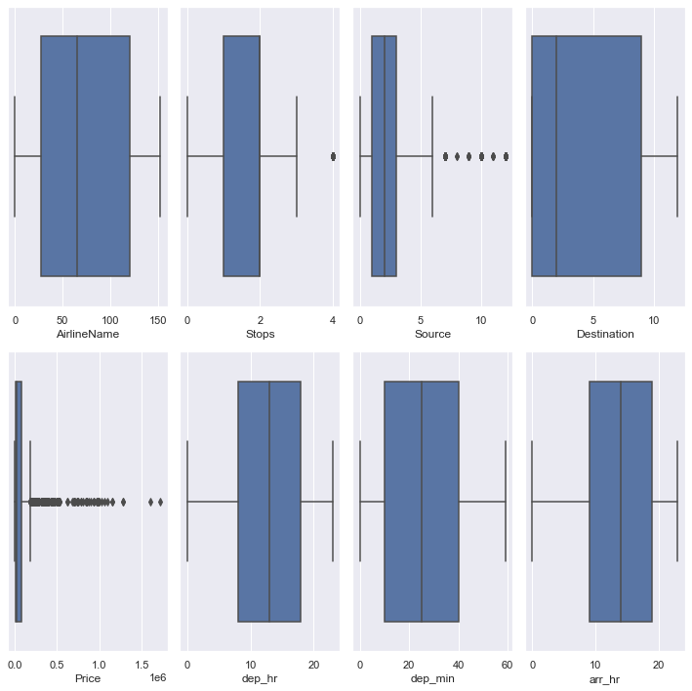
Remove Skewness
Removing outliers from the data using Z score.
Splitting the data and then removing skewness.
Removing skewness from the data.
Scaling the data using standard scaler so that there is no biasness during model learning.
Using PCA and SequentialFeatureSelector for feature selection.

Slide 15
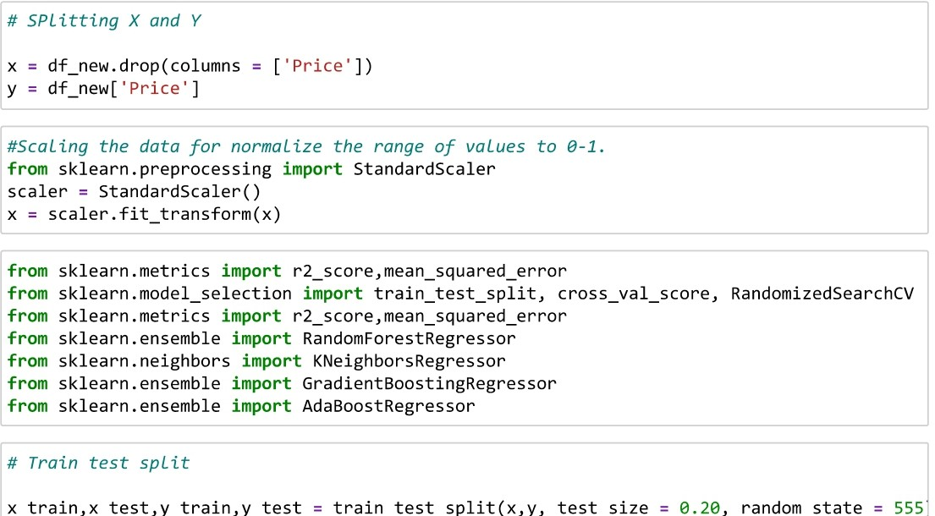
Splitted the train and test data for model building,
After train test split, we apply the below Regression algorithms and cross Val score to find the best scoring one.
Random Forest
K- Neighbors
Gradient Boost
Ada Boost

Slide 16
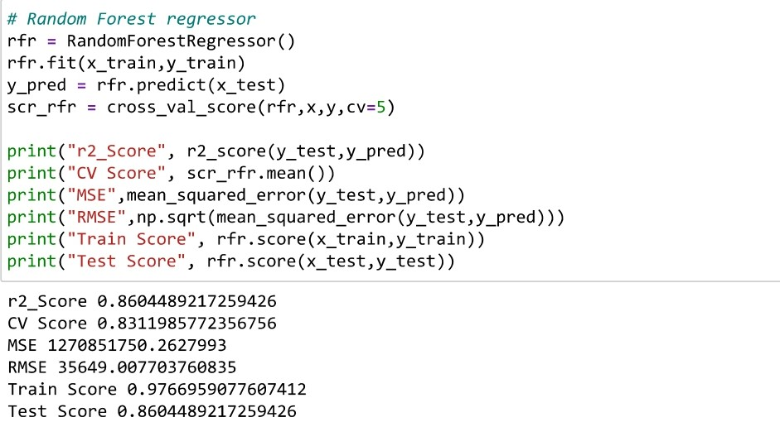
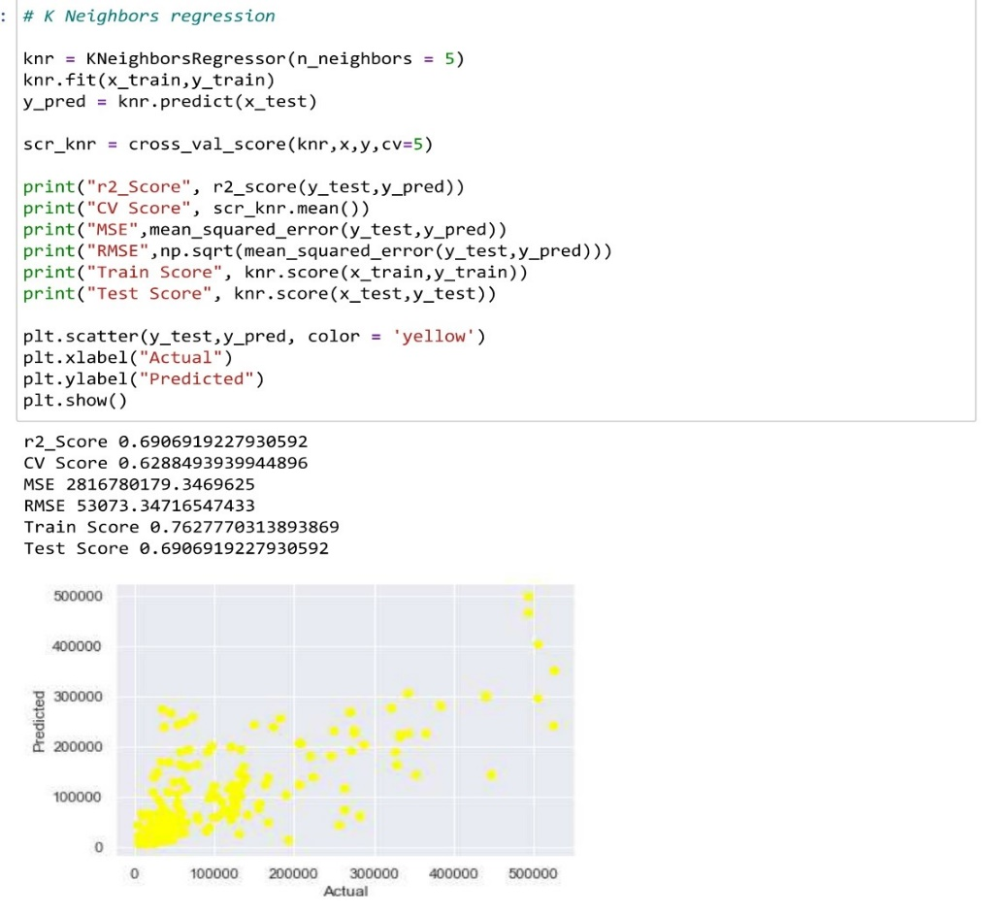
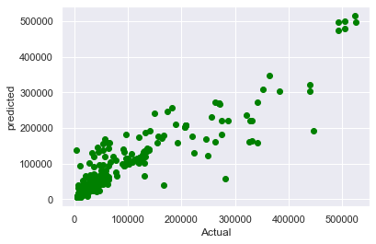
Model Building:
Random Forest has CV Score –86.04%
K- Neighbors has CV Score – 69.06%

Slide 17
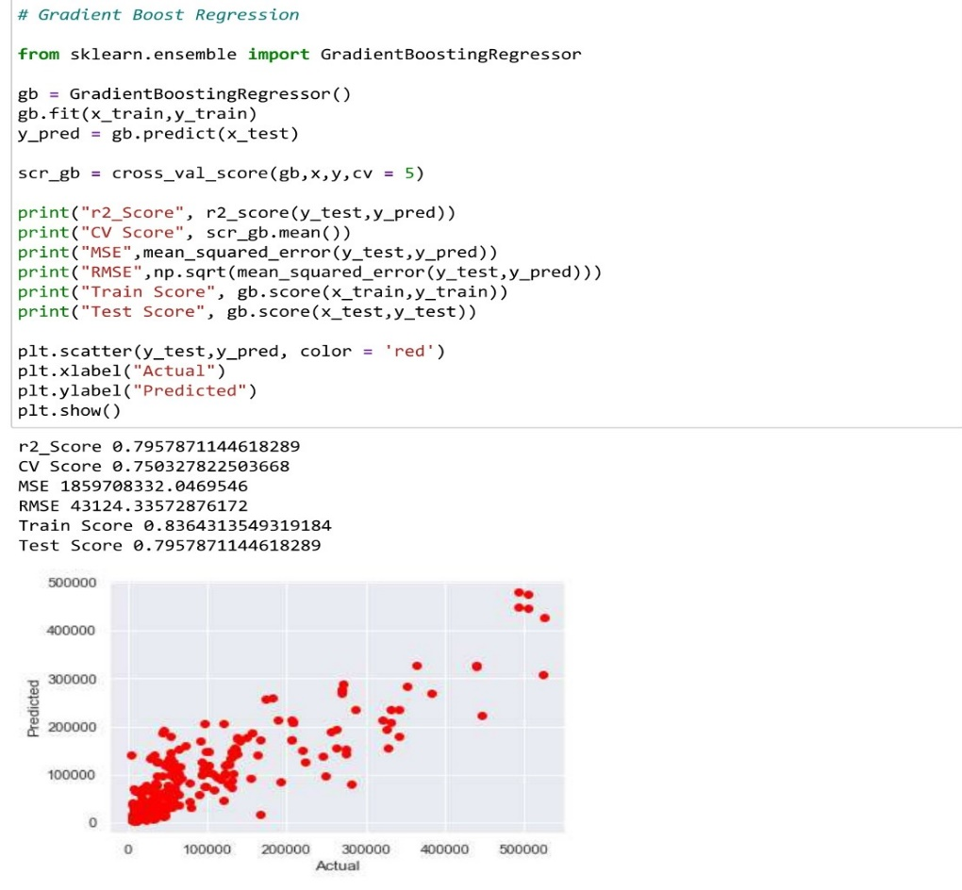
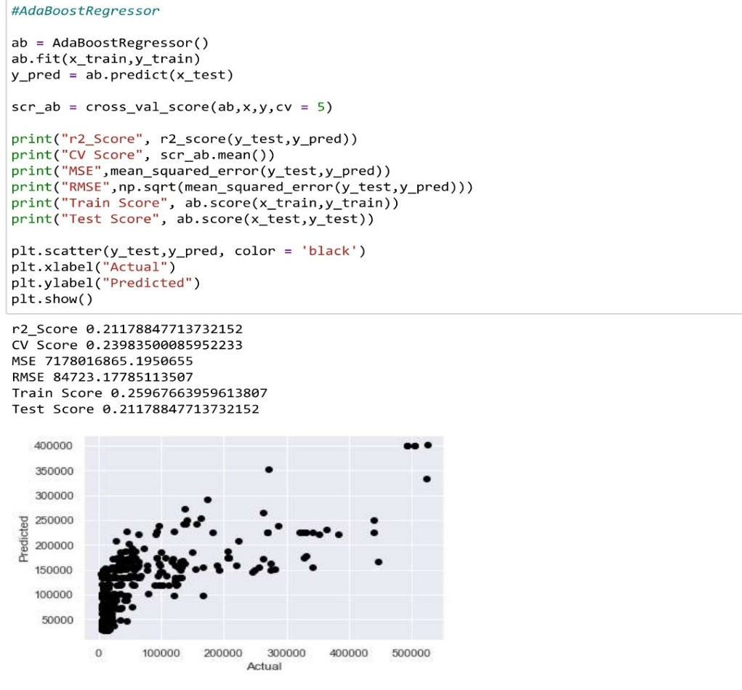
Gradient Boost has CV Score – 79.57%
Ada Boost has CV Score – 21.17%

Slide 18
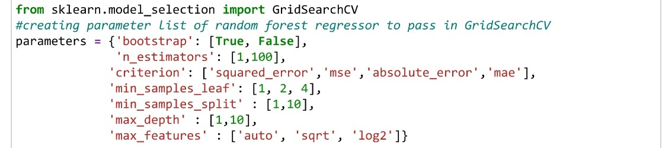
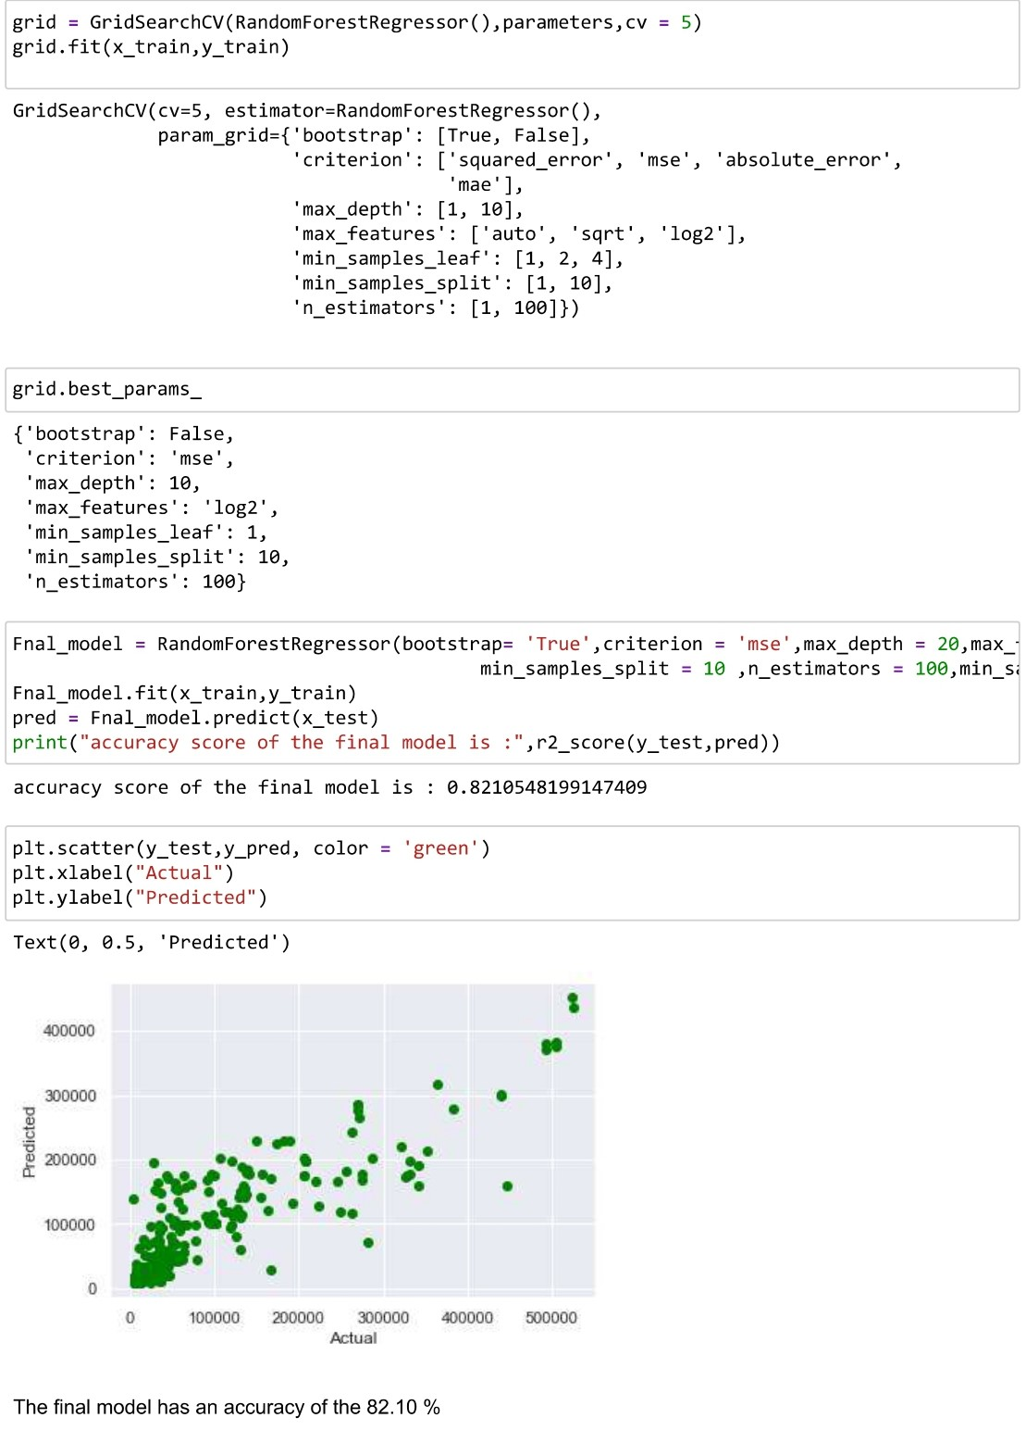
Hyper Parameter Tuning for the final model -> Random Forest

Slide 19
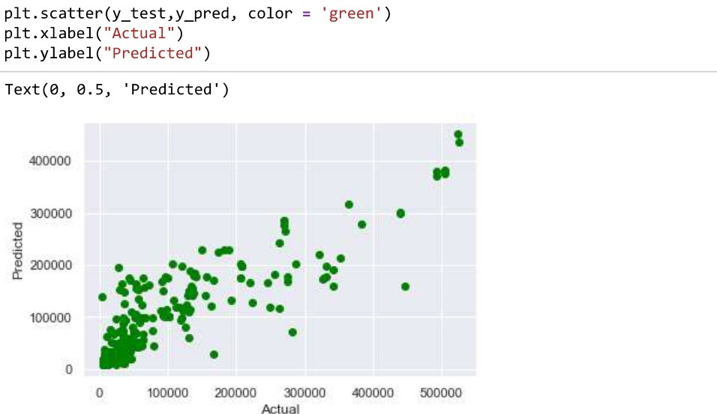
Hyper Parameter Tuning for the final model -> Random Forest

Slide 20
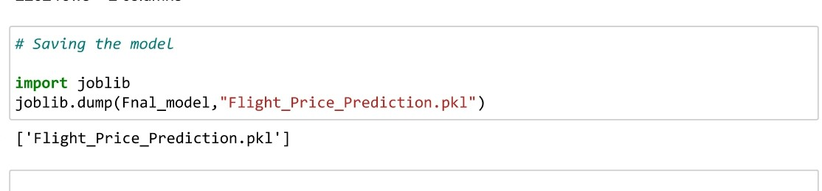
Finally Saving the model .pkl file and Loading the test data File,

Slide 21
Thank You !! ☺

