Slide 1
English Premier League…
Analysis on teams and league progress over the seasons…
Notes:
There are total of 25 seasons from 1993-94 to 2017-18
9664 records – matches
Date, FTR, HTR, FTHG, FTAG

Slide 2
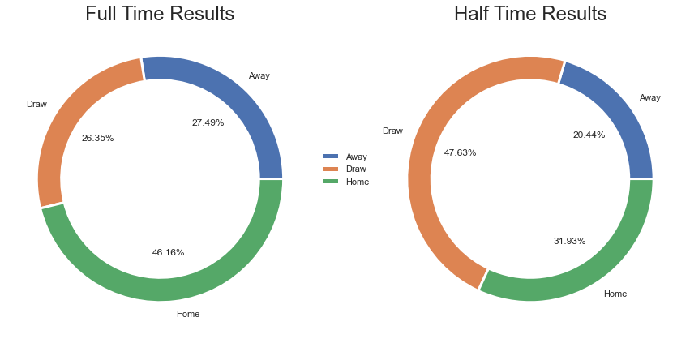
Result Distribution:
The above “Pie” charts shows the comparison of results at Half Time and Full Time.
We can observe that for ‘Away Team’ to win the match they should try to be in lead at First Half Time.

Slide 3
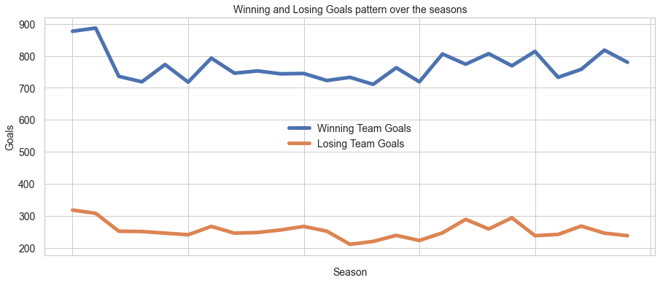
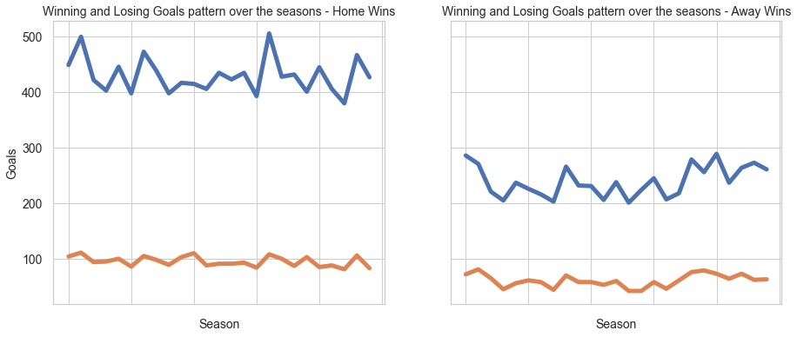
Goals pattern Over the Seasons:
There is significant difference in winning and losing goals
The difference in high in home wins and reduces to half in away wins

Slide 4
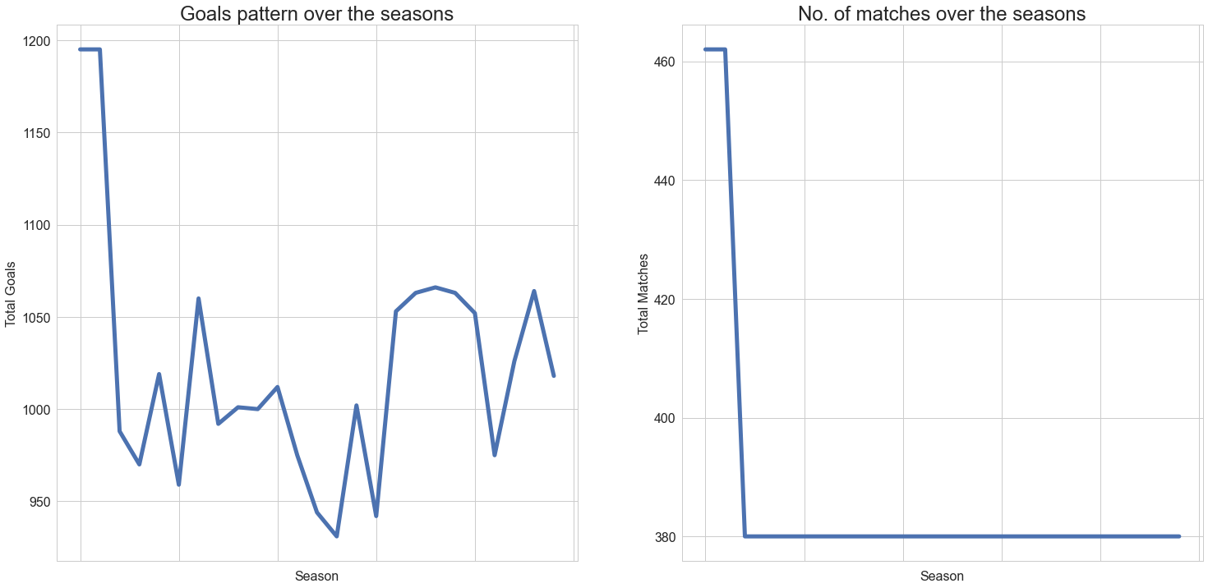
Goals pattern Over the Seasons:
Total Goals per season has gone down, this is due to the fact that the number of games per season has decreased since the earlier stages of the league.

Slide 5
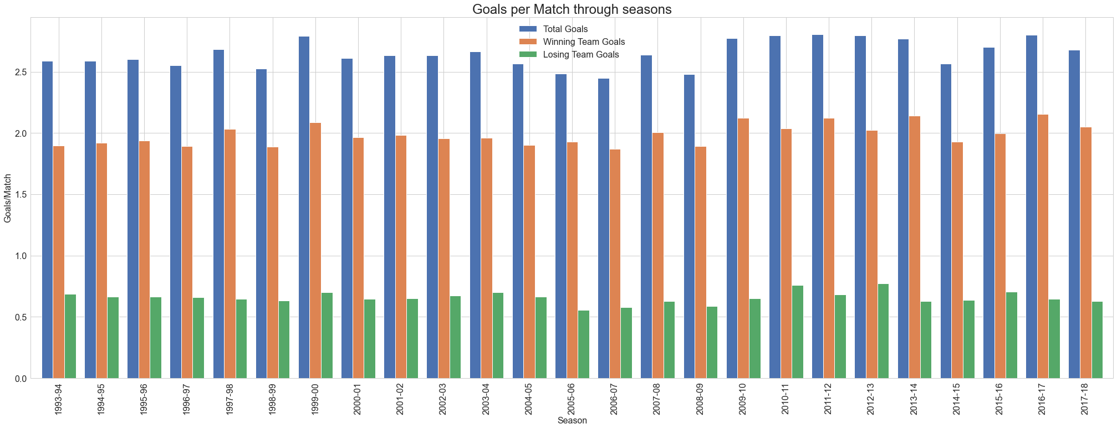
Average goals pattern over the seasons:
As shown earlier reduction in goals through seasons is only due to reduction of matches. This can be proven by this bar graph representing average goals per match is similar throughout seasons.

Slide 6
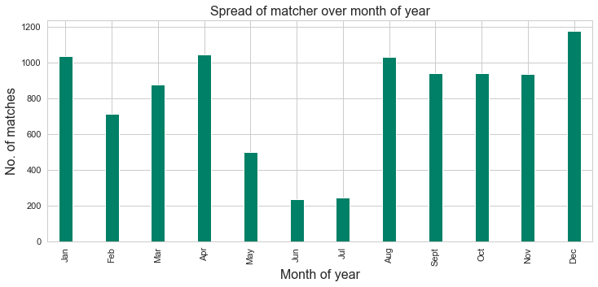
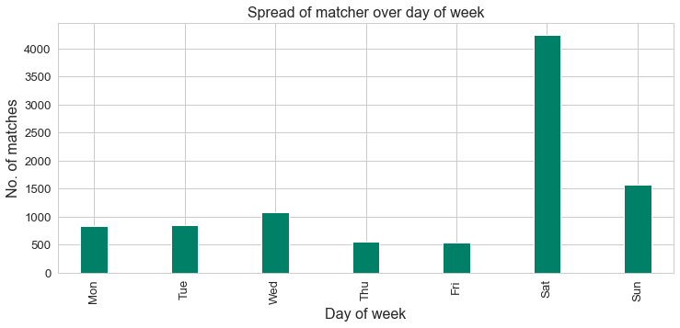
Spread of matches:
Above graph shows how the matches were played on each month on a year and day of a week.
Significantly less no. of matches are played in June and July (Summers)
More matches are scheduled on Saturday followed by Sunday (To attract more crowd)

Slide 7
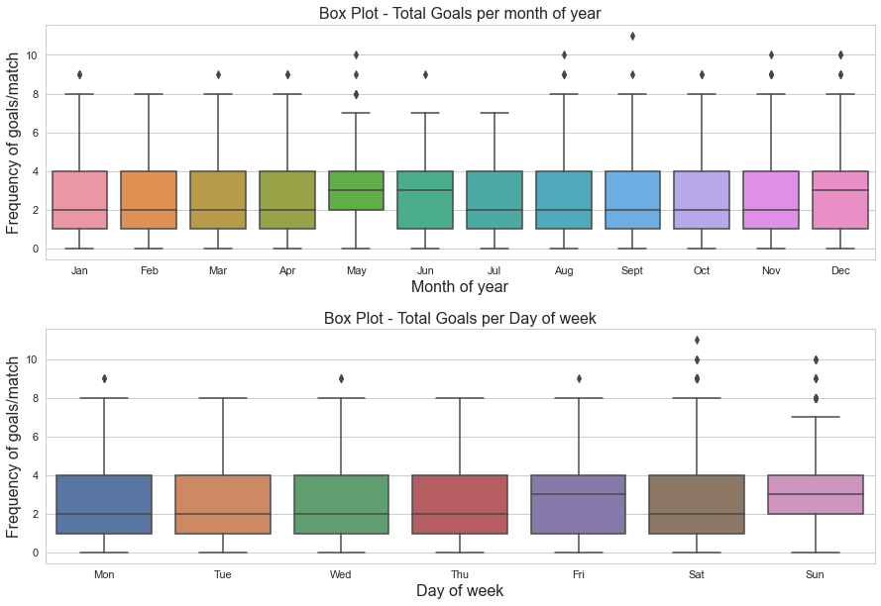
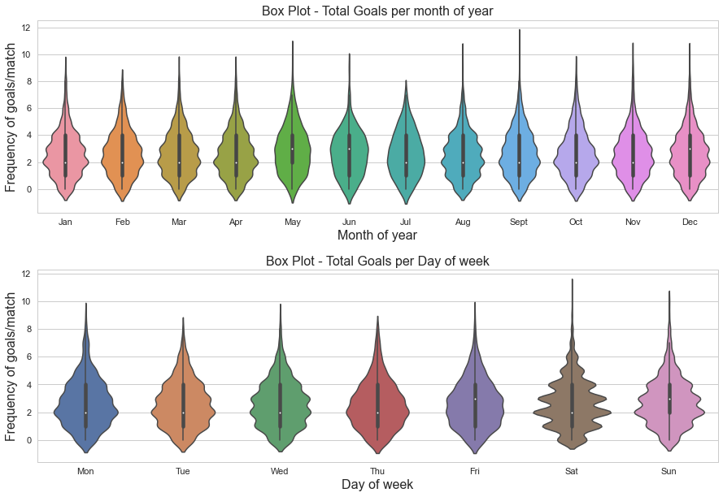
Spread of goals:
Above graph shows number of goals per match on each month on a year and day of a week.
Less goals per match is seen in June and July (Summers)
Max goals per match is seen on Saturdays

Slide 8
Team Performance Analysis…

Slide 9
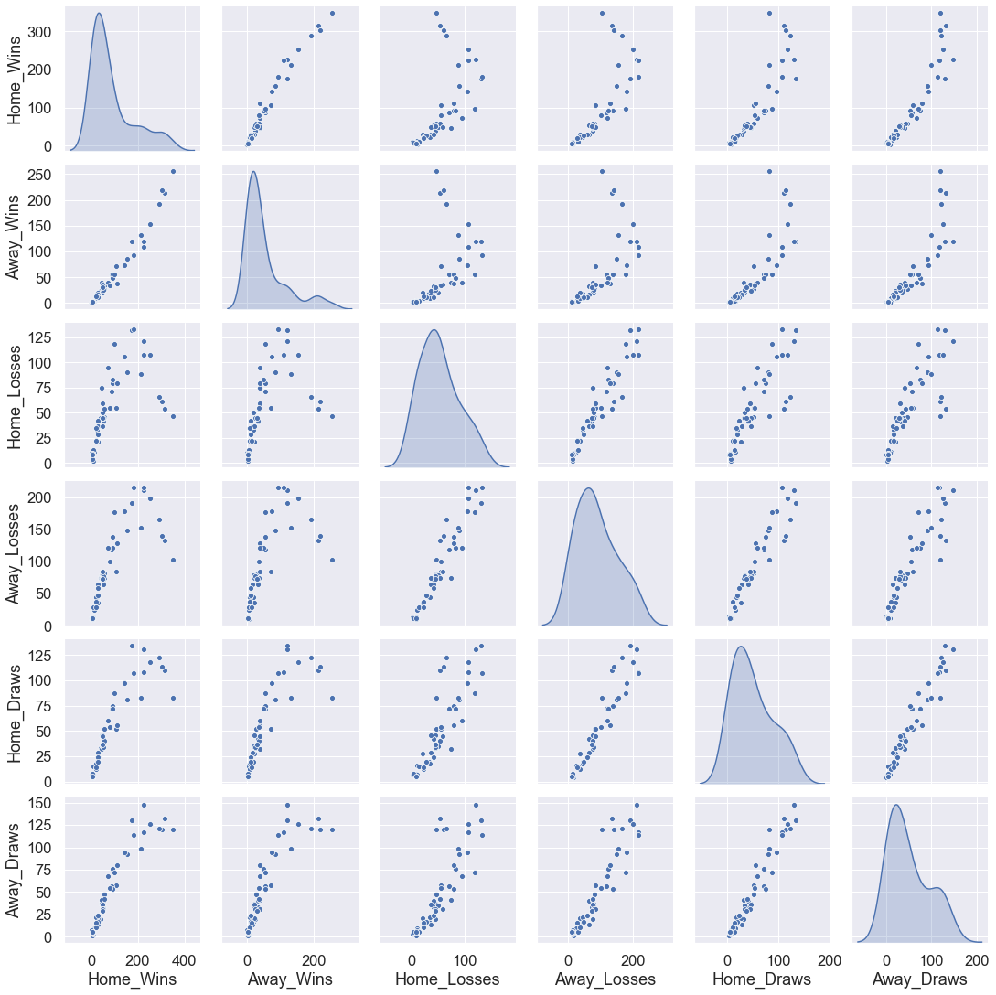
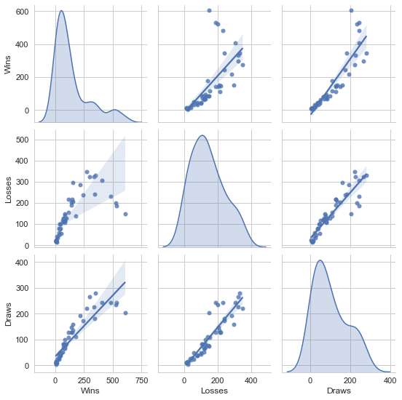
Correlation in teams’ Home and Away performance:

Slide 10
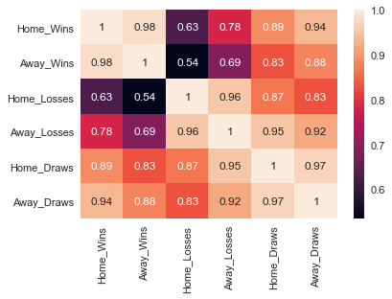
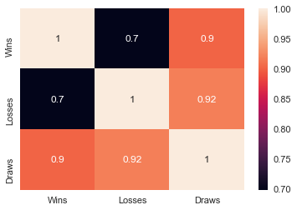
Correlation Takeaways:
Home Wins and Away Wins are Highly correlated
Home Draws and Away Draws are Highly correlated
Home Losses and Away Losses are Highly correlated
Draws are equally correlated with Wins and Losses
Correlation Heatmap:

Slide 11
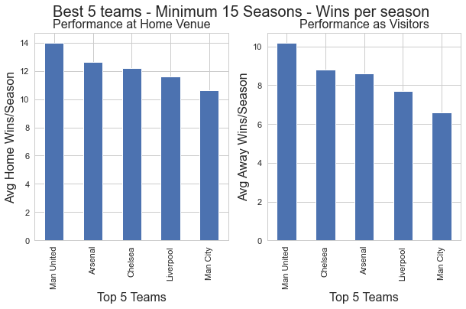
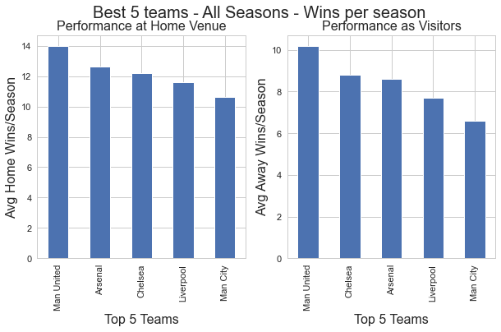
Top 5 teams’ home/away wins:
We can observe that teams which perform well at home are the teams which perform well at away games as well

Slide 12
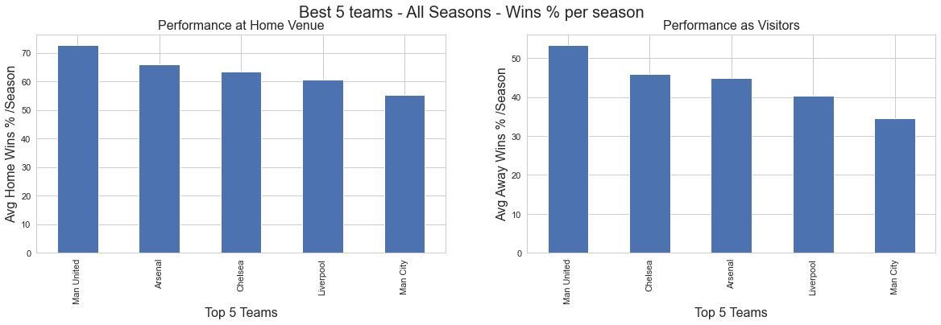
Top 5 teams’ home/away wins:
Normalizing performance analysis by converting values to percentages.

Slide 13
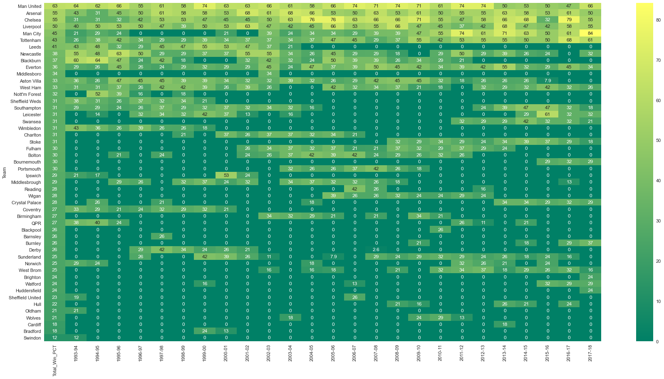
Teams Win % over the seasons:

Slide 14
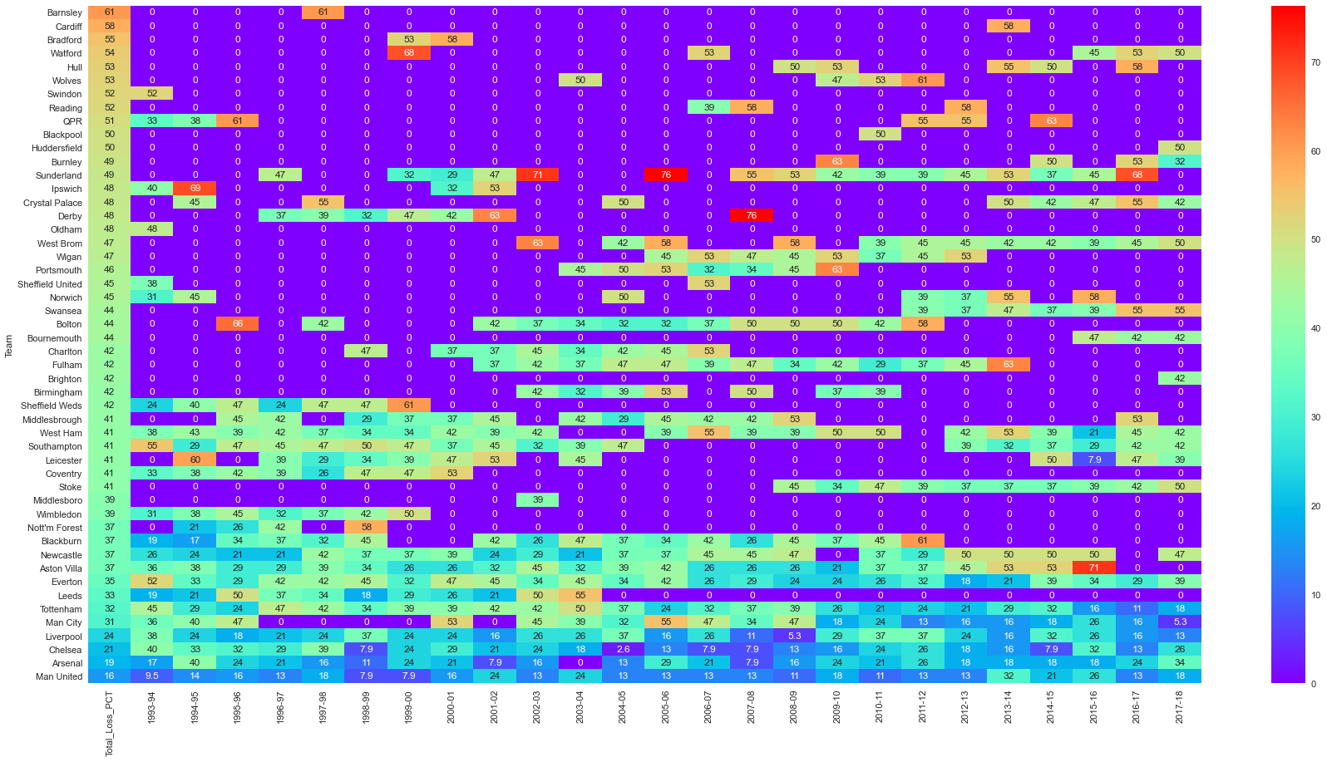
Teams Loss % over the seasons:

Slide 15
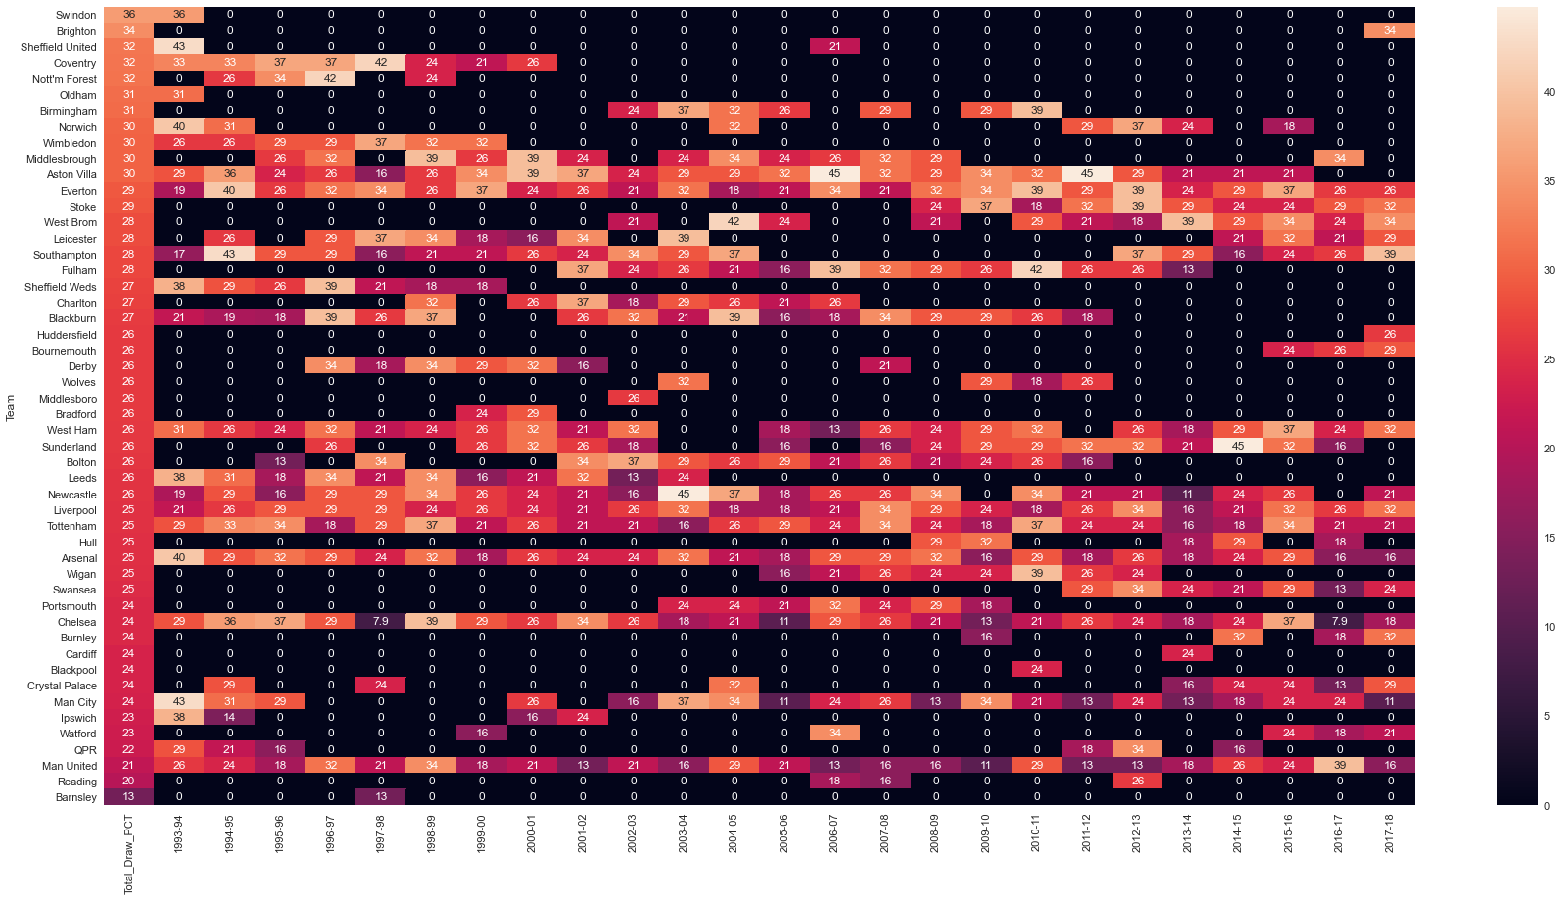
Teams Draw % over the seasons:

Slide 16
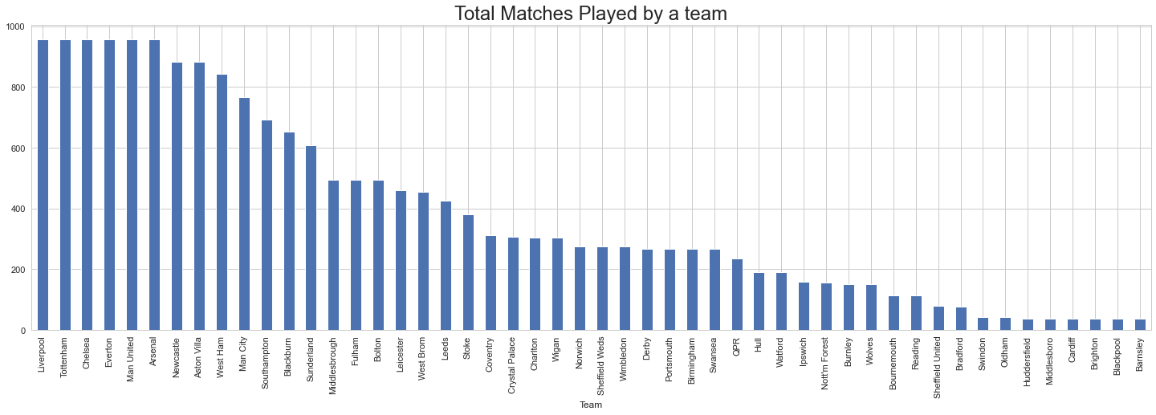
Total matches played by a team:
Top performing teams have played more matches – more seasons
Poor performance teams have played less matches – less seasons

Slide 17
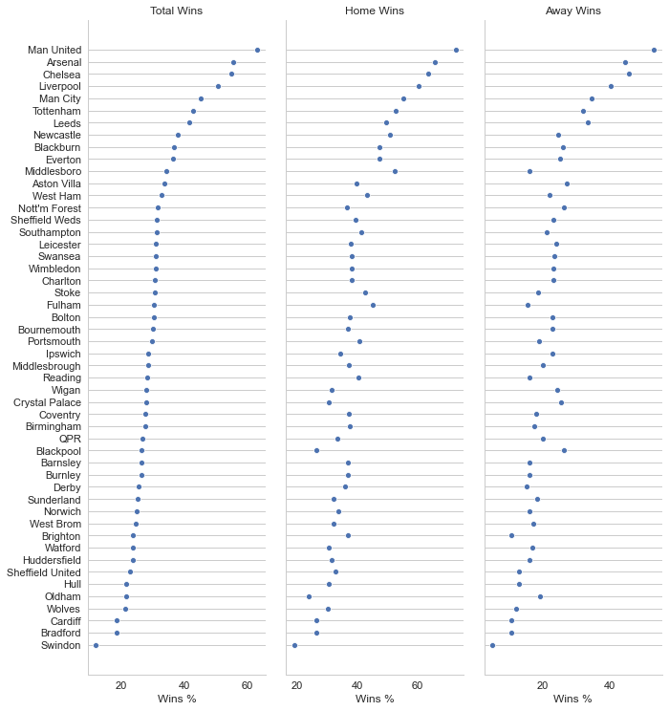
Teams’ Win Analysis:
There is a clear pattern that teams which perform well away are best teams and there are very few teams in this category.

Slide 18
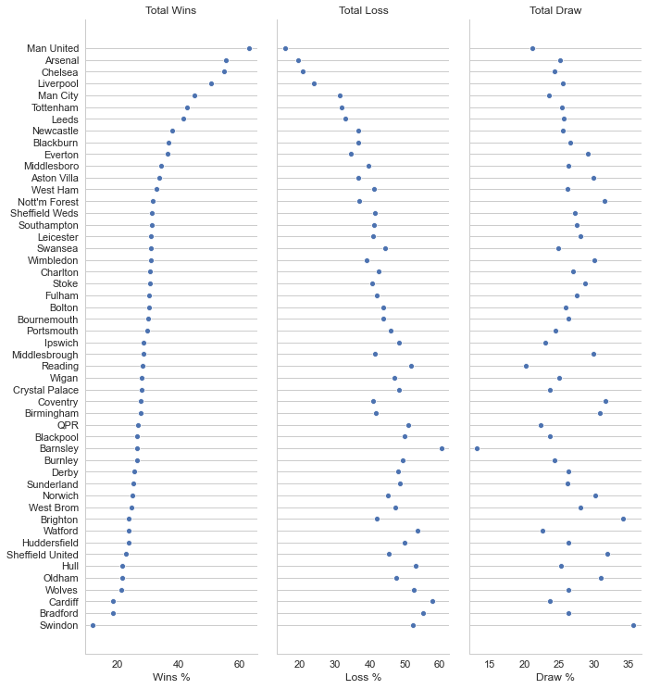
Teams’ performance analysis:
We can observe that top 8 teams have very high win % compared to loss and draw %.

Slide 19
Comparing Top and Bottom performers…

Slide 20
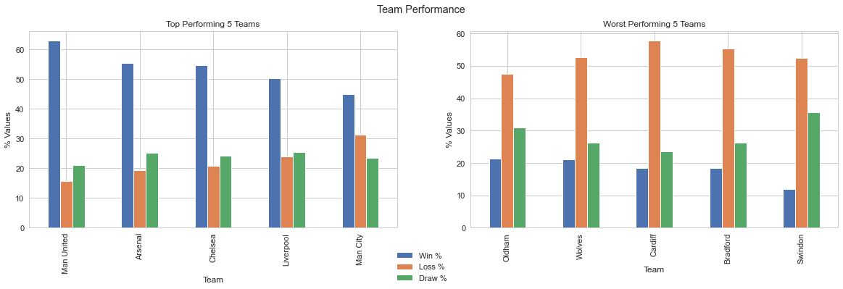
Comparing Wins, Losses and Draws Share:
Top Teams have more draws than losses and very high wins
At same place bottom teams have more losses than draws and very less wins

Slide 21
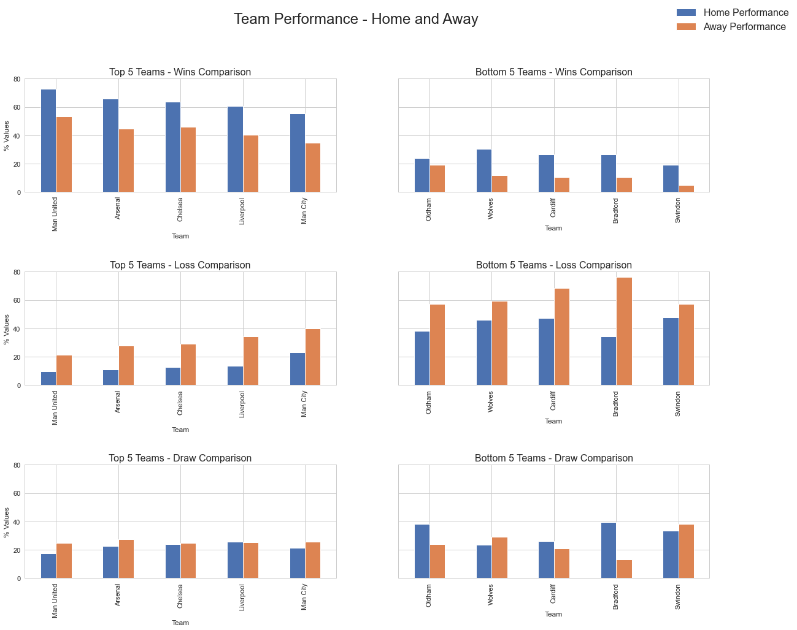
Comparing performance:
Top teams have very high wins compared to bottom teams
Top teams have very low losses compared to bottom teams
Draw seems to be slightly higher with bottom teams

Slide 22
Conclusions…

Slide 23
Analysis Drawn:
For a team to win in away matches they must try to lead in the first half (Slide 2)
Goal pattern through out the seasons is seen to be constant (Slide 3, 4, 5)
League is less competitive – Winning team goals are more than losing teams – 300% (Slide 3)
Home wins have more difference compared to away wins
Summers gather less crowd hence significantly less matches are played (Slide 6)
More matches are played on weekends – Mostly on Saturdays (Slide 6)
Less goals per match are seen during summers – May be because players get weird out soon (Slide 7)
Home and away performances are seen to be highly correlated (Slide 9, 10, 17)
Top 8 teams either win a match or manage to draw rather than losing it (Slide 13, 14, 15, 18, 20)
Top performing teams are the teams which are playing all seasons consistently (Slide 13, 14, 15, 16)
Poor performing teams are opting out 3-5 seasons of poor performance (Slide 13, 14, 15, 16)
Top performing teams wins more and loose less; Bottom performing teams lose more and win less (Slide 20)

Slide 24
Actionable Insights:
To sustain in the league
Perform well in away matches – At least manage a draw
Lose less matches at home (Helps improve win to loss ratio – Slide 20)
Perform consistently through out seasons
To win the league
Manage lead in the first half
Win more away matches (Top teams lose more away matches than home – Slide 21)
Manage draw rather than lose
Make league more competitive
Divide teams into groups (Based on last season performance) - Increases competitiveness with in the group
Top team among the groups to compete again
Matches at neutral venues

Slide 25
Thank You…
Analysis by:
Raghava Joijode
email: raghava.joijode@gmail.com

