Slide 1
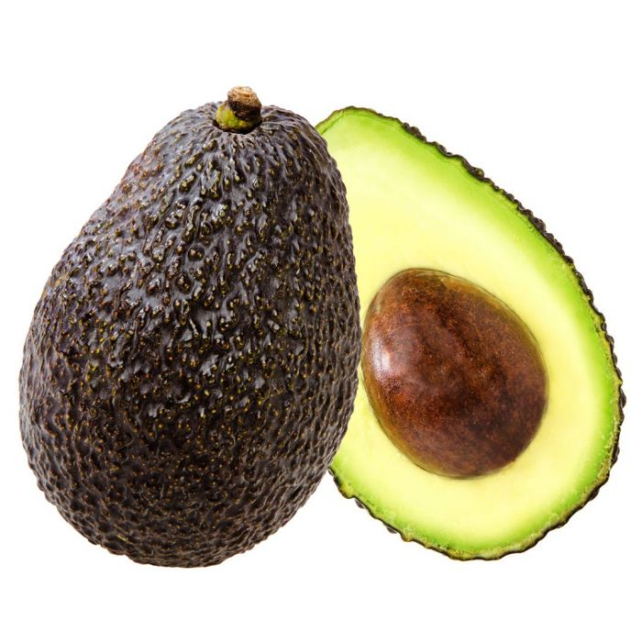
Hass Avocado Price Prediction…

Slide 2
Agenda…
Problem Statement
Understanding Data - Features
Feature Engineering
Explorative Data Analysis
Processing Data
Building Models
Predicting Prices
Evaluating Models
Plotting Models

Slide 3
Problem Statement & Data…

Slide 4
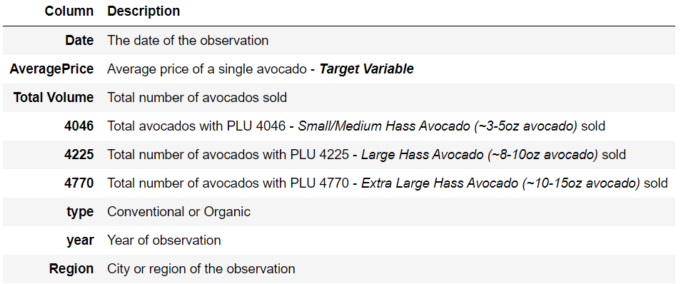
Problem Statement
About Data
The dataset consists of the information about HASS Avocado sales.
We have details of historical data on avocado prices and sales volume in multiple US markets along with other features like date of sale, average price, total volume sold, total bags sold, year and type of avocado.
We are also provided with size of avocado’s – like 4046, 4225, 4770
18249 observations
13 features
Up on further analysis:
10 Numeric features
3 Categorical features
Given historical data on avocado prices and sales volume in multiple US markets, the goal is to predict average price of avocado using best regression model we know so far.

Slide 5
Feature Engineering & Data Insights…

Slide 6
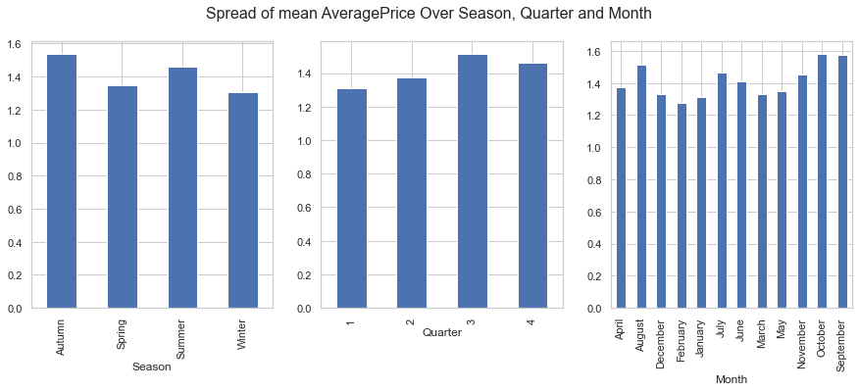
Data pre-profiling observations
Data processing
Derive some insightful columns from Date - like 'Season', 'Month', 'Quarter'
Average Price (Target variable) is normally distributed but slightly right skewed
Conventional and organic avocados are uniformly distribute in terms of observations
Organic avocados are more costlier and are less in volume
Region and Date are uniformly distributed and have high cardinality
Observations
Average price drops in the months of December, January, February, May, June, July
No much variance in price w.r.t Quarter - So we can drop this column
In winters Avocado prices drops more than any other seasons
As seasons and Date are correlated with Month
And as Month gives more info we can drop `Season`, `Date` and have `Month` column as an important feature

Slide 7
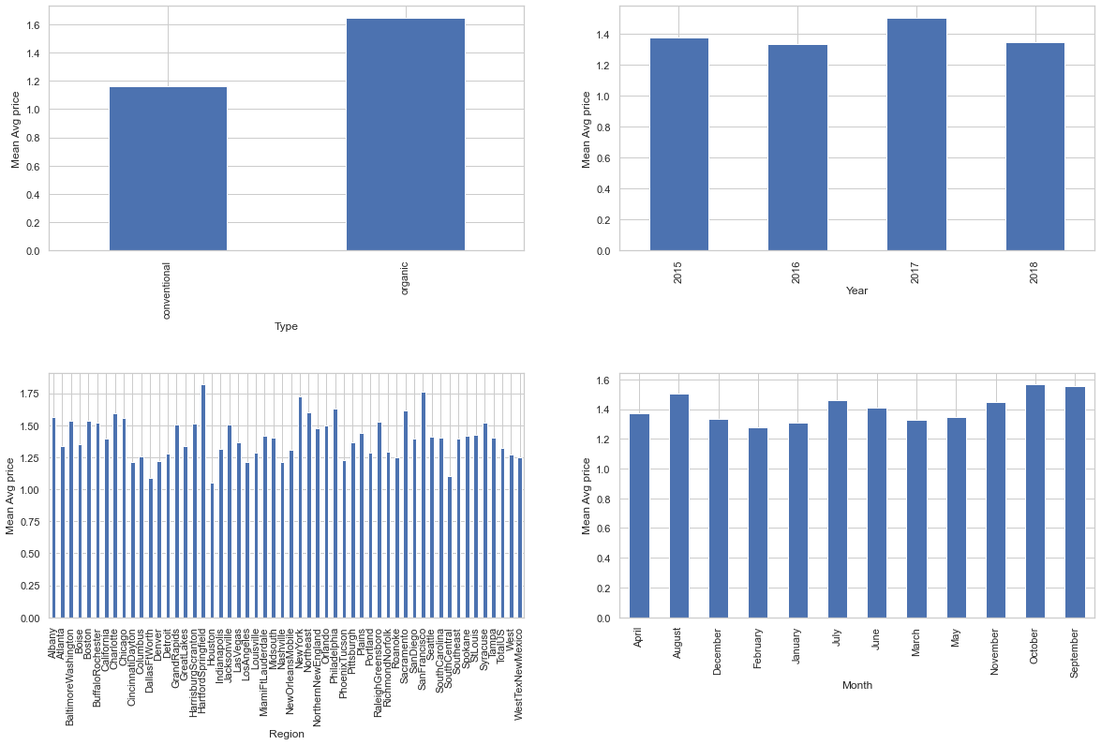
Mean Average Price w.r.t Categorical Columns - Type, Year, Region, Month

Slide 8
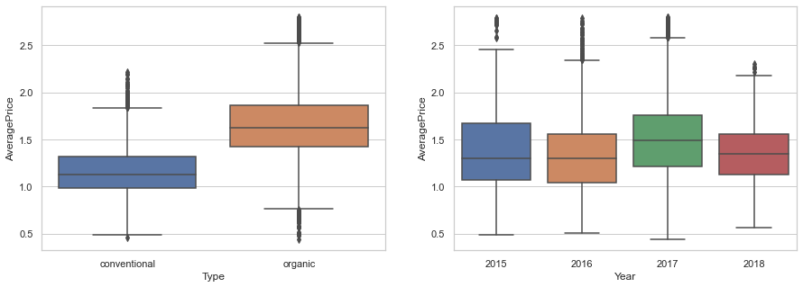
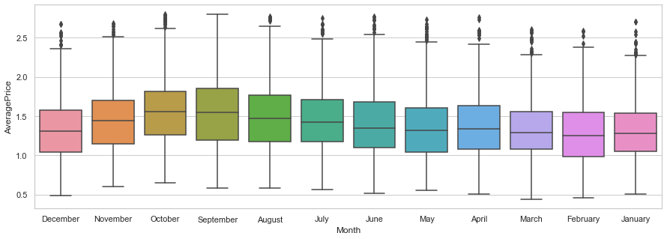
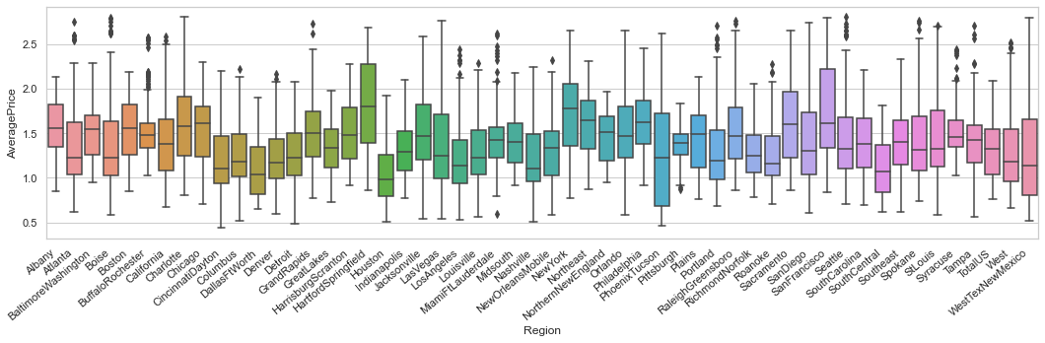
Box Plot to see for outliers
There are some outliers present but these are not too extreme so we do not drop any records

Slide 9
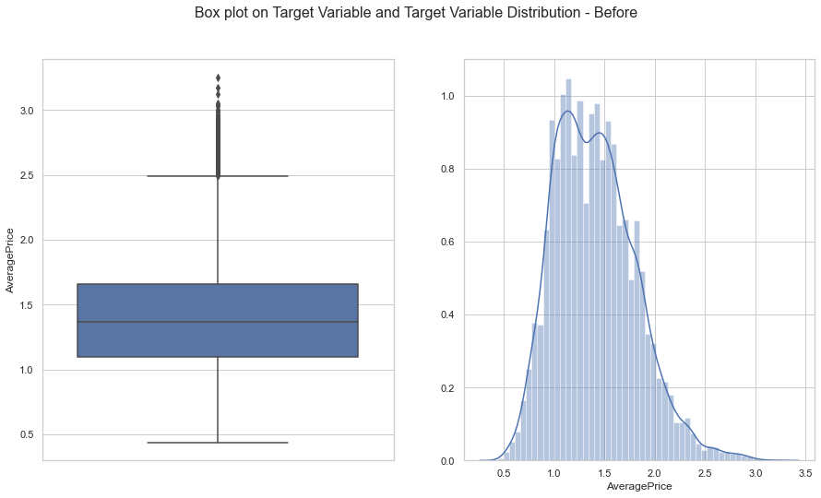
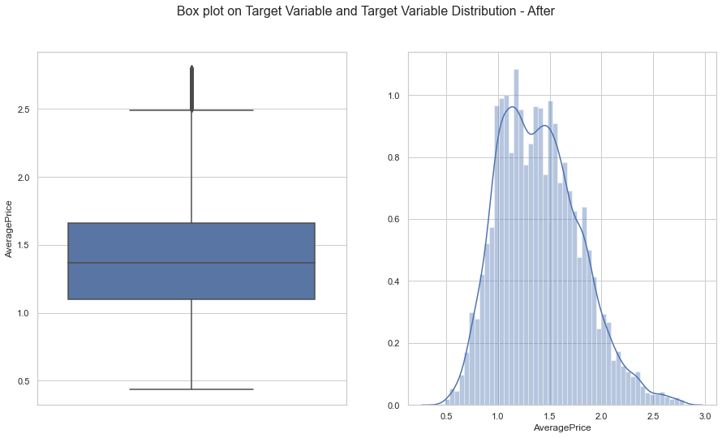
Distribution of Average Price (Target Variable)
Dropping observations with positively skewed data on average price.

Slide 10
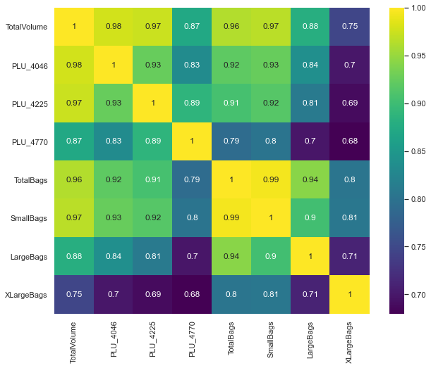
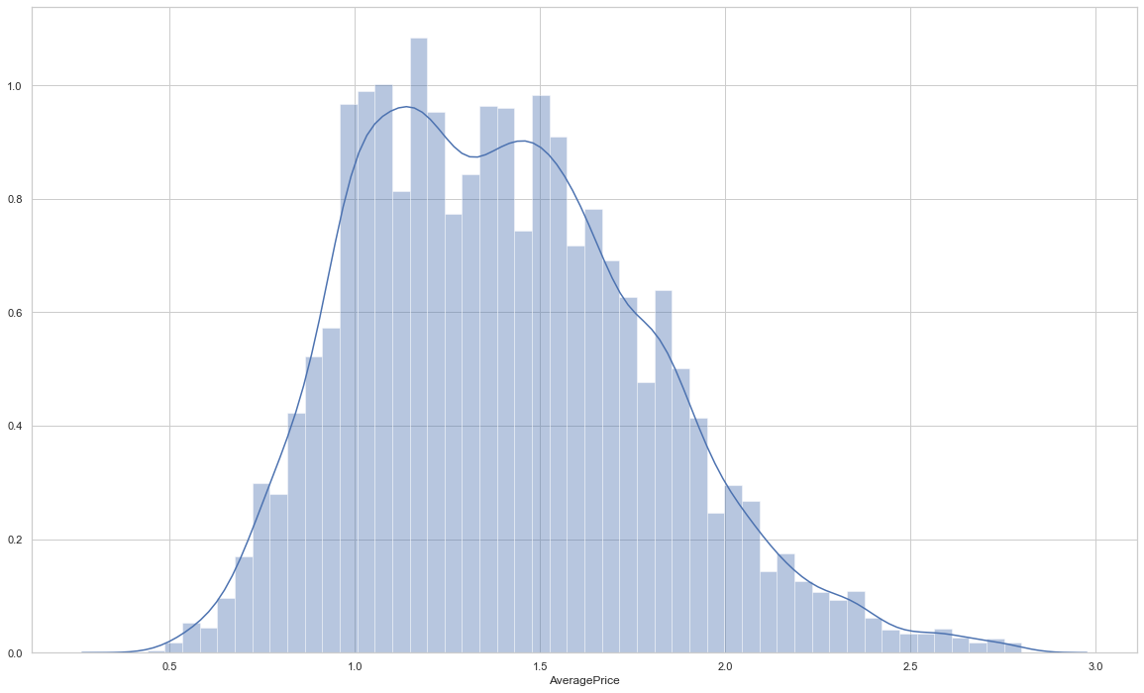
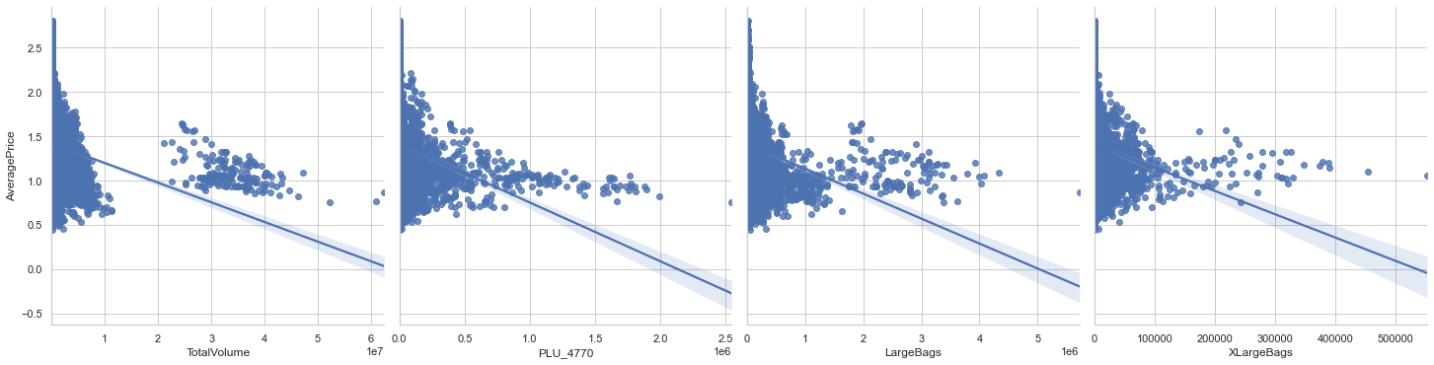
Checking for Assumptions
Normal distribution of target variable…
Checking for correlation of numerical target variable
So dropping 'PLU_4046', 'PLU_4225', 'TotalBags', 'SmallBags' which has very high correlation with TotalVolume
Linear relation with numeric features

Slide 11
Processing Data…
Before building models we need to prepare data and do necessary transformations…

Slide 12
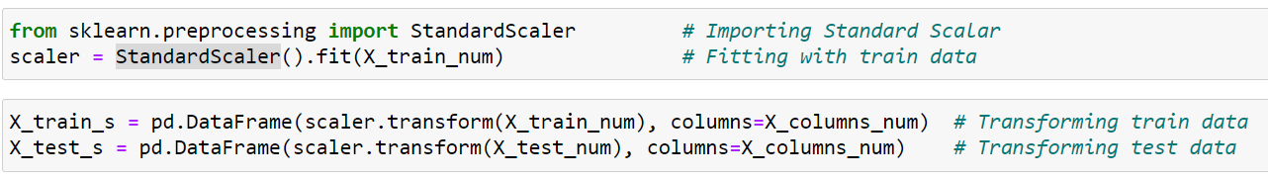
Feature scaling
Feature scaling, also known as data normalization is a method used to normalize the range for features of data. This step makes all the features in a same scale before modelling
We use Standard Scaler from sklearn package to do scaling of numerical features
Standard Scaler standardizes a feature by subtracting the mean and then scaling to unit variance
Unit variance means dividing all the values by the standard deviation
We create Standard Scaler on train data and then transform train and test data using the same scaler.

Slide 13
Encoding
Encoding is the process of converting data from one form to another
As machines cannot understand the categorical value we will transform to numerics while maintaining the importance
There are 4 categorical features and as per below table we will perform encoding on each feature
Column Name | Encoding Type | Justification
Type | OneHotEncoding | Only 2 unique values
Year | LabelEncoding | To keep the ordinal importance
Region | TargetEncoding | High cardinality, so do TargetEncoding to have an effect of each Region on Average Price
Month | TargetEncoding | High cardinality, so do TargetEncoding to have an effect of each Region on Average Price

Slide 14
Building Models…

Slide 15
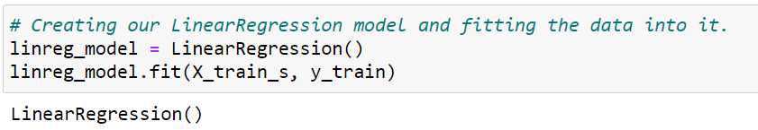
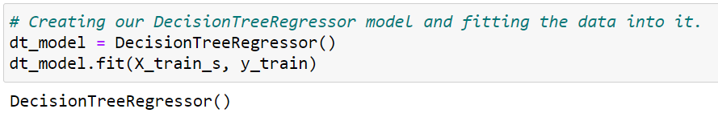
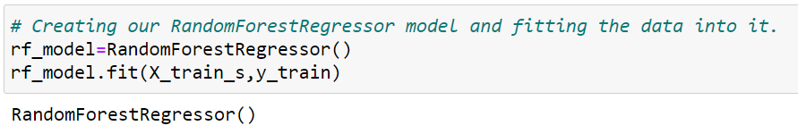
Models
Linear Regression
Decision Tree Regressor
Random Forest Regressor

Slide 16
Predicting & Evaluating Prices…

Slide 17
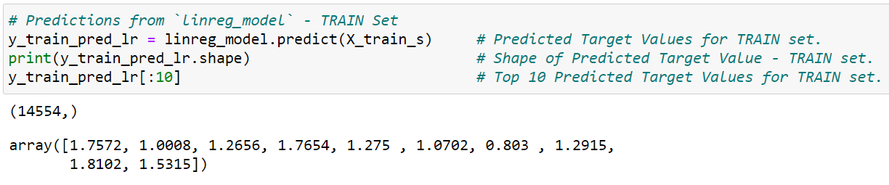
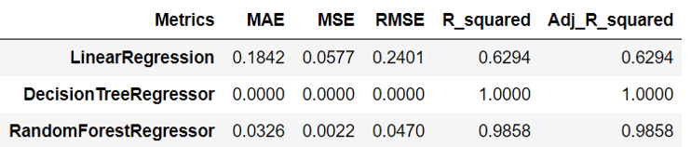
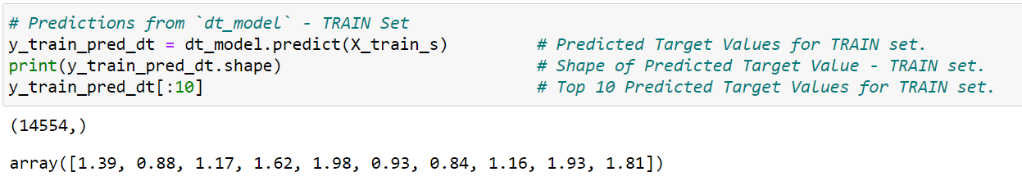
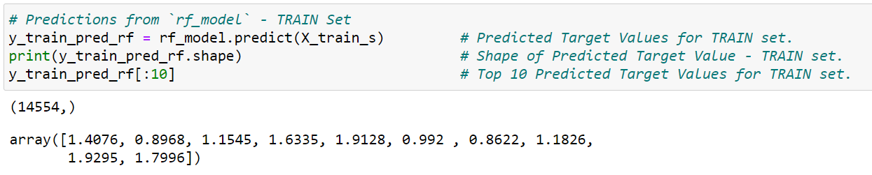
Predictions of Train Dataset
Linear Regression
Decision Tree Regressor
Random Forest Regressor

Slide 18
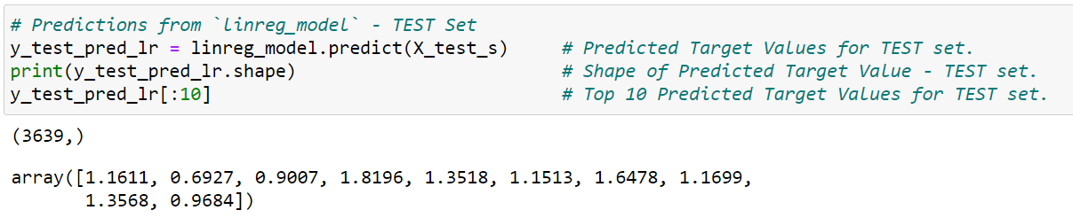
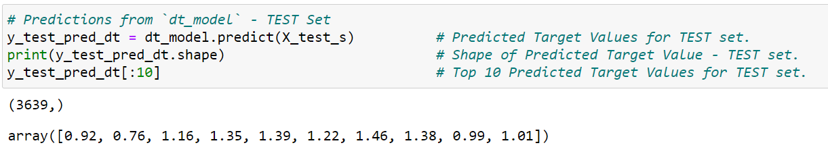
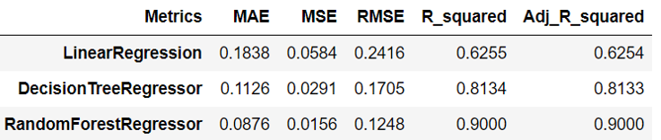
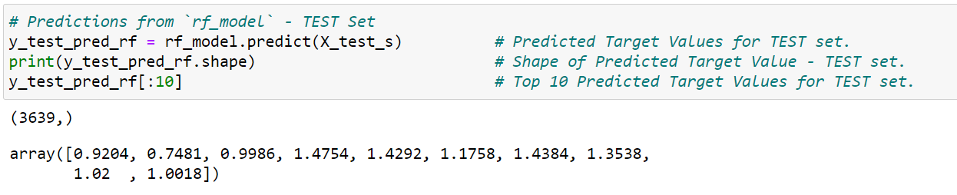
Predictions of Test/Future Dataset
Linear Regression
Train Metrics
Decision Tree Regressor
Test Metrics
Random Forest Regressor

Slide 19
Hyperparameter Tuning…

Slide 20
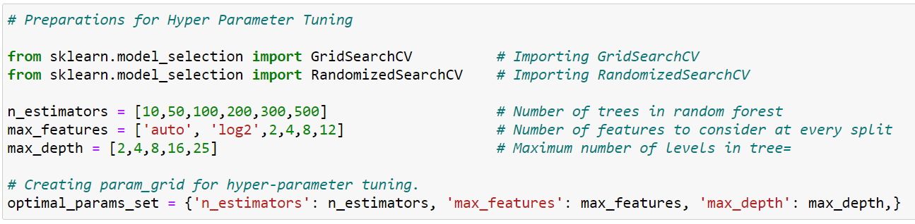
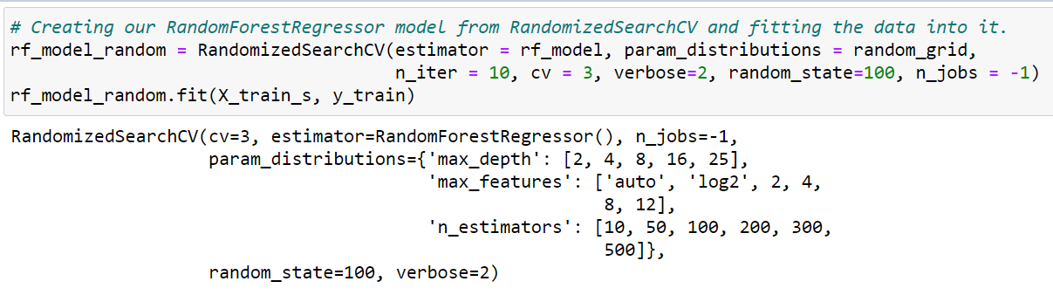
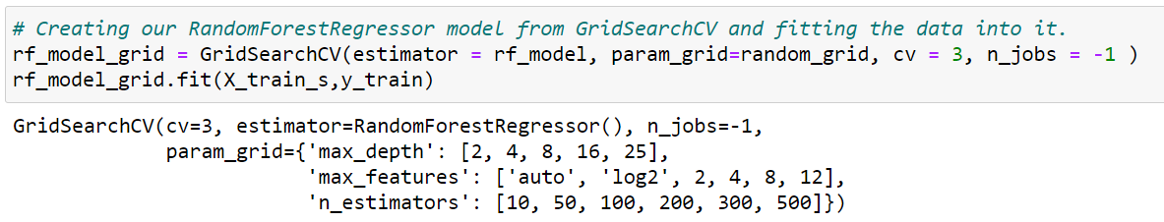
Hyperparameter Tuning
Hyperparameter tuning is the problem of choosing a set of optimal hyperparameters for a learning algorithm
Grid Search CV is an exhaustive search for selecting a model
Grid Search, estimator(model) is trained with each and every possible combination of parameters set and the one with best score is returned
Randomized Search CV is a way of training estimator(model) by randomly selecting few combinations of parameters set and the one with best score is returned
The number of search iterations is set based on time or resources

Slide 21
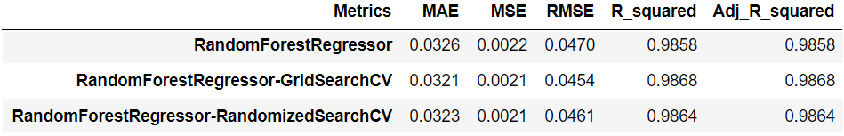
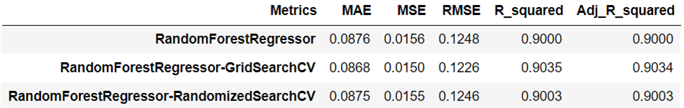

Evaluating of hyperparameter tuned models
Train Metrics
Test Metrics

Slide 22
Plotting Models…
Comparing predicted values with actual and plotting them for the models we built…

Slide 23
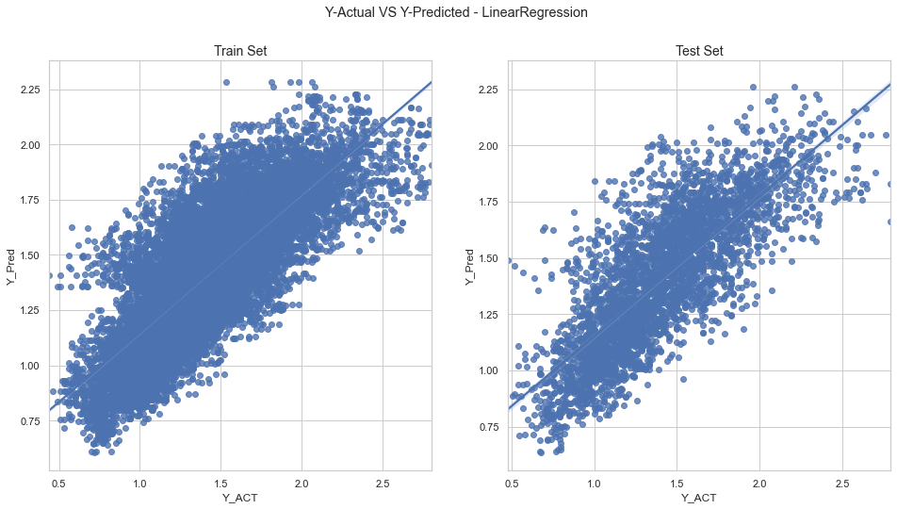
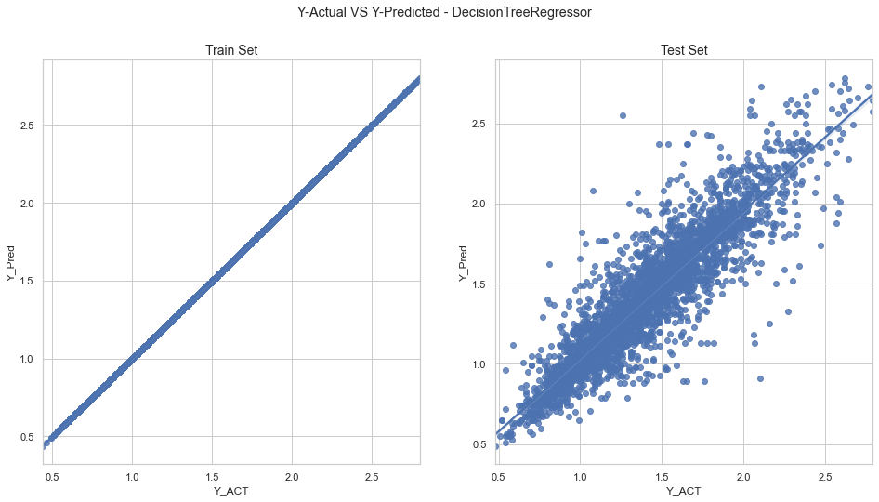
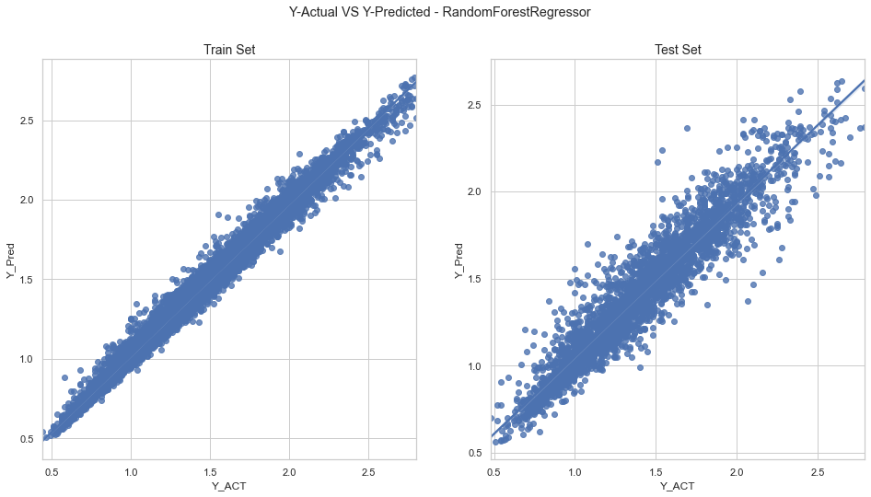
Linear Regression
Decision Tree Regressor
Random Forest Regressor

Slide 24
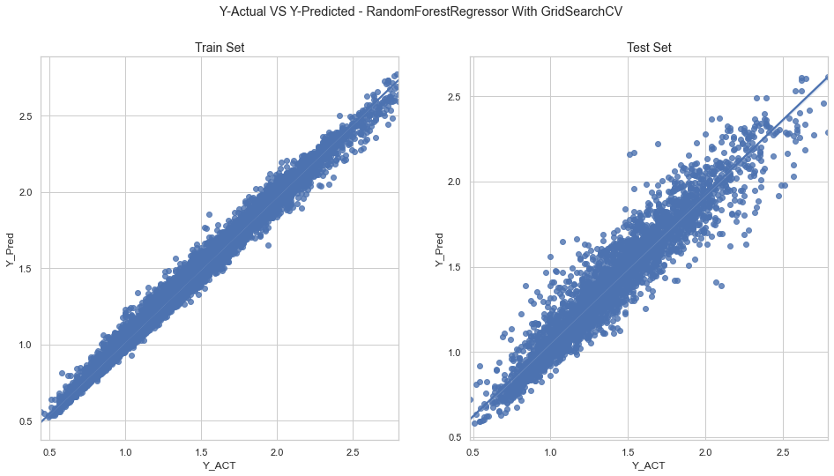

Random Forest Regressor with Grid Search CV
Random Forest Regressor with Randomized Search CV

Slide 25
Conclusions…

Slide 26
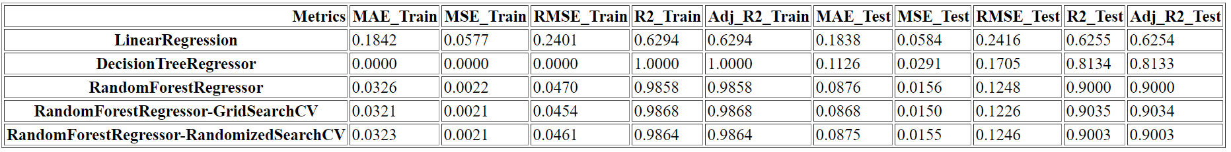
Analysis Drawn
From the above metrics we can draw below analysis,
Linear Regression Model has less R-Squared Value - Under-Fit Model
Decision Tree Regressor Model has maximum R-Squared Value for train data and less R-Squared Value for test data - Over-Fit Model
Random Forest Regressor Model has better R-Squared Value for test data
We can best version of Random Forest Regressor by hyper parameter tuning with ‘Grid Search CV’ or ‘Randomized Search CV’

Slide 27
Thank You…
Raghava Joijode
email: raghava.joijode@gmail.com

