Slide 1
The Ontology of Coexistence
Madhyasth Darshan ontology — Section 1 only
AnalyticMadhyasthDarshan.org
1 / 37
Notes:
Companion to the released study at AnalyticMadhyasthDarshan.org. This deck covers Madhyasth Darshan's own ontology (Section 1), not Advaita, modern philosophy, or comparative review.

Slide 2
The study questions
What is Existence? What exists?
Does what exists begin at some time?
Does the individual self (jeevan) begin or end with the body?
Is the world finally real?
AnalyticMadhyasthDarshan.org
2 / 37
Notes:
These framing questions open the full study. This presentation answers them from Madhyasth Darshan's ontology alone.

Slide 3
Existence as coexistence
Formless Omnipresence (satta) and countless bounded units — co-eternal, beginningless
Neither pole is produced from the other; change is unit-activity, development, and awakening
Coexistence is not inert juxtaposition — ground and units are inseparable
Mutual recognition, complementarity, and relationships follow from saturated plurality
AnalyticMadhyasthDarshan.org
3 / 37
Notes:
Madhyasth Darshan defines existence as ever-present coexistence. Development expresses complementarity toward designed statuses; at the knowledge order this scales to undivided society and universal orderliness.

Slide 4
Resolution Centred Materialism
Madhyasth means mediative — the bond holds without collapse into either pole
Satta regulates and conserves every unit without itself acting
The mediative role recurs in the atom nucleus and in jeevan as atma
Samadhanatmak bhautikvad — Resolution Centred Materialism
AnalyticMadhyasthDarshan.org
4 / 37
Notes:
Section 1 develops in layers: poles and saturation, what units are, unit-activity, four orders and relationships, regulation and composition, jeevan structure, then development, knowledge, conservation, and societal fulfilment.

Slide 5
1.1 Coexistence — two inseparable aspects
Omnipresence (satta / vyapak): formless, all-pervasive, non-transforming, actionless energy
Units of nature: formful, active, countable entities within saturated nature
Consciousness and Knowledge here do not mean a mind that knows — sentience belongs to jeevan
Realisation Knowledge (anubhav jnan) is the ontological given in every unit
What is evident is that consciousness and matter are inseparably present… existence itself is eternally manifest in the form of coexistence.
SB, p. 48
AnalyticMadhyasthDarshan.org
5 / 37
Notes:
This study uses Omnipresence in prose; translations often print Omnipotence for satta.

Slide 6
1.1 Structural features of coexistence
Satta and units never existed as separate poles
Omnipresence has no absent place — even where no local unit appears
Units are distinct by boundaries within saturation, not by leaving the ground
Satta is state-complete (sthitipurn); saturated nature is state-dynamic (sthitishil)
AnalyticMadhyasthDarshan.org
6 / 37
Notes:
Inter-unit distance is regulated as satta as Space (shunya) between bounded wholes, provisioning mutual recognition. Change is unit-activity alone.

Slide 7
1.2 Saturation (samprikt)
The ever-present bond between formless satta and each formful unit
Omnipresence does not act, transform, or be consumed in saturating a unit
Inherent energy resides in each unit as a consequence of coexistence
Basic impulsion — inherent drive to be active, not an external push
AnalyticMadhyasthDarshan.org
7 / 37
Notes:
Illustrative picture: a cell in nutrient medium or a sponge soaked in water — permeated through the medium, not drained from a finite store.

Slide 8
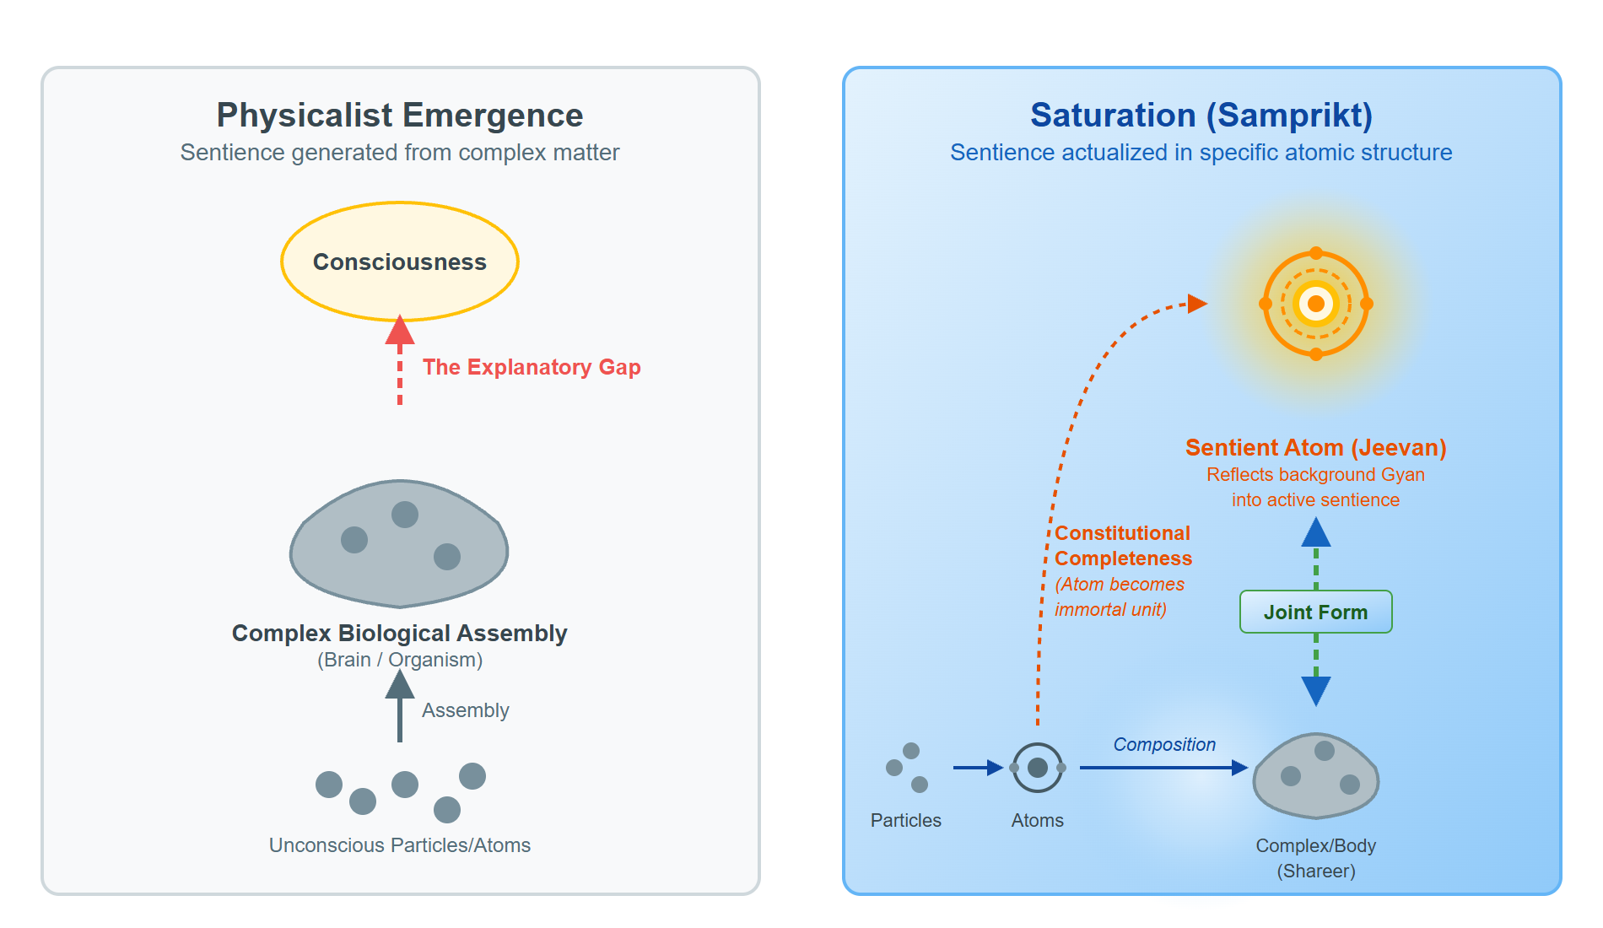
1.2 Mutual dependence for manifestation
Ground's uniform energy and unit-activity always appear together
Neither pole creates the other's existence — only its manifestation
Saturation endows capacity, ability, and receptivity for relationships
Conducive environment and naturalness activate what saturation places in the unit
Without absolute energy, there is no basic impulsion in matter, and without matter, absolute energy is not revealed.
MVD, p. 40
AnalyticMadhyasthDarshan.org
8 / 37
Notes:
Unit + Energy fullness = Activeness (SB, p. 69). Saturation is where a unit gets regulation, activeness, and forcefulness without external efficient cause.

Slide 9
1.3 What every unit is
Four inseparable aspects: form, properties, essential nature, and dharma
Properties: generative, degenerative, and mediative effects in mutuality
Dharma — what a unit cannot be separated from; indestructibility is ultimate dharma
Unit + environment = the unit as a whole
AnalyticMadhyasthDarshan.org
9 / 37
Notes:
Ness is what makes a unit the kind of unit it is. Natural state moves toward development; excited state toward decline.

Slide 10
1.3 Development, complementarity, and restfulness
Complementarity — reciprocal exchange within the natural state
Participation means recognising and fulfilling relationships
Restfulness (vishram) when all relationships are recognised and fulfilled
Harmony among the four aspects is the essence of coexistence (MVD, p. 21)
Each unit moves towards 'development' in its natural state and 'decline' in its excited state.
SB, p. 14
AnalyticMadhyasthDarshan.org
10 / 37
Notes:
Endeavour aligned with innateness moves toward fulfilment; against it gives rise to problems. Even atomic particles recognise and fulfil one another.

Slide 11
1.4 All change is unit-activity
Omnipresence does not change — all change appears as unit-activity
Inseparable triad: effort, motion, and result (shram–gati–parinam)
Not three sequential steps — three joint aspects of one activity
Saturation → forcefulness → basic impulsion → activity → effort-motion-result → development
Every physical-chemical activity is an inseparable presence of effort, motion and result.
SB, p. 58
AnalyticMadhyasthDarshan.org
11 / 37
Notes:
Satta grounds all units as supreme cause (mahakaran) in the sustaining sense. Causal work of change is done by units themselves. Kaal is duration of unit-activity.

Slide 12
1.4 Origination versus causation
Units are co-eternally present — not created from nothing
Causation names what produces change when units transform
Insentient orders: state and motion inseparable — force in state, power in motion
Physicochemical give and take appears as reciprocal exchange in activity
AnalyticMadhyasthDarshan.org
12 / 37
Notes:
Full treatment of time (kaal) and spacetime physics is in the Nature of Time study. Here only the core claim: kaal is duration of unit-activity; satta is timeless as ground.

Slide 13
1.5 The four orders of nature
Material (padarth), bio/pranic (pran), animal (jeev), knowledge/human (gyan)
Each order is a stable plateau — higher orders include lower dharmas cumulatively
Hope to live (jeene ki aasha) marks the animal order — sentience threshold
Existence is stable; development is definite — laws inherent to being
AnalyticMadhyasthDarshan.org
13 / 37
Notes:
Material and pranic orders are insentient (jada). Jeevan first appears at the animal order. Knowledge order adds six svabhav qualities developed as human values.

Slide 14
1.5 Progression and definiteness
Niyati-kram — fixed order emergence on Earth (material → pranic → animal → knowledge)
Niyati-vidhi — definiteness in each order's proper conduct
Statuses embedded in progression toward constitutional, activity, and conduct completeness
Countless means practical uncountability — real particulars, indefinitely many
AnalyticMadhyasthDarshan.org
14 / 37
Notes:
Each order cyclically manifests through saturation in a different mode: material units active, bio pulsate, animal carry hope of living, knowledge-order hopeful and conscientious.

Slide 15
1.6 Units in relationships
Relations between units actualise complementarity as value in mutuality
Relationship — mutuality with expectations predetermined toward completeness
Association — mutuality with voluntary expectations (contrast: neighbours sharing a wall)
Essentiality in every order is value — reciprocated and mutually recognised
Nothing is isolated – that is the principle.
JV, p. 43
AnalyticMadhyasthDarshan.org
15 / 37
Notes:
Value kinds include object values (utility, art) and, at the knowledge order, jeevan harmonies, human values, established relationship values, and expression values.

Slide 16
1.6 Recognition, fulfilment, and realisation
Every unit recognises its relationships and fulfils them
Capacity, ability, and receptivity endowed through saturation
Knowledge order: knowing → believing → recognising → fulfilling
Completeness drive turns unit-activity toward fulfilling relationships step by step
Every entity of nature recognises another; that is why it fulfils.
JV, p. 69
AnalyticMadhyasthDarshan.org
16 / 37
Notes:
Higher statuses need inherent capacity and conducive environment together — illustrated by seed and naturalness. Realisation in coexistence when relationships are fully evident across nature.

Slide 17
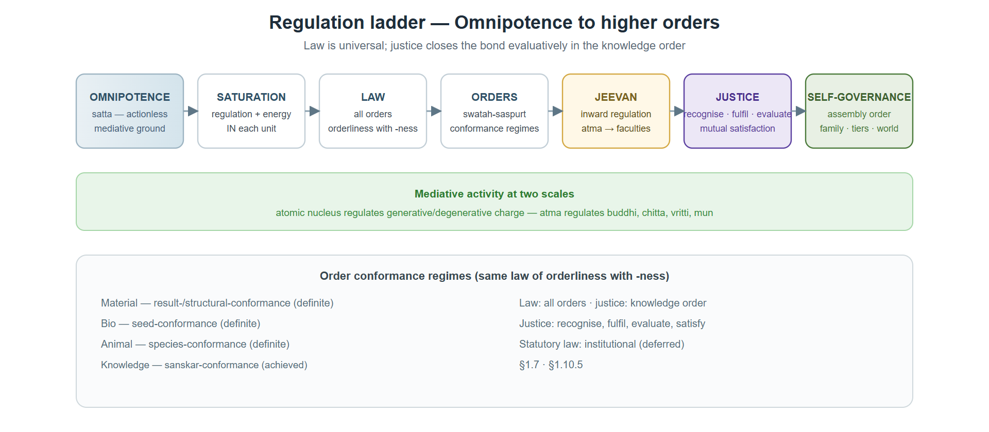
1.7 Regulation and law
Regulation ladder: saturation → law → order conformance → inward regulation → justice → assembly self-governance
Satta does not descend as statutory command
Orderliness (vyavastha) is self-regulation (swatah-saspurt) — inherent in nature's orders
Law — regulation and orderliness already structurally real in coexistence
Omnipotence is mediative, therefore the nature saturated in it is regulated and conserved.
MVD, p. 26
AnalyticMadhyasthDarshan.org
17 / 37
Notes:
The mediative (madhyasth) role gives the darshan its name. Nucleus within every atom is mediative activity regulating generative-degenerative activities.

Slide 18
1.7 Conformance regimes and justice
Material: result-/structural-conformance (definite)
Bio: seed-conformance (definite)
Animal: species-conformance (definite)
Knowledge: sanskar-conformance (achieved through knowing → believing → recognising → fulfilling)
Justice (nyaya) — evaluative closure when jeevan can evaluate and err
AnalyticMadhyasthDarshan.org
18 / 37
Notes:
Statutory and public law (dharma-niti, rajya-niti) codifies assembly order separately; conduct may satisfy legality while violating justice.

Slide 19
1.8 Composition and assemblies
Complementary units that fulfil relationships compose into larger units
Each composition opens relationships at a higher tier
Mixture (mishran) vs compound (yaugik) — components keep vs new unit signature
Composition is not development — plateau crossed only at atomic constitutional completeness
Everywhere, there exists a natural inclination towards coexistence… atomic particles to assemble into atoms, atoms into molecules, molecules into molecular forms.
JV, p. 67
AnalyticMadhyasthDarshan.org
19 / 37
Notes:
Assemblies persist in natural state and decline when fulfilment breaks down. Human assemblies require achieved, evaluative recognition and fulfilment.

Slide 20
1.9 Jeevan — structure and faculties
Jeevan — sentient self that works through the body; constitutionally complete unit
Five inseparable aspects: mun, vritti, chitta, buddhi, and atma
Projection (paravartan) and reflection (pratyavartan) cycle
Atma is nucleus; buddhi, chitta, vritti, mun in first through fourth orbits
The nucleus of the sentient unit… is referred to as atma.
MVD, p. 78
AnalyticMadhyasthDarshan.org
20 / 37
Notes:
Faculties are the atom's constitutional structure, not optional layers on an aggregate. Koshas (sheaths) track developmental envelopes of the joint form — distinct from faculties.

Slide 21
1.9 Faculties versus koshas
Faculties — invariant parts and orbital structure of the jeevan atom
Koshas — developmental envelopes of body + jeevan joint form
Animal-order and pre-awakening humans: four koshas
Awakening adds vigyanmaya — five koshas for awakened humans
The two five-fold structures do not align one-to-one
AnalyticMadhyasthDarshan.org
21 / 37
Notes:
Evaluation through six perspectives (drishti) is developed in Section 1.10.5. Four felt harmonies within jeevan follow in Section 1.10.6.

Slide 22
1.10 Four kinds of progress — do not collapse
Niyati-kram — fixed order emergence (material → pranic → animal → knowledge)
Niyati-vidhi — definiteness in each order's conduct
Vikas-kram — atomic development until constitutional completeness (T1)
Jagriti-kram — awakening within constitutionally complete jeevan
AnalyticMadhyasthDarshan.org
22 / 37
Notes:
Macro order chain and atomic development run on different levels. Molecules participate in composition and vikas-kram at atomic scale; crossing T1 is not the same as niyati-kram.

Slide 23
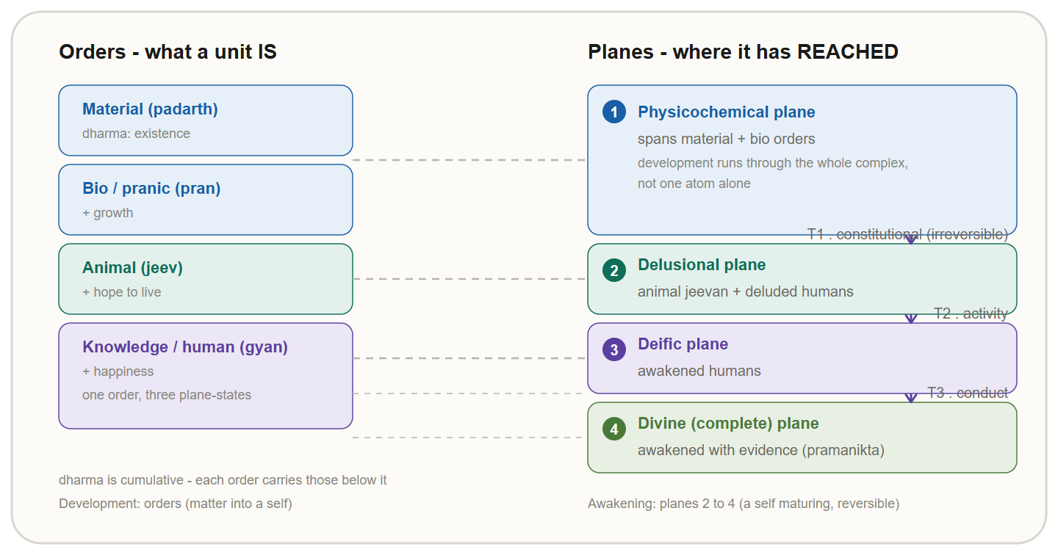
1.10 Orders, planes, and human types
Order — what a unit is; plane (pad) — how far development has gone
Physicochemical plane — insentient development toward T1
Delusional plane — sentient jeevan or pre-awakening human (body mistaken for self)
Deific plane — awakening human (T2); Divine plane — conduct completeness (T3)
AnalyticMadhyasthDarshan.org
23 / 37
Notes:
Two insentient orders share one plane; knowledge order spans three plane-states. Order and plane must not be used interchangeably.

Slide 24
1.10.3 Constitutional completeness (T1)
T1 — irreversible sentience threshold at the atomic level
Not neural complexity, molecular size, or mere order-chain elevation
Gathanpurnata — qualitative change without quantitative change
Latent intelligibility in satta actualized when particle constitution closes
When the contraction and expansion activity increases… it attains constitutional completeness, becoming a jeevan atom.
MVD, p. 91
AnalyticMadhyasthDarshan.org
24 / 37
Notes:
Hope-bondage replaces molecular-bondage and weight-bondage at T1. Sentience becomes evident when structure is complete enough to reflect what saturation already grounds.

Slide 25
1.10.4 Awakening milestones T2 and T3
T2 — activity completeness (kriyapurnata); delusional → deific plane
T3 — conduct completeness (vyavaharpurnata); deific → divine plane
Awakening requires human body as enabling medium — enriched nervous system and imagination
Delusion confuses body with self; awakening is orbital faculties in accordance with atma
AnalyticMadhyasthDarshan.org
25 / 37
Notes:
Perceiver status (drishta pad) — enlightenment and realisation within the truth of coexistence — is what awakened humans attain at T2 and T3.

Slide 26
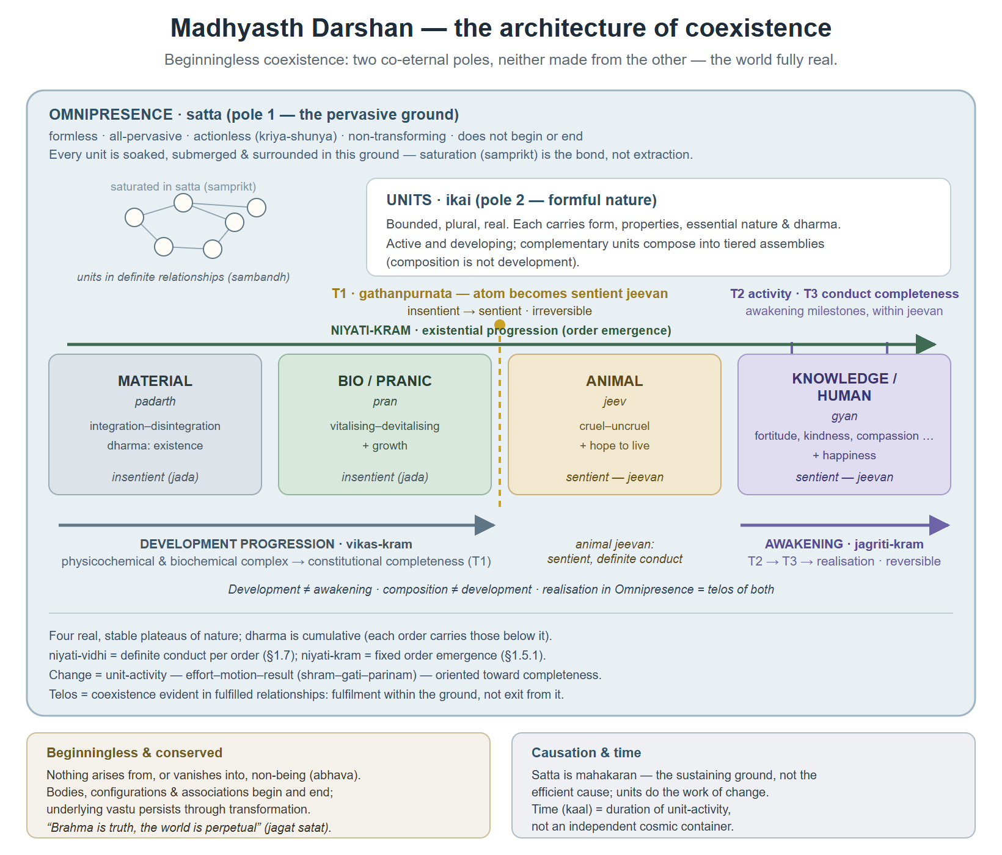
1.10.4 Full architecture
Coexistence and saturation, four orders, three progressions
Completeness transitions T1–T3
Conservation and causation framing
AnalyticMadhyasthDarshan.org
26 / 37
Notes:
Summary figure pulling together the full Section 1 architecture. Companion figure 1-saturation-samprikt.svg traces saturation through composition to body and jeevan.

Slide 27
1.10.5 Six perspectives and humane refuge
Pleasant-unpleasant, healthy-unhealthy, profit-loss — lower refuge (legitimate but insufficient)
Justice-injustice, dharma-adharma, truth-untruth — humane refuge
Nyaya regulates conduct; dharma disciplines thought; satya grounds realisation
Justice — recognise relationships, fulfil values, evaluate, mutual satisfaction
Recognising relationships, fulfilling values, evaluating, and achieving mutual satisfaction is justice.
MVD, p. 311
AnalyticMadhyasthDarshan.org
27 / 37
Notes:
Below knowledge order, recognition and fulfilment are lawful without bearing the name justice. Unit dharma (Section 1.3) must not be confused with dharma-adharma perspective.

Slide 28
1.10.6 Jeevan values and inward regulation
Happiness — harmony in mun and vritti
Peace — harmony in vritti and chitta
Contentment — harmony in chitta and buddhi
Bliss — harmony in buddhi and atma
Inward regulation — atma disciplines orbital faculties and body
Jeevan continues to exist even after death as it does while driving a body.
JV, p. 20
AnalyticMadhyasthDarshan.org
28 / 37
Notes:
Awakening channels energies through curiosity, enthusiasm, delight, elation, and realisation. Activity and conduct completeness evidence perceiver status.

Slide 29
1.11 Four senses of knowledge
Realisation Knowledge (anubhav jnan) — ontological given in all saturated units
Gyan as satta — intelligibility-ground; not a knowing subject
Realisation in coexistence — telos when relationships fulfilled and evident
Gyan udghatan — unfolding exclusive to awakened jeevan
AnalyticMadhyasthDarshan.org
29 / 37
Notes:
Conflating these senses misreads Omnipresence as cosmic mind or treats fulfilled relationships as private belief. Three different senses: orderliness in all units, active sentience at gathanpurnata, unfolding through awakened humans.

Slide 30
1.11 How knowledge is achieved
Knowledge inherent everywhere — unfolding through awakened humans
Knowledge order: knowing → believing → recognising → fulfilling
Deluded human: believing separated from knowing
Awakened human: Believe what is known; Know what is believed (MVD, p. 12)
Human is joint form of jeevan and body — knower remains jeevan, not body alone
AnalyticMadhyasthDarshan.org
30 / 37
Notes:
When jeevan knows coexistence and believes in that reality, it spontaneously recognises relationships and fulfils values in behaviour. Realised knowledge evidences as wisdom, science, and humane conduct (gyan-vivek-vigyan).

Slide 31
1.11.3 Complete knowledge and conduct-evidence
Knowledge of jeevan, holistic view of existence, and humane conduct — inseparable
Test: Realisation – Behaviour – Experiment (MVD, p. 12)
Humane conduct verifies knowledge — not an ethical appendix
Conduct completeness (T3) evidences authentic conduct (pramanikta)
What is knowledge? Knowing and believing constitute knowledge.
JV, p. 165
AnalyticMadhyasthDarshan.org
31 / 37
Notes:
Claiming coexistence without evidencing resolution, prosperity, fearlessness, and coexistence in living has not closed the evidence cycle.

Slide 32
1.12 Conservation and the perpetual world
Coexistence conservation — particulars persist through configuration change
Jeevan persistence — separate commitment from constitutional immortality
Beginningless existence — nothing arrives at birth nor departs with death
Jagat satat — the world is perpetual (MVD, p. 13)
That which exists continues to be, and that which was not, does not come into existence.
SB, p. 49
AnalyticMadhyasthDarshan.org
32 / 37
Notes:
Brahma is truth, the world is perpetual. Coexistence as organic whole does not dissolve plurality into the ground. Realisation in Omnipresence is coexistence evident in fulfilment.

Slide 33
1.13 Human goals and jeevan values
Jeevan goal: happiness (sukh)
Human goals: resolution, prosperity, fearlessness, coexistence
Resolution = happiness; peace with resolution and prosperity in family
Contentment through orderly society; bliss through evidencing understanding
The goal of jeevan is happiness, and the human goal is resolution, prosperity, fearlessness, and coexistence.
JV, p. 165
AnalyticMadhyasthDarshan.org
33 / 37
Notes:
Animal collectivity under fear contrasts with awakened human sociality founded on the four outcomes. Ethics — right-use of body, mind, and wealth — gives goals purpose.

Slide 34
1.13 Undivided society and universal orderliness
Human dharma present as undivided society (akhand samaj) and universal orderliness
Four outcomes evidenced at assembly scale when justice cycle completes
Family-based self-organising order scales toward world family and world order
Overcomes sectarian consciousness toward one undivided human society
The undividedness grounded in human dharma itself is undivided society and universal orderliness.
SB, p. 247
AnalyticMadhyasthDarshan.org
34 / 37
Notes:
Universal orderliness evidenced through study of science and wisdom aligned with coexistence — not coercion or opinion. Institutional governance belongs in linked studies.

Slide 35
1.14 Framing questions — Madhyasth Darshan answers
What is existence? Eternally present coexistence of satta and units
What exists? Omnipresence and real sentient and insentient units
Does it begin? No — bodies and configurations do
Does jeevan begin or end with the body? No — constitutional immortality and conservation
Is the world finally real? Yes — jagat satat
AnalyticMadhyasthDarshan.org
35 / 37
Notes:
Method of knowing: staged study → experiment and practice → realisation with evidence in conduct. Full epistemic method in Knowledge, Knower, and Known study.

Slide 36
1.14 What the darshan establishes
Coherent ontology of coexistence, saturation, unit structure, and conservation
Immortal jeevan and post-death continuity — commitments within that ontology
Grounded in constitutional immortality and conservation (Sections 1.9–1.12)
Comparative testing with Advaita and modern views — in the full study, not this deck
AnalyticMadhyasthDarshan.org
36 / 37
Notes:
This deck covers Section 1 only. For Advaita Vedanta (Section 2), modern philosophy and science (Sections 3–4), comparison (Section 5), and critical review (Section 6), see the full study PDF and HTML at AnalyticMadhyasthDarshan.org.

Slide 37
Key takeaways
Existence = coexistence of Omnipresence and real units — beginningless, indestructible at the level of being
Saturation bonds ground and units; all change is unit-activity
Four orders, relationships toward completeness, regulation ladder to justice
Constitutionally complete jeevan — T1 sentience, T2–T3 awakening
Knowledge evidences in conduct; fulfilment scales to undivided society
AnalyticMadhyasthDarshan.org
37 / 37
Notes:
Full study: Studies/The-Ontology-of-Coexistence/The-Ontology-of-Coexistence.pdf References and glossary in study Appendix.

