Slide 1


SMART INDIA HACKATHON 2024
STUDENT INNOVATION
Problem Statement ID –SH1592
Problem Statement Title- Student Innovation
Theme- Clean And Green technology(e.g., "Online e-commerce platform for local artisans")
PS Category- Software
Team ID-48686
Team Name (Hustle Squad)

Slide 2
ARTIZON
Hustle Squad
Our artisan marketplace is an innovative online platform connecting local artists with buyers and renters. It showcases unique, handcrafted products while supporting the local creative community. The platform offers both purchase and rental options, catering to various customer needs and preferences

Slide 3
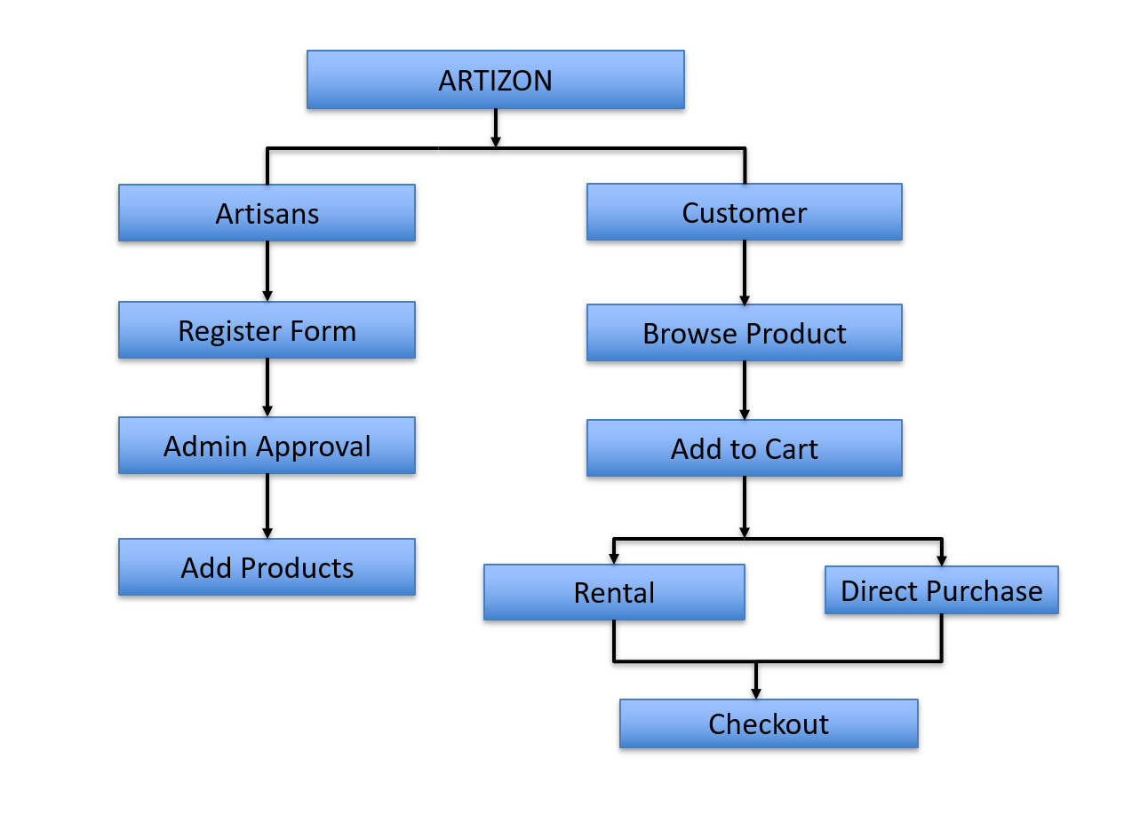
TECHNICAL APPROACH
Hustle squad
Technologies to be used:
Frontend (HTML, CSS, JavaScript)
Backend (NodeJS)
Database (MongoDB)
Payment Gateway integration
Cloud hosting (AWS)
Methodology:
The system will have two main user flows: artisan registration and product listing; customer browsing and purchasing.
The platform will be built using modern web technologies and follow an agile methodology.

Slide 4
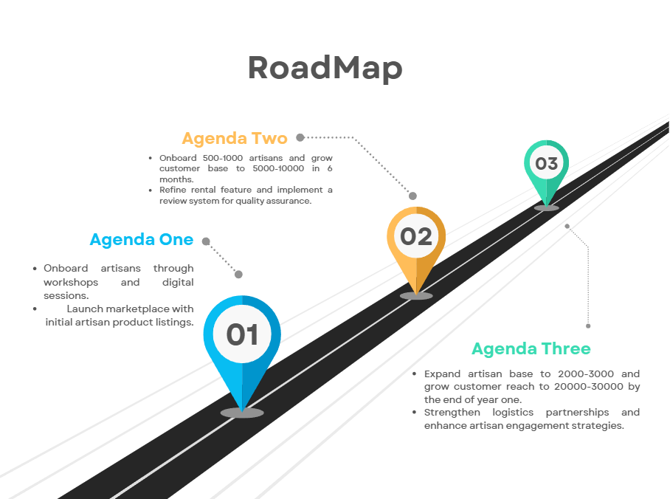
FEASIBILITY AND VIABILITY
Hustle squad
User-Friendly: Minimal onboarding friction, scalable to other regions.
Roadmap: Expand from local to national and global markets.
Artisan & Customer Growth: 500 artisans and 1000 customers in 6 months.
Rental Feature: Managed through a review and rating system to ensure trust.
Logistics: Partner with local delivery services for cost-effective, safe delivery.
Onboarding Artisans: Digital and in-person workshops, incentives, and follow-up evaluations.
Financial Model: Commission-based with premium listing services.
Revenue Growth: 15% increase in sales, moderate growth in the rental market.
Challenges: Scaling delivery and increasing artisan engagement through partnerships and education.

Slide 5
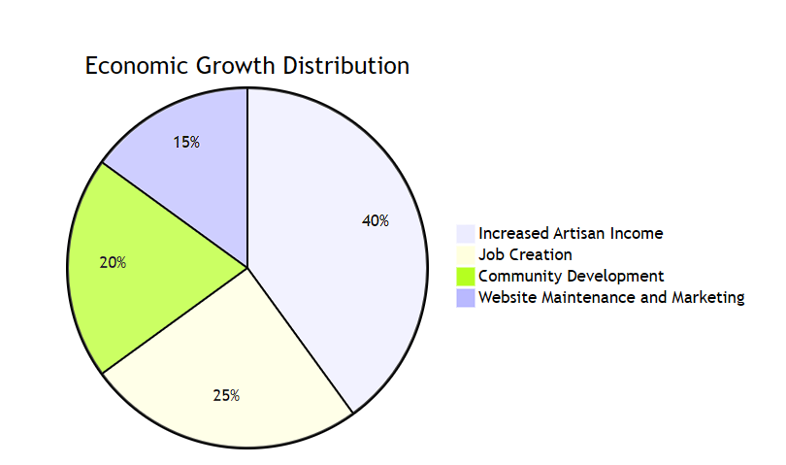
IMPACT AND BENEFITS
Hustle squad
Economic:
• Local artisans can expect a 15% increase in sales due to exposure to online buyers, based
on market analysis of similar platforms.
• Average rent income will increase as per product type.
Social:
• Connect 500+ artisans in rural areas within the first 6 months of launch.
• Platform supports traditional craftsmanship, aiming to preserve at least 10 regional art forms.
Environmental:
• Support for sustainable production: set of listed products will use eco-friendly materials.
• Reduction of carbon footprint by promoting local sales instead of imports.

Slide 6
RESEARCH AND REFERENCES
Hustle
squad
Reference:
Empowering Local Artisans through Mobile E-commerce :
Ch. Venkata Kalyan; V. V. S. N Akhila Sree Rajeswari;
Y. Sri Deepak Phaneendra; S. Ravi Kishan:
Lokart: Empowering Local Artisans through Mobile E-commerce | IEEE Conference Publication | IEEE Xplore
EPICRAFT- Ecommerce for Artisans:
(PDF) EPICRAFT- Ecommerce for Artisans (researchgate.net)
E-Commerce Website for Artisans (ijrpr.com)
IARJSET-ICMART-13.pdf

