Slide 1
Project Overview
ISO 26262 Functional Safety Analysis of an Electronic Steering Lock (ESL)
Objective: To apply the ISO 26262 concept phase workflow to identify hazards, derive safety goals, and develop functional safety requirements for an Electronic Steering Lock system.
Scope: Electronic Steering Lock (ESL) system at the conceptual system level.
Workflow: Item Definition → HAZOP → HARA → Safety Goals → Functional Safety Concept → FSRs

Slide 2
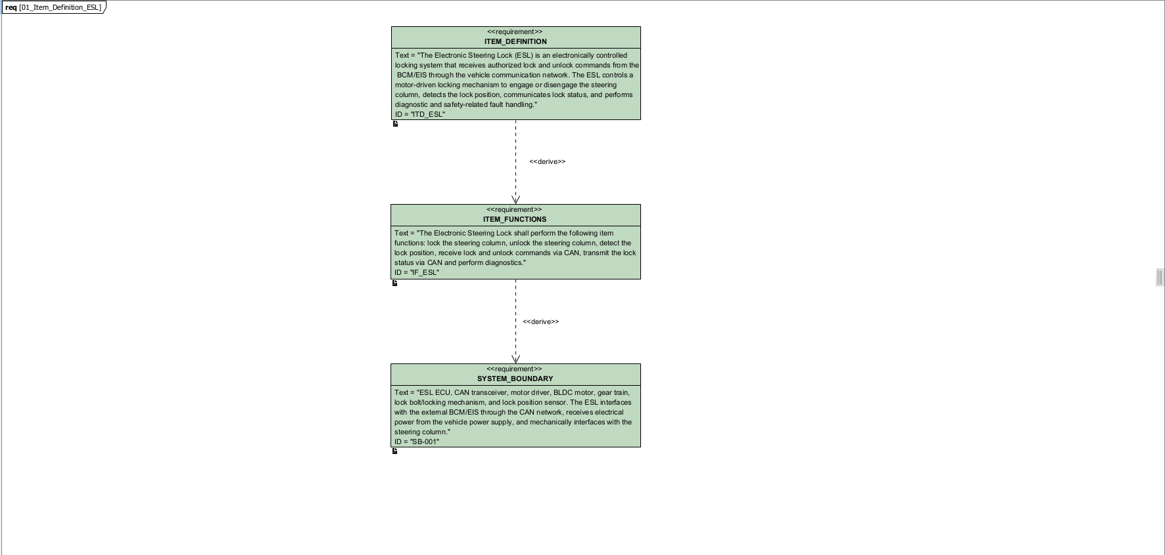
Item Definition for Electronic Steering Lock

Slide 3
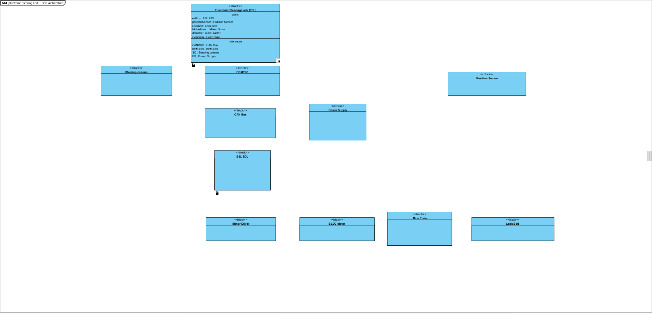
Block Definition Diagram for ESL_Item_Architecture

Slide 4
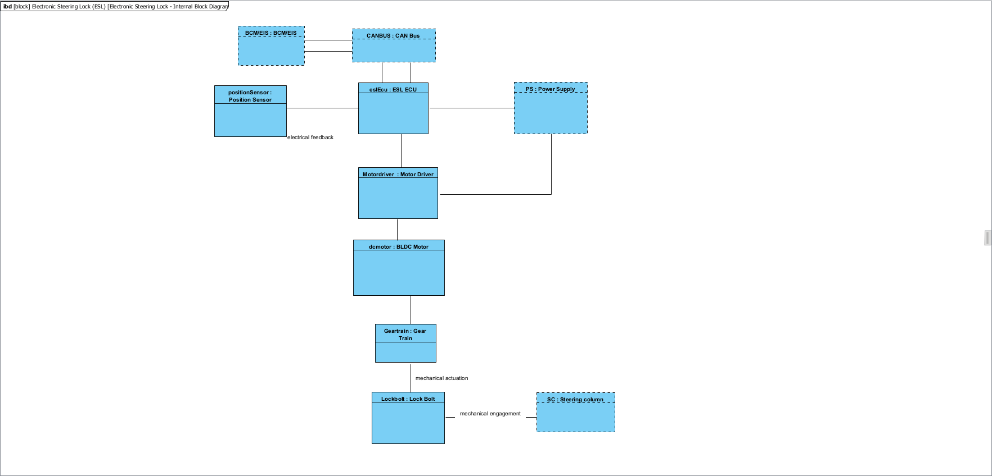
Internal Block Diagram for ESL

Slide 5
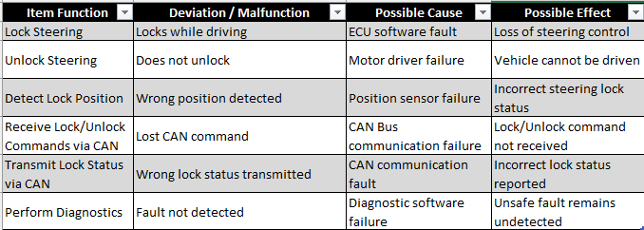
HAZOP

Slide 6
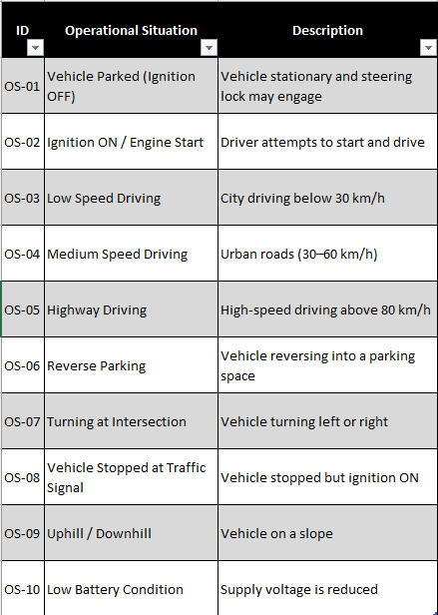
Operational Situations

Slide 7
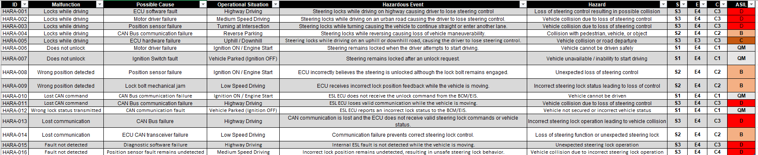
Hazard Analysis and Risk Assessment (HARA)

Slide 8
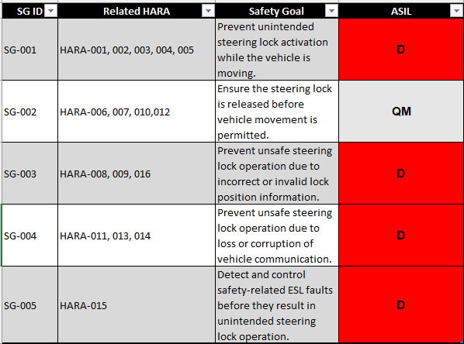
Safety Goals

Slide 9
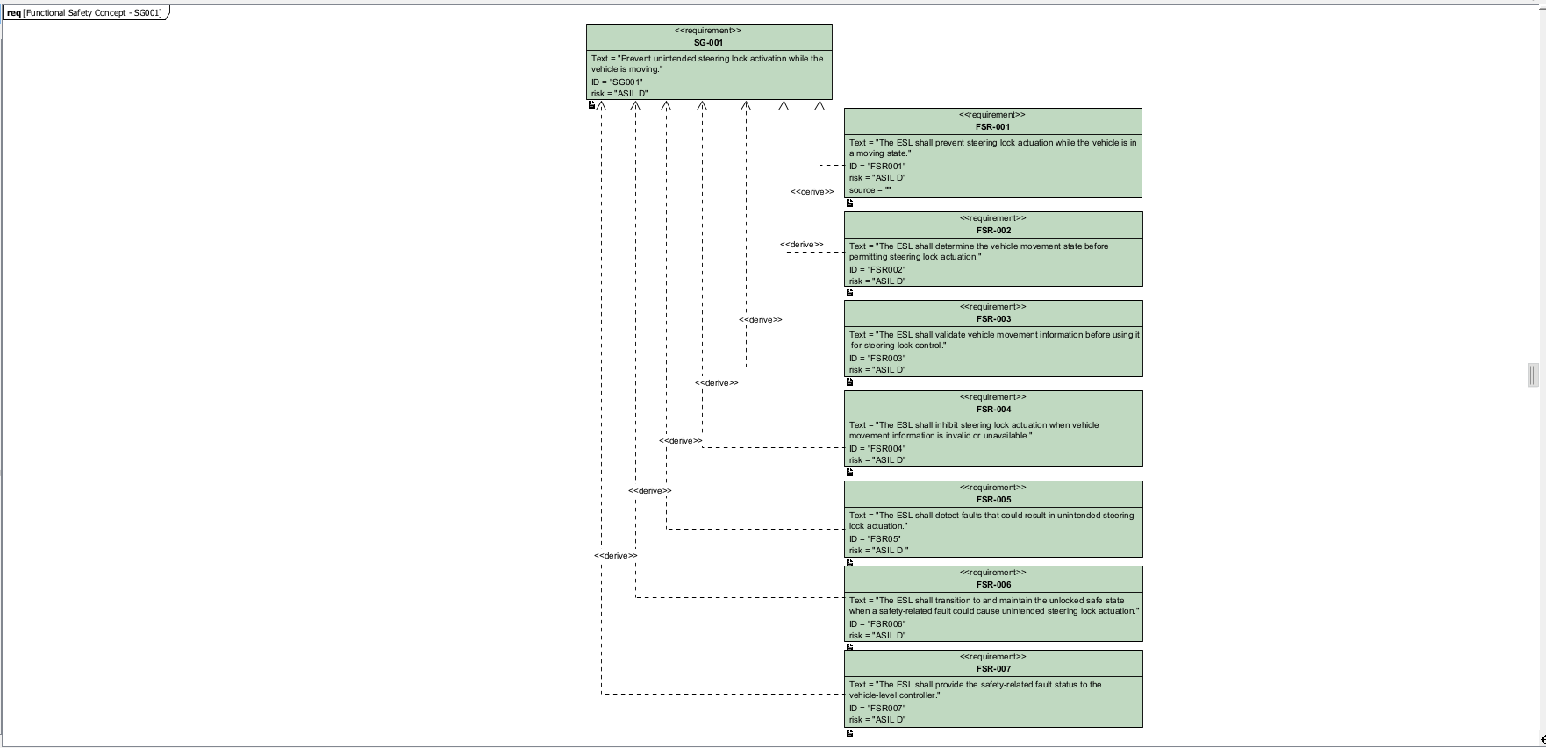
Functional Safety Concept – SG-001
ASIL D Safety Goal and Derived Functional Safety Requirements

