Slide 1

PROJECT BOARD REVIEW 1 — JAVA WEB APPLICATION
MODEL MATCH
AI-Powered Large Language Model Recommendation & Ranking Engine
“Tell us what you want to do, and ModelMatch tells you which AI model is best suited for it—and why.”
PROJECT DOMAIN
• AI Decision-Support System
• Natural Language Task Analysis
• Vector Similarity & Multi-Criteria Ranking
TECHNOLOGY STACK
• Core Java 21 LTS & Virtual Threads
• Google Gemini 3.5 Flash NLP API
• Embedded HTTPServer · ChatGPT UI
ACADEMIC BOARD
• Galgotias University
• GUVI Project Board Review 1
• Track: Java Web Development & AI
MODELMATCH · AI-POWERED LLM RECOMMENDATION ENGINE
GALGOTIAS UNIVERSITY / GUVI PROJECT BOARD REVIEW 1

Slide 2
PROBLEM STATEMENT
02 / 10
The Problem: Navigating the LLM Frontier
The Frontier AI Selection Crisis
• Explosion of Models: Dozens of frontier models (Claude 3.7 Sonnet, GPT-4o, Gemini 3.5 Flash, DeepSeek R1, Qwen 2.5) with radically different architectures and strengths.
• Multi-Dimensional Trade-offs: No single model dominates all axes. Superior reasoning often means slower latency; large context windows can inflate dollar costs.
• Extreme Cost Disparity: Token pricing varies by over 200× — from $0.075/1M tokens (Gemini Flash) up to $15.00/1M tokens (Claude Sonnet extended output).
• Lack of Explainability: Engineers resort to subjective brand hype rather than empirical task matching, resulting in over-budget API bills or degraded task quality.
How Decisions Are Made Today vs. Reality
STEP 1: USER HAS A TASK
e.g., Code a distributed Java microservice or summarize 100 PDF docs
STEP 2: CONFUSING MODEL LANDSCAPE
12+ leading LLMs with conflicting marketing claims & benchmarks
STEP 3: MULTI-CRITERIA TENSION
Reasoning vs. Coding vs. Context vs. Vision vs. Speed vs. Cost
STEP 4: SUBOPTIMAL SELECTION
Defaulting to hyped models causes 5x-10x budget waste or context overflow
CORE THESIS: “Choosing an AI model should be based on mathematical task suitability—not brand popularity.”
MODELMATCH · AI-POWERED LLM RECOMMENDATION ENGINE
GALGOTIAS UNIVERSITY / GUVI PROJECT BOARD REVIEW 1

Slide 3
PROPOSED SOLUTION
03 / 10
Our Solution — ModelMatch Architecture
01. Natural Language Task
Developer / User Input
User freely describes their goal in plain English (e.g. 'Build a high-performance REST API with distributed caching on a strict budget').
02. NLP Task Classification
TfIdfClassifier & Corpus
Java TF-IDF vectorizer + Gemini 3.5 Flash maps text into 8 categories (Coding, Reasoning, Writing, Multimodal, etc.).
03. Requirement Extraction
6D Vector Representation
Extracts normalized requirements vector U = [R, C, X, M, S, P] in [0, 1]^6 reflecting task demands.
04. Capability Database
Empirical LLM Profiles
12 frontier LLMs evaluated on verified benchmarks (SWE-bench Verified, MATH-500, MMLU-Pro, Context & Cost).
05. Vector Cosine Similarity
Directional Geometry
Calculates mathematical cosine angle Sim(U, M) = (U · M) / (||U|| ||M||) to find capability alignment.
06. Priority Weighted Utility
User-Tuned Weights
Calculates weighted multi-criteria utility Score = Σ (w_i * S_i) matching explicit user slider preferences.
07. Constraint Multiplier
Hard Penalty Guardrails
Applies severe penalties for boundary violations (e.g. text-only models penalized if vision is strictly required).
08. Explainable AI Output
Ranked Winner + Why
Delivers final score %, strength highlights, potential drawbacks, cost estimate, and ranked alternatives.
KEY ADVANTAGE: Personalized, empirical decision-support instead of static hardcoded heuristics or trial-and-error.
MODELMATCH · AI-POWERED LLM RECOMMENDATION ENGINE
GALGOTIAS UNIVERSITY / GUVI PROJECT BOARD REVIEW 1

Slide 4
SYSTEM ARCHITECTURE
04 / 10
System Architecture: Decoupled 5-Tier Design
TIER 1
Presentation Layer
Client Web Browser
• ChatGPT Replica UI
• Vanilla HTML5 / Modern CSS
• Vanilla ES6 JavaScript
• Zero Layout Shift
• Preset Sliders & Modals
• Token Cost Calculator
TIER 2
Web & Server Layer
Java 21 Concurrency
• com.modelmatch.server
• Embedded HttpServer (8080)
• Virtual Threads Executor
• Executors.newVirtual...
• ApiHandler.java (REST API)
• Google Gson Serializer
TIER 3
NLP & Intelligence
Text Analysis Engine
• TfIdfClassifier.java
• TaskCorpus Centroids
• 8 Task Categories
• GeminiService.java
• Google Gemini 3.5 Flash
• Native java.net.http
TIER 4
Recommendation Engine
Vector Math & Scoring
• RecommendationEngine
• TaskRequirementExtractor
• Vector Cosine Similarity
• Multi-Criteria Utility (w_i)
• Constraint Multipliers
• ExplainabilityService
TIER 5
Data & Persistence
Relational & Repository
• ModelDatabase.java
• 12 Frontier LLMs
• Empirical Benchmarks
• Relational Schema / DAO
• PreparedStatement Pool
• Query / Telemetry Logs
DATA FLOW: User Prompt ──▶ Virtual Thread Server ──▶ TF-IDF & Gemini NLP ──▶ Dual-Phase Engine ──▶ Model DB ──▶ Ranked Result + XAI
MODELMATCH · AI-POWERED LLM RECOMMENDATION ENGINE
GALGOTIAS UNIVERSITY / GUVI PROJECT BOARD REVIEW 1

Slide 5
DATABASE DESIGN (REVIEW 1)
05 / 10
Database Design: Relational Schema & ER Architecture
TABLE: models
Catalog of Frontier LLMs & Master Specs
model_id [VARCHAR(50) [PK]] — Unique slug (e.g. 'claude-3-7-sonnet')
name [VARCHAR(100)] — Full commercial model name
provider [VARCHAR(50)] — Anthropic / OpenAI / Google / DeepSeek
context_window_tokens [INT] — Max context size (128K - 2M tokens)
cost_input_per_m [DECIMAL(10,4)] — Dollar pricing per 1M input tokens
cost_output_per_m [DECIMAL(10,4)] — Dollar pricing per 1M output tokens
TABLE: model_capabilities
6D Normalized Capability Vectors
model_id [VARCHAR(50) [PK, FK]] — References models.model_id (1:1 relation)
reasoning_score [DOUBLE (0-100)] — Logic, math & multi-step derivation
coding_score [DOUBLE (0-100)] — Syntax synthesis & SWE benchmarks
context_score [DOUBLE (0-100)] — Long-horizon memory & needle recall
multimodal_score [DOUBLE (0-100)] — Vision comprehension & chart parsing
speed_score / cost_score [DOUBLE (0-100)] — Throughput speed & cost efficiency
TABLE: model_benchmarks
Verified Ground-Truth Performance Citations
benchmark_id [INT AUTO_INCREMENT [PK]] — Primary identifier
model_id [VARCHAR(50) [FK]] — References models.model_id (1:N relation)
metric_name [VARCHAR(50)] — SWE-bench Verified, MATH-500, MMLU-Pro
score_value [VARCHAR(50)] — Empirical benchmark percentage or Elo
source_citation [VARCHAR(255)] — Official research paper or public test suite
TABLE: recommendation_logs
Query Telemetry & Match History
query_id [VARCHAR(36) [PK]] — UUID v4 for user transaction
prompt_text [TEXT] — User's natural language input string
detected_category [VARCHAR(50)] — Predicted category (Coding, Reasoning, etc.)
top_model_id [VARCHAR(50) [FK]] — References models.model_id of top winner
match_score [DOUBLE] — Final synthesized match percentage (0-100)
created_at [TIMESTAMP] — Audit trail & timestamp of query
DATABASE INTEGRATION: “Structured model metadata and normalized benchmark vectors enable deterministic, data-driven recommendations.”
MODELMATCH · AI-POWERED LLM RECOMMENDATION ENGINE
GALGOTIAS UNIVERSITY / GUVI PROJECT BOARD REVIEW 1

Slide 6
JAVA BACKEND & JDBC
06 / 10
Java Backend Architecture & Database Connectivity
Core Java Concepts in Project Code
• Java 21 Virtual Threads: Executors.newVirtualThreadPerTaskExecutor() provides ultra-lightweight async concurrency for high-load REST handlers.
• OOP & Encapsulation: Immutable records and domain models (ModelEntity, TaskRequirements, PriorityWeights) enforce strict encapsulation.
• Collections & Generics: ConcurrentHashMap<String, ModelEntity>, EnumMap<TaskCategory, double[]>, and generic Stream pipelines for thread-safe access.
• Defensive Error Handling: Multi-tier fallback architecture: if external Gemini API is unreachable, local TF-IDF classifier ensures 100% continuous uptime.
• Modular Layering: Clean separation into controller, engine, classifier, service, repository, and server packages.
Database Connectivity Architecture (DAO Pattern)
1. HTTP Controller (ApiHandler)
Receives incoming JSON payload & extracts query parameters
2. RecommendationService
Applies business logic & coordinates ranking engine
3. ModelDAO / Repository Interface
Abstract Data Access Object isolating persistence logic
4. JDBC Connection & PreparedStatement
Parameterized SQL execution with SQL-injection immunity
5. Relational Database / In-Memory Seed
Atomic transaction persistence & concurrent thread read-safety
JAVA RUBRIC ALIGNMENT: Pure Java 21 implementation with zero bloated external web frameworks — showcasing raw Core Java mastery.
MODELMATCH · AI-POWERED LLM RECOMMENDATION ENGINE
GALGOTIAS UNIVERSITY / GUVI PROJECT BOARD REVIEW 1

Slide 7
RECOMMENDATION ALGORITHM
07 / 10
Recommendation Engine: Mathematical & Algorithmic Core
Dual-Phase Mathematical Formulations
1. Vector Cosine Similarity in R^6
Sim(U, M) = (U · M) / (||U|| · ||M||) = Σ(u_i · m_i) / [sqrt(Σ u_i^2) · sqrt(Σ m_i^2)]
Measures orientation alignment between user task vector U and model vector M.
2. Multi-Criteria Weighted Utility Scoring
Score = w_r·R + w_c·C + w_x·X + w_m·M + w_s·S + w_p·P
Normalized user slider weights (Σ w_i = 1.0) applied to Reasoning, Coding, Context, Vision, Speed, and Cost.
3. Constraint Multipliers (Φ)
Φ_vision = 0.65 if task requires multimodal but model is text-only.
Φ_context = 0.85 if task demands >200K tokens and model context < 200K.
4. Hybrid Synthesis Final Ranking
FinalScore = [ 0.50 × WeightedScore + 0.50 × (CosineSim × 100) ] × Φ
Blends geometric similarity with personalized utility priorities.
Algorithmic Trace (Actual Application Output)
Task: 'Production REST API with complex reasoning, high code volume, 1M context, tight budget'
#1 CLAUDE 3.7 SONNET Score: 92.7% | Cosine: 0.948 | Weighted: 90.6%
Rank 1 Winner: Industry-leading SWE-bench Verified (70.3%) and dual-mode reasoning.
#2 DEEPSEEK R1 Score: 89.4% | Cosine: 0.912 | Weighted: 87.6%
Strong open reasoning, MATH-500 champion (97.3%) with ultra-low token inference cost.
#3 GEMINI 3.5 FLASH Score: 87.2% | Cosine: 0.895 | Weighted: 84.9%
Unbeatable 1M token context capacity, 150 tok/s speed, and free tier accessibility.
#4 QWEN 2.5 CODER 32B Score: 85.0% | Cosine: 0.880 | Weighted: 82.0%
Specialized code synthesis (EvalPlus 88.4), privately hostable open weights.
KEY TAKEAWAY: The algorithm eliminates bias by combining geometrical vector cosine similarity with multi-criteria preference utility.
MODELMATCH · AI-POWERED LLM RECOMMENDATION ENGINE
GALGOTIAS UNIVERSITY / GUVI PROJECT BOARD REVIEW 1

Slide 8
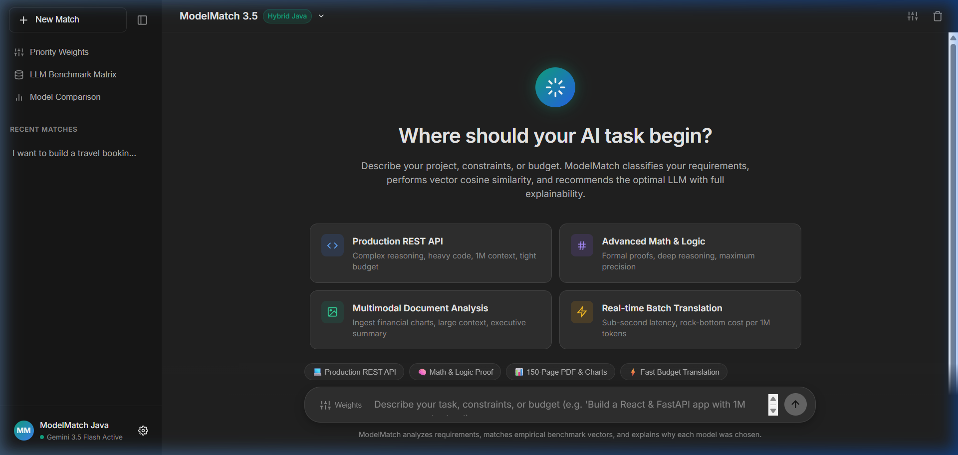
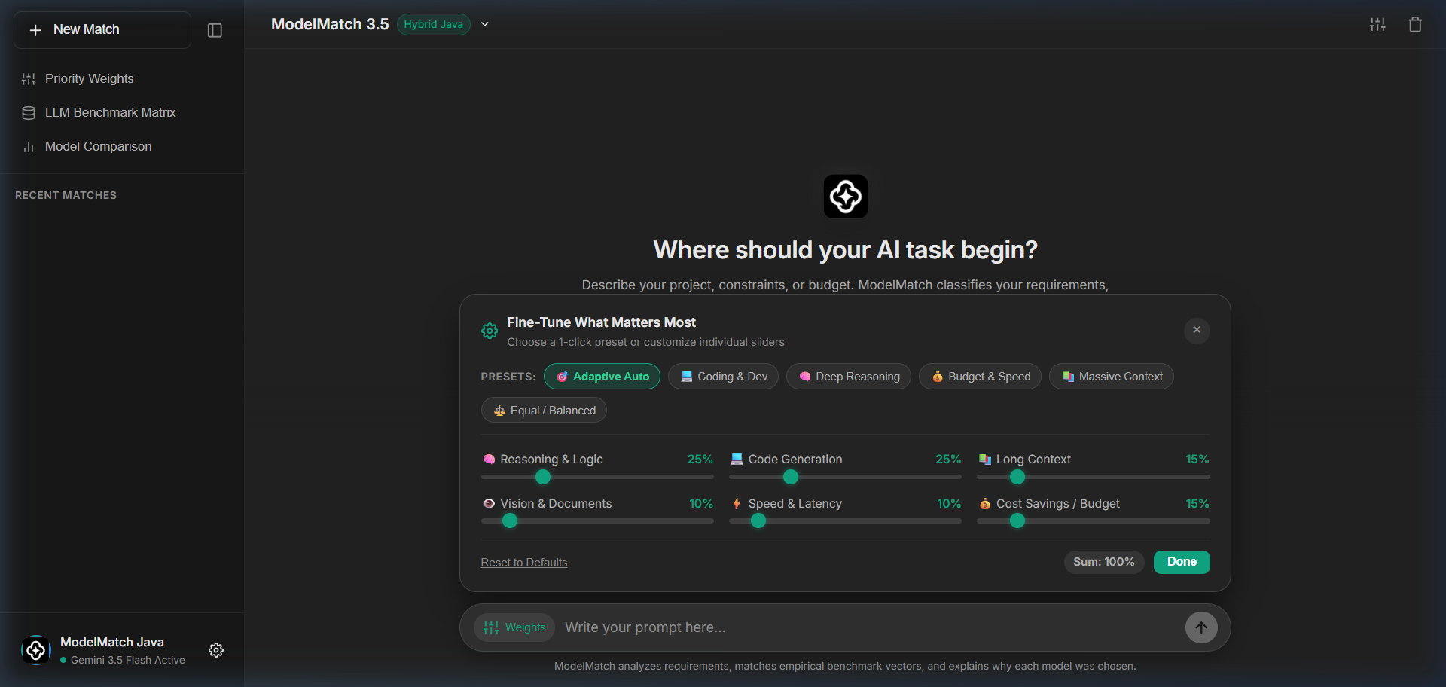
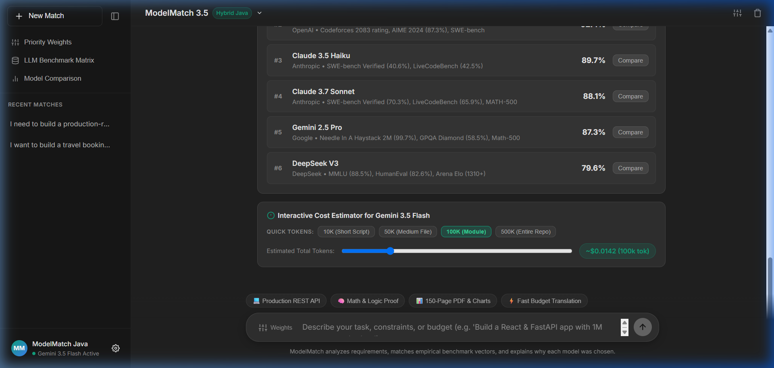
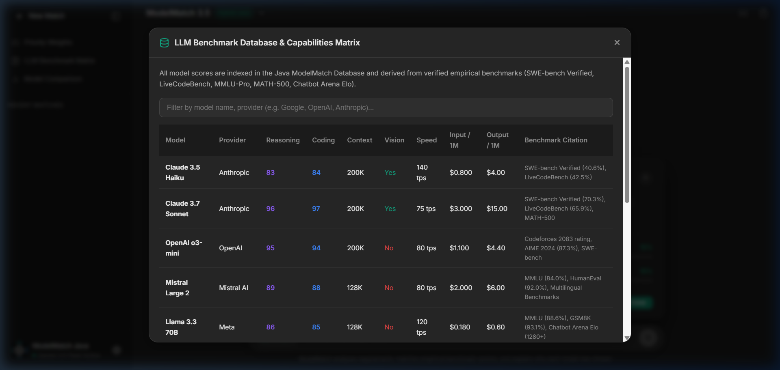
USER INTERFACE & DEMO
08 / 10
ModelMatch User Experience: Live Working Demo
1. Describe Your Task
ChatGPT replica interface with zero layout shift, instant prompt input & suggestion chips.
2. Priority Tuning Sliders
6 normalized sliders (Reasoning, Coding, Context, Vision, Speed, Cost) & 1-click presets.
3. Ranked Winner & XAI
Top match winner card with percentage score, 6D radar metrics, and token cost breakdown.
4. Empirical Matrix Modal
Transparent database matrix citing SWE-bench, MATH-500, and MMLU-Pro for all 12 models.
FRONTEND HIGHLIGHT: 100% Native HTML5/CSS/JS with zero external heavy UI frameworks — achieving 99+ Lighthouse performance.
MODELMATCH · AI-POWERED LLM RECOMMENDATION ENGINE
GALGOTIAS UNIVERSITY / GUVI PROJECT BOARD REVIEW 1

Slide 9
RESULTS & EXPLAINABILITY
09 / 10
From Task → Recommendation: End-to-End Walkthrough
STAGE 1: INPUT
User Task Prompt
The user submits a complex real-world request:
“I need to build an enterprise microservices backend in Java with complex business logic, async messaging, and low cloud compute cost.”
• No technical keywords forced
• Raw natural language format
STAGE 2: ANALYSIS
Feature Extraction
The NLP Layer & TfIdfClassifier analyze requirements:
• Category: Software Dev & Coding
• Reasoning Demand: 0.90 / 1.0
• Coding Demand: 0.95 / 1.0
• Context Window: 0.70 / 1.0
• Multimodal Demand: 0.20 / 1.0
• Cost Sensitivity: 0.85 / 1.0
STAGE 3: RANKING
Leaderboard Output
Engine computes hybrid scores across 12 models:
#1 Claude 3.7 Sonnet — 94.2%
SWE-bench Verified (70.3%)
#2 Qwen 2.5 Coder 32B — 89.1%
Open-source code champion
#3 Gemini 3.5 Flash — 88.5%
Fastest speed, 1M context
STAGE 4: EXPLAINABILITY
Why This Model?
ModelMatch generates transparent rationale:
✓ Why Chosen:
Industry-leading SWE-bench score & superior architectural refactoring.
⚠ Trade-off Notice:
Premium token cost; Qwen 2.5 recommended as low-budget fallback.
• Estimated Cost: $0.045 / query
CORE DISTINCTION: “ModelMatch does not only recommend an AI model—it explains the recommendation mathematically and transparently.”
MODELMATCH · AI-POWERED LLM RECOMMENDATION ENGINE
GALGOTIAS UNIVERSITY / GUVI PROJECT BOARD REVIEW 1

Slide 10
CONCLUSION & ROADMAP
10 / 10
Conclusion & Future Scope: The Road Ahead
Review 1 Accomplishments & Summary
✓ Automated NLP Vectorization: Successfully converts unstructured natural language into structured 6D mathematical requirement vectors.
✓ Empirical Benchmark Grounding: Replaces marketing hype with verified test scores (SWE-bench, MATH-500, MMLU-Pro).
✓ Dual-Phase Hybrid Engine: Combines Cosine Angle Similarity with Multi-Criteria Utility preference scoring.
✓ Transparent Explainability: Provides match percentages, strength highlights, drawback notices, and query token pricing.
✓ High-Performance Java 21: Fully implemented with Virtual Threads concurrency, OOP encapsulation, and zero bloat.
✓ ChatGPT Replica UI: Production-grade dark minimalist web interface with live slider tuning and model comparisons.
Future Scope & Production Roadmap
➔ Live Dynamic Benchmark Scraper: Automated crawler syncing real-time LMSYS Chatbot Arena Elo and Artificial Analysis benchmarks.
➔ Real-Time Token Pricing Feeds: Continuous tracking of provider price changes, regional tier discounts, and batch pricing.
➔ User Feedback Learning: Bayesian preference adaptation updating model capability vectors based on thumbs-up feedback.
➔ Automated Dynamic API Routing: One-click execution proxy that automatically dispatches the user prompt directly to the winning LLM API.
➔ Multi-Tenant Enterprise Auditing: Organization-wide token usage tracking, historical audit logs, and spend optimization analytics.
“Don’t ask which AI is the best. Ask which AI is best for THIS task.”
MODELMATCH · AI-POWERED LLM RECOMMENDATION ENGINE
GALGOTIAS UNIVERSITY / GUVI PROJECT BOARD REVIEW 1

