Slide 1
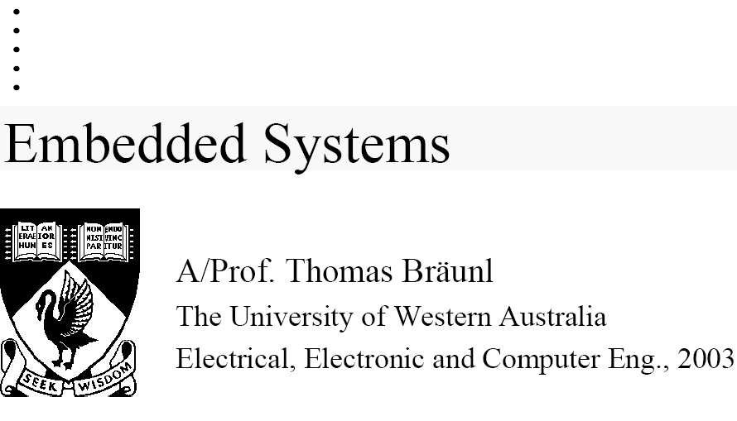
EMBEDDED SYSTEMS

Slide 2
Textbook:
T. Bräunl Embedded Robotics, Springer 2003

Slide 3
Plan of class
Week 1:
  Servo programming
  Evolutionary algorithms
Week 2:
  Humanoid Robots
  Models of robotics
    Mapping, grammars, automata, probabilistic, Braitenberg Vehicles, natural language, logic based learning.

Slide 4
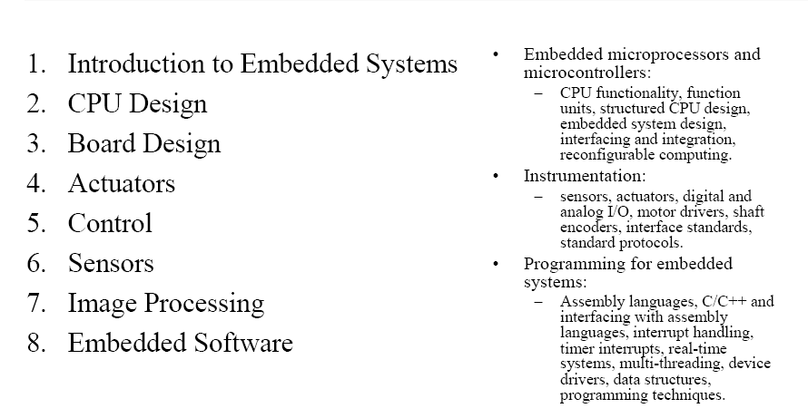
What in class?

Slide 5
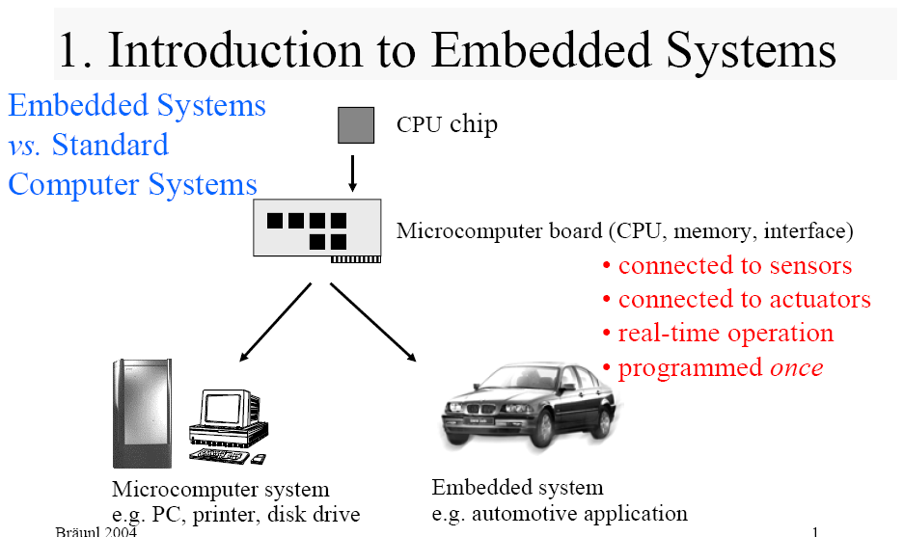

Slide 6
1.1 Definition
Definition for: embedded system
A combination of hardware and software which together form a component of a larger machine.
An example of an embedded system is a microprocessor that controls an automobile engine.
An embedded system is designed to run on its own without human intervention, and may be required to respond to events in real time.
Source: www.computeruser.com/resources/dictionary

Slide 7
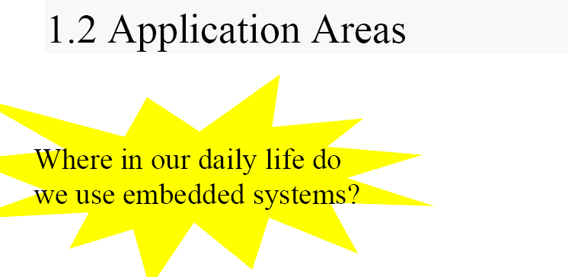
Applications Areas

Slide 8
Application Areas
• TV
• stereo
• remote control
• phone / mobile phone
• refrigerator
• microwave
• washing machine
• electric tooth brush
• oven / rice or bread cooker
• watch
• alarm clock
• electronic musical instruments
• electronic toys (stuffed animals,handheld toys, pinballs, etc.)
• medical home equipment (e.g. blood
pressure, thermometer)
• …
• [PDAs?? More like standard computer system]
Consumer Products

Slide 9
Application Areas
Medical Systems
  pace maker, patient monitoring systems, injection systems, intensive care units, …
Office Equipment
  printer, copier, fax, …
Tools
  multimeter, oscilloscope, line tester, GPS, …
Banking
  ATMs, statement printers, …
Transportation
  (Planes/Trains/[Automobiles] and Boats)
radar, traffic lights, signalling systems, …

Slide 10
Application Areas
Automobiles
  engine management, trip computer, cruise control, immobilizer, car alarm,
  airbag, ABS, ESP, …
Building Systems
  elevator, heater, air conditioning, lighting, key card entries, locks, alarm systems, …
Agriculture
  feeding systems, milking systems, …
Space
  satellite systems, …

Slide 11
Application Areas
Facts:
  1997: The average U.S. household has over 10 embedded computers (source: www.it.dtu.dk/~jan)
1998: 90% Embedded Systems vs. 10% Computers
  (source: Frautschi, www.caliberlearning.com)
2001: The Volvo S80 has 18 embedded controllers and 2 busses (source: Volvo)

Slide 12
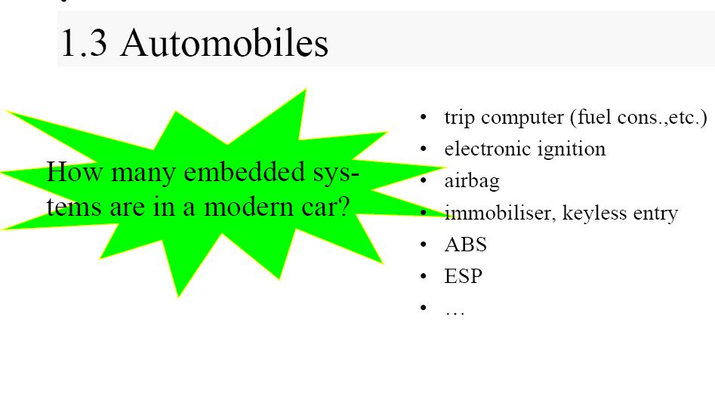
Automobiles

Slide 13
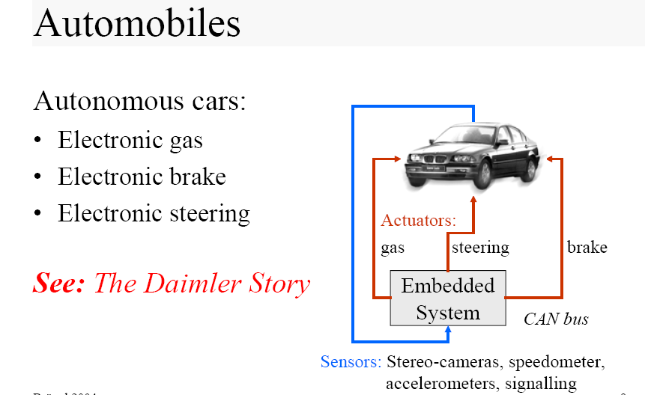

Slide 14
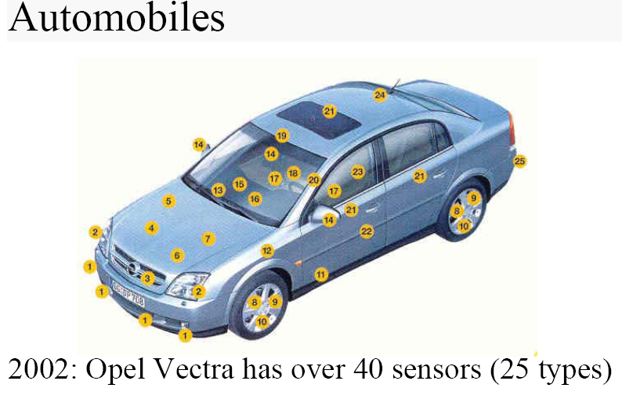

Slide 15
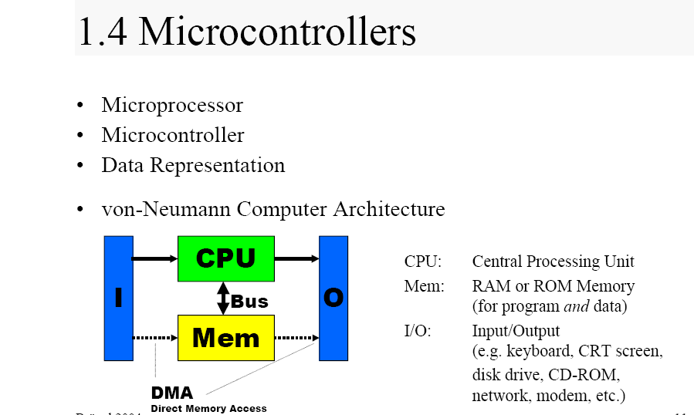
Microcontrollers

Slide 16
Microcontrollers
Microprocessor
  CPU (on single chip)
Microcontroller
CPU + Timers + I/O (+RAM) (+ROM)
    Reduced chip count for board design
    Embedded system
    Today’s Technology:
      Surface Mount Device (SMD)
      Ball Grid Array (BGA)

Slide 17
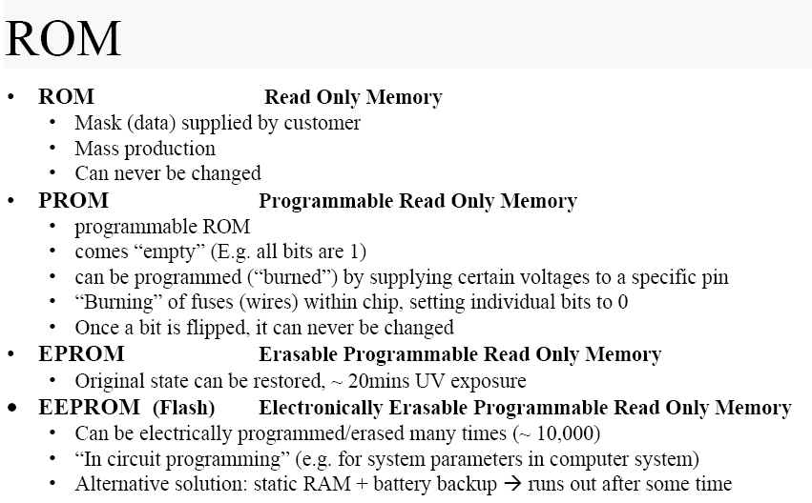

Slide 18
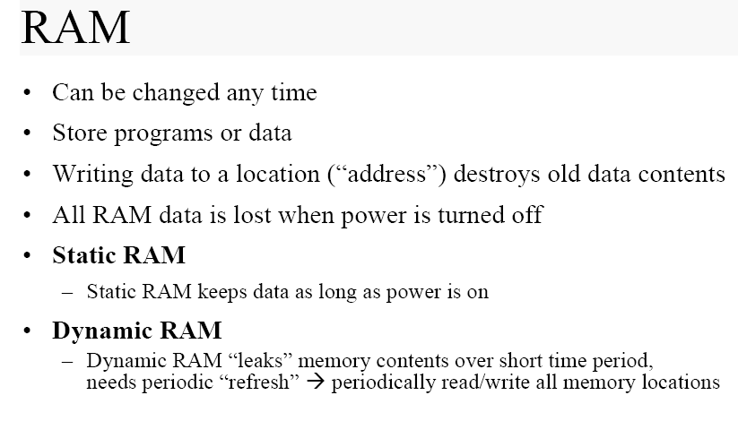

Slide 19
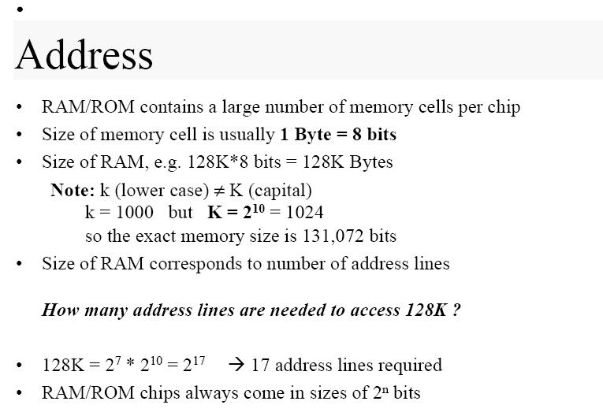

Slide 20
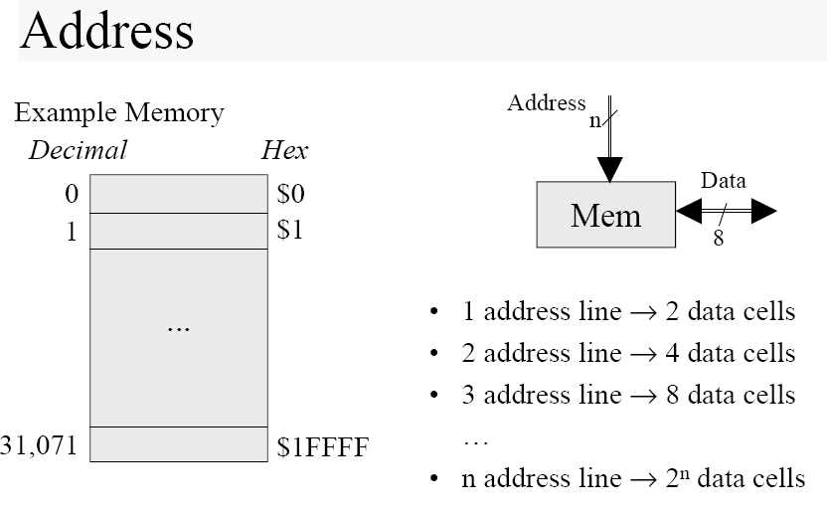

Slide 21
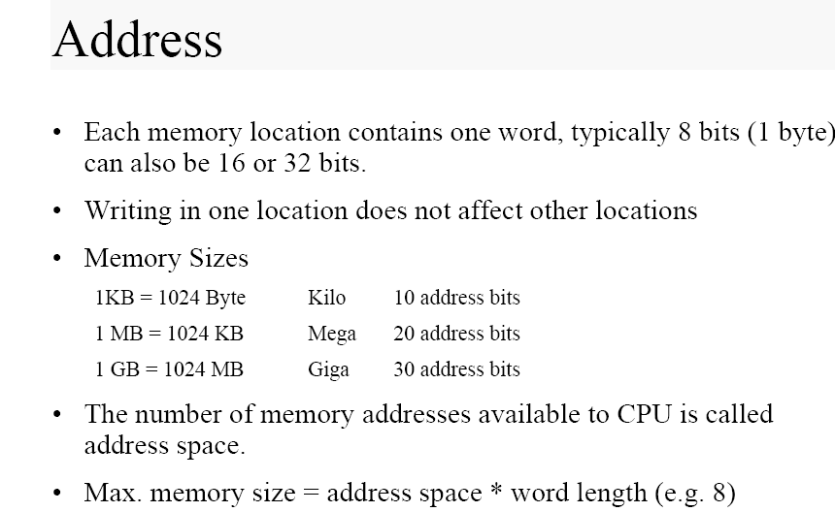

Slide 22
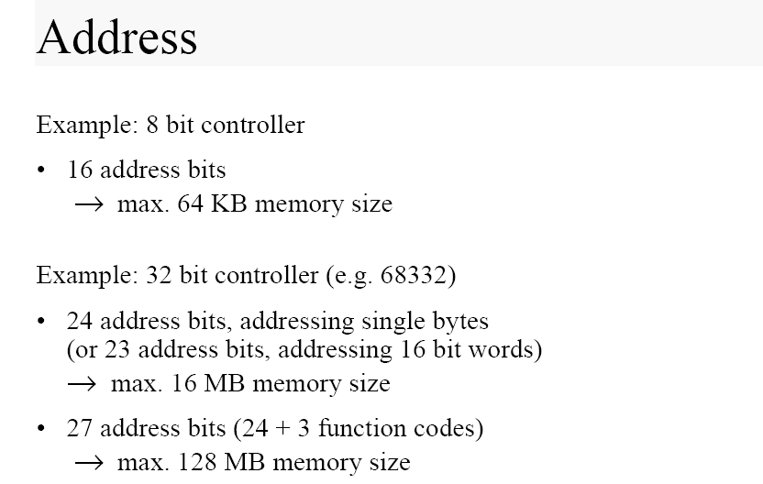

Slide 23
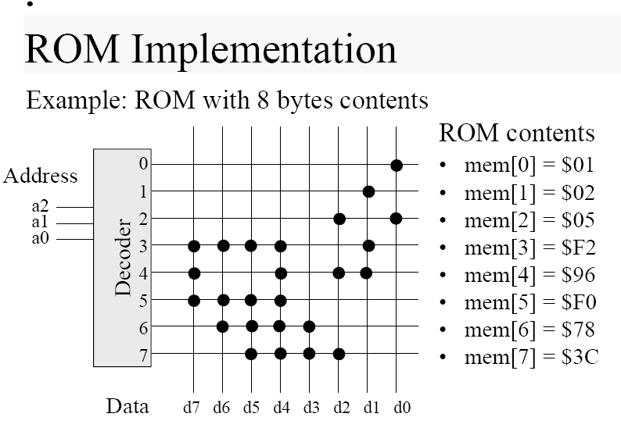

Slide 24
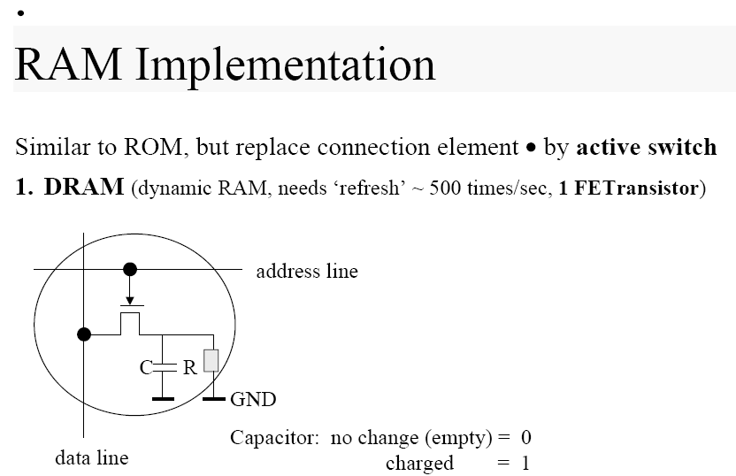

Slide 25
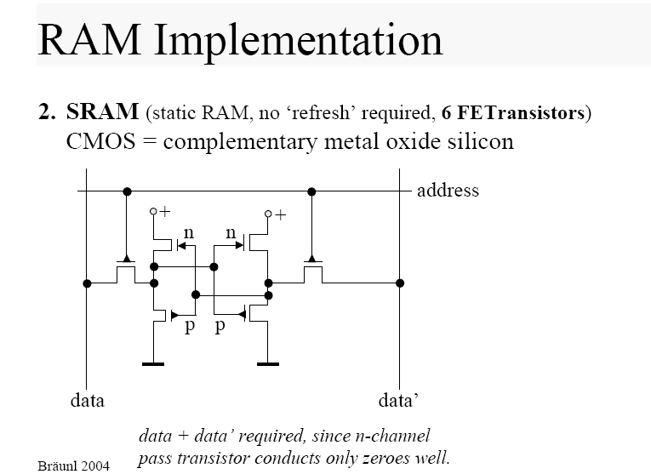

Slide 26
Input and Output
Required to communicate with outside world
PC System:
  Keyboard
  Monitor
  Parallel port (printer port)
  Serial port + USB
Embedded System:
  Sensors (e.g. in automobile: acceleration sensor, seat sensor)
  Actuators (e.g. in automobile: valves for airbags)

Slide 27
Input and Output
Input / output device implementation can be:
• Memory-mapped
• I/O mapped (ports)
• DMA (direct memory access)

Slide 28
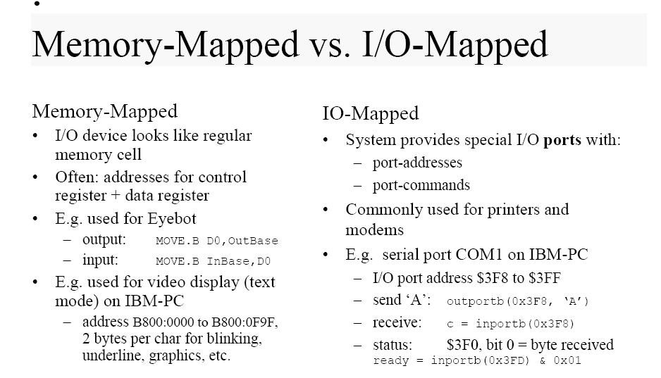

Slide 29
