Slide 1
Angular Boilerplate 30/04/2020

Slide 2
Introduction
As part of the Aerolines vertical there are multiple projects that use Angular as their base framework for handling the Front End. Thus a Boilerplate has been developed to achieve the following:
Maintain a common framework across different projects.
To ensure best practices are being followed while starting a project.
To compare existing project for implementing best practice for UI development.
To ensure a faster turnaround time, as a team has to just checkout the code from Git, install the dependencies and start coding.
This presentation aims to give a brief about the boilerplates salient features and the issues and enhancement it addresses.

Slide 3
Why do we need a framework ?
Since Angular is already a framework why do we need a framework on top of the existing framework ?
This is a valid question as Angular already provides a framework for building Front-End applications, however Angular only provides a MVVM framework on Front-End, it does not provide any rules regarding optimizing the application in terms of coding practices and asset management (code, css/scss etc). The Boilerplate is an effort to laydown the guidelines for optimal code structure and asset management.

Slide 4
SCSS Optimization
The boilerplate suggests the following practices for SCSS optimization:
Better code organization: This is an important step as organizing the code helps in reducing the overall bundle size by avoiding code repetition thereby improving the speed at which the bundles are loaded by the browser and also improves the interpretation and compiling of code by the browser. This extends to both CSS and TS/JS code.
Enforcing Good practices for writing CSS: Using the proposed code structure, a developer would have to use the correct CSS files (entry points) for writing the styles intended for specific purposes, this would avoid style repetition, while also avoiding forcing of style overriding by using !important etc. Also when it provides a standard to follow when different members in a team develop an Angular application, it also improves the readability and eases the understanding of the code. In order to achieve this lets refer to the image in the next slide.

Slide 5
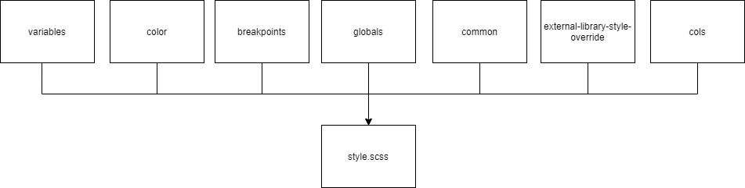
SCSS Optimization
Figure 1: Global SCSS Framework
As can be seen in the image above the overall SCSS file structure has been broken into different files that would reduce the scope of the functionality to what each file is intended to do. The responsibility and distribution of code as per the files are listed below:
style.scss: This is the main entry point for css and all the global files are linked to the application using style.scss. This file would only contain imports and nothing else.
variables.scss: This file would contain all the variable declaration of the css property values.

Slide 6
SCSS Optimization
color.scss: This file would have the color palette defined in it.
breakpoints.scss: This contains all the breakpoints for desktop, tablet and mobiles.
global.scss: This will be the place for all global style definitions.
common.scss: This is the place for defining CSS classes that would be common across different components. This if followed diligently would eliminate the need for repeating CSS styles across components.
external-library-style-override.scss: This file can be used for overriding the default styles for material/primeng component wherever required, without enforcing style override using !important. Please ensure that in order to override the style information use either the same tree structure as defined in the component’s css or scope the style information by using a parent css class.
cols.scss: This is a mixin that creates a 12 column layout that can be used for developing responsive layout. Note: It would be advisable not to edit this file.

Slide 7
Good Practices (Typescript)
Enforcing Good Practices for implementing Angular framework: Using the proposed framework a developer would follow a better code writing style and also implement the best practices as suggested for Angular.
Things to consider: While developing an angular application the following points should be considered:
Although we write our code in Typescript, everything ultimately compiles to Javascript. This is the most important factor to be considered while planning the layout of an application, as Typescript only provides us a guidelines for strict type checking, post compilation all the TS code gets compiled to JS code. This means that the way Browser reads and interprets Javascript does not change and hence any poorly managed code affects the way the browser loads and parses it.
Separation of concern. It is important to maintain separation of concern by isolating each actor’s responsibility by limiting it to only the purpose its meant to serve. To explain further a component class should only be responsible for interacting with its html template and nothing else. Similarly a service should act as a source for data handling and storage and at times act as a bridge between components.

Slide 8
Good Practices… (Continued)
Using smart and dumb components. While developing an application it is important to identify the components that would be used for operations such as acquiring data from services, and also handle user interactions, such components are also called smart components. Dumb components are those which only concern themselves with receiving inputs and broadcasting data as outputs, dumb components are important as they can be used as generic components which means they can be used across different user stories or even projects, Angular material and PrimeNG components are perfect examples of dummy components.
Avoid Hardcoded Data. Use external JSON files instead as a source for static data to be displayed across applications. This enhances experience by changing data without recompiling the application and also helps in developing applications with multi-lingual support.

Slide 9
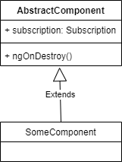
Good Practices… (Continued)
Handle subscriptions smartly. RxJS provides us with observables and subscriptions for data binding which if kept unchecked affects the overall application performance severely. Angular provides component lifecycles and ngOnDestroy is one lifecycle method that can be used for unsubscribing from the component’s subscriptions, however this leads to repeating the same code and lifecycle method in every component which makes the code redundant and also may lead to the chances of omitting the implementation of the lifecycle method as the number of components increase. In order to handle such a situation it’s better to create a parent component that handles the code for unsubscribing from subscriptions in the ngOnDestory lifecycle method and extending every component from the Parent class.

Slide 10
Good Practices… (Continued)
Lazy Loading is a boon but not every module needs to be lazy loaded. Angular provides the mechanism to lazy load modules which means that whenever the user navigates to a particular route the module for that route is loaded on demand. While this keeps the size of the main bundle in check however care needs to be taken to see if there is any benefit offered by lazy loading the modules for every route, consider the following use cases before applying route based lazy loading:
Size of the module – The benefits of lazy loading are offered in case of modules that are considerably big, hence separating them keeps the main bundle optimized. A smaller bundle on the other hand will not affect the size of the main bundle if its included in the main bundle. Lazy loading it would only affect the user experience as the user would have to wait until the module is loaded when they visit the specific route.
Alternate methods of dynamic loading of modules – Instead of loading modules only when the user visits a particular route, we can also resort to deferred loading. For every application we can analyze the sections that will have the maximum user visits, based on that information we can pre-fetch the modules in the background when the application loads. Following this practice a user will not have to wait for the module for the visited route to load when the router url is hit.

Slide 11
Good Practices… (Continued)
Implement Angular Universal (SSR): Server Side Rendering (SSR) is a method of serving angular applications from a server instead of the browser. This ensures that the angular code is compiled and rendered at the server (instead of browser) and the fully qualified HTML is sent to the browser. This implementation results in faster rendering of the first page of angular application. Click here for more info.
Consider app-shell in Angular: App-shell is a technique of rendering a portion of page via route at build time. It improves user experience by static loading of a common skeleton until the user waits for the entire page to load. Click here for more info.
. PreLoading: Preloading is a conceptual approach which is used in angular if we want to
preload style of any page before the page load. In angular we marked this style as a part
of bundle and it will automatically download parallel to very first page of the application
loaded.

Slide 12
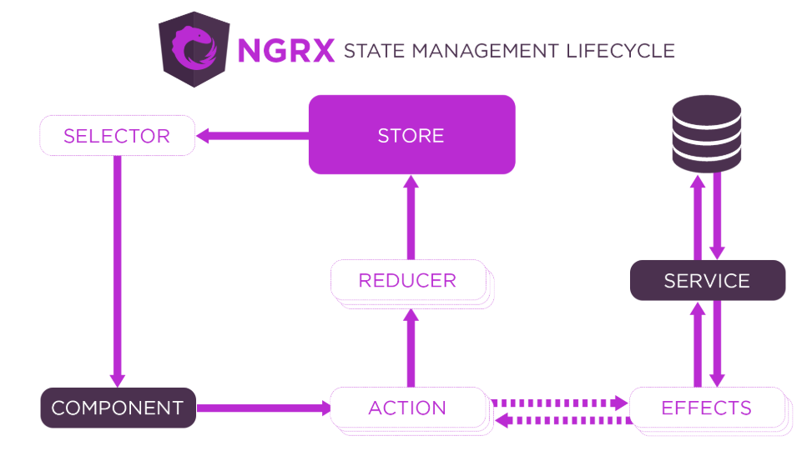
Good Practices… (Continued)
NgRx Store: Store is RxJS powered state management for Angular applications, inspired by Redux. Store is a controlled state container designed to help write performant, consistent applications on top of Angular. Click here for more info.

Slide 13
Good Practices… (Continued)
Change Detection: Turn Change Detection off for components that do not need live data reload. (Refer to this article for implementing Change Detection)
Angular 8 natively provides scaffolding for a web worker which can be used to boost performance by running threads that’s separate from the browser.

Slide 14
Where is the Boilerplate located ?
The source for the Boilerplate is hosted in Innersource (GitLab), to checkout the code use the following url → <link>.
The GitLab branch has an exhaustive Readme as a guidance tool along with a SampleModule that contains a collection of POCs for the best practices.

Slide 15
Prerequisites for Boilerplate
The following frameworks and tools are required to setup and run the boilerplate code.
An IDE (VS Code/ Sublime/ Atom or any other)
Node.js (version 10+)
Angular CLI (version 8+)
The external libraries which are used in application are as follow (they will automatically get installed when you setup the code as mentioned in next slide).
RxJs (version 6.4)
NgRx (version 8.6)

Slide 16
Setting up the Boilerplate
Set up
Git clone using the url given in the previous slides.
Install the dependencies using npm install
Start Coding.
Remove the dependency on SampleModule before pushing the code in production.
Suggested Reading
Although the previous slides have discussed in details about the best practices, I am summing some points up to ensure the purpose of the boilerplate is not misused:
Have a thorough understanding of the purpose of the scss files in the shared folder before planning out the styles to be applied across the application.
Go through the examples in the SampleModule so that you are aware of what goes where.
Be really judicious about breaking the component pattern into Smart and dumb component so that the components can be kept generic.
Detach the SampleModule from the application before moving to production.

Slide 17
Recommended Read
For further information on developing better Angular applications along with some advanced UI (not angular specific) topics please refer to the following PowerPoint presentation in <Link>.

Slide 18
Thank You.

