Slide 1

Department of Computer Science and Engineering
Major Project Presentation–2 | 7CSE-1 | Team-8
LOGO: Video Text Spotting with Language Collaboration and Glyph Perception Model
Under the guidance of
Dr. Md. Sharfuddin Waseem
Assistant Professor, CSED
Presented by
Damera Raghav (B23CS007)
Kambhampati Sanjana (B23CS008)
Chada Jayasen Reddy (B23CS015)
Patel Vyshnavi (B23CS050)

Slide 2
Presentation outline
01
02
03
Project Analysis
Project Design
Project Implementation
Problem and motivation
Objectives
Existing vs. proposed system
Datasets
Requirements
System architecture
Language Synergy Classifier and glyph branch
Score fusion and VPMM
Tracking and our extensions
Code and data-flow design
Environment and training
Ablation and final results
Efficiency
Qualitative and error analysis
Demo, conclusion, future work

Slide 3
Project Analysis
01
What problem LOGO solves, what exists today, and what the project needs

Slide 4
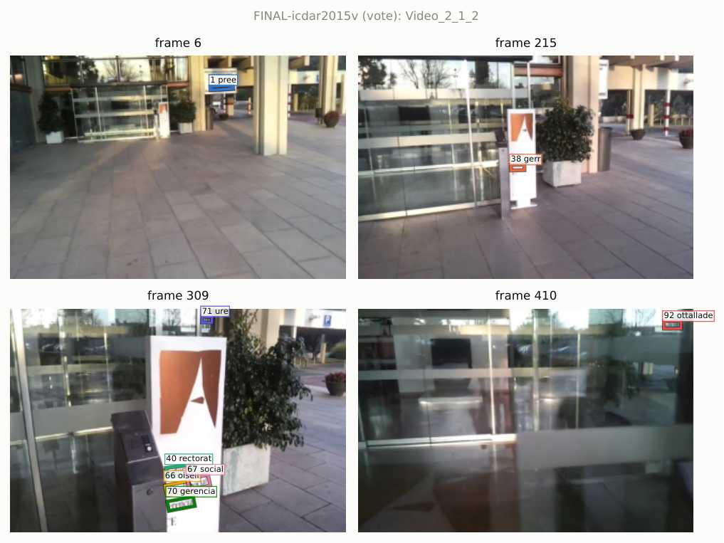
Problem: text in video is hard to read reliably
Video text spotting means finding every word in every frame, reading it, and following the same word across frames.
What makes it hard
Image quality: motion blur, low resolution, glare and perspective distortion
Small text: about one third of words in ICDAR video sets are under 20 px tall
Look-alike clutter: fences, windows and patterns trigger false detections
Identity over time: a word must keep one ID as the camera and object move
LOGO answers this by letting a text recogniser vote on what the detector found, and by using glyph (character-shape) supervision so the recogniser sees character strokes clearly.
ICDAR2015 Video_2_1_2: small, blurred signage across four frames (our tracker output)

Slide 5
Objectives
01
Detect
02
Recognise
Locate oriented text in each video frame with a rotated-box detector
Read each detected word with a language-aware recogniser (ABINet)
03
Verify
04
Perceive glyphs
Use the recogniser’s confidence to re-score detections and suppress non-text
Add a glyph segmentation branch so features focus on character strokes
05
Track
06
Evaluate
Link words across frames with position-aware visual features (VPMM + LST-Matcher)
Measure detection, tracking and end-to-end spotting on ICDAR2013/2015 video

Slide 6
Existing systems vs. the proposed system
Aspect | Existing approaches | Proposed LOGO pipeline
Detection | Detector score alone decides what is text; clutter passes through | Detector score fused with a language score from the recogniser
Recognition | Visual features only; blurred or small characters are misread | ABINet with iterative language correction plus a glyph segmentation branch
Tracking | IoU or appearance matching between consecutive frames (e.g. FREE, GoMatching) | VPMM features (centre-line position + visual) fed to a long/short-term matcher
Text per track | Each frame keeps its own reading; a word can flicker between spellings | Track-level voting picks one text per track (our extension C3)
Hardware | Large backbones trained on multi-GPU servers | Runs end to end on a single 6 GB laptop GPU

Slide 7
Datasets
Dataset | Videos | Train (with GT) | Test | Test GT | Used for
ICDAR 2013 Video | 28 | 13 | 15 | Available | Training, validation
ICDAR 2015 Video | 49 | 25 | 24 | Not public | Main benchmark (val split)
DSText | 100 | 50 | 50 | Not public | Small, dense text study
Ground truth converted from ICDAR XML to one JSON schema per video; frames extracted once and shared by all stages
ICDAR 2015 test labels are not public, so results are reported on a held-out validation split of the training videos
Fixed splits (seed 42) stored in splits/ so every experiment sees the same videos

Slide 8
Requirements
Hardware
Software
Modules
NVIDIA RTX 3050 Laptop GPU, 6 GB VRAM
8 GB system RAM
~50 GB disk for videos, frames and checkpoints
Python 3.11, uv for environments
PyTorch 2.1.2 + CUDA 12.1
Ultralytics YOLO11 (OBB) / PaddleDetection
ABINet, GoMatching (third_party)
OpenCV, motmetrics, pytest
Data: GT conversion, frames, splits
Detector, LSC + glyph branch
Fusion, VPMM, tracking
Voting, evaluation
Demo (CLI and Gradio)

Slide 9
Project Design
02
Architecture of the pipeline and the role of each module

Slide 10
System architecture
Each stage writes its output to runs/<exp_id>/<stage>/<dataset>/ and the next stage reads it, so any stage can be re-run alone.
C2 soft
C3
Frames
Detector
LSC
Fusion
VPMM
Tracker
Voting
Video decoded to JPEG frames
YOLO11s-OBB rotated boxes + scores
ABINet reads each crop: text, confidence, features
det score combined with language score
centre-line position + visual features
LST-Matcher links boxes into tracks
one text per track; weak tracks dropped
Glyph branch
(training only)
Paper (LOGO, arXiv 2405.19194)
Our extensions

Slide 11
Language Synergy Classifier and glyph perception
Language Synergy Classifier (LSC)
Glyph segmentation branch
Each detected quad is rotated upright and cropped to 32 × 128
ABINet (vision model + language model, 3 refinement iterations) reads the crop
Outputs per box: text, mean character confidence, end-token probability p_eos and a 26 × 512 feature map
Is it text? hard: decoded string non-empty; soft: 1 − p_eos
Fine-tuned on crops cut from our training videos (10 epochs, AMP, effective batch 48)
Taps three ResNet-45 feature maps: F0 (32 ch, 32×128), F1 (64 ch, 16×64), F2 (512 ch, 8×32)
Top-down decoder G2 → G1 → mask S_m with skip connections
Trained against pseudo glyph masks; loss L = L_rec + L_seg (MSE)
Used only during training: no inference cost
Effect (+GS row, ICDAR15 val): spotting IDF1 33.38 → 36.08 and LSC time 55.6 → 26.1 ms/frame

Slide 12
Score fusion and the Visual-Position Mixed Module
Score fusion
VPMM
s = (1 − w) · s_det + w · s_lang
P = ReLU(W₂ ReLU(W₁ L))
F = MLP(flatten(P + V))
w = 0.5 averages detector and recogniser evidence
Hard (paper): s_lang ∈ {0, 1}
Soft (C2, ours): s_lang = 1 − p_eos ∈ [0, 1], so uncertain reads lower the score gradually instead of all-or-nothing
Boxes whose fused score falls below the threshold are dropped before tracking
L: 26 points sampled along the box centre line, normalised by image size
V: the LSC feature map (26 × 512) for the same box
Position and appearance are added per reading position, then mixed to a 1024-d track embedding
Lets the tracker separate identical-looking words at different places

Slide 13
Tracking and track-level text voting
LST-Matcher (from GoMatching)
C3: track-level text voting (ours)
Transformer association head adapted to take VPMM features instead of DeepSolo queries; upstream code left unchanged
Short-term: match to tracks in the previous frame; long-term: match to a trajectory memory
Thresholds: match 0.4, trajectory 0.6, overlap 0.2
Trained 30k iterations on 6-frame clips (lr 5e-5, warm-up 1k, AMP)
Box | Reading | Weight
frame 12 | bricome | 0.41
frame 13 | bricomer | 0.83
frame 14 | bricomer | 0.77
frame 15 | brlcomer | 0.22
→ bricomer
illustrative
Weight = text confidence × language score; readings normalised (lowercase, a–z, 0–9)
The reading with the largest summed weight is written to every box
Tracks shorter than 3 boxes or with mean language score < 0.5 are removed

Slide 14
Code and data-flow design
Package | Responsibility
logo.data | Parse ICDAR XML, unified GT schema, frame extraction, splits
logo.detector | YOLO11-OBB (in-process) or PP-YOLOE-R (Paddle subprocess) inference
logo.lsc / logo.glyph | Rotated crops, ABINet wrapper, LSC training, glyph branch and pseudo masks
logo.scoring | Hard / soft score fusion
logo.vpmm / logo.tracking | VPMM module, LST adapter, simple and embedding trackers
logo.voting / logo.eval | Track voting; detection, MOT and spotting metrics
Design principles
One YAML config per experiment; base.yaml lists every key
Stages communicate only through files (JSON / JSONL)
Atomic writes, so an interrupted run never leaves half files
Third-party code wrapped, never edited
Every deviation from the paper logged in docs/decisions.md

Slide 15
Project Implementation
03
Training, results, efficiency and analysis on ICDAR video benchmarks

Slide 16
Implementation and training
~4,800
53
20+
3
lines in the logo package
test files (pytest)
experiment configs
models trained
Model | Initialisation | Training setup
Detector: YOLO11s-OBB | DOTA-pretrained | 50 epochs, 1024 px, batch 4, AMP, mosaic off for last 5
LSC: ABINet + glyph branch | Official ABINet weights | 10 epochs, lr 1e-4 → 1e-5, effective batch 48, AMP
Tracker: VPMM + LST-Matcher | GoMatching association head | 30k iterations, lr 5e-5, 6-frame clips, AMP
All training fits a single 6 GB laptop GPU: batch sizes were halved with gradient accumulation where needed, and detection validation uses a 0.05 confidence floor to avoid rotated-NMS memory spikes.

Slide 17
Ablation on ICDAR 2015 video (validation)
Configuration | Det F | Track MOTA | Track IDF1 | Spot MOTA | Spot IDF1
Baseline | 71.80 | 46.01 | 57.80 | -6.20 | 33.90
+ LSC (hard) | 73.51 | 43.83 | 56.44 | -9.84 | 33.38
+ Glyph branch | 73.30 | 43.51 | 56.32 | -4.24 | 36.08
+ VPMM / LST | 73.51 | 45.52 | 51.95 | -10.47 | 30.31
+ Soft fusion (C2) | 73.35 | 45.13 | 52.76 | -10.77 | 30.97
+ Voting (C3) | 73.51 | 46.23 | 52.26 | -13.89 | 30.81
All (final) | 73.35 | 45.80 | 53.06 | -13.13 | 32.15
What we learned
Language re-scoring raises detection F-score by 1.7 points
Glyph supervision gives the best spotting IDF1 (36.08) and halves LSC time
Learned tracking with VPMM lowers IDF1 versus the simple tracker on this small split
C2 and C3 recover part of that: final IDF1 53.06 vs. 51.95
Bootstrap 95% intervals overlap zero, so these gains are not yet significant
Values in %. Bold = best in column. IoU 0.5.

Slide 18
Final pipeline results
ICDAR 2013 Video (val)
ICDAR 2015 Video (val)
66.18
61.54
49.57
45.80
53.06
32.15
Tracking MOTA
Tracking IDF1
Spotting IDF1
Tracking MOTA
Tracking IDF1
Spotting IDF1
Configuration
YOLO11s-OBB detector → fine-tuned ABINet LSC with glyph training → soft fusion (w = 0.5) → VPMM + LST-Matcher → voting (τ = 0.5, min length 3)
Tracking MOTP 77.4 (ICDAR13) and 74.6 (ICDAR15): box placement is good once a word is found; recall is the main limit

Slide 19
Efficiency on a 6 GB laptop GPU
19.3
FPS with glyph-trained LSC (fastest)
9.2
FPS for the full final pipeline
304 MB
peak GPU memory
The final run uses the slower soft-fusion LSC pass and the learned tracker; the recogniser dominates run time.

Slide 20
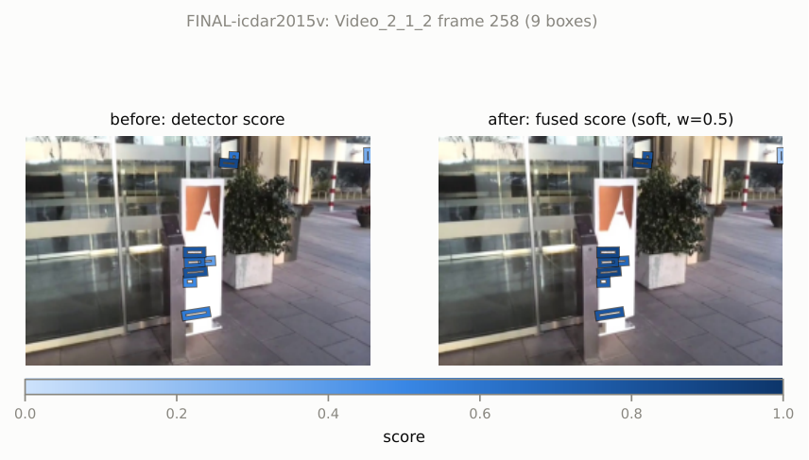
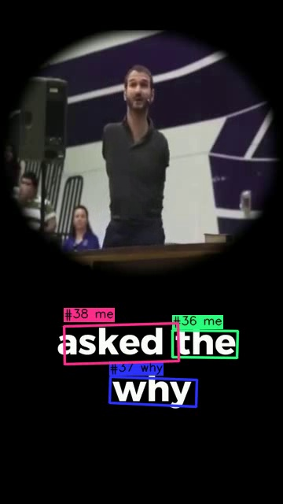
Qualitative results
Language re-scoring on ICDAR15 Video_2_1_2, frame 258: box shade shows score before (left) and after soft fusion (right)
Demo output: each word keeps its #track ID

Slide 21
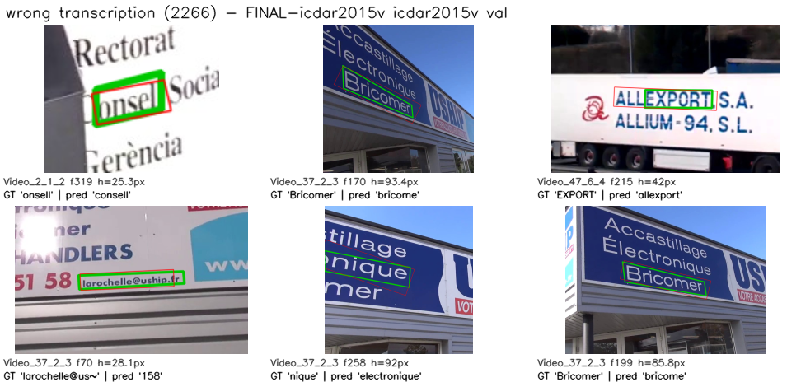
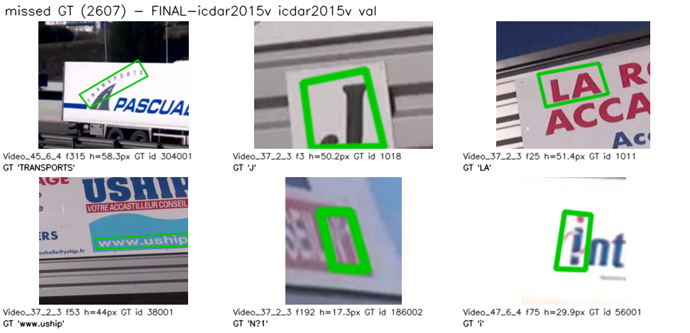
Error analysis
Error type | <20 px | 20–50 px | >50 px | Share
Missed text | 519 | 1,386 | 702 | 40.9%
Wrong transcription | 125 | 1,236 | 905 | 35.5%
False positive | 120 | 404 | 426 | 14.9%
ID switch | 6 | 290 | 57 | 5.5%
Fragmentation | 10 | 122 | 70 | 3.2%
Final pipeline, ICDAR15 val, by text height. Galleries: green = ground truth, red = prediction
Missed and misread text make up three quarters of all errors
Most misreads are near-misses: a dropped or extra character
Detector recall is the first bottleneck

Slide 22
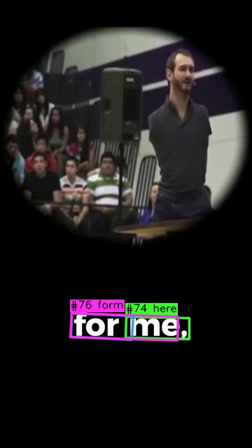
Live demonstration
One command runs the full pipeline on any video and writes an annotated MP4.
python scripts/demo.py --video in.mp4 --out out.mp4
python scripts/demo.py --video in.mp4 --out out.mp4 \
--config configs/E4-base.yaml --device cpu
python scripts/demo.py --gradio # web page on :7860
What the demo shows
Rotated boxes with #track-ID and voted text on every frame
Summary: tracks found, longest track and end-to-end FPS
Temporary stage files are cleaned up after the run

Slide 23
Conclusion and future work
Conclusion
Future work
Re-implemented the full LOGO pipeline as tested, stage-by-stage code
Language re-scoring and glyph supervision improve detection and spotting
Added soft fusion (C2) and track voting (C3), which raise tracking IDF1 over the VPMM baseline
Whole system trains and runs on a single 6 GB laptop GPU
Improve recall on small text: higher input resolution, text-specific detector pre-training
Train the tracker on more videos to close the IDF1 gap with the simple tracker
Report on the official ICDAR test server and on DSText
Larger evaluation so gains can be shown to be statistically significant

Slide 24
Thank you
Questions and discussion
Damera Raghav
Kambhampati Sanjana
Chada Jayasen Reddy
Patel Vyshnavi
B23CS007
B23CS008
B23CS015
B23CS050
Guide: Dr. Md. Sharfuddin Waseem, Assistant Professor, CSED

