Slide 1
Hackathon Brazil housing

Slide 2
Contents:
Objective
Visualization using graph
Conclusion
Suggestion

Slide 3
Objective
As work from home has become new normal for workers , Many workers are planning to relocate to different cities to live and work remotely.
Castro Brazila Inc, is a real estate management company help workers to choose city to relocate from Sao Paulo and Rio de Janeiro to other cities of Brazil where Rent cost is low.
Castro Brazila Inc suggests city based on worker’s requirements.

Slide 4
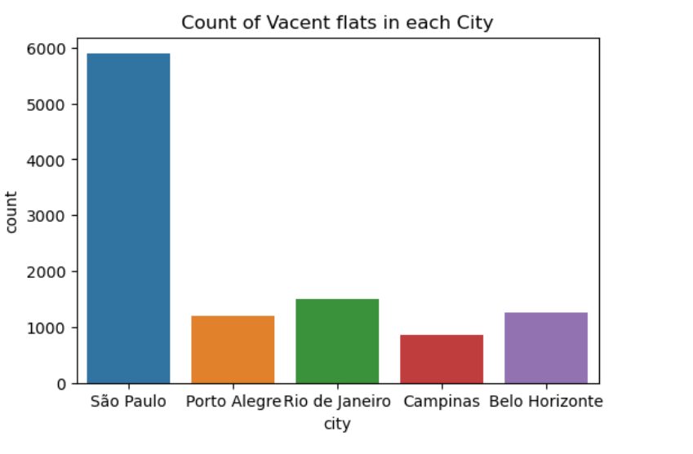
Univariate analysis
City
Nearly 1000 vacant flats available in cities except Sao Paulo and Rio de Janeiro.

Slide 5
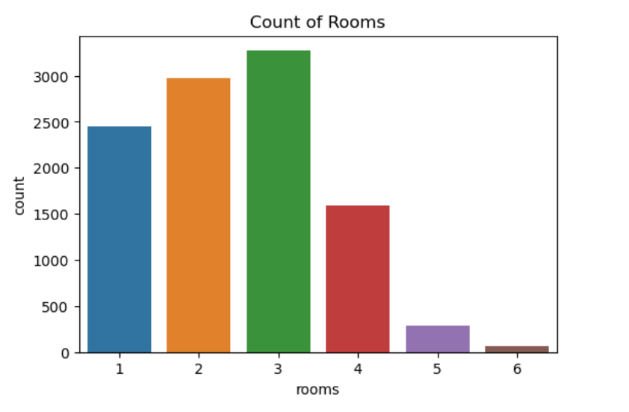
Univariate Analysis
Rooms
There are 2400 1bhk room
3000 3bhk rooms
2700 2bhk rooms are available for rent.

Slide 6
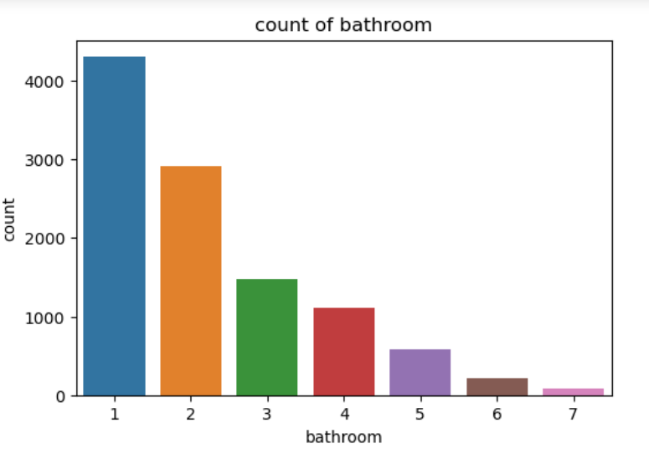
Univariate Analysis
Bathroom
4000+ flats have 1 bathroom
3000 flats have 2 bathrooms.

Slide 7
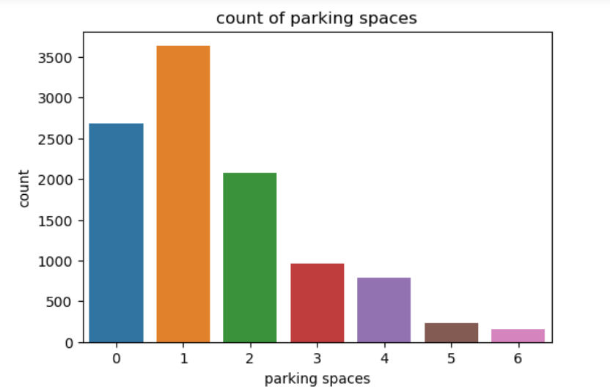
Univariate Analysis
Parking spaces
3500 flats have 1 parking spaces
2500 flats have 0 parking spaces
Less homes have more parking spaces.

Slide 8
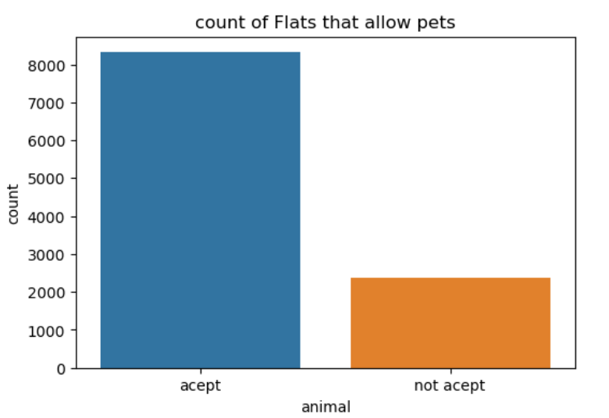
Univariate Analysis
Pets
pets are accepted in 8000
2000 plus flats does not allow pets

Slide 9
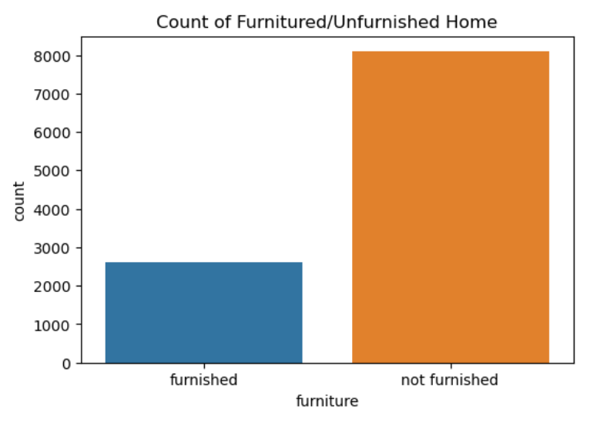
Univariate Analysis
Furniture/Unfurnished Home
2500 flats are furnished
8000 flats are unfurnished

Slide 10
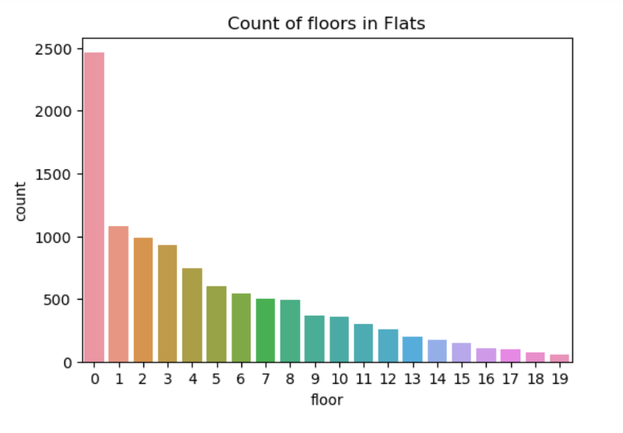
Univariate Analysis
Floors
2400 flats has 0 floor
Many flats have 0 floor.

Slide 11
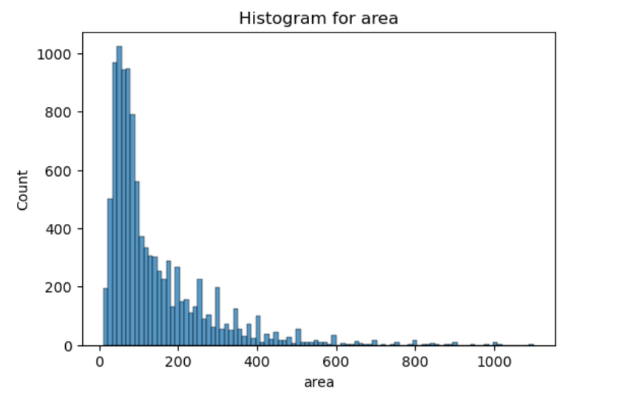
Univariate Analysis
Area
Many Flats has area between 100 -150.

Slide 12
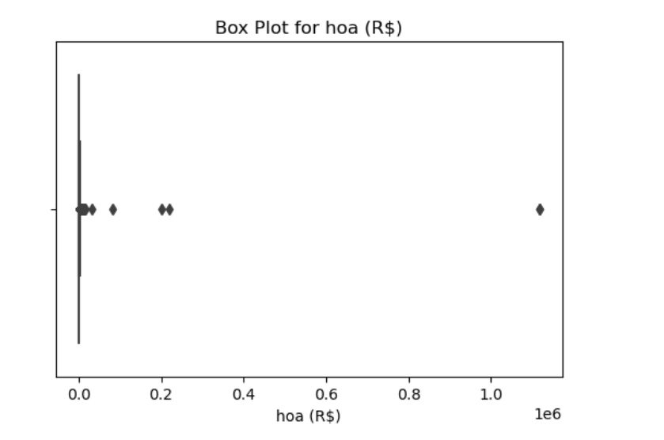
Univariate Analysis
Hoa
house owner assoiation tax (R$) data has is between 0 to 0.1.

Slide 13
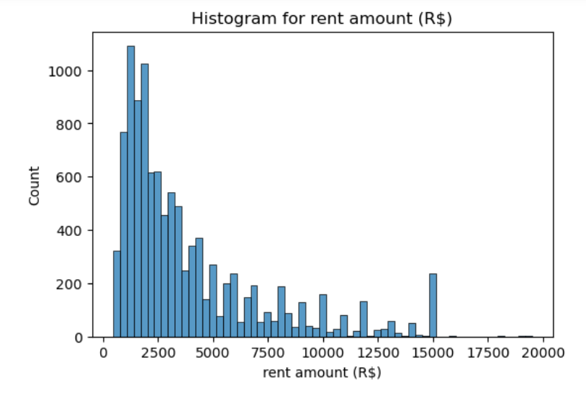
Univariate Analysis
Rent Amount
Nearly 1000 flats have rent 1500-2500(R$)

Slide 14
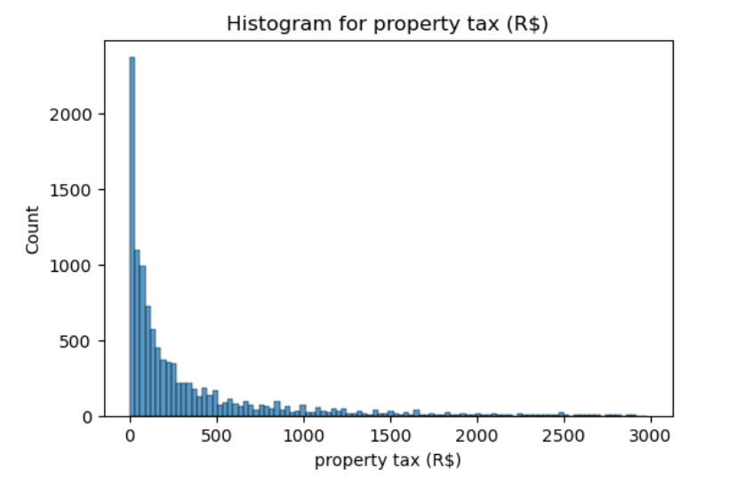
Univariate Analysis
Property tax
2000 plus flats have property tax (R$) 0

Slide 15
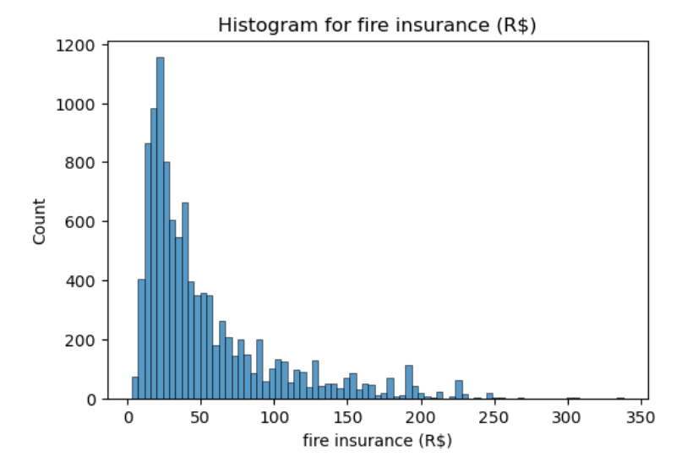
Univariate Analysis
File Insurance amount
1000 plus flats have file insurance amount in range 25 to 30 R$

Slide 16
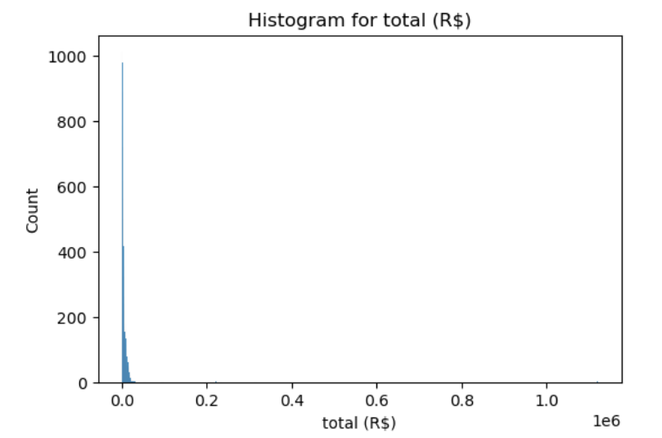
Univariate Analysis
Total
total (R$) data has outliers

Slide 17
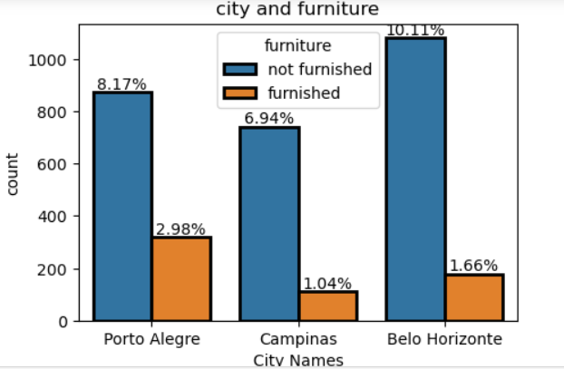
Bivariate Analysis
City and furniture
Porto Alegre has more furnished home

Slide 18
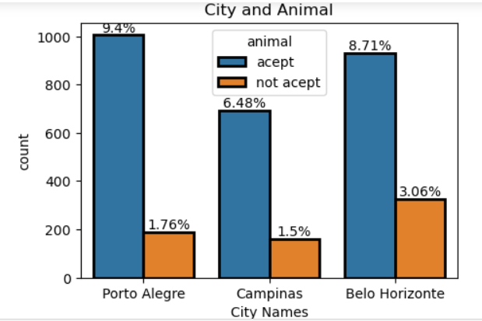
Bivariate Analysis
City and animal
9.4% of flats accept pets in porto alegre
6.48% of flats accept pets in Campinas
8.71% of flats accept pets in Belo Horizonte.

Slide 19
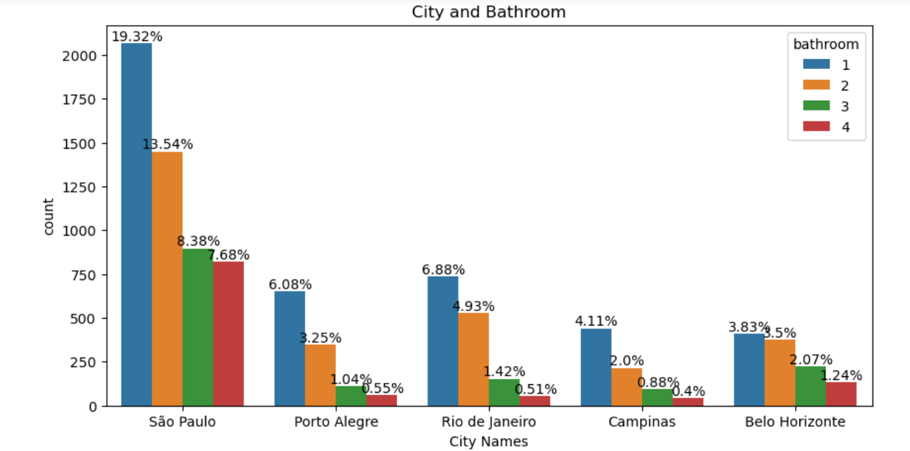
Bivariate Analysis
City and Number of Bathroom
1 bathrooms flats are more in all cities.

Slide 20
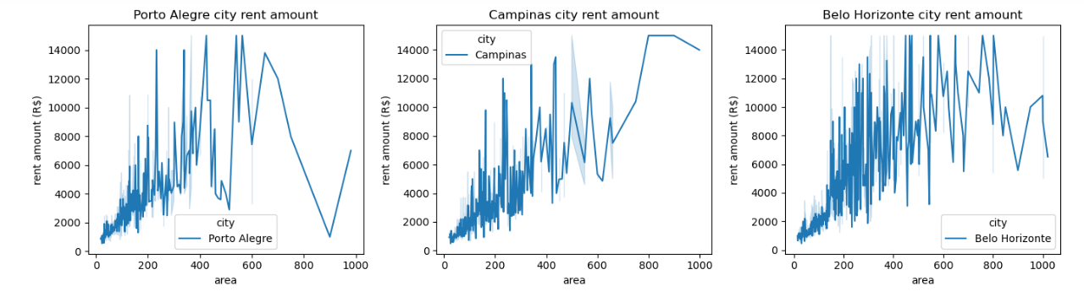
Average rent amount according to area
Rent amount increases with increase in area of flat.

Slide 21
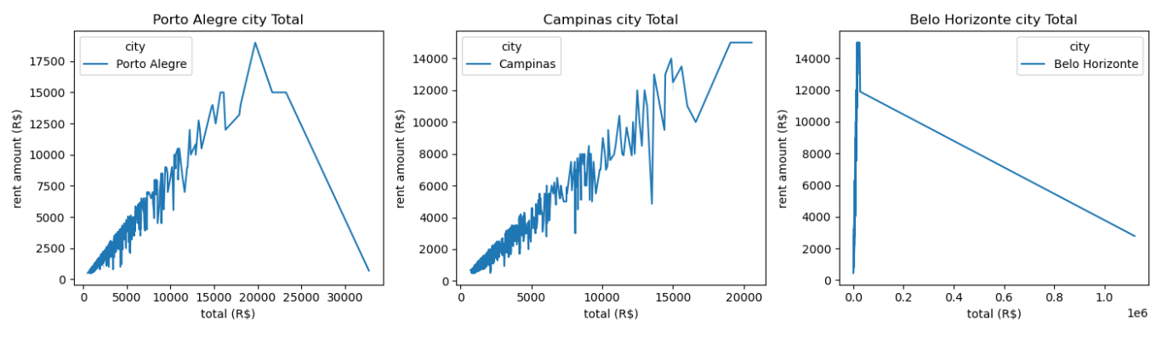
total & rent amount
Rent amount increases with increase in total.

Slide 22
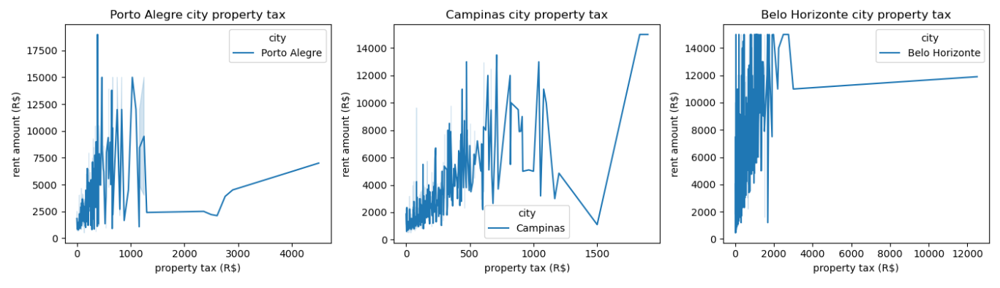
Property tax according to rent amount
Property tax increases with increase in rent amount.in porto alegra and campinas. & Belo horizonte has same property tax for all rent amount.

Slide 23
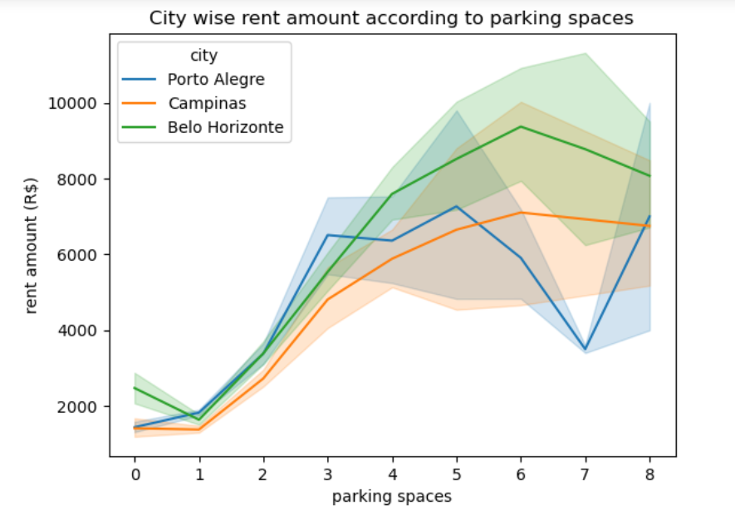
Multivariate Analysis
City wise Average rent amount acc to parking spaces
parking price increases with increase in Average rent amount.

Slide 24
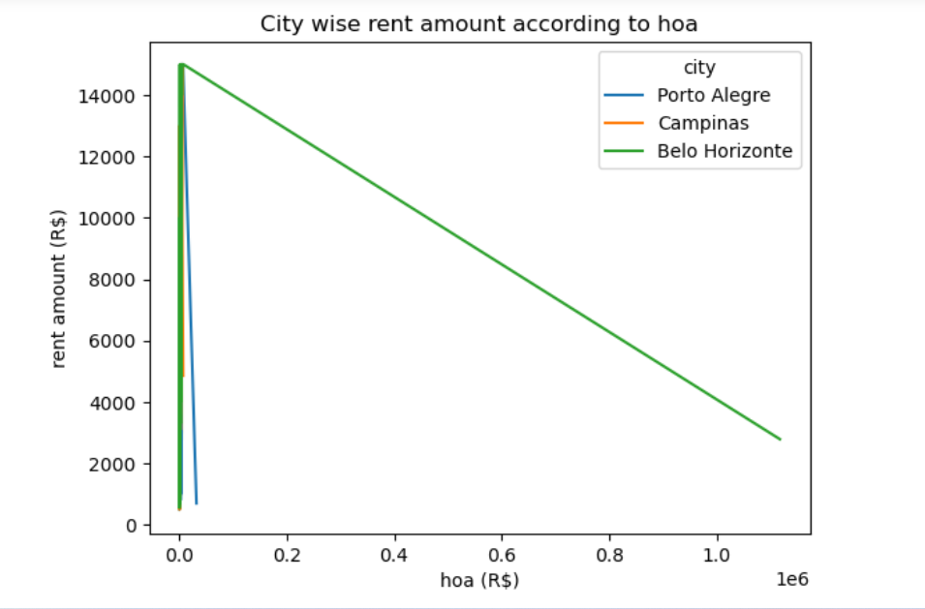
Multivariate Analysis
City wise Average rent amount acc to Hoe
Belo Horizonte hoa decreases with increase in rent amount

Slide 25
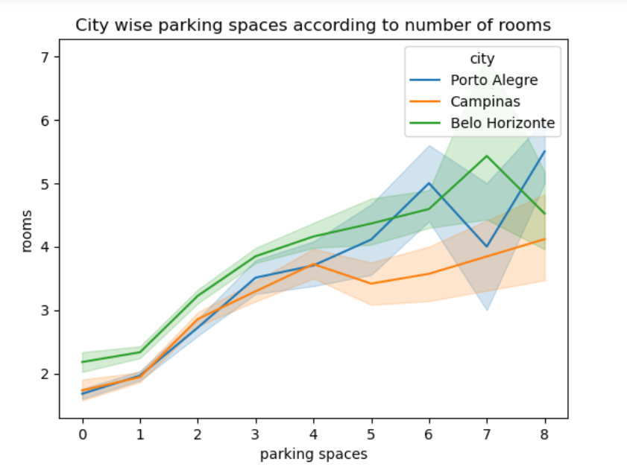
Multivariate Analysis
City wise parking spaces acc to number of rooms
parking spaces increases with increase in number of rooms.

Slide 26
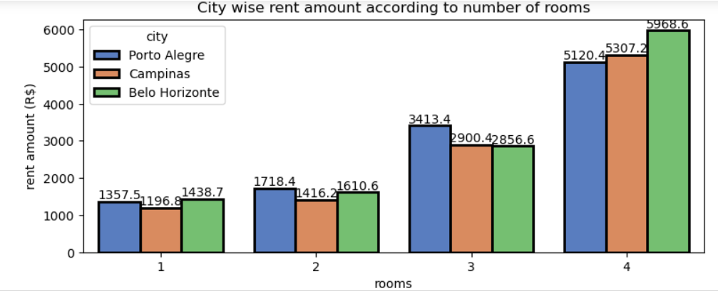
Multivariate Analysis
City wise rent amount acc to number of rooms
Low priced 1bhk flat is available at Campinas
2bhk flats are available for low price in Campinas
3 bhk flats are available for low price in Campinas & Belo Horizonte

Slide 27
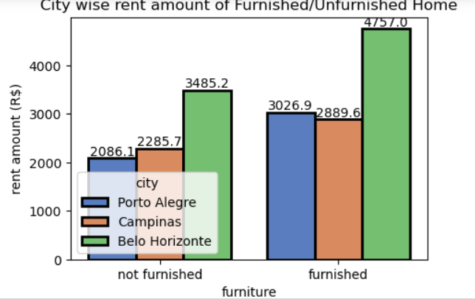
Multivariate Analysis
City wise rent amount of Furnished/Unfurnished Home
Rent amount is high for furnished home compared to unfurnished home

Slide 28
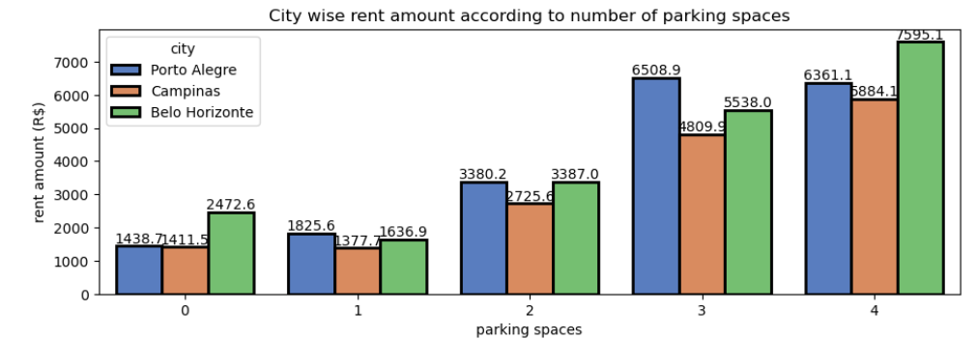
Multivariate Analysis
City wise rent amount acc to number of parking spaces
Average Rent amount is low for 0 & 1 parking spaces,3 to 5 parking spaces has almost same rent amount.

Slide 29
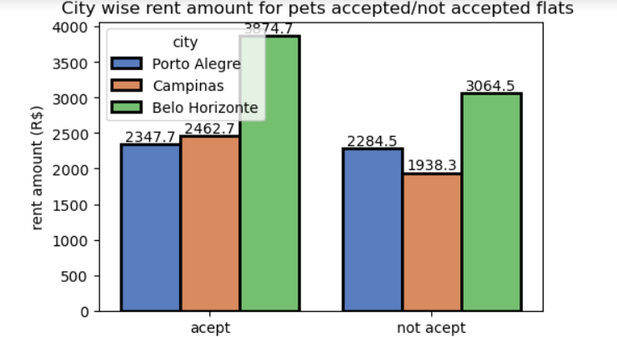
Multivariate Analysis
City wise rent amount for pets accepted/not accepted flats
Average Rent amount is high for pet accepted flats compared to pets non accepted flats

Slide 30
Conclusion:
Rent amount increases with increase in number of rooms
Rent Amount of flats Increase with increase in number of bathroom
Rent amount increases with increase in area of flat
Rent Amount is low for unfurnished homes
Rent amount is low for Flats which does not allow pets
Rent amount is low for 0 & 1 parking spaces,3 to 5 parking spaces has almost same rent amount
Parking spaces increases with increase in number of rooms
Property tax remains same for all rent amount

Slide 31
Suggestions
Bachelors:
1bhk flat
Number of bathrooms =1
Parking spaces=1
Campinas is suggested.
Where we can get furnished home at average of 3000 & unfurnished home at average of 2500.
Pets accepted flats at 2300 & Pets not accepted flats at the price. 2100

Slide 32
Suggestions
Mid size family:
2bhk flat
1 to 2 parking spaces
In Campinas we can get 2bhk flat for low price.
we can get Pets allowed home at average of 2300 & Pets not allowed home at average of 2100.
we can get furnished home at average of 3000 & unfurnished home at average of 2500 in Campinas
Campinas is suggested for mid size family.

Slide 33
Suggestions
For Large family
3bhk
1 to 2 parking spaces
In Campinas & Belo Horizonte we get 3bhk flat for low price
Property tax is low in Belo Horizonte
we can get Pets allowed home at average of 4000 & Pets not allowed home at average of 3500.
In Campinas lass & Belo Horizonte suggested for 3bhk family.

Slide 34
Thank You

