Slide 1
Spam mail classifier

Slide 2
Introduction
In the present world scenario every individual are having mail accounts. so interacting with people with emails have become trending from past 20 years.
With the growing technologies and digitial world,marketing the products have become a fashion and increasing day by day.

Slide 3
Objectives:
Get to know how danger the spam emails will have on every individual.
Having a look how the spam messages would be looking like.
Implement an algorithm that can able to classify spam mails.
Getting information that provides an evidence of classifying an email to spam.
Working with real world dataset of emails that are used in industry.

Slide 4
Tools and programming :
Java as programming language.
JDK as well as JRE.(for compiling and running the code)
Eclipse IDE for writing the code.
Windows operating system.(OS)

Slide 5
Methodology:
we will write a java code that takes a zip file as input which contains set of emails and filter the spam mails out of it.
Input:
1.A zip file of emails that are to be classified.
2.Text file all the words by which emails are to be classified.

Slide 6
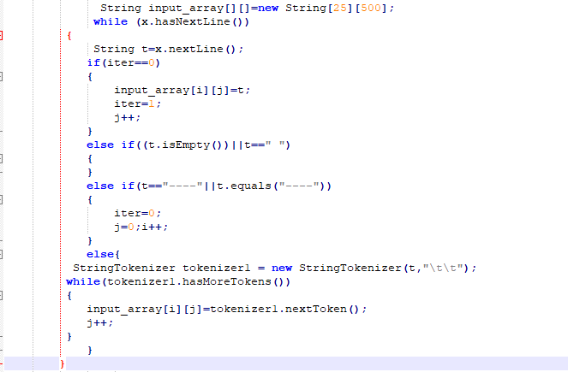
Implementation:
Getting individual words in to an sepearte array:

Slide 7
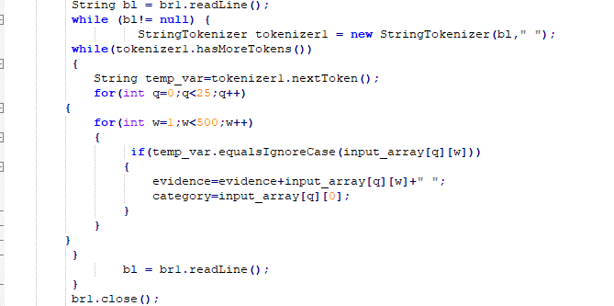
Implementation:
compare words in mails with spam words in array :

Slide 8
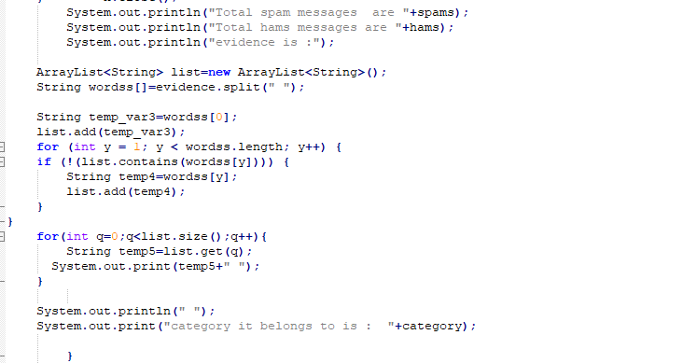
Implementation:
If a mail is spam,get what category it belongs to:

Slide 9
Conclusion
Finally with the Java code we can able to classify whether as given mail belongs to spam or not.
We are able to specify to which category of spam it beongs to if a mail is classified as spam.

Slide 10
References
https://www.scribd.com/document/359720216/P1-pdf
https://www.sciencedirect.com/science/article/pii/S2405882316300412
http://airccse.org/journal/jcsit/0211ijcsit12.pdf

Slide 11


Slide 12


